Slide 1
PHASE-1b ACtivities
L. Demaria – INFN Torino

Slide 2
Introduction
The inner layer of the Phase 1 Pixel detector is exposed to very high level of irradiation. A lifetime of maybe less than 2 years at luminosity (L_{int}=200 fb^{-1;} ~2 10¹⁵/cm²) is expected.
The Idea is to profit from the first replacement of the inner layer to introduce a new detector (sensor+ROC) that
  has much longer lifetime
  will improve pixel detector performance

Slide 3
Link to Phase II
The development should have a longer term goal, pointing to the phase 2 detector. Therefore the new layer should target to requirements for the phase 2
  Phase1b is a step forward to Phase 2 pixel
  In the Tracker we need to define how much forward it is useful
The Phase 2 requires the full redesign of the pixel detector. This requires several years of development and we intend to start the effort of designing a new pixel chip now

Slide 4
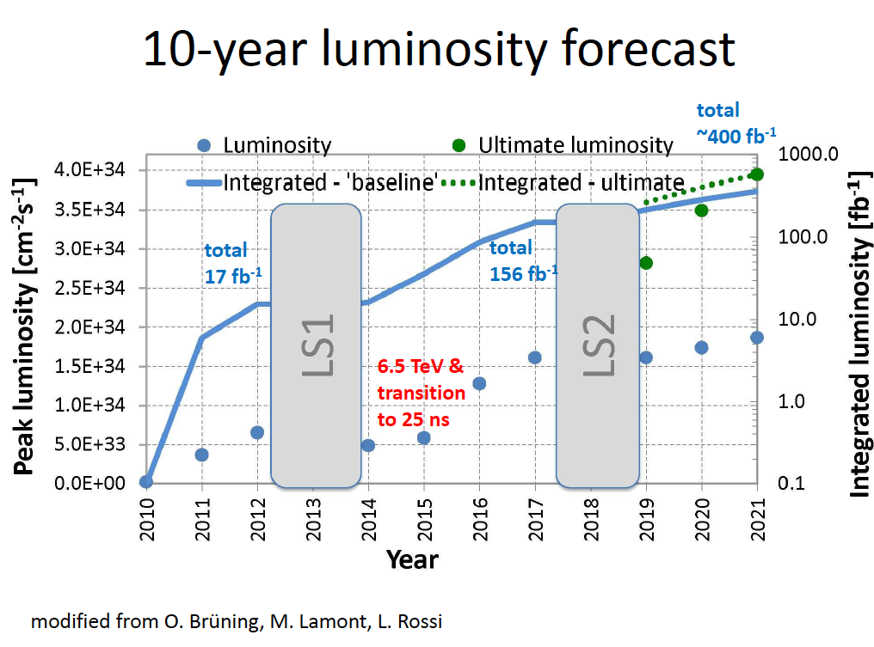
We need to keep in mind that LHC luminosity predictions have uncertainties in both direction, either to lower or to higher intensities, and on times

Slide 5
This talk
We had the first Phase1b meeting last TK week with an ample participation and several contributions. You can find it at
  https://indico.cern.ch/conferenceDisplay.py?confId=154789
I will report here on the work to understand the new pixel chip.
  Groups interested are INFN and FNAL but new collaborators are welcome
  .

Slide 6
New Pixel Chip goals
Efficient at very high rates
  Study of the best suited unconstrained chip architecture
Significantly smaller pixel size
  Strongly dependent on sensor thickness and type
  Final answer should come from physics simulation studies
Intrinsically compatible with different sensors
  Baseline: planar/3D pixel/diamond
Considering the support for intermediate level trigger
Easy module assembly and costs

Slide 7
Consideration on Pixel size
Obvious limitations on pixel size
  VLSI technology used
    130nm is a solid technology
    65nm seems feasible in few years
  analog electronics is the bare minimum
    FEI4 in 130nm analog part is (50x150) μm²
  digital electronics, more space for more intelligence
  Last but not least: engineers time to optimize the design
    See experience of MediPix for digital cells
Thinner sensors are desirable
Charge sharing should be preserved, this implies to decrease the pitch in Rφ proportionally
  i.e. 60 μm for 180-200 μm thick
Segmentation in z should not deteriorate resolution at low angles (long cluster)

Slide 8
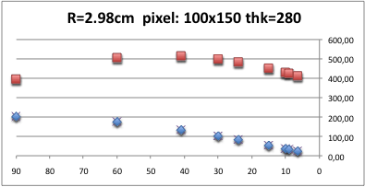
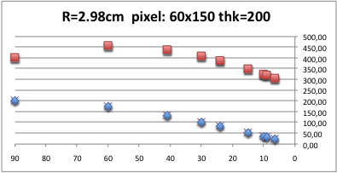
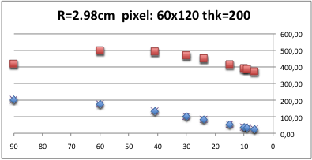
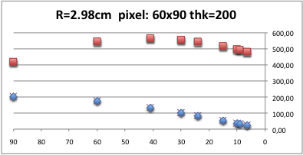
Pixel Rates @ 2 10³⁴cm⁻²s⁻¹
Pixel (particle) flux
For 200 micron detector 60 micron ~ok
Smaller z pitch determine larger clusters
theta
Pixel rate (RED) vs Theta [in blue is the particle flux, in red the pixel flux]
MULTIPLY by 2.5 for HL-LHC ➔ 1.5 GHz/cm2

Slide 9
Understanding the architecture

Slide 10
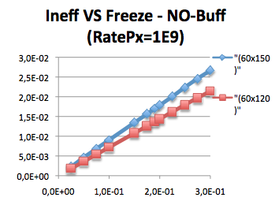
Inefficiency due to FREEZE time
The pixel with a hit is in FREEZE until it is readout by the column. If a second hit arrives during freeze, it will be lost.
The time needed by the readout is linearly dependent with the #hit per column, therefore also to the length of the column
The plot shows the inefficiency vs FREEZE time in case of 1 GHz/cm^{2.}
End of Column readout time (microsec)

Slide 11
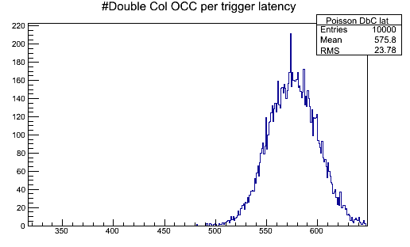
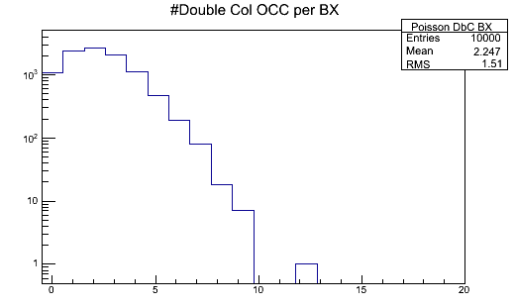
Example of 60x150 μm² pixel @1.5GHz
Considering a 6.4 microsec of trigger latency, double column, and a chip ~2cm large, the number of pixel data are up to 650 per trigger
Number of pixel to be readout per column
every BX is 2.2 and up to 9.
Freeze can take up to 3BX per pixel to be
readout. This means up to 675ns and therefore ~3% inefficiency

Slide 12
How much digital circuitry in the pixel ?
Local (in-pixel) buffering is needed due to avoid overwriting or lost data while the pixel is busy to be readout (short time for readout, long time for trigger latency)
Time-Stamp is needed IF buffering is done
  Could be stored in PUC or EoC
Trigger matching can be done either inside the pixel or at end of column
  End of column
    Long buffers in small space (but gain from higher VLSI)
    Quiet pixel
  PUC
    More digital electronic, larger size
    Less data going to periphery
Digitalization can be done either at pixel or end of column

Slide 13
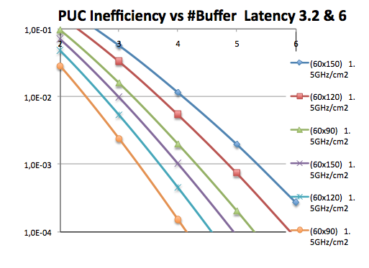
Local storage until Latency
Inefficiency of pixel overwrite in case of storage
In buffer until the trigger arrives after dome latency
@1.5 GHz/cm2 pixel rate 60x120 μm² size needs only 4 buffers to have <1% inefficiency
Decreasing the size, less local buffers are needed (per PUC)

Slide 14
Plan of progress
A roadmap for the new detector has to be defined
We had a first iteration today among few people involved D.Cristian, G.Deptuch, A.Rivetti, M.Swartz, myself

Slide 15
Initial R&D
Sensor
  3D, diamond (extension of existing R&D program)
  Thin planar
    Simulation to determine performance as a function of electronics threshold, sensor thickness, and pixel dimensions.
  CMS MC studies of smaller pixels
    B tagging in high pT jets
ROC
  Radiation tests of CERN test structures in additional IC processes
    Develop design rules for analog & digital circuits
  Develop circuit elements to explore limits of
    FE noise
    Signal speed
    Power requirements
    Size requirements (pixel size)
    Discrimination threshold
  VHDL simulation of readout architectures
  Understand GBT requirements
  Explore use of FEI4 circuit elements
Trigger
  CMS MC studies to determine requirements & rates
    e/tau region of interest trigger?
    Other ideas??

Slide 16
Conclusion
Good time to start to design a completely new pixel chip, optimizing the segmentation, the thickness and the type of sensor to use
Vital to set up a collaboration of several groups/laboratories with chip design capabilities and experience. INFN and FNAL are the first showing a clear interest on a concrete project
The earliest opportunity is the first replacement of Phase 1 inner layer(s)
We are defining a road map for the initial R&D phase and we should continue in defining also the further steps of the project

