Slide 1
Mechanical Work Plan Discussion
Bill Cooper
Fermilab

Slide 2
What we started with
A proposal for single-stack modules with integrated “vertical” connections between the two sensor layers of a stack
A concept for positioning, supporting, and cooling modules to form double-stacks
Approximate dimensions of rods to fulfill that concept
Possible end and side elevation views of rod arrays to provide r-phi hermeticity
A concept for supporting rods in those arrays
A proposal for ensuring rod overlap at Z = 0

Slide 3
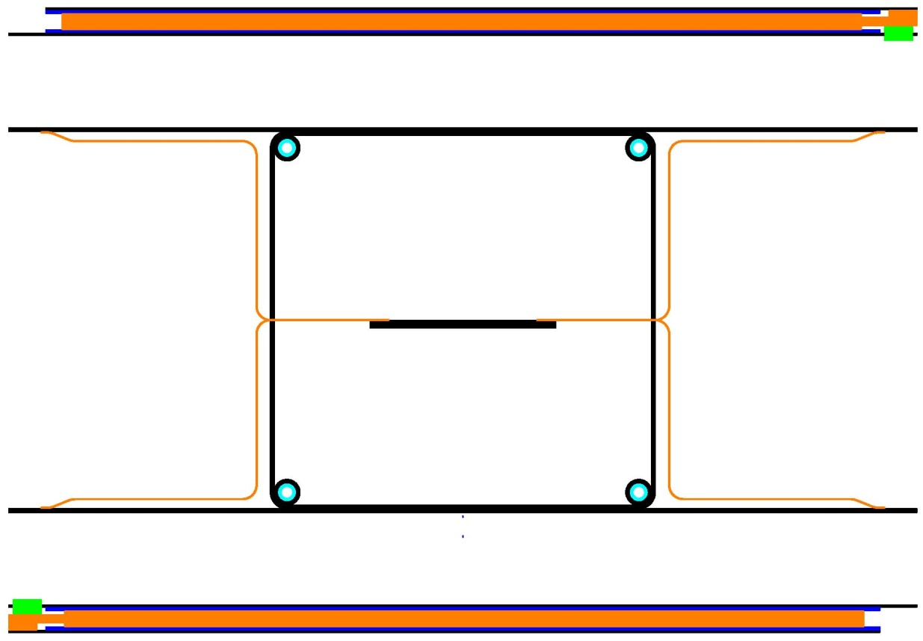
What we started with
Rod with two single-stack modules
Modules connect to rod flanges mechanically, thermally, and electrically.
Module
Cooling tubes
(2 supply, 2 return)
Box
GBT’s
40-60 mm
(box is rectangular, but not necessarily square)
Rod flanges
DC-DC converters
Module

Slide 4
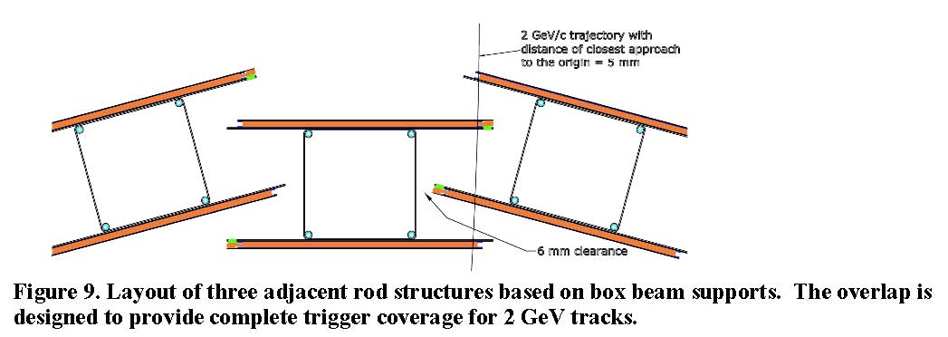
What we started with
Example of r-phi overlap between adjacent rods

Slide 5
What we have
First sensors to test the concept of integrated “vertical” connections
Stack connection concepts
Four varieties of short (~ 0.73 m), carbon fiber laminate box structures for rods
  Made on a four-piece mandrel provided by UC Davis
  All are made from K13C2U RS-24 (Mod.) carbon fiber
Copper on kapton mesh to allow reliable connections to carbon fiber laminate
  Two short box structures have no mesh
  One short box structure has mesh over most of its periphery
  One short box structure has mesh near each of its two ends
  One short box structure has centrally located mesh
An evaporative CO2 cooling system to allow thermal testing
A test station for thermal measurements in vacuum

Slide 6
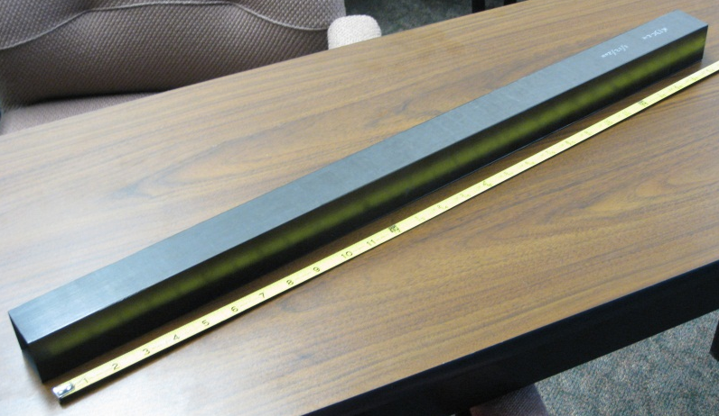
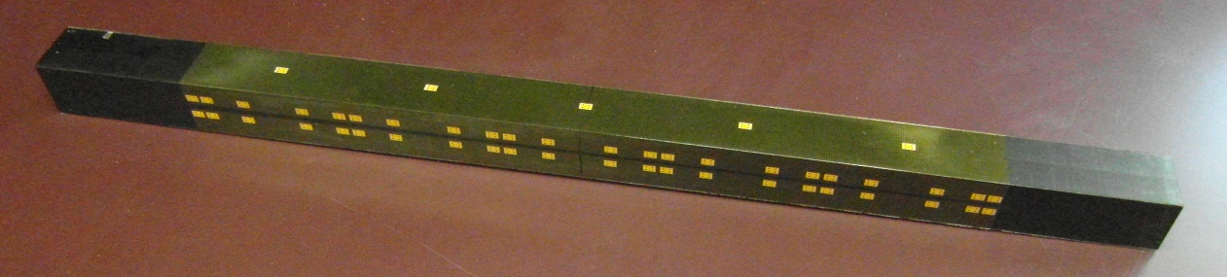
What we have
Box without mesh
Box with mesh for 5 module Z locations
  One purpose of the testing is to determine how much of the box surface should be covered with mesh.
  Mesh is co-cured in contact with carbon fiber.
  Nominal copper thickness = 5 µm. Nominal copper coverage = 30% by area.
  Pads connect to mesh with plated-through holes.
  Extra contact pads were provided for testing.

Slide 7
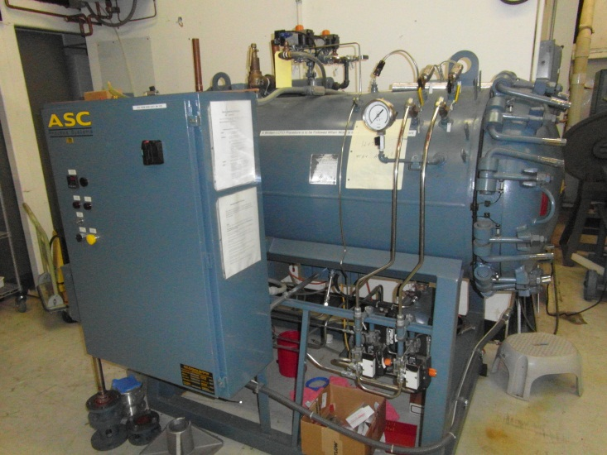
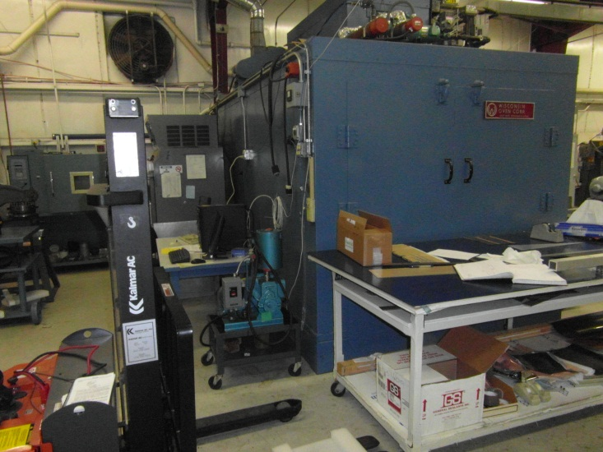
What we have
Carbon fiber fabrication facility (Lab 3)
  Autoclave
  ~ 27” dia. X 48” long
  Walk-in oven
  ~ 6’ x 6’ x 12’
  Several small ovens

Slide 8
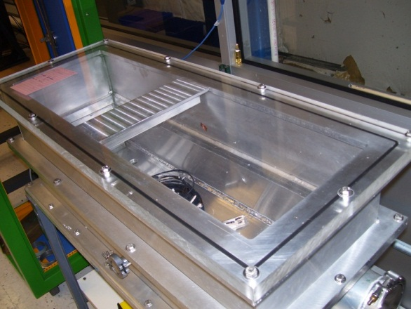
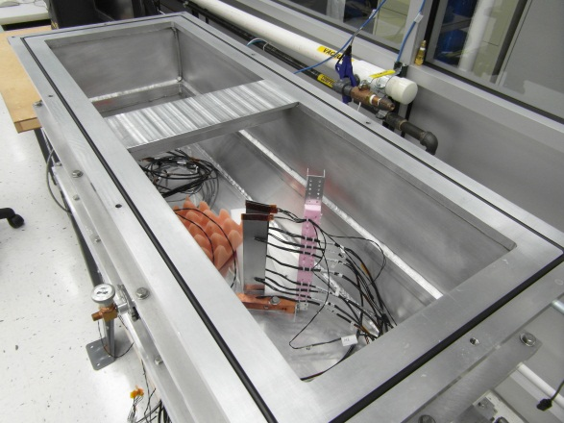
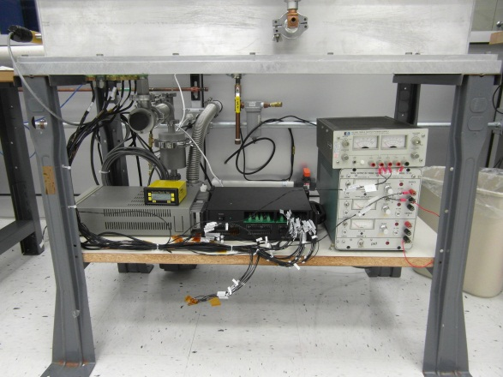
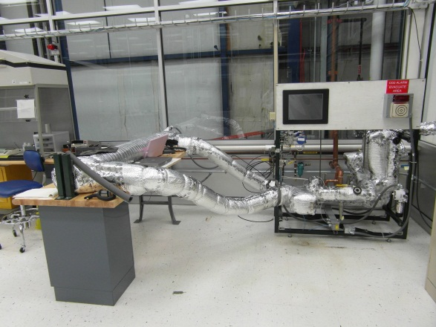
What we have
Thermal test station with vacuum box (Lab C clean room)
  16 channels of PT100 readout
CO2 test station (Lab C clean room)
  Built for CMS pixel testing, but tracker could ask for time

Slide 9
Proposed R&D and tests
Load and deflection measurements of a full length rod box
  Design of a mandrel for making a full length box has begun
Measurements of geometric precision of a full length box
  CMM measurements of short boxes have given good results.
Electrical performance of boxes with mesh
  Preliminary tests were conducted at Fermilab
  Tests are underway at ITA Zaragoza, Spain (Fernando Arteche)
Integration of rod boxes into a rod prototype with cooling
Fabrication of carbon fiber laminate structures for modules
Development of concepts to hold modules on a rod and provide electrical connections to/from them
Thermal tests of a short rod with modules

Slide 10
Proposed R&D and tests
Development of concepts to hold DC-DC converters within a rod box
  Requires cutting openings in the sides of the box and testing their electrical and mechanical effects on the box integrity
Integration of rod boxes into a rod prototype with cooling
Fabrication of carbon fiber laminate structures for modules
Development of concepts to hold modules on a rod and provide electrical connections to/from them
Thermal tests of a short rod with modules
  Need to fabricate cooling tubes and integrate them with the rod box
Thermal and electrical tests of a full length rod with modules

Slide 11
Other R&D and tests
Development of DC-DC converters with less material
Design of mounts and installation methods for the DC-DC converters
Cable design and testing
Thermal and electrical testing of a rod with all required features
Tuning of rod geometry to match the end view geometry
Design and testing of membranes and an outer cylinder for support of the rod arrays
Design and testing of connection methods for the CO2 cooling tubes

Slide 12
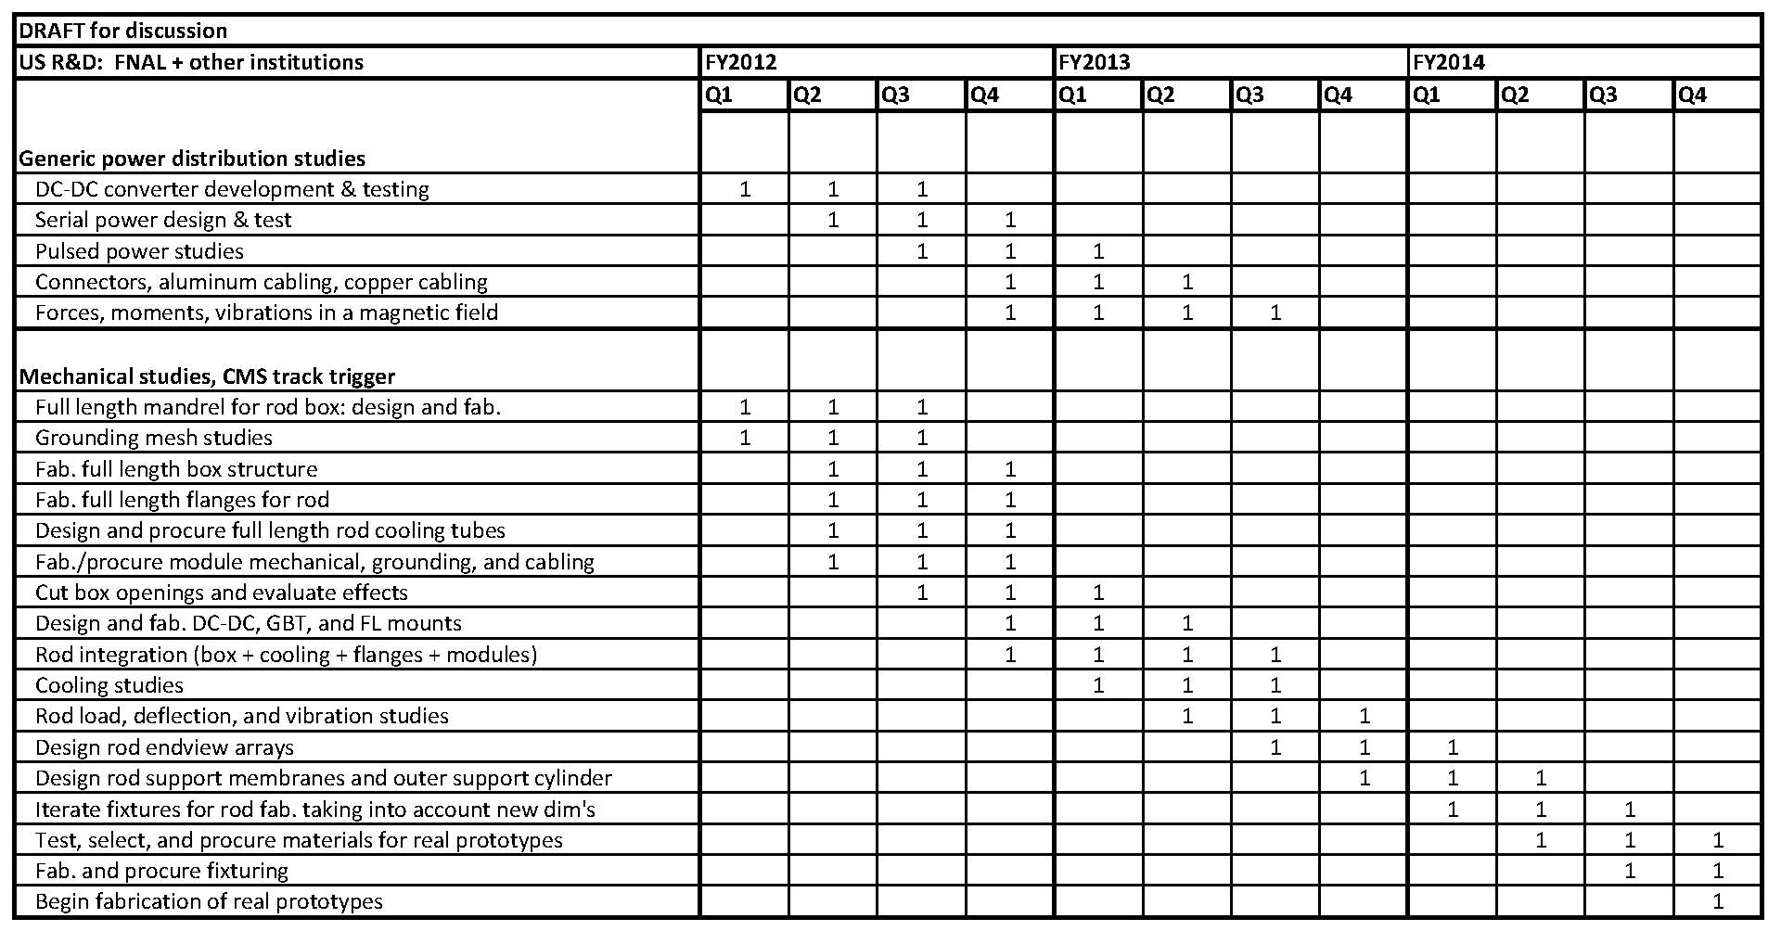
Schedule for Discussion

