Slide 1

Technical Progress on the
Phase 1 Pixel Detector
Simon Kwan
Fermilab
CMS Upgrade Week
Plenary Session

Slide 2
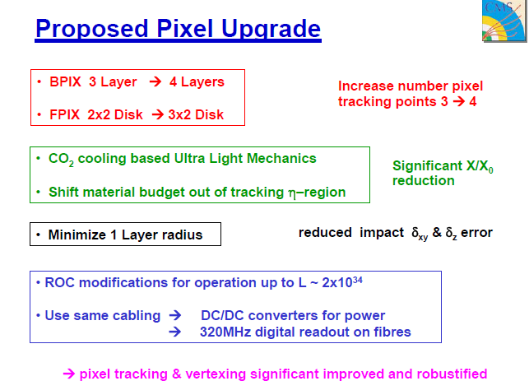

Slide 3
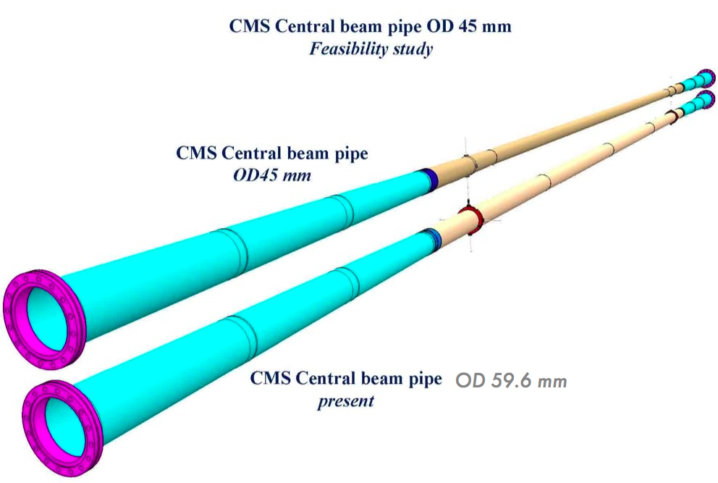
Beam Pipe
New design:
Conical section extends to lower |Z| to compensate for smaller diameter of central section
Support flange embedded in the pipe machining process
NEW
Different choice of material. AlBe instead of stainless steel for the external parts
OLD

Slide 4
Beam Pipe
Timeline:
  Call for Tender docs finished and sent out
  Answer received and currently under evaluation
  Try to meet December deadline for finance committee
  Placement of contract on February 2012
  Beam pipe delivered to CERN mid 2013

Slide 5
Baseline CO₂ Cooling Plant concept
The LHCb system has a perfect track record, no need to modify the concept
3 years of low temperature operation with no problems at all
CMS system has 8 times higher power
Bigger pumps and suitable heat exchangers exist on the market

Slide 6
Redundant concept
For CMS at point 5 we propose 2 identical systems, A and B
  only one design needs to be made and debugged
FPIX runs on A, BPIX runs on B
Different temperatures for FPIX and BPIX without problem
If one plant fails or needs maintenance, BPIX and FPIX can both run on either of the two cooling plants but in this exceptional case, they have to agree, on a common temperature.

Slide 7
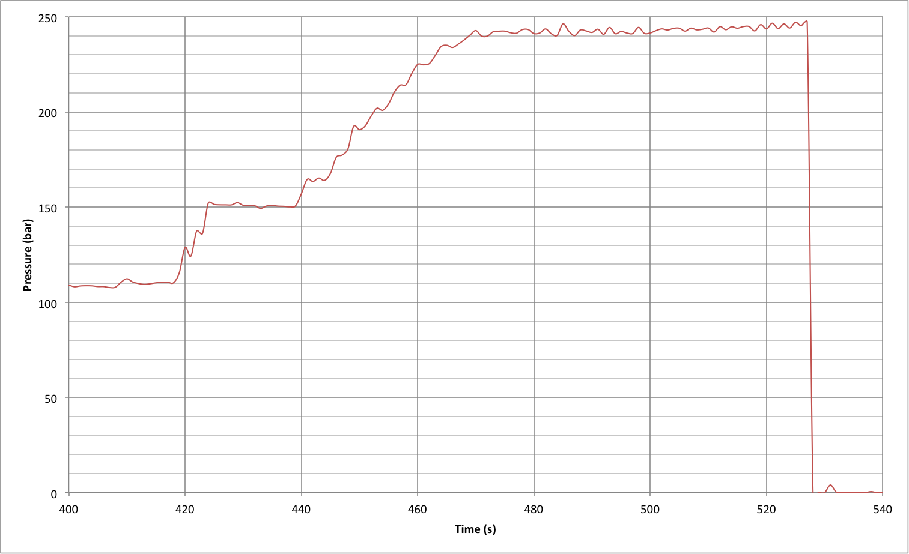
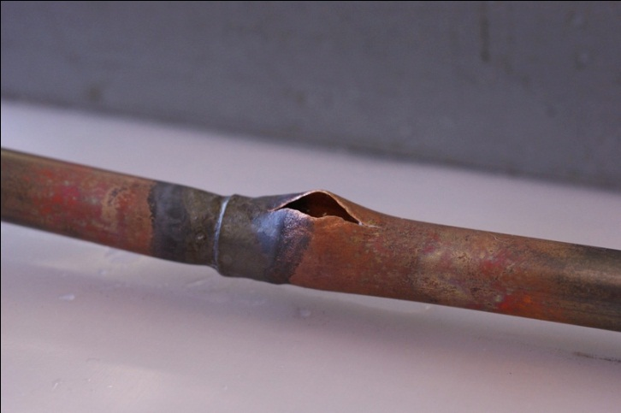
Results: Rupture pressure
Certification procedure
Pipe mock-up study
Pipe rupture: 247bar

Slide 8
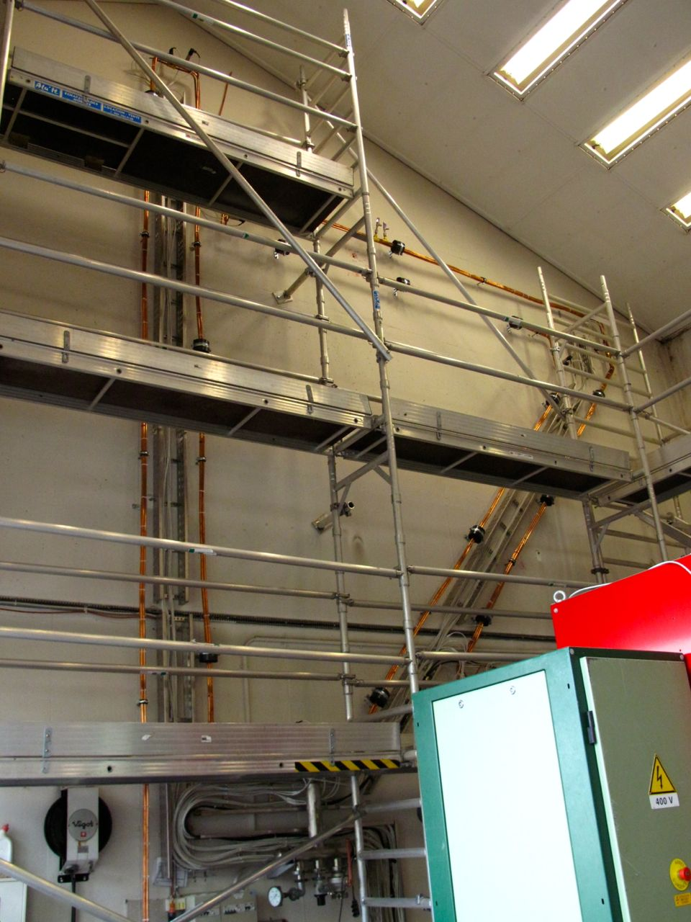
Long transfer lines studies - Status
Piping installed
  2 lines of 65m – 14mmOD tubes: 14,7l of CO₂.
Safety pressure test done (90bar) and OK.
DAQ commissioning:
  All sensors (14 PTs and 28 TTs) installed and cabled.
  Software ready (labview based interface).
  Noisy acquisition card needs to be replaced.
        Measurement can already start with software patch or noisy cards.
Cooling plant chiller will be ready in the next weeks.
Insulation to be installed when first test and commissioning done.

Slide 9
Converging concepts
All loops start with a capillary to minimize flow difference between on-off operating conditions
DC-DC converter and opto converters at the beginning of the loop to start boiling and enter the annular flow regime
Detector tube optimized for acceptable temperature gradient
Return line of larger diameter to avoid unnecessary temperature gradient

Slide 10
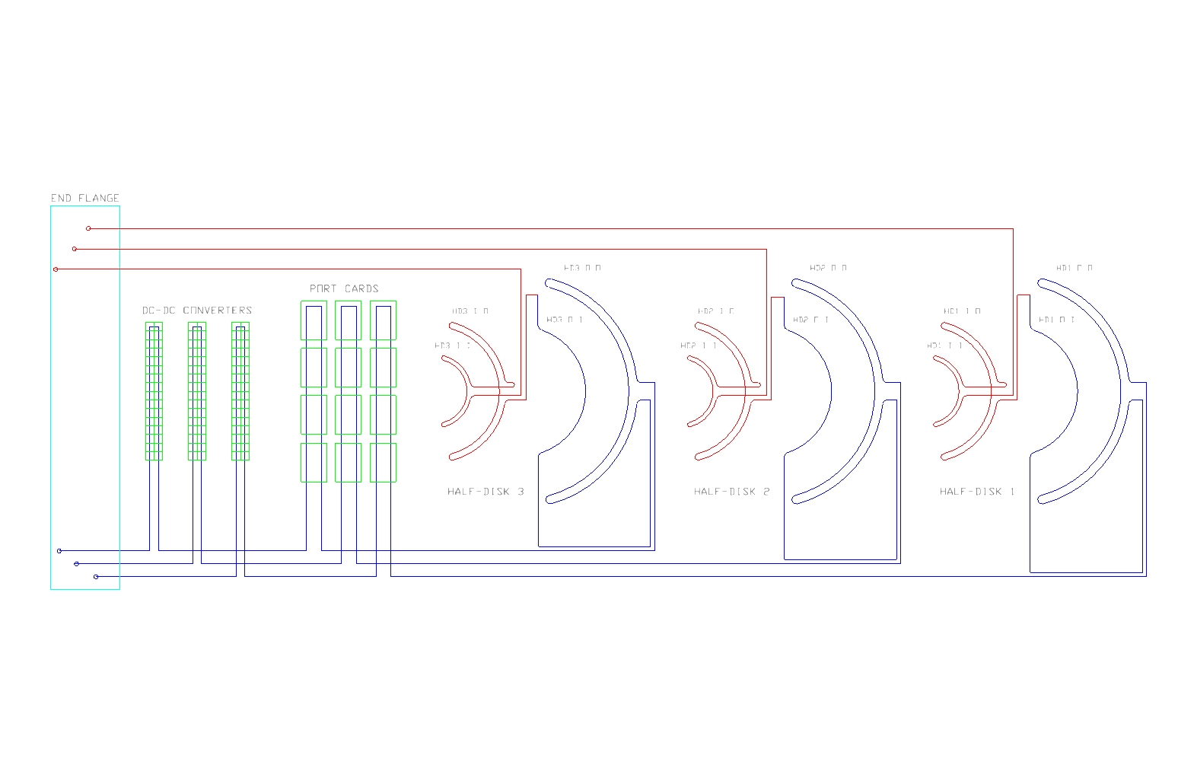
New FPIX loop layout
Courtesy: Kirk Arndt

Slide 11
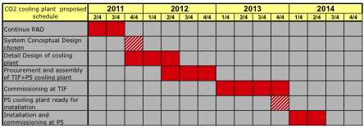
CO2 Cooling: schedule
Concept is to procure material and build two plants one for TIF and one for P5
About 1 year of commissioning at TIF before shipping one of the plant to P5
Ready for installation at the beginning of 2014

Slide 12
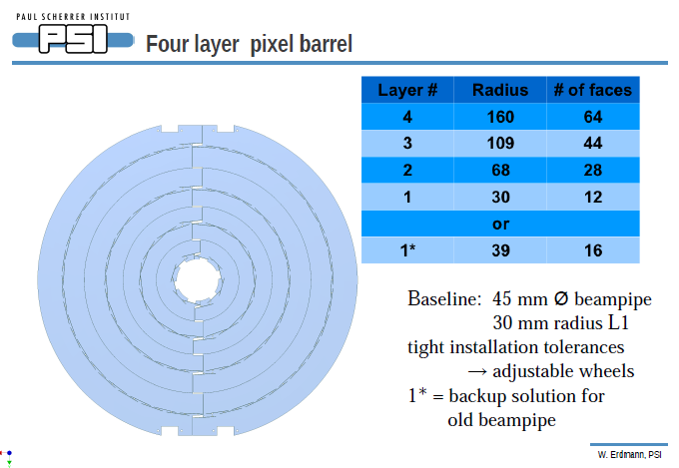

Slide 13
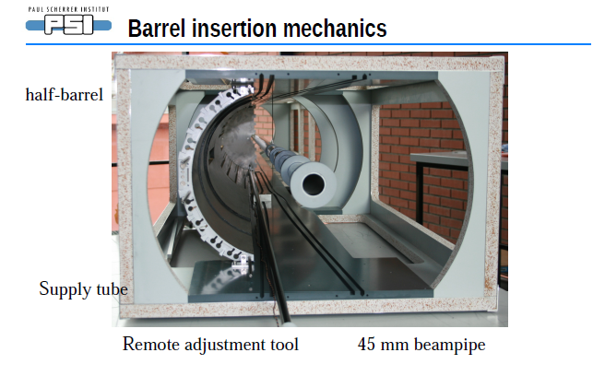

Slide 14
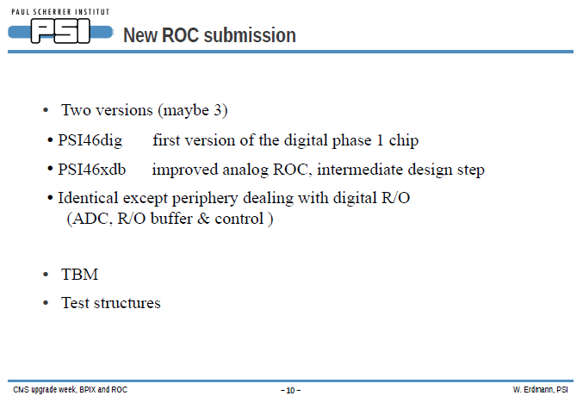

Slide 15
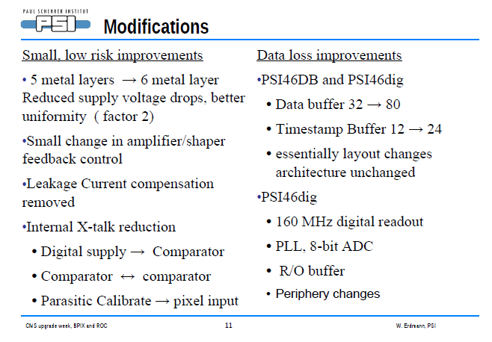

Slide 16
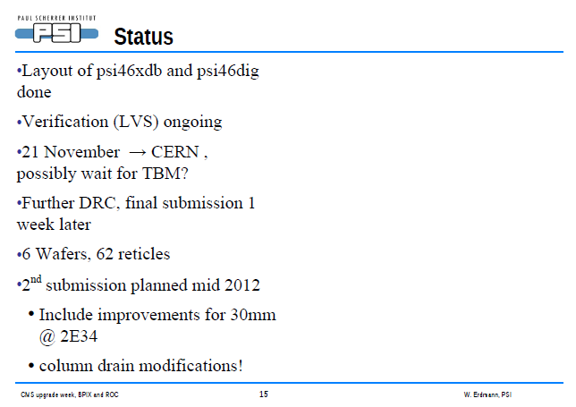

Slide 17
TBM Design Status
Message from Ed Bartz Nov 4, 2011
I see no way to meet the mid November date for the fpix. I have asked Roland how much he can delay. I would like a month. I have spent the last month getting the analog simulation functional. I am now simulating the PLLl etc, do work can again progress.
Latest message from Roland: will contact Kostas about a shift of the engineering run submission by 4 weeks

Slide 18
Phase I Upgrade FPix Readout Outline
Front-end electronics has the same tree structure as the current electronics
Data are sent from detector modules to Port cards via aluminum flexible readout cables, and converted to optical signals there
DataKeeper ASICs will provide multiplexing of data streams from two Detector modules to a single readout optical fiber in order to fit into already installed 8 fibers per Port card
TPLL is used to recover commands from the Clock/Control channel
Delay25 is used to align clock, commands, and data
I2C slow control uses existing design of a CCU board (including resets)
Power distribution is based on air core DC-DC converters, located at the far end of the Service Cylinder, next to the End Flange
Picture does not show TPLL used to recover Clock and Trigger commands, and Delay25 ASIC used to align Clk/Dat signals
S. Los / E. Bartz

Slide 19
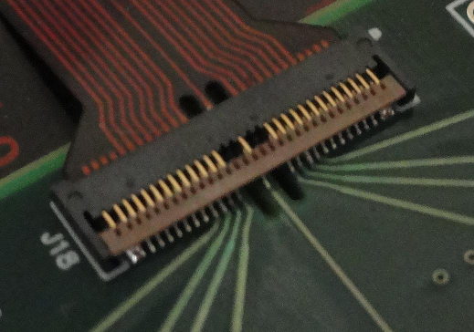
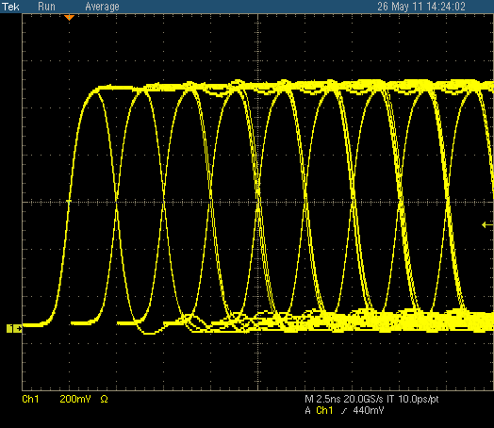
Aluminum Readout Cable
A prototype aluminum cable was manufactured
600 mm cable, double-sided, aluminum clad polyimide
Connector has a 0.4 mm pitch / independent contacts on top/bottom
BV behavior was tested on a previous (copper) prototype, and it was running up to 1500 V
DATA (x2) / 400 Mbps | Vaa/0.5A (x3)
CLK (x2) | Vra/0.5A (x3)
CTR (x2) | Vdd/0.7A (x4)
SDA (x2) | Vrd/0.7A (x4)
RCK (x2) | BV (x2)
RDA (x2) | GND (x2)
RTD (x2)
RST (x1)
Token In/Out (x1)
Measurements were taken using a pre-compensation circuit at the driving end (65pf || 27.4 ohm)
Pattern is created of superimposed pulses with different widths, multiples of 2.5ns
Similar compensation can be done at the ALT impedance matching input signal attenuator, if used with POH
S. Los

Slide 20
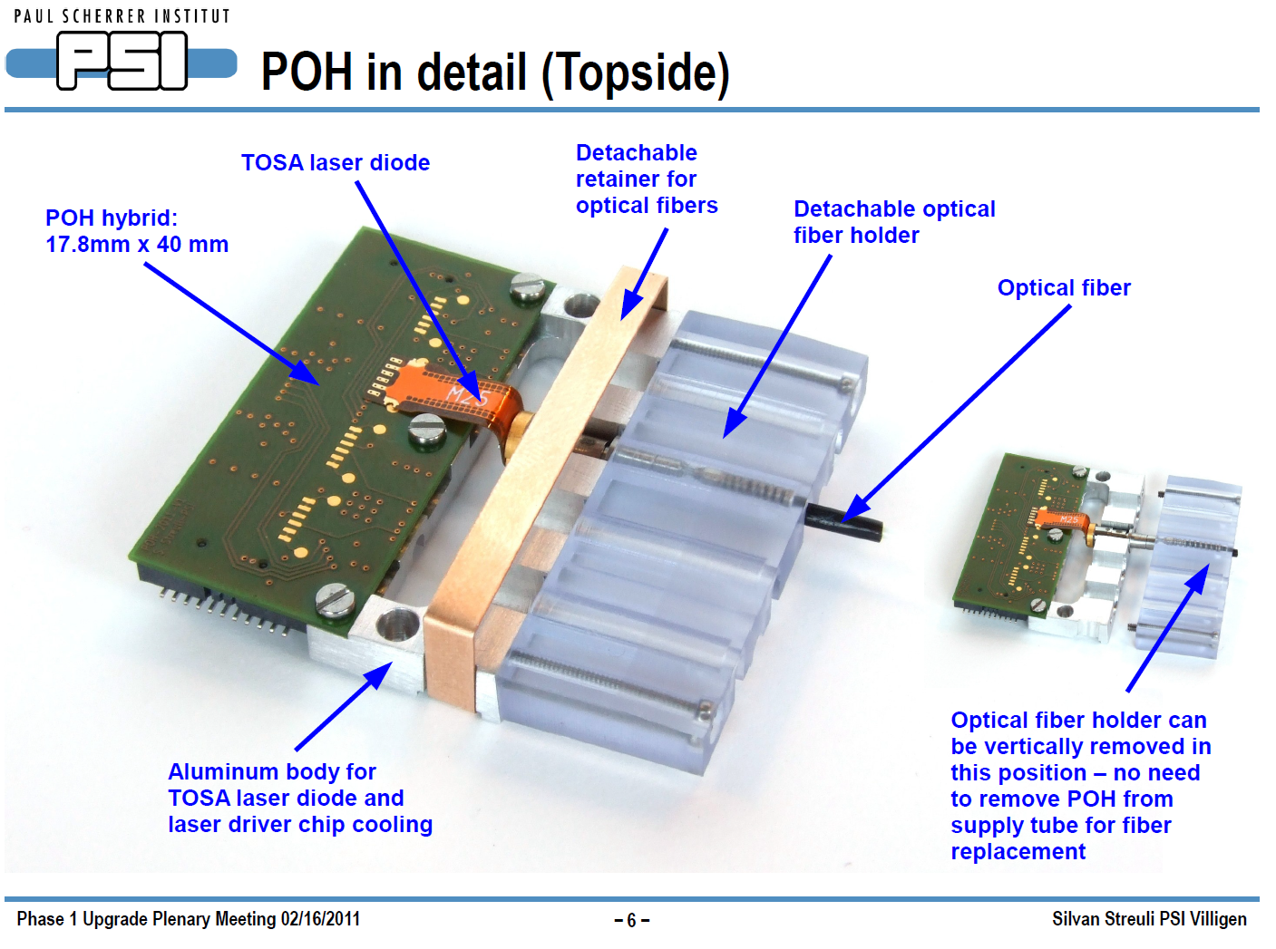
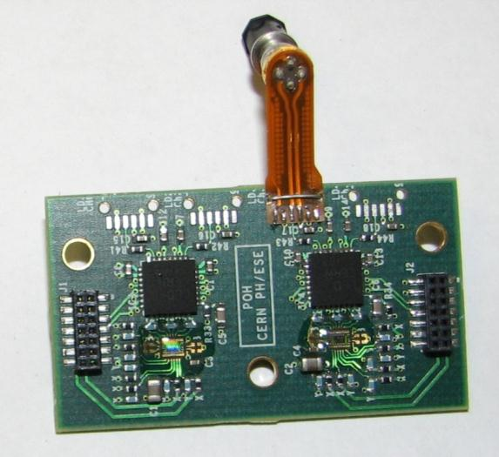
Pixel OptoHybrids at Fermilab
Current Design Prototypes
CERN
PSI
(TOSA sits up too high)
22.5 mm x 40 mm
17.8 mm x 40 mm
Design Goal – a single optohybrid that meets the needs of FPIX and BPIX

Slide 21
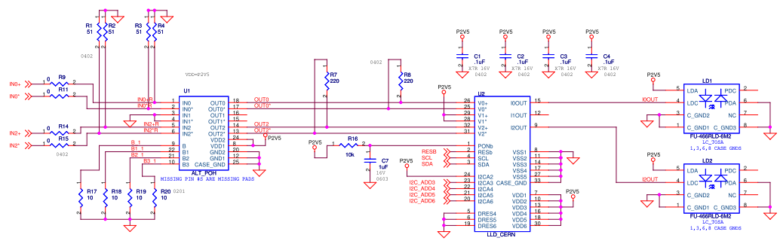
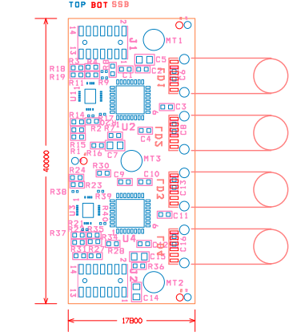
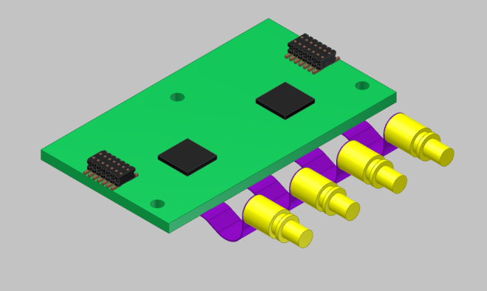
Pixel OptoHybrids at Fermilab
Towards a Common POH Design
Simplified Schematic
(Complete)
Compact Layout
(In progress)
Common POH
(BPIX and FPIX)

Slide 22
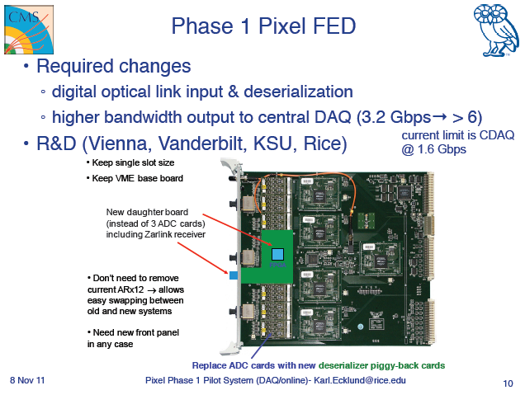

Slide 23

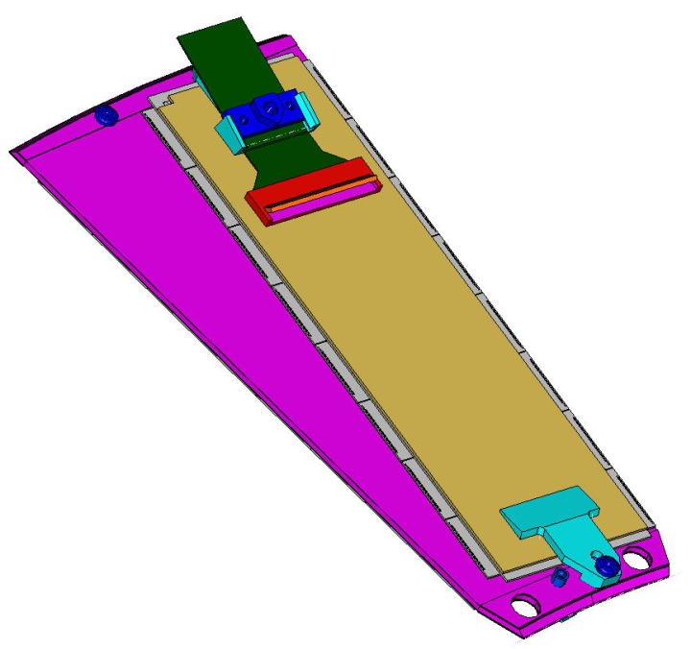
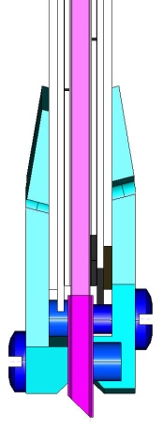
Basic Design of the Pixel Blade
Threaded insert
Solid TPG (0.68 mm thick, highly thermally conductive with in-plane k = 1500 W/mK) encapsulated with carbon-fiber facing (0.06 mm thick).
Extra layer of carbon-fiber at blade ends with 45º cut.
Cooling is arranged at the ends of the blade which is structurally and thermally bonded to cooling rings.
All blades are identical with one module on each side. (Only 2x8 module is used.)
Modules, which are glued with holders at ends, are removable.
Aluminum threaded inserts are glued on blade for module mounting.
One module holder provides cable strain-relief for the flex cable.
Removable module assembly
Through holes to access screws of neighboring blades

Slide 24
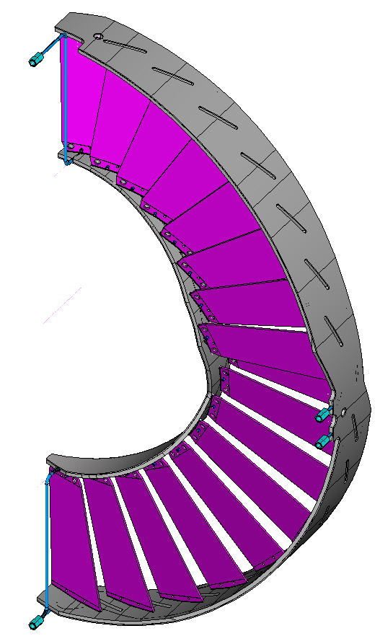
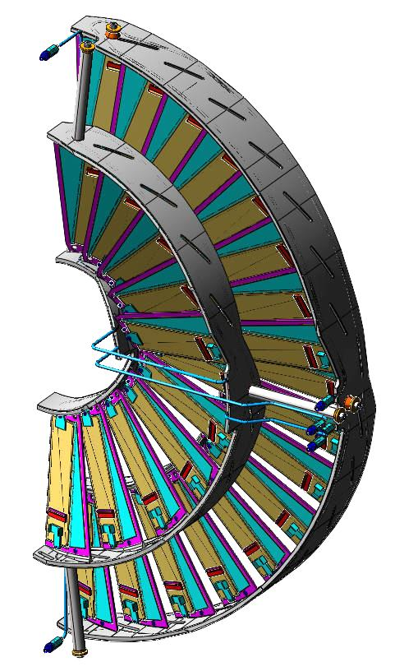
Basic Design of the Half Disk
Half disk consists of one inner and one outer blade assembly.
Both assemblies are fastened to the half cylinder individually with 3 mounts.
Outer blade assembly consists of 17 blades.
Inner blade assembly, with an inverted cone layout, consists of 11 blades.
All blades are bonded to 2 half rings that act as heat sinks.
Each bonded assembly can be mechanically/thermally tested as a unit prior to mounting modules.
Bonded Outer Ring Assembly
ready to take modules

Slide 25
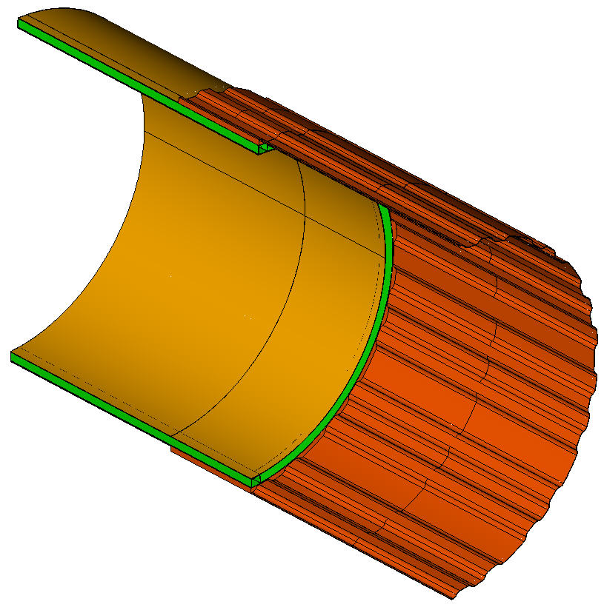
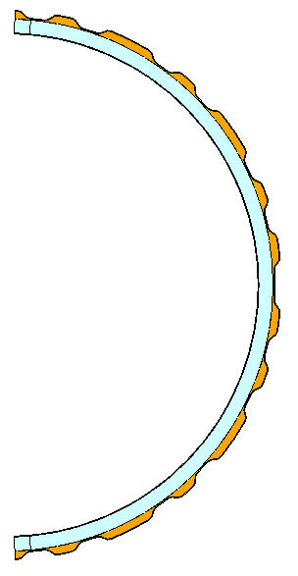
Conceptual Design of Half Cylinder
Thin, front section with 27 troughs → cooling tubes and cables of the inner assemblies can be removed
from the outside of the HC, while outer assembly tubes and cables are kept inside the HC
All carbon-fiber reinforced plastic design consisting of 3 sections:
- front corrugated single-wall section (1 mm thick)
- transition section where front and rear sections are glued together
- rear section (which is basically the same as the existing design)
Filled with cf in transition section
- enhance stiffness
- increase surface area for gluing
rear section (shorten)
transition section
front section
Note: only a short length of rear section is shown

Slide 26
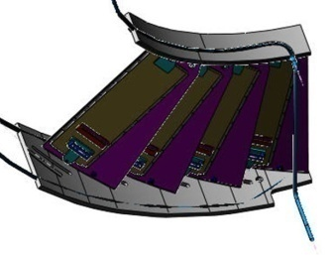
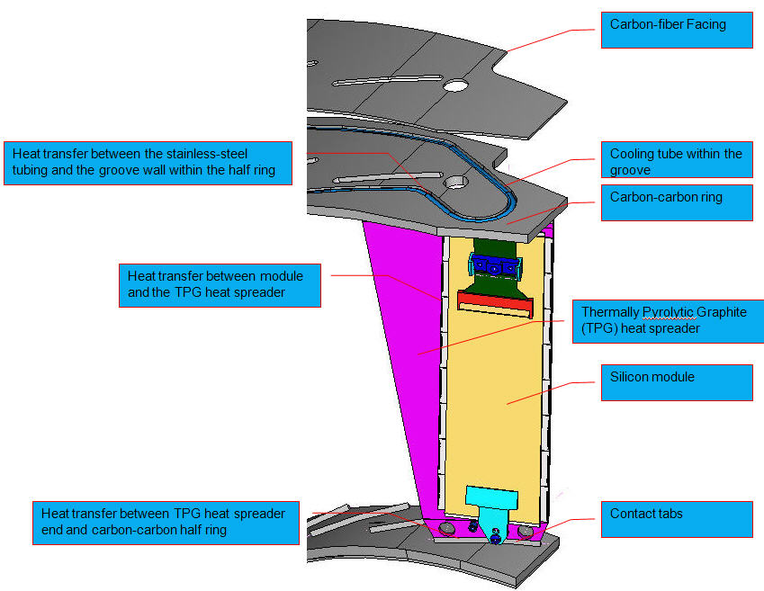
4-Blade Thermal Testing Assembly
Use this test to verify the overall temperature drop experimentally from the CO2 coolant to module (Goal: to be within 10ºC with a heat load of 3W per module, agreed upon at the last CMS Tracker Upgrade Mechanics/Cooling Meeting as the cooling performance specification for the design)
4 TPG blades will be bonded to 2 CC ring segments
Dummy 2x8 modules will be glued to blades

Slide 27
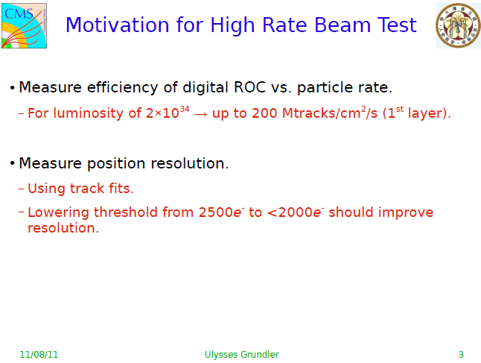

Slide 28
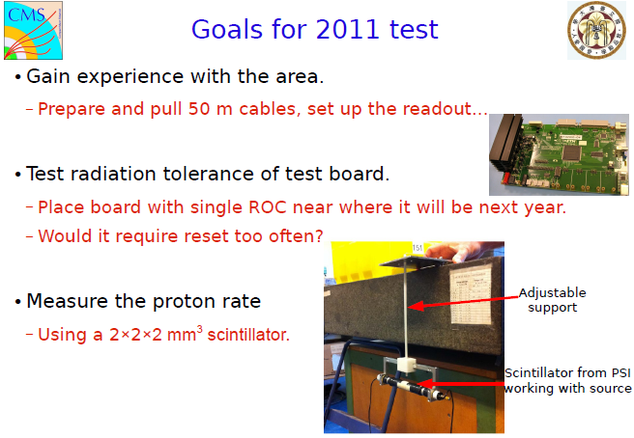

Slide 29
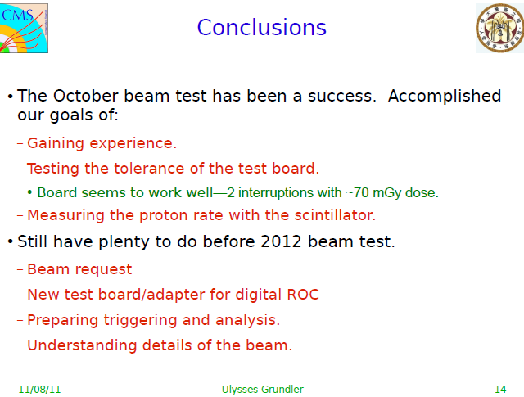

Slide 30
Why talk about FNAL test beam?
No beam will be available at CERN during Long Shutdown 1 (all of 2013)
PSI46dig_v2 (pixel ROC for Phase 1) is likely to be ready for a beam test of rate capability exactly when LS1 starts.
Rate capability can be tested at PSI, but only with low energy pions → precision measurements are problematic

Slide 31
High Rate test beam at FNAL:
What is required?
Short section of beamline (less than 1 meter)
Beam spot larger than 1 pixel ROC (8mm x 8mm)
Rate adjustable up to ~500 MHz/cm²
High energy particles (to minimize interactions and multiple scattering)
Area identified: M03
A new running condition is required (radiation safety ok)
The sooner a request is made to FNAL, the better.

Slide 32
Pixel Phase 1 Pilot System
General Considerations
No or little impact on the current detector operation
Will use the new PSI46dig ROC and new TBM
Use the same electronic circuits that we plan for the FPIX upgrade detector
New FED; modified DAQ software
What do we gain from doing this than couldn’t be accomplished by doing a full system test of the real components/circuits that we will use for the Phase 1 upgrade
  PROS: P5 running in collider environment; head-start on DAQ, DCS, DQM etc;
  CONS: resources, diversion from Operation and main Upgrade effort; results may be affected by the existing system constraints

Slide 33
Plan
Build a few blades using the new FPIX 2x8 module design
Mount the new modules on to the Al brazed channel and existing Al ring support (same mechanical support/cooling arrangement as the current FPIX detector) as third disk on one of the existing FPIX half cylinders
The geometrical configuration is similar to the outer assembly for the FPIX upgrade
New HDI, Al cable, (probably) new port card, POHs
CCU board and token ring already exists
Since we are not short of fibers, we have the flexibility of using either TBM_bpix or TBM_fpix with or without the new Datakeeper
Will try to use as close to the new FPIX readout chain as possible

Slide 34
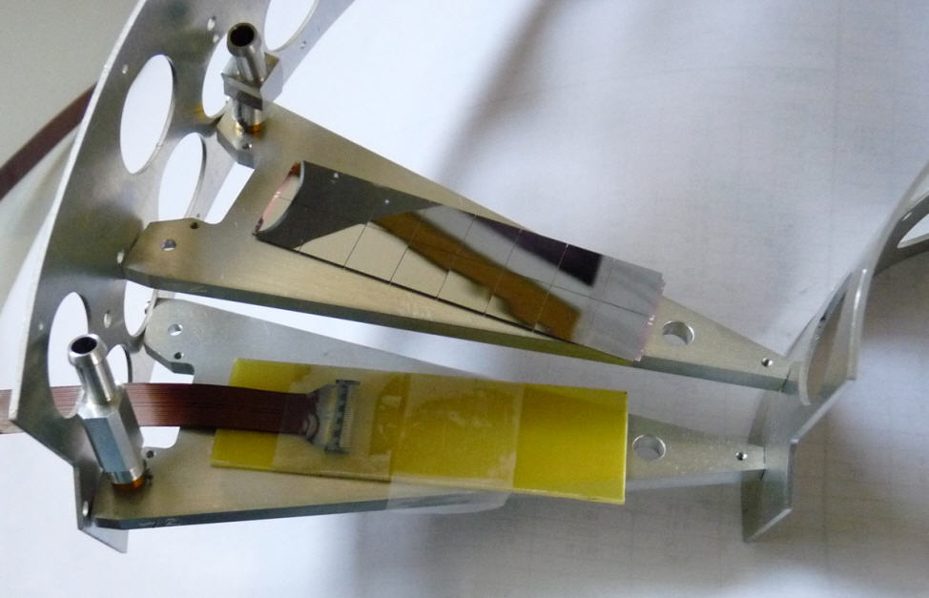
Pilot System Model

Slide 35
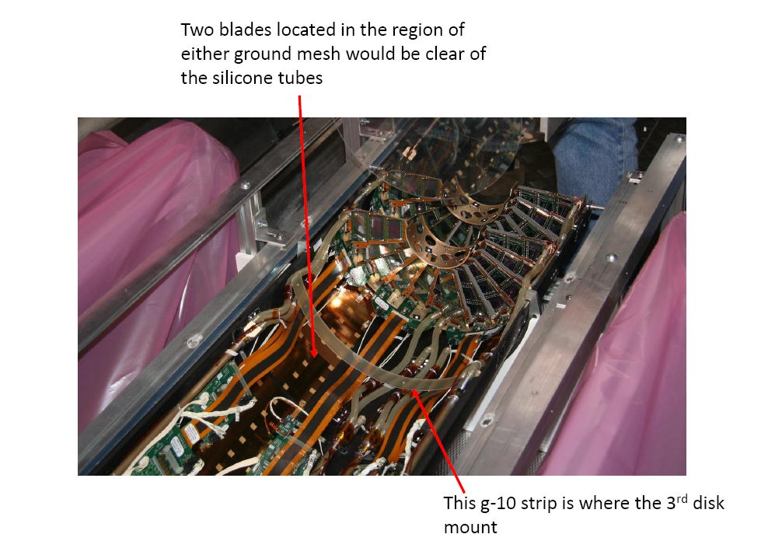
From Joe Howell
Notes:
Next slides show mechanical considerations.
Existing silicone tube can not fit between the outer ring of the pilot half-disk and the half-cylinder. Perhaps the silicone tube can be slid through gaps between cooling channels of the pilot detector half-disk that panels normally block. (note: in the current detector, we made an ovalized Al pipe to pass under half-disk 2 for cooling lines for HD1). This is preferred than making a new long ovalized Al pipe to get the cooling lines for HD1 and HD2 passing through HD3. Since HD3 will mostly be empty, there’d be plenty of space for us to slide the silicone tube between gaps.

Slide 36
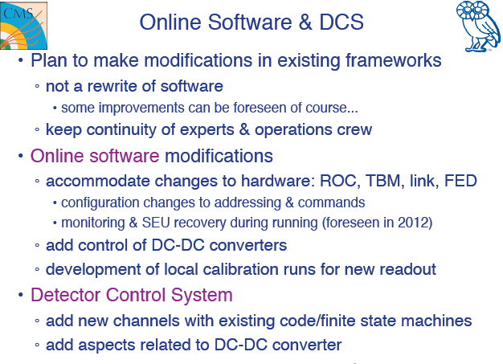

Slide 37
Interested Parties
CERN (activities to be defined; would like to see the list of tasks first before deciding)
Finland – Helsinki (VTT bump—bonding)
France – Lyon (DAQ)
UK – RAL (DAQ, FED firmware)
US – FNAL, Purdue, Vanderbilt, MRI institutes (KU,KSU, Rice, Rutgers, UIC, UNL, UPR)

Slide 38
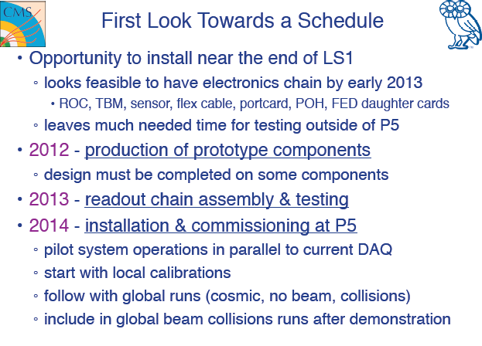

Slide 39
Phase 1b Activities: Introduction
The inner layer of the Phase 1 Pixel detector is exposed to very high level of irradiation. A lifetime of maybe less than 2 years at luminosity (L_{int}=200 fb^{-1;} ~2 10¹⁵/cm²) is expected.
The Idea is to profit from the first replacement of the inner layer to introduce a new detector (sensor+ROC) that
  has much longer lifetime
  will improve pixel detector performance

Slide 40
Link to Phase II
The development should have a longer term goal, pointing to the phase 2 detector. Therefore the new layer should target to requirements for the phase 2
  Phase1b is a step forward to Phase 2 pixel
  In the Tracker we need to define how much forward it is usefull
The Phase 2 requires the full redesign of the pixel detector. This requires several years of development and we intend to start the effort of designing a new pixel chip now

Slide 41
New Pixel Chip goals
Efficient at very high rates
  Study of the best suited unconstrained chip architecture
Significantly smaller pixel size
  Strongly dependent on sensor thickness and type
  Final answer should come from physics simulation studies
Intrinsically compatible with different sensors
  Baseline: planar/3D pixel/diamond
Considering the support for intermediate level trigger
Easy module assembly and costs

Slide 42
Initial R&D
Sensor
  3D, diamond (extension of existing R&D program)
  Thin planar
    Simulation to determine performance as a function of electronics threshold, sensor thickness, and pixel dimensions.
  CMS MC studies of smaller pixels
    B tagging in high pT jets
ROC
  Radiation tests of CERN test structures in additional IC processes
    Develop design rules for analog & digital circuits
  Develop circuit elements to explore limits of
    FE noise
    Signal speed
    Power requirements
    Size requirements (pixel size)
    Discrimination threshold
  VHDL simulation of readout architectures
  Understand GBT requirements
  Explore use of FEI4 circuit elements
Trigger
  CMS MC studies to determine requirements & rates
    e/tau region of interest trigger?
    Other ideas??

Slide 43
Simulation Studies
Simulation software for TDR studies
  Using CMSSW release CMSSW_4_2_3_SLHCx with CMSSW_4_4_X tracking (handles high PU better)
    Not moving releases until we have results on the ZHbb analysis for TDR
  Full (GEANT4) simulation used for tracking studies: tracking efficiency and fake rates, b-tagging studies
  Modified Fastsimulation for physics studies (but see later)
Results to be included in the TDR
  Effect of new ROC (reduce data loss)
  Effect of additional pixel layer
    Recovery of efficiency in case of TIB inefficiency
  Effect of smaller pixel size/closer radius (Phase 1b)
  Effect of upgrade on a physics channel (boosted ZHbb)

Slide 44
Upgrade Tracking
Study at <PU>=50 (100) for 25 (50) ns crossing time
  Data loss used in simul. due to ROC/readout limitations (from TP)
  Do we have new data loss numbers for redesigned ROC chip?
Tracking steps modified for upgrade geometry and high PU
  Extra layer: quadruplet seeds and efficient triplet seeding (3-out-of-4)
  Tuning of tracking steps for <PU> of 50 and 100 to reduce fakes
    Drop pair seeds, low pT seeds, and detached tracking steps
    Optimization still ongoing
Current Detector | Radius (cm) | % Data loss at 2×10³⁴ @25ns | % Data loss at 2×10³⁴ @50ns
BPIX1 | 4.4 | 16 | 50
BPIX2 | 7.3 | 5.8 | 18.2
BPIX3 | 10.2 | 3.0 | 9.3
FPIX1&2 |  | 3.0 | 9.3
Phase 1 Detector | Radius (cm) | % Data loss at 2×10³⁴ @25ns | % Data loss at 2×10³⁴ @50ns
BPIX1 | 3.9 | 4.7 | 9.4
BPIX2 | 6.8 | 1.5 | 3.1
BPIX3 | 10.9 | 0.6 | 1.2
BPIX4 | 16.0 | 0.28 | 0.59
FPIX1-3 |  | 0.6 | 1.2

Slide 45
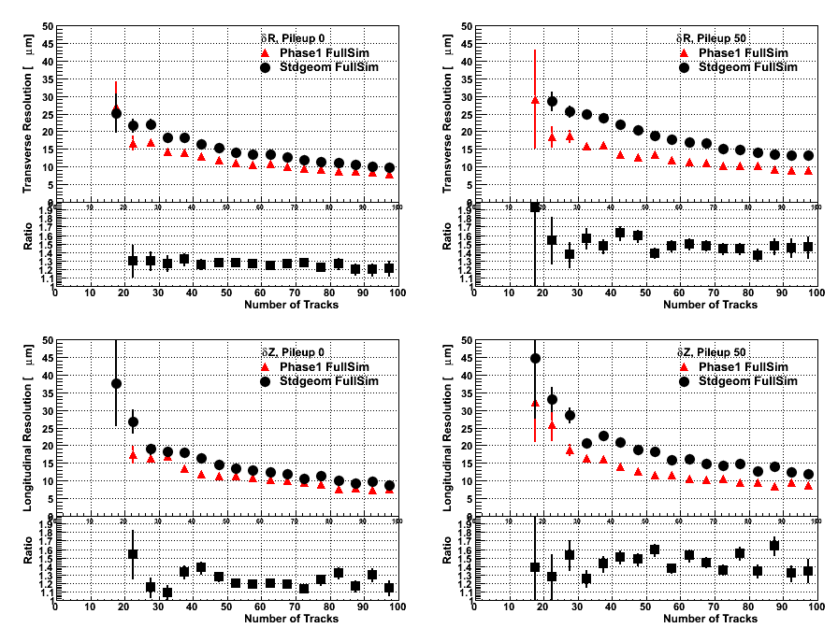
Primary Vertex Resolution vs N_{tk}
Using ttbar, we want to demonstrate why the resolution gets more worse for stdgeom (still under study)
Transverse
No pileup
<PU>=50
Longitudinal
No pileup
<PU>=50
Current Pixel Geometry
Phase 1 Upgrade Geometry

Slide 46
Effect of ROC Data Loss
Worsening of b-tagging (<PU>=50, ttbar)
CombinedSecondaryVertex
b-tagging algorithm
Current Geometry
Phase 1 Upgrade Geometry

Slide 47
Effect of Extra Layer
Improvement for b-tagging (<PU>=50, ttbar)
  Already significant Improvement for upgrade geometry even without ROC data loss
CombinedSecondaryVertex
b-tagging algorithm
<PU>=50 no data loss
<PU>=50 with (Pixel ROC) data loss

Slide 48
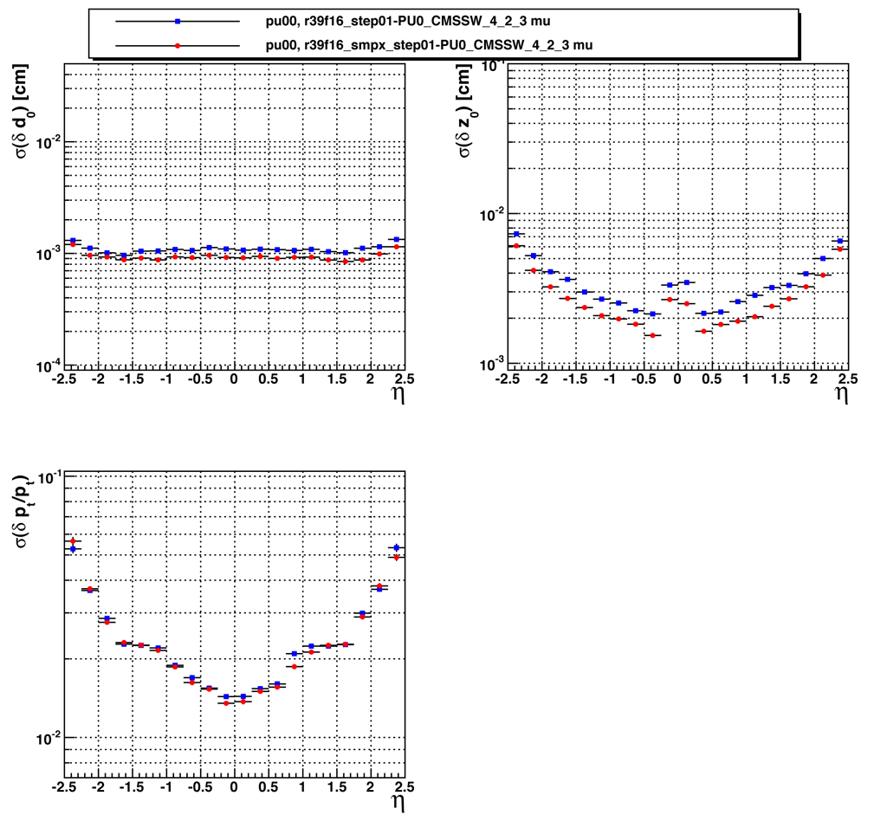
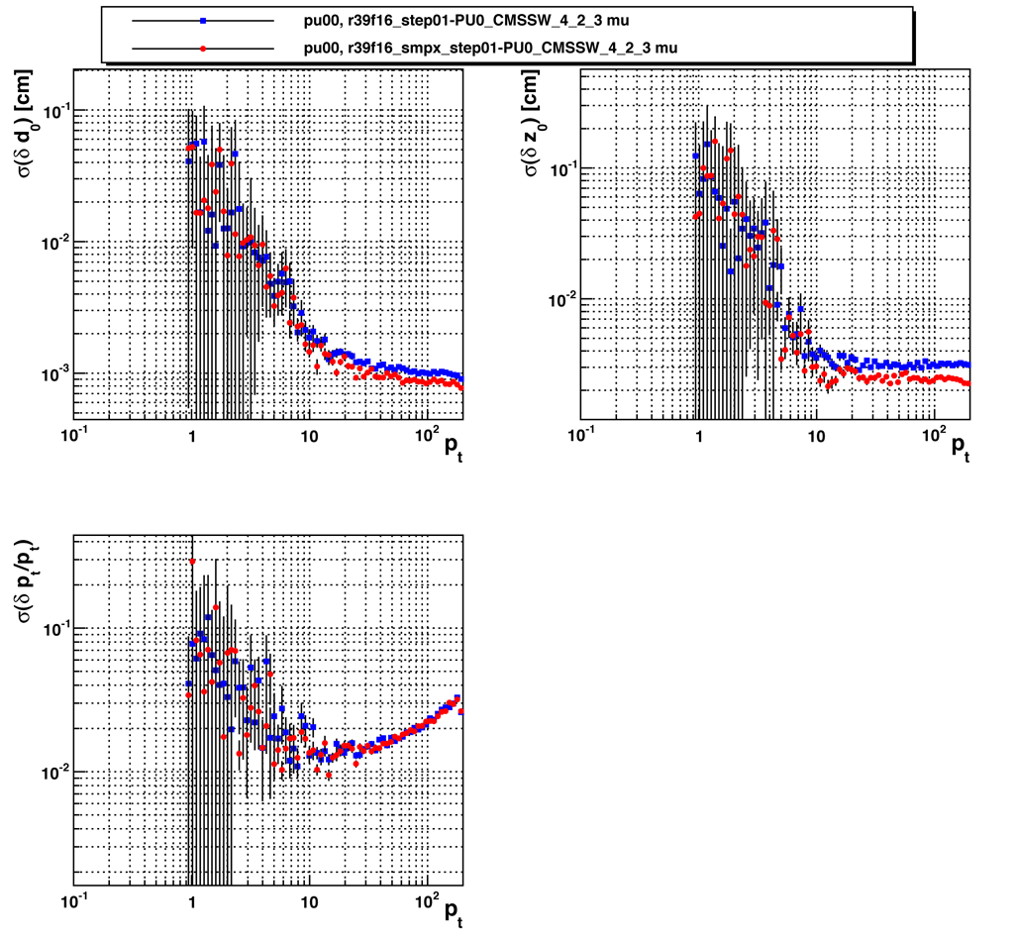
Phase 1b Studies
Resolution plots from MTV (not plotted against absolute p)
Transverse
Longitudinal
eta
p_{T}
p_{T}
Phase 1
Smaller Pixel Size

