Slide 1
HCAL Technical Progress
Chris West, University of California, Santa Barbara

Slide 2
Overview
Great deal of progress cannot be fully summarized in 20 min; some selection necessary
Will focus on:
  SiPM R&D
  μTCA development

Slide 3
Silicon Photomultiplier R&D

Slide 4
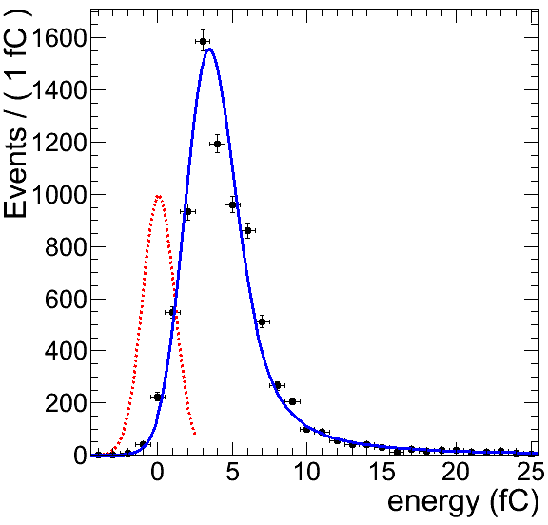
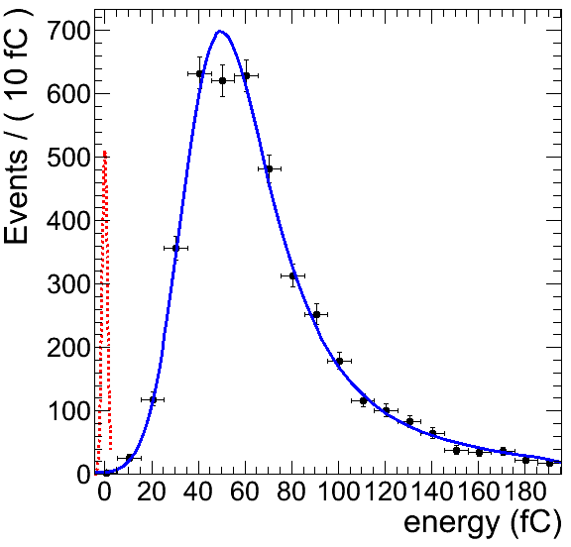
HPD vs. SiPM
HPD
SiPM
SiPM have 2-3 orders of magnitude higher gain and photo-detection efficiencies than HPDs and do not have the discharging behavior of HPDs in intermediate magnetic fields

Slide 5
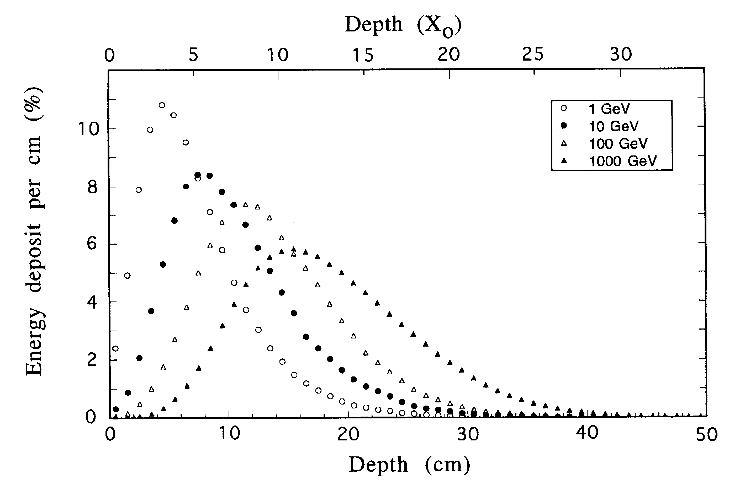
Physics Motivation
Longitudinal shower leakage limits power of H/E selection, particularly at high p_{T}
Very little leakage here. Longitudinal segmentation would allow better particle ID at trigger and analysis level
ECAL
HCAL
Depth 1
HCAL
Depth 2
HCAL
Depth 3
At high energy, everything looks like a jet

Slide 6
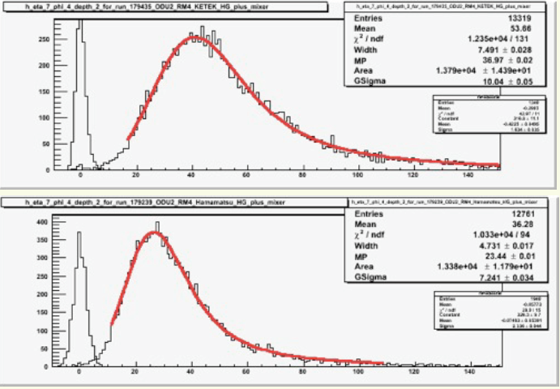
Test beam data
See talk by A. Heering
240 KETEK devices tested at October test beam
KETEK+ mixer
Hamamatusu+ mixer

Slide 7
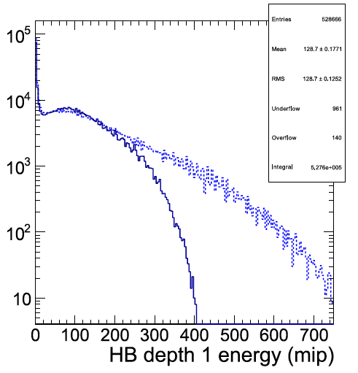
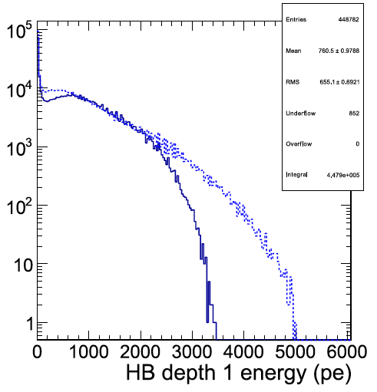
Light Mixer
See talks by R. Ruchti,
J. Anderson
No Light Mixer
With Light Mixer
Increase uniformity of SiPM illumination while maintaining high transmission
  Maximizes dynamic range
Successful tests with Ketek device at depth 1, ongoing research to understand behavior at other depths
Lessons learned
  Square cross-sections present problems machining, finishing
No Light Mixer
With Light Mixer

Slide 8
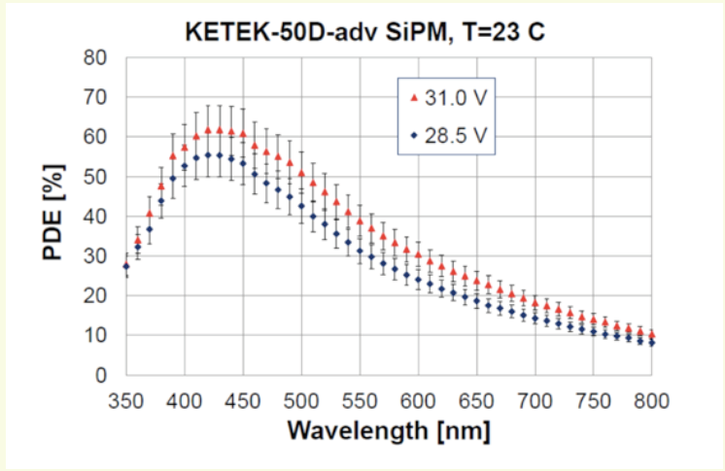
PDE of KETEK

Slide 9
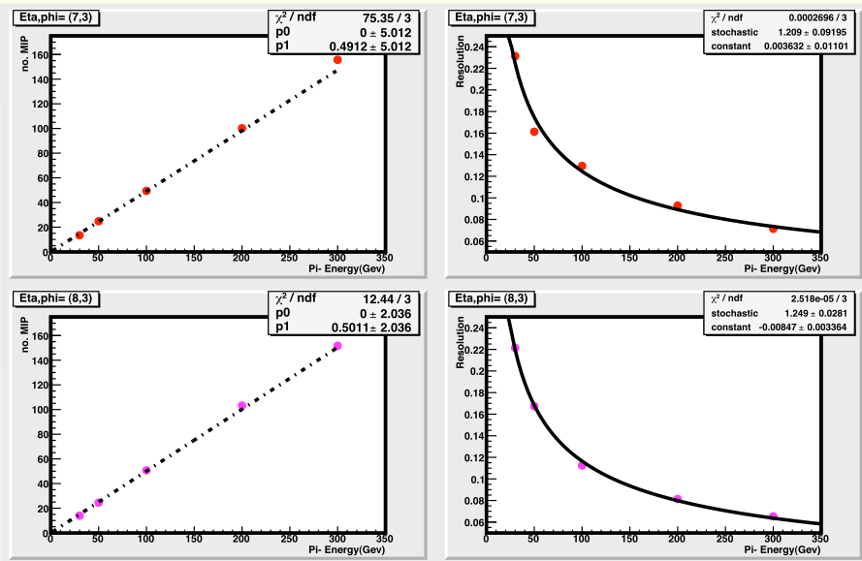
Linearity and Resolution
Linearity
Energy Resolution
(η,φ)=(7,3)
~8% at 300 GeV
(η,φ)=(8,3)

Slide 10
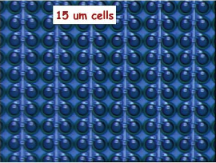
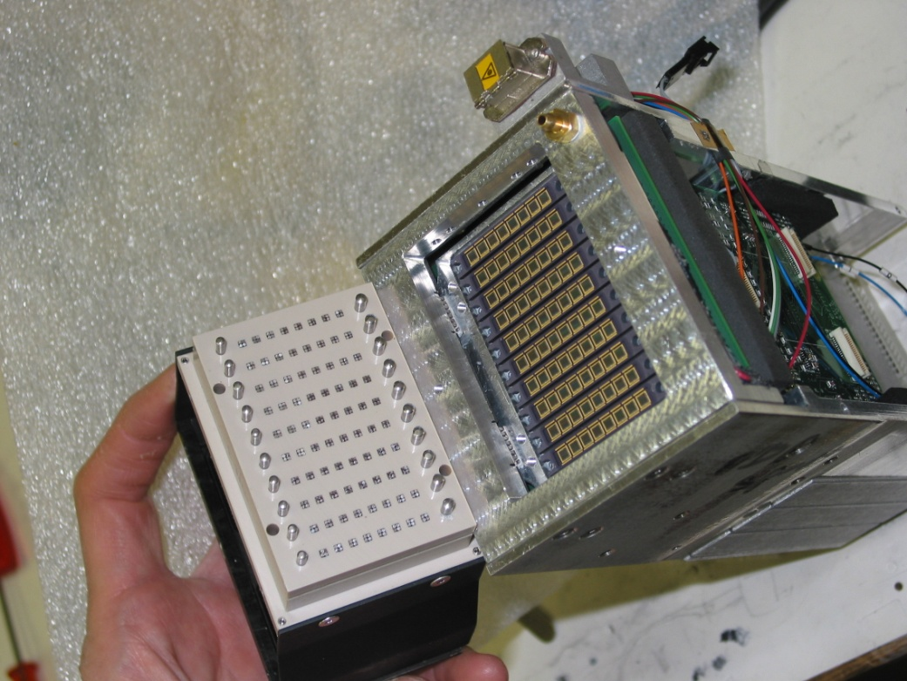
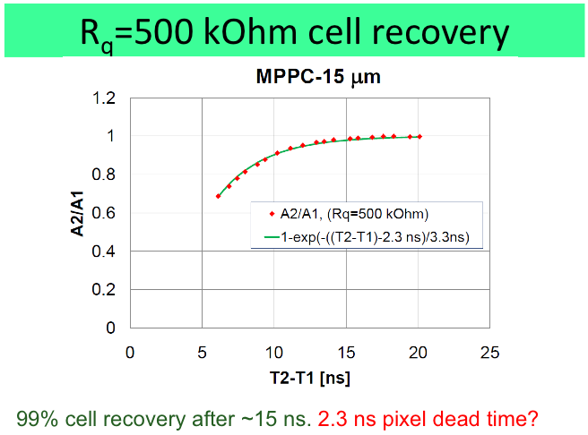
SiPM Recent Results
See talk by C. Tully
Pixel Dead-time Issue solved in 15 micron Hamamatsu Device
  99% cell recovery after 15ns
Full-Scale Test Beam Evaluation
  July and Oct at H2 setup ECAL+HCAL

Slide 11
Future SiPM development
See talk by A. Heering
Ketek – new development
  Thicker epitaxial layer for higher PDE at 520 nm and lower gain
  15 micron round devices (d=2.5mm)
HPK– no new wafer development
  Buy more packages for HE development
  Wait for high PDE thin film Rq
FBK and Zecotek/others waiting for better PDE prototypes

Slide 12
SiPM Summary
Progress in finding devices that will match the needs of HB
Successful test of production parts for HO
Light mixer results are mixed

Slide 13
Backend electronics upgrade

Slide 14
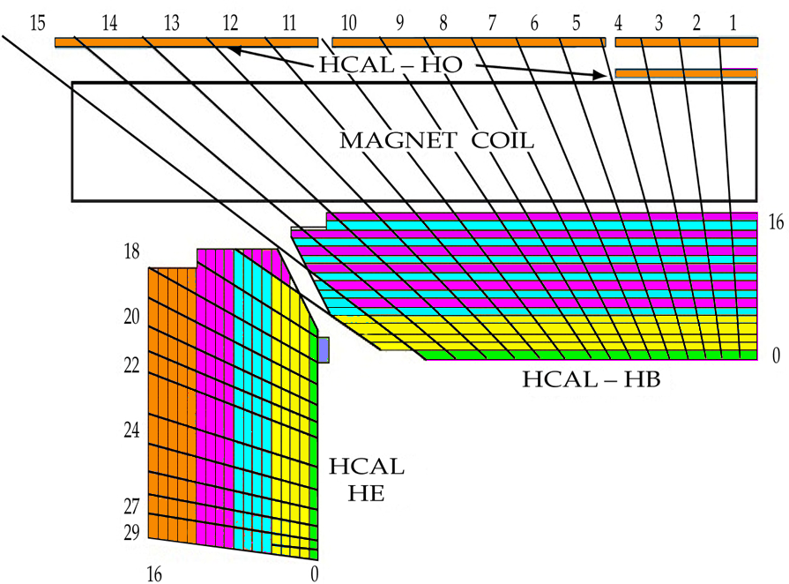
Motivation
Depth segmentation in HB/HE
Rising and falling-edge timing in HF
Must support ~3-fold increase in data volume
Must be ready by 2013 to support upgrades

Slide 15
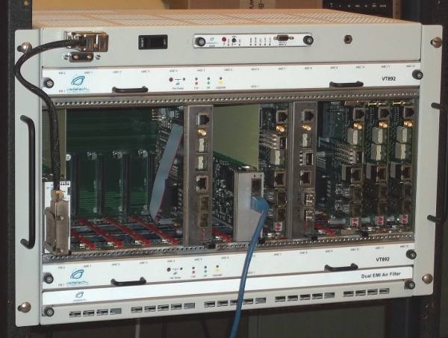
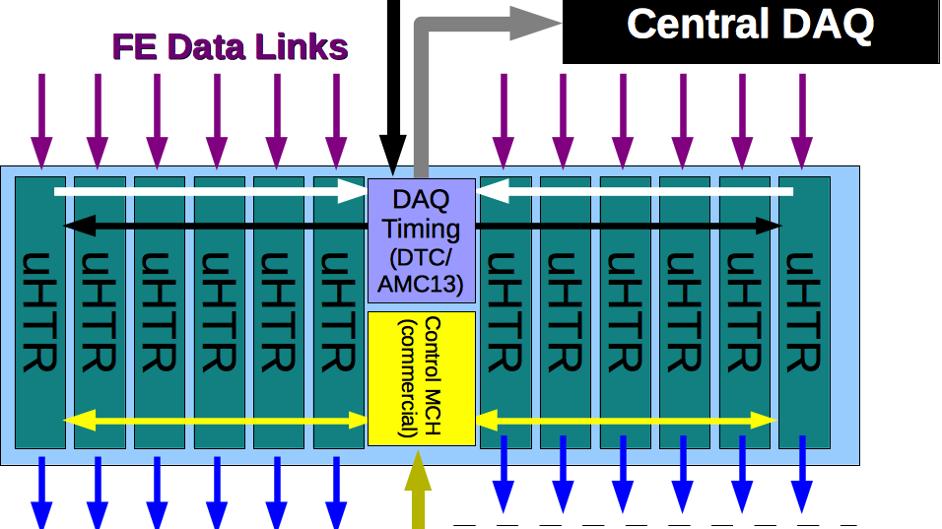
HCAL μTCA Crate

Slide 16
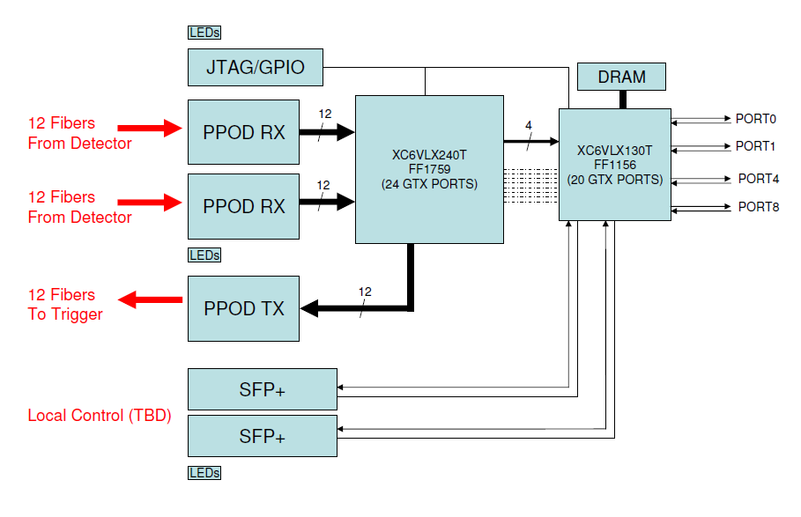
uHTR and miniCTR2
See talk by E. Frahm
μHTR architecture
miniCTR2 a test version of μHTR with reduced link count and a Virtex 5 FPGA
3 miniCTR2a and 7 miniCTR2c cards produced

Slide 17
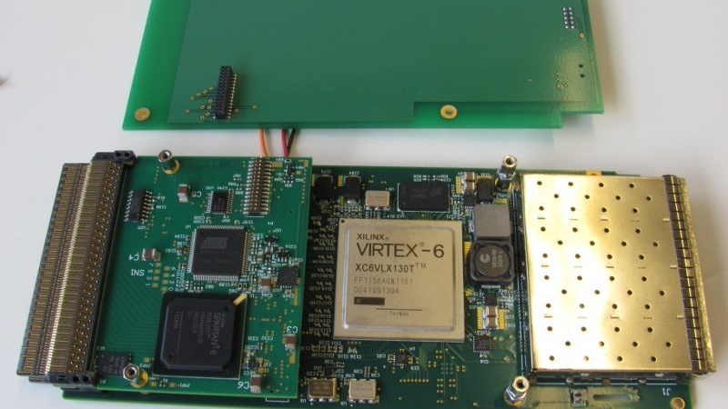
AMC13
See talk by E. Hazen
12 boards produced:
3 good, 8 passed preliminary tests, 1 bad
Tongue 3 PCB
(optional, for initial programming)
Atmel AVR-32 uC
MMC Functions
Tongue 2 PCB
Spartan 6 FPGA
Fabric B TTC distribution
Firmware management interface to MMC
Virtex-6 LX130T FPGA
DAQ functions, buffering
6 Gb links to backplane
Tongue 1 PCB

Slide 18
Firmware Status
Highlights of miniCTR2 firmware support:
  Address table management of FPGA resources
  Input spy capabilities
  Reloading firmware GbE via IPBus
  Clock initialization
AMC13 features available ~December 2011:
  MMC (AMC standard plus extensions)
  Ethernet interface
  TTC/Clock distribution
In progress: development of miniCTR2 firmware for ngCCM and front-end emulators

Slide 19
Software Status
Address table support for uTCA targets via HAL-table, integrated with xdaq or standalone
  Discussions at this meeting on merging features/API with microHAL
Xdaq applications for configuring miniCTR2s, with associated hyperdaq pages

Slide 20
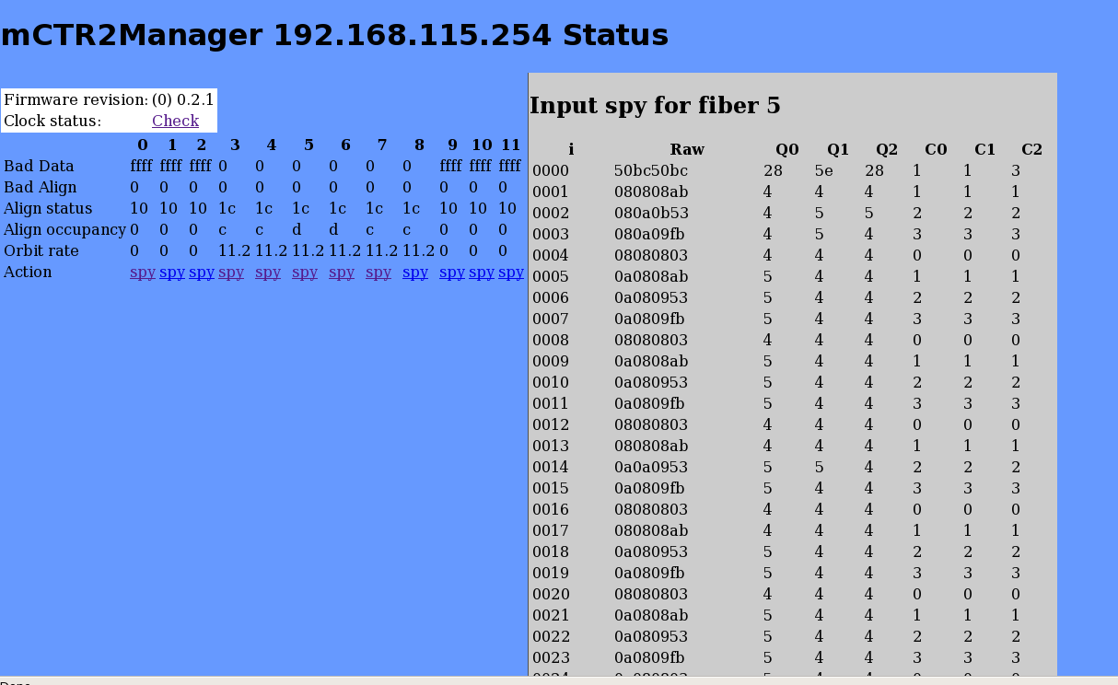
miniCTR2 Software Support
See talk by P. Rumerio
Methods developed to
  Spy input data
  Initialize links
  Read out basic monitoring information

Slide 21
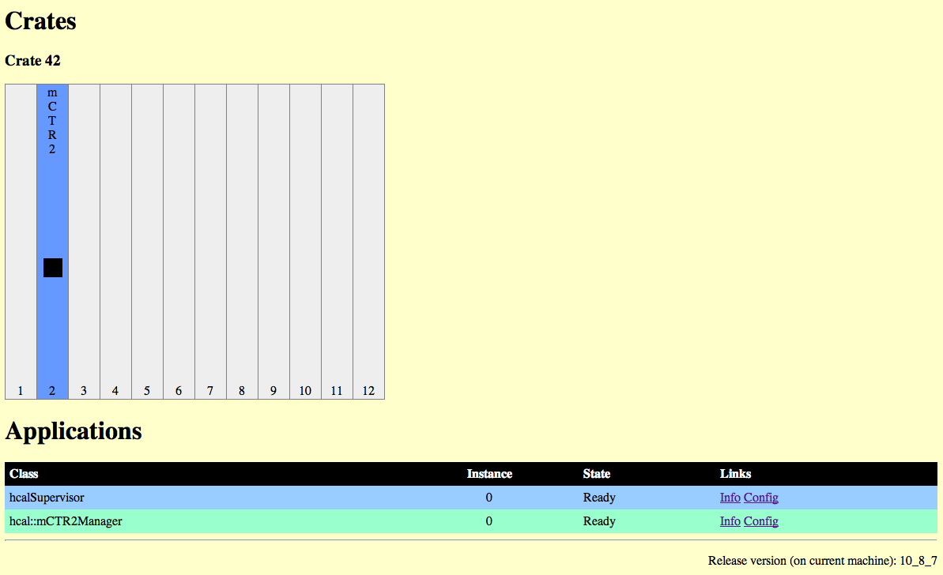
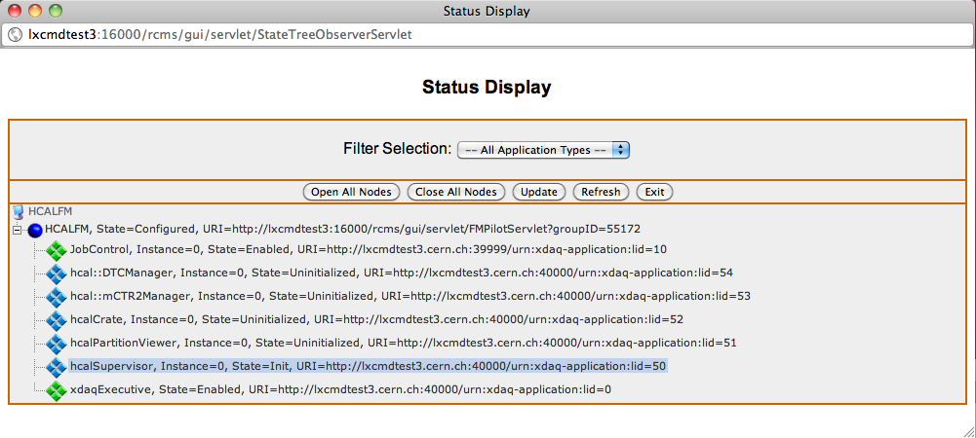
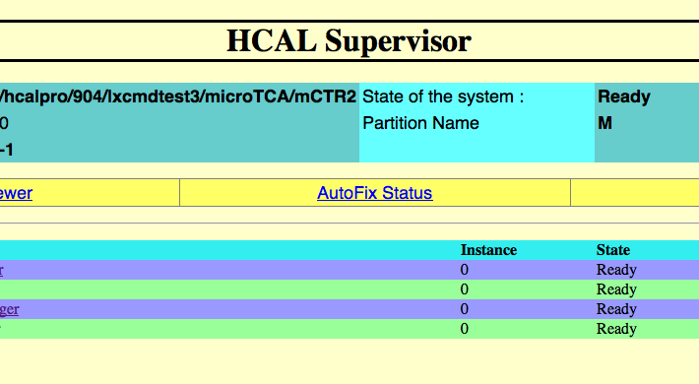
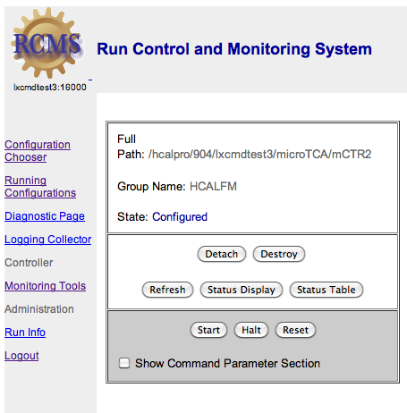
Work on integration

Slide 22
Slice test in 2012
See talks by J. Mans,
J. Whitmore
Front end
Split digital signals 50/50 from FE to verify μTCA technology
  Create HLT stream with ~0.1 Hz rate based on L1A number, compare with μTCA data acquired with local DAQ
  Resulting digis should be identical
For test:
  Splitters (purchased, splitter boxes designed)
  6 HB/HE HTRs, 2 HF HTRs
  1 uTCA crate (1 DTC, 12 miniCTR2s, 1 MCH)
    Crate under purchase, miniCTR2 boards under fabrication in India
Later stages:
  Integrate trigger, then full cDAQ
Optical
Splitter
HCAL
Upgrade
Crate
HCAL
Crate
Local DAQ
Global DAQ

Slide 23
Conclusions
Significant progress in μTCA support
Lab and test beam studies show promising SiPM candidates for upgrades

