Slide 1
R&D on TSVs with IPDIA
CMS Upgrade Week at Fermilab
Tracker Phase 2 Parallel session https://indico.cern.ch/sessionDisplay.py?sessionId=9&confId=153564#20111107
G. Blanchot

Slide 2
Outline
Targeted applications of the R&D project with IPDIA.
The 3T demonstrator ASIC
Bump bonding preparation:
  Wafer bumping at IBM.
  TSVs etching at IPDIA.
  Foreseen test plan.
Conclusion

Slide 3
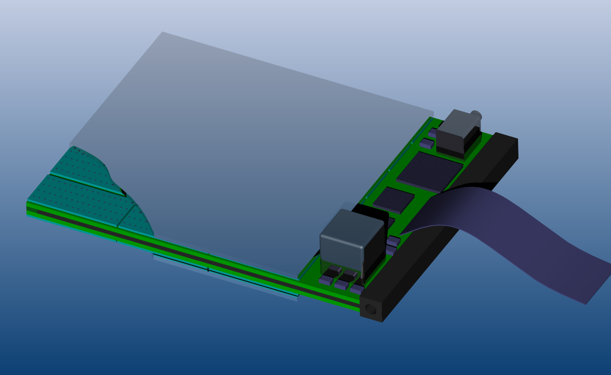
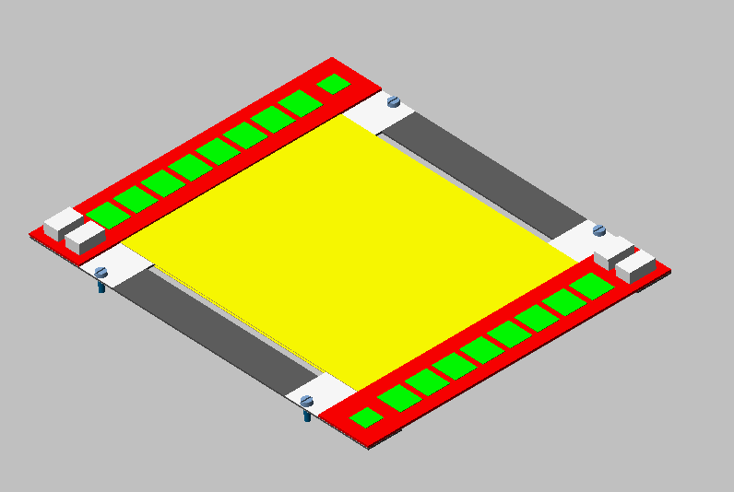
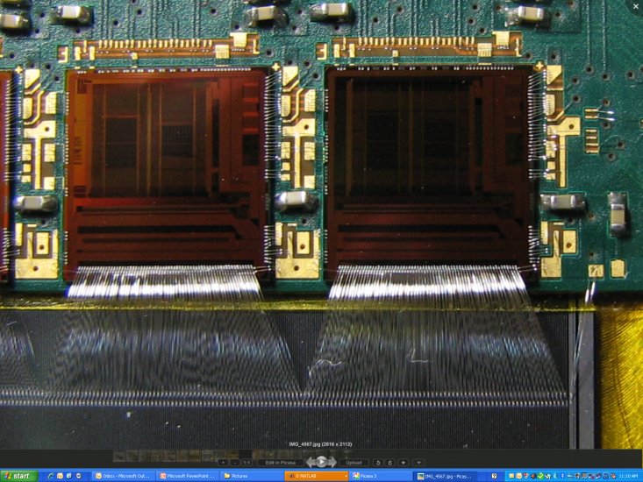
Scope of the R&D activity
Double sided pixelated strip modules have been considered for the tracker trigger modules.
  Dense integration requirement for a Sensor – ASIC – Hybrid stack motivated the TSV studies for pixel ASICs.
Hybrid pixel/strip modules aim for the highest integration.
  Mass reduction drives the need for highly integrated hybrids.
  Try to avoid wire bond dead space: small die size wire bonded ASICs result in poor module area usage.
  3D integration of ASICS and passives need to be explored at some point.
Examples:
  Pixelated strip front-end ASIC.
  Low power GBT, laser driver, laser diode 3D integration.
  Charge pump and capacitors integration.
R&D project
  Demonstrator ASIC: 3T chip.
  Bump Bonding and TSV: IPDIA contract.
  IPDIA manufactures also Silicon capacitors for hybrid circuit integration.
Dead space

Slide 4
Pixelated strip ASIC connectivity
Double sided pixelated strip modules example
Without TSVs: chip wire bonded on substrate, sensor bump bonded after (fine pitch).
…
Substrate 1
Cooling
Substrate 2
With TSVs: coarse pitch bumps on the other side of the ASIC enable bump bonding on substrate.
…
One substrate instead of two
Substrate
…

Slide 5
Hybrid Pixel – Strip Module
Without TSVs:
Edge side powering of large ASICs can pose problems.
Wire bonds have limited current capabilities: large resistivity of bond wires
Pixelated Sensor
Cooling and support
Strip Sensor
With TSVs:
Hybrid extends under the pixel ASICs for better power distribution.
Power path without wire bonds.
No direct cooling contact.
Pixelated Sensor
Cooling and support
Strip Sensor

Slide 6
Integration of circuits on hybrid
Very compact front-end is now under development:
Flip chip C4’ed CBCs.
High density substrate.
Compact and low mass.
Modules will have many other circuits to be complete:
Low power GBT packaged in 8 × 8 mm2 BGA package.
Charge pumps to enable different voltage domains, require external capacitors.
Laser driver, laser diode,optical fiber connection.
They all require non negligible board area.
TSV and bump bonding technology is accessible today:
Become better acquainted with large area bump-bonding techniques (i.e. sensor to read-out chips, chips to substrate).
Keep open the possibility of using a simple TSV technology for stacking sensors, ASICs and hybrids.
Understand basic technologies and tricks for C4 assembly mixed with wire-bonding

Slide 7
3T: Track Trigger Testchip
3T: a demonstrator ASIC for large bump bonded areas
Single design, two operation modes.
Mode 1: pixel ASIC emulator
Mode 2: sensor emulator.
Two 3T dies bump bonded together to emulate a sensor-pixel ASIC assembly.
3T wafers: IBM 0.25μm.
6 wafers un-bumped (1 diced for standalone tests at CERN, 5 at IPDIA).
6 wafers C4 bumped (3 at CERN, 3 coming).
Interconnecting 3T devices: IPDIA
Thinning wafers down to 200 μm, try down to 150 μm.
Etch TSVs on the un-bumped wafers.
Redistribution layer with coarse pitch bumps to connect the TSVs on the other side of the chip.
Flip chip the 3Ts together to form the sensor-pixel ASIC stack.
Flip chip the resulting stack on a test board.

Slide 8
The 3T Test ASIC
16 mm
Periphery
Output Shift Register
7.2 mm
Input Shift Register
Periphery
ASIC emulator: Lower layer chip

Slide 9
The 3T Test ASIC
16 mm
Periphery
7.2 mm
Periphery
Sensor emulator: Upper layer chip
Slice: see next slide

Slide 10
The 3T Test ASIC
Test patterns are shifted into the input shift register.
The patterns flows between the 2 chips, through the bumps.
The pattern is read out from the next output shift register at the end of the chain.
Mode=UPPER
Output shift register (wire bond pads)
Mode=LOWER
Input shift register (wire bond pads)
Upper layer chip
Lower layer chip

Slide 11
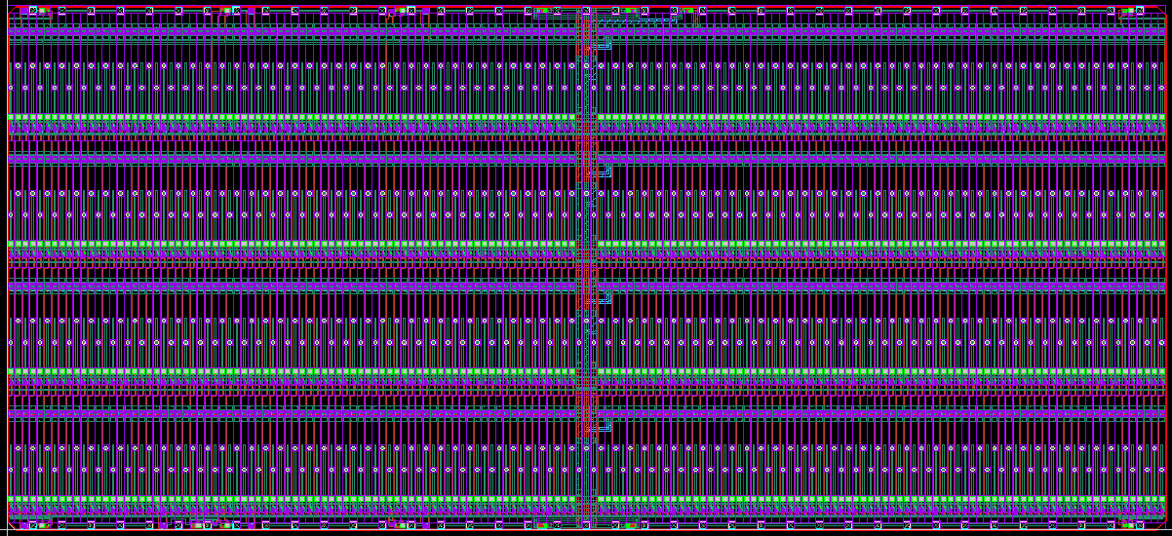
The 3T Test ASIC
16 mm
7.2 mm
Wire bond pads
C4 bump pads

Slide 12
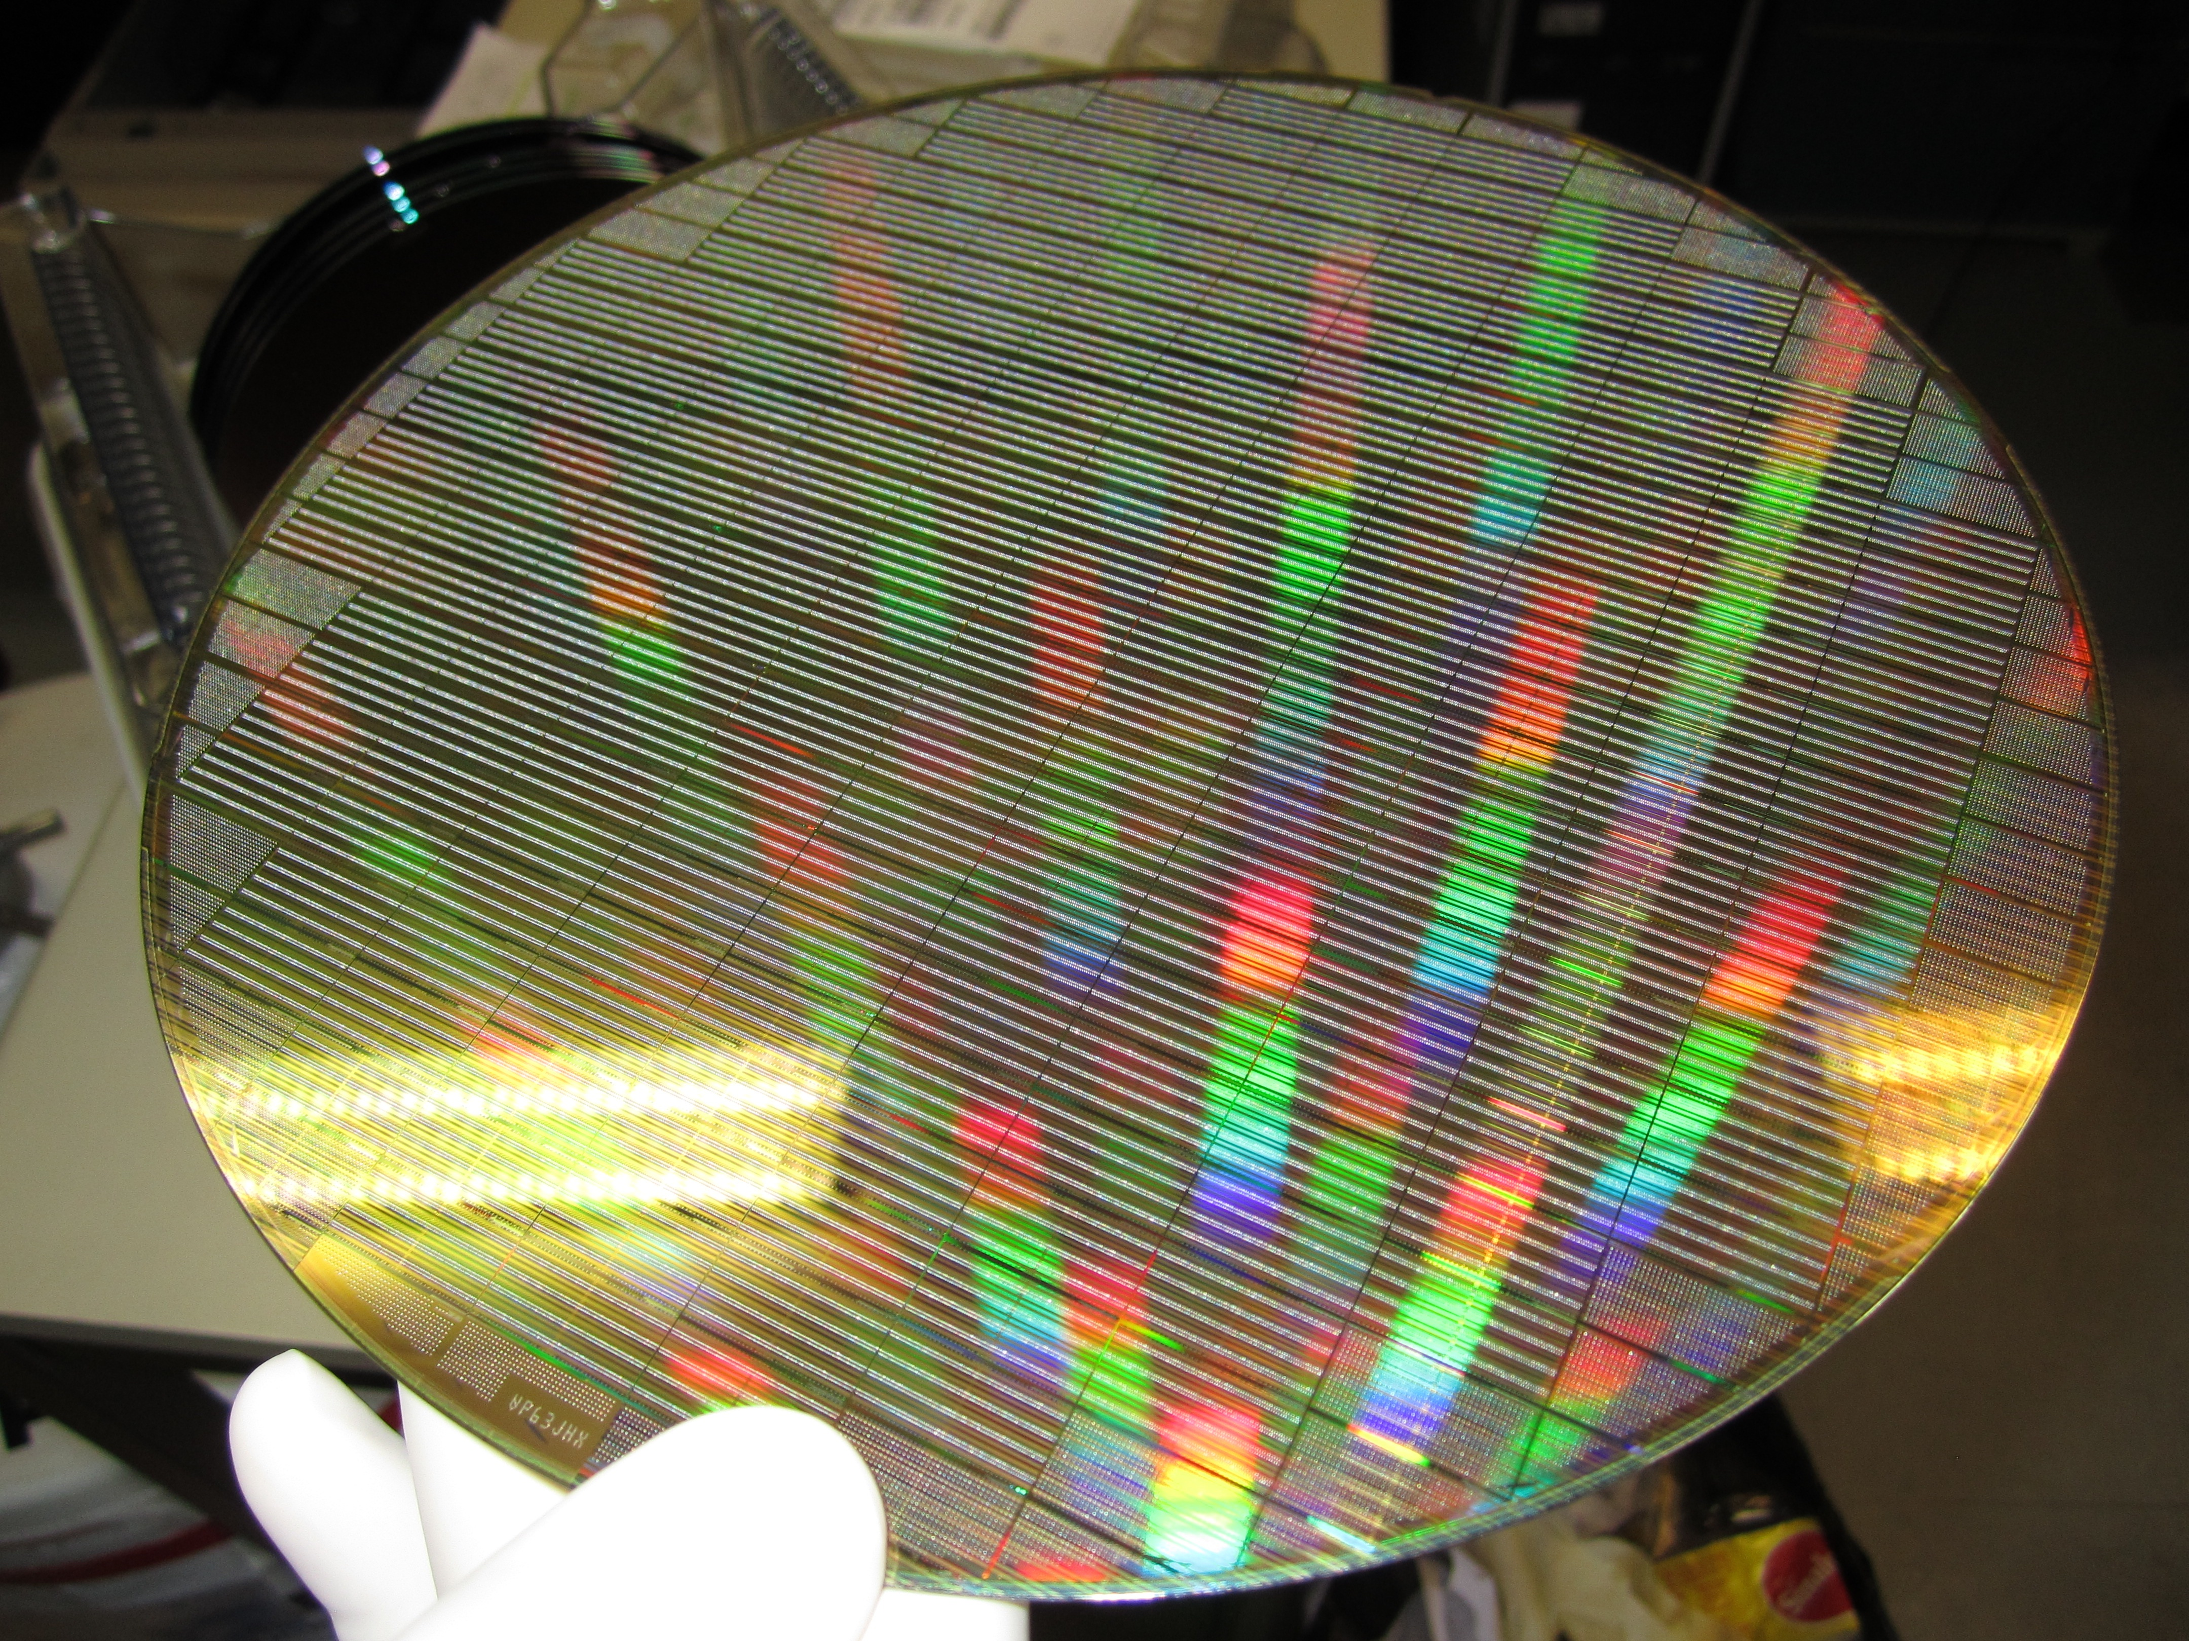
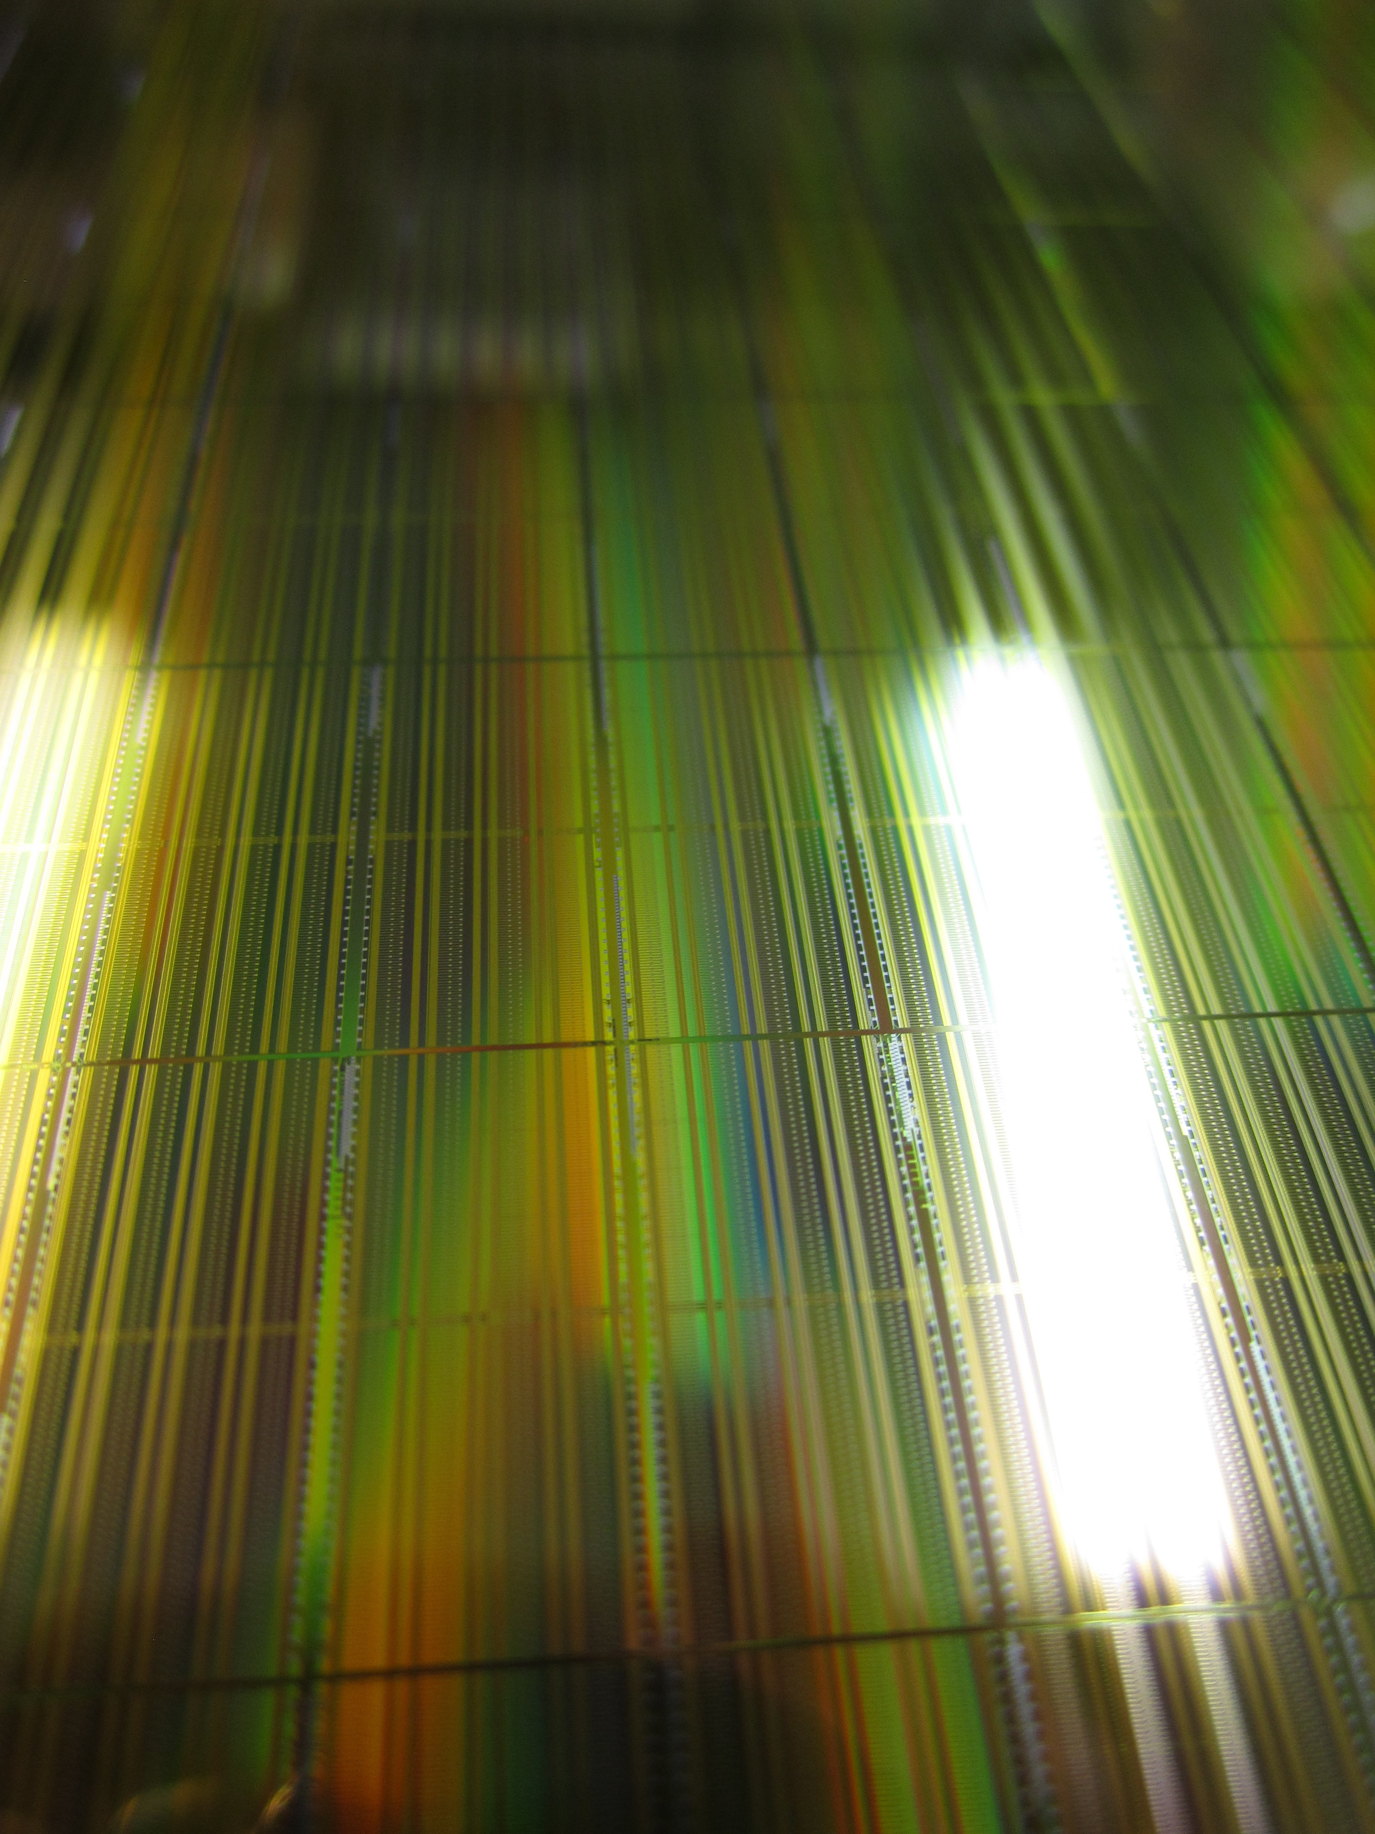
Bump bonding preparation
3T test chip designed in inexpensive ¼ micron tech.
4 wafers bumped with C4 by IBM.
4 un-bumped wafers.
Standalone chips have been tested first.
Now going on with the bump bonding of the chips.

Slide 13
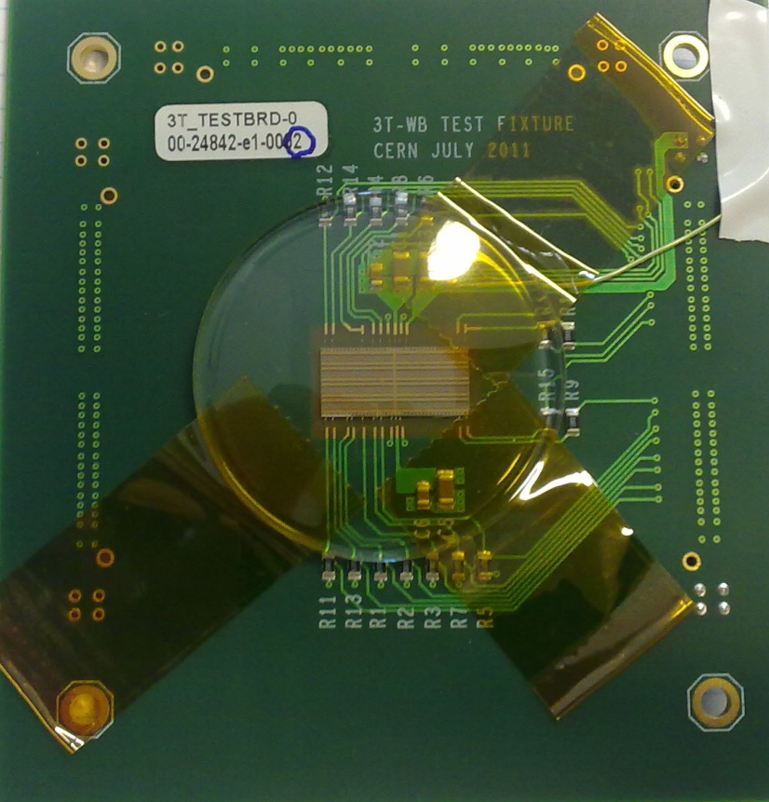
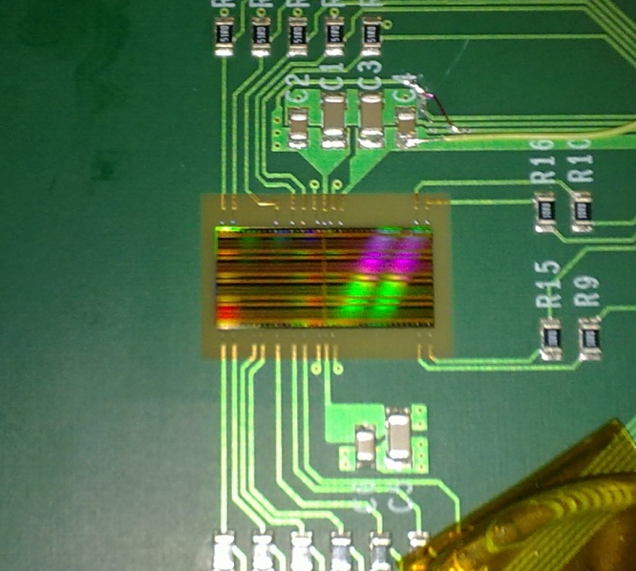
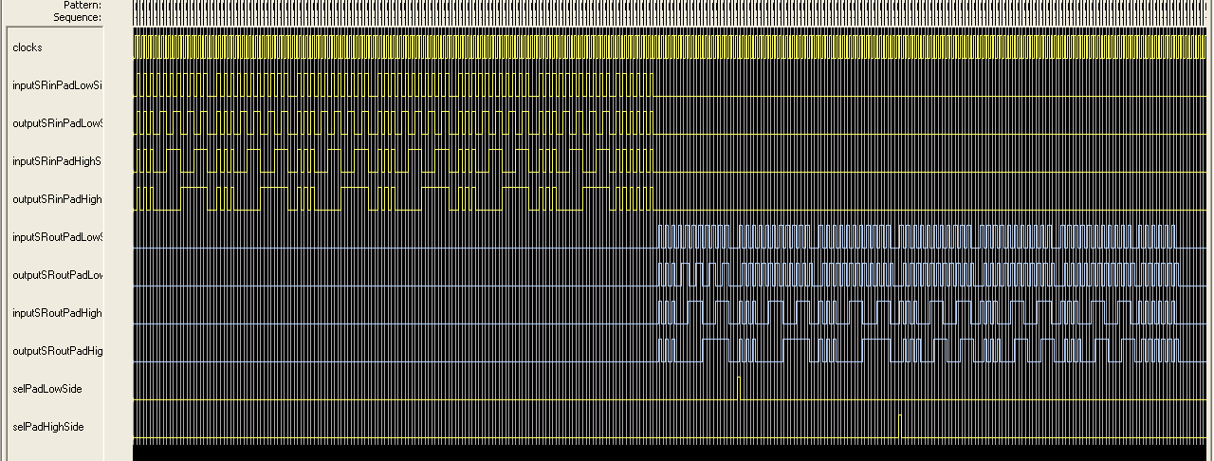
3T single chip testing
Standalone test: 2 modes enabled at same time.
Test patterns flow successfully from the input to the output shift register.
The chips are fully functional.

Slide 14
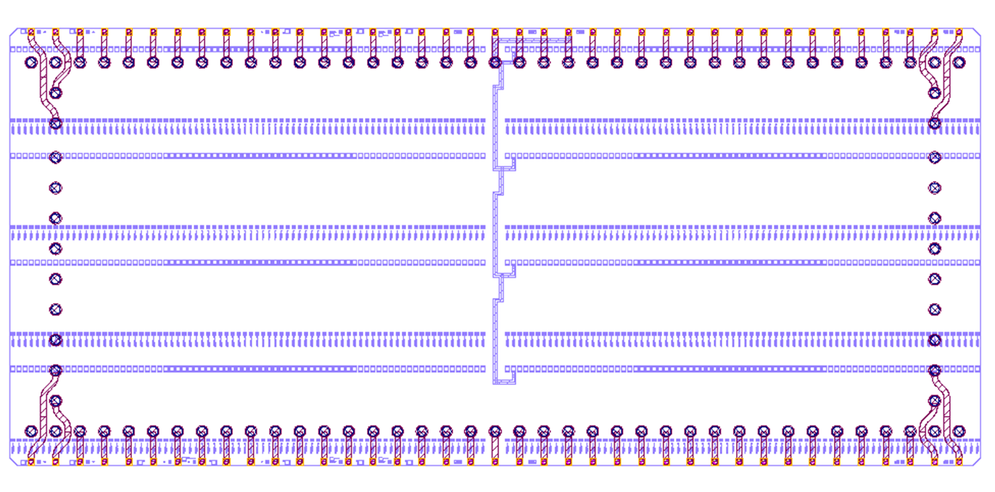
Etching of TSVs at IPDIA
Sensor mode 3T
Starting with a bare pixel mode 3T chip, with the original bond pads facing upwards.
Through silicon vias are etched under the bond pads to bring the connectivity on the other side of the chip.
A redistribution layer is deposited on the bottom of the stack.
Bumps are then deposited on the new redistribution layer.
One bumped 3T chip (sensor) is bonded with the TSV’d 3T chip (pixel mode).
The flip chip stack can be assembed onto a test board.
The flip chip assembly of the 3T, the etching of TSVs, redistribution layer and new bumps can be done at IPDIA (France), a company specialized in the 3D integration.
Pixel mode 3T
Test board
23 functional connections need to be brought under the pixel-mode 3T through TSVs.
TSVs pitch = 400 μm.
Under bump diameter = 200 μm.
The dummy bond pads are also fitted with TSVs and attached to dummy under bumps.
The under bump pattern is arranged as a frame for mechanical strength of the final assembly.

Slide 15
Foreseen test plan
Etching of TSVs
  5 wafers have been sent to IPDIA for TSV etching.
  Deposition of redistribution layer and bumps.
  Due mid 2012.
Testing of a standalone 3T stack
  Bump bond 3T chips together.
  Design standalone test board for bump bonded stack.
  Test standalone stack.
  Expected: end summer 2012.
Testing of 3T array structure
  Dice an array of 3 × 6 bumped chips in one piece.
  Bump bond TSV’d chips with the sensor array, abuted on alll sides..
  Design array test board.
  Testing.
  Expected: end 2012.
Sensor mode 3T
Pixel mode 3T
Test board
Sensor mode 3T array (bumped)
Pixel mode 3T (TSV’d)
Pixel mode 3T (TSV’d)
Pixel mode 3T (TSV’d)

