Slide 1
EODU, Mixers and Plans for 2012
B. Baumbaugh, C. Broughton, C. Burke, J. Conti, K. Daily, J. Freeman, A. Heering, D. Karmgard,
S. Los, J. Marchant, M. O’Brien, P. Rose, R. Ruchti,
I. Schmidt, J. Taylor, M. Vigneault

Slide 2
Mixer Study Objectives
High light transmission
Uniformity of distribution of illumination
Light reduction per photo element

Slide 3
Mixers - 1
Mixer formats
  Single structures
    Varying cross sections, materials and properties
  Multi-element structures
    Use in HO and HB ODU
    Intention is to expand application to HE ODU

Slide 4
Mixers - 2
Single structures
  Cores
  Aperture surface preparations
  Thicknesses
  End finishing

Slide 5
Mixers - 3
Test Setups
  1. CCD imaging
      Uniformity studies
      Pulseheight histogramming technique
  2. P/N diode current sensing
      Transmission measurement
  3. Beam tests

Slide 6
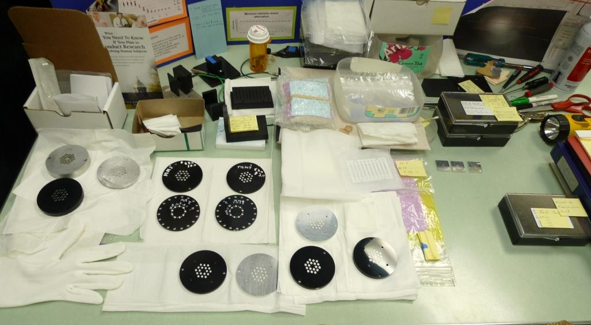
HO Mixers

Slide 7
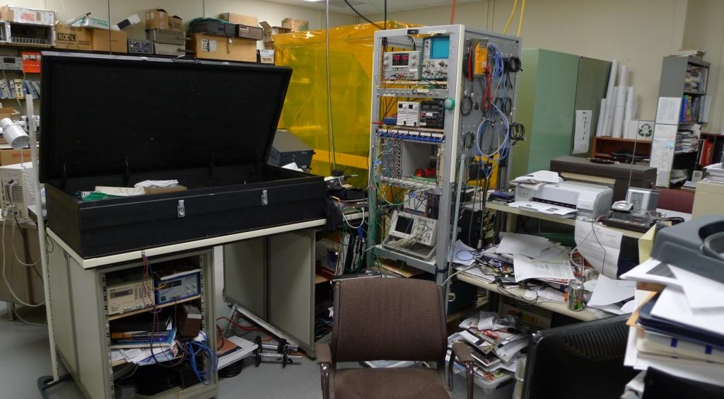
Test Station for Current Measurements

Slide 8
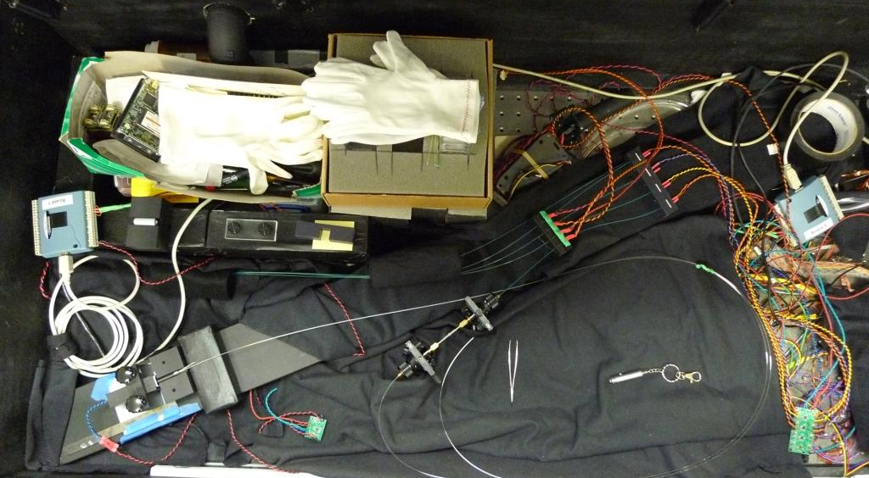
Current Measurements

Slide 9
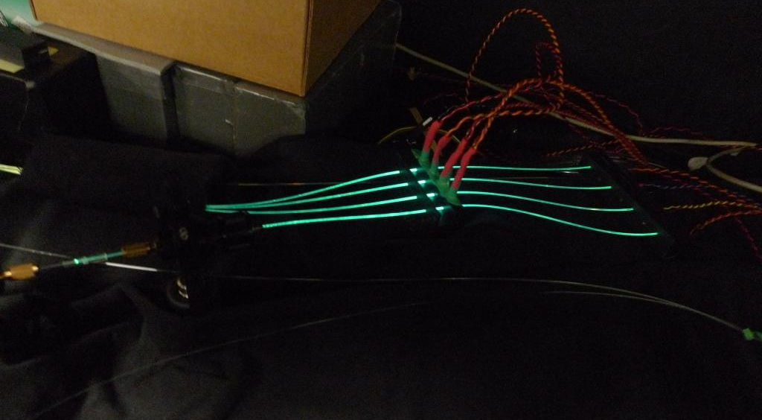

Slide 10
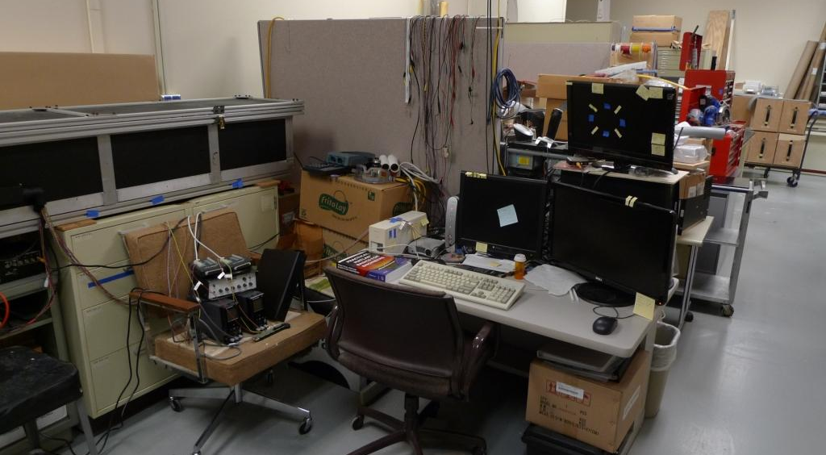
Test Station for CCD Imaging

Slide 11
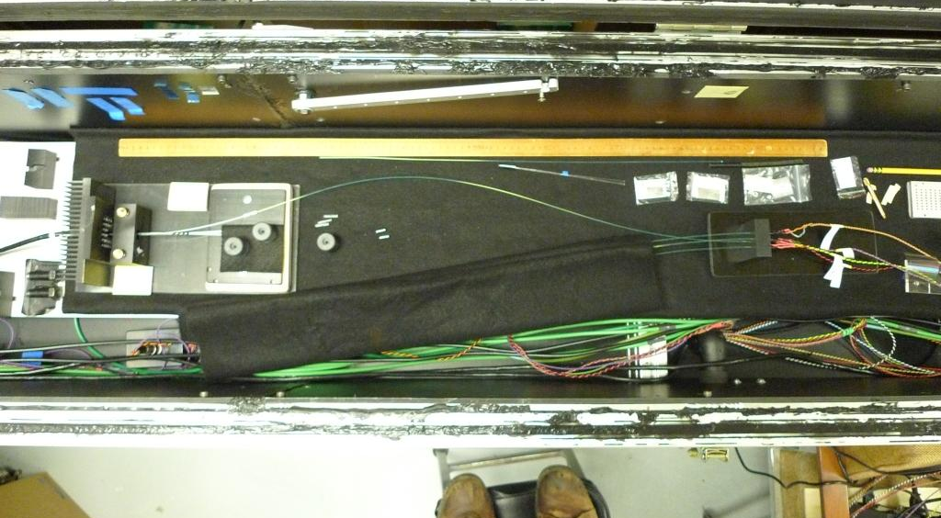
CCD Testing

Slide 12
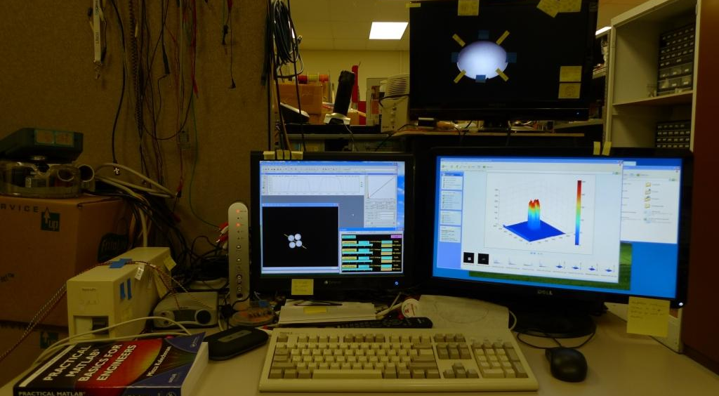
CCD Imaging

Slide 13
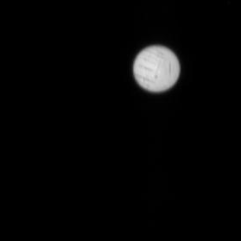
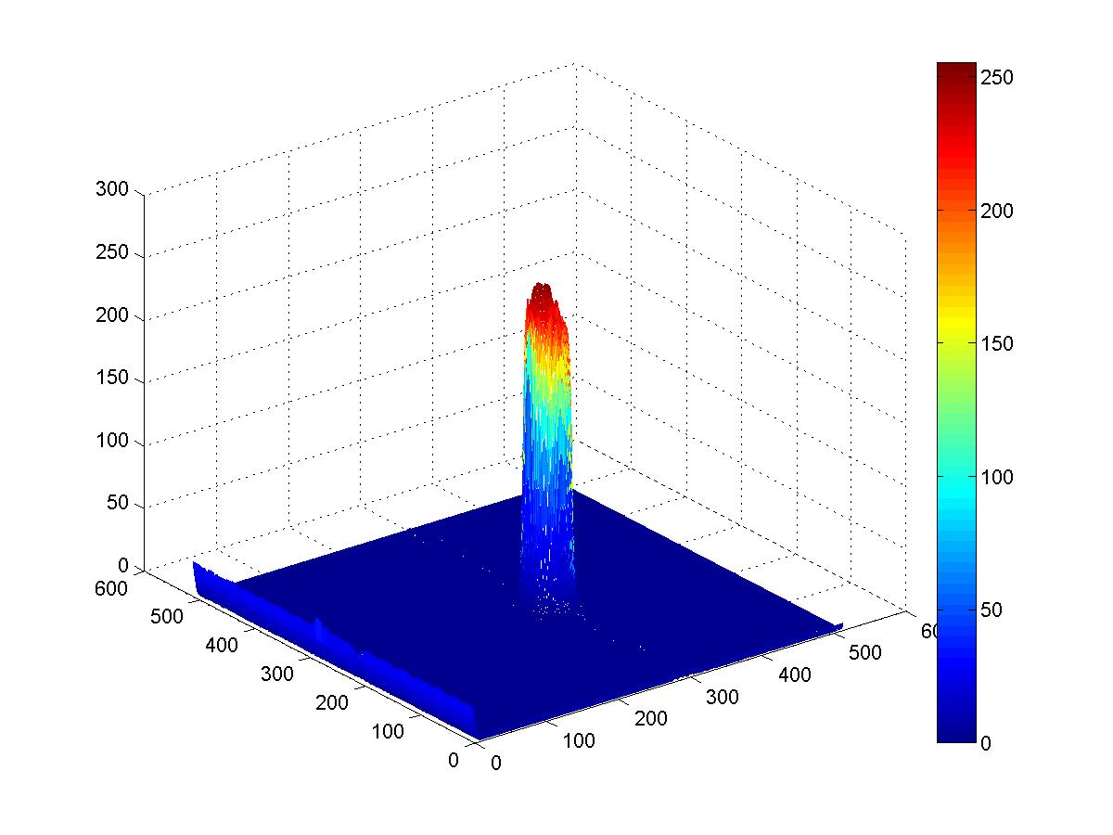
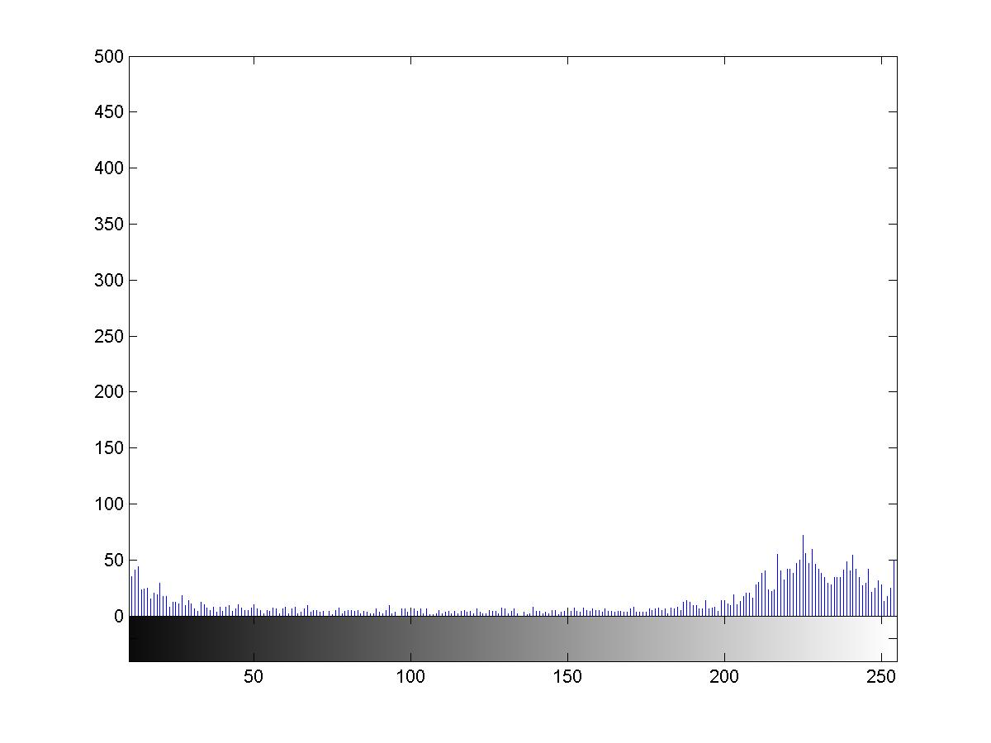
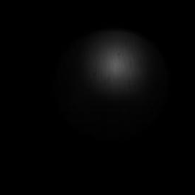
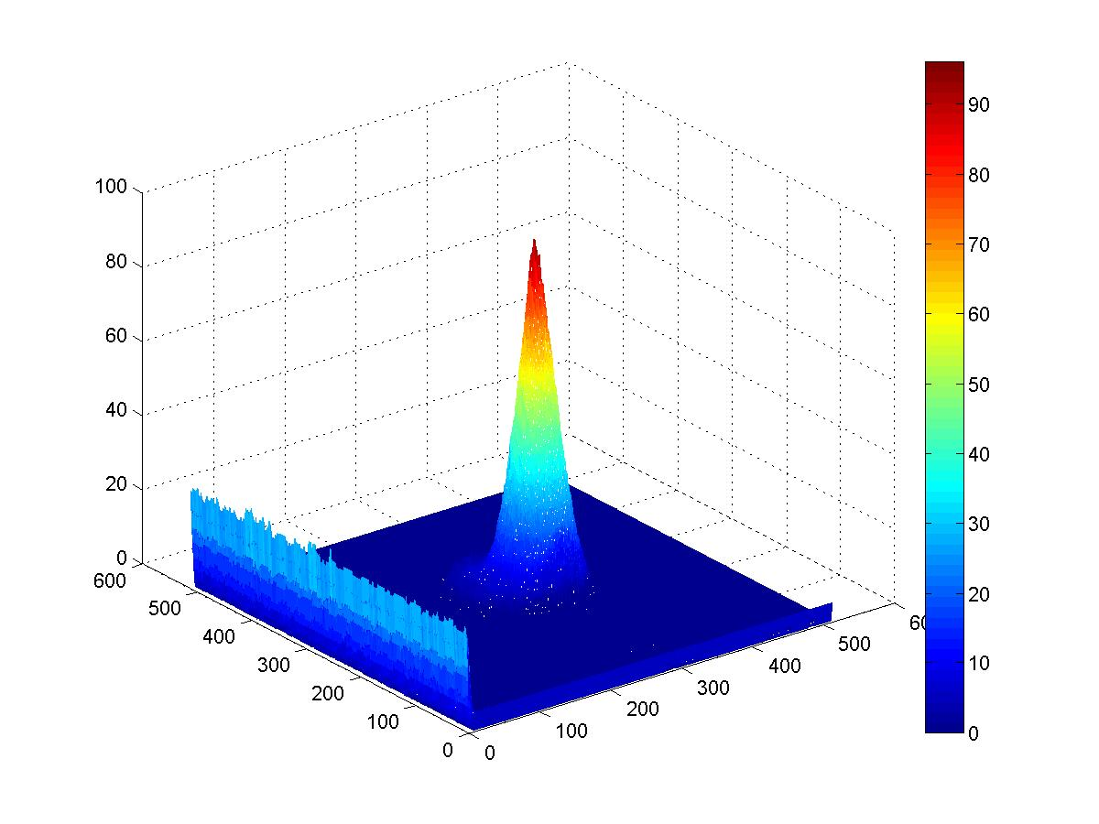
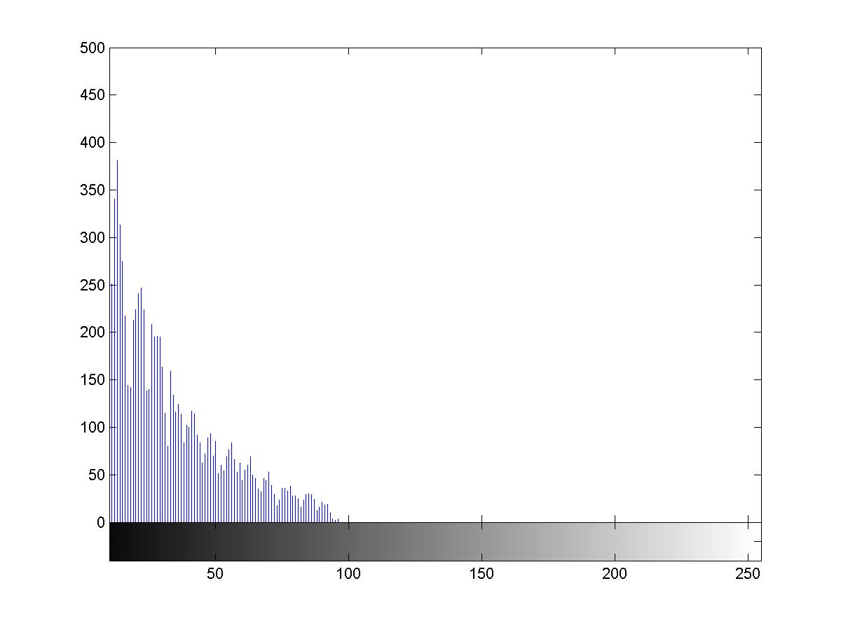
Mixer characterization
– on the right track

Slide 14
Mixer Characterization
– illustrating problems…

Slide 15
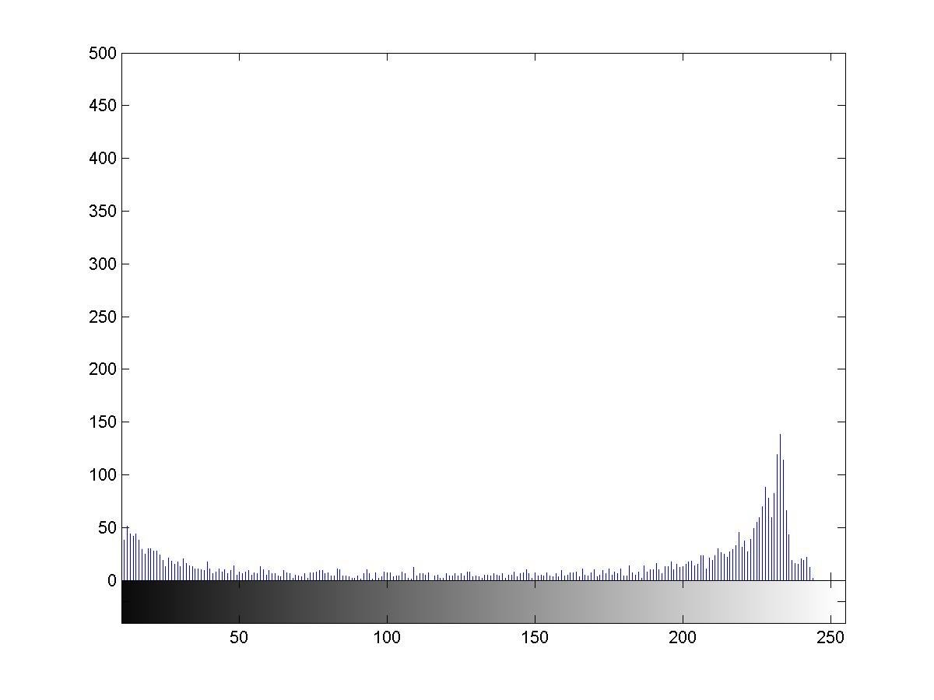

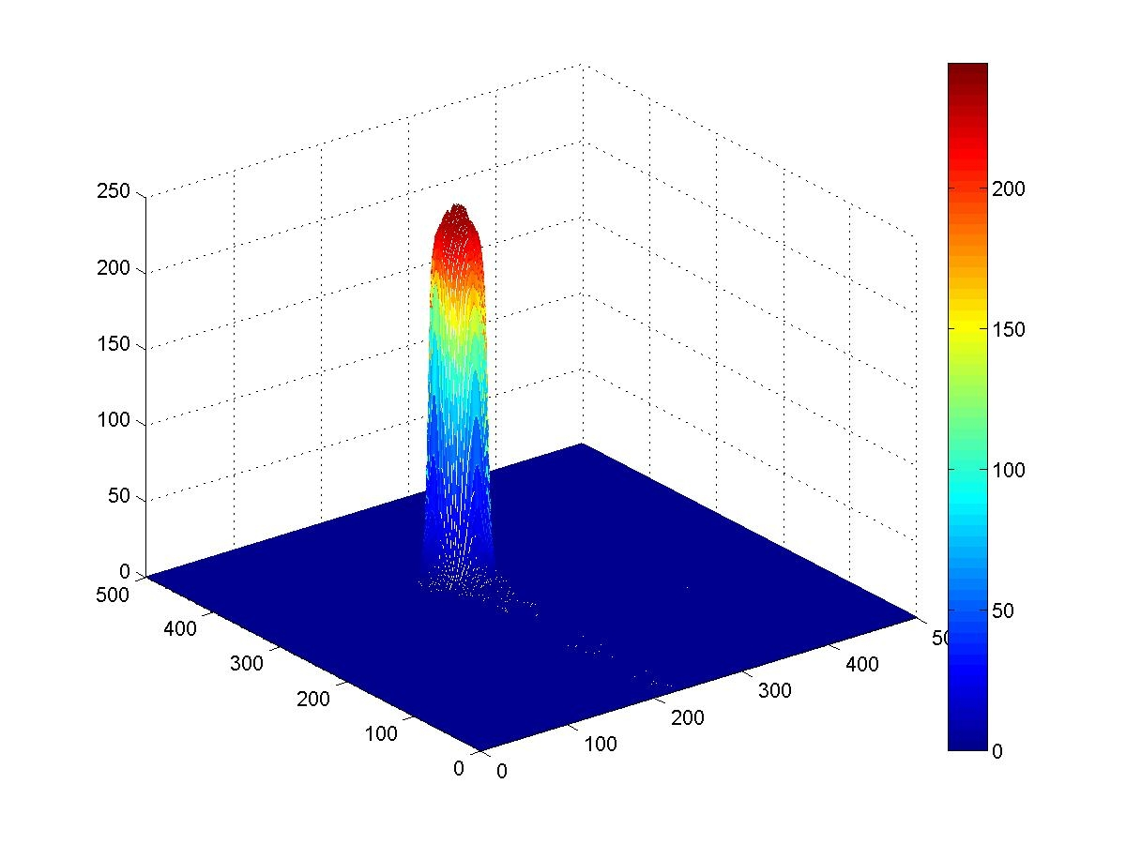
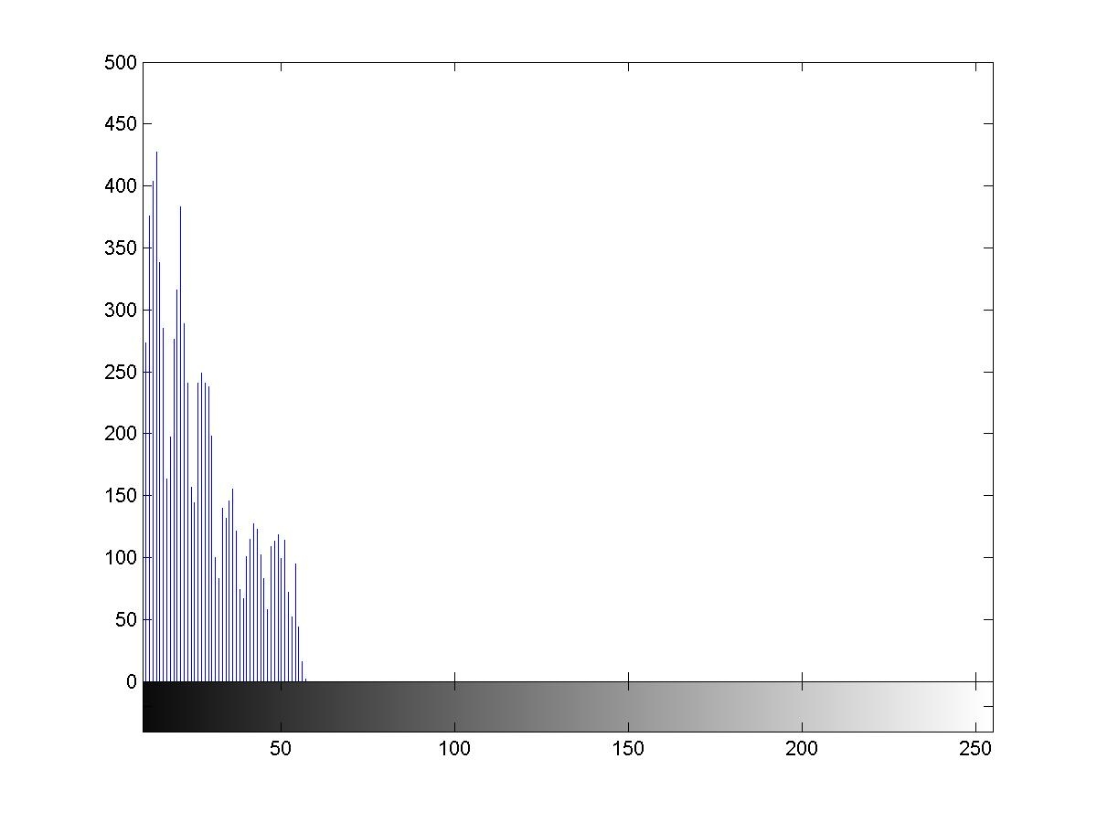


Mixer Characterization - recent

Slide 16
HO Mixers – Current Studies
- 3
- 2
- 1
Row 1
Row 2
Row 3
Row 4
Row 5
Row 2 - 4

Slide 17
Transmission measurements

Slide 18
HO Mixer Disks
C1: 4/5 mm thick, 4mm dia
C1: 4mm thick 4mm dia
A.HO.0.01Al4, e, b, j 78%
A.HO.0.04Al5, e, b, j 77%
D.HO.0.01 Delrin4, e, b, j 78%
D.HO.0.04 Delrin5, e, b, j 78%
D.HO.0.02 Delrin, e, b, P3 82%
D.HO.0.03 Delrin, e, b, P3 85%

Slide 19
HO Mixer Disks
SGS: 4/5 mm thick, 3.25mm dia
D.HO.1*2.01 Delrin4, b, P3 84%
D.HO.1*2.02 Delrin4, b, P3 84%
D.HO.1*2.03 Delrin4, b, P3 81%
D.HO.1*2.04 Delrin5, b, j 77%
A.HO.1*2.04 Al5, bond, j 82%

Slide 20
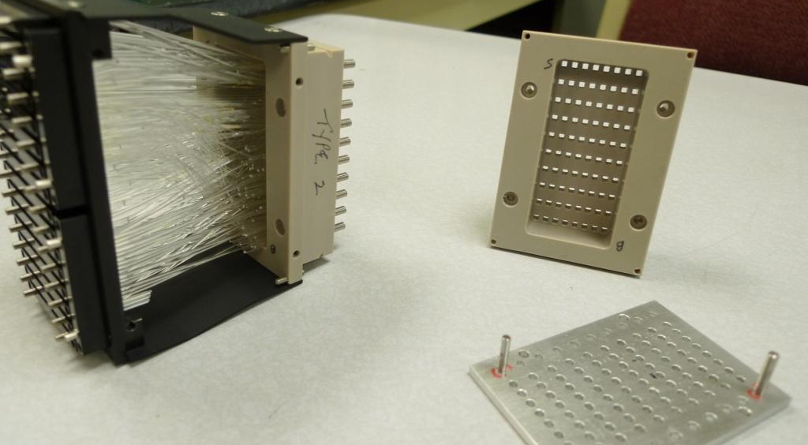
HB Structure

Slide 21
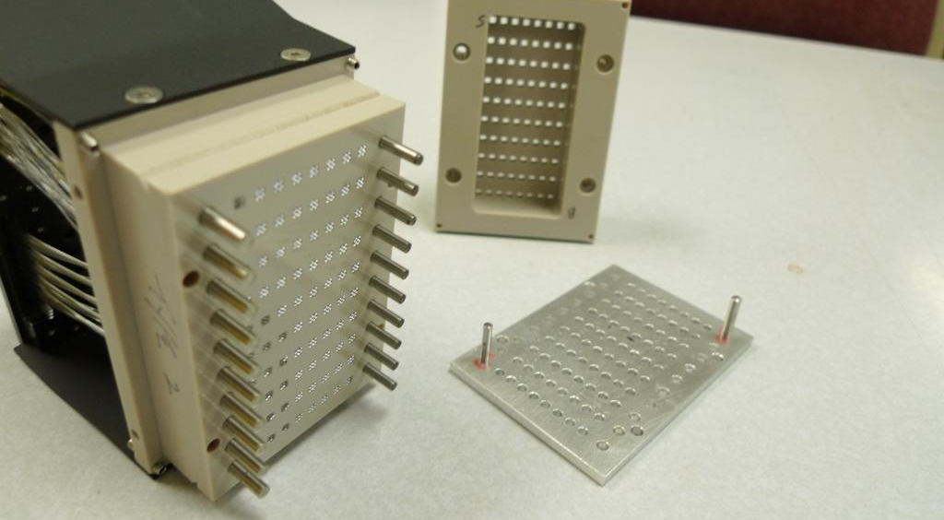
HB Structure

Slide 22
HB Mixer Plates
SGS, 4/5mm thick, 3.25mm dia
A.HB.11 Al4, bond, P3 89%
A.HB.12 Al4, bond, P3 89%
A.HB.13 Al4, bond, P3 89%
A.HB.14 Al4, bond, P3 87%
A.HB.15 Al4, bond, P3 89%
A.HB.05 Al5, bond, j 82%

Slide 23
Lessons learned…
Square cross sections are better avoided – machining and surface issues; corners…
Cylindrical thick-clad fiber mixers have good characteristics…
  Excellent surface properties
  Thick cladding keeps light away from support/mounting structure
  Excellent light transmission
  Challenges – dimensional tolerances and bonding
Would be good to have SiPM of circular shape to match the cylindrical mixers

Slide 24
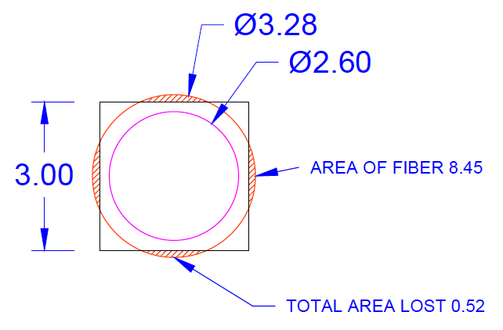
Cross section issues…

Slide 25
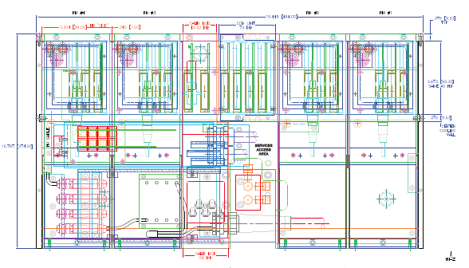
HE RBX

Slide 26
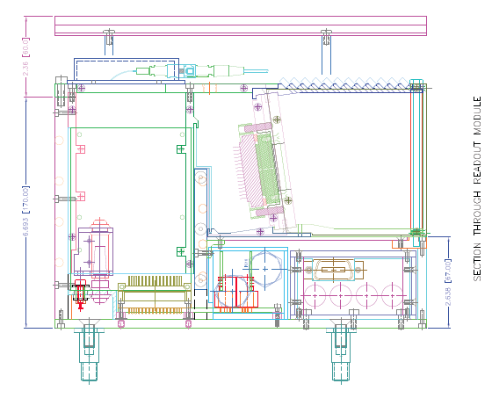
HE RBX

Slide 27
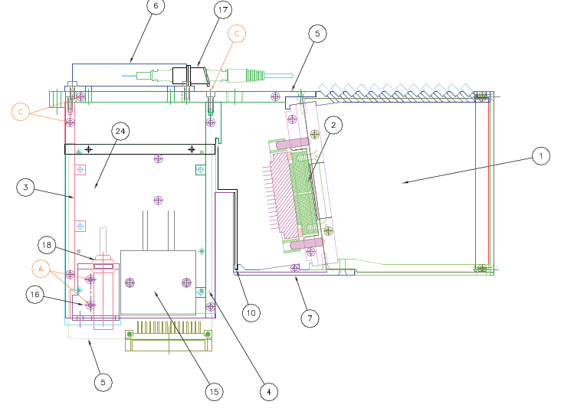
HE RM

Slide 28
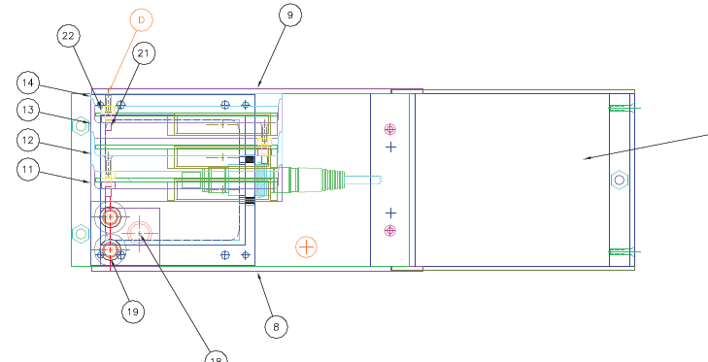
HE RM

Slide 29
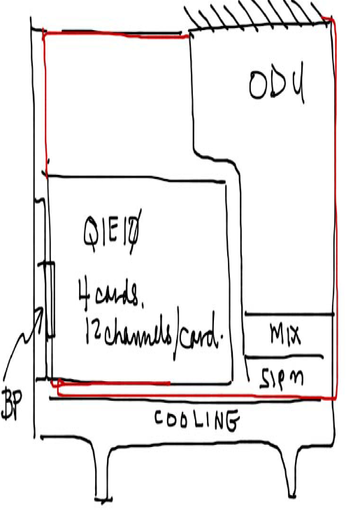
A possible approach to HE RBX

Slide 30
Thoughts for 2012/2013
Redesign the HE RBX – working prototype in 18 months (summer 2013)
  RM
    Four QIE cards (12 channel)
    One control card
    Compatibility with HB and HE – goal to use same cards
Built RM for H2 beam tests for summer/fall 2012
    These would be existing RM, but HPD replaced by SiPM
    For studying depth sampling in HE
    Make a full complement (4) of HE/RM with SiPM readout

