Slide 1
HF Upgrade
HF Upgrade
November 7, 2011
T. Shaw

Slide 2
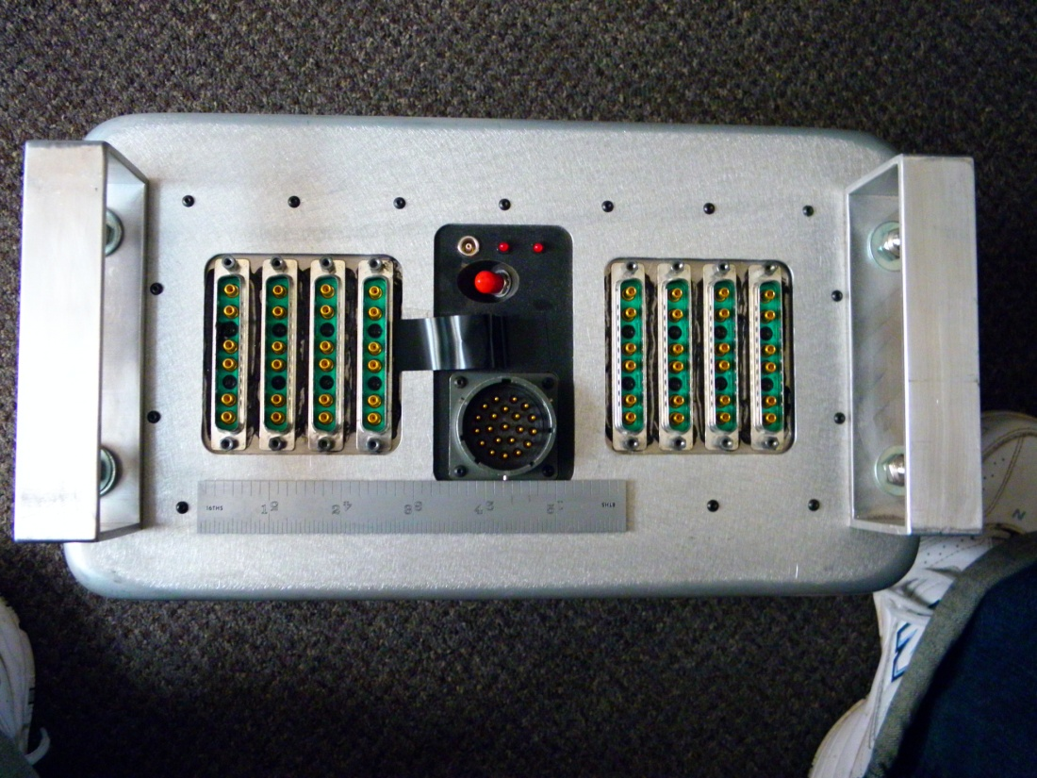
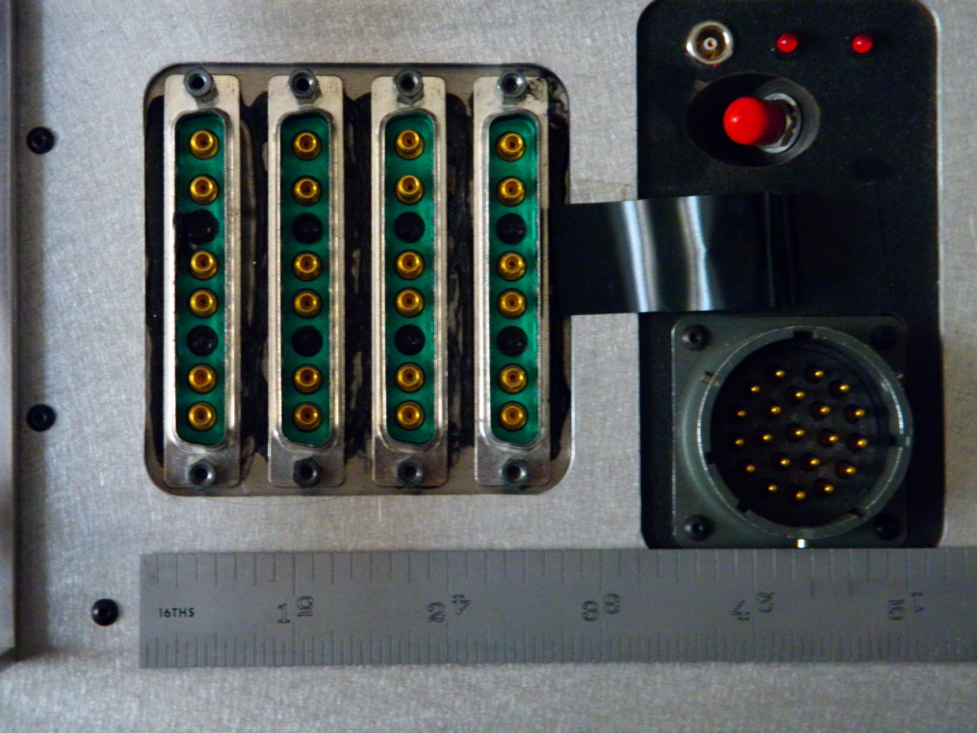
Existing RoBox
24 PMTs/RoBox
  Signal & Reference signals sent on a
  Pair of Coax for each PMT
72 RoBox in system

Slide 3
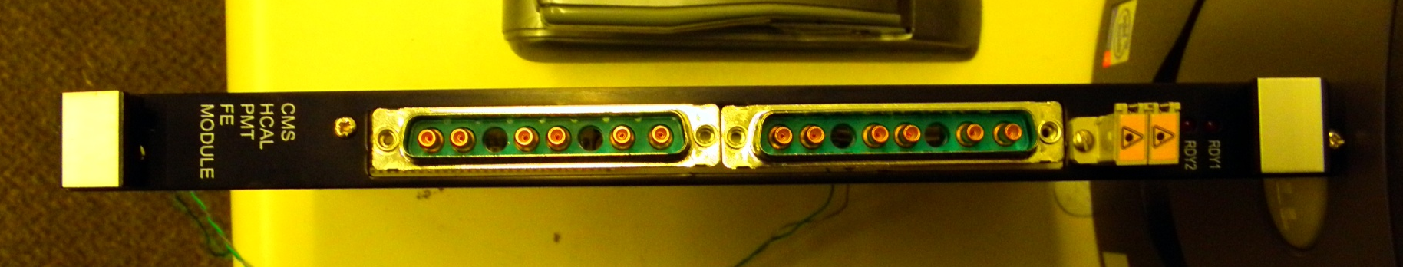
Current HF FE Module Front Panel
Each FE module reads out 6 QIEs.

Slide 4
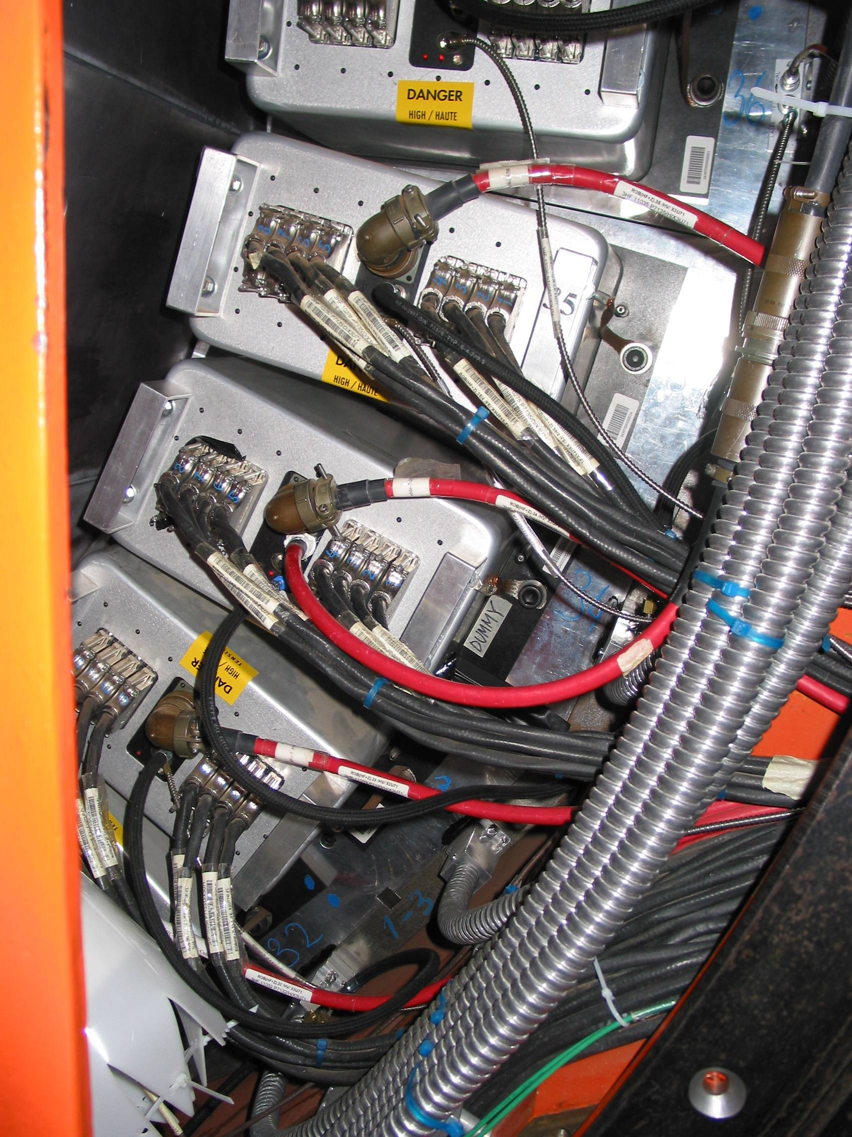
HF Cable Upgrade
Current plans – Intermediate upgrade of cabling ONLY
  Multi-anode readout -> Fit 2x or 4x channels/cabling into available space; no degradation in performance
  Marching orders say to plan for 4x number of current cables.
  Use same FE modules
    Some kind of patch panel/connector adapter near FE crates to convert new cabling to present connectors.

Slide 5
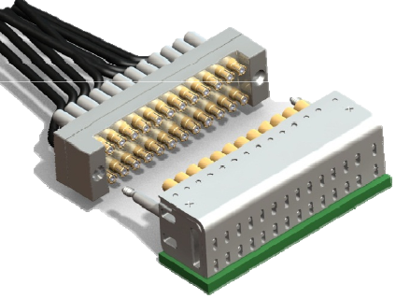
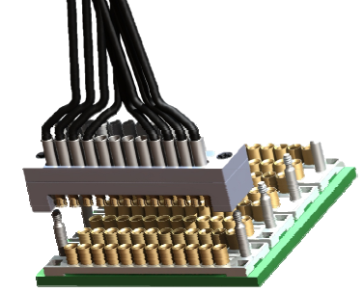
Cabling Selection
Cabling tested during November Testbeam
  Winchester Electronics CMTS system customized to our application – 24 individual coax contacts/connector

Slide 6
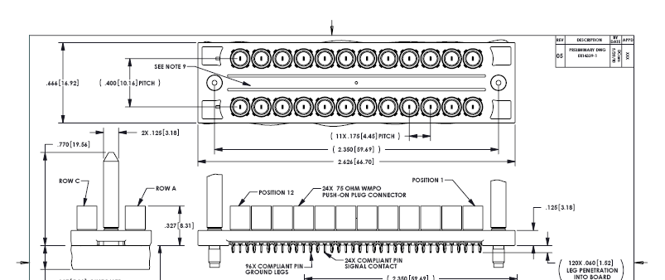
Winchester Hybrid
Each connector has contacts for 24 coax. Vertical and right angle connectors
Exist. No cable mount. 75 ohm.
Vendor has provided us with 50 ohm pins and cable connectors.

Slide 7

Winchester Hybrid- ROBox end

Slide 8

Winchester Hybrid- Readout Card end

Slide 9
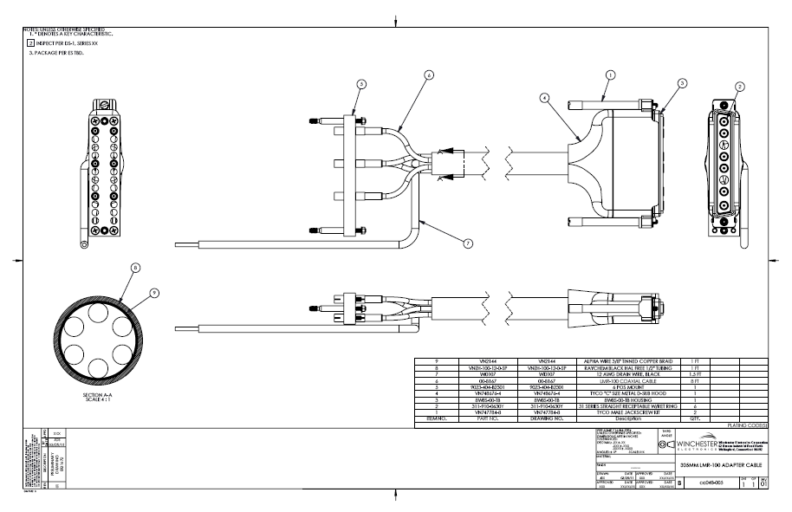
Winchester Hybrid- Readout Card Adapter

Slide 10
Winchester solution -> Possible Readout card/crate
SOME PRELIMINARY THOUGHTS – Assumes 4 anode readout
Assuming we will maintain Eurocard format
9u card size would allow for 48 channel cards; this would be the same as what is proposed for an RM in HB/HE/HO
The new backplane would have 1.2" spacing rather than the current 0.8". This is due to new connector size.
QIEs would be placed on both sides of the board.
With 1.2" spacing, we can have 14 slots. One slot for a ngCCM and one slot for a calibration module, leaves 12 slots for FE cards.
Thus, a crate would cover 6 ROBOX. We would need a total of 12 9U crates in place of the 24 6u crates we have now.

Slide 11
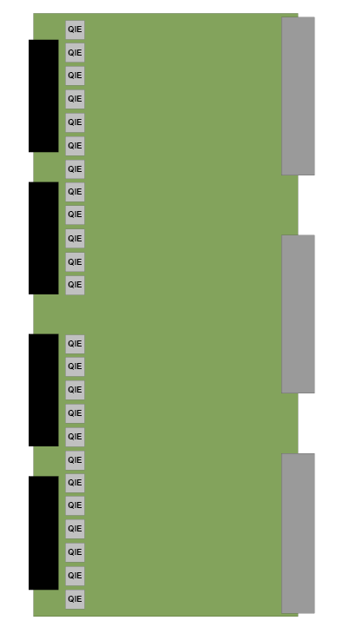
9U Card Format
FPGA logic, serializers and fiber drivers
Could be onboard or use transition module
48 channel card – 24 QIEs on both top/bottom

Slide 12
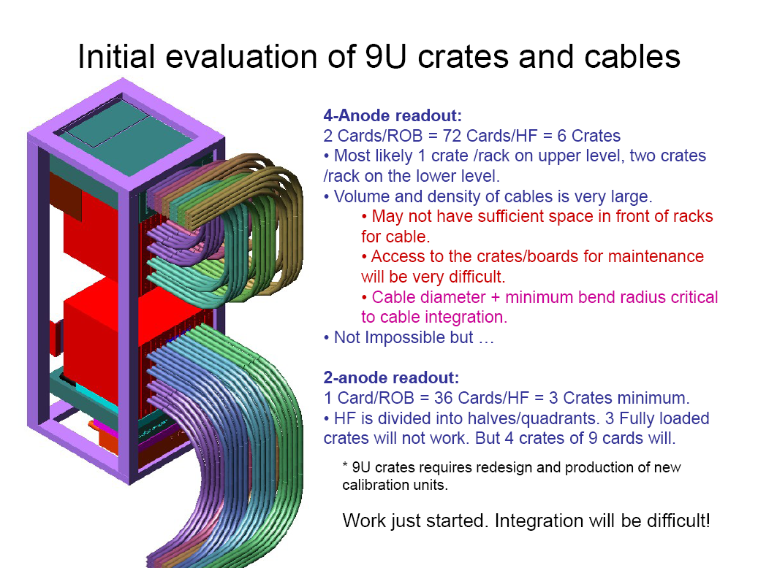
From IANOS
X2?

Slide 13
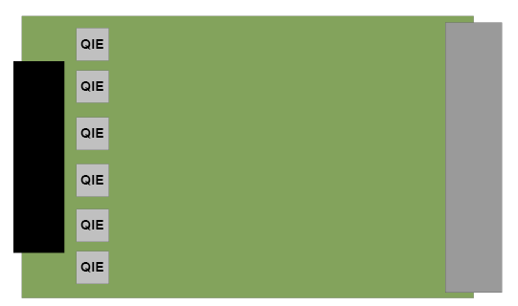
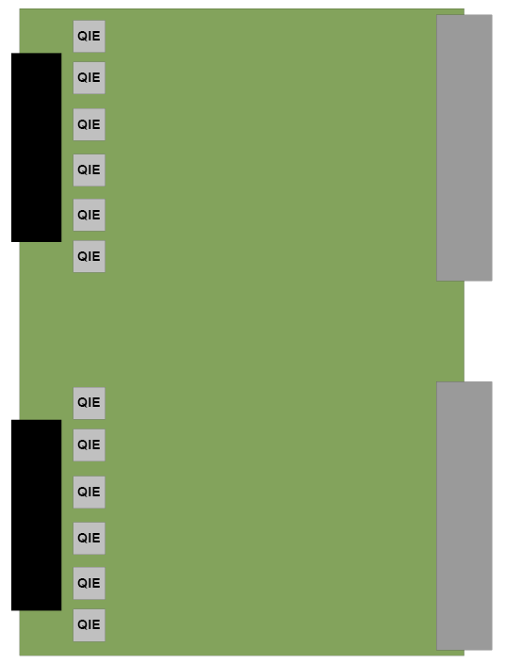
3U or 6U formats also possible
12 channel 3U card
Custom backplane could funnel
Data to the FPGA, serializer and fiber
Drivers located on a transition module
24 channel 6U card

Slide 14
Conclusions
HF readout crate requires
  QIE card
    How many channels?
  Custom backplane
  FPGA mezzanine/transition card
  Decision on 2 or 4 anode readout?

