Slide 1
Trigger Upgrade Schedule
  W.H. Smith
  Physics Department
  U. Wisconsin – Madison
  Joint HCAL/Muon/Trigger Session
  November 9, 2011

Slide 2
Major CT Schedule Milestones
End of LS1 (December, 2014):
  All Calorimeter Trigger Fibers installed
  OptoSLBs installed in ECAL (# TBD), uHTRs installed in HF +..
  ORMs installed on RCT cards (to match ECAL oSLBs & HCAL uHTRs where installed – HF + … )
  All Cal Trigger uTCA Crates installed without electronics
  Prototype Calorimeter Trigger Processor (CTP) cards installed in one uTCA Cal Trigger Crate interfaced to & read out by DAQ, as well as sending a trigger bit to Global Trigger as technical trigger bit.
Review Charge: January 2016:
  Full Upgrade Calorimeter Trigger system installed, commissioned and operational.
Review Charge: End of LS2:
  Delay system production by time from Jan 2016 to end LS2
  Schedule up until production stays the same since need to complete work in LS1

Slide 3
Calorimeter Trigger Primitives
Present Connections
HCAL HTR
Cards
To DAQ
Existing Copper Cables
Regional
Calorimeter
Trigger
Via
HCAL
DCC2
To DAQ
Via GCT
ECAL TCCs
Existing Copper Cables
To DAQ
Via ECAL
DCC

Slide 4
Calorimeter Trigger Primitives
Connection Evolution
HCAL HTR
Cards
To DAQ
Existing Copper Cables
Regional
Calorimeter
Trigger
Via
HCAL
DCC2
To DAQ
ORMs
Via GCT
ECAL TCCs
Existing Copper Cables
To DAQ
Via ECAL
DCC
ECAL
Indiv. Fibers (LC)
HCAL uHTR
Cards
Trigger
Primitive
Optical
Patch Panel
(Modular – grows
to meet needs)
To DAQ
Optical Ribbons
Via BU
“AMC13”
ECAL Opti. Ribbons
SLHC
Cal Trigger
Processor
Cards
HCAL Opti. Ribbons
To DAQ
ECAL TCCs
Optical Ribbons
To DAQ
Via BU
“AMC13”
OSLBs
Via ECAL
DCC

Slide 5
Calorimeter Trigger Primitives
Final Situation
HCAL uHTR
Cards
Trigger
Primitive
Optical
Patch Panel
(Full)
To DAQ
Optical Ribbons
Via BU
“AMC13”
ECAL Opti. Ribbons
SLHC
Cal Trigger
Processor
Cards
HCAL Opti. Ribbons
To DAQ
ECAL TCCs
Optical Ribbons
To DAQ
Via BU
“AMC13”
OSLBs
Via ECAL
DCC

Slide 6
CT Schedule through 2013
  Rev A Calorimeter Trigger Processor Prototype: Mar ’12
  Rev A CTP Prototype Testing SW & FW: Mar ’12
  Testing of Rev A CTP Proto: Mar-Apr’12
  Rev A Optical Receiver Mezzanine (ORM) Prototype: May ’12
  Rev A ORM Testing SW & FW: May ‘12
  uTCA Crate & backplane constructed: Jun’12
  Integration of ORM first prototype with Calorimeter Trigger Processor (CTP) Prototype Board Jul-Oct ’12
  Integrate ORM first proto. w/ECAL oSLB & HCAL uHTR in 904, Oct-Dec ‘12
  Construction of Rev B prototype series CTP & ORM Cards Jan-Mar’13
  Rev B Prototype CTP & ORM Testing SW & FW Mar’13
  Testing of Rev B prototype series CTP & ORM Cards Apr-Jun’13
  Testing & Integration of Rev B prototype series CTP & ORM Cards in 904 with ECAL oSLBs & HCAL uHTRS, Jul-Oct’13
  Installation & Testing of uTCA Cal trigger crate at Point 5, Oct-Dec’13
  Final ORM testing SW & FW: Oct’13
  Production & testing of ORMs Oct-Dec’13

Slide 7
CT Schedule 2014
  Testing & Integration of 1 Crate’s worth of optical fibers connected to oSLB’s & uHTRs (where applicable) & RCT at Point 5, Jan-Mar’14.
  Complete Production of uTCA backplanes & crates by Vadatech: Jan’14
  Test of of uTCA backplanes & crates by Vadatech: Feb-Mar’14
  Integration of ORM & CTP SW & FW at Pt. 5: Mar-Apr’14
  Installation of uTCA Crates & Backplanes at point 5: Apr-Jun’14
  Installation of fiber optic plant to oSLB’s, uHTRs and ORM’s in RCT cards at point 5, Apr – Jun’14
  Testing & Integration of oSLBs, fibers, uHTRs and ORMs in RCT cards at point 5, Jun– Oct.’ 14
  Validation of Algorithms in CTP FW, Jun-Oct’14
  Re-commission existing cal trigger with ORM’s in RCT, Oct-Dec.’14.
  Production of CTP Cards: Jun-Sep’14
  Testing of production CTP Cards: Oct-Dec.’14
  Completion of Production SW & FW: Dec’14

Slide 8
CT Schedule 2015+
  Parallel operation of 1 crate with SW & FW including algorithms during data-taking Jan-Jun’15
  Integration of production SW & FW at 904 & Pt. 5: Jan-Mar’15
  Integration testing in 904 with ECAL TCC/oSLBs & uHTRs: Jan-Mar ’15
  Installation & test in pt. 5: Apr -Jun ’15
  Commission full system: Jul-Sep’15
  Parallel Operation full system demonstration: Jul-Dec’15
  Full System Operation: Jan ‘16 onward

Slide 9
DRIFT TUBES: Trigger Upgrade
Replace all MB1s theta TRB (120 u.) with the new boards based in FPGA
  To be completed in LS1
  Goal: to increase #spare
Relocate Sector Collector electronics (TSC=trigger, ROS=readout) from UXC to USC
  To be completed in LS1
  Goal: reduce the critical electronics in UXC, removing single point of failures
Produce a new Trigger Sector Collector
  Funded for 2014-2015, design can start earlier
  Goal: New interface to the new DTTF that has to be produced at the same time

Slide 10
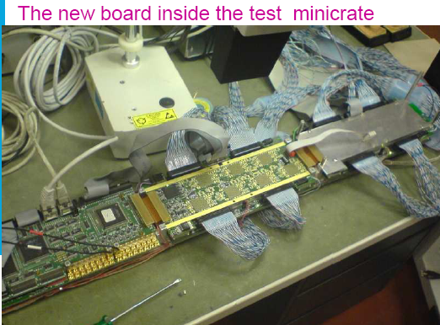
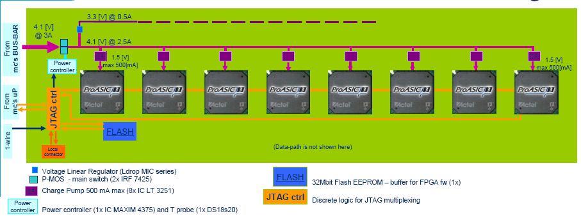
DRIFT TUBES: TRB theta
Goal: Replace all MB1s theta TRB (120 u.) with the new boards based in FPGA to increase #spares
  Project is progressing satisfactorily
  First PCB prototype produced and assembled with 1 FPGA/8 BTIs
  Testing of the board is underway
  Radiation test by neutrons from d-BE @ 5.5MeV done on main components. Results show that this components are suitable for SLHC.
  Further irradiation tests with the full board to take place at LHC irradiation facility H4IRRAD

Slide 11
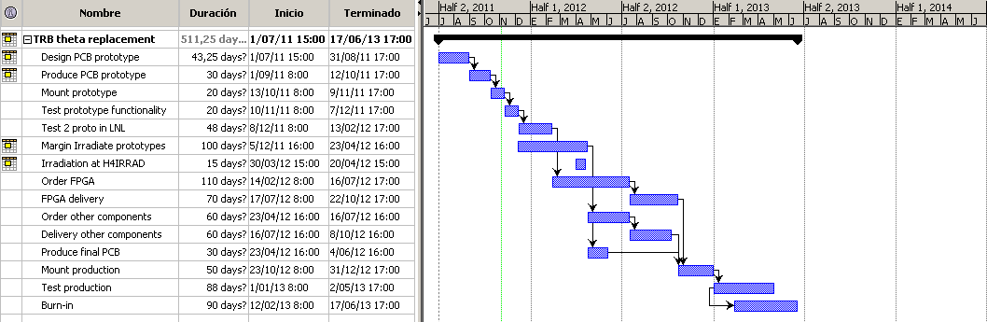
DRIFT TUBES: TRB theta
Installation in 2013-2014
MILESTONES:
-Test prototype functionality during next 2-3 months (key point to insure we don´t incorporate extra delays)
-Test prototype at LNL with a full DT chamber (guarantee proper integration and final functionality)
-Irradiation test of full board in H4IRRAD (depends when access is available, May 2012?)
* Installation and commissioning planning is delicate due to interference with HO interventions, availability of central services, SC relocation, etc => Careful planning with technical coordination
* Budget secured through MoB, no major concerns at present
* In general, could always profit from extra delays in the LS1

Slide 12
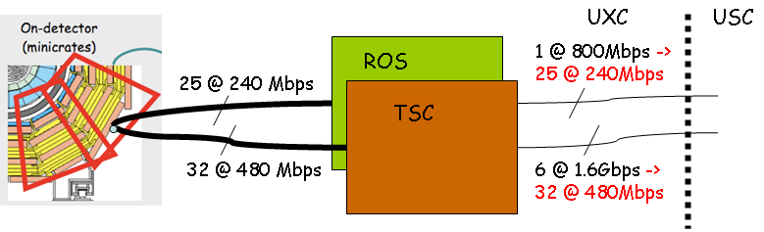
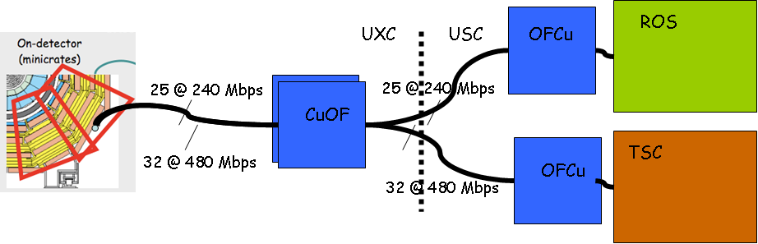
DRIFT TUBES: SC relocation
Goal: Replace SC crate with simple CuOF electronics and place TSC (Trigger Sector Collector) and ROS (Read Out Server) in USC during LS1
12

Slide 13
DRIFT TUBES: SC relocation
(STATUS cont’d)
Fibers study:
  Market survey has been taking place in the last months and some suitable candidates seem to be available
  Installation details are being studied
  Testing system for the final batch of fibers under development
OFCU
  Architecture has been decided and seems to comply satisfactorily with the different constraints (available rack space in USC, cabling, etc) => re-check L1A latency
  OFCU-TSC first prototype under production
  OFCU-ROS design of the first prototype under going
MILESTONES
-Finalize the architecture of the system by the end of the year (basically done)
-Identify suitable CUOF devices radiation tolerant (underway)
-Production of the CUOF prototype (Q1-Q2 2012)
-Test full chain CUOF+OFCU+TSC/ROS by Q1-Q2 2012.
-Detailed study of the L1A latency

Slide 14
DRIFT TUBES: New TSC
Goal:
  Reduce complexity (presently 2 crates/wheel) using modern technology, providing a more integrated TSC-DTTF solution
  Try to be ready for phase-2 upgrades
Plans:
  Design the detail of the system (form factor, optical technology etc.) together with the new DTTF
    Plan to reuse the optical receivers initially used in the OfCu boards (snap-on)
  Planned immediately after the LS1
    The SC relocation will allow to test a prototype of the new system together with the old one (fiber splitting) in USC

Slide 15
DTTF Schedule
Technology demonstrator
  Firmware design, component selection - July 2012
  PCB design - Dec. 2012
  Board for test 2nd Q. 2013
Prototype Boards
  Design 4th Q. 2013
  Test 2014
Production System
  Board Production - 2015
  System setup - 2016
Commissioning – 2016
Note: Schedule can be advanced to have commissioning in 2015, but with little contingency

Slide 16
CSC MPC Schedule
Continue testing of MPC2010 and SP10 prototypes
  test stands at Rice and UF for firmware and hardware developments
  have 6 Muon Port Cards with new mezzanines and 2 SP10 boards
  move prototypes to bld.904 in the 1st half of 2012 and integrate into cosmic stand
Proceed with the Spartan-6 design
  1st prototype of the MPC mezzanine by April 2012
Production and Installation
  production prototype by end of 2012
  integration tests with the SP board in the 1st half of 2013
  Install & test of prototypes in UXC55 in 2nd half of 2013
    Need 120 (one per peripheral crate = 60 + 60 spare) fiber plant installed by June 2013
    Test with prototype CSC TF Sector Processor card in USC55
  fabrication and tests of 80 mezzanine boards – 2nd half of 2013
  equip all MPC boards with new mezzanines, re-work front panels,
  re-test boards – end 2013 - early 2014
  Install 60 upgraded MPCs at CMS – spring 2014

Slide 17
CSC TF Schedule
Task Start End
SP prototype test (VME), firmware development Nov 2011 Nov 2012
integration tests with MPC prototypes, 5 MPCs to SP Apr 2012 May 2012
Investigating uTCA migration, in parallel with other work Nov 2011 May 2012 uTCA crate and MCH
uTCA prototype design + production May 2012 Mar 2013
uTCA prototype tests Mar 2013 Sep 2013
uTCA prototype DT integration July 2013 Sep 2013
Pre-production + tests Sep 2013 Apr 2014
Full production + tests Apr 2014 Jan 2015
Installation and commissioning at P5 Jan 2015 Jun 2015

Slide 18
GT time-table Milestones 1
End of LS1 (December, 2014)
  μGTL: some features of this card is implemented
  μTCS: some features of this card is implemented
  Conversion crate: for some modules are available
  Sending the read-out record to DAQ
    if AMC 13 with GT requirements are available on time →yes
    otherwise either new Greg‘s card or new commercial GT Card →yes
  SW Layers for accessing the card registers are implemented:
    XML hardware abstraction
      API for resolution of name to register address
      Tree organization of registers
    GT Control web interface
      Full display of register tree possible
      Offline mode with hardware emulation

Slide 19
GT time-table Milestones 2
January 2016
  Full Upgrade Global Trigger hardware system installed, commissioned and operational
  Full upgrade Global Trigger software layers operational
    Interface are available for docking to XDAQ
    Otherwise we can not deliver TS from this point of view for the new system
  μGMT (Global Muon Trigger) is maybe available?
    It depends on man power
    Otherwise conversion crate
      Worry about latency

Slide 20
GT Schedule through 2012
Develop the concept for Conversion crate
  We need the accepted CMS Internal Note Global Trigger upgrade IO proposal
Evaluate first μGT firmware concept based on commercial Card
Evaluate Greg‘s card
  Define GT requirements for the new card
  specify the new card together with Greg?
Evaluate AMC 13
  Define GT requirements for changing AMC 13?
First suggestion of SW for GT
  Internal note for interface

Slide 21
GT Schedule through 2013
Develop the concept of μTCS
  The first implementation with some features
μGTL implementation
Implementation of Conversion crate
  for GMT?
  for μGTL
SW layers based on new cards
μGMT/GMT ?

Slide 22
GT Schedule 2014+
2014:
  Testing one μTCA Crate @ 904
    Sending the data via fiber optic from psb_ogti to new system
    testing some μTCS features
    testing some μGTL feautures
  Test the SW layers for getting access to the registers in μTCA environment.
  December, 2014: Have a single full-function pre-production prototype available.
2016:
  January, 2016 Full final system commissioned

Slide 23
EXTRA

Slide 24
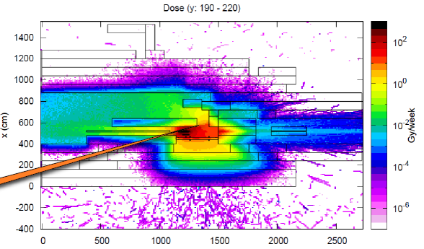
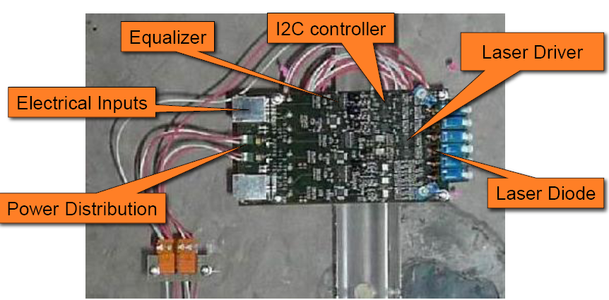
DRIFT TUBES: SC relocation
STATUS:
  Architecture of the system basically finalized
  Cost-book and responsibilities sharing pretty much defined, still few details missing
  Overall financial contributions seem within cost expectations.
  At present we are in the process of defining the incomes arrival profile.
CuOF
  Testing board to validate final components produced and assembled
  First irradiation tests being performed, seem promising
CUOF
24

Slide 25
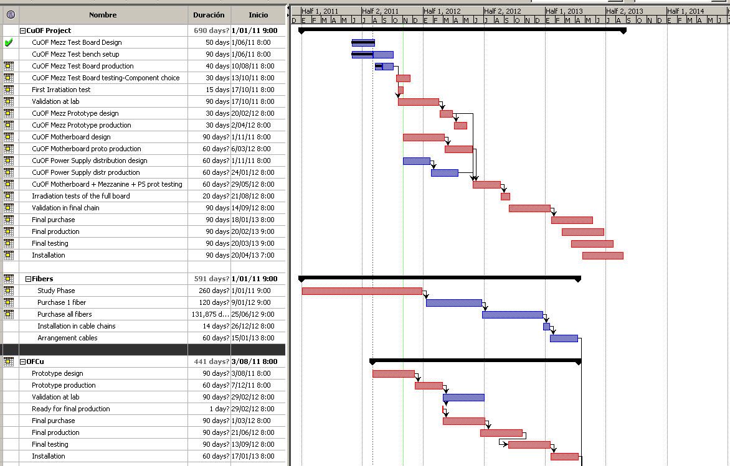
DRIFT TUBES: SC relocation
Schedule is tight
aiming to parallelize as much as possible the different tasks

