Slide 1
Microelectronics for HEP
A. Marchioro, CERN/PH
CMS Upgrade Meeting @ FNAL, November 2011

Slide 2
My favored disclaimer for this kind of talks…
“Prediction is very difficult,
especially about the future”
Niels Bohr

Slide 3


Serious about it?

Slide 4
Topics
Introduction
Recent progress and projections in:
  Technology
  A/D converters
  3D integration
  Serial Transmission
Summary

Slide 5
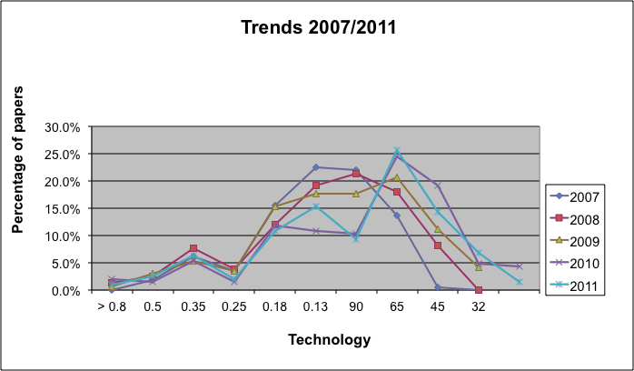
Trends at the
International Solid State Circuit Conference
Percentage of papers @ ISSCC using a given technology node

Slide 6
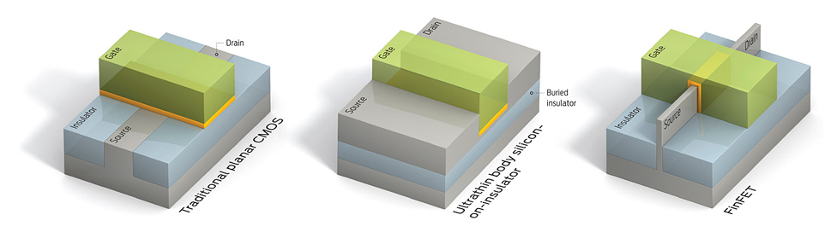
Device Technology
(or what are Moore’s problems)
Lithography
Novel devices (because of Boltzmann…)
Ultimate (atomistic) limitations
“Annoying” particles

Slide 7
CMOS in N-well technology
B
S
G
D
D
S
P⁺
N⁺
N⁺
P⁺
P⁺
N⁺
P-substrate
N-well
NMOS
PMOS
D
D
S
B
S
B
G
or
G
G
G
B
B
S
S
D
D

Slide 8
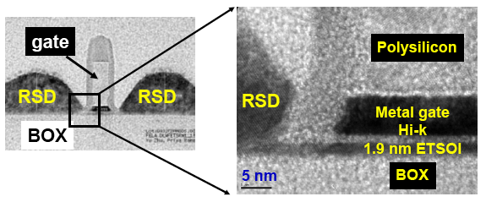
The ‘real thing’
Mukesh Khare IBM

Slide 9
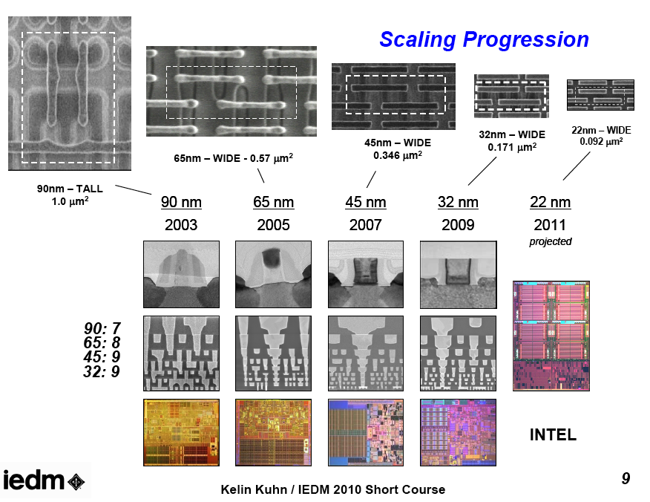
The real thing

Slide 10
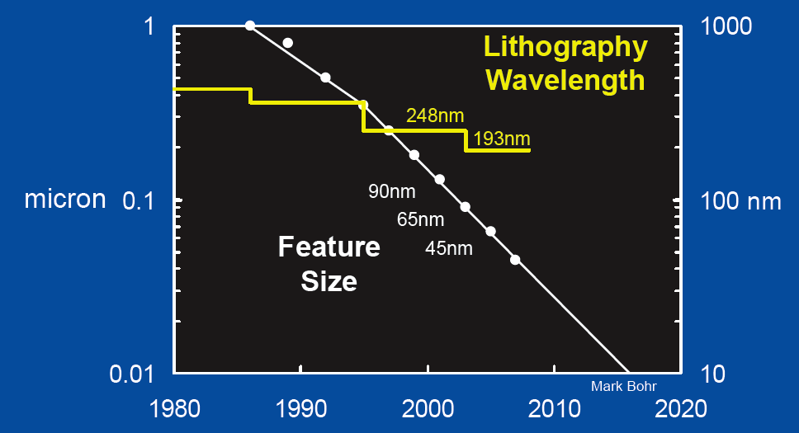
Litho: smaller than wavelength!
from M. Bohr, Intel

Slide 11
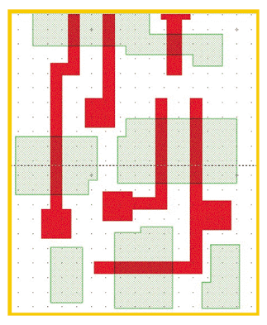
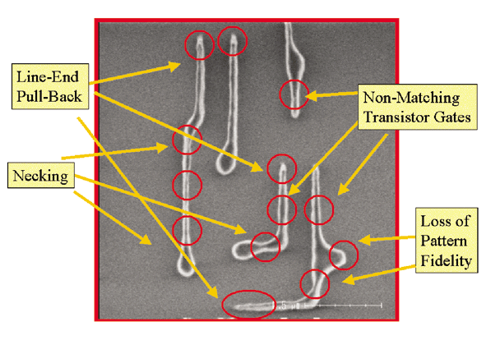
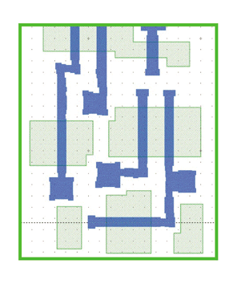
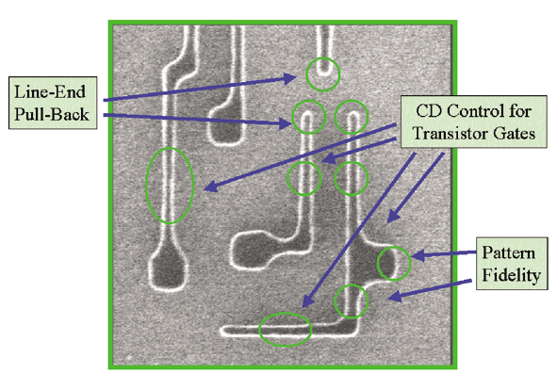
90-65 nm solution: Optical Proximity Correction
Original layout
OPC corrected mask

Slide 12
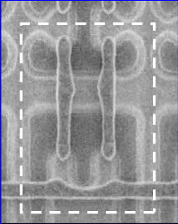
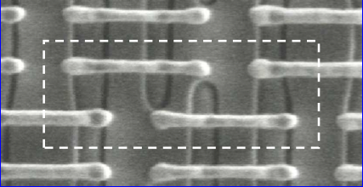
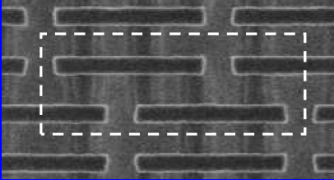
With shrinking…
65 nm
45 nm
90 nm
… lithography and process are improved!!!
from Kelin J. Kuhn, Intel, IEDM 2007

Slide 13
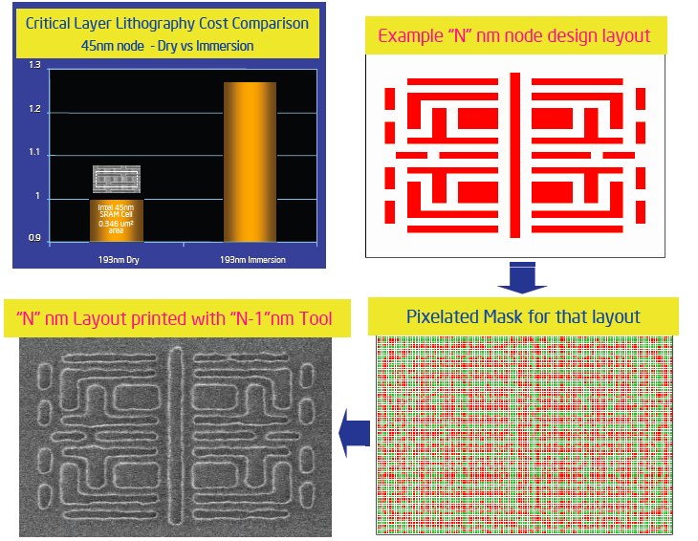
Instead of fighting diffraction … use it !
Wavelength
of light used!
from M. Bohr, Intel
Notes:
Instead of fighting diffraction, USE IT!

Slide 14
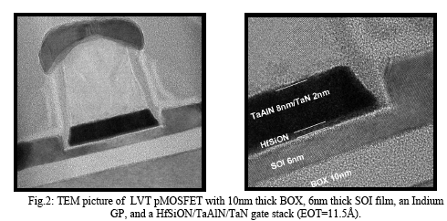
Ultrathin body and Buried Oxide
Potentially unusable for applications in HEP
from Leti/ST, @ IEDM 2010

Slide 15
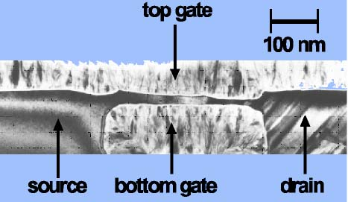
Channel control: 2 or 3 gate solutions
IBM 1997

Slide 16
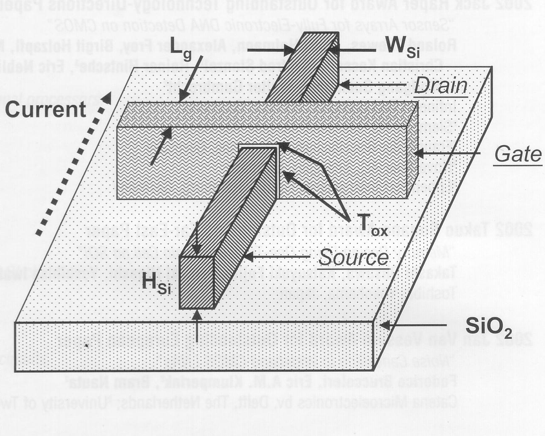
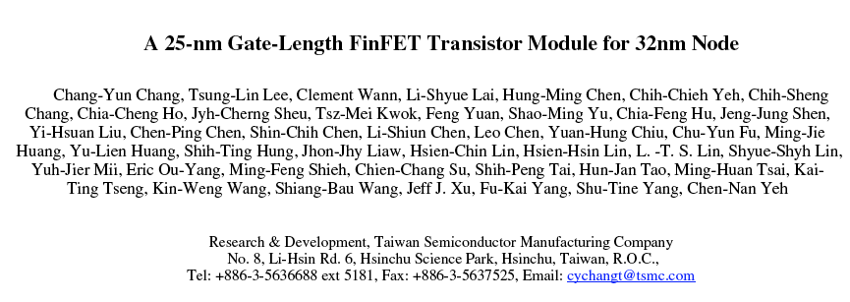
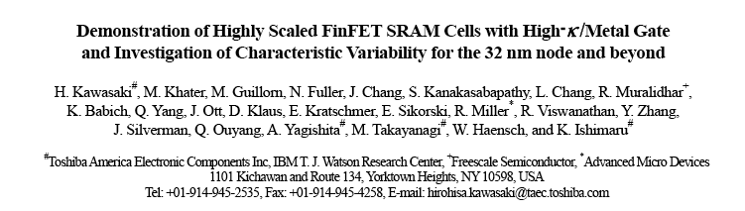
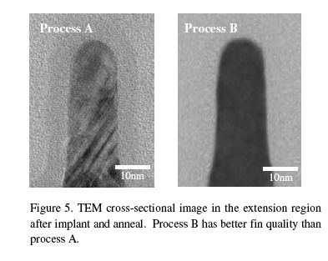
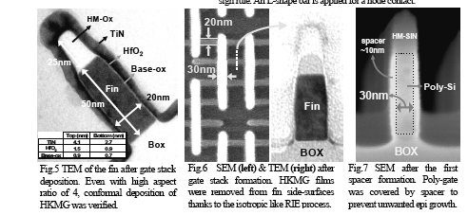
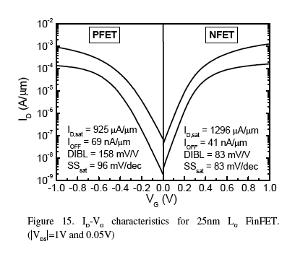
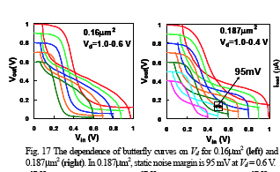
The FinFET transistor
Potentially OK for applications in HEP
from IEDM

Slide 17


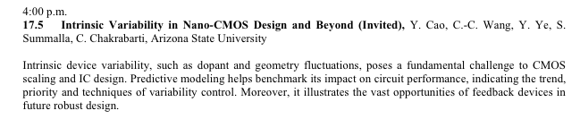
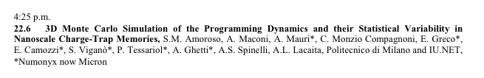
Statistical fluctuation is a hot subject

Slide 18
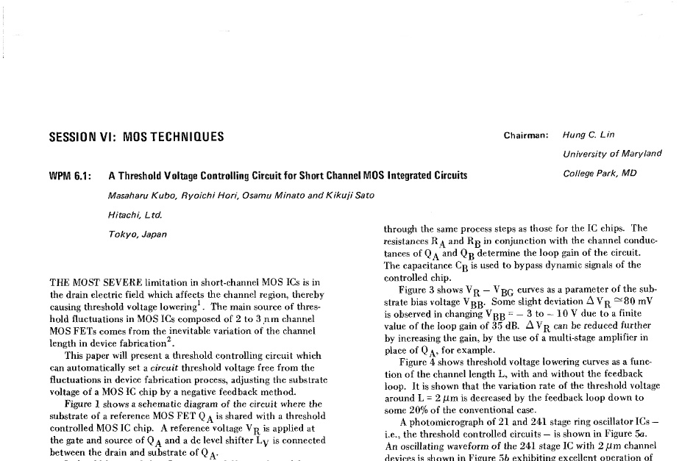
What is the problem?

Slide 19
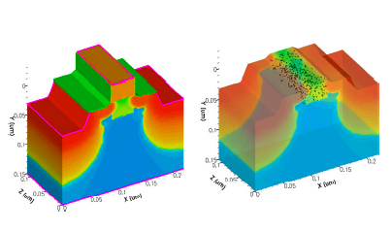
Where does variability come from?
from Asenov

Slide 20
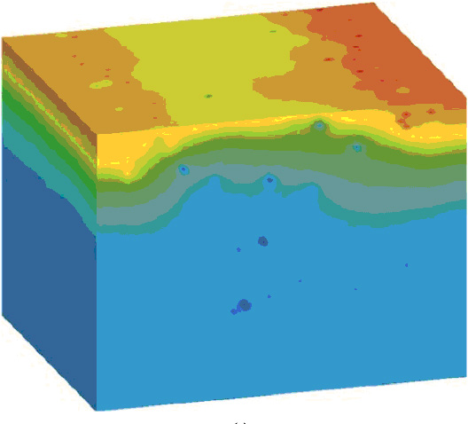
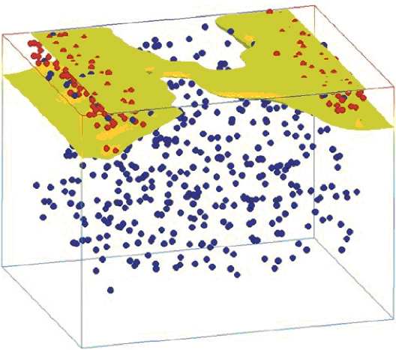
Atomistic view of 40 nm device
From Asenov, IEEE TRANSACTIONS ON ELECTRON DEVICES
VOL. 50, NO. 9, SEPTEMBER 2003

Slide 21
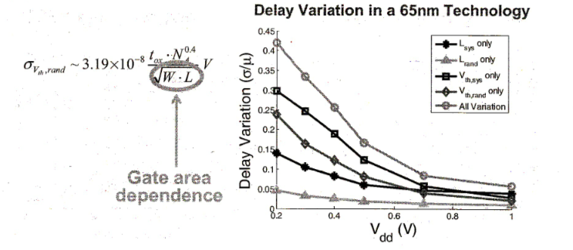
Random dopant fluctuations
from Sylvester (U. Michigan)

Slide 22
Perspective
Well, assume that we fail in making 10¹¹ transistors all absolutely perfect on a chip
Then, what can we do?
For memories (volatiles and not) redundancy and repair is already in use since many years
For FPGAs it might not be a big deal, software will avoid faulty cells at compilation time (assuming we know where they are)
For hardwired logic ASICs and processors the problem is harder, but who cares having a faulty processor if there are anyway > 10 on a chip?
But the catch might be in testing…

Slide 23
Another problem…
Similarly to what we know in HEP, charged particles flying around can cause troubles and this is becoming visible in deeply scaled (and high transistor count) commercial devices such that:

Slide 24
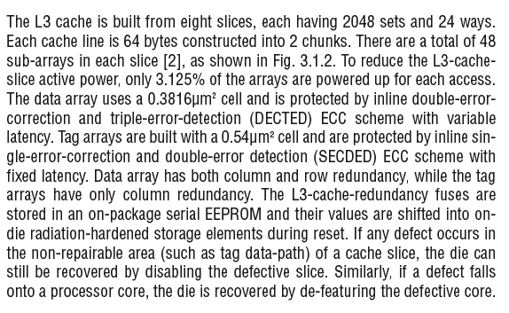
Intel is worried about SEU
from S. Rusu, Intel @ ISSCC2009, describing the 45nm Xeon processor

Slide 25
A/D Converters summary of performance

Slide 26
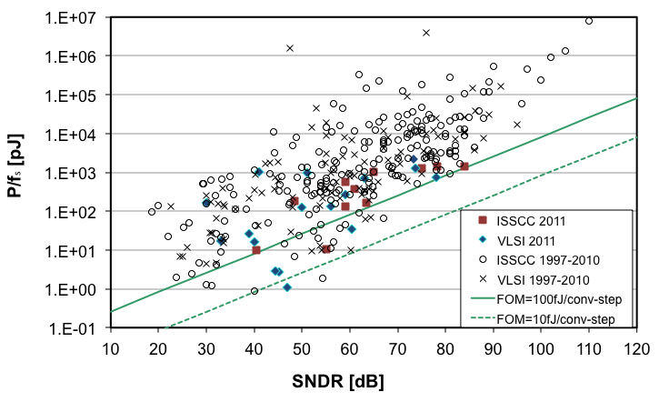
ADC Trends
8 bit
10 bit
16 bit
Energy to make a full conversion
ADC FOM = energy necessary to make
a one bit (or full) comparison in the ADC
from B. Murmann, Stanford University,
with annotations
Notes:
Y axis is = Power / fs = Energy / T / (1/T) = Energy
The conversion energy is allowed to increase if the resolution (dB) increases.
For physics it is better to use multiple ADCs on a limited scale, rather than a high precision ADC!!!

Slide 27
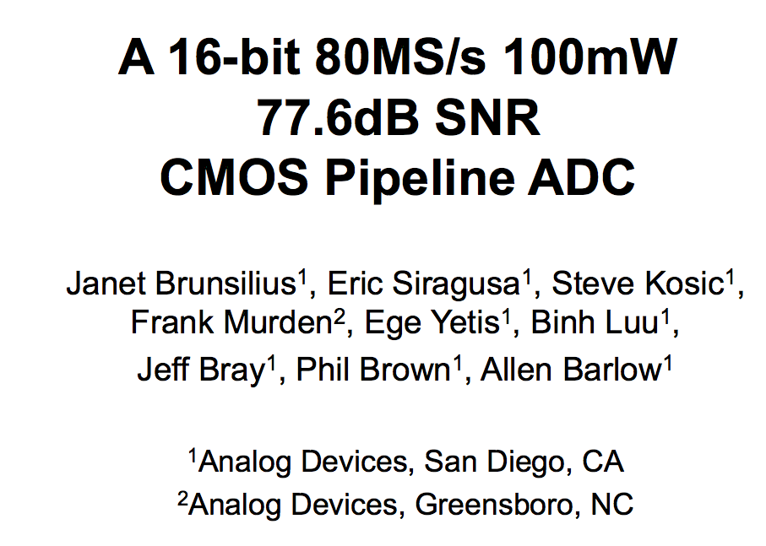
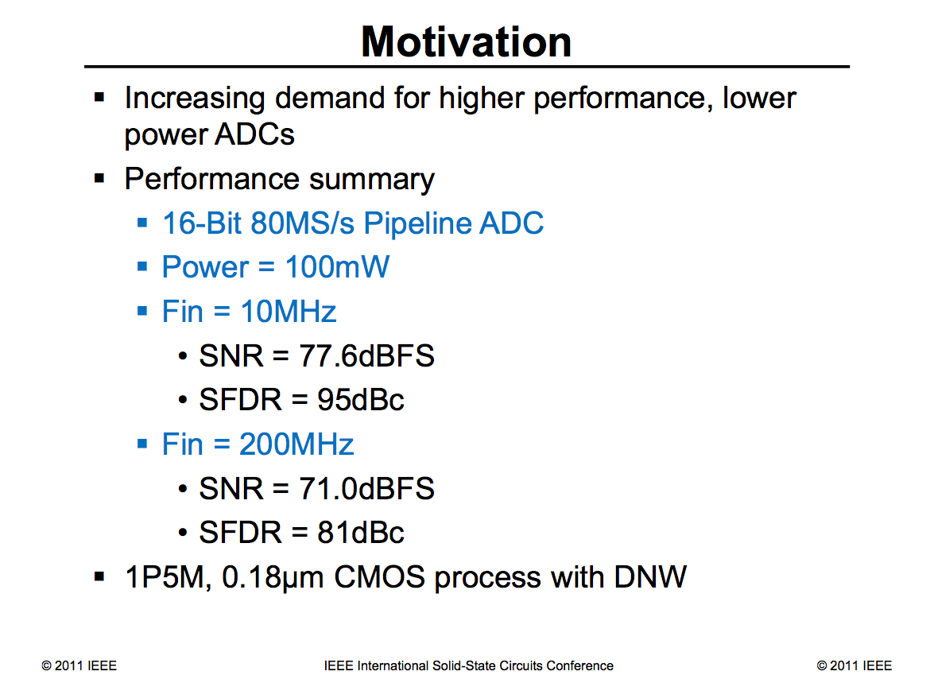
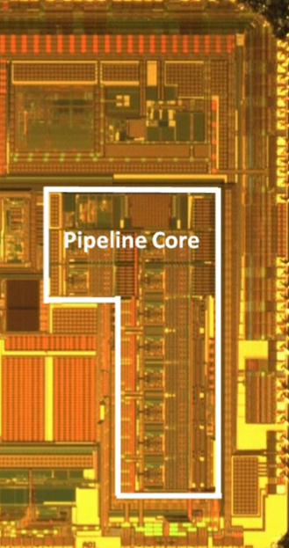
A recent example
from ISSCC 2011

Slide 28
What is better for detector ADCs?
Assume we want to cover a 16 bit dynamic range with a 10 bit resolution
A full 16 bit converter would use:
100 fJ/bit/conv * 2¹⁶ = 6.5 nJ/conv
Four 10 bit converters (à la eCal) would use:
4 * 100 fJ/bit/conv * 2¹⁰ = 0.4 nJ/conv
(of course one would need four pre-amps here)

Slide 29
TSVs and Interconnect

Slide 30

Excitement!

Slide 31
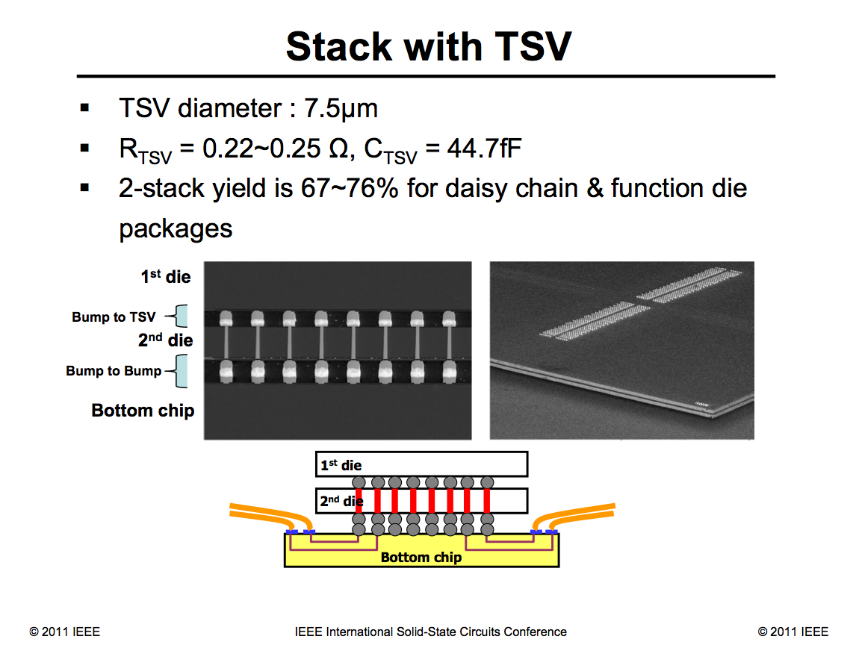
… and reality

Slide 32
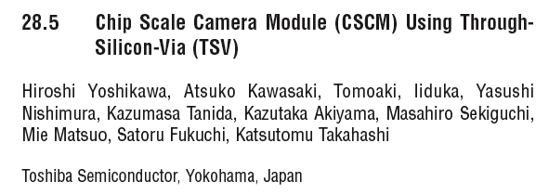
Some more excitement!!

Slide 33
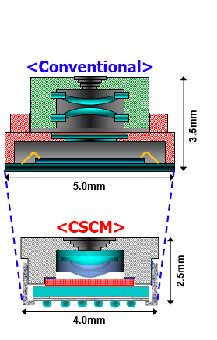
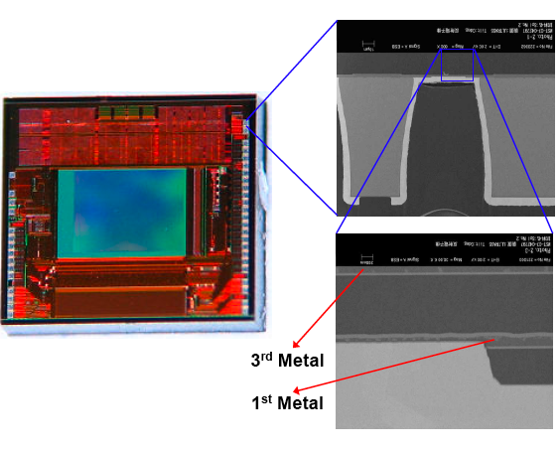
… but again, not many vias

Slide 34
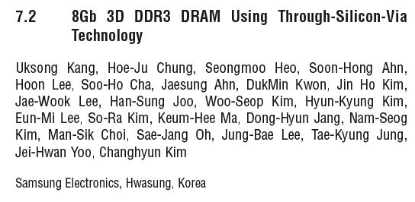
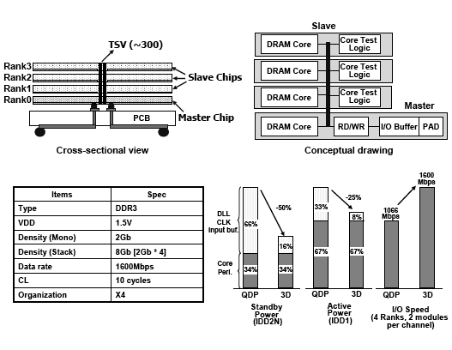
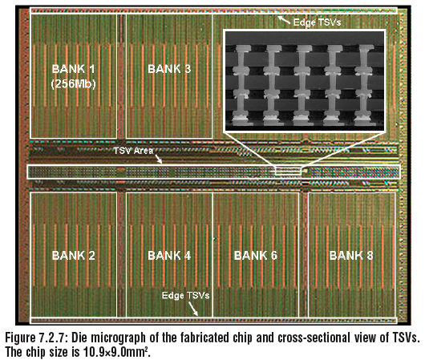
Samsung says a bit more:

Slide 35


Samsung DRAM with TSV
… but a repair scheme is necessary and:

Slide 36
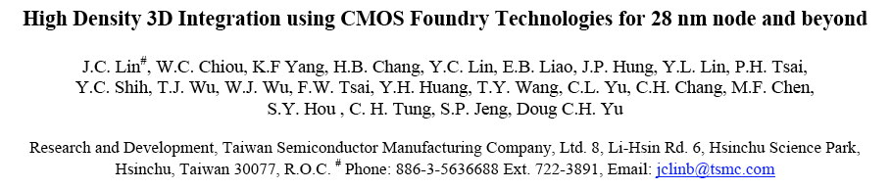
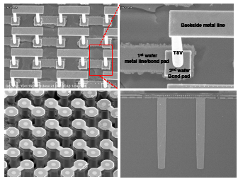
Significant recent progress
From IEDM 2010

Slide 37
Open issues with high-density TSVs:
Unexpectedly foundries seem interested to apply TSV at the forefront tech nodes (see TSMC and Samsung), not really useful for HEP
It may turn out that TSV will only be a “same foundry” option (i.e. no detector wafer from external foundry)
  Via first or middle seems rather unpractical
TSV alone is not the end of the story, one also needs a reliable interconnect technology between wafers

Slide 38
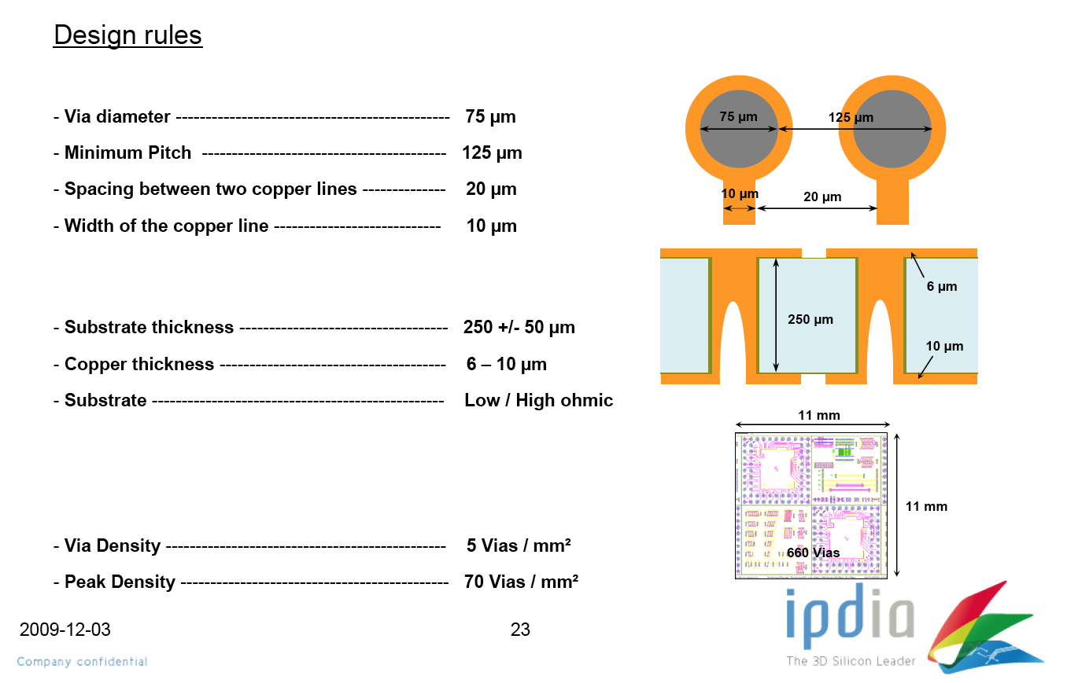
“Low density” TSV from IPDIA

Slide 39
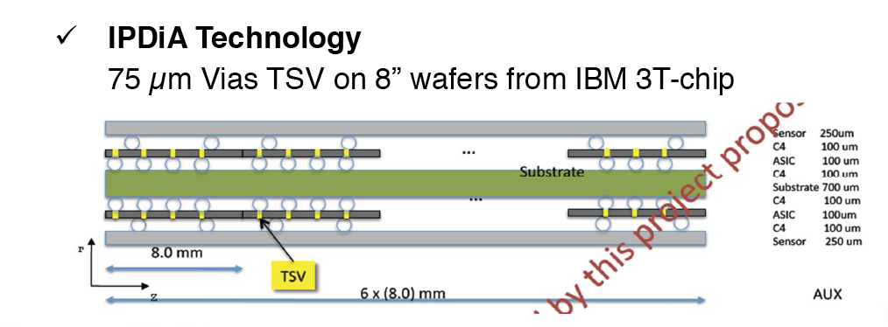
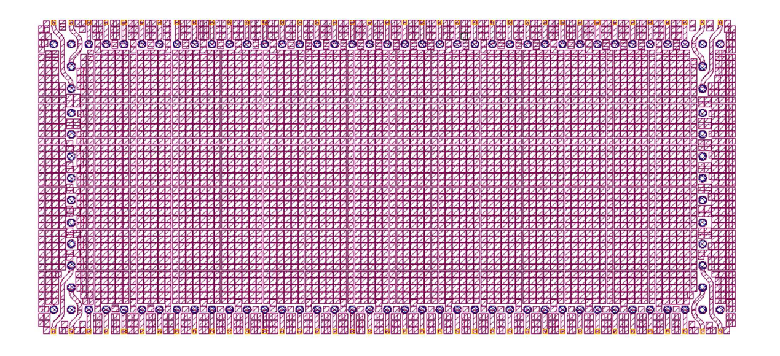
Low density TSV on 3T demonstrator
TSV on periphery to replace wire bonding
C4 to connect to “detector”
Backside of 3T demo chip with
TSV, redistribution layers and
300 um bumps

Slide 40
Optical and Serial Transmission

Slide 41
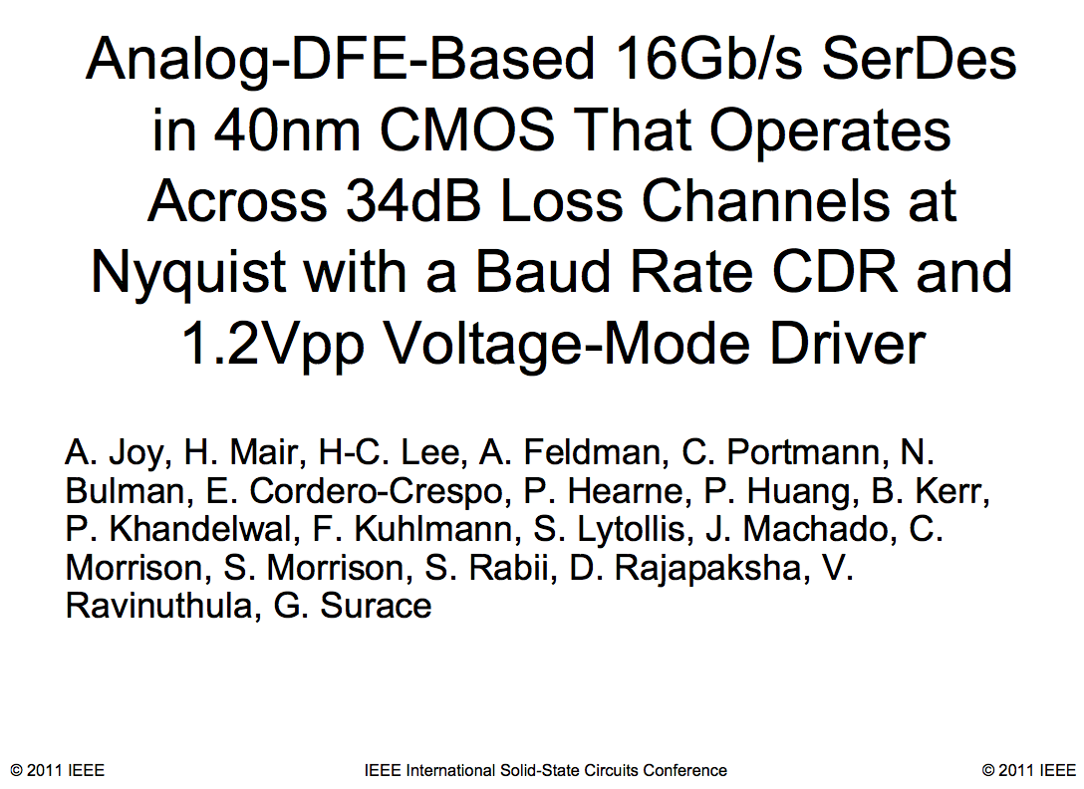
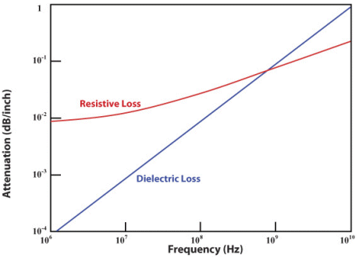
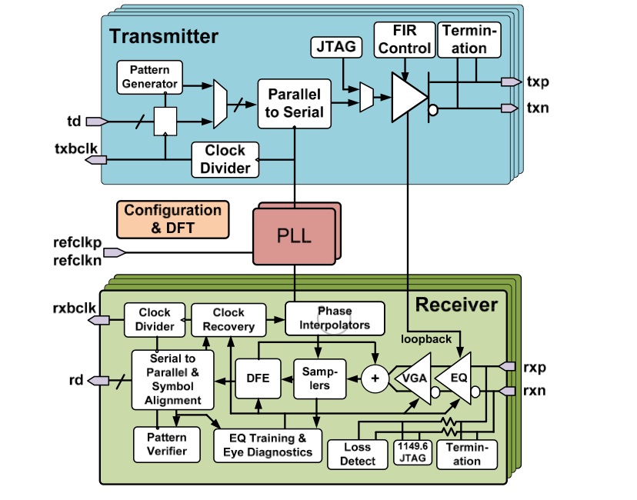
High speed serial on Copper
Attenuation as a function of frequency on FR4 trace,
notice @ 10GHz loss is 1 dB/inch
From ISSCC 2011
Notes:
20.3 - Analog-DFE-Based 16Gb/s SerDes in 40nm CMOS That Operates Across 34dB Loss Channels at Nyquist with a Baud Rate CDR and 1.2V_{pp} Voltage-Mode Driver [Abstract] [Digest Paper] [Visuals] Title (Sorted Alphabetically): Analog-DFE-Based 16Gb/s SerDes in 40nm CMOS That Operates Across 34dB Loss Channels at Nyquist with a Baud Rate CDR and 1.2V_{pp} Voltage-Mode Driver Author: Joy, Andrew K.; Mair, Hugh; Lee, Hae-Chang; Feldman, Arnold; Portmann, Clemenz; Bulman, Neil; Cordero Crespo, Eugenia; Hearne, Peter; Huang, Patty; Kerr, Ben; Khandelwal, Pulkit; Kuhlmann, Franz; Lytollis, Shaun; Machado, Joaquim; Morrison, Casey; Morrison, Scott; Rabii, Shahriar; Rajapaksha, Dushmantha; Ravinuthula, Vishnu; Surace, Giuseppe Subcommittee: Wireline Session: 20 - High-Speed Transceivers & Building Blocks Author Affiliation: Texas Instruments; Arda Technologies Author Country: United Kingdom

Slide 42
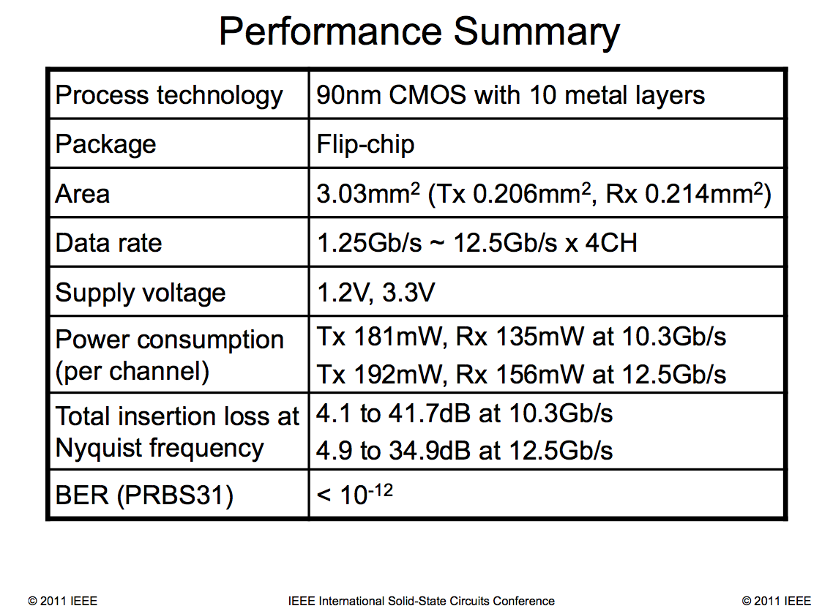

Copper links
From ISSCC 2011

Slide 43



A 40Gbit/sec Tx-Rx (i.e. the GBT+++)
From ISSCC 2009
Notice the low speed I/O interface!
Chips consume 2.8W each

Slide 44


Another 40 Gbit/s
Input is @ 10 Gb/s I/O interface!
Chip consumes 1.8W
From ISSCC 2009

Slide 45
Summary
While “The End of …” was announced many times already, there are still people who find effective solutions for very hard problems
Components for LHC detectors were designed and fabricated in the early 2000’s with technology just one generation behind state-of-the art
  Which technology should we target for 2022?
  Possible answer:
    65 nm? Think: most certainly 45, 32/28, 22, 15, 7 nm will be out by then
Analog and Digital designs are becoming more and more difficult because of the many effects that have to be taken into account at design time
  limits of fabrication must be taken into account early by designers

Slide 46
Take home messages
Microelectronics will most certainly NOT be the show-stopper for building better instruments for physics
  But be careful about the “Media-Markt effect”, i.e. the fact that impressive technologies are readily available at low cost and in high volume does not, unfortunately, imply that we (HEP) can access them easily
But much more investments will be necessary to attract, hire, train and educate, electronic engineers to work with detector physicists to conceive, develop and build better instruments
  What is the correct P:E ratio to keep up with rate of external development?
We also need to maintain contact with industry not by telling them what to do but by humbly learning how to use their tricks to our advantage (there is a very fine line here!)
Our projects are executed painfully slowly and the forefront of technology is accelerating away from HEP

Slide 47
Spares

Slide 48

Cylindrical FinFET transistor (2)
TSMC, 2004
Abstract:
A new nanowire FinFET structure is developed for CMOS device scaling into the sub-10nm regime. Accumulation mode P-FET
and inversion mode N-FET with 5 nm and 10nm physical gate length, respectively, are fabricated. N-FET gate delay (CV/I) of
0.22ps and P-FET gate delay of 0.48 ps with excellent subthreshold characteristics are achieved, both with very low off leakage
current less than 10 nA/um. Nanowire FinFET device operation is also explored using 3-D full quantum mechanical simulation.

Slide 49
Problems with Lithography
Layout
as fabricated
Rounded poly
L_{eff} error
Rounded diff
W_{eff} error
Array effects
L_{eff} error at borders

Slide 50

Variability at low voltage
from Krishnamurthy (Intel)

Slide 51
FOM 2008 and 2009
FOM = energy necessary to make
a one bit comparison in the ADC
ISSCC 2008
ISSCC 2009
Notes:
Explain what the FOM is: Energy to do one conversion of one bit

Slide 52
The last 20 years of predictions
Prediction
Prediction
Prediction
Analysis
Analysis
Analysis
1970
1990
2000
1970
2000
2010
1970
2010
2020

Slide 53
Reasons for saturation of the S-curve
~1990: “Lithography stops at the wavelength of light”
~1995: “Analog Design is over!”
~2000: “Too hard to make 12” wafers economically”
~2002: “Microprocessors will never reach 10 GHz”
~2005: “Design complexity becomes unmanageable”
~2008: “Cost of new fab becomes unbearable”
~2011: “Process variability will be uncontrollable”

Slide 54

…and they were all wrong, or just too conservative

Slide 55

On cost of fabs
If sleepless tonight, have a look at:
http://en.wikipedia.org/wiki/List_of_semiconductor_fabrication_plants

Slide 56
Turn-on-off control

Slide 57

To beat Boltzmann:
If one gate is good, two are better
Avoid drain-to-channel coupling to reduce Short Channel Effects and Drain Induced Barrier Lowering

