Slide 1
Forward Calorimetry Task Force
Brad Cox and Randy Ruchti
8 November 2011

Slide 2
In June CMS Week
We had presentation and discussion of detector concepts
  Dan Green: Calorimetry Requirements
  Chris Tully: CFCAL
  Roger Rusack: Calorimetry Concept
  Harvey Newman: Calorimetry Approaches
  Nural Akchurin: Calorimetry Strategies
  Burak Bilki: Digital Calorimetry

Slide 3
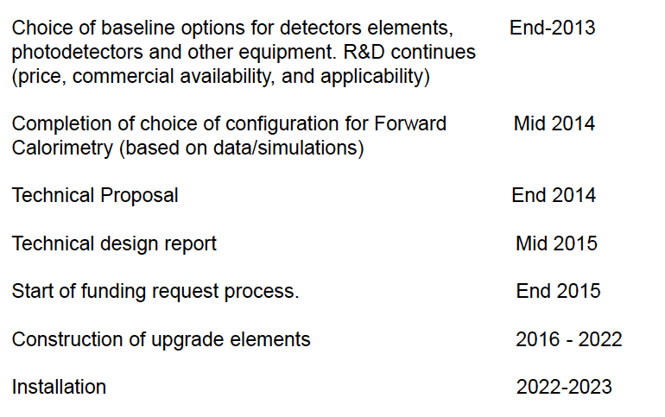
Milestones to be ready for Phase II

Slide 4
Focus of Today’s Meeting
Simulation update
Updates on technology R&D
  For lack of time (5 ½ hours) we cannot hear all…
At CMS Week in December 2011 we will revisit discussion of Detector Conceptual Designs…
  And we will hear from those who could not fit in today…
Speakers are reminded to stay on time…

