Slide 1
CSC Frontend Trigger Electronics Upgrade
Jason Gilmore
Vadim Khotilovich
Alexei Safonov
CMS Upgrade Workshop
FNAL
November 8, 2011

Slide 2
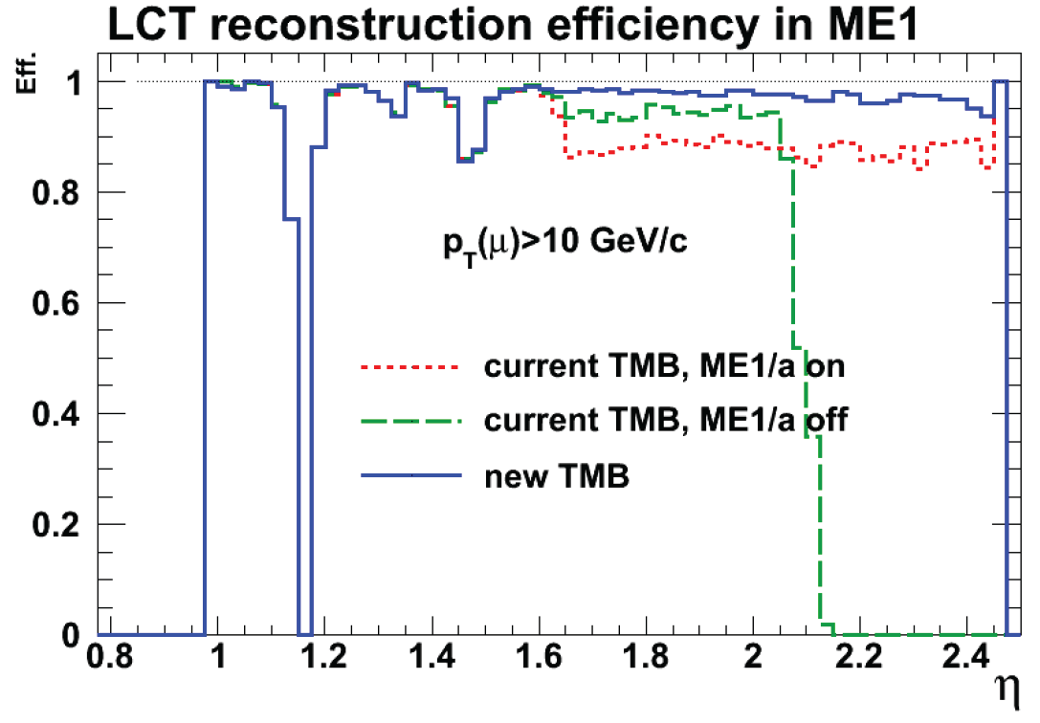
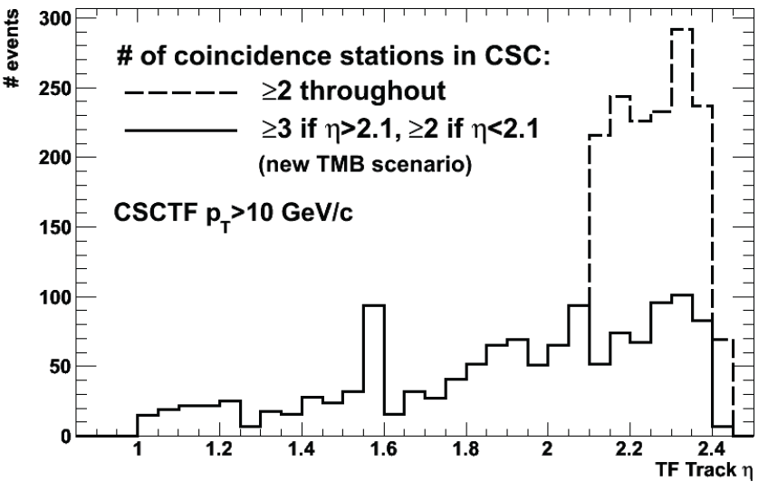
CSC: Frontend Trigger Problem
Out-of-time PU induces deadtime at higher luminosity → look at PU100
Particular issue is the ME1/1 “TMB” building chamber track segments
  Two aspects making ME1/1 special:
    Very high occupancies
    ME1/1 TMBs effectively serve two chambers (inner ME1/a, outer ME1/b)
Need better FPGA to maintain efficiency
  The algorithm is ready (V. Khotilovich)
  Design of prototype TMB completed
Improve muon trigger efficiency for |η|>2.1
  Rate increase compensated by requiring 3 station coincidence for |η|>2.1
    With new TMB can do w/o efficiency loss
    Needs firmware modifications in CSCTF

Slide 3
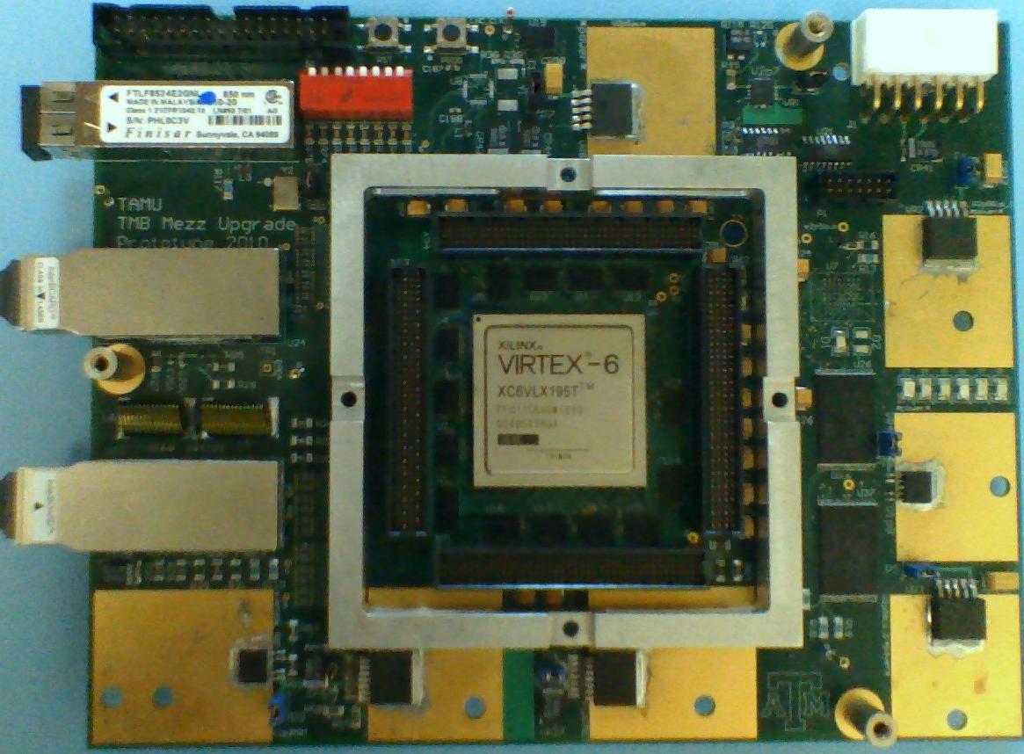
TMB Mezzanine Prototype
Virtex-6 FPGA + PROMs
QPLL
Snap12 Fiber Transmitter
- only for testing
Snap12 Fiber Receiver
- fibers from 7 CFEBs
PCB Dimensions: 7.5” wide by 5.9” high
11 mm clearance from TMB main board
I/O Voltage-level shifters, 3.3 V to 2.5 V
3

Slide 4
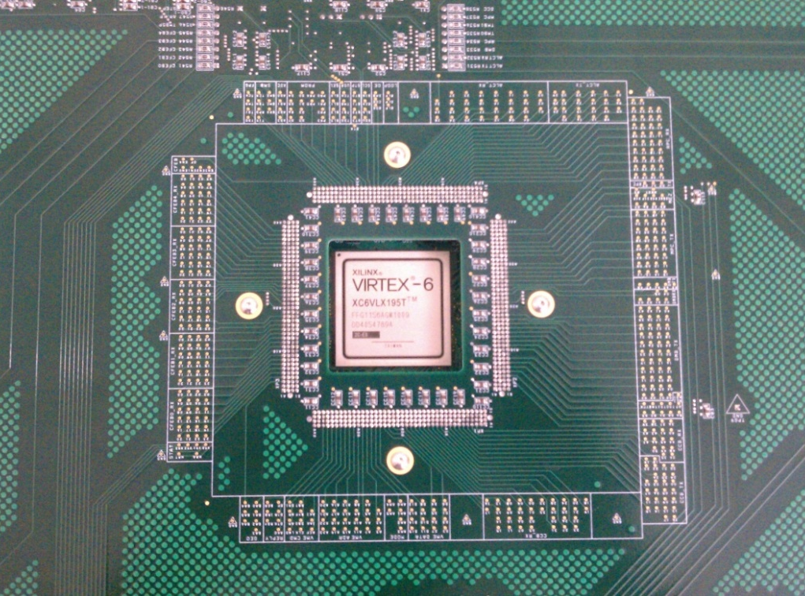
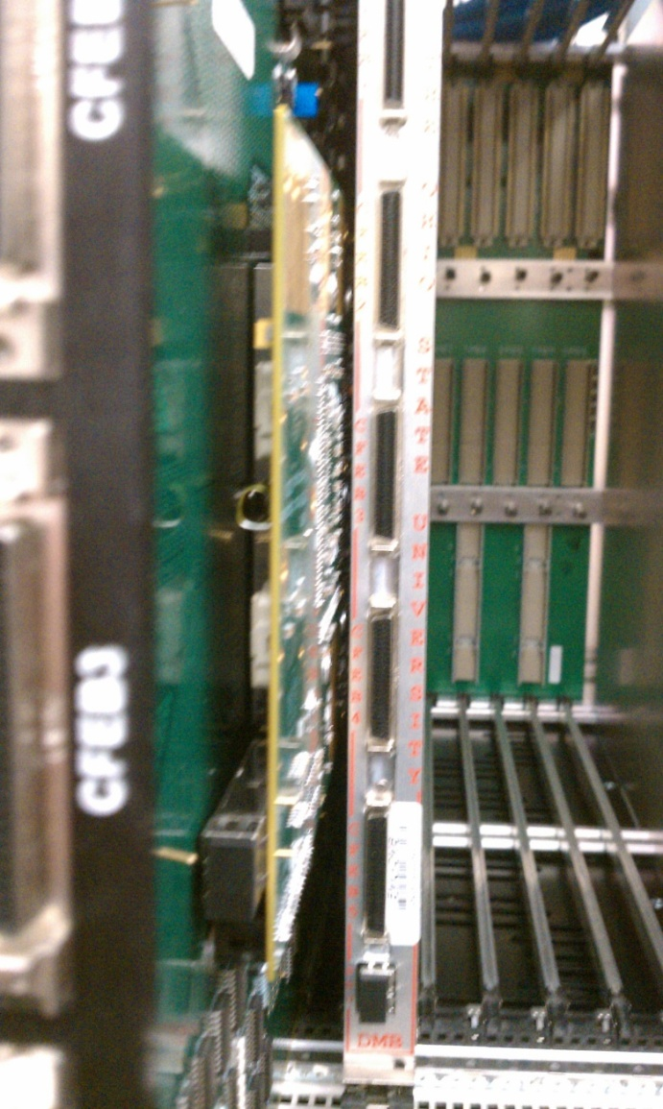
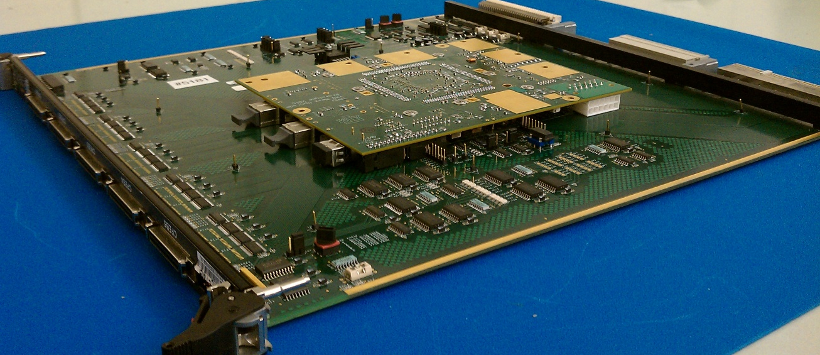
TMB Mezzanine Installation

Slide 5
TMB Upgrade Progress
Algorithm development and simulation
  This has been largely completed
Firmware design
  Old Virtex-2 firmware has been ported to Virtex-6
    Still need to implement new trigger algorithm
Electronics Testing
  Cooling, Power and Mechanical Fit: all good
    Less than 8 A draw on 3.3 V power supply
    FPGA core temp maintained under 65 C
  Fiber communication from 7 CFEBs via Snap12
    PRBG data tests perfect @3.2 gbps
  System integration tests, 8 communication paths
    Signal connections: all good so far
  Radiation and SEU testing: OK so far, more coming

Slide 6
TMB Integration Testing
Integration with EMU system elements
  CCB, MPC, DMB and CFEB tests completed
CFEB communication performance
  Fiber reliability tested with PRBG data
    Realistic operation proven with comparator pattern data
  Cable function tests for backwards compatibility
    Functionality proven with comparator pattern data
DMB communication tests
  CFEB comparator data transfers through TMB to DMB
MPC pattern testing
  Performed standard backplane communication tests
CCB clock and command function tested
Still to do: ALCT & RPC I/O tests
  Preparing infrastructure for this now

Slide 7
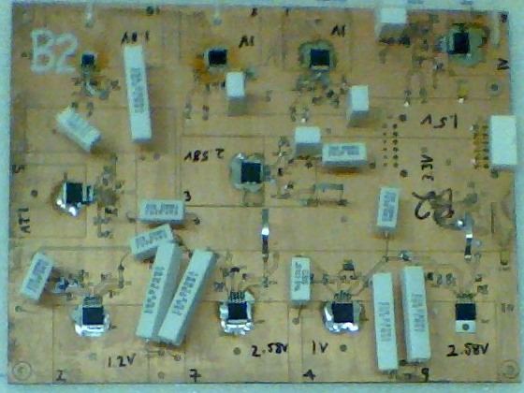
Voltage Regulator Radiation Tests
Testing performed at the Texas A&M Nuclear Science Center
  1 megawatt reactor operating at 6 kW, provides 9.9 *10⁸ n/cm²s
Multiple samples of several COTS regulators, two exposures
  First exposure represents ~10 SLHC year dose
  Second exposure adds ~20 SLHC years, total of 30 year dose
  Regulator performance tested before and after each exposure
    Regulators were unpowered during exposure
Several regulators showed no ill-effects
  National Semi LP38501 and LP38853
  Micrel 49500 and 69502
  TI TPS74901
Others did not fare so well…
  Maxim 8557
  Sharp PQ035ZN1, PQ05VY053, PQ070XZ
  TI TPS75601, TPS75901
  No improvement seen with additional cool-down time

Slide 8
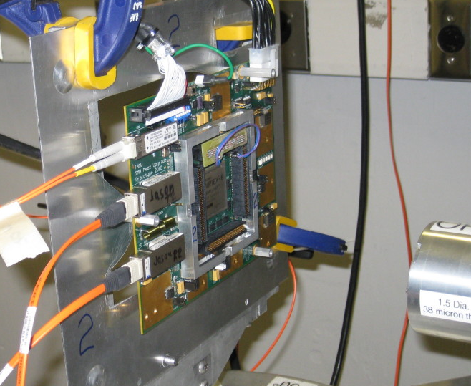
SEU Testing of COTS Components (1)
Testing performed at Texas A&M Cyclotron
  55 MeV protons with uniform flux, collimated to 1.5” diam
  Maximum proton flux ~3 *10⁷ cm⁻²s⁻¹
  45 to 90 minute runs on each target device, 5-10 kRad
Two samples tested for each COTS component
  Reflex Photonics Snap12 Receiver: r12-c01001
    PRBG data transfers @3.2 gbps on each of six links
    σ = (8.18 ± 0.34) *10⁻⁹ cm²
  Reflex Photonics Snap12 Transmitter: t12-c01001
    Tested for use in DMB upgrade
    PRBG data transfers @3.2 gbps on each of six links
    σ = (7.31 ± 2.44) *10⁻¹¹ cm²
  Finisar Optical Transceiver: ftlf8524e2gnl
    Tested for use in CFEB upgrade
    randomized GbE data packets to PC
    σ = (1.02 ± 0.27) *10⁻¹⁰ cm²

Slide 9
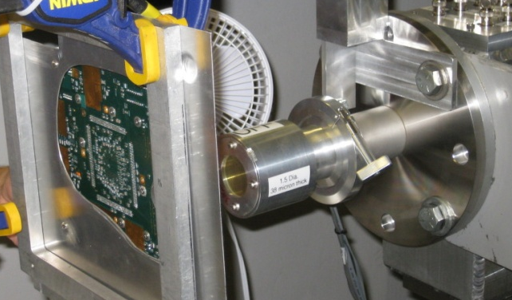
SEU Testing of COTS Components (2)
Xilinx Virtex-6 FPGA: xc6vlx195t-2ffg1156ces
  GTX Transceiver (55% used)
    PRBG data transfers @3.2 gbps
    σ = (7.55 ± .79) *10⁻¹⁰ cm²
  Block RAM (74% used)
    4 kB BRAM readout to PC *No SEU Mitigation Logic implemented*
    σ = (5.69 ± .58) *10⁻⁸ cm²
  CLB (38% used):
    4 kB CLB-RAM readout to PC *No SEU Mitigation Logic implemented*
    σ = (3.71 ± .47) *10⁻⁸ cm²
TI Bus-Exchange Level-Shifter: sn74cb3t16212
  PRBG data transfers @15 MHz
  No SEU observed, σ_{90%} < 1.73 *10⁻¹¹ cm²
Additional SEU testing is planned
  Implement mitigation in firmware
  Use higher-rate beam for increased dose, ~50 kRad

Slide 10
Coming Soon
Equipment and procedures for production testing
  TMB Mezzanine test stand with full capability at TAMU
    Fiber link tester for Snap12 links
      May use a prototype board for PRBG data to production boards
    CFEB emulator board with support for 5 cables
    Crate tests with loopback boards as well as standard CMS EMU electronics
  Software and automation
    Develop a custom GUI to run standard EmuLib routines and log results
Preproduction run coming soon, 4 boards
  Holding off for final radiation test
Final production, mid-2012
  Need 72 boards for ME1/1 operation
  Total of 90 boards to be produced
  Estimate ~4 months required for testing production boards

Slide 11
CSC TMB Upgrade Outlook
We are close to a final, proven design
  Fully compatible with old and future CFEBs
  Possible installation without a long shutdown
    For TMB Mezzanine alone, could install ME1/1 in ~2 weeks
    New CFEBs and fiber installation take longer of course…
TMB Mezzanine development nearly done
  A prototype has been built & tested
  PCB modifications for production have been made
  Preproduction run is in the works
    Quotes requests have been submitted
  Production test station is under development

Slide 12
Extras

Slide 13
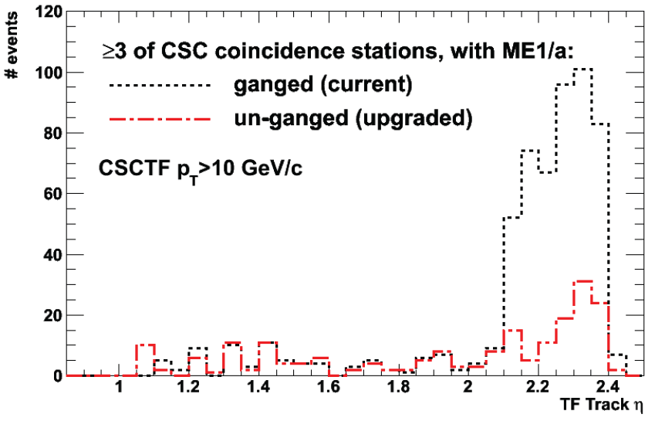
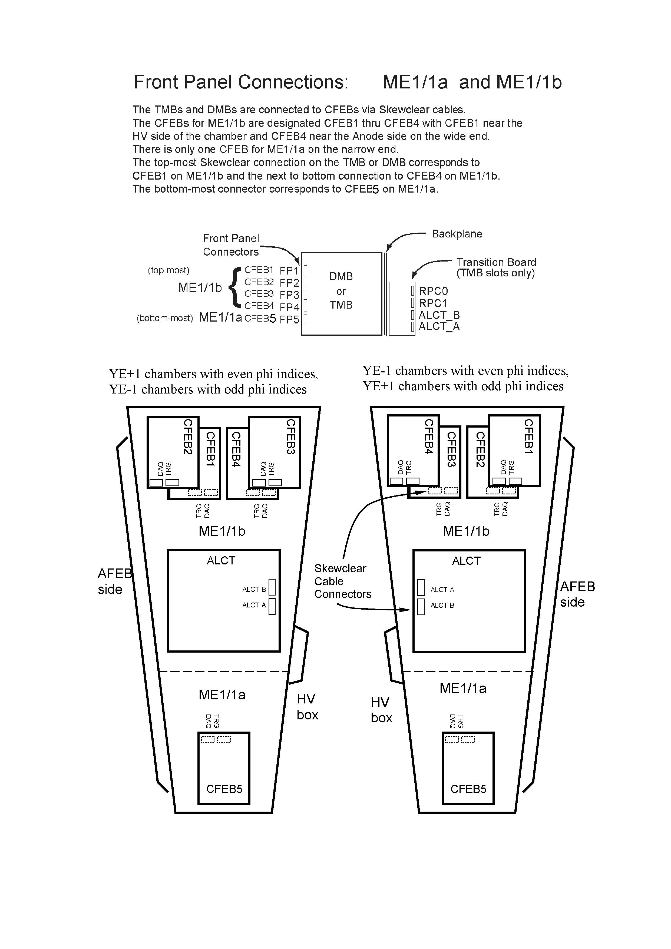
CSC: The “Ganging” Problem
The forward region will jump up again when new ME4/2 arrives
  With sufficient redundancy switch to 3 stations coincidence in the entire endcap
  “Triple ganging” is the reason
Solution requires new electronics for ME1/1
  Front end (DCFEBs)
  Related EMU electronics
    TMB, DMB
Strips: 1 16 17 32 33 48
…
…
…
Electronics
Channel 1
…
Channel 16

