Slide 1



CMS Binary Chip (CBC):
status and development
D.Braga, L.Jones, P.Murray, M.Prydderch (RAL)
G.Hall, M.Pesaresi, M.Raymond (IC)
CMS Upgrade Week, FNAL, 07 Nov 11
Notes:
Some of the slides have a brief comment here

Slide 2
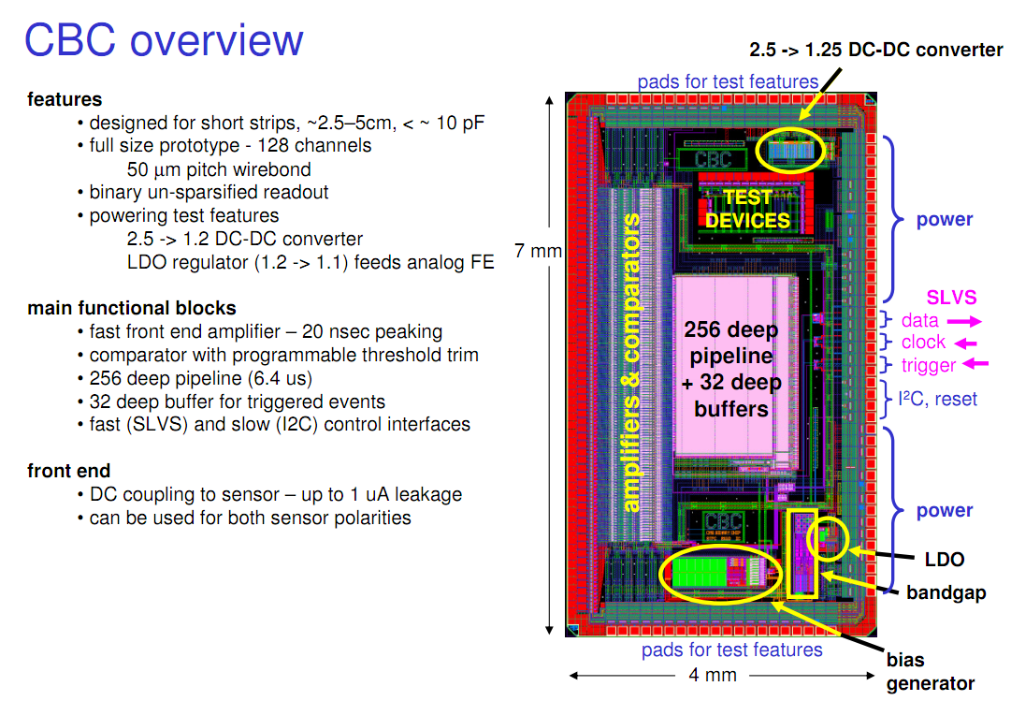
from M.Raymond’s: http://www.hep.ph.ic.ac.uk/~dmray/CBC_documentation/CBC_status_Oct_2011.pdf

Slide 3
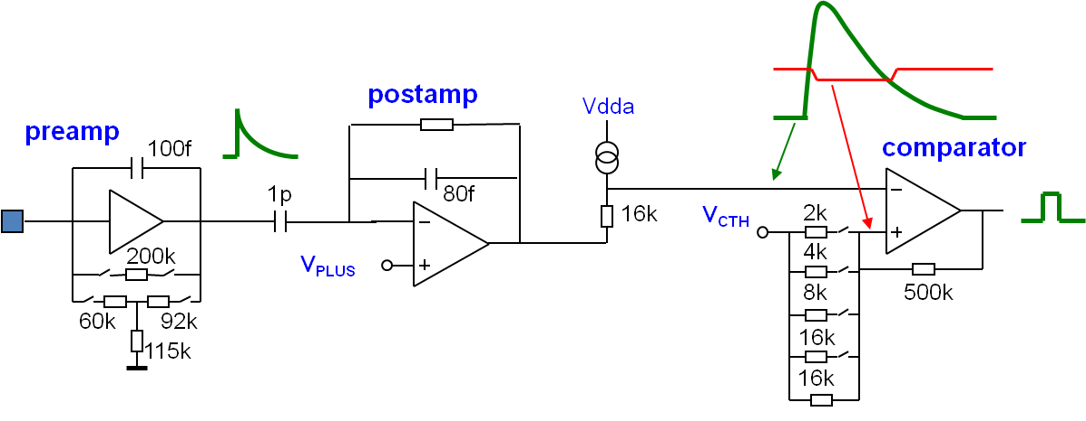
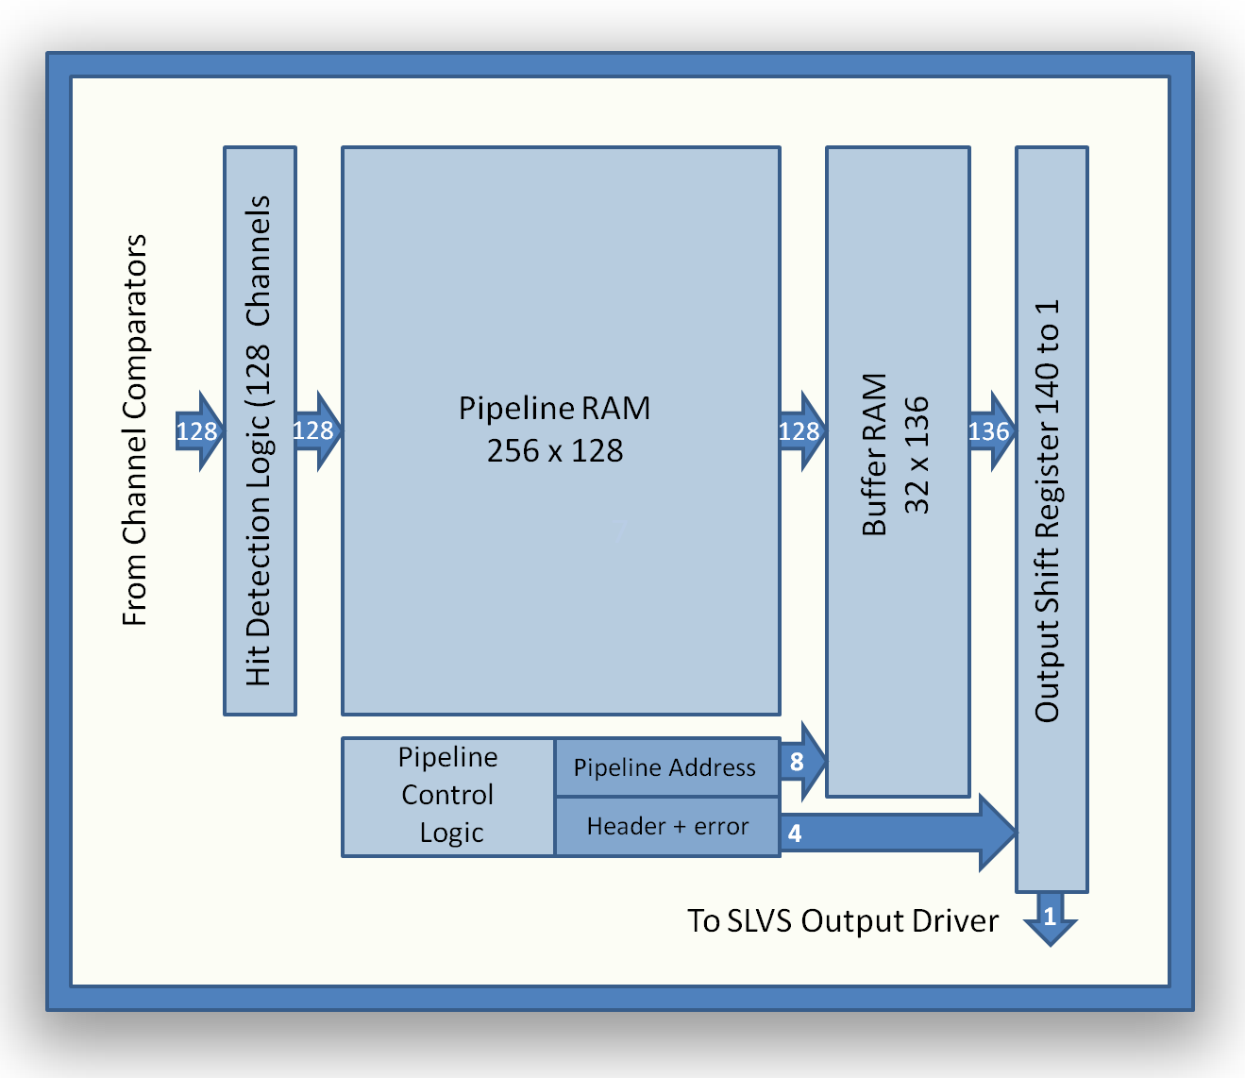
Architecture
preamp: leakage tolerance 1μA verified, both polarities
postamp: gain: ~ 50 mV / fC
comparator: input peaking time ~20ns
global threshold
8b programmable offset
programmable hysteresis

Slide 4
Test Results
s- curves for range 1 - 8 fC : 1 fC steps
gain
Noise and power
e.g. for 5pF input capacitance:
noise: ~ 800 e_{RMS}
total power: < 300 μW/channel
Notes:
Chips on test bench since February 2011

Slide 5
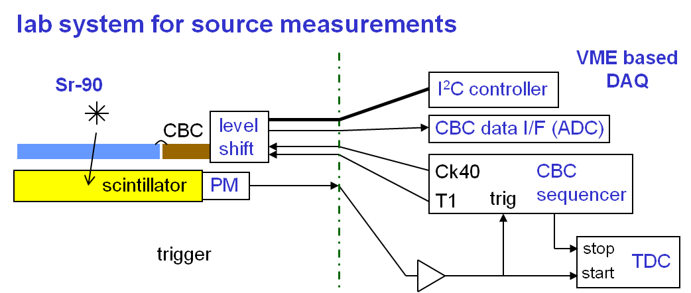
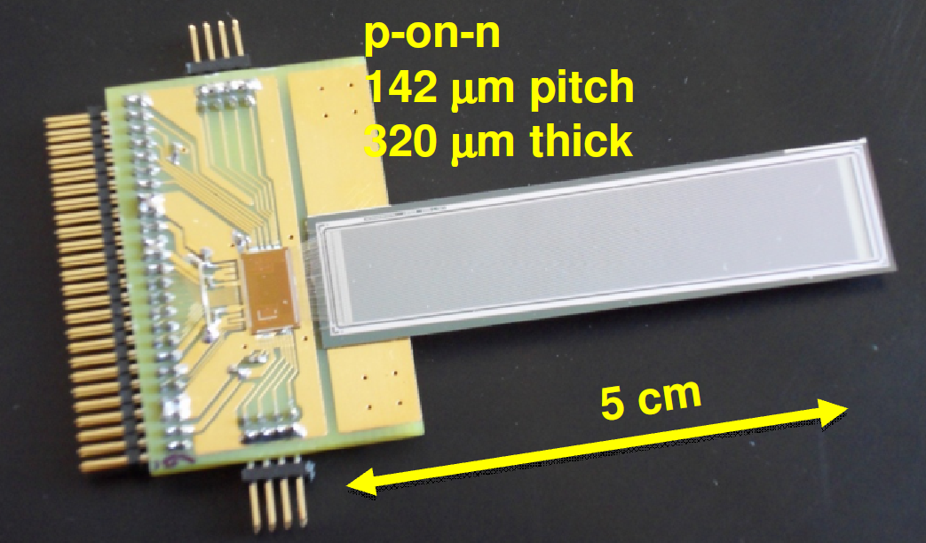
Beta-source results
  Sr-90 source, 5cm p-on-n strip sensor
  Scintillator trigger is time-stamped with 1ns resolution to select events in phase with 40MHz CBC clock
  Landau fitting of correctly-timed events gives 840e noise
Notes:
Results from Sr-90 test with detector confirms chip test results.
Also CBC module operated parasitically in UA9 crystal collimation test beam
(September 2011, H8 beam line, 400 GeV protons)

Slide 6
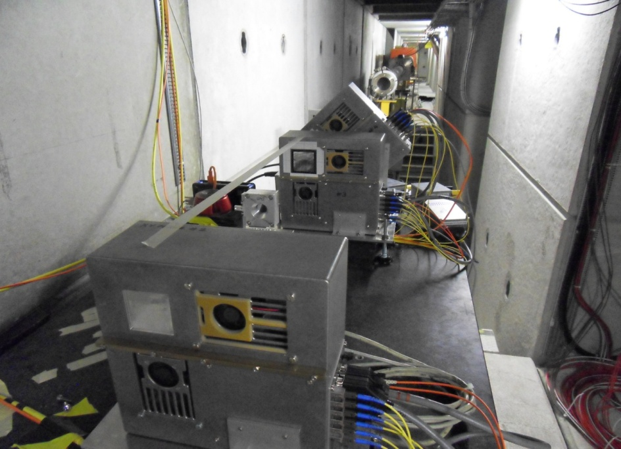
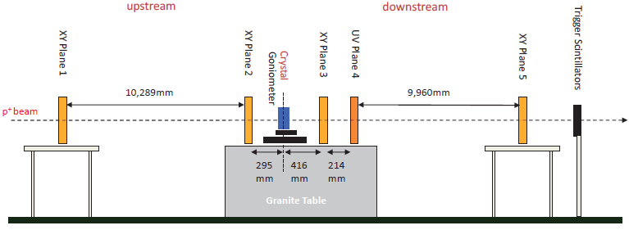
Parasitic beam test
  CBC+sensor recently operated parasitically in 400GeV proton beam (UA9 crystal collimation test – September 2011)
  for further details see: M.Pesaresi et al 2011 JINST 6 P04006
UV plane 4
XY plane 3
XY plane 2
Notes:
Results from Sr-90 test with detector confirms chip test results.
Also CBC module operated parasitically in UA9 crystal collimation test beam
(September 2011, H8 beam line, 400 GeV protons)

Slide 7
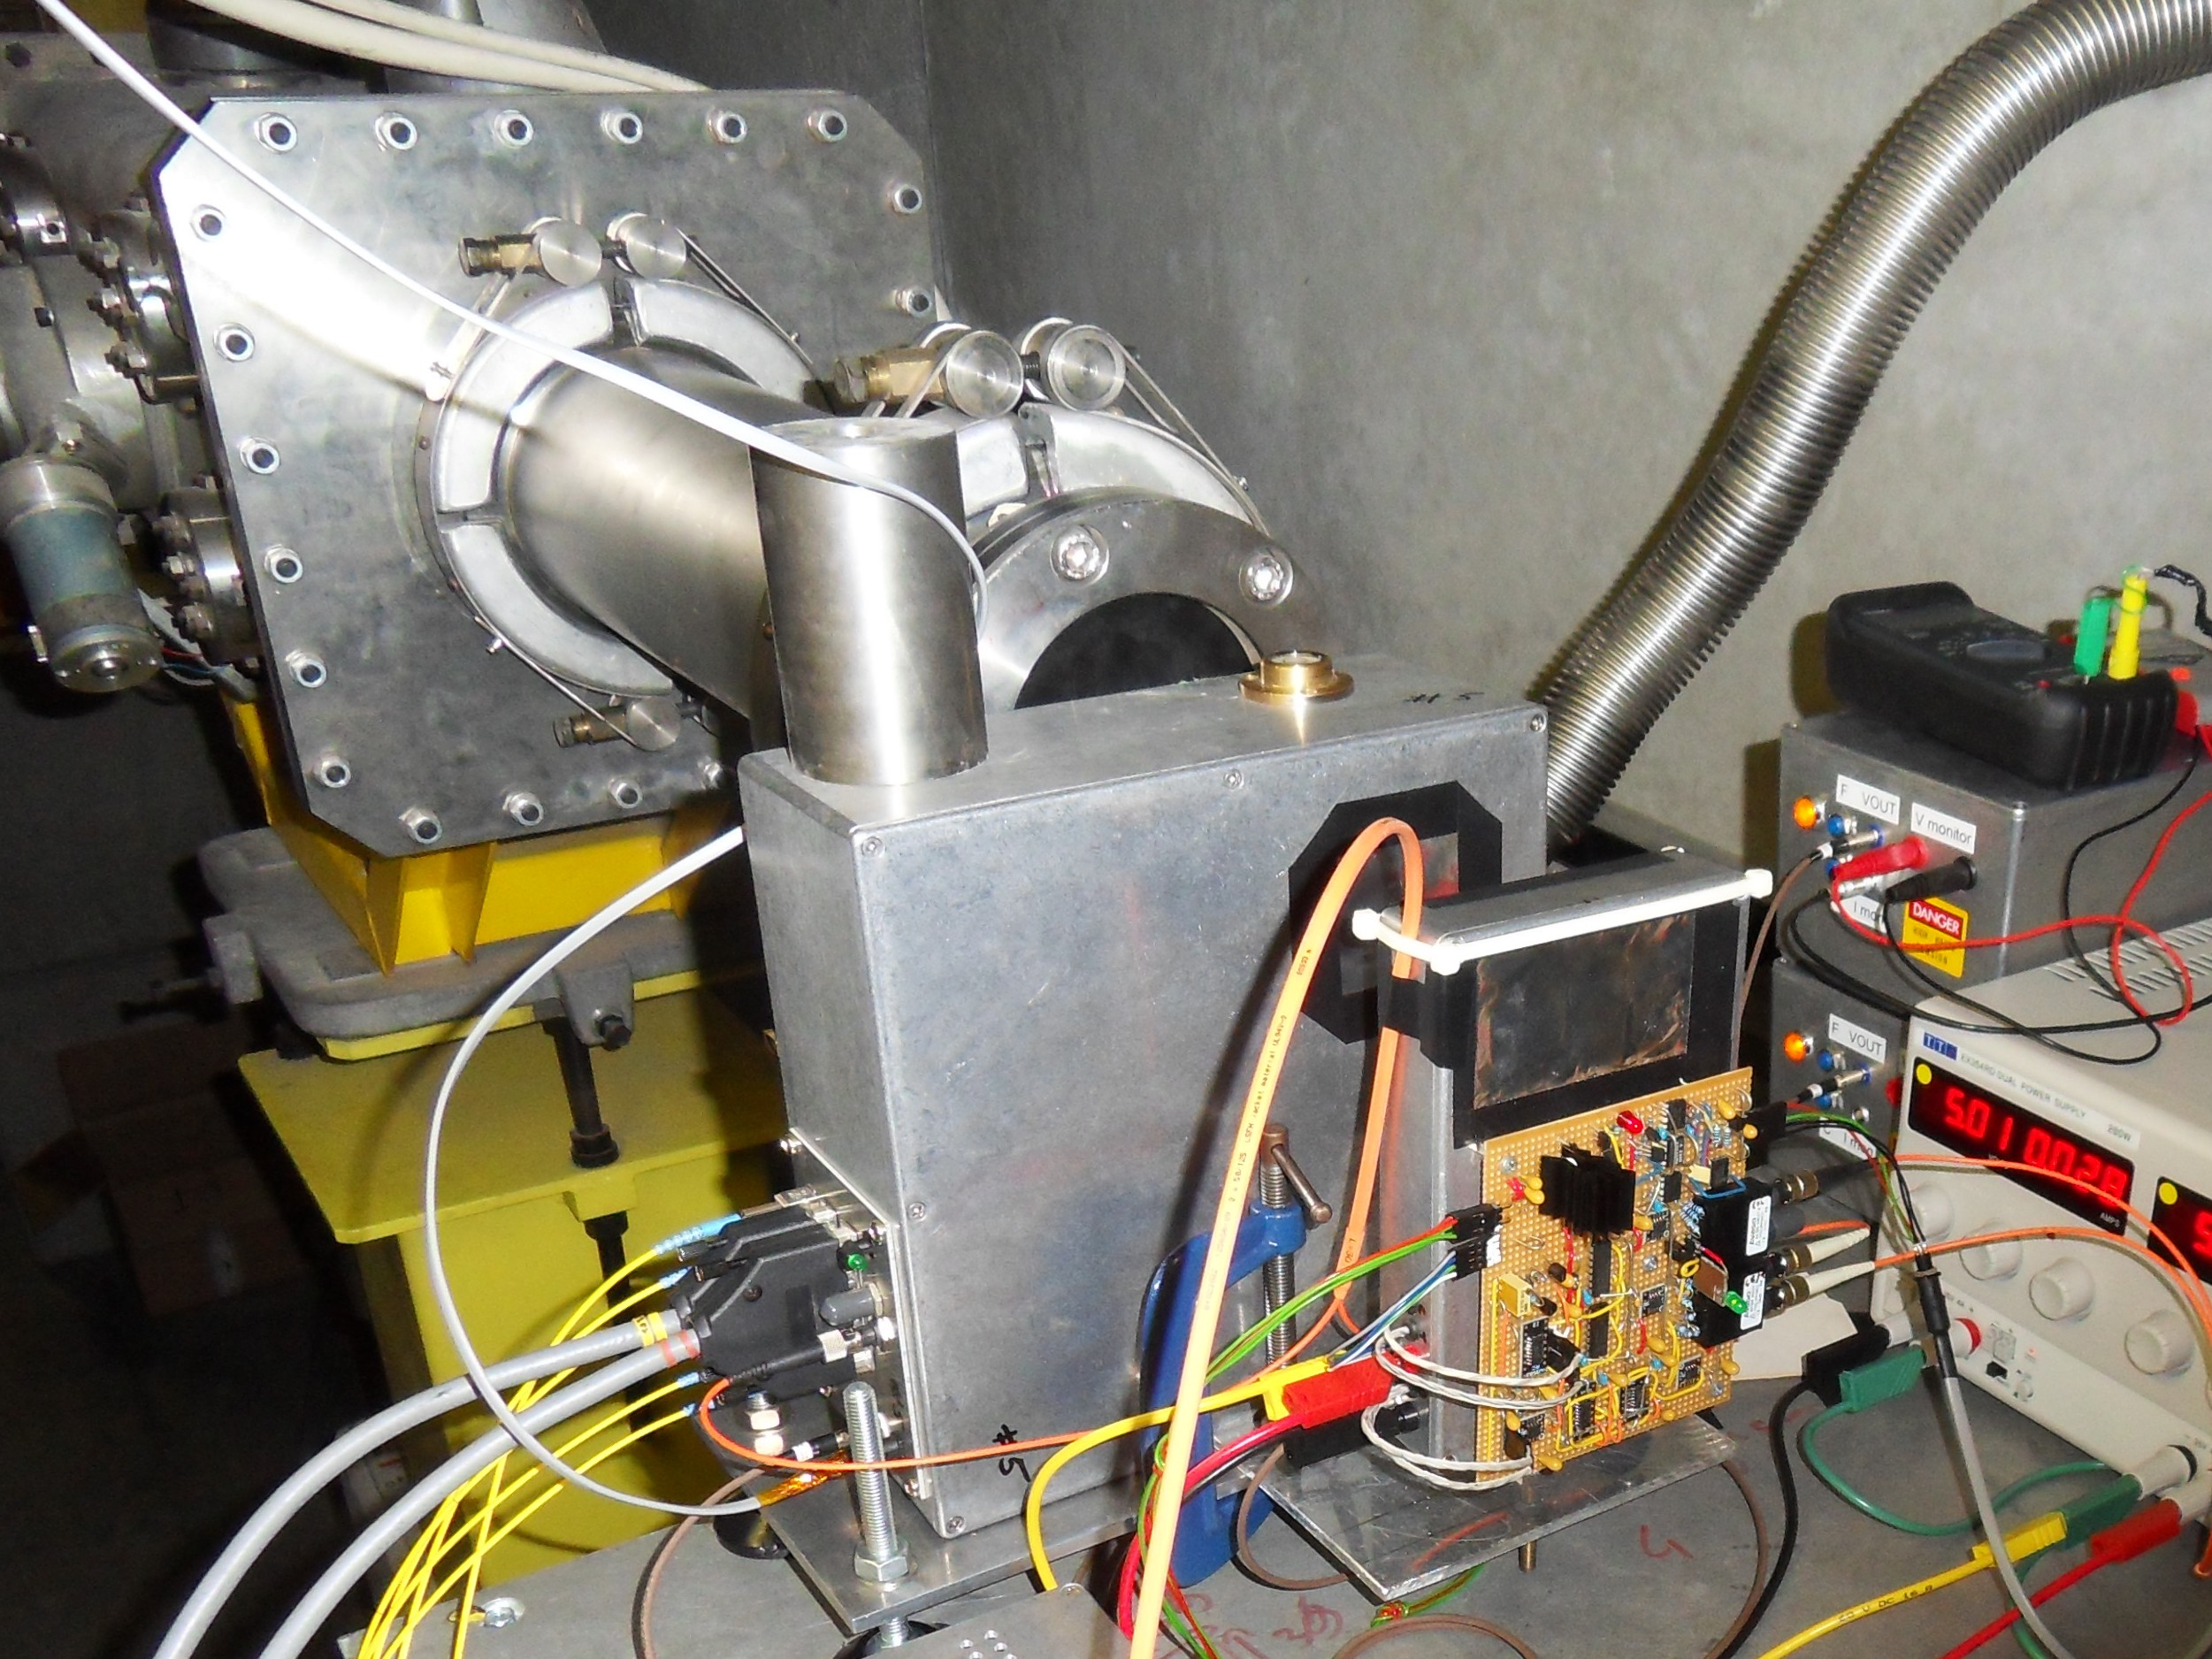
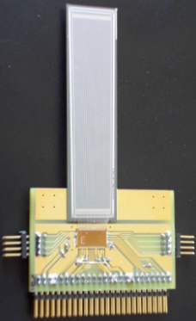
First results
beam profile
APV plane
counts
comparator threshold scan
CBC + sensor
5 mm / division
similar result to that obtained with beta source

Slide 8
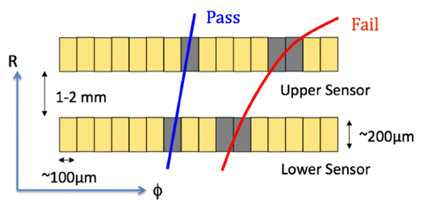
P_{T} Discrimination
  Correlates hits in two closely separated sensors to discriminate between high and low P_{T} tracks
  P_{T} cut of ~2GeV should give reduction rate of ~20
  (see M.Pesaresi Development of a new silicon tracker at CMS for Super-LHC, CERN-THESIS-2010-083)

Slide 9
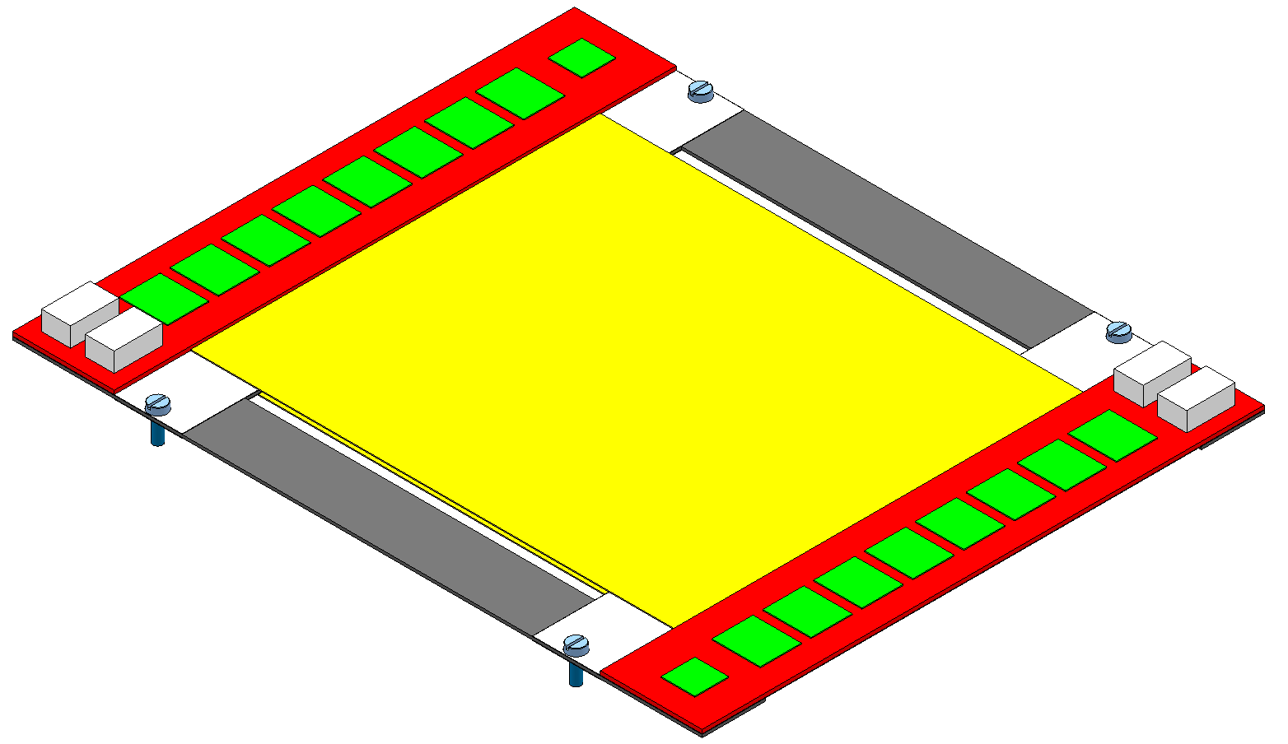
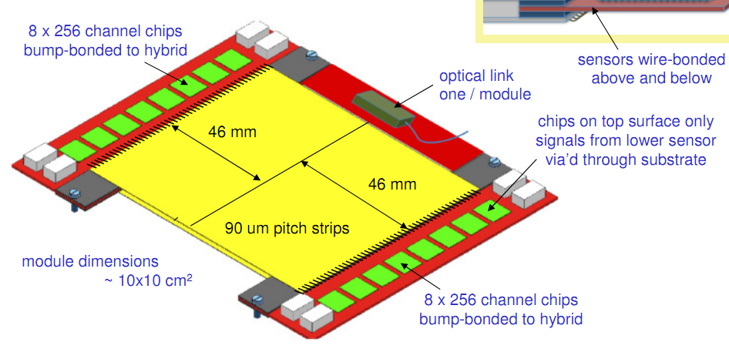
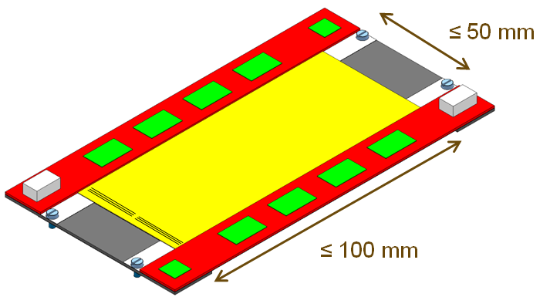
P_{T} module: strip+strip (2S)
More info on module developments in D.Abbaneo’s talk
http://indico.cern.ch/getFile.py/access?contribId=168&sessionId=29&resId=0&materialId=slides&confId=120853

Slide 10
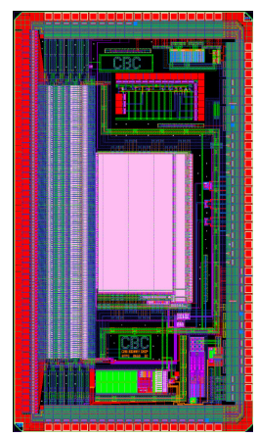
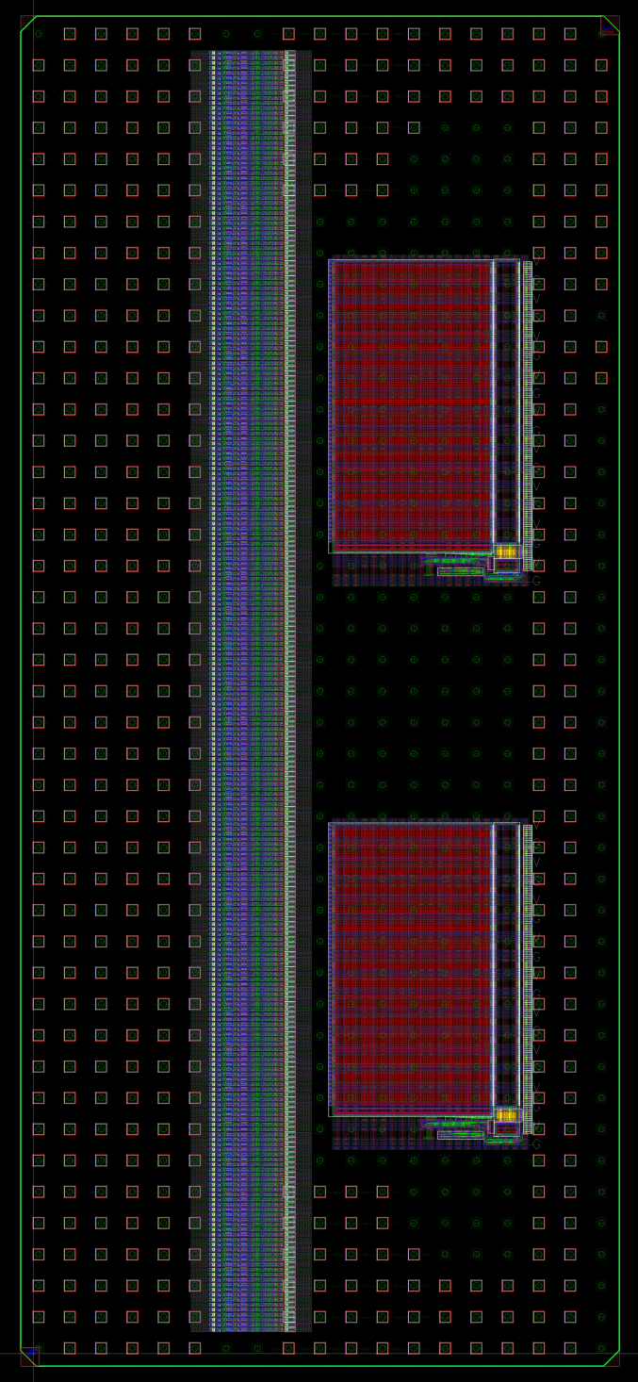
Next Version
INTER-CHIP
SIGNALS
  250μm C4 Bump Bonding
  256 channels
  Internal test pulse calibration
  Monitoring ADC
  Keep DC_DC and LDO
  Multi-mode readout:
  (3 consecutives frames when triggered)
  Layout reuses existing blocks where possible
INPUTS
VDD/GND
+
I/O
existing chip
128 channels
wirebond: 50 um pitch
7mm x 4mm
next version
256 channels
bump-bond: 250 um pitch
10.75mm x 4.75mm
INTER-CHIP
SIGNALS

Slide 11
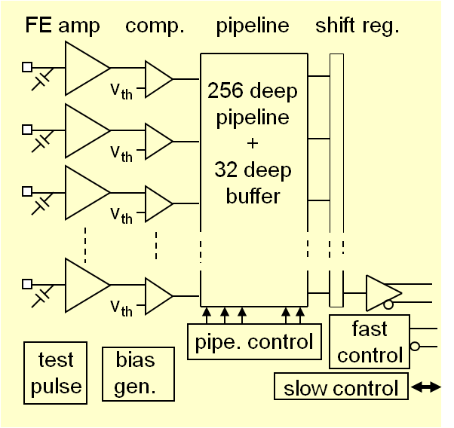
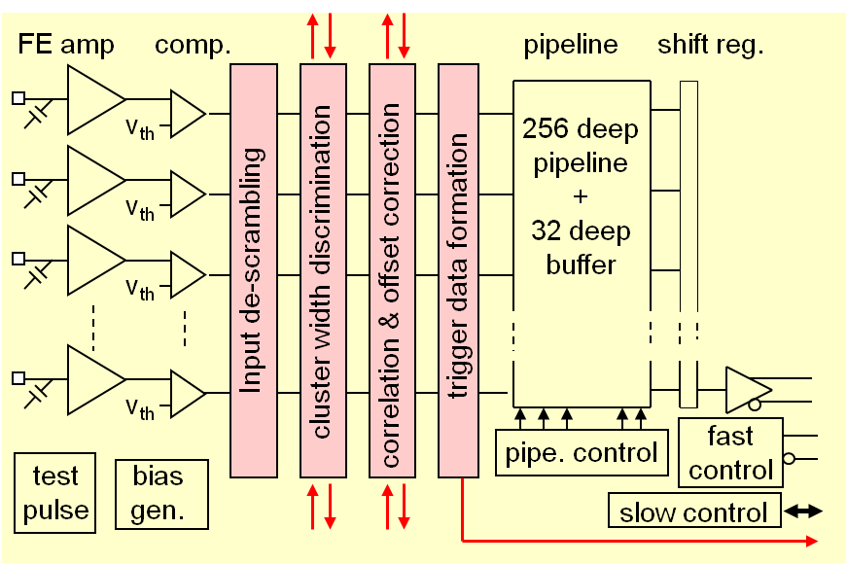
Trigger Logic
current CBC
CBC + added triggering logic
  input de-scrambling allows for flexible connections on the module prototype
  cluster width discrimination excludes wide clusters
  correlation & offset correction corrects for phi offset across module and perform correlation
  trigger data formation and off-chip transmission just simple OR for next version
      → 1 bit to signify high PT stub detected (no stub address)
    final requirements still under consideration: synchronous or asynchronous options are possible

Slide 12
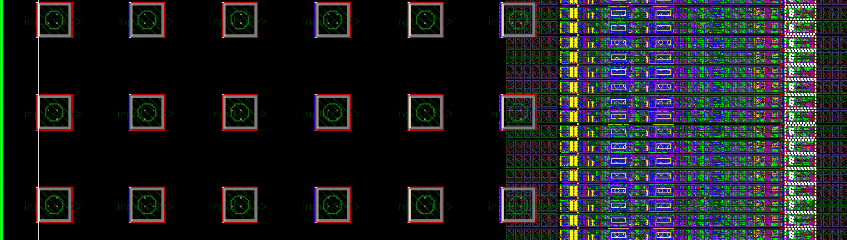
Input de-scrambling/mapping
  Input PADs arranged in rows of 6: these 6 pads can be connected to any combination of 3 channels from the inner sensor layer and 3 channels from the outer sensor.
  Comes after the comparator so does not affect the front-end.
  Allows flexibility in module-prototyping.

Slide 13
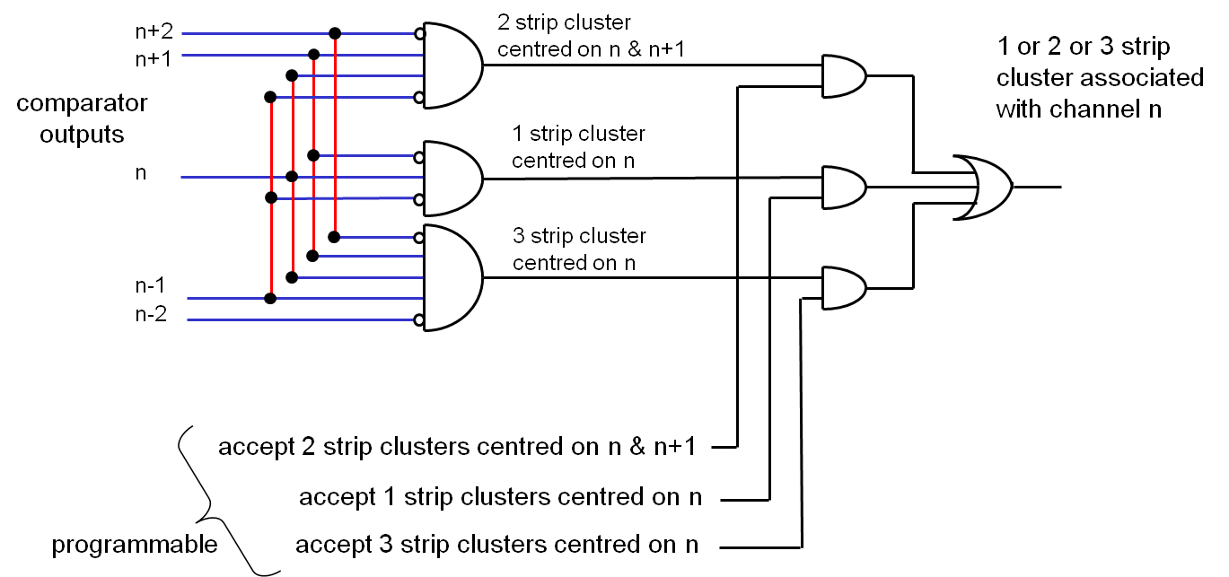
Cluster Width Discrimination
  Looks at adjacent channels from same detector layer
  Rejects clusters above a programmable max-width
  Needs inputs from neighbouring chips at the edges

Slide 14
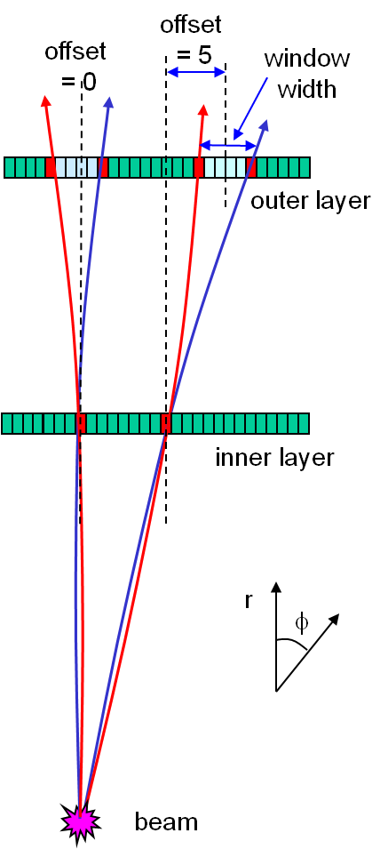
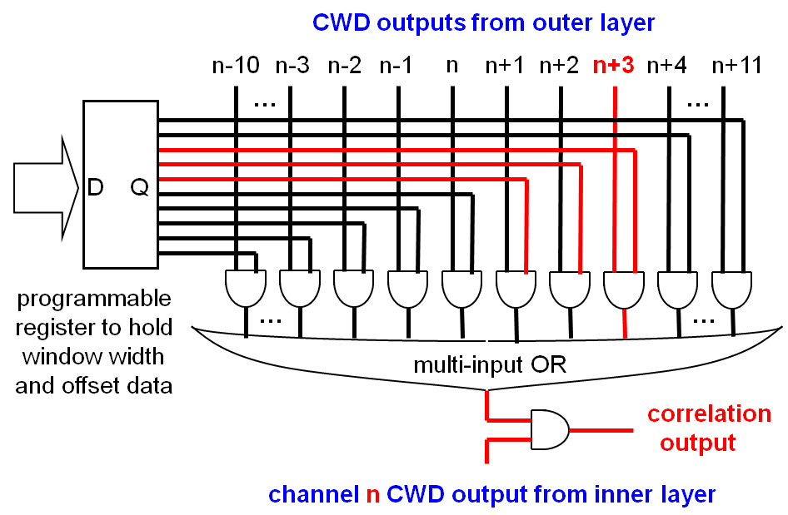
Correlation & Offset Correction
  Window width determines Pt cut
  Offset varies depending on location across sensor (& separation between layers)
  Needs also inputs from neighbouring chips at the edges

Slide 15
Summary
    STATUS:
  Results on test bench and with beta source confirm expectations
  CBC + detector also recently tested in proton beam. Preliminary results encouraging.
    FUTURE PLAN
  Submission of next version featuring 256 channels, bump-bonded PADs and coincidence logic for L1 trigger - early next year
  Future tests of radiation hardness

Slide 16
Backup Slides

Slide 17
threshold uniformity
comparator
128 channels
before tuning
thresholds
before tuning pk-pk threshold spread ~30 mV (~ 0.6 fC)
tuning reduces spread to ~ mV level
timewalk
timewalk spec. < 16 ns between 1.25 and 10 fC
signals, with comp. threshold set to 1 fC
measurements just within spec.
events above threshold
after
timewalk: threshold at 1 fC
comparator global threshold [mV]
VDDA
comparator
postamp
O/P
16k
V_{CTH}
2k
4k
8k
500k
postamp O/P
O/S adjust
8-bit value
(per channel)
hysteresis
16k
16k

Slide 18
power features
DC-DC & LDO outputs
DC-DC switched capacitor converter
  converts 2.5 -> ~ 1.2
clearly functioning
effect of switch noise needs careful study
LDO linear regulator
provides clean,regulated rail to analog FE
  ~ 1.2 Vin, 1.1 Vout
dropout ~ 40 mV for 60 mA load
provides > 30dB supply rejection up to 10 MHz
(see May talk for more detail)
LDO dropout
40 mV

Slide 19
beta source results
method
choose comparator threshold (programmable)
  count number of clusters in CBC output signal
  for fixed number of scintillator triggers
repeat for range of comparator thresholds
plot no. of clusters vs. comparator threshold
shape depends on signal arrival time (TDC value)
need to select events by TDC value so that
triggered timeslice contains all signal sizes (T_{OPT})
if select signals occurring too early/late then get
spectrum where some signals fire comparator in
previous/subsequent timeslice
(see backup slides for more detailed explanation
of histogram shapes)
TDC = T_{OPT} - 15 ns
TDC = T_{OPT}
no. of clusters
TDC = T_{OPT} + 15 ns
comparator threshold [mV]

Slide 20
beta source - landau fitting
Sr-90 source
can fit raw data with curve generated from Landau distribution
compare most prob. signal size with electronic test
charge injection
-> most prob. signal value ~3.7 fC (23,000 e)
840 electrons noise
electronic charge injection
4 fC
3 fC
no of events
2 fC
1 fC
comparator threshold [mV]

Slide 21
comp. threshold scan explanation - early events
select events using TDC values
if select events occurring too early then:
for low thresholds:
  all signals fire comparator in timeslot before
for high thresholds:
  only big signals fire comparator in triggered timeslot
high thresh
low thresh
comp. O/Ps
for low thresh
all signals fire comparator in timeslot before
comp. O/Ps
for high thresh
only big signals fire comparator in triggered timeslot
triggered
timeslot
TDC = T_{OPT} - 15 ns
so counts inrease as comparator
threshold increases
comparator threshold [mV]

Slide 22
comp. threshold scan explanation - late events
if select events occurring too late then:
for low thresholds:
  all signals fire comparator in triggered timeslot
for high thresholds:
  big signals fire comparator in timeslot after
high thresh
low thresh
comp. O/Ps
for low thresh
all signals fire comparator in triggered timeslot
comp. O/Ps
for high thresh
big signals fire comparator in timeslot after
triggered
timeslot
TDC = T_{OPT} + 15 ns
so counts drop quickly as comparator
threshold increases
comparator threshold [mV]

Slide 23
comp. threshold scan explanation - optimum timing
for optimum time of trigger selection (T_{OPT}):
for low thresholds:
  all signals fire comparator in triggered timeslot
for high thresholds:
  all signals big enough to cross threshold do so
  in the triggered timeslot
high thresh
low thresh
comp. O/Ps
for low thresh
all signals fire comparator in triggered timeslot
all signals big enough to cross high threshold
do so in triggered timeslot
comp. O/Ps
for high thresh
TDC = T_{OPT}
triggered
timeslot
comparator threshold [mV]

Slide 24
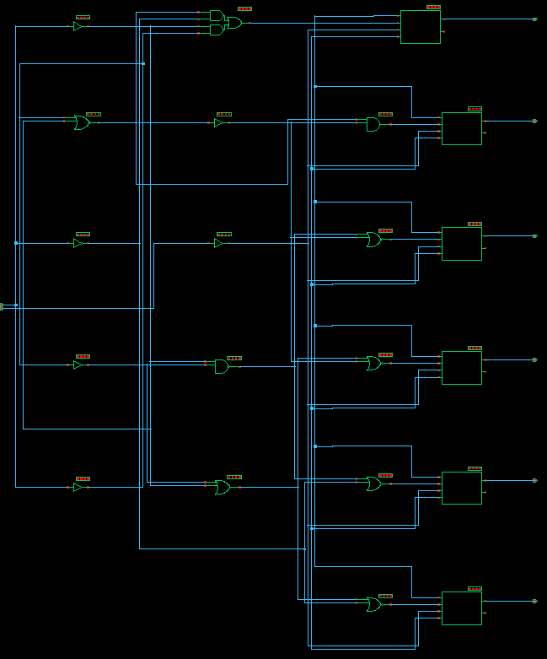
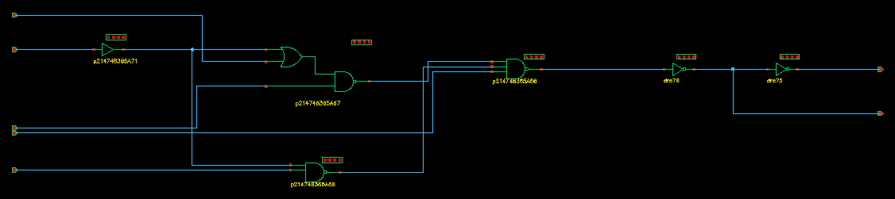
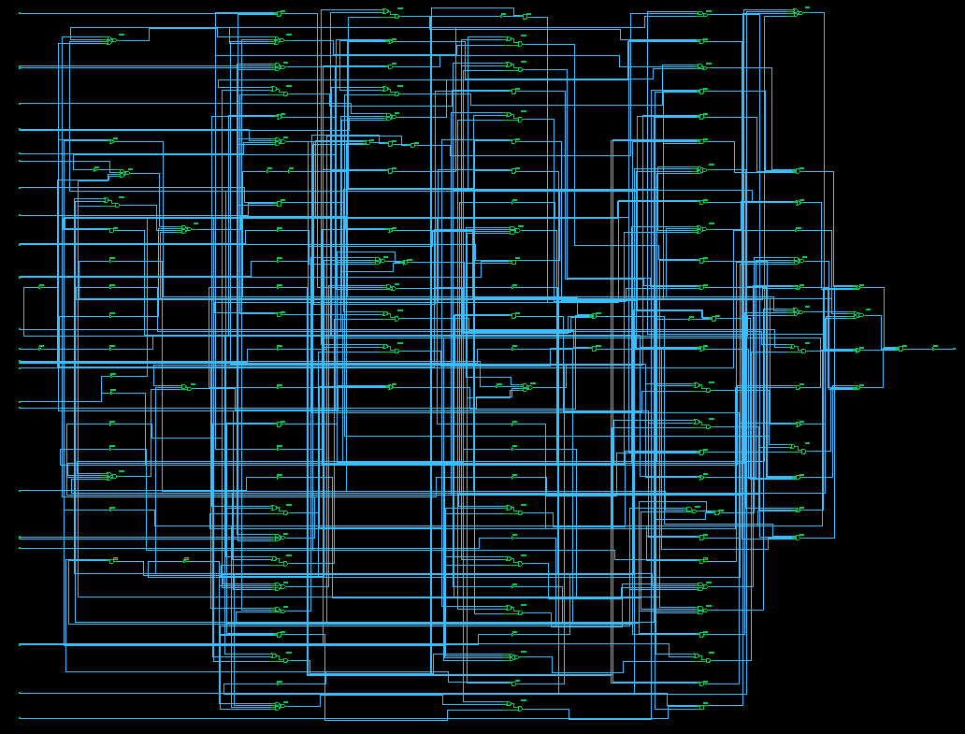
Schematics
Input de-scrambling
Cluster width-discrimination
x 256
Correlation and offset correction
x 256
x 128

Slide 25
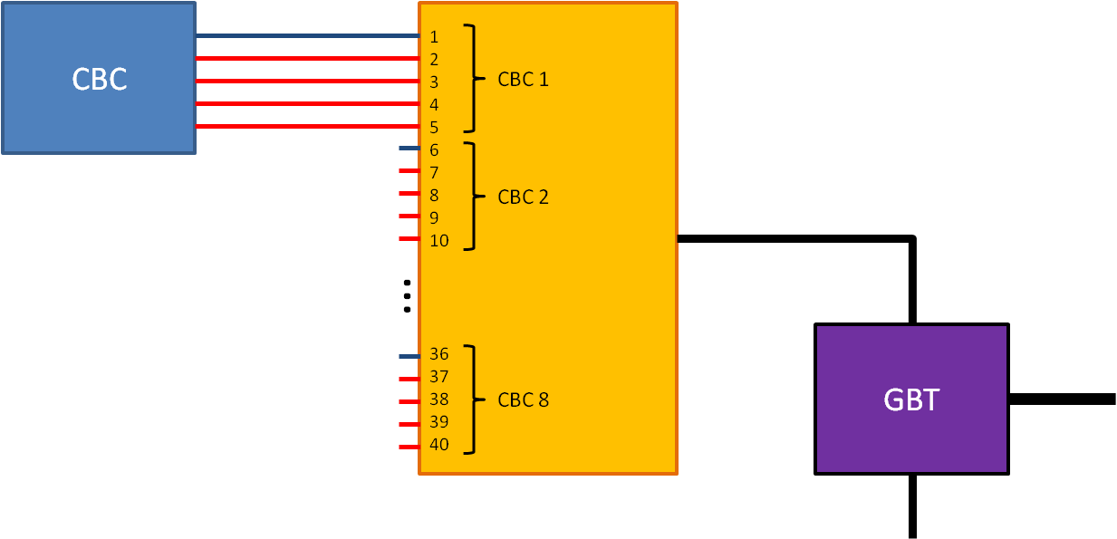
Proposal: fully synchronous readout
1
2
3
Up to 6 stubs/module*BX
(to be discussed)
1)
7b
+
1b
hit address (xy)
extra bit
triggered data
2)
3b
7b
+
1b
CBC ID
hit address
triggered data
1b
10b
10b
10b
1b
8b
3)
+
Concentrator ID
Stub 1
Stub 2
Stub 3
extra
Triggered data
Notes:
In this case the CBC ID is only 3b (8CBCs/half-module) and the concentrator ID (1b=2concentrators/module) is added only once in the data packet.
We have now 3 spare bits which can be used for overflow flagging or to increase the triggered data rate (or both).

Slide 26
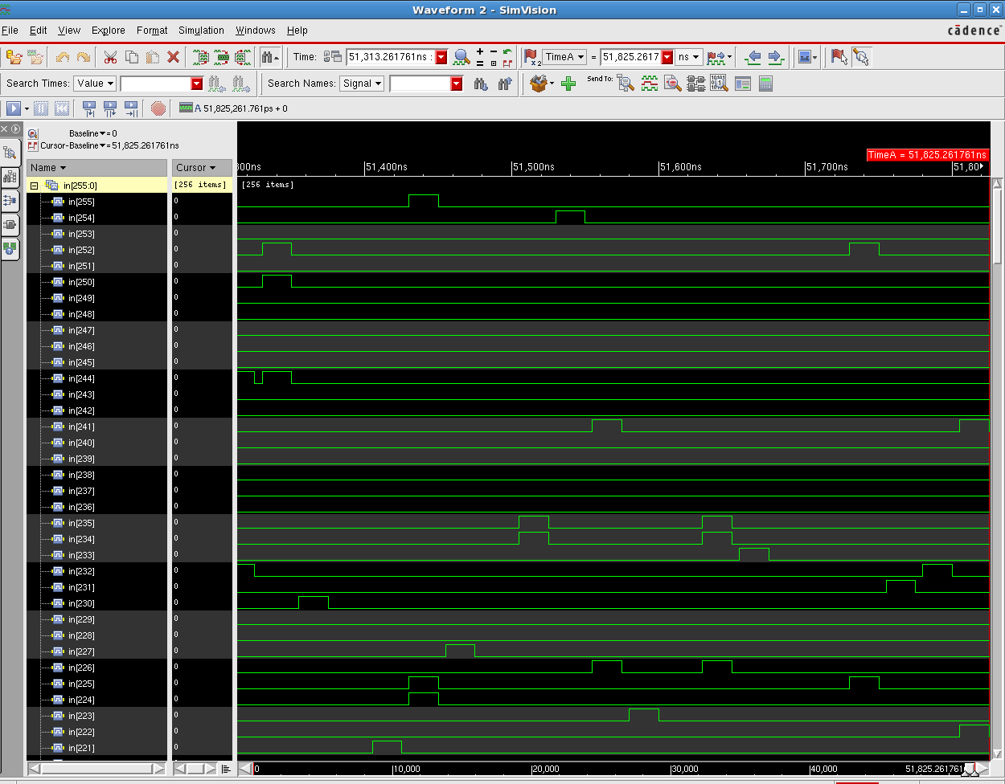
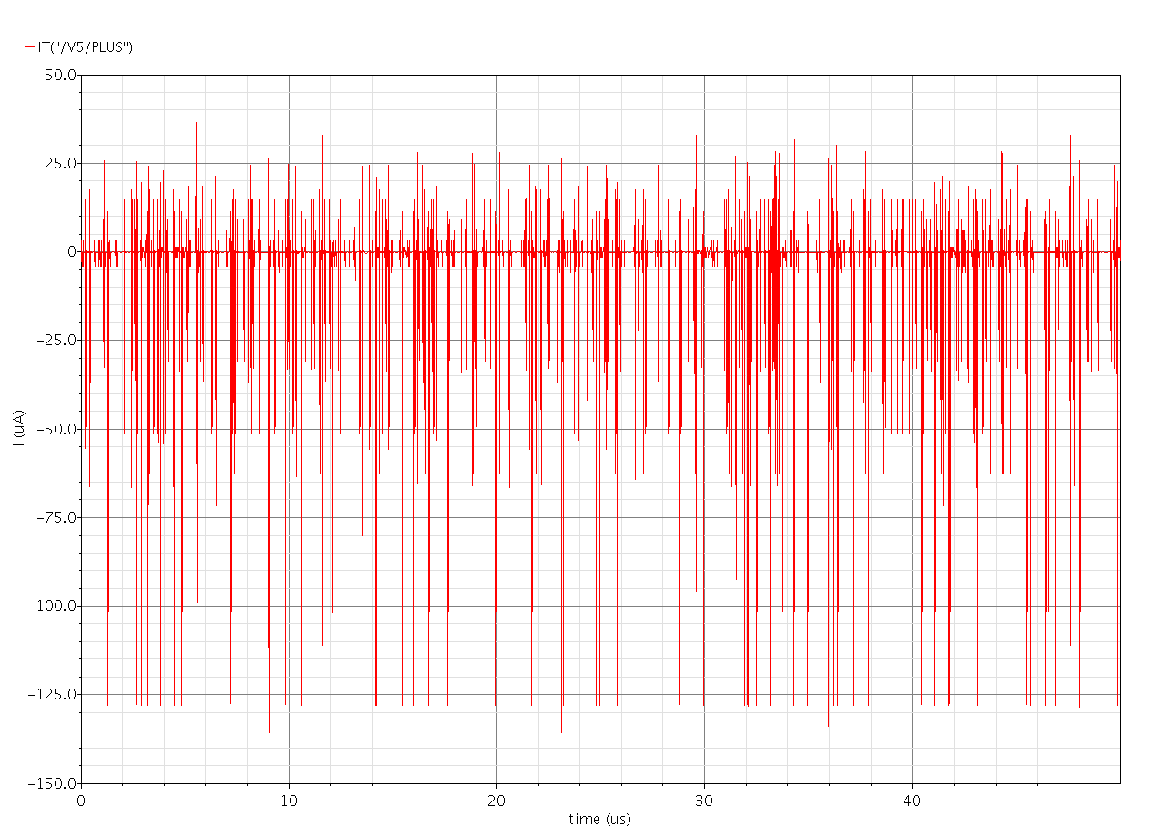
Channel Logic Power Consumption:
Verilog code to simulate random hits on both layers (@ 3% occupancy).
→RMS power consumption
NB: new functionality added so needs updating
→ Total: 2.6μW/channel
4/7

Slide 27
Power consumption Summary:
Function | Power/channel
CWD + correlation + offset correction | 2.6μW
Extra SIOSLVS for trigger data | 18.4μW
Triggered data readout | ~50μW
Trigger data formation | ~20÷30μW?
TOTAL | ~90÷100μW
7/7

Slide 28
