Slide 1
Progress on module with hybrid architecture for track triggering
A. Marchioro / CERN-PH
CMS Upgrade Workshop @ FNAL
November 2011

Slide 2
Acknowledgements
Basic ideas of high pT discrimination based on two parallel strip layers, edge connected: R. Horisberger, circa 2009
Previous work of L. Jones et al. on triggering based on stub primitives
Finding high pT particles from stubs detailed by many authors, for a good review of the CMS ideas see presentation by M. Pesaresi @ Vertex 2010
Many details of this concept discussed and refined with D. Abbaneo
Data on analog FE: J. Kaplon (CERN/PH-ESE)
Major effort still to be done for mechanics and cooling

Slide 3
Outline
Introduction
Proposed module architecture
  Recap of general features
Macro Pixel ASIC (MPA)
  Design details
  Ongoing work
Conclusions

Slide 4
Motivation and objectives
Provide prompt information from the tracker as to identify particles with transverse momentum higher than a given minimum (~2 Gev/c)
Objective
  Equip part of the tracker (barrel and end-cap) with modules capable of identifying quickly stubs pointing outward at a sufficiently stiff radial direction
  Combine this info outside of the tracker to find full tracks
  Avoid having to read the whole tracker at each BX blindly
  Retain the obvious L1 storage
  Do all of the above with an affordable power consumption
But:
  Cabling will have to be completely rearranged, both for power and opto
  L1 latency to increase by ~2x current value

Slide 5
Module

Slide 6
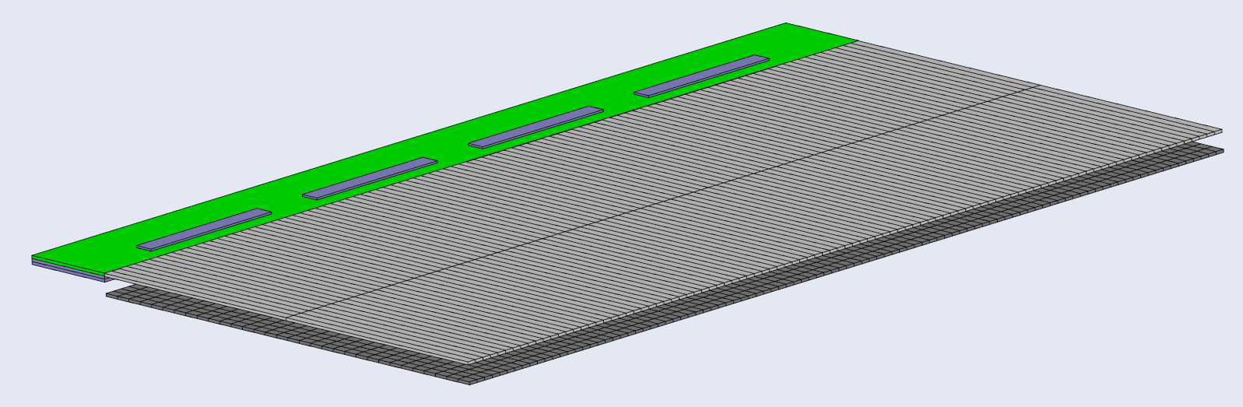
Hybrid strip-pixel Module Concept
Z
φ
Use one layer of short strip: ~24 mm
and one layer of ~1.5 mm long macro-pixels
In the pixelated layer, perform the OR of the pixels in the Z direction and use it as single strip in Z
Coincidence of the two layers provides pT cut
Pixel position provides Z coordinate
Thickness: two sensors + Pixel strip RO + cooling interposer + hybrid sideways

Slide 7
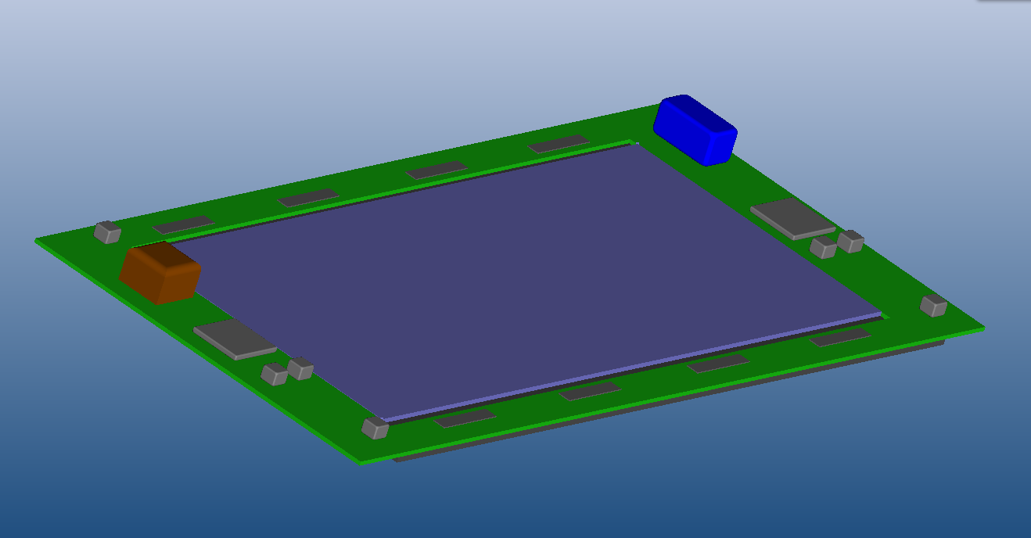
~5 x 10cm Hybrid Module
2.5 cm
10 cm
2.5 cm
Z
φ

Slide 8
Simplified cross-section
~ 48 mm
Short Strip ASIC
Strip sensor
Cooling
R
Substrate
Pixel Sensor
MacroPixel ASIC
Ζ
Pix Sensor 250um
C4 bumps 125 um
Pix chip 250 um
TPG+Carbon 600um
TPG / Substrate 900 um
Strip Sensor 250 um
Pixel ASIC on bumps (250 um)
Advantages of this solution:
  Wire bonding and simple C4
  All silicon stack (no substrate under Sensor)
    Low mass (cooling) interposer
    No substrate-Si CTE mismatch problem

Slide 9
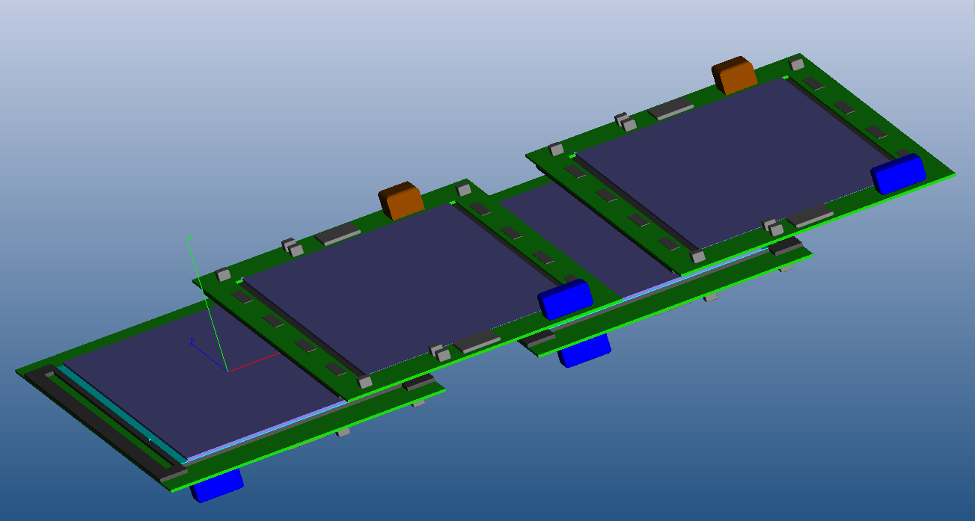
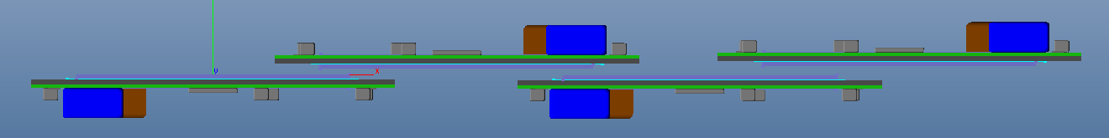
Possible ROD assembly (with invisible mechanics, sorry Hans, Antti…)

Slide 10
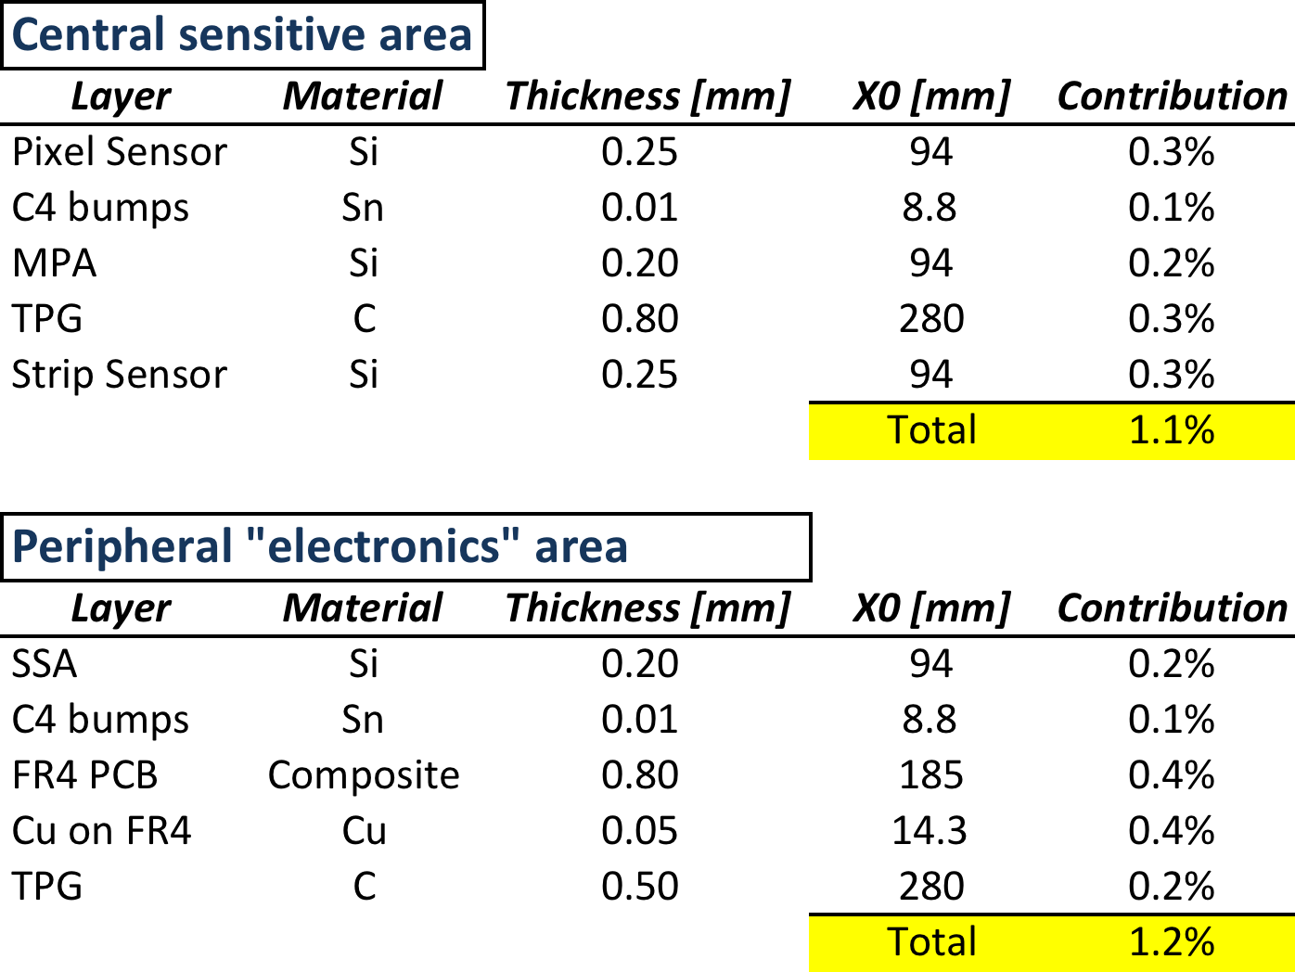
Material Estimate (at η = 0)
_________________________
- In the “electronics” area, the size of the SSA and C4 bumps have been exaggerated to the entire hybrid area
but passive components not accounted for
- DC/DC and GBT not accounted for

Slide 11
MPA ASIC

Slide 12
Macro-Pixel-ASIC global floorplan
~12 mm
…
Pixel Cells
~24 mm
MPixel ASIC size:
~ 12 x 24 mm2
Pixel size: ~ 100 um x 1500um
# pixels: 128 x 16 = 2048
Readout on one edge only
Periphery
(all functionalities described
below have to be packed here)

Slide 13
Module functional block diagram
Pixel Layer
MPA
Trigger
Logic
FE
Buffer to
Link
Event
Store
CLK & Cntrl
Strip Layer
SSA
TX
FE
CLK & Cntrl

Slide 14
MPixel ASIC: more details
to SSA
MPixel
Event
Store
FE
from MPixel column
Event
Formatter
Strip
Event
Store
@ L1
CLK Generation
& Cntrl
Clocks
Position
decoder
Config Regs
Windowed
pT coincidence
Strip
Wide cluster
elimination
Intf to GBT
Link
Trigger Logic
@ each BX

Slide 15
Module Read Out Architecture
MPA
MPA
SSA
SSA
MPA
MPA
MPA
MPA
SSA
SSA
MPA
MPA
MPA
MPA
SSA
SSA
MPA
MPA
MPA
MPA
SSA
SSA
MPA
MPA
LP
GBT
Powering
&
Control

Slide 16
Alternative: Star Scheme
MPA
MPA
SSA
SSA
MPA
MPA
MPA
MPA
SSA
SSA
MPA
MPA
MPA
MPA
SSA
SSA
MPA
MPA
MPA
MPA
SSA
SSA
MPA
MPA
“Concentrator”
LP
GBT
Powering
&
Control
Notes:
This scheme only makes sense if the same “concentrator” can be used for the strip only module,
In addition, the relative advantages and disadvantages still have to be digested by the design committee.

Slide 17
Hybrid Module Power objectives
 | # elements | Pwr/element[mW] | Power [mW]
Pixel | 2048 * 16 | < 0.080 | 2,620
Strips | 256 * 8 | 0.250 | 512
Trigger Logic @ 160MHz with α = 1% | 10⁶ * 16 * 160 | 0.000015 | 384
LP-GBT | 1 | 500 | 500
DC-DC [η = 85%] | 1 | 600 | 600
Total |  |  | ~4,600
For a ~10 x 4.5 cm² module

Slide 18
MPA Details

Slide 19
Present functionality
Clock and resync generation (based on bunch structure)
Lateral extension to neighbor MPAs and SSAs
MPA to SSA retiming
Cluster centroid calculation (approximated to left for even cluster)
Phi re-alignement
Coincidence Pixel-Strip finding
L1 Event buffer for both pixels and strips in MPA
Stub position encoding (limited to 6 per MPA)
Event building in ring configuration
Bus output to LP-GBT
Not yet implemented:
  Sign and magnitude of bending ins stub

Slide 20
MPA chip-to-chip connectivity mapping
MPA<i-1>
RightOut
Pix[125:128]
RightIn
Pix[129:132]
MPA<i>
LeftIn
Pix[-3:0]
LeftOut
Pix[1:4]
RightOut
Pix[125:128]
RightIn
Pix[129:132]
MPA<i+1>
LeftIn
Pix[-3:0]
LeftOut
Pix[1:4]

Slide 21
Strips to pixel connectivity mapping
MPA
Chip<i-1>
MPA
Chip<i>
MPA
Chip<i+1>
PlusIn[1:6]
MinusIn[1:6]
PlusIn[1:6]
MinusIn[1:6]
<6>
<6>
<6>
<6>
<128>
<128>
Strip[123:128] Strip[1:6]
<128>
SSA
Chip<i-1>
Strip[123:128] Strip[1:6] Strip[1:128] Strip[123:128] Strip[1:6]
SSA
Chip<i>
SSA
Chip<i+1>

Slide 22
Trigger (coincidence) generation
Retime[1:0]
PixCluster
Elimin &
Centroids
LeftRightIn
<8>
Column
OR-ing
PixelOredHitReg
<2048>
<128>
<136>
PixelHitReg
<128>
<128>
PixelHit
Retiming
<8>
LeftRightOut
Z
Priority
Encoder
Coincidence
<512>
<128>
PixelPipeReg1
PixelPipeOut[511:0]
<512>
<512>
Minus
<6>
StripCluster
Elimination
& Centroids
Φ
Shift
(2 of 64 bits)
StripHitReg
<140>
CentroidsRetime
<128>
<140>
<128>
<128>
Plus
<6>
PhiShift[]
ClusterCut[3:0]
MatchMask[1:5]
Retime
Strip[1:0]

Slide 23
Event Formatting
EvFileReady
ReadAddress
{Chip#, Z}
StubIdxt
EventFile
6 * <7:0>
StubsIdxReg[47:0]
Event<15:0>
StubEncoder
Coinc<1:128>
<3>
StubCount

Slide 24
Event assembly on module

Slide 25
Data Collection on module
Data__
Header
Trigger Data Path
Data__
LP
GBT
MPA 1
MPA 2
…
MPA 16
16 input @160 Mbit/s
<15:0>
4 input @ 160 MHz
…
L1 Data Path
25
LP-GBT available BW:
20 bits @ 160 Mbit/s

Slide 26
Event Format during Building
3 bit
12 bit
T
Len
BX #
Stub<i>
Stub<1>
k * 16 bit
Stub<2>
…
Phi Add
LR
Chip#
Z
Stub<n>
7 1 4 4 bit
16 bit
Header is: T bit indicates truncation to 7 stubs
Len: 3 bit event (i.e. # of stubs) length
BX: 12 bit bunch crossing #
Stub is: 7 bit phi address
4 bit Z coordinate (each MPA has 4, two MPA in Z per module)
4 bit chip #
1 bit free
k max is 8 (1 header + 7 stubs)
Avg number of stubs that can be inserted in each 25 ns period
(i.e. in 4 words of 16 bit) is: (64 – (12+4) / 16 = 3
Bending magnitude not included

Slide 27
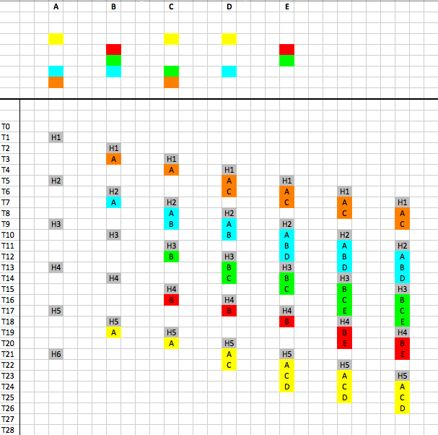
Simplified event building sequence
Module #
Time

Slide 28
Data Collection with Redundancy
MPA
MPA
MPA
MPA
MPA
MPA
SSA
SSA
SSA
SSA
SSA
SSA
MPA
MPA
MPA
MPA
MPA
MPA
MPA
MPA
MPA
MPA
MPA
MPA
SSA
SSA
SSA
SSA
SSA
SSA
MPA
MPA
MPA
MPA
MPA
MPA
MPA
MPA
MPA
MPA
MPA
MPA
SSA
SSA
SSA
SSA
SSA
SSA
MPA
MPA
MPA
MPA
MPA
MPA
MPA
MPA
MPA
MPA
MPA
MPA
SSA
SSA
SSA
SSA
SSA
MPA
SSA
MPA
MPA
MPA
MPA
MPA
LP
GBT
LP
GBT
LP
GBT
Powering
&
Control
Powering
&
Control
Powering
&
Control

Slide 29
MPA to MPA Event Building
MPA n
MPA n+1
Event Building Logic
Event Building Logic
From local
Coinc Logic
From local
Coinc Logic
<16>
FIFO
<16>
FIFO
<16>
<16>
<16>
FIFO
<16>
FIFO
From previous MPA

Slide 30
Conclusions

Slide 31
Status and Plans
Verilog modeling is progressing well, major functionality all implemented and being debugged with “random” events (thanks to “simple” generator written by S. Mersi)
Timing (pipeline) being refined
  Logic blocks to be shifted between pipe stages to shorten latency
Critical blocks digital being implemented in 65 nm to get a better guess on timing and power consumption (D. Monzat)
Module assembly discussed with Endicott for first assessment of manufacturability
Plans:
  Stub bending (sign and magnitude) to be added
  Functional verification with real physics events and distributions
  Work to start on auxiliary blocks:
    65nm CMOS targeted
      Critical timing LP-GBT blocks being modeled and simulated
    Internal Slow Control and monitoring
      Digital temp sensor per MPA
  Work to start in 2012 on analog circuitry with expertise coming from NA62 pixel design

Slide 32
Critical technologies
 | Difficulty level (1 easy, 5 hard) | Comment
Analog Circuitry | 3 | Novelty required to reduce power, but is there any margin left?
Digital Circuitry | 3 | Fair amount of logic to be squeezed into periphery
ASIC Technology | 4 | Very large MPA, but fully testable prior to assembly
Local Interconnect | 5 | No risky technology involved, but sensors are bigger than commercial MCMs and little in-house (HEP) experience
Powering (DC-DC) | 4 | Must educe amount of material in passives
Links | 5 | With 65nm speed ok, but power and size to be reduced

Slide 33
Spares

Slide 34
What the LP-GBT could be
LP-GBT: ~ ¼ power version of the current GBT, i.e. same protocol, same speed
To achieve this porting to 65nm is mandatory
Pin count reduction is mandatory (to reduce space on hybrid)
LD and GBT-IA also requires optimization
Some other simplifications:
  No e-links
  Simple parallel 160 Mbit/sec, 20 lines interface, no resync, single-ended
  Same high speed Input/Output speed (saves one PLL)
But requires:
  Simple SCA
    One I2C user port
    Few (max 8) parallel programmable lines
    Few (max 4) analog channels with slow ADC (12 bit)
    Built-in Temp sensor

Slide 35
Macro-Pixel-Asic detailed floorplan
Configuration Registers
Single Pixel size: 100 x ~1400 μm²
Analog Pre+Shaper: 100 x 600 μm²
Bias, DACs etc: 100 x 50 μm²
Configuration Regs: 100 x 50 μm²
Storage & Trigger : 100 x 600 μm²
Routing & Interconnect: 100 x 100μm²
C4 Bump-bond pad: 90 x 90 μm2
Pitch 200 μm in X, 300 in Y
Overall L1 memory requirement for
Width :
(5 [bit/16 pixel] + 1 [bit/strip]) * 128 = 768 bit
DACs, Bias etc
Analog FE
Analog FE
Analog FE
Analog FE
Analog FE
Analog FE
Analog FE
Analog FE
Size of RT SRAM
Storage and
Trigger logic
 | 1 bit | 200 kbit
130 nm | 4.2 μm² | 910 x 910μm²
65 nm | 1.5 μm² | 550 x 550μm²
Shared Routing and Logic

Slide 36
Pixel Logic details
Config Regs
Bias control
Mask
Mpixel
Store
(256 deep)
FE
L1
Clk

Slide 37
Pixel to pixel pipeline
<4>
Chip<i>
Column
OR-ing
PixelHitReg[1:2048]
PixelOredHitReg[1:128+8]
<2048>
<128>
<4>
<4>
Chip<i-1>
Column
OR-ing
PixelHitReg[1:2048]
PixelOredHitReg[1:128+8]
<2048>
<128>
<4>

