Slide 1
Phase II Tracker Electronics
Status of System Development

Slide 2
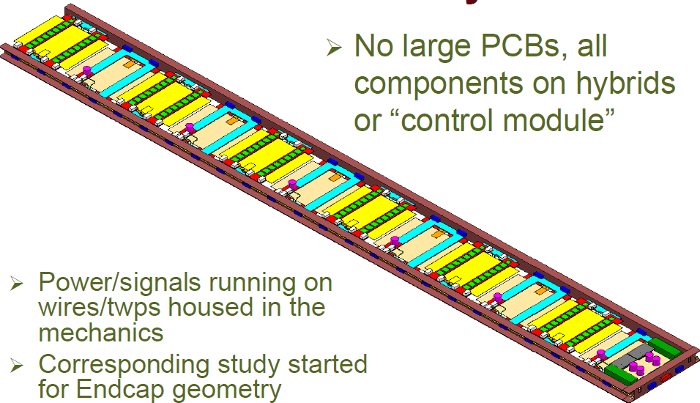
Electronic system development is driven by detector requirements
Until 2010: Single and double-sided Rods
CBC FE chip: binary, unsparsified readout
GBT-VL Link to backend
Module
Hybrid
GBT

Slide 3
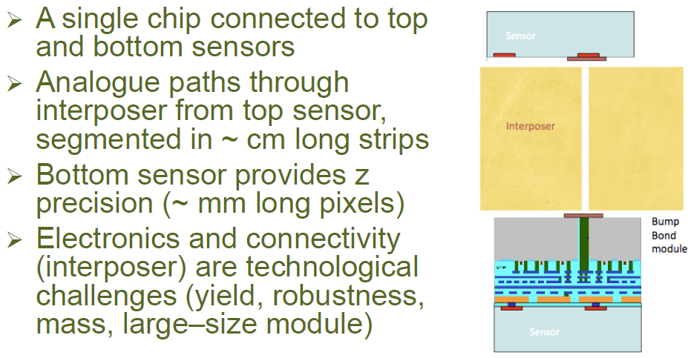
In 2010, Pixellated Pt modules were also being developed

Slide 4
System design was started with simplest module at front-end…
Front-End Hybrid
Hybrid controller
Clk,Trigger
Fast Config
40MHz
320Mbps
8
40MBps
DMux
CDR
e-port
8x40Mbps
Mux
320Mbps
Data
CBC256
Mon
Ctrl
I2C
I2C Status
& Control

Slide 5
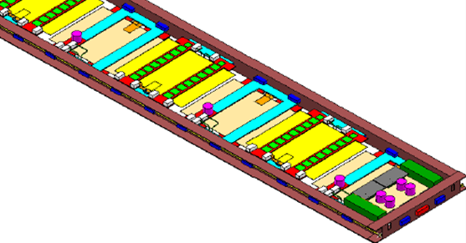
…and a GBT at the rod-edge
GBT
Clk Block
I2C
e-port
Demux
e-port
2
E-links
Framer
SerDes
10 ports @ 320 Mbps
1 GBT reads out 10 FEH
mux
e-port
Legend
e-port
Trigger
Clock
Control/Status
I2C
Data
GBT-SCA
Slow Control e-link
1 port @ 80 Mbps

Slide 6
2010 System vision: up to 10 FEH (5 modules) connected to one GBT
Clk Block
I2C
e-port
320
Demux
e-port
320
Framer
SerDes
2
40MHz
Hybrid controller
8
40MBps
DMux
CDR
e-port
mux
8x40Mbps
Mux
e-port
320
CBC256
Mon
Ctrl
e-port
GBT-SCA
Legend
Data throughput dominated by CBC unsparsified readout stream
ATLAS has similar architecture, with reduced bandwith
Trigger
Clock
Control/Status
Data

Slide 7
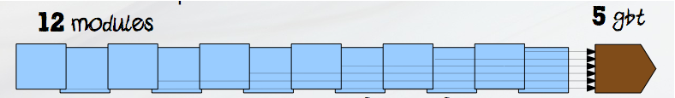
…But: architecture does not scale easily to Rod with stereo modules
10
1 rod needs 5 (GBT+SCA), 10 fibres
1 GBT+SCA serve: 2.5 modules, 10 hybrids, 80 CBCs
1 module communicates via: 8 SLVS pairs + 4 I2C pairs
4
4
4
SLVS
2
2x320
4x320
4x320
I2C
2
2
GBT-SCA
4
4

Slide 8
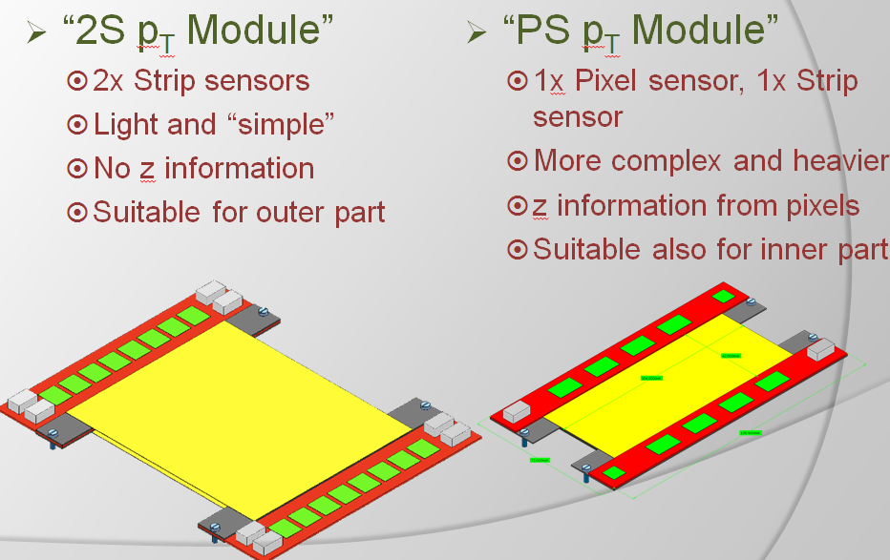
At end-2010, two-in-one modules with Triggering capabilities were proposed

Slide 9

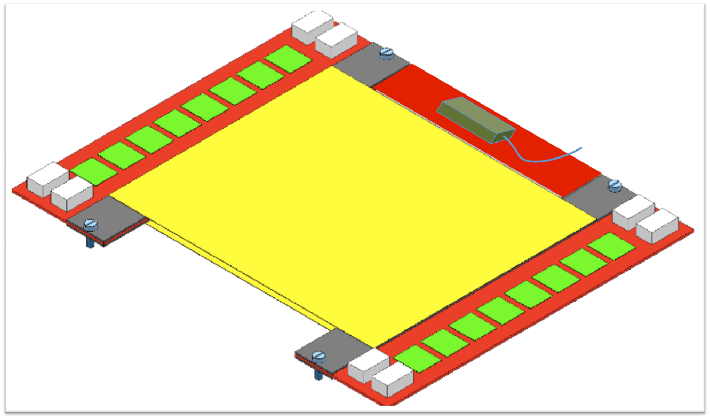

2S-Pt module:
From two-in-one to all-in-one
Module becomes standalone building block
  Front-end chip
  LP-GBT
  SF-VL
  Ancillary electonics (control, monitoring, aggregation, timing distribution)
  DC/DC converter
Can be envisaged because Tk is fiber-rich

Slide 10

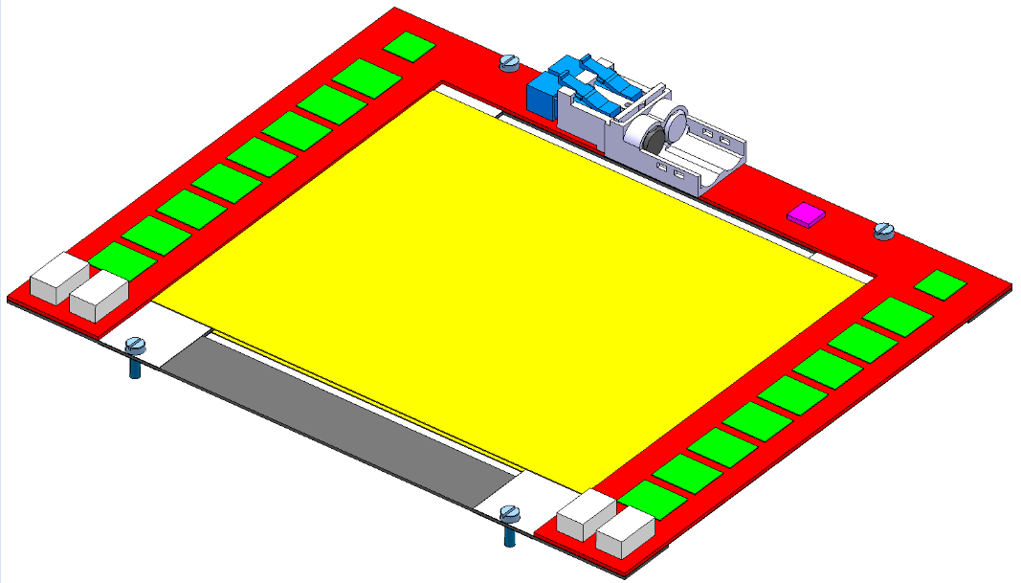
A clear vision, but a lot of work ahead!
From dream to reality

Slide 11
2S-Pt module: electronic system, assuming low power GBT with parallel 20b interface
40MHz
Clk out
Clk in
160MHz, 40MHz
4
40MBps
Trig/fast config out
4 lines to all CBCs
Data in
1x160Mbps
8x40Mbps
L1 readout data in
1 line from each CBC
2x160Mbps
4.8Gbps
VTRx
8x4x80Mbps
trigger data in
4 lines from each CBC
Data out
8x160Mbps
CBC-pt
256
Concentrator & Controller
½ GBT-LP
I2C
I2C
2 lines to/from all CBCs
SCA I/O
D & A I/O
2S-Pt Hybrid

Slide 12
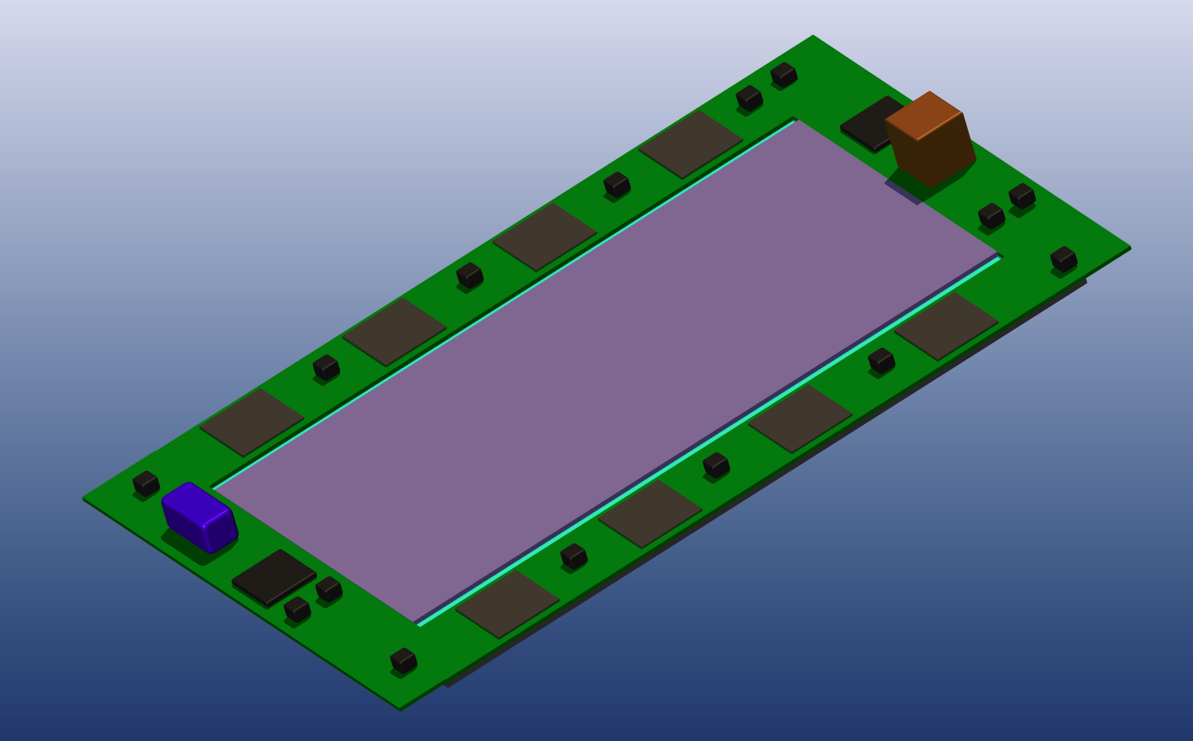
PS-Pt module for inner layers
DC/DC
CBC-light/SSA
Sensor
SF-VL
LP-GBT

Slide 13
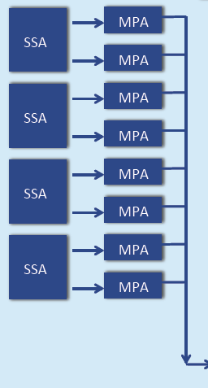
PS-Pt Block diagram, assuming low power GBT with parallel 20b interface
?
160MHz, 40MHz
1x160Mbps
4.8Gbps
VTRx
10x160Mbps
10x160Mbps
½ GBT-LP
I2C
SCA
PS-Pt Hybrid

Slide 14
Electronic System Overview
Front-end Module
Back-end
LV/HV PS
DC/DC
FE-Hybrid
CBC light
MPA128
CBCpt 256
FED/FEC
12
8x12
CTRL
Conc
Ctrl
Conc
Ctrl
m-Rx
GBT
FPGA
Process &
Route
TRIG
LP-GBT
SF-VL
12
8x12
m-Tx
DAQ
Rod edge
PP1
Legacy fiber plant
Module specific
Common to 2S, PS and 3D modules

Slide 15
Electronic System Contributors
Aachen ?
Module
LV/HV PS
DC/DC
CERN
FE-Hybrid
IC-RAL
Lyon?
IC-RAL
Strasbourg
+???
CBC light
MPA128
CBC256
FED/FEC
12
8x12
CTRL
Conc
Ctrl
Conc
Ctrl
m-Rx
GBT
FPGA
Process &
Route
TRIG
LP-GBT
SF-VL
12
8x12
m-Tx
DAQ
Rod edge
PP1
FNAL
3DPt module
Legacy fiber plant
CERN
CERN
+???
Module specific
Common to 2S, PS and 3D modules

Slide 16
Conclusion
Phase II TK electronics R&D is under way
3 chips in Si (CBC, FEAFS, VICTR), at least 5 more being discussed (MPA, 3DDataFlow, LP-GBT, CBClight, Concentrator&Controller)
Agressive packaging/interconnect technologies under investigation (C4, HDSubstrate, 3D, TSV, opto, …)
Fallback paths are available (PS -> 2S, LP-GBT ->GBT, etc…)
Advanced CMOS processes (65nm for MPA and LP-GBT)
Very challenging program
  Avoid maintaining parallel developments for much longer
  Concentrate effort
  Be prepared for long development time
  New collaborators welcome NOW
Backend development options to be considered soon

