Slide 1
Low Power GBT
CMS Tracker Oriented
Preliminary Design Specification
A. Marchioro,
P. Moreira
Nov 2011

Slide 2
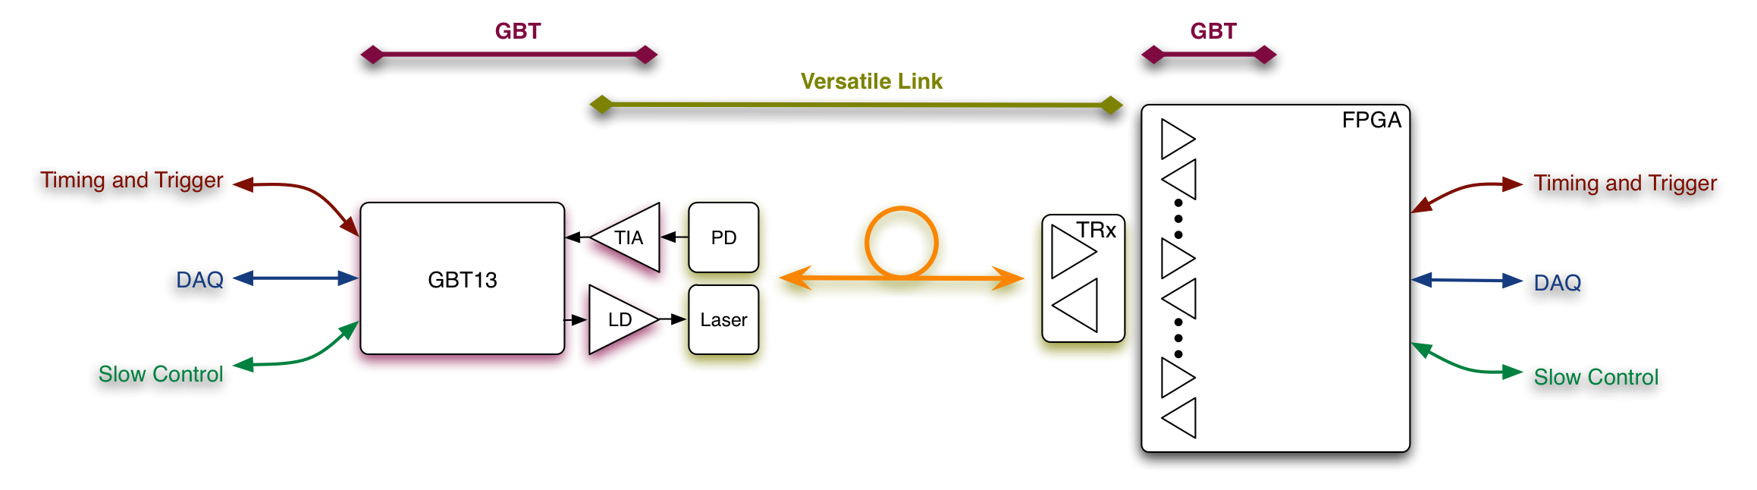
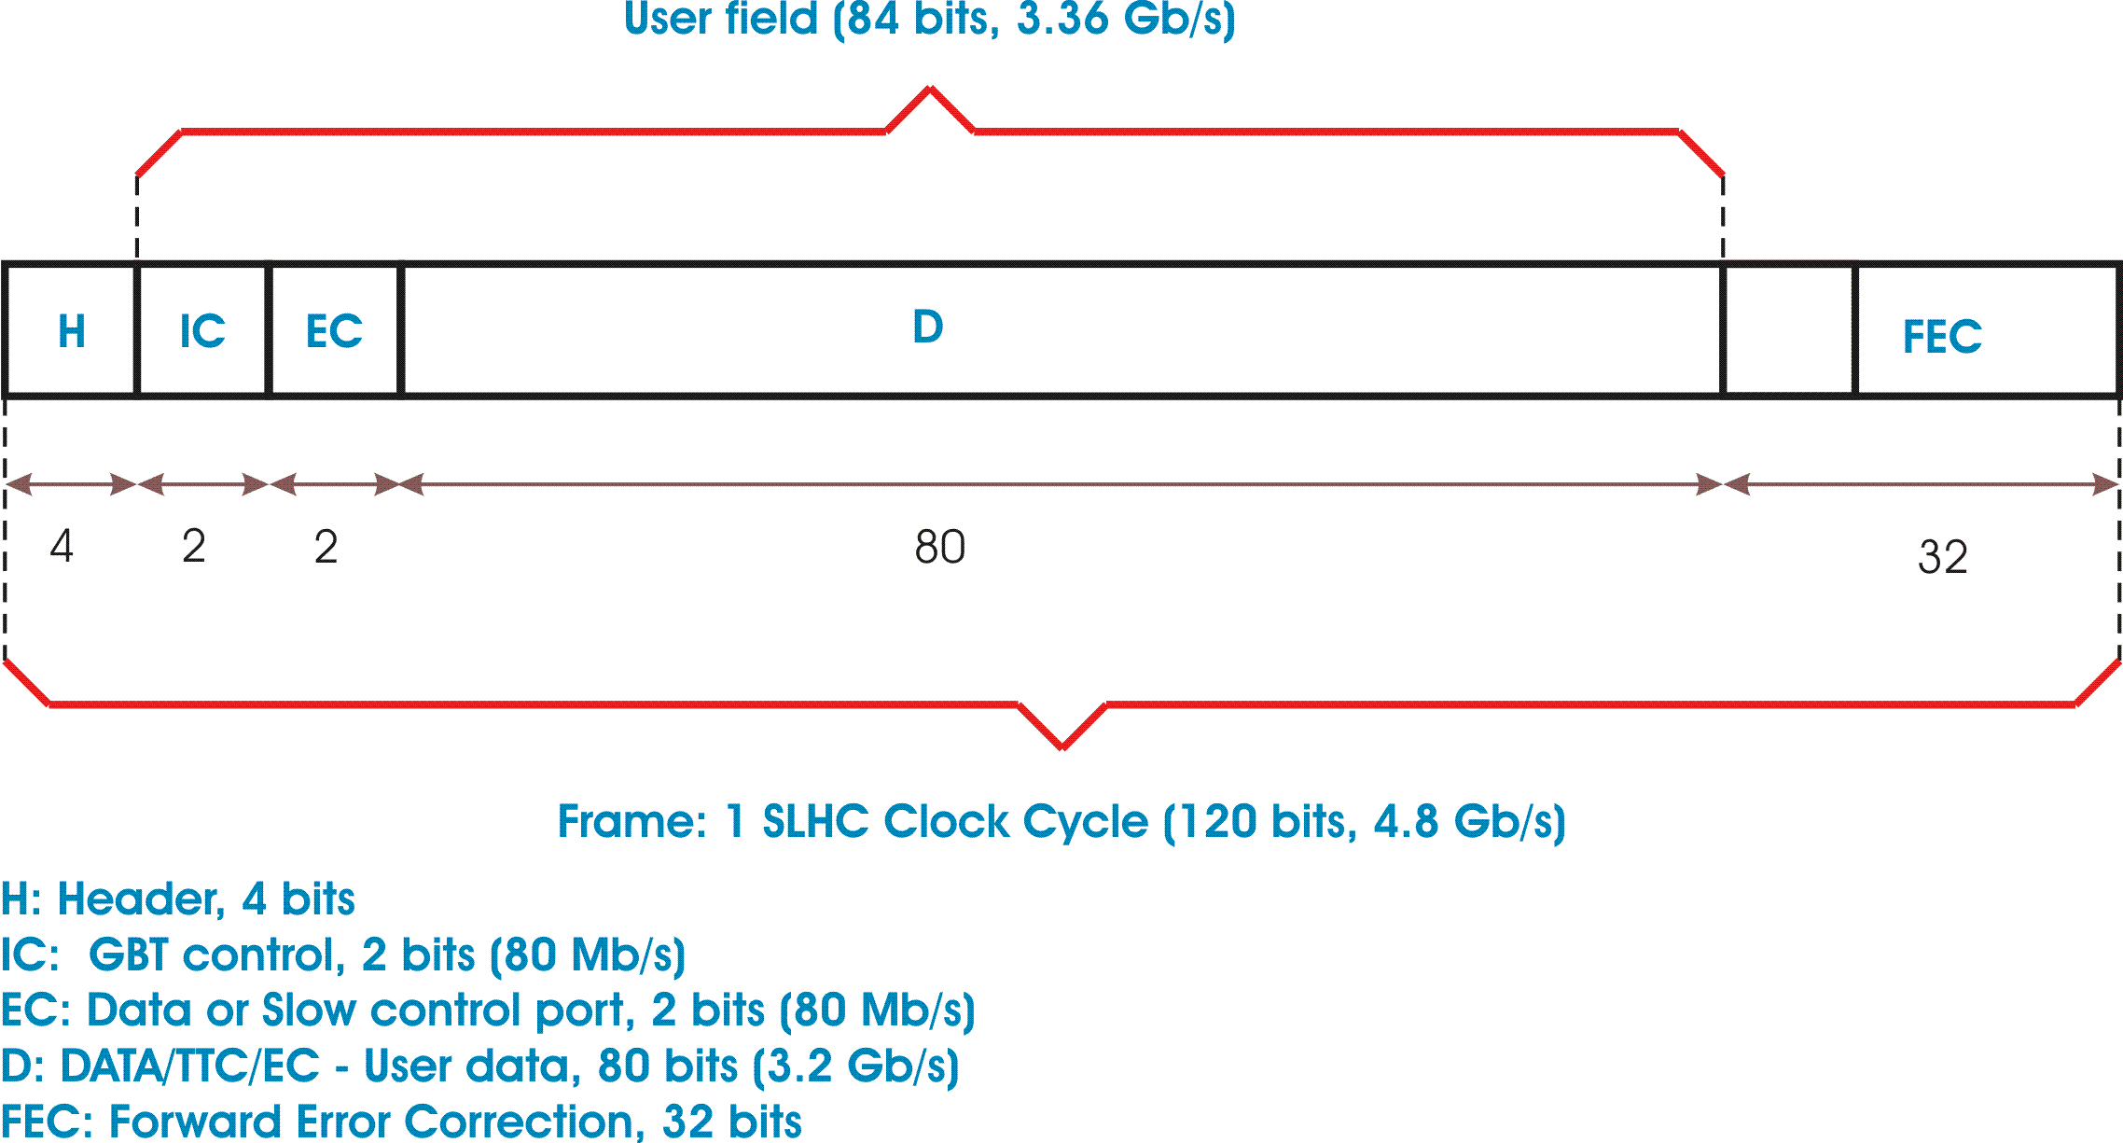
Recap of present GBT (1)
On-Detector
Custom Electronics & Packaging
Radiation Hard
Off-Detector
Commercial Off-The-Shelf (COTS)
Custom Protocol

Slide 3
GBT-SERDES CORE
DES
Frame
Aligner
FEC
Decoder
De-Interleaver
De-scrambler
Header decoder
Parallel
Out/
BERT
dOut [29:0]
120
120
120
120
rxDataValid
Serial
input
rxClock40
rxClock160
Phase
Shifter
ClkOut3
ClkOut2
ClkOut1
ClkOut0
Clock
Generator
RX: 40 MHz & 160 MHz
Clock
reference
Control
Logic
rxRdy
TX: 40 MHz & 160 MHz
txRdy
I2C
JTAG
AUX[n:0]
RST
SER
FEC
Encoder
Interleaver
Scrambler
Header encoder
Parallel
In/
PRBS
dIn [29:0]
Serial
out
120
120
120
txDataValid
txClock40
txClock160
Full custom
Data path
PROMPT
Clocks
Control bus
Power On
RESET
reset

Slide 4
Forward Error Correction (FEC)
Data from J. Troska

Slide 5
Objectives for LP-GBT
LP-GBT is a ~ ¼ power version of the current GBT, i.e. same protocol, same speed
To achieve this target, porting to 65nm is mandatory
Pin count reduction is mandatory (to reduce space and mass on hybrid)
LaserDriver and GBT-TransImpedanceAmplifier also requires optimization but will remain separate chips
  Need for a 2.5 V source for the laser diode powering (step-up from 1.2 V)
Keep compatibility with off-detector GBT side (GLIB etc.)
Some other simplifications:
  No e-links
  Simple parallel 160 Mbit/sec, 20 lines interface, no user-side resync, single-ended
  Same speed for Input/Output speed (saves one PLL)
  No multiple protocols
But also requires:
  Simple Slow Control Components
    One I2C user port
    Few (max 8) parallel programmable lines
    Few (max 3-4) analog channels with slow ADC (12 bit)
    Built-in Temp sensor
  Programmable phase 40 and 160 MHz clock output

Slide 6
User Signals
CLK40{2}, CLK160{2}
Din<19:0>
Dout<19:0>
SerOut{2}
SerIn{2}
LP-GBT
LD_Cntrl<1:0>
I2C_CLK, I2C_D
ParPort<7:0>
ADC_In<3:0>
Scan<3:0>

Slide 7
User Bus Interface
Data Out:
  160 MHz data bus is internally synchronized with user adjusted 160 MHz clock
Data In:
  User must provide data to LP-GBT using the 160 MHz clock allowing proper set-up and hold time
Dout<19:0>
CLK160
DLL
160 MHz
Phase adj.
Din<19:0>

Slide 8
Possible pin assignment
Pin | Width | Function | Type
CLK40 | 2 | 40 MHz clock, phase adj. | SLVS, terminated on TX
CLK160 | 2 | 160 MHz clock, phase adj. | SLVS, terminated on RX
DIN | 20 | Data Input Bus (@ 160 MHz) | Single ended, 0-1.2V
DOUT | 20 | Data Output Bus (@ 160 MHz) | Single ended, 0-1.2V
I2C_CLK | 1 | I2C clock | Single ended, 0-1.2V
I2C_D | 1 | I2C Data | Bidirectional, 0-1.2 V, external pull-up
PAR_PORT | 8 | Bidirectional parallel lines, individually programmable I/O | Bidirectional, 0-1.2 V
ADC_IN | 3 | Analog inputs | Analog Input, 0-1.0 V
SCAN_CLK | 1 | Scan clock | Single ended, 0-1.2V
SCAN_MODE | 1 | Scan mode | Single ended, 0-1.2V
SCAN_DIN | 1 | Scan Data Input | Single ended, 0-1.2V
SCAN_DOUT | 1 | Scan Data Output | Single ended, 0-1.2V
SERIAL_OUT | 2 | High Speed serial output | Dedicated differential
SERIAL_IN | 2 | High Speed serial input | Dedicated differential
GND | 15 | Ground
VDD_A_D | 16 | Power for analog and digital
TOTAL | 96

Slide 9
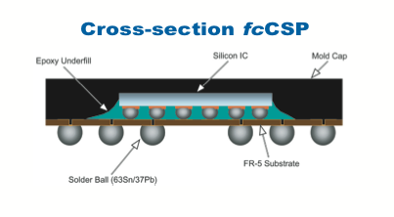
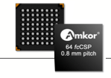
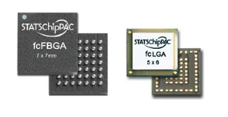
Pinout and suggested packaging
< 100 pins
.5mm BGA (CSP) type
  Thickness ~ 0.5 mm
Body size ~8x8 mm²
Chip size < 2.5x2.5 mm²
GB-LD in reduced 16 pin QFN (3x3 mm²)
GB-TIA in same case as pin-diode

Slide 10
Slow control functionality
Single I2C bus master to access FE chips
  Pull up @ 1.2 V
8 lines of programmable direction IO for local control of switches, DC-DC converters, reset lines, etc.
3 analog input with calibrated 12 bit ADC for analog environmental monitoring of voltages and currents
On chip Temperature sensor
Slow control traffic is embedded in the EC bits of the regular GBT frame

Slide 11
Timing distribution
40 and 160 MHz on differential SLVS (scalable low voltage signaling) lines
  Phase shift in steps of .78 ns (8 steps @ 160 MHz)
  Need to identify correct phase for sampling
    Can be done with one of the 20 data lines @ 160 MHz
TTC source timing distribution will need to be re-engineered
  New FEC…
Bunch crossing synchronization pulses (or reset) can be sent in bunch gaps
  Also using some of the 20 incoming data lines

Slide 12
Conclusions
A substantial power and size reduction of the current GBT is necessary to satisfy the requirements of a new CMS tracker, if triggering functionality is going to be included.
It appears possible to design a LP-GBT at about 0.5 W (single 1.2 V supply) of consumption in 65 nm
  At the cost of removing several features from the more generic GBT130
What is actually specific for the Trigger Tracker project ?
  Nothing really, this is a simplified GBT (or perhaps a big brother of the GOL) with embedded simple slow control functions
  Perhaps useful also for other upgrades ?
LP-GBT would be architecturally very similar to the GBT but the redesign of many blocks will still be necessary
  Work has started on some critical blocks and first prototypes to be submitted for evaluation in 2012

