Slide 1
TLB project status report
Laboratoire Leprince Ringuet
LLR Polytechnique IN2P3/CNRS
Project manager : P. BUSSON (LLR)
Technical manager / designer : T. ROMANTEAU (LLR)
M. LOUZIR (LLR), PCB design
P. DINANCOURT (LAL), CAO librarian
Presented by: J.C. DA SILVA“ECAL-HCAL Interface Working Group” convener

Slide 2
Project goals
TLB purpose and requirements
“Test Link Board” (TLB), a design study platform for modern serial link
  Set up of a CAD design flow for Multi Giga Transceiver (MGT)
    Importance of simulations for 4 Gbps to 10 Gbps links
    High number of parameters (CTLE, DFE, FFE), optimization needed
    Analogue and digital effects modeling in IBIS-AMI models
    Design methodology for advanced Signal Integrity (SI) PCB
    Allegro constraints manager (Cadence) design basis for PCB routing
  Applicable for CMS’s TCCxx upgrade
    No software change at a first step : TLB must be plugged on TCCxx cards (SLB like)
    Useful for TCCxx/oSLB test bench development
Studies for trigger implementation and TCCxx/oSLB test bench
  4,8 Gbps base line with a more compact data format for TCCxx upgrade
    Use as SLB like, up to 23 bits free in frame can now be used for “real time bunch tag”
    For E-Endcap 9 bits trigger vector can be upgraded to 11 bits
  TCCxx/oSLB test bench development in charge at LLR
    Optical I/O available, take profit as real time survey
    Auto align algorithm between TBL card
    Spy buffer for TTC command history
    Predictable pattern generator for data checking at test bench receiver side

Slide 3
Architecture for TLB
Constraints / Hardware choices
Mechanic constraints
  TLB must be plugged on a TCC48 card :
    used in a 1 slot VMEwidth → low profile components on bottom side of TLB
    SFP+ not compatible with TCCxx → TLB’s PCB is extended outside the front pannel of TCCxx cards
  Low space available on PCB, three high density connectors for TCCxx plugging
  Up to 9 TLB could be plugged on TCC68/TCC48 mother board
Electronic constraints, solutions and associated technologies
  4,8 Gbps min → 1 FPGA XCVLX6 with 8 GTX MGT serdes (6,6 Gbps max, 2 used)
  3,3V level signal on TCCxx side, 2,5V on TLB → buffered level translator
  Very low clock jitter for clock of MGT → clock jitter reduction device is used
  Mono 3,3V power supply source, low noise power supply requested for MGT
    Low chip count requested → 2 x LTM4615 devices with low mechanical profile : 2 x DC/DC converters + 1 x LVDO linear regulator per device
Architecture choices
  Embed two SFP+ optical transceiver as available reference solution
  One alone, firmware downloaded from a low cost EEPROM solution from Xilinx
  JTAG hardware and software reused from TCC48 platform

Slide 4
Design methods automation
Status of the design
CAO based design
  New PCB and schematic symbols were developed at LAL Orsay and LLR
  Pre layout simulation performed on critical nets to define constraint templates
  PCB routing based on constraints previously simulated and/or entering
  Clock jitter reduction solution tested on a separate testing platform then implemented
Firmware code development
  Version “SLB like” purpose, code writing is greatly advanced but not complete
  Full VHDL description, attempt to be DO-254 compliant
TLB design status (Design started at end of February 2011)
  Schematic complete, few update added in accordance with VHDL code development
  Signal integrity simulation is in progress
  PCB technology and cross section largely discussed with manufacturer
    Via in Pad solution adopted to solve implementation of complex power supply system in a low space
    Laser via and blind via adopted to solve the high net density and low pin spacing
  Class 7, PCB design at LLR not fully completed
  Available on Q1-2012

Slide 5
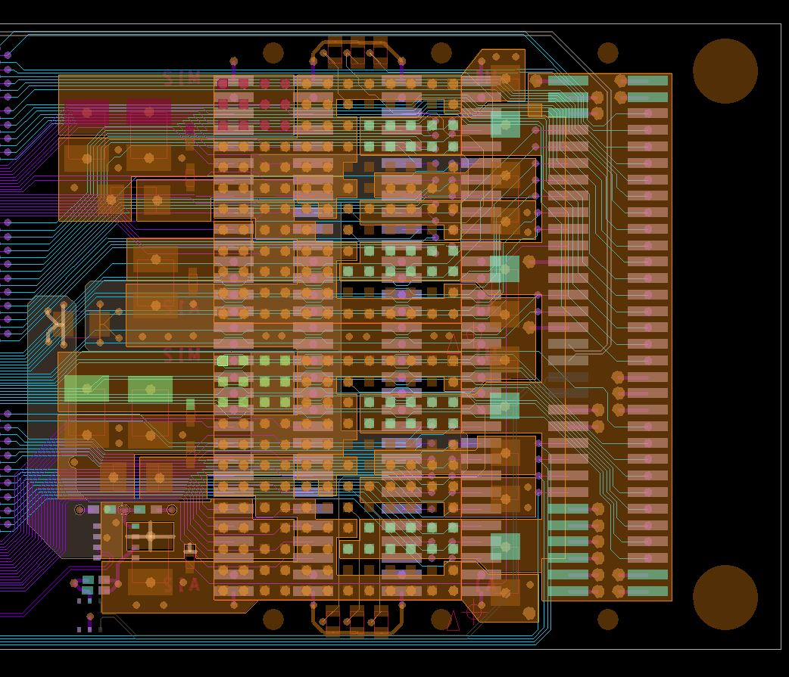
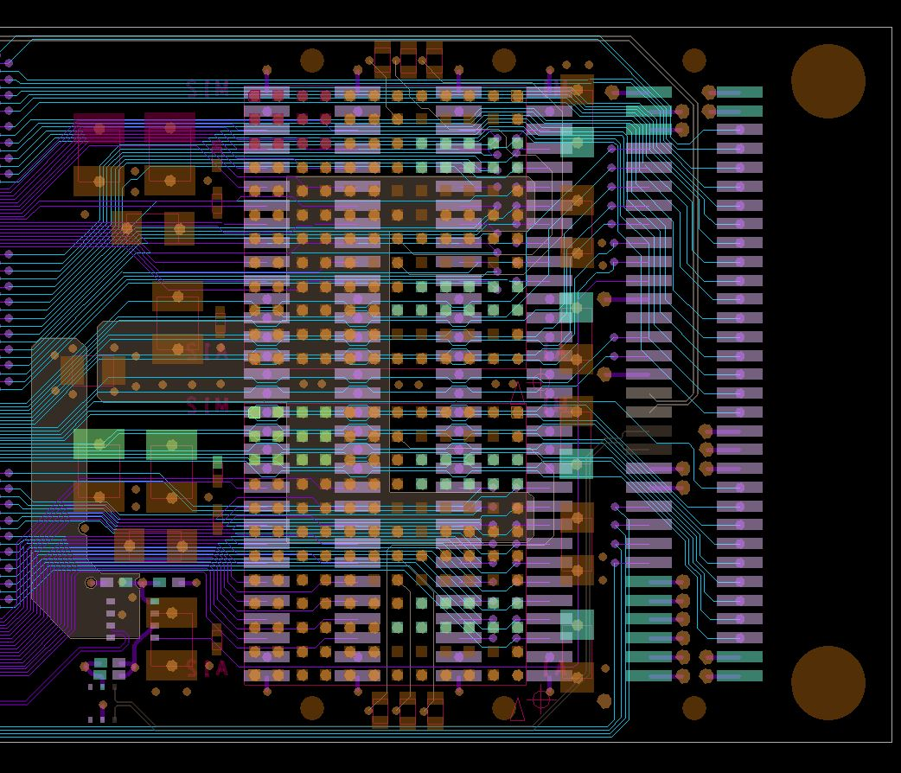
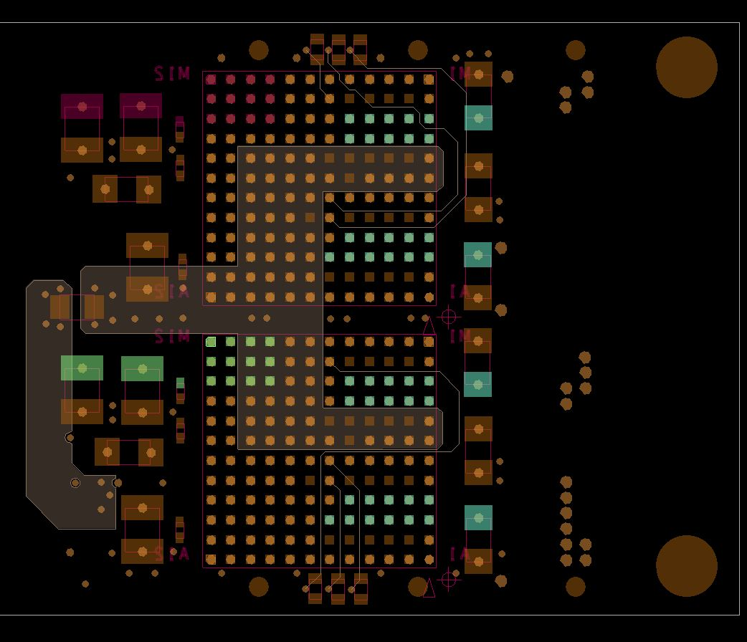
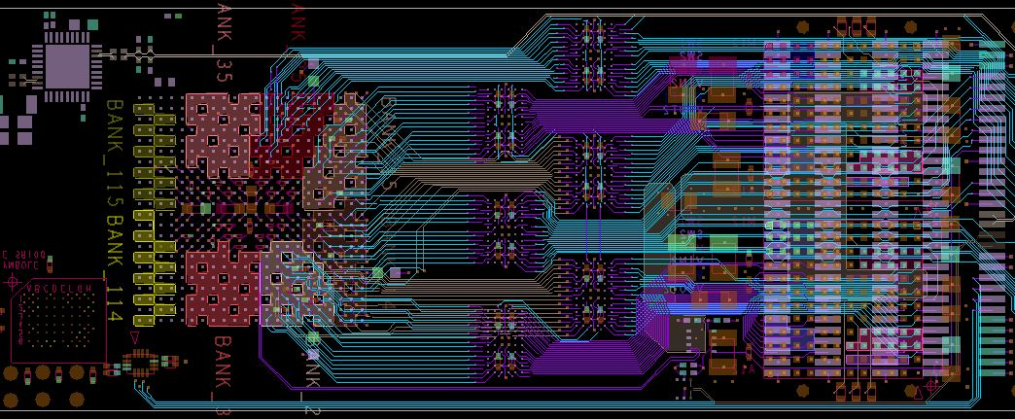
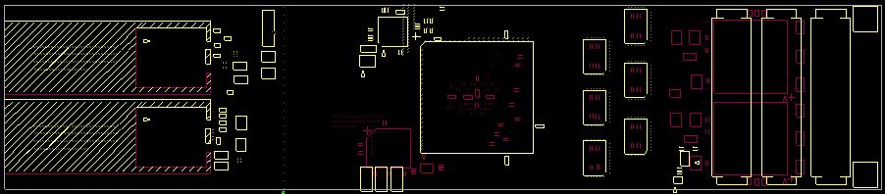
PCB routing highlight
Power supply detailed view / global view
TLB → SLB elongated mechanical format
  Power supply system on bottom side (low profile)
  JTAG EPROM on bottom side
  All others components on top side
    High density “SLB like” connector
    Level translator buffer
    FPGA
    Clock jitter cleaner
    Small from factor card cage (SFP+)
Power supply based on 2 x LM4615
  Via in all pad of LM4615
  External filtering components
  Low noise MGT supply included
  2 internal layer power plan
  Complex power scheme
    3.3V, 2,5V, 1.8V, 1.5V, 1V-VCCINT
    1,2V-MGT, 1V-MGT

