Slide 1
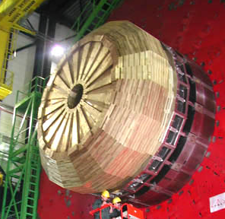
CMS Hadronic Endcap Calorimeter Upgrade Studies by
Yasar Onel
November 8, 2011, Fermilab
CMS Upgrade Workshop

Slide 2
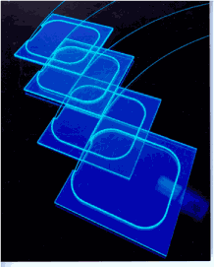
Current Design: “Scintillators”
Megatiles of large scintillator sheets divided into components. They are inserted into 9mm thick spaces between absorbers.
Light emission from tiles wavelength: λ=410-425 nm.
Signal collected with wavelength shifting fibers absorbs blue, emit at λ=490 nm
For the barrel and endcap detectors, the photosensors are hybrid photodiodes (HPDs) are used.

Slide 3
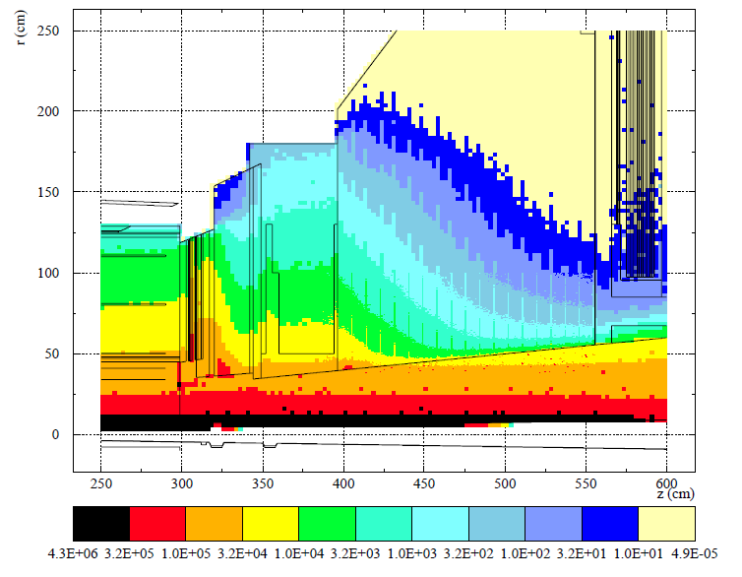
FLUKA Simulations
Simulation studies show that the scintillators are not going to be radiation hard for high
Luminosity LHC runs.

Slide 4
Outline
We are proposing to replace HE scintillators with quartz plates for high luminosity LHC runs.
0th Phase of R&D
  Show that Quartz is Radiation Hard
1st Phase of R&D
  Cherenkov Light Collection from Quartz Plate
  Tests of WLS fiber Embedded Quartz Plate Calorimeter
2nd Phase of R&D
  Light enhancement tools: ZnO, PTP
  Tests of PTP Deposited Quartz Plate Calorimeter
3rd Phase of R&D
  Alternative readout options: SiPM
  Radiation Hard WLS Fiber options

Slide 5
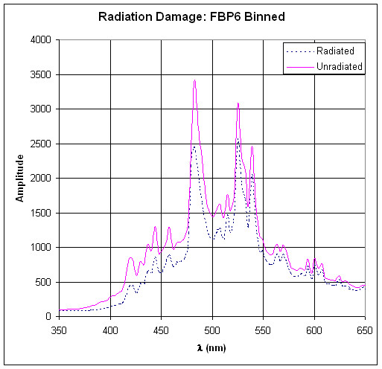
Quartz Radiation Damage Studies
  We tested more than 10 different types of quartz with electron, proton and neutron irradiation. Polymicro quartz core, quartz clad fiber with a polyamide buffer looks promising.
  Electron Irradiation Tests:
  Dumanoglu et al. “Radiation-hardness studies of high OH content quartz fibres irradiated with 500 MeV electrons” Nucl. Instr. Meth. A 490 (2002) 444-455
  Proton Irradiation Tests:
  Cankocak et al. “Radiation-hardness measurements
  of high OH content quartz fibres irradiated with
  24 GeV protons up to 1.25 Grad“
  Nucl. Instr. and Meth. A 585 (2008) 20–27
  Neutron and Gamma Irradiation Tests:
  U. Akgun et al. “Radiation Damage in Quartz Fibers
  Exposed to Energetic Neutrons”, in preparation

Slide 6
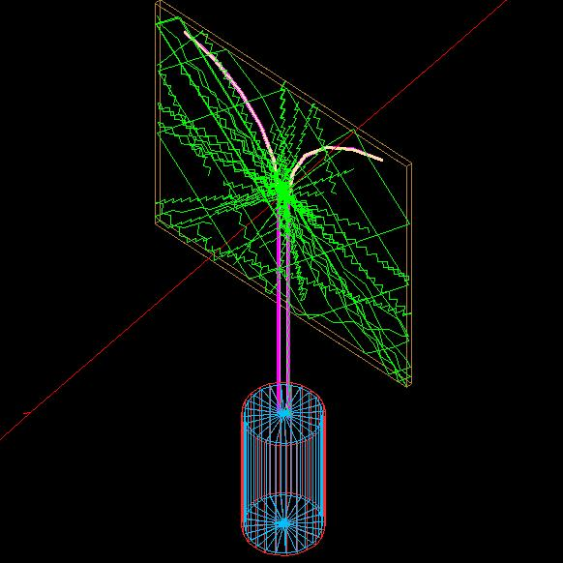
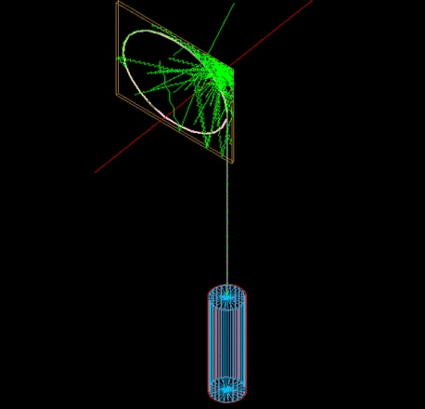
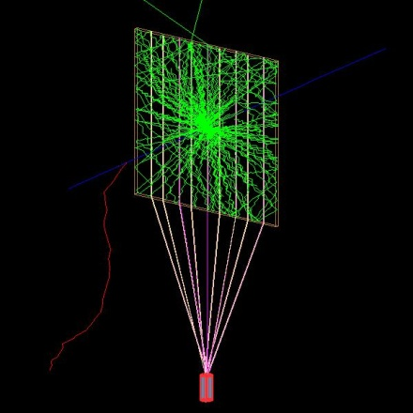
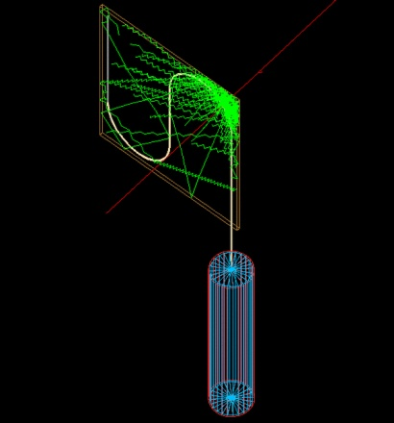
Cherenkov Light Collection in Quartz
Good : Quartz is radiation hard.
Bad : We have to collect cerenkov photons. Very little light !! At fixed angle.
Strategy: Go deep in UV to collect Cerenkov photons.
We did R&D studies on
  WLS fiber geometry
    Cerenkov light collection, uniformity, and efficiency
  Wrapping material reflectivity tests, Aluminum, Tyvek, HEM, Mylar.

Slide 7
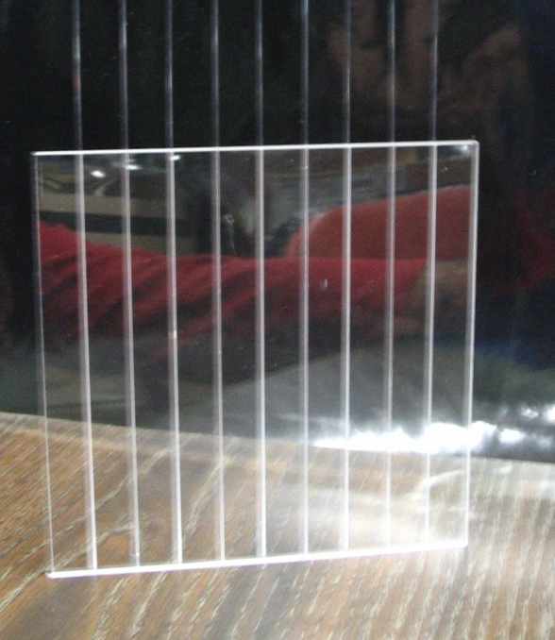
WLS Fibers in Quartz
We showed that Cherenkov light collection inside the quartz is feasible with UV absorbing WLS fibers.
F. Duru et al. “CMS Hadronic EndCap Calorimeter Upgrade Studies for SLHC - Cerenkov Light
Collection from Quartz Plates” , IEEE Transactions on Nuclear Science, Vol 55, Issue 2, 734-740, 2008.

Slide 8
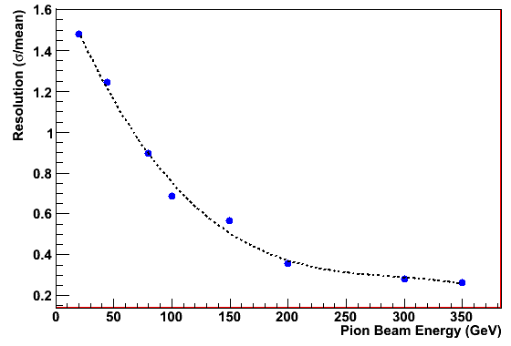
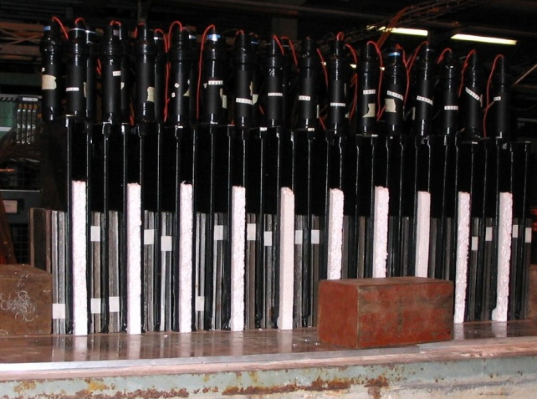
QPCAL with WLS Fibers
We built and tested “WLS Fiber Embedded Quartz Plate
Calorimeter Prototype”
U. Akgun et al., "Quartz Plate Calorimeter as SLHC Upgrade to CMS Hadronic Endcap
Calorimeters", XIII International Conference on Calorimetry in High Energy Physics,
CALOR 2008, Pavio, Italy, May 2008, J.Phys.Conf.Ser.160:012015, 2009

Slide 9
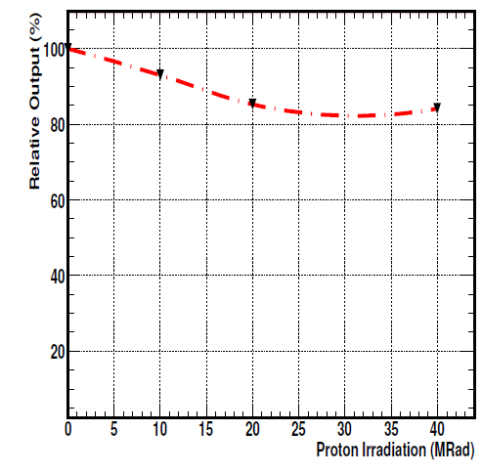
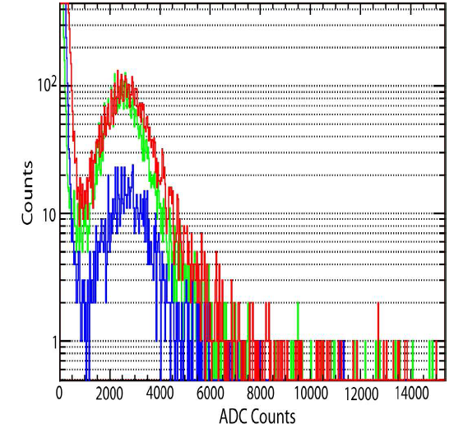
Radiation Hard Wavelength Shifters
Since the WLS fibers are not radiation hard, we tried radiation hard light enhancement tools (pTp, and ZnO) with quartz.
  U. Akgun et al., "P-Terphenyl Deposited Quartz Plate Calorimeter Prototype", IEEE
  Nuclear Science Symposium Conference, Dresden, Germany, 19-25 October 2008

Slide 10
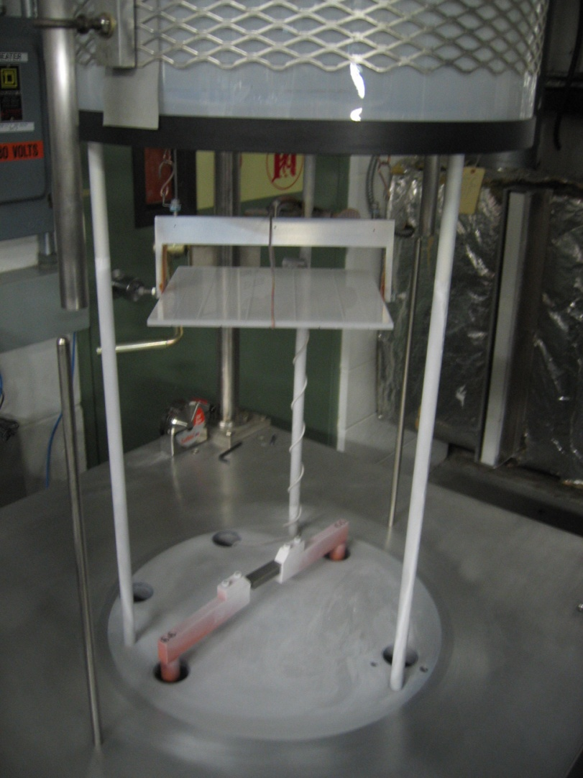
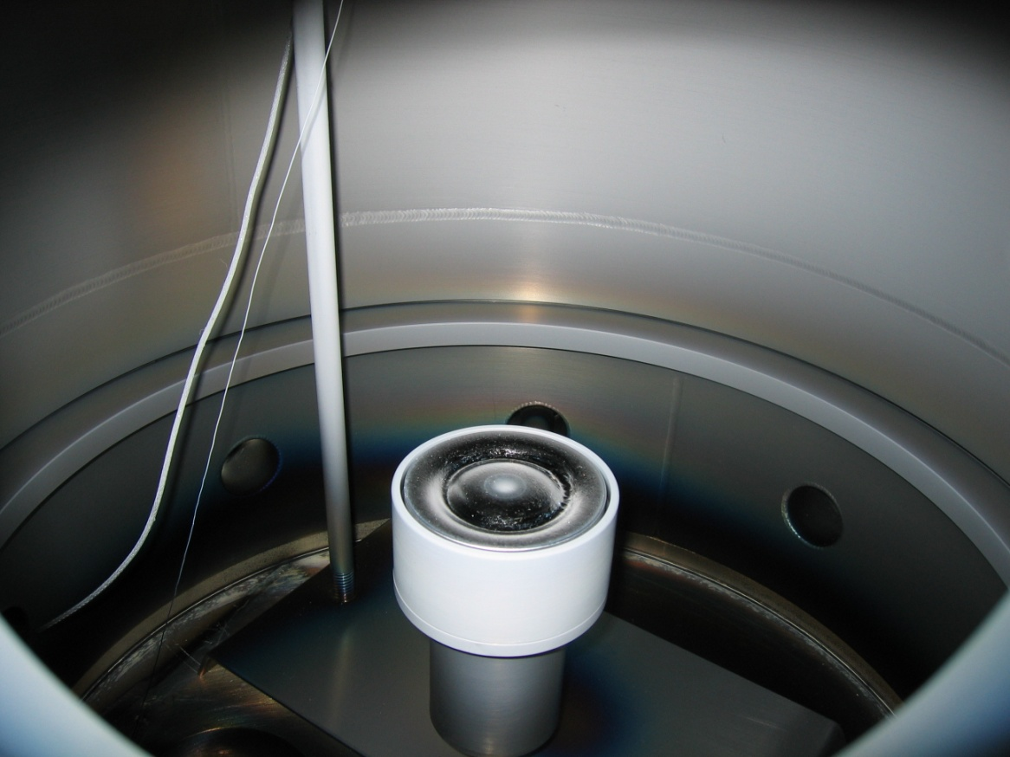
Covering Quartz Plates with pTp and ZnO
We evaporated PTP and RF sputtered ZnO over quartz plates

Slide 11
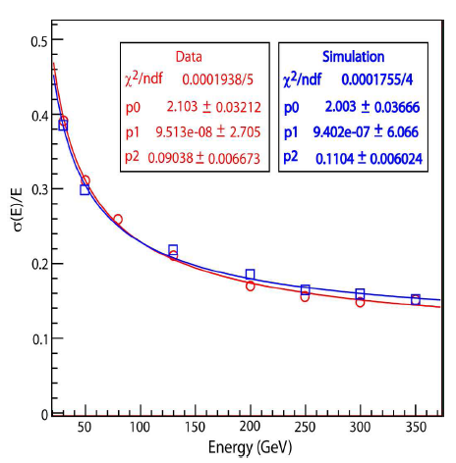
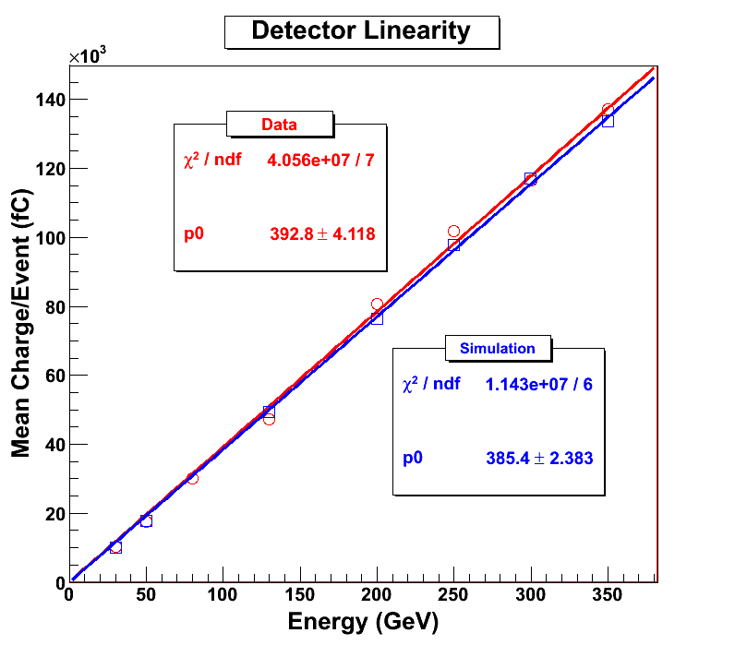
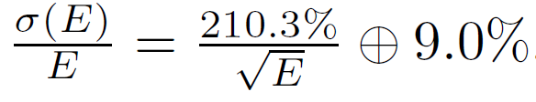
QPCAL with pTp
We built and tested “PTP Deposited Quartz Plate
Calorimeter”
U. Akgun et al. "CMS Hadronic Calorimeter Upgrade Studies - P-Terphenyl Deposited Quartz Plate Calorimeter Prototype ", APS 2009, Denver, CO, USA, May 2009
B. Bilki et al. “CMS Hadron Endcap Calorimeter Upgrade Studies For Super­LHC”, CALOR 2010, Beijing, China, May 2010

Slide 12
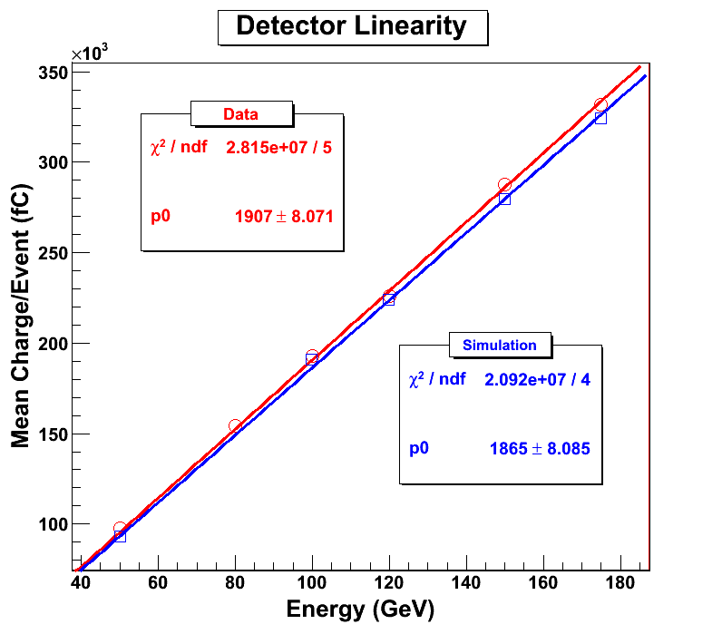
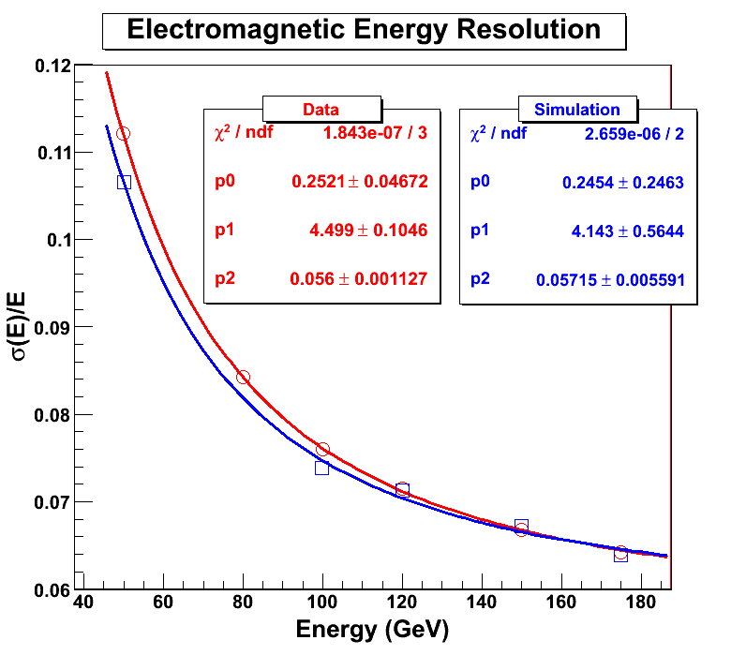
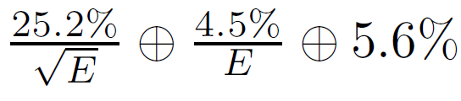
QPCAL with pTp – EM Mode
We can use combination as radiation hard CMS Endcap Calorimeter (EE + HE).
U. Akgun et al. “CMS Hadronic Endcap Calorimeter Upgrade Studies for SLHC P-Terphenyl Deposited Quartz Plate Calorimeter Prototype'‘
IEEE Transactions on Nuclear Science, Volume 57, Issue 2, 754-759, 2010

Slide 13
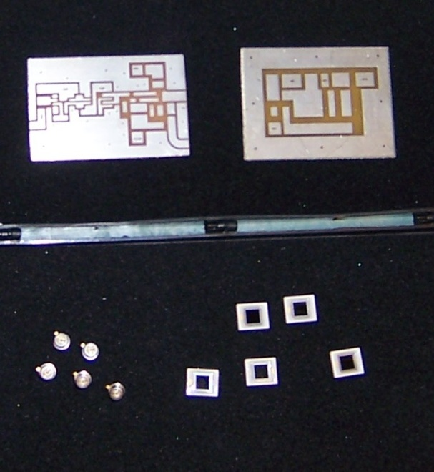
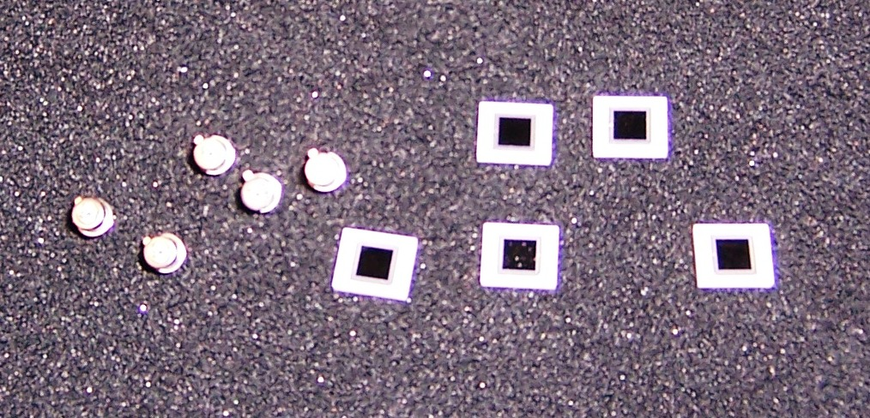
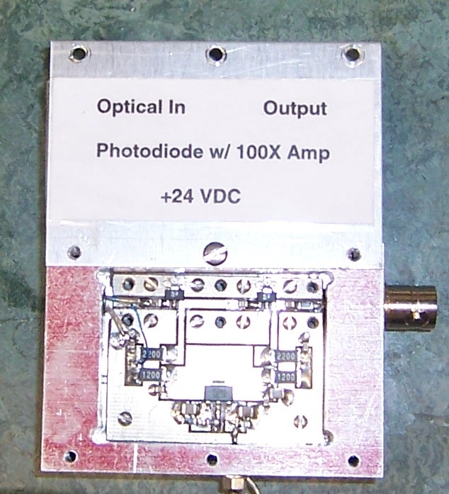
New Readout Options
We tested;
*) Hamamatsu S8141 APDs (CMS ECAL APDs).
The circuits have been build at Iowa. These APDs are known
to be radiation hard; NIM A504, 44-47 (2003)
*) Hamamatsu APDs: S5343, and S8664-10K
*) PIN diodes; Hamamatsu S5973 and S5973-02
*) Si PMTs

Slide 14
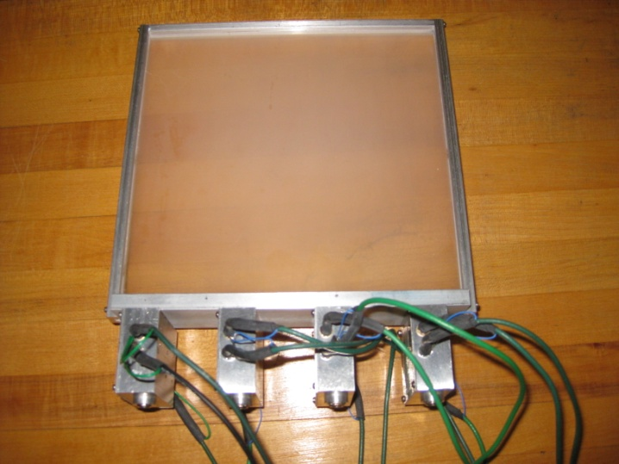
Alternative Readout
We constructed and tested alternative readout options
from pTp deposited quartz plates:
APD, SiPM, PIN diode.
They are not very effective and most importantly, the APD and SiPMs are not radiation hard enough for us.

Slide 15
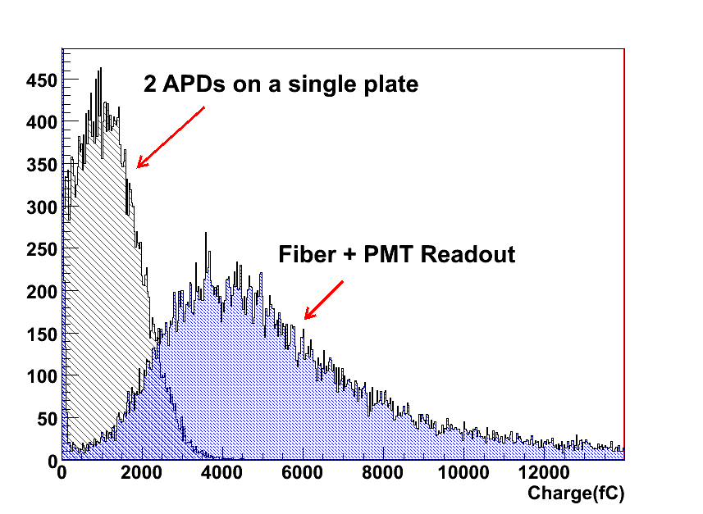
New Readout Options
We have tested ECAL APDs as a readout option. 2 APD connected to plain quartz
Plate yields almost 4 times less light than fiber+PMT combination.

Slide 16
Microchannel PMT
Fast response time, high gain, small size, robust construction, power efficiency, wide bandwidth, radiation hardness, and low cost.
8 stage device is assembled from micro-machined dynodes which exhibits a gain of up to 2-4 per stage on single stage.
The total thickness is less than 5 mm. 8x4 pixel micro-dynode array is shown

Slide 17
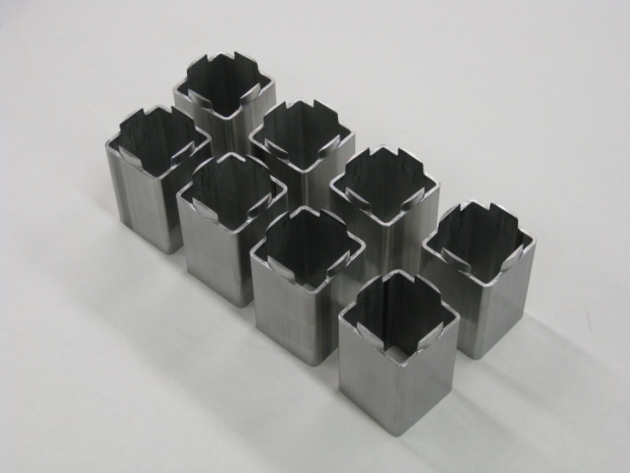
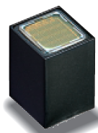
New Hamamatsu PMTs
During our HF Upgrade studies we extensively tested Hamamatsu 7600 series.
Ultra Bialkali will make them better than any other option.
Mashed architecture makes it B field hard. With no shielding it deviates only 2.5% at 200 Gauss.
We also built mu shileds for these PMTs. They’ll function in much higher B Fields.
"Study of Various Photomultiplier Tubes with Muon Beams And Cerenkov Light Produced in Electron Showers", CMS NOTE 2010-003, Journal of Instrumentation 5 P06002, 2010

Slide 18
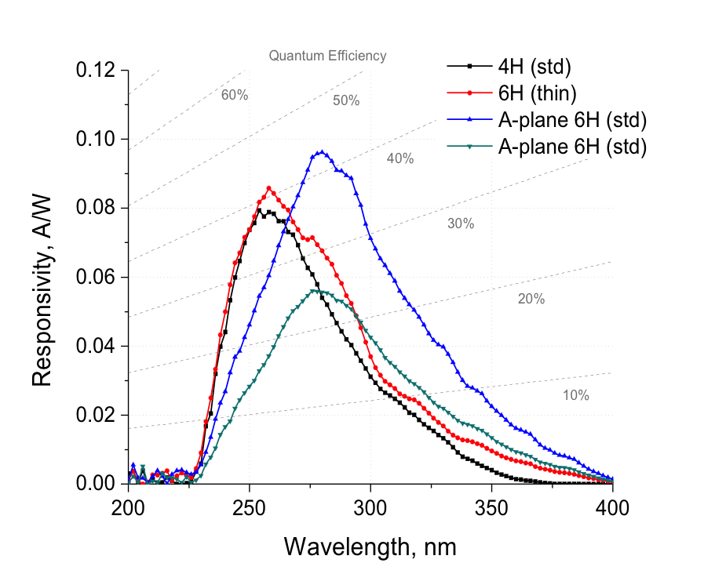
New Radiation Hard APD
We are in contact with J. Russ on new radiation hard APD option. The APD has low response wavelength, and it is radiation hard up to 10¹⁵ neutrons.
We are planning to test them on quartz plates, ASAP.

Slide 19
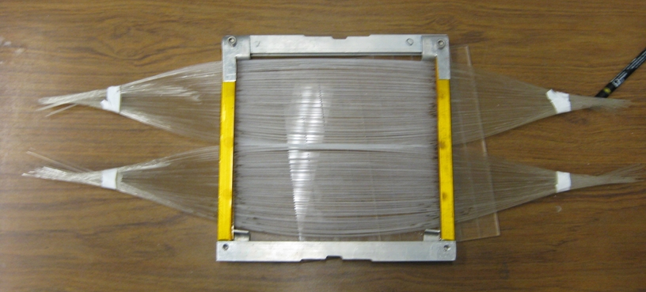
Radiation Hard WLS Fiber
We Develop Radiation Hard Wavelength Shifing Fibers: Quartz fibers with PTP/ZnO covered core.
We built a radiation hard WLS fiber prototype. Deposited pTp on the stripped region, on both face. Then the whole ribbon will be sandwiched between quartz plates.

Slide 20
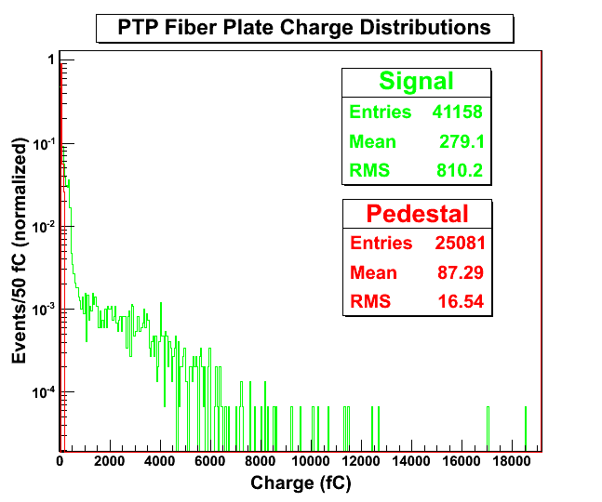
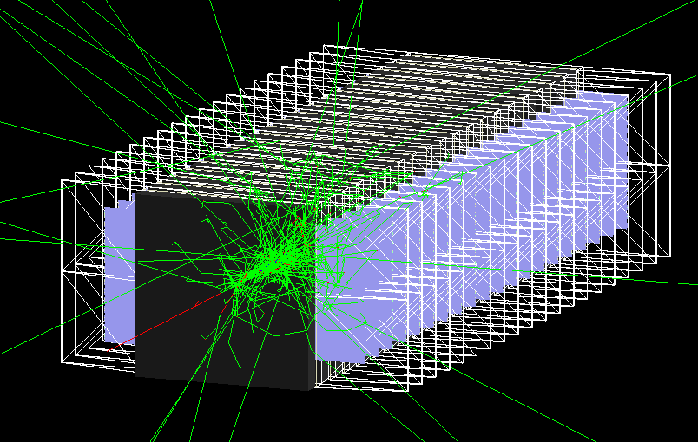
Radiation Hard WLS Fiber
We prepared a “homemade” rad-hard WLS fiber. We stripped the plastic cladding from
QP fibers for “middle 20 cm” portion of 60 cm fibers.
This unit was tested with 80 GeV electron shower. The red line show the pedestal.
With a very simple prototype we collected substantial signal.
We try to optimize the model using Geant4 simulations.

Slide 21
HE Upgrade Plans
We have two “viable” options for HE Upgrade, these can also be applied to EE region with 2 cm absorber thickness.
Will read signal from PTP deposited plate, directly.
  This will require radiation hard detector: Hamamatsu 7600 series, or multi channel PMT
  The current technology of APD and SiPM is NOT enough.
  New radiation hard APD option needs to be tested.
Will use WLS fibers
  This requires rad-hard WLS fiber, which DOES not exist.
  We built a primitive prototype with PTP, it is promising. Need R&D on PTP, ZnO deposition on quartz fibers. Sapphire fiber is another option.

Slide 22
HF Upgrade Phase II SLHC
OPTION
… Now, something totally different:
Digital Calorimetry and Particle Flow
with RPCs and GEMs
CALICE Analysis Notes: CAN-030, CAN-031, CAN-032.
Q. Zhang et.al., “Environmental dependence of the performance of resistive plate chambers”, JINST 5 P02007, 2010.
B. Bilki et.al., “Hadron showers in a digital hadron calorimeter”, JINST 4 P10008, 2009.
B. Bilki et.al., “Measurement of the rate capability of Resistive Plate Chambers”, JINST 4 P06003, 2009.
B. Bilki et.al., “Measurement of positron showers with a digital hadron calorimeter”, JINST 4 P04006, 2009.
B. Bilki et.al., “Calibration of a digital hadron calorimeter with muons”, JINST 3 P05001, 2008.

Slide 23
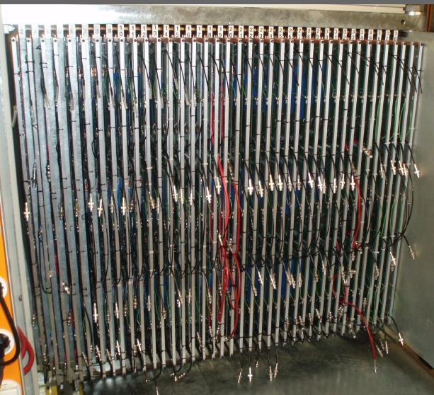
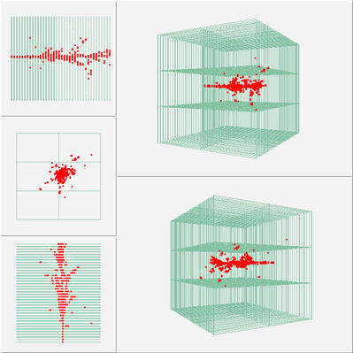
HF Upgrade Phase II SLHC
OPTION D
Needs development of a low resistance glass with the optimum resistivity to allow larger counting rates but still have the desirable RPC performance.

Slide 24
Forward Lepton-Photon System and Physics for CMS:
E-M compartment shields HF from raddam at SLHC
Improves HF jet energy and angle resolution
Improves MET by adding muon momentum
Extends improves measurement of PDF’s
Better calibration of HF
Technology to improve HE

Slide 25
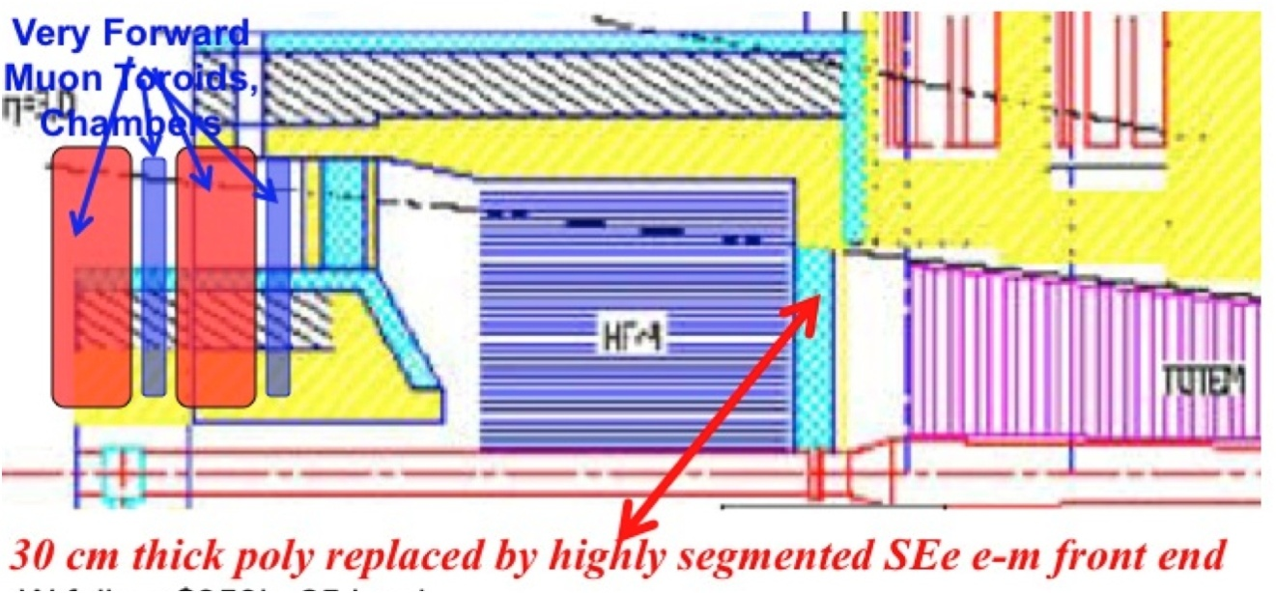
At present, there is a 30 cm thick passive polyethylene shield in front of HF.
Replace by
FE electromagnetic tracker/preradiator/em cal.
Behind HF: massive passive shielding.
Replace by
iron muon toroid system &chambers

Slide 26
Proposal (CMS Upgrade Proposal)
We propose to replace the passive poly front end in front of HF (and behind Castor) with a 1-2 mm resolution tracker/preradiator (~3-4 Lrad) to track charged particles, and to identify electrons and photons, is followed by a fined grained e-m calorimeter of 25 Lrad, sampled every Lrad, with Moliere-radius transverse sized cells. Tungsten foils are preferred for both compactness and structural issues. Less than $500k in W foils are needed in this compact device, about 0.8 m radius x ~25 cm thick. The technology for the calorimeter to do this – at present - is based on either:
Quartz plates/fibers – This leverages the R&D on quartz plates for the HE raddam upgrade.
Secondary Emission modules - In a Secondary Emission detector module, Secondary Emission electrons (SEe) are generated from an SE cathode when charged hadron or electromagnetic particles or particularly shower particles penetrate the sampling module placed between absorber materials (in calorimeters. SE is known to be very rad-hard, as used in PMT 50 GRad)

Slide 27
Design
The modules envisioned are compact, high gain, high speed, exceptionally radiation damage resistant, rugged, and cost effective, and can be fabricated in arbitrary tileable shapes.
The SE sensor module anodes can be segmented transversely to sizes appropriate to reconstruct electromagnetic cores with high precision.
The GEANT4 estimated in a 1(5) cm sampling Cu calorimeter response performance is between 35-50 (7-10) Secondary Emission electrons per GeV, with a gain per SEe >10⁵ per SEe, and an e/pi<1.2. The calorimeter pulse width is estimated to be <15 ns.
A recent test using a mesh dynode PMT has confirmed MC results.

Slide 28
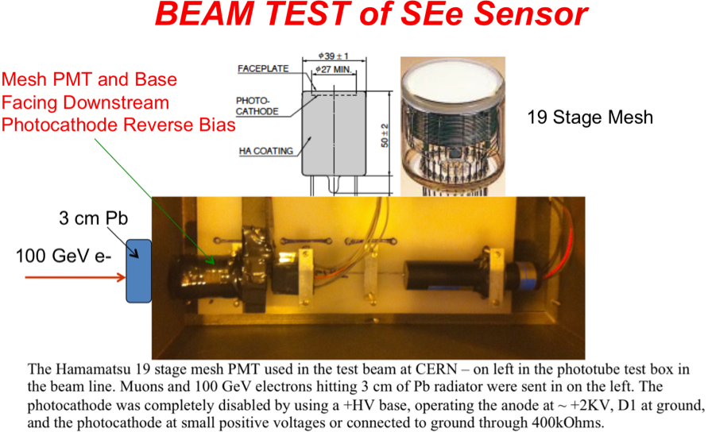
CERN Test Beam
The Hamamatsu 19 stage mesh PMT used in the test beam at CERN as a SE-sensor – on left in the phototube test box in the beam line. Muons and 100 GeV electrons hitting 3 cm of Pb radiator were sent in on the left. The photocathode was disabled by using a +HV base, operating the anode at ~ +2KV, D1 at ground, and the photocathode at small positive voltages or connected to ground through 400kOhms.

Slide 29
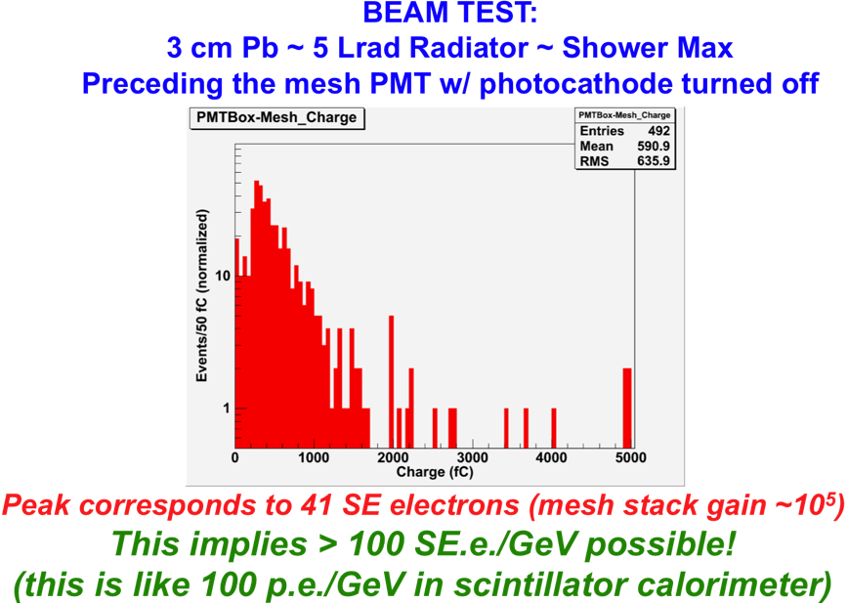
CERN Test Beam
Beam test results of Mesh SEe “sensor”:
100 GeV electrons into 3 cm Pb, with one SE sampling “cell”= disabled photocathode mesh PMT.
The “peak” in mesh PMT signal corresponds to 41 SEelectrons (mesh gain ~10⁵) at about shower max. The large width is essentially entirely consistent with shower fluctuations on a single shower sampling after 3 cm Pb. This implies > 100 SEe are possible per GeV - these SEe are exactly the same as pe in a sicntilaltor calorimeter.

