Slide 1
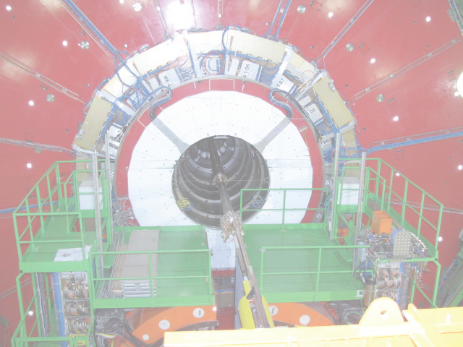
ME4/2: CSC Factory & FAST site
CMS Upgrade Meeting
November 8, 2011
David Saltzberg (UCLA) for the ME4/2 team
(Thanks to Eric Takasugi from whom I stole many slides)

Slide 2
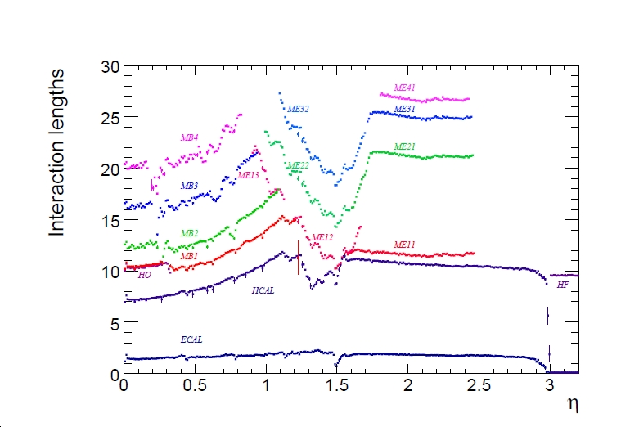
The Missing Chambers
<4m steel!
in physics discovery region

Slide 3
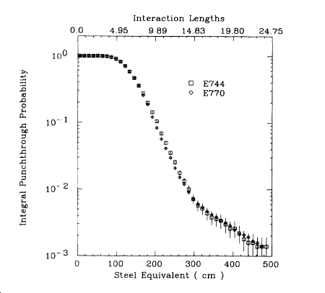
Punch-through
(including decay-in-flight within shower)
Need to reduce fake muons at trigger and analysis level
  Need O(10⁻⁶) or better for Exotics searches
  Need redundancy for long-term operation
  Extra track segment may well be useful
  ~ x5 improvement
100 GeV hadrons
☹
Sandler et al., PRD42, 759 (1990)

Slide 4
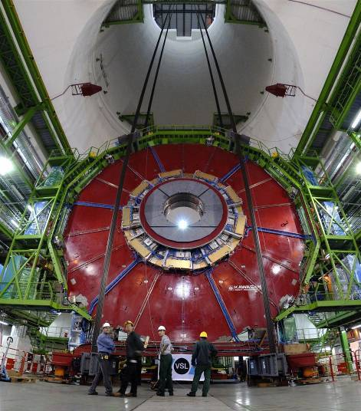
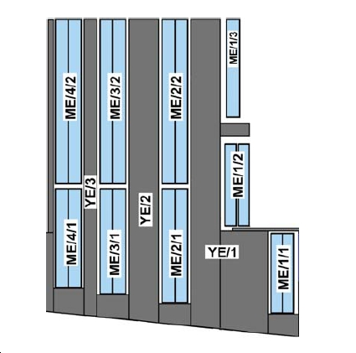
ME 4/2
    36 CSC’s needed per endcap
    (have 5 so far)
    Empty Space

Slide 5
Anatomy of ME4/2 Project
Industry
  skin production
  → panel production
Fermilab
  cutting drilling, milling, cleaning, polishing
CERN/Prévessin (building 904) chamber construction factory (Panels → chambers)
  Construction of Anode & Cathode panels
  Assembly of chambers
  Final Assembly and Testing (FAST)
Installation at CERN Pt. 5

Slide 6
Panel Production in Industry
Skins:
  Copper-clad FR4 (glass reinforced)
  5’ x 12’ x 1/16” thickness
  7 layers FR4 + 35 µm Cu sheet
  Pressed together at high temperature (325º F)
Panels
  High-strength structure of polycarbonate core + 2 skins
  Core + sheets “prepreg” + skins pressed together
(Pass around samples)

Slide 7
History & of our panel Order
2010:Prototype panels built by Laminates USA.
  Agent. Actual skin & panel production subcontracted to industry. Successful full-sized prototypes delivered.
  These are currently being used to build 3 CSC’s at the new factory (#201, #202, #203)
Jan ’11: Contract for panels for one endcap given, P.O. through CERN
~July ’11: became clear the order was unlikely to be filled
late Sept. ’11: order was cancelled
early Oct ’11: Request for quotes through FNAL

Slide 8
Current Status of Order
Request for quotes closed Oct 28
(Say a few things verbally without putting on the slides)

Slide 9
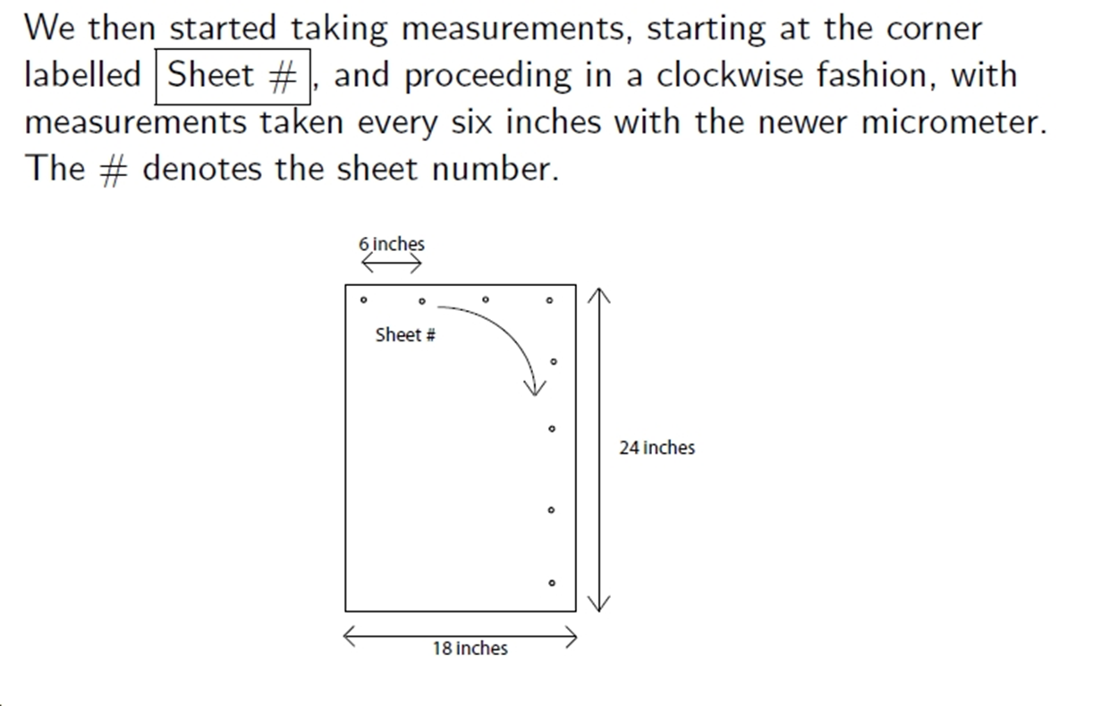
Sample Skin
Thickness Measurement
spec
Number/mil
individual measurement accuracy § 0.2 mil
correlations among successive measurements
mean = 61.4 mil
standard dev.= 2.3 mil (not Gaussian)
worst data point 7 mil off nominal
  (but within 5 mil of mean, which is the intent of the spec)
mils

Slide 10
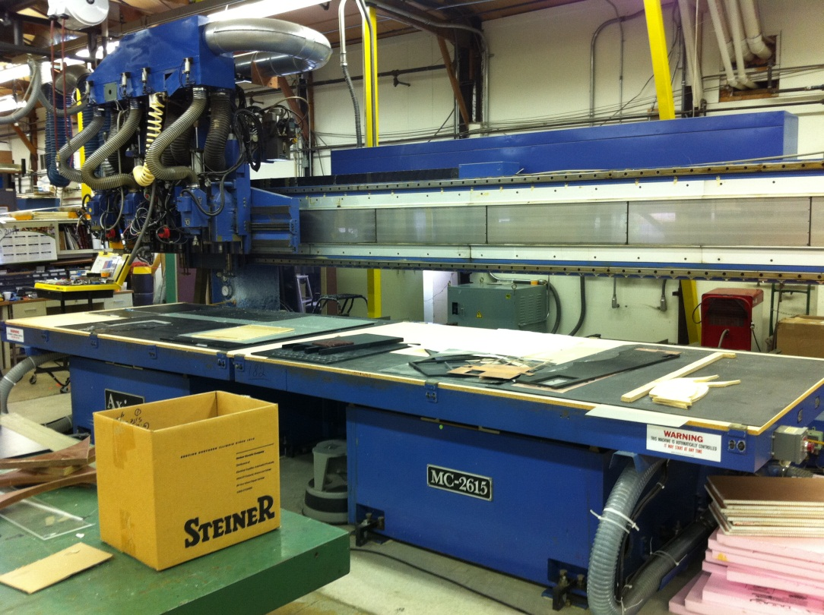
Fermilab Facility (Part I)
Axxiom machine
  Drilling & cutting
  Final shape is trapezoidal with precision holes that must line up between panels

Slide 11
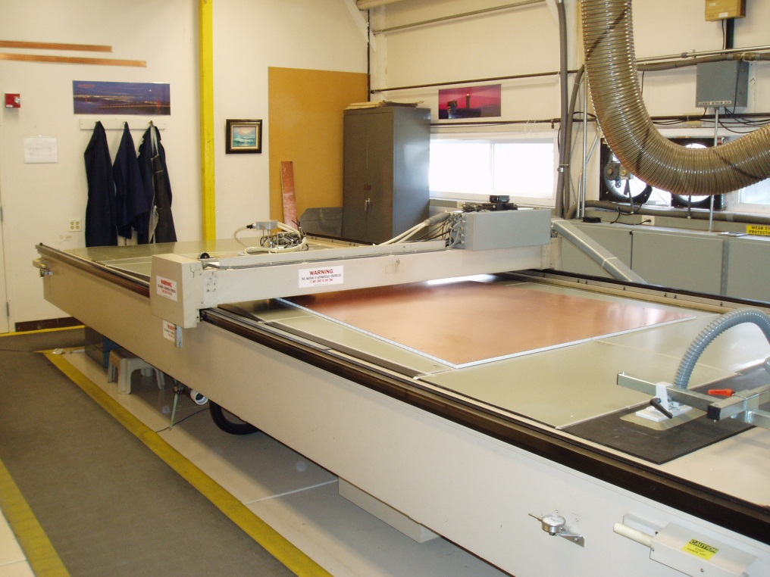
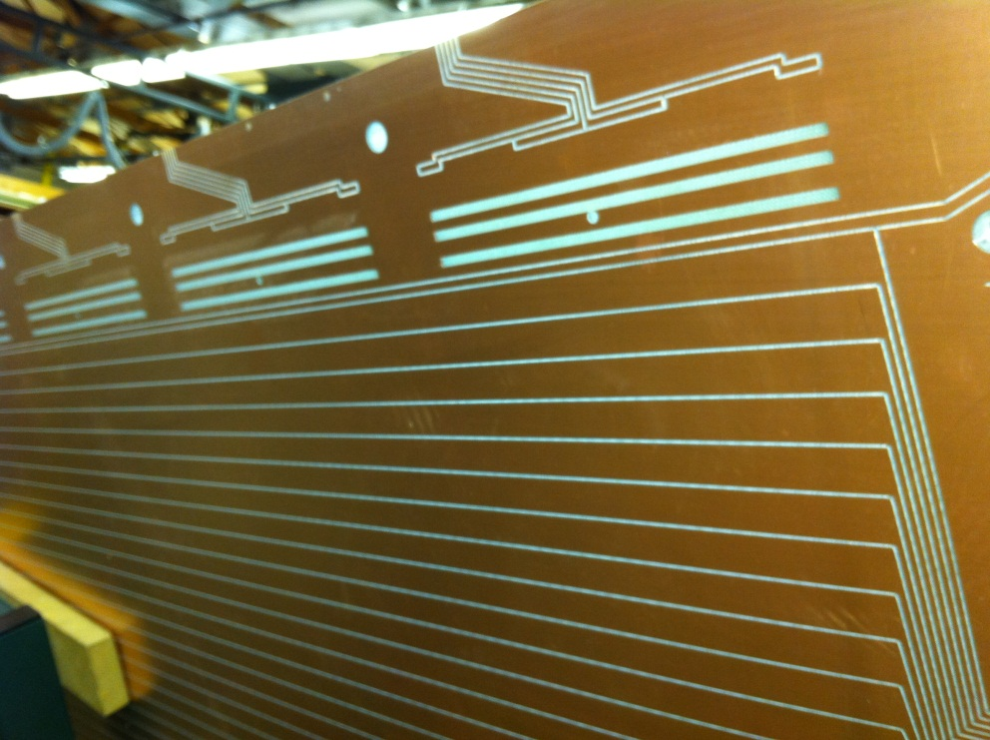
Fermilab Facility (Part II)
Milling cathode strips
  Gerber machine
  critical precision, measures in the bending plane

Slide 12
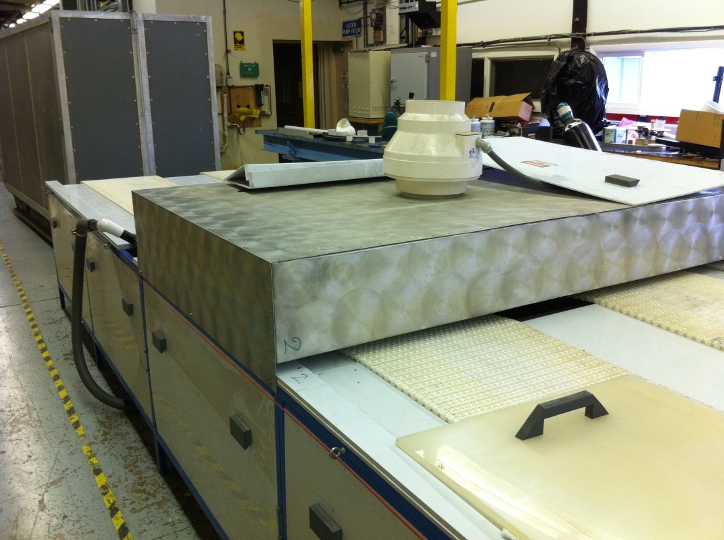
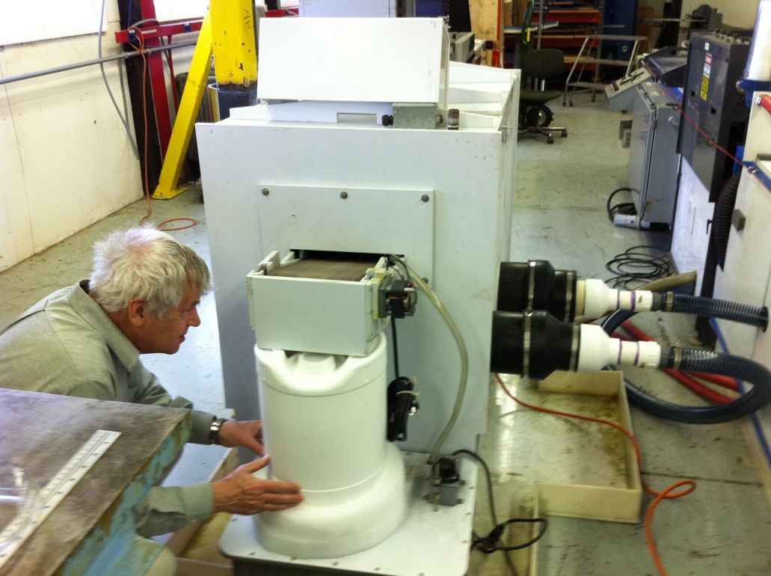
Fermilab Facility (Part III)
Cleaning & polishing

Slide 13
Shipping to CERN
Crates that carry panels to Fermilab, then to Europe will be designed to also hold complete chambers, for storage before installation at Pt. 5.
Currently have enough prototype panels at CERN that construction of 3 chambers is nearly complete (#201, #202, #203)

Slide 14
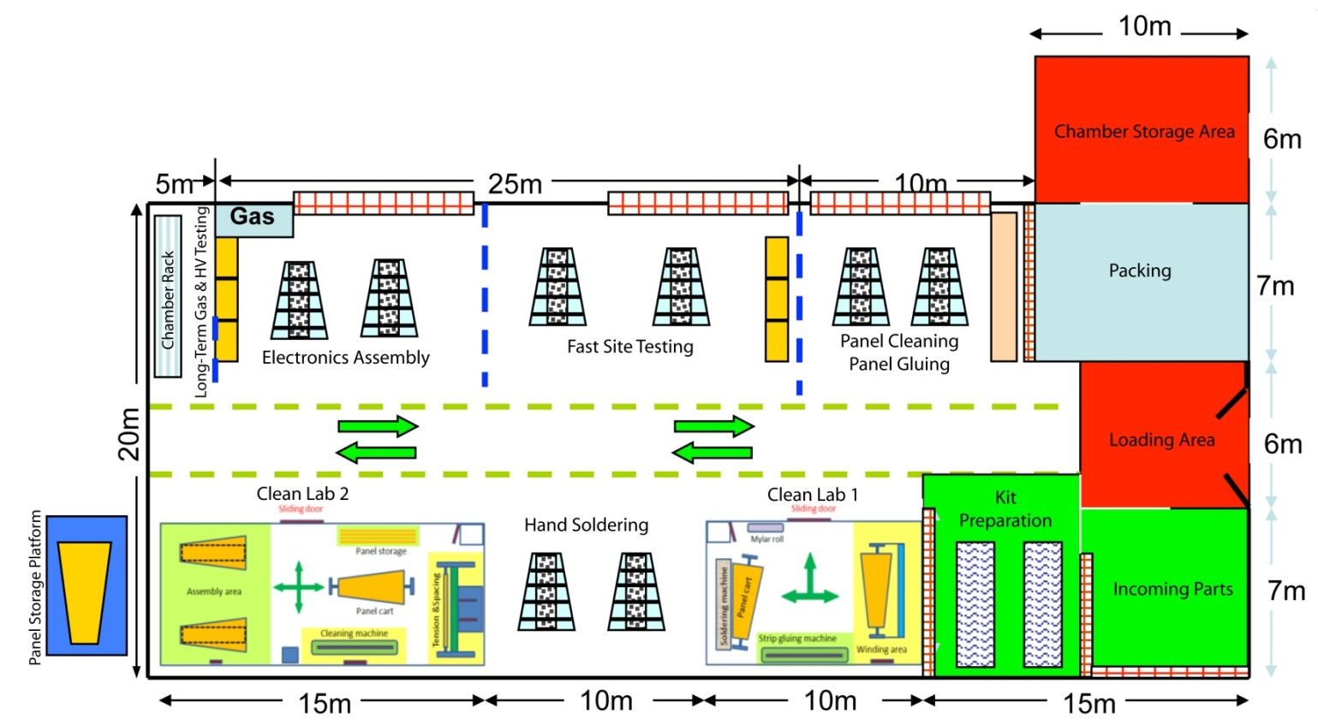
Building 904 Factory
(CERN/ Prévessin)
A terrific facility
  Thanks to CMS technical division and CERN service teams for support: safety, gas, electricity, HVAC, civil eng., clean labs, etc.

Slide 15
904 Responsibilities
Managers
Factory Manager: Armando Lanaro (UW)
Floor Manager & Safety Sandro Di Vincenzo (CERN)
Production Leaders
Production Project Engineer Boris Bochin (PNPI)
Inventory, Travelers, Kits Leonid Shchipunov (Andrey Vorobyev) (PNPI)
Panel Gluing Area Steven Kreyer (UCSB)
Cleanroom 1 (Winding/Soldering) Stanislav Gets (Slava Golubev ) (PNPI)
Soldering area Zheng Wang (IHEP)
Cleanroom 2 (Testing/assembly) Boris Bochin (Slava Golubev ) (PNPI)
Leak + long-term test area Xiaofeng Yang (UCLA)
Chamber handling/storage Leonid Shchipunov (Andrey Vorobyev ) (PNPI)
QC/QA, data logging Boris Bochin (Andrey Vorobyev) (PNPI)
Production consulting Oleg Prokofiev (FNAL)
FAST site
Petr Levchenko (PNPI), Valentin Sulimov (PNPI), Matthias Weber (UCLA)

Slide 16
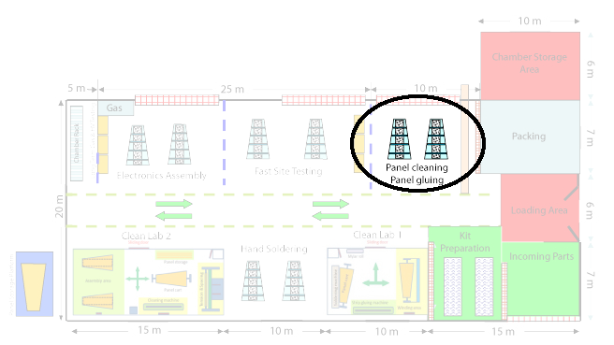
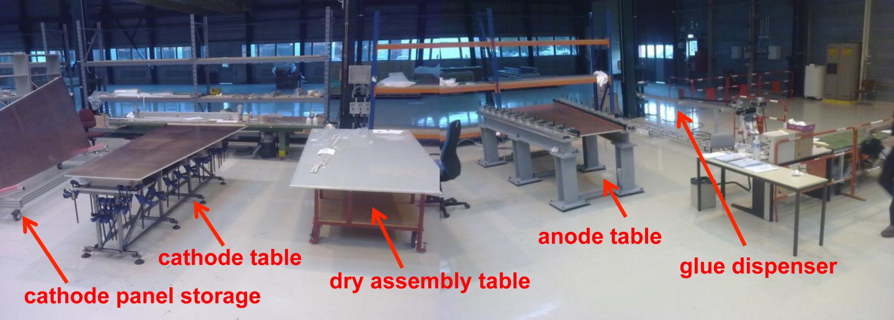
Panel Epoxying (Part I)
Figure: Armando Lanaro

Slide 17
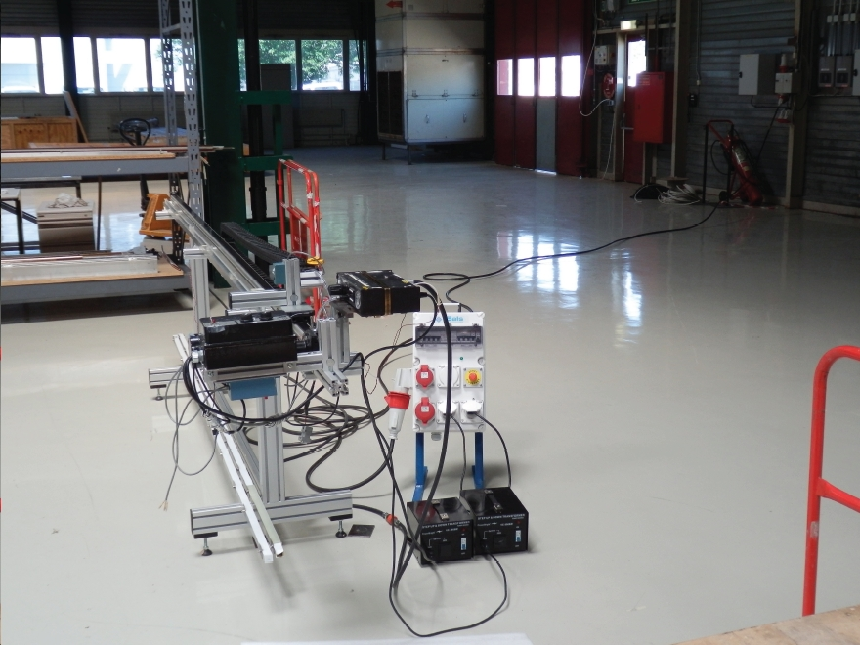
Panel Epoxying (Part I)
Glue Dispensing Machine
Anode Panel Table
Cathode Panel Table
Figure: Steven Kreyer

Slide 18
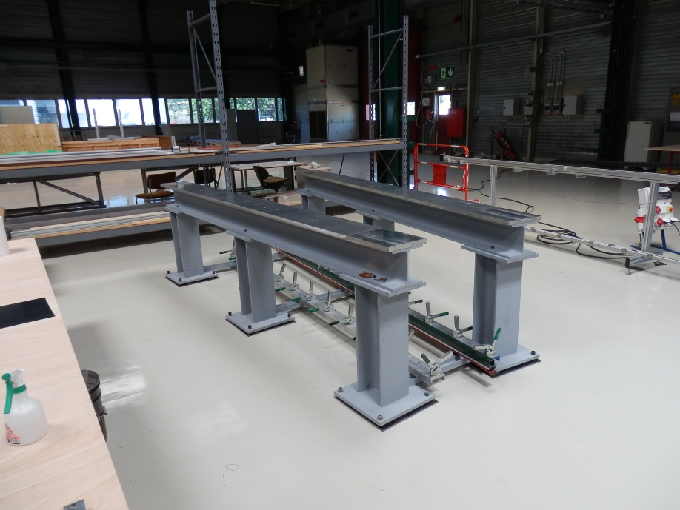
Panel Epoxying (Part I)
Glue Dispensing Machine
Anode Panel Table
Cathode Panel Table
Figure: Steven Kreyer

Slide 19
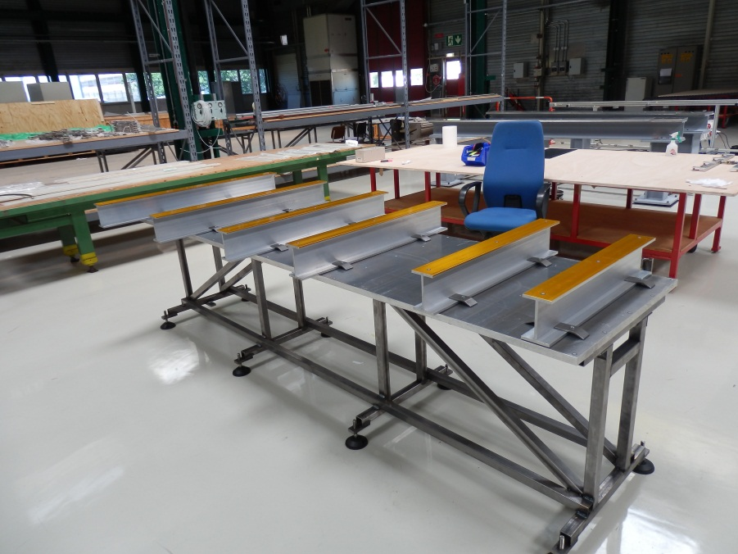
Panel Epoxying (Part I)
Glue Dispensing Machine
Anode Panel Table
Cathode Panel Table
Figure: Steven Kreyer

Slide 20
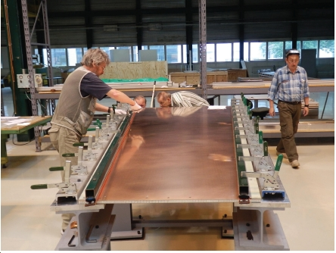
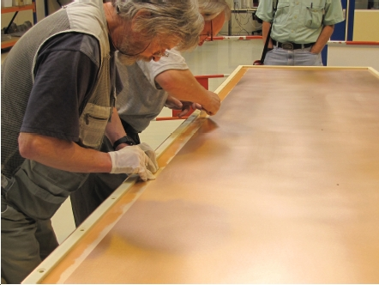
Panel Epoxying (Part II)
Cathode Panel
  Glue spacer bars
  Glue insulation strips
Anode Panel
  Glue wire fixation bars
Epoxy takes ~16 hours to set
Figures: Steven Kreyer

Slide 21
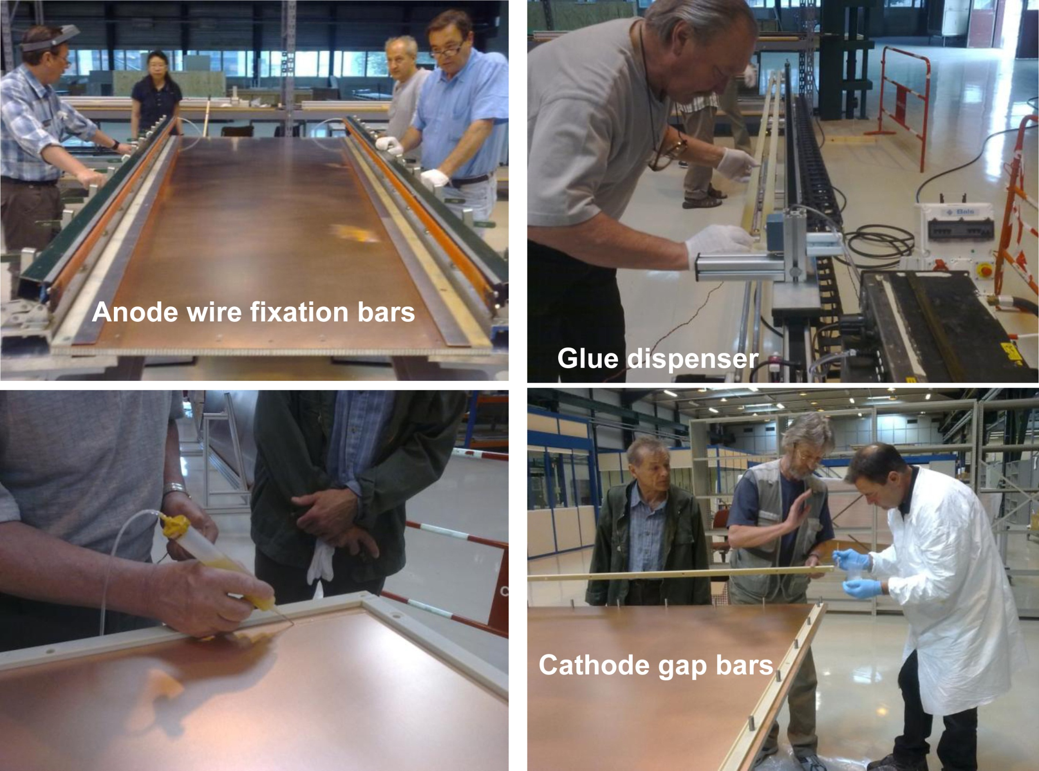
text

Slide 22
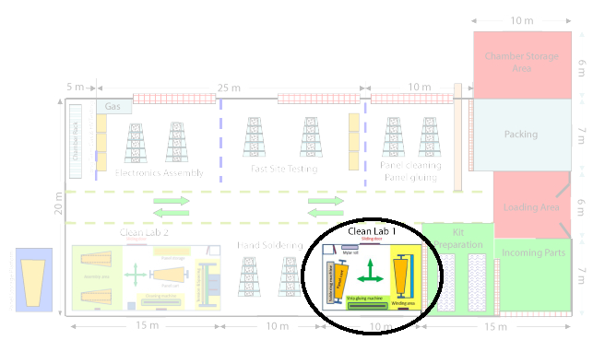
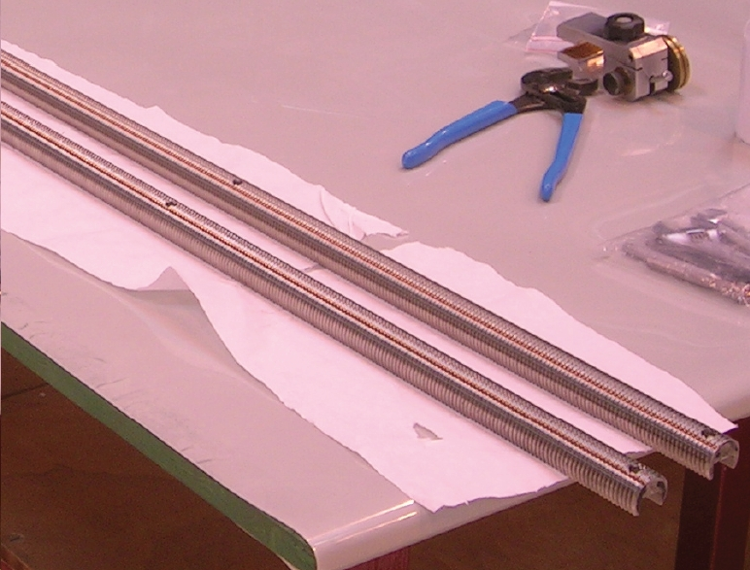
Wire Winding (Part I)
Start with installation of wire guides (combs)
Hand-soldering of field-shaper wires (thicker wires, Ф=200¹m)
Confirm tension with resonance

Slide 23
Wire Winding (Part I)

Slide 24
Wire Winding (Part I)
Start with installation of wire guides (combs)
Hand-soldering of field-shaper wires (thicker wires, Ф=200¹m)
Confirm tension with resonance
Figures: Steven Kreyer

Slide 25
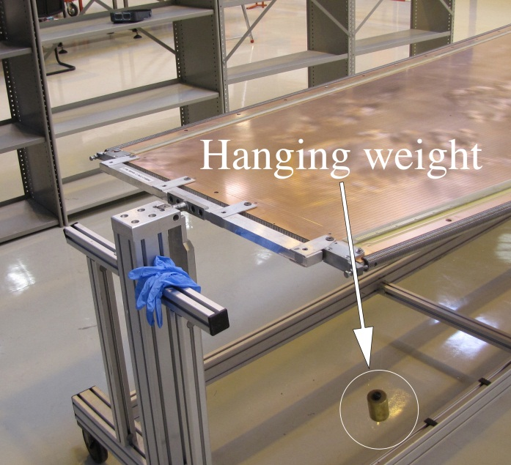
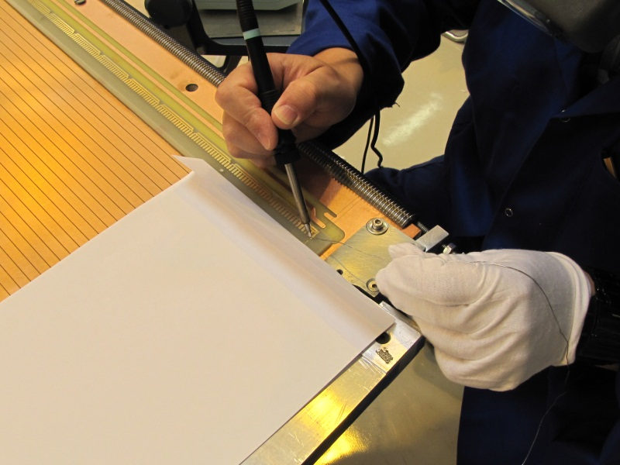
Wire Winding (Part I)
Start with installation of wire guides (combs)
Hand-soldering of field-shaper wires (thicker wires, Ф=200¹m)
Confirm tension with resonance
Figures: Steven Kreyer

Slide 26
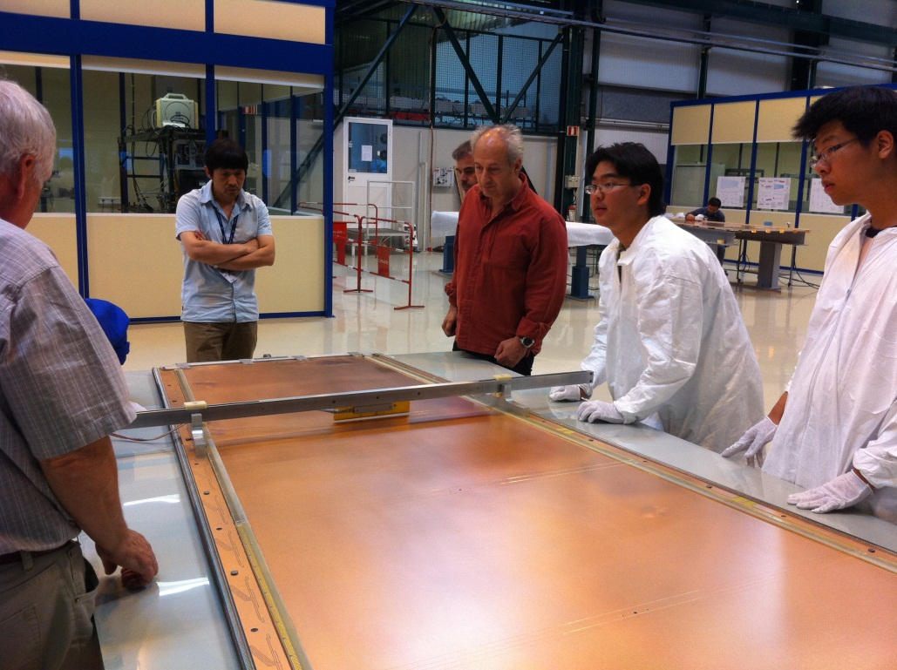
Wire Winding (Part I)
Start with installation of wire guides (combs)
Hand-soldering of field-shaper wires (thicker wires, Ф=200¹m)
Confirm tension with resonance

Slide 27
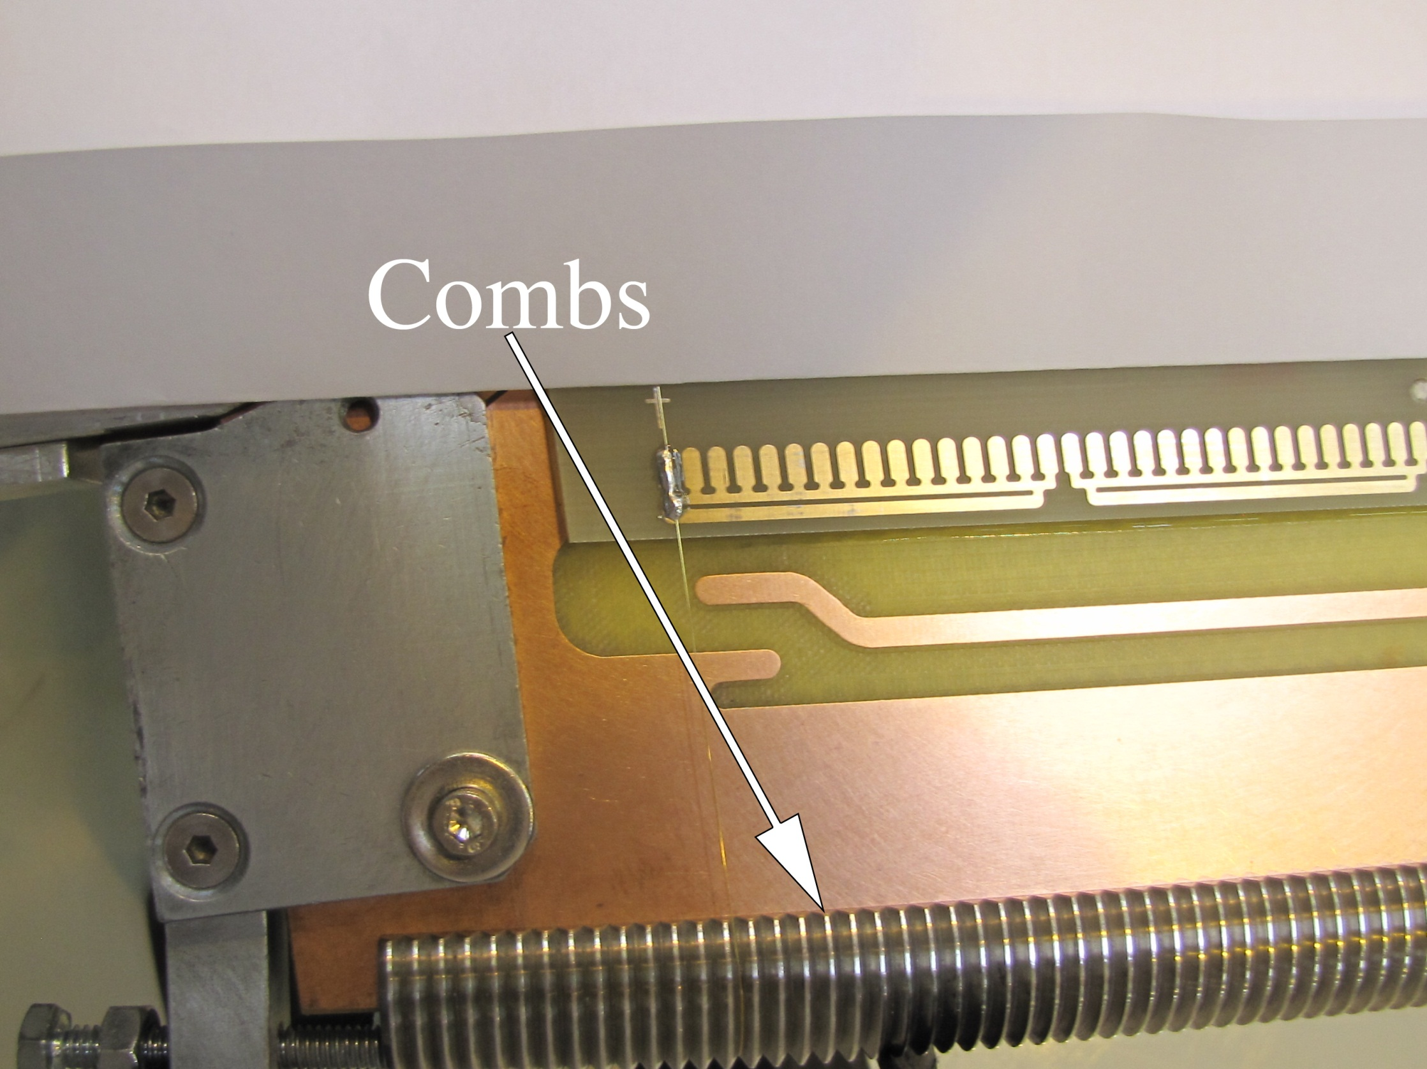
Wire Winding (Part I)
Start with installation of wire guides (combs)
Hand-soldering of field-shaper wires (thicker wires, Ф=200¹m)
Confirm tension with resonance
Figure: Steven Kreyer

Slide 28
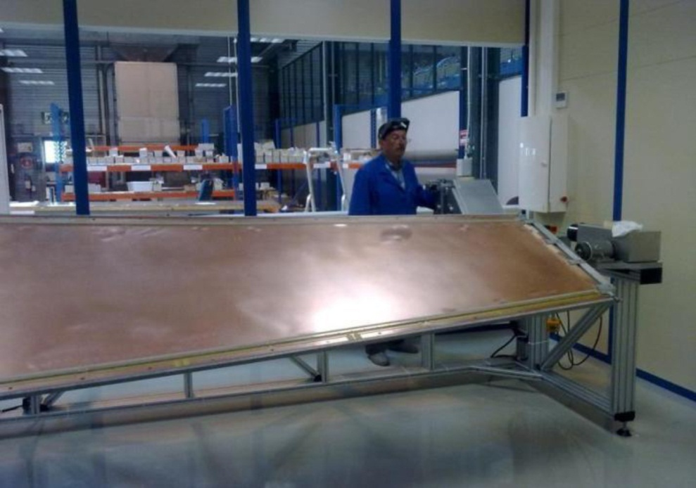
Wire Winding (Part II)
FNAL machine
Wire all the 50¹m sense wires
4 hours to wind one anode panel
Covered with mylar to protect wires during soldering
Wire-ends fastened with mylar strips
Show movie...

Slide 29
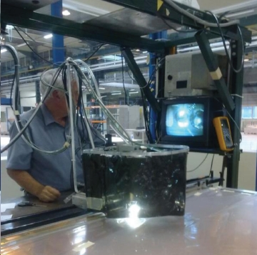
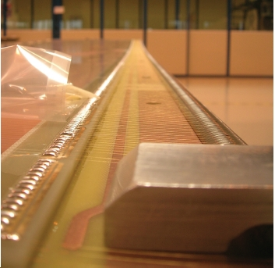
Machine Soldering

Slide 30
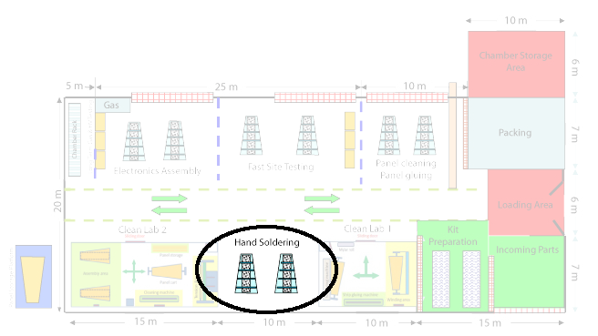
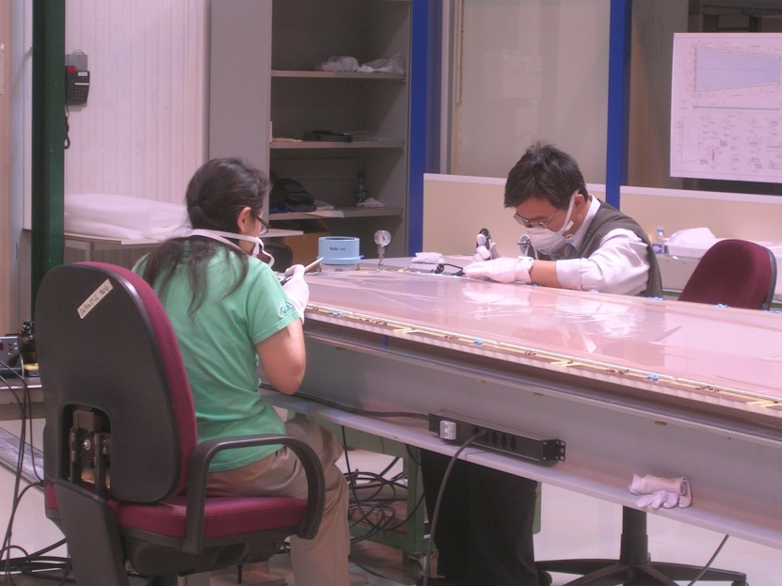
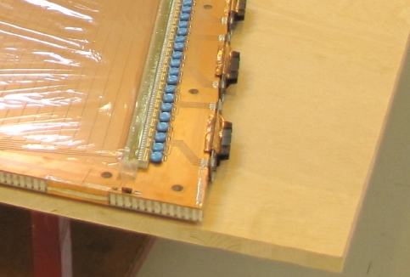
Component Soldering
All (non-wire) components, e.g. capacitors, resistors, are hand-soldered
IHEP responsibility

Slide 31
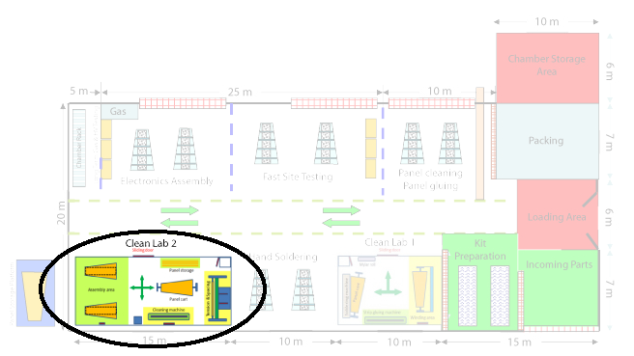
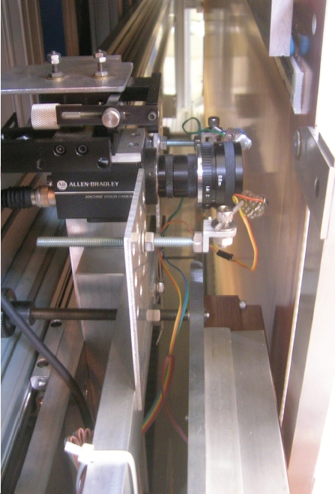
Pitch Testing
Wire pitch is measured by two CCD cameras

Slide 32
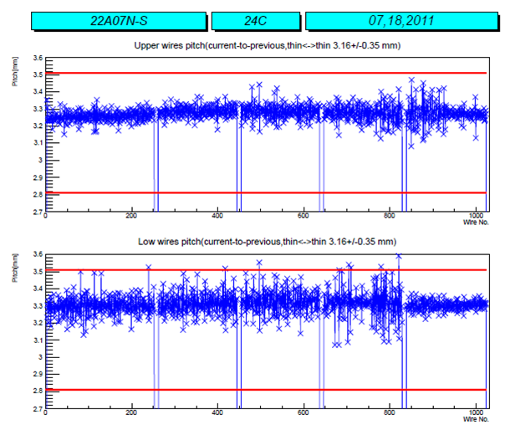
Pitch Measurement Example
Upper
mm
Lower
mm
Wire Number

Slide 33
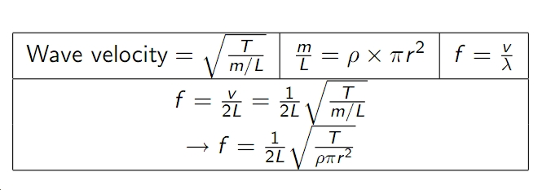
Tension Testing
Tension is measured by the fundamental resonant frequency of the wire
T = (f £ L £ r )² £ ½ £ constant

Slide 34
Electrical & Gas Leak testing
Each Anode panel tested for current leakage & corona discharge
Before sealing chamber, global HV test in air.
Finish assembly of chamber by adding frame, seal with RTV, and test with Argon
  Extending clean room #2 to conduct in stable pressure, temperature, humidity environment
  < 1cm³/minute (spec is 2 cm³/minute)
  Automatic pressure monitoring being developed

Slide 35
HV & electrical testing
Place under HV and look for current leak
  short-term (24 hours at 4kV)
  First chamber (#201) 0.99¹A (typical last time 3¹A)
Capacitive testing (strip-to-strip) is as expected
#201 currently under long term (2 months) HV testing
  HV slowly ramped up from 3.6kV to 4kV
Then, will move to FAST site
  put on electronics and “final” parts
  testing

Slide 36
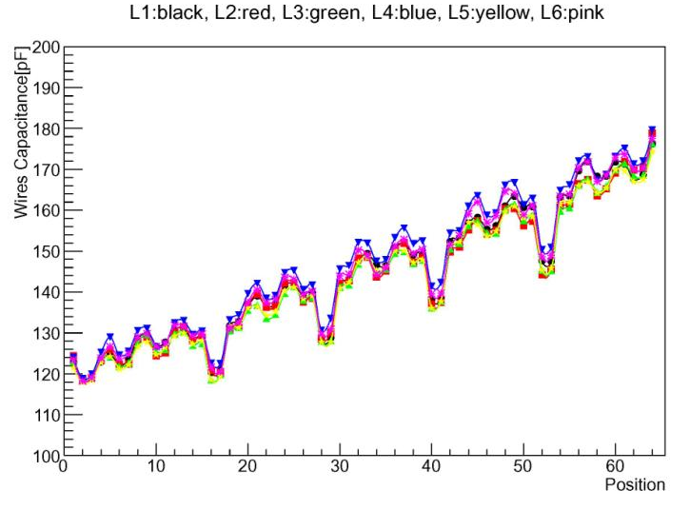
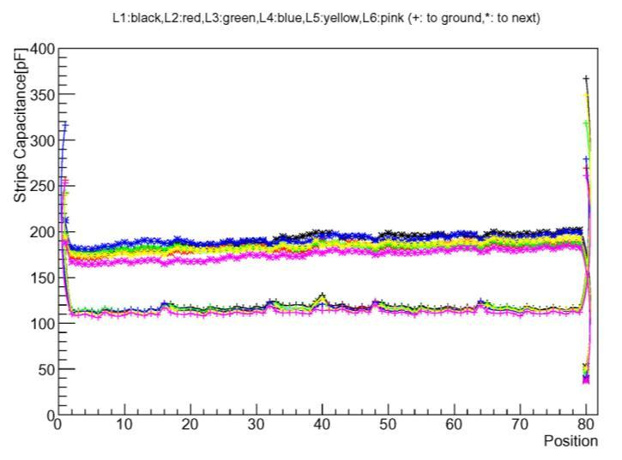
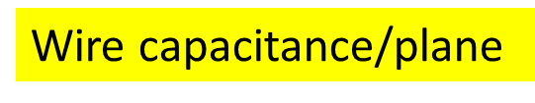
Capacitance Testing
Xiaofeng Y.

Slide 37
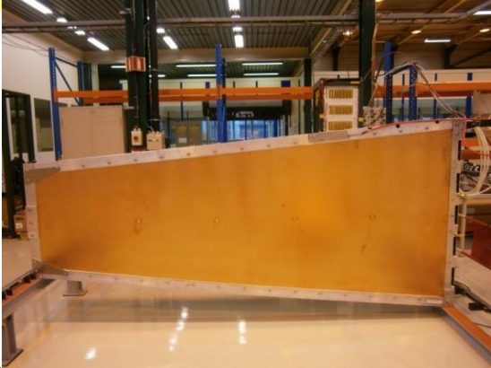
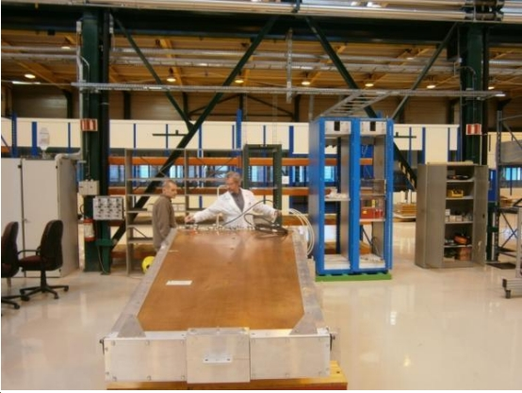
Chamber #201
Passed all tests. Undergoing long-term HV testing followed by Final Assembly and Testing with electronics.

Slide 38
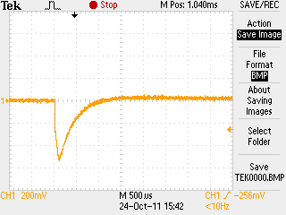
Cosmic Ray Test of #201
Cosmics found in each layer

Slide 39
Two other chambers from panel prototypes under construction
Chamber #202 & #203 will be ready for leak testing as soon as aluminum frames arrive (this week)
  Then proceed to gas-leak test
Chamber #203 had some problems
  warped panel (fixed)
  defective or mislabled epoxy from vendor
  probably never will be installed in Pt. 5.
  possible demonstration unit

Slide 40
Upcoming improvements to
904 Facility
Cleanroom #2 extension
  For pressure testing in stable environment
0.5 Ton crane
  For storing completed chambers on mezzanine

Slide 41

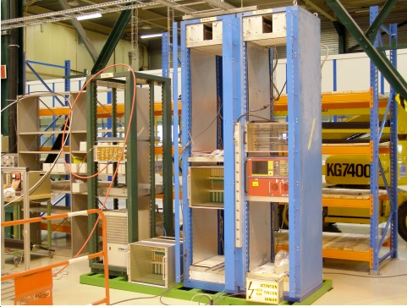
FAST site (Part I)
New postdoc joined team, Matthias Weber
Petr Levchenko & co.
  installed new rack in 904
  assembling peripheral crate, LV, HV, cooling, water, AC hookups, cables, cable trays...

Slide 42
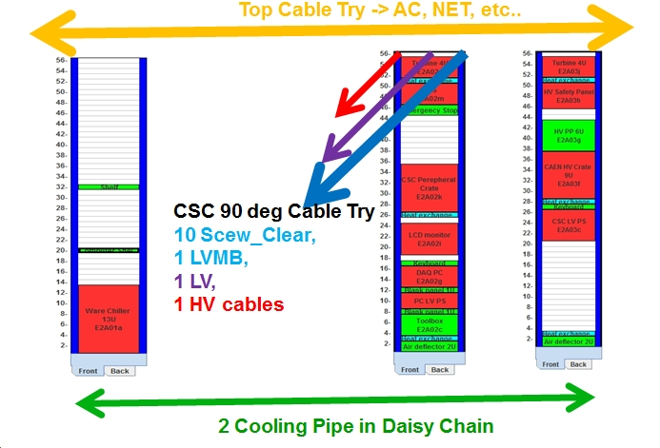
drawing by Peter Levchenko

Slide 43
FAST site (Part II)
Testing new configuration on cosmic stand with much help to Matthias from Karoly Banicz, Jingua Liu, Frank Guerts
  Readout with only a single peripheral crate
  Required development of TF-DDU
  Dedicated new computer about to arrive
Working with experts, esp. Alex Madorsky on reviving old FAST site software
Should be ready to run a few tests on new FAST site with new computer and new chamber by early January.
Development of software Jan-March
  in time for full production

Slide 44
FAST Site (Part III)
(for experts)
Have “yellow page” with CCB utilities
Trying to enable L1A request from TMB to CCB
Old test software successfully compiled. Can modify config files and configure system. Once DDU passthrough is working, first level tests will be ready.

Slide 45
FAST site (part IV)
FAST is “Final Assembly” not just “Testing”
Nearly all parts for chambers #201,202,203 are in building 904
Parts for full production to be sent from Wisconsin soon
Will set up “assembly line” mode for Final Assembly and Testing of rest of chambers.

Slide 46
FAST site milestones
Should be ready to run a few tests on new FAST site with new computer and new chamber by early January.
Development and deployment of software Jan-March
  well in time for full production
Set up FAST site in “assembly-line” mode by April.

Slide 47
Upcoming Schedule Milestones
Critical path is placing order for skins
  Long lead time for order of copper
Assuming order is placed this week, panels should start to appear at 904 by end of Spring.
Two endcaps requires 67 more chambers. Can deliver 4 chambers per month to FAST site.
FAST testing may be upgraded to “2 at a time”
Dick Loveless will give finer scheduling details in his talk.

Slide 48
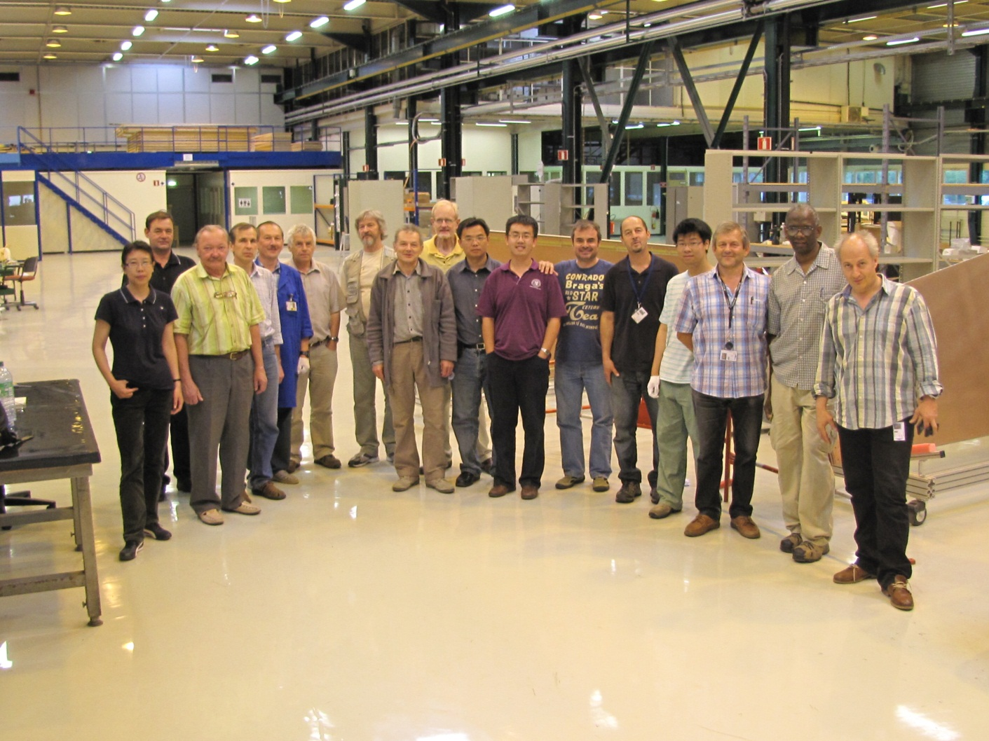
Conclusion (Part I)
Armando Lanaro and team have built a truly impressive facility at Building 904

Slide 49
Conclusion (Part II)
Major operation
  Industrial partners, Fermilab facility, building 904
  Thanks again to Austin Ball, CMS Technical Division and CERN service team for help making 904 a success
Successful construction of one chamber. New team has learned all the fine points of chamber construction.
Lost time with vendor problems. Need to push hard. Ball is in our court now.

