Slide 1
Electrical and electronic systems projects
Magnus Hansen
Sergei Lusin
20111110

Slide 2
Upgrades
Maintain or Improve performance
  For physics
Maintain or Improve reliability
  For CMS availability
Maintain or improve maintainability
  For total cost of ownership
Maintain compatibility with CMS interfaces or agree on evolution
  TTC, TTS, DAQ, DCS, etc.

Slide 3
New standards: What we want
Integration in the existing infrastructure
  E.g. crate cooling with vertical air-flow
Limit the number of families of crates and power system
System control
  Common control and monitoring software
  Common system management hardware
Purchasing and maintenance contracts
  Preferably analogous to the CAEN (LV, HV etc) and WIENER (LV, Crates) frameworks currently in place.

Slide 4
What we want to avoid
Skimping on any part of upgraded system such that it is marginal in terms of reliability or performance
  Power supplies
    On-detecor (can any fw build cause overload and subsequent shutdown of the power regulator?)
    Off-detector
  Cooling
  Mechanical elegance
    E.g mezzanine cards with scattered connectors, i.e. mechanically over-constrained

Slide 5
Upgrade of CMS Power System
CMS detector power system has operated reliably over the course of CMS running …
  But the detector power system has been designed to provide power only for the CMS front-end systems
  Electronics in S1 and S2 areas of USC are powered directly from machine power grid fed by 18 KV line from Point 6
  Instabilities in this power have led to loss of data-taking readiness for CMS
  Extension of coverage of CMS detector power system to include S1 & S2 would improve data-taking readiness as well as simplifying detector operation
Current capacity of CMS detector power system insufficient to power both detector and USC electronics
  Have studied several proposals to extend CMS power system during LHC long technical stop
S. Lusin, UW/CERN

Slide 6
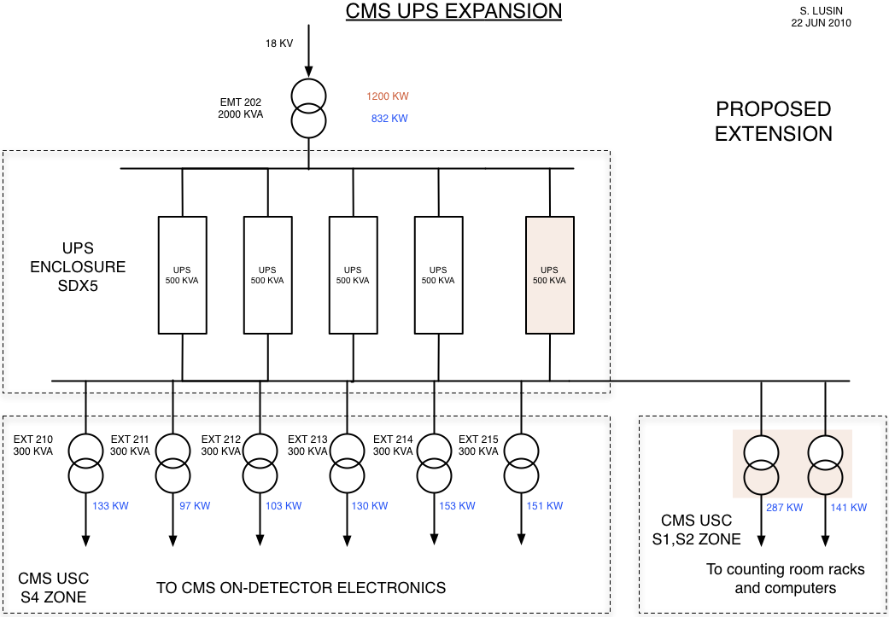
Proposal for UPS Expansion …
Extending the coverage of the CMS Detector power system to include S1 & S2:
  Add 500 KVA UPS to current installed capacity of 2 MVA
  Add cabling to connect to EXD1 & EXD2 switchboards feeding USC
  Power cabling from USC switchboards to S1 & S2 stays as is
  Expansion of system will take place on surface, not underground
  Additional details such as S1 & S2 isolation transformers to be worked out, but will not change scope of proposal
1700 KW
Worst-case
832 KW
Current Conditions
133 KW
97 KW
103 KW
130 KW
153 KW
151 KW
287
KW
141
KW
S. Lusin, UW/CERN

Slide 7
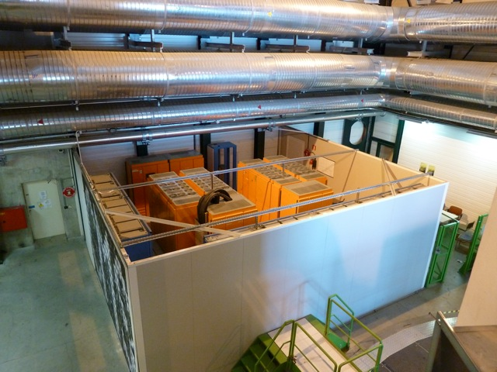
Logistics …
UPS enclosure in SDX5 currently contains 4 500 KVA units, phase compensators and switchgear
Extension will require another switchboard and phase compensator, in addition to the 500 KVA UPS unit
Enclosure is full, must be expanded
  Most likely by extending wall in the direction of Saleve
S. Lusin, UW/CERN

