Slide 1


Draft LS1 Schedule
CMS Upgrade Week and Workshop
Technical Coordination Parallel Session
November 2011, FNAL

Slide 2
Assumptions
Working time
  8h/day, 5 days a week
  No work during the CERN Xmas holidays
Start Date
  Nov 17th 2012
Duration
  20 to 24 months
Key objectives
  Install TK seal to allow for cold operation
  Install and bake-out new Beam Pipe
  Install YE4, ME4/2, RE4
  Perform maintenance/upgrade on DT/HO

Slide 3
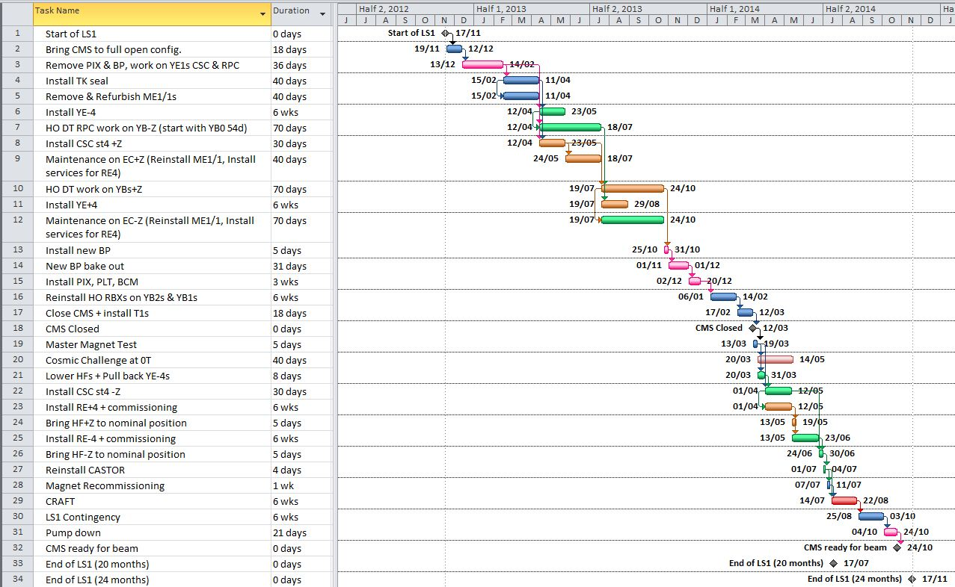
Top Level Draft Schedule

Slide 5
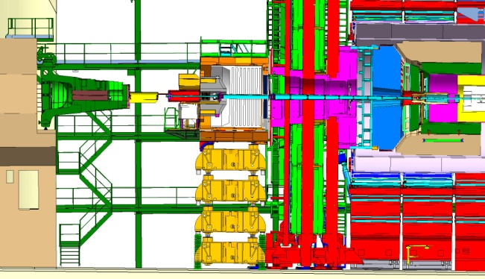
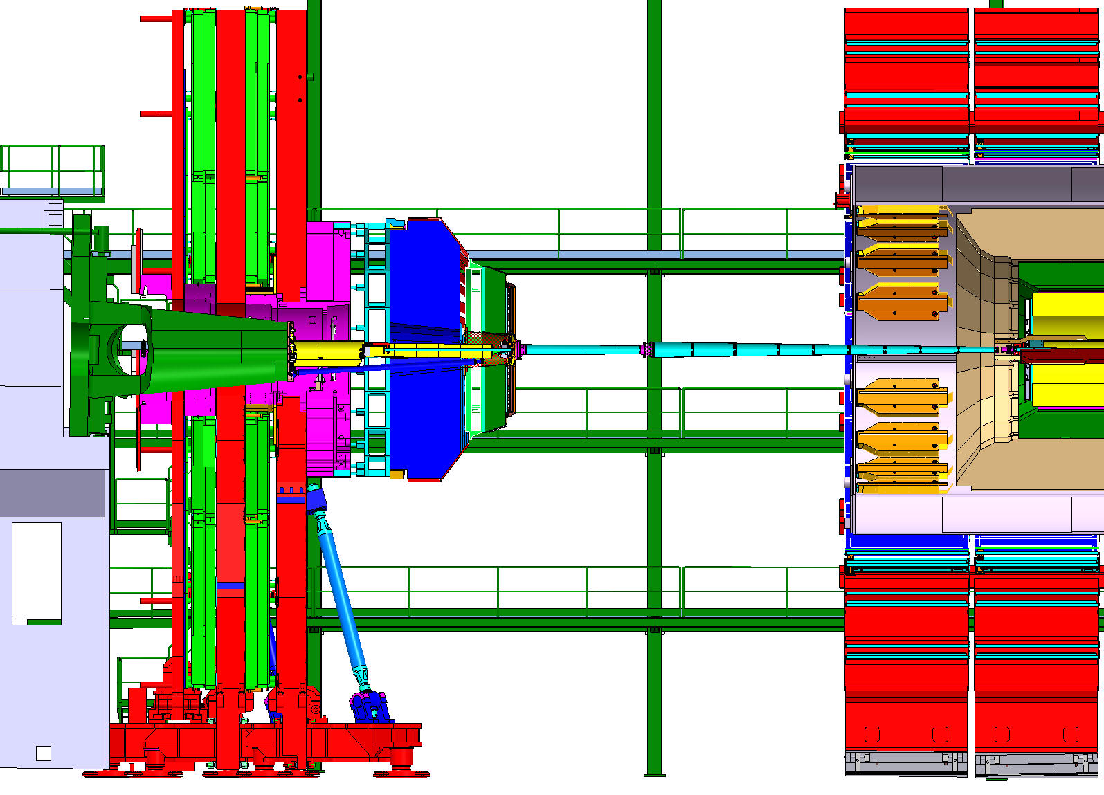
Task #2 – Bring CMS to full open Config
Start configuration
End configuration
A
Time period: 19 Nov 12 – 12 Dec 12
Duration estimated from previous
opening operations: 18d
Bringing beam pipe to 1Bar included
Could be interleaved with partial
removal of Beam Pipe
G

Slide 7
Task #3
Configuration on both ends
G
Time period: 13 Dec 12 – 14 Feb 13
Duration: 36d
Includes:
  Remove of the whole CMS beam pipe
  Install Light Weight platform
  Install PIX table
  Remove BCM1
  Remove PIX
  Maintain RPC/CSC on YE1s
  Remove PIX table
  Install Surkov Frame

Slide 9
Tasks #4 & 5
Configuration both ends
G
Time period: 15 Feb 13 – 11 Apr 13
Duration: 40d
Includes:
  Install TK seal + partial commissioning
  Remove ME1/1 chambers
  Start refurbishing ME1/1 chambers in SX5
  Fine tune End Cap position to allow for upgrade of
  YE3s cooling infrastructure (for ME4/2 and RE4)
Remove Light Weight platform

Slide 11
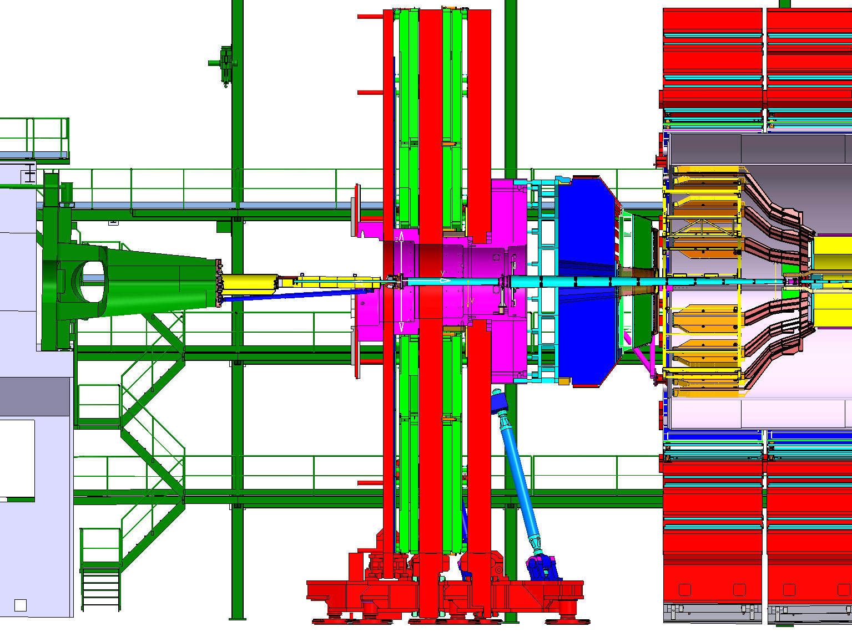
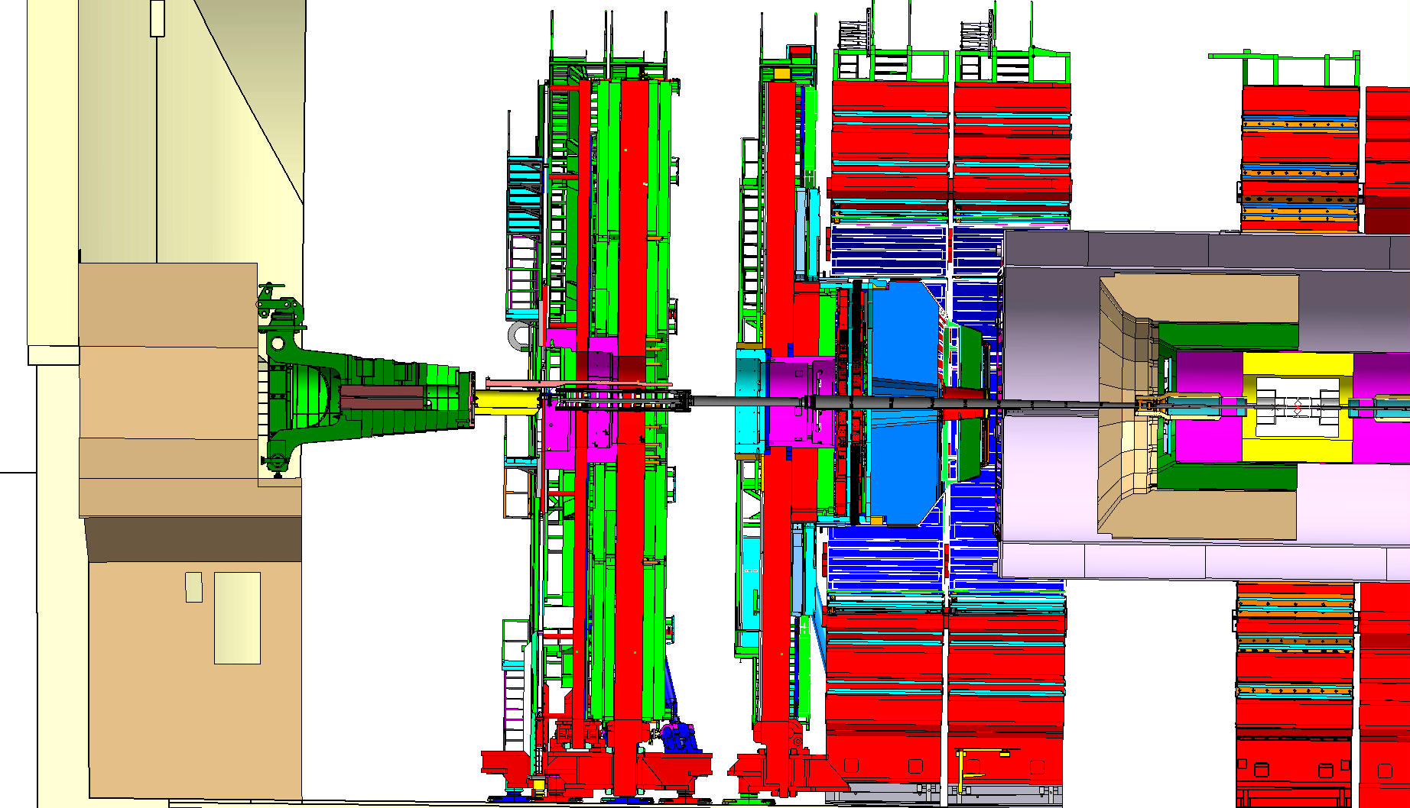
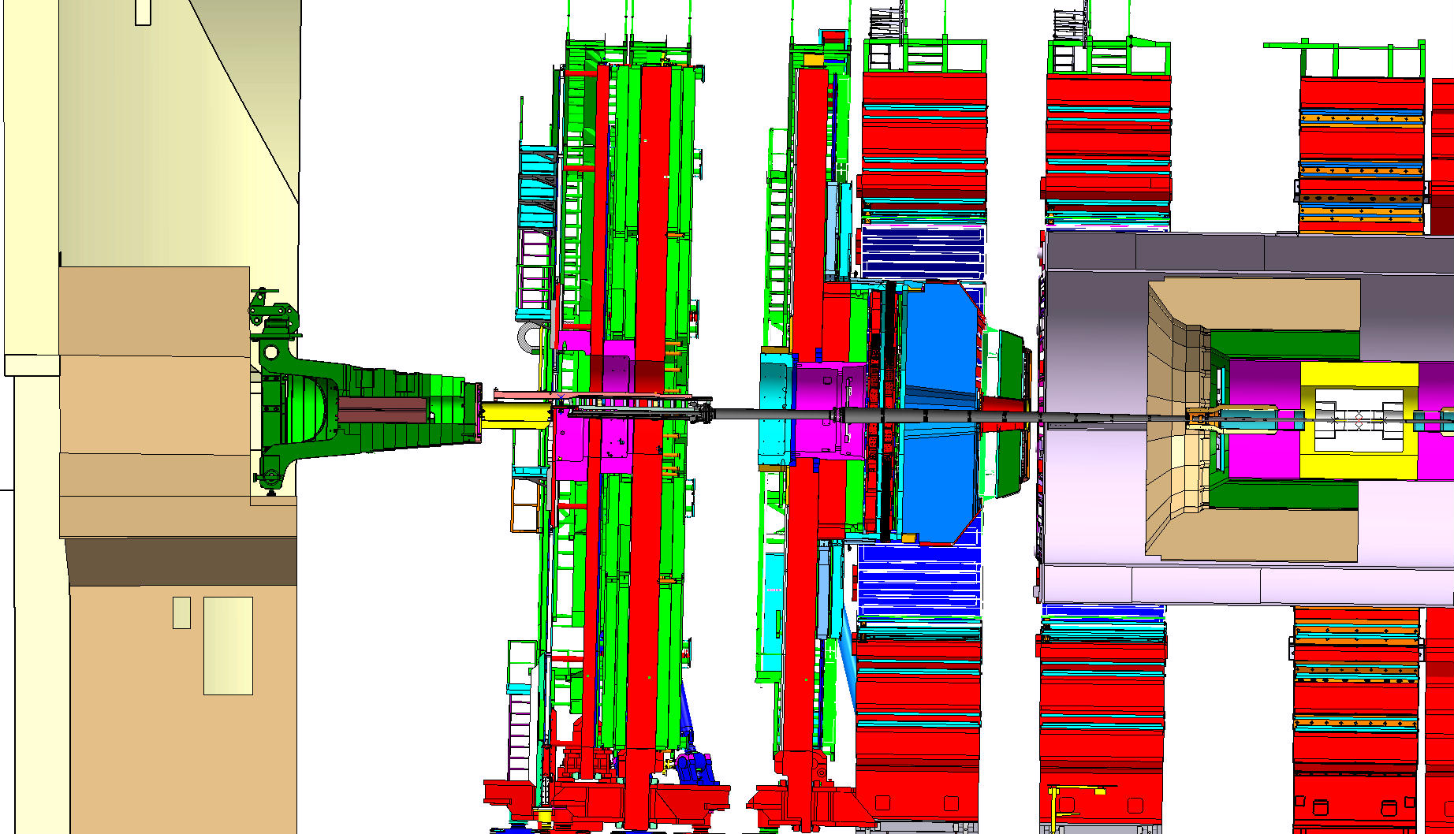
Tasks # 6,7,8 and 9
Configuration +Z end
Configuration -Z end
E
G
Time period: 12 Apr 13 – 18 Jul 13
Includes:
  Install ME42: 30d
  Move to EC open config.
  Reinstall ME1/1
  Install RE4 services
  Maintain EC systems
  Access to Vac Tank through
  ladder like access
Includes:
  Install YE-4: 6 weeks
  Work on YB0 for HO, DT, RPC: 54d
  Modify YBs configuration
  Work on YB1/2 for HO, DT, RPC
  Access to Vac Tank through ladder like system

Slide 12
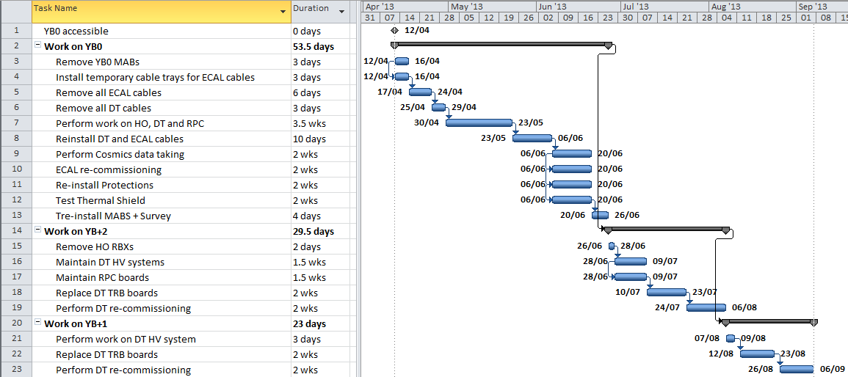
Task # 7
Once sequence is agreed upon, each task will be broken down in finer details

Slide 14
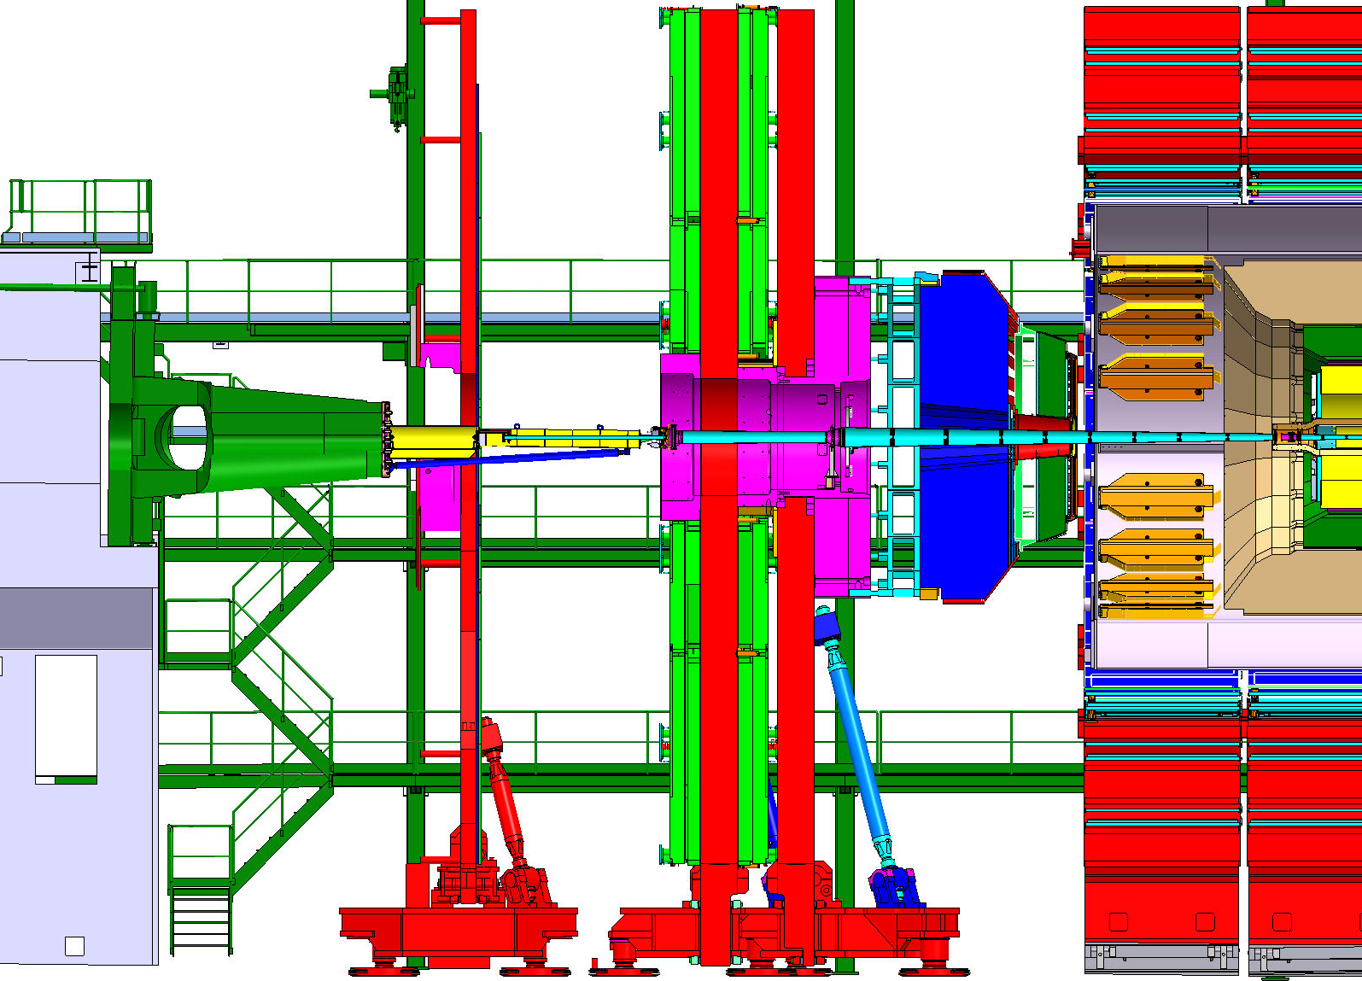
Tasks # 10,11 and 12
Configuration +Z end
Configuration -Z end
F
Includes:
  Install YE-4: 6 weeks
  Work on YB0 for HO, DT, RPC: 54d
  Modify YBs configuration
  Work on YB1/2 for HO, DT, RPC
  Access to Vac Tank through ladder like system
  Install fwd part of BP
  Restore full open config.
Time period: 19 Jul 13 – 24 Oct 13
Includes:
  Install RE4 services
  Maintain EC systems (change EC configuration as needed)
  Access to Vac Tank through
  ladder like access
  Install fwd part of BP
  Restore full open config.

Slide 16
Tasks #13,14 & 15
Configuration on both ends
G
Time period: 25 Oct 13 – 20 Dec 13
Includes:
Remove Surkov frame (end of TK seal activity)
Install Light Weight platform
Complete installation of new Beam Pipe: 5d
Bake-out new beam pipe: 31d (continuous)
Install PIX table
Perform trial insertion of new PIX mockup
Install PIX, PLT, BCM, PIX seal
Delivery date for the new Beam Pipe is critical

Slide 18
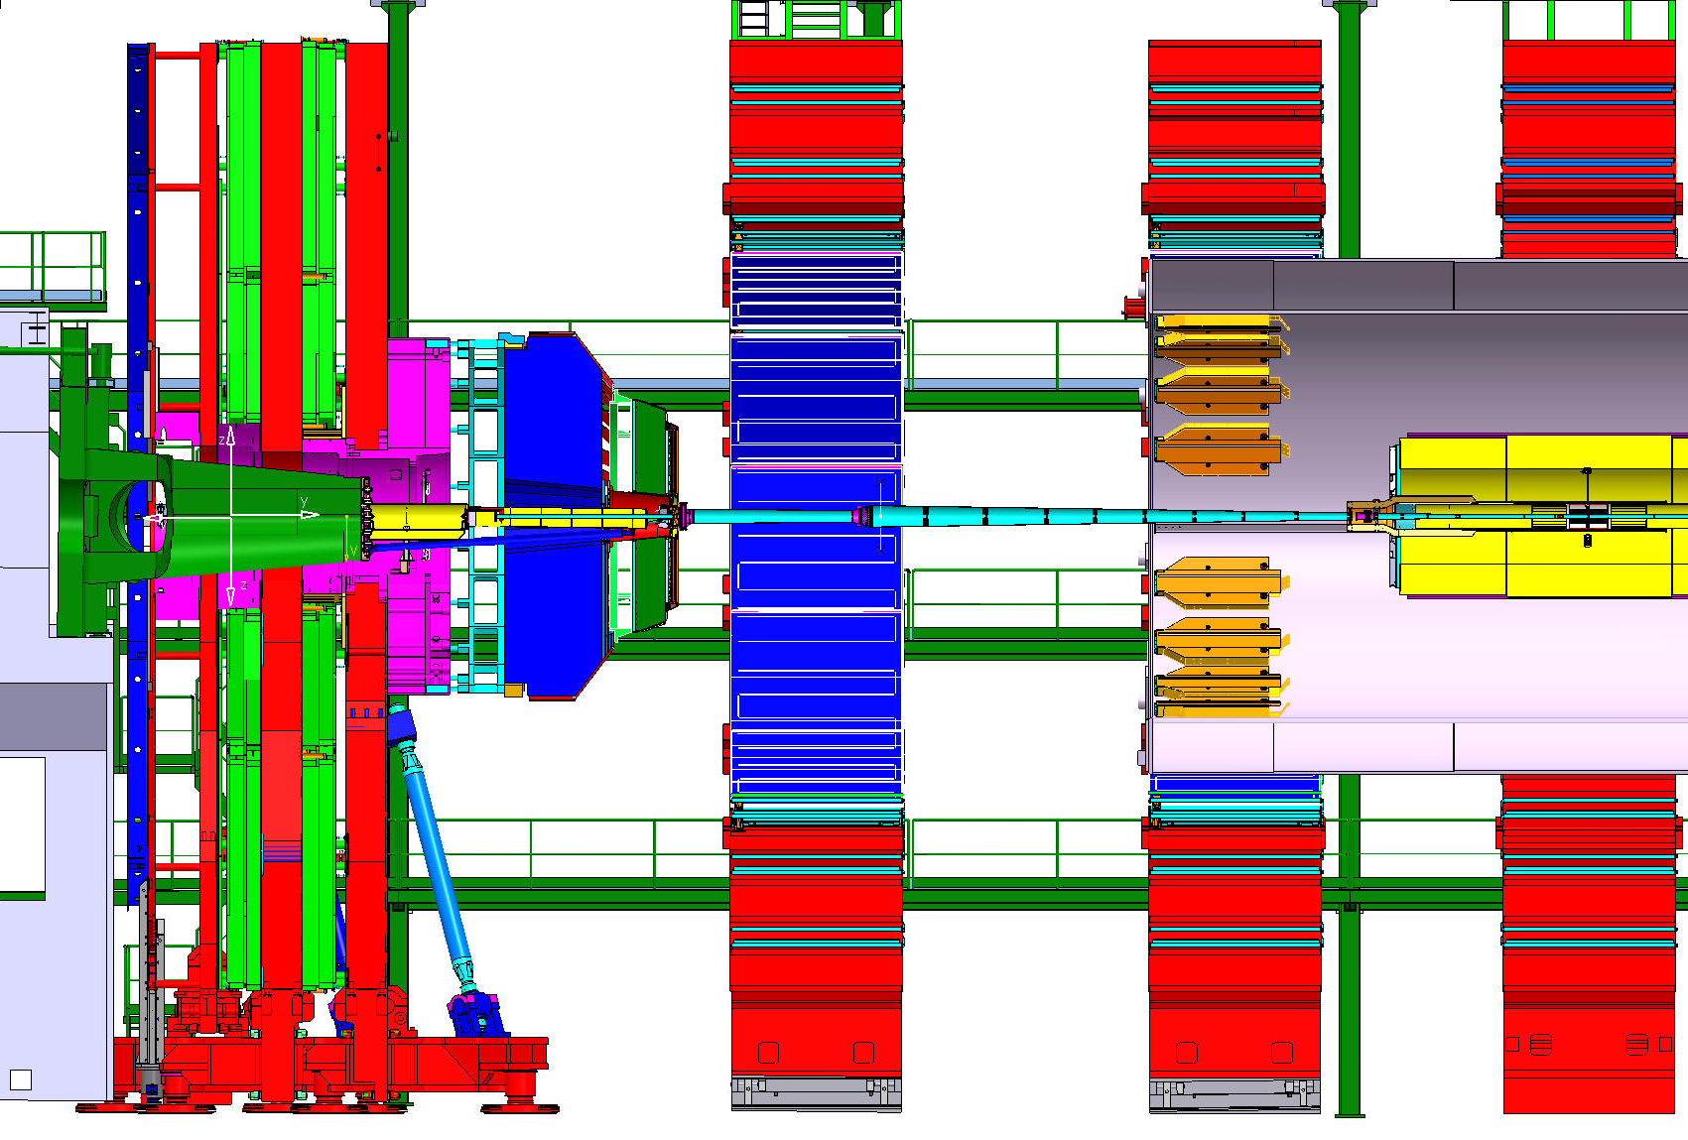
Task #16
Configuration on both ends
H
Time period: 06 Jan 14 – 14 Feb 14
Duration: 6w per end. Work in YB1/2 gap
Includes:
Open YB2 to access IP side
Reinstall YB2/1 HO RBXs (HPDs qualified at Princeton)
Close & lock YB2s

Slide 20
Task #17
Start configuration
End configuration
G
Time period: 17 Feb 14 – 12 Mar 14
Duration estimated from previous
opening operations: 18d
Includes:
  Close and lock End Caps
  Put HFs on 2 risers
  Install Totem T1s
  Put HFs on 4 risers
A

Slide 21
CMS closed 5months
Before end of LS1

Slide 23
Task #19 – Master Magnet Test
Configuration on both ends
A
Time period: 13 Mar 14 – 19 Mar 14
Duration: 5d
Final opportunity to test the TK seal
Check magnetic behavior of YE4s
5 months before the end of LS1₂₀ to fix a major Magnet/TK problems

Slide 25
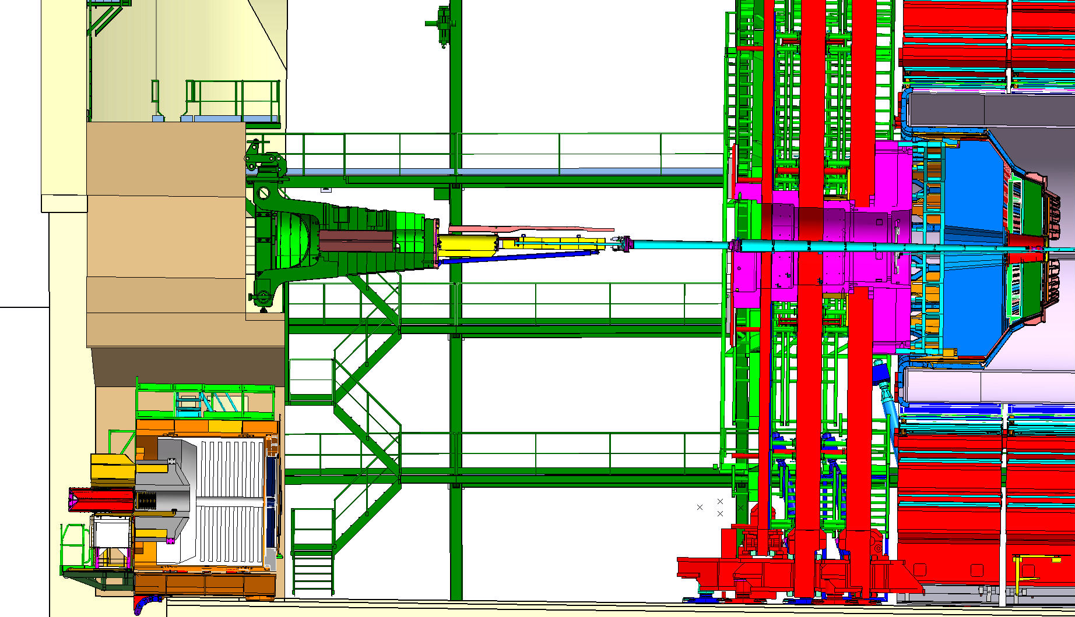
Tasks #21 to 26
Configuration on both ends
C
Time period: 20 Mar 14 – 30 Jun 14
Includes
  Lower HFs to garages
  Pull back YE4s
  Install RE+4
  Install ME-4/2
  Install RE-4
  Move HFs to beam level
Cosmic Challenge at 0T on-going

Slide 27
Tasks # 27
Configuration on both ends
A
Time period: 01 Jul 14 – 04 Jul 14
Duration: 4d
Re-install CASTOR

Slide 29
Tasks # 28 – Magnet Re-commissioning
Configuration on both ends
`
A
Time period: 07 Jul 14 – 11 Jul 14
Duration: 1w

Slide 31
Tasks # 29 – CRAFT
Configuration on both ends
A
Time period: 14 Jul 14 – 22 Aug 14
Duration: 6w
Can take place during LHC re-commissioning

Slide 33
Tasks # 30 – LS1 contingency
Contingency management
  6 weeks on the critical path: ~7.5%
  Saturdays held as slack
  Xmas breaks not counted

Slide 35
Tasks # 31 – Beam Pipe pump down
Configuration on both ends
A
Time period: 04 Oct 14 – 24 Oct 14
Duration: 21 continuous days

Slide 36
With current scope, 20 month shutdown would be too short
24 month shutdown would be appropriate

