Slide 1
Common System Integration
Update on new beam pipe
Update on CO2 cooling activities (see talk by Hans)
Outline of LS1 and future (as it is known today)

Slide 2
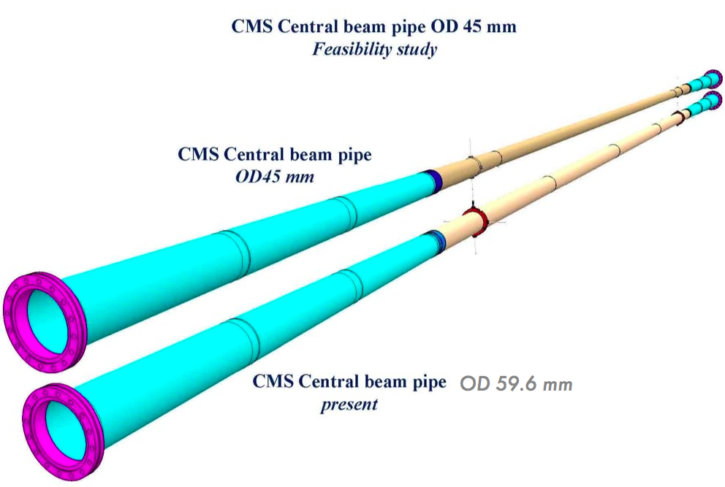
Beam Pipe
New design:
Conical section extends to lower |Z| to compensate for smaller diameter of central section
Support flange embedded in the pipe machining process
NEW
Different choice of material. AlBe instead of stainless steel for the external parts
OLD

Slide 3
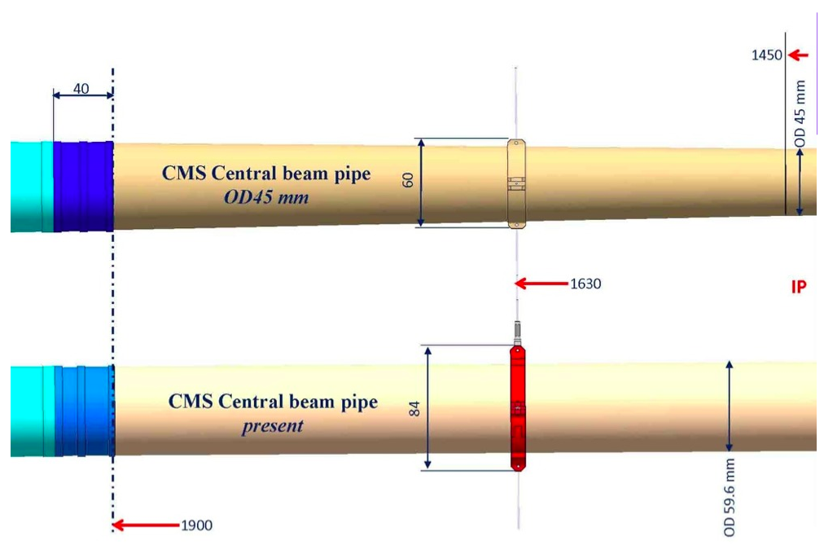
Beam Pipe
No need for transition piece
Conical part extended closer to IP
Support at 1.6m milled from AlBeMet

Slide 4
Beam Pipe
Design ready.
New features for ease of surveying incorporated at the support flange^{(*)}
Central section in Be (±1900mm) includes now the beginning of the conical section (cylindrical ±1450mm)
3 options for the conical section:
  AlBeMet (62% Be) including flanges [baseline]
  AlBeMet (62% Be) with flanges in Al alloy [option 1]
  Al alloy for both pipe and flanges [option 2]
  Further option concerns the support ring at ±1450mm being either milled directly from the Be ingot or machined as a separate cylinder for later mounting (like we have today)
(*) In order not to interfere with the beam optics for high beta star operation, the position of the new beam pipe need to be known and monitored to a high degree of precision

Slide 5
Beam Pipe
Timeline:
  Call for Tender docs finished and sent out
  Answer received and currently under evaluation
  Try to meet December deadline for finance committee
  Placement of contract on February 2012
  Beam pipe delivered to CERN mid 2013

Slide 6
Beam Pipe
TDR Chapter outline:
  design and choice of material
  consideration on aperture calculation and high beta operation
  installation procedures, survey and precision needed/achievable
  interplay between installation survey and "online" measurement and general strategy to cope with b)
  beam-gas improvements from simulation
  strategy for "spare" beam pipe and implications.

Slide 7
CO2 Cooling: general strategy
Maximum flexibility and redundancy: 2 plants, each one capable of full flow/power, but normally operated separately on Bpix and Fpix (2 manifolds one for FPix and one for Bpix)
Can be connected to existing brine
Insulated boxes containing all pipework and active components; instrumentation and piloting outside for better accessibility
Components being selected, part list under definition

Slide 8
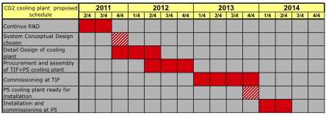
CO2 Cooling: schedule
Concept is to procure material and build two plants one for TIF and one for P5
About 1 year of commissioning at TIF before shipping one of the plant to P5
Ready for installation at the beginning of 2014

Slide 9
CO2 Cooling: integration at P5
Two options for installing the plant:
  USC magnet cryo area
  UXC X4 far side.
  Both locations are acceptable for the Integration Office.
USC location is preferred:
  accessibility of the plant
  no radiation : enlarges the range of materials that can be used
  no magnetic field: piloting of valves can also be electrical and not necessarily pneumatic (dependency on one less system)
  this solution requires the OK from the Radiation Protection: collecting documentation for calculations to be done
Services:
  “Brine” (see next slide concerning performance tests)
  Existing pipework between UXC balconies and PP1 qualified for pressure, qualification for flow range on-going
  Option for installing new pipes also under consideration

Slide 10
CO2 Cooling: “Brine”
Due to emergency re-design of present cooling system, it is unknown what are the maximum performances that can be achieved on both the primary circuit and the detector cooling plants
Verifications needed: Temperature/Power curve for the brine circuit, Temperature/power curve for each C6F14 plant
Possibly under-designed:
chiller/brine evaporator, single heat exchangers
Performance test is due during Xmas stop 2011/2012, to carefully schedule any consolidation work in LS1

Slide 11
LS1
Preliminary baseline proposal put forward recently (LMC-109) https://espace.cern.ch/lhc-machine-committee/Presentations/1/lmc_109/lmc_109b.pdf
17fb⁻¹
150fb⁻¹
7E33
LS1
≥1E34
2011 |  |  |  |  |  |  |  |  |  |  |  | 2012 |  |  |  |  |  |  |  |  |  |  |  | 2013 |  |  |  |  |  |  |  |  |  |  |  | 2014 |  |  |  |  |  |  |  |  |  |  |  | 2015 |  |  |  |  |  |  |  |  |  |  |  | 2016 |  |  |  |  |  |  |  |  |  |  |  | 2017
J | F | M | A | M | J | J | A | S | O | N | D | J | F | M | A | M | J | J | A | S | O | N | D | J | F | M | A | M | J | J | A | S | O | N | D | J | F | M | A | M | J | J | A | S | O | N | D | J | F | M | A | M | J | J | A | S | O | N | D | J | F | M | A | M | J | J | A | S | O | N | D | J | F | M | A | M | J | J | A | S | O | N | D
4Tev?
LHC:
Splice consolidation
repair interconnects
Alice:
detector completion
ATLAS:
consolidation (IBL)
new beam-pipe
CMS:
consolidation
FWD muon upgrade
new beam-pipe
LHCb:
consolidation
new beam-pipe
Comm.
LS2
50ns
6.5Tev
p-Pb
Pixel Phase I
25ns
Can this be combined with LINAC4 connection ?
BUT, LS2 is just around the corner ….

Slide 12
LS2 and future
400fb⁻¹
LS2
≤2E34
LS3
2018 |  |  |  |  |  |  |  |  |  |  |  | 2019 |  |  |  |  |  |  |  |  |  |  |  | 2020 |  |  |  |  |  |  |  |  |  |  |  | 2021 |  |  |  |  |  |  |  |  |  |  |  | 2022
J | F | M | A | M | J | J | A | S | O | N | D | J | F | M | A | M | J | J | A | S | O | N | D | J | F | M | A | M | J | J | A | S | O | N | D | J | F | M | A | M | J | J | A | S | O | N | D | J | F | M | A | M | J | J | A | S | O | N | D
LS2
LS3
LHC:
Collimation
Prepare for crab cavities
RF cryo system
ATLAS:
New pixel detector
Detector for ultimate luminosity
ALICE:
Inner vertex system
CMS:
New HCAL photodetectors
Completion of FWD muons
LHCb:
Full trigger upgrade
New vertex detector etc.
LHC:
installation of the HL-LHC Hardware
CMS:
New hardware for HL-LHC (new tracker etc.)

Slide 13
LS1: list of planned activities
Repair defected interconnects (10-15% of total)
Consolidate all interconnects with new design (10k!)
Finish off pressure release valves (DN200; 4 sectors: 2-3, 4-5, 7-8, 8-1)
Bring all necessary equipment up to the level needed for 7TeV/beam
Not necessary to install the DS collimators in IR3
LINAC4 will not be connected to PSB during LS1
Repair He leaks (sectors 3-4 and 4-5)
Replace a few magnets for various reasons (~15)
R2E (mainly Pt1 and Pt5)
Maintenance of all the systems after 3 years of operation
F.Bordry

Slide 14
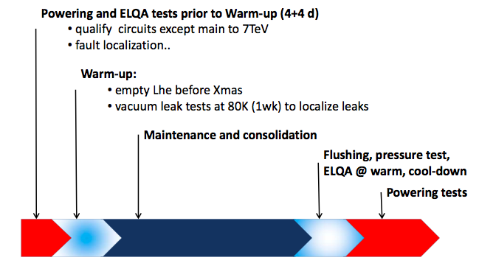
LS1: list of planned activities
K.Foraz

Slide 15
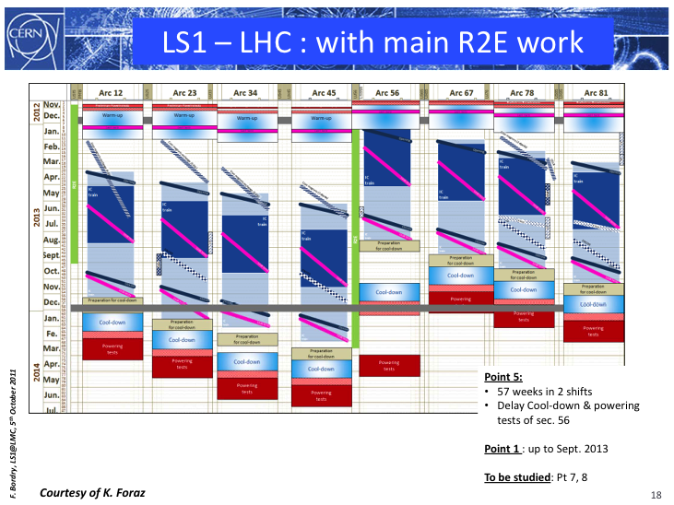
LS1: list of planned activities
Preliminary powering tests •Warm‐up
•Opening
•Splice consolidation
(incl. Leak tests)
Y line consolidation
DN200
•Closure
•Leak tests
•Preparation for cool‐down
•Cool‐down
•ELQA@cold
•Powering tests
K.Foraz

Slide 16
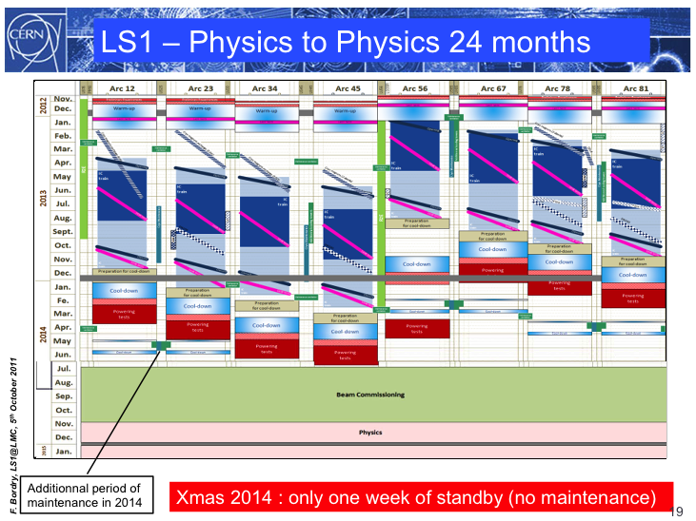
LS1: list of planned activities
commissioning
Physics
K.Foraz

