Slide 1
Beam test of new ROCs
David Christian
Fermilab
November 8, 2011

Slide 2
Why talk about FNAL test beam?
No beam will be available at CERN during Long Shutdown 1 (all of 2013)
PSI46dig_v2 (pixel ROC for Phase 1) is likely to be ready for a beam test of rate capability exactly when LS1 starts.
Rate capability can be tested at PSI, but only with low energy pions → precision measurements are problematic
Note: FNAL machines will be shut down for ~11 months in 2012-2013. The shutdown is currently scheduled to start on March 1, 2012, but this date is likely to slip by 2-3 months.

Slide 3
What is required?
Short section of beamline (less than 1 meter)
Beam spot larger than 1 pixel ROC (8mm x 8mm)
Rate adjustable up to ~500 MHz/cm²
High energy particles (to minimize interactions and multiple scattering)

Slide 4
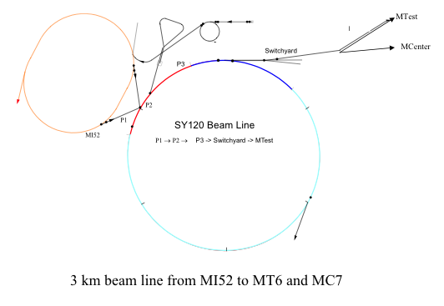
Fermilab Accelerator Complex
MTest
MCenter
(next slide)
P2
P1
MI52
P1 → P2 →
3 km beam line from MI52 to MT6 and MC7

Slide 5
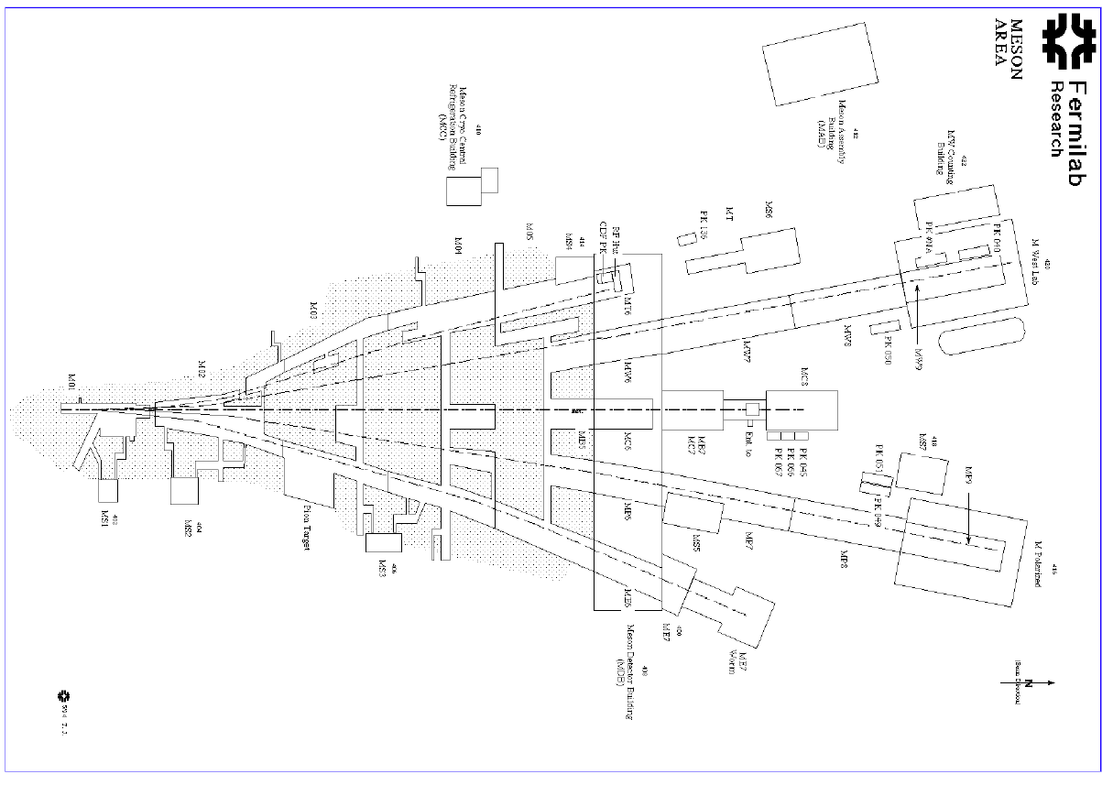
Test beam facility
Proposed location

Slide 6
Detail
A variety of beams can currently be delivered to MT6, but only at much lower intensity than required (Area is lightly shielded).
Upstream enclosures are shielded for primary beam (much higher intensity than required).
Rate is limited by a “pinhole collimator” in M03.
Capability of splitting primary beam many ways still exists.
Can get the desired rate and spot size in M03 using two beam splits & existing quads.

Slide 7
Video
Video of M03

Slide 8
Conclusion
Rates tests of the pixel ROC can be done at FNAL.
A new running condition is required (radiation safety ok)
The sooner a request is made to FNAL, the better.

