Slide 1
HL-LHC Signal Cabling, Patch Panels
Design
G. Girardot (EN-EL-CS)
2025-04-04
EDMS TBD

Slide 2
Why Patch Panels Are Essential
The HL/LHC project is the top priority for the upcoming long technical shutdown (LS3). Its success is crucial for opening new perspectives for CERN, as highlighted by our new director.
We are facing a significant challenge, with considerable amounts of material and equipment to dismantle and reinstall. The schedule is very tight, and we must anticipate as much work as possible before LS3 to meet this challenge within the allotted time.
To optimize the LS3 installation schedule, it is imperative to gain at least two additional months.One of the proposed technical solutions involves installing patch panels at the top of the CORE to facilitate and anticipate cable pulling during the RUN3_2025-26 period. If this solution is not approved or supported by the users, the pressure to reduce the installation time for all equipment will increase.

Slide 3
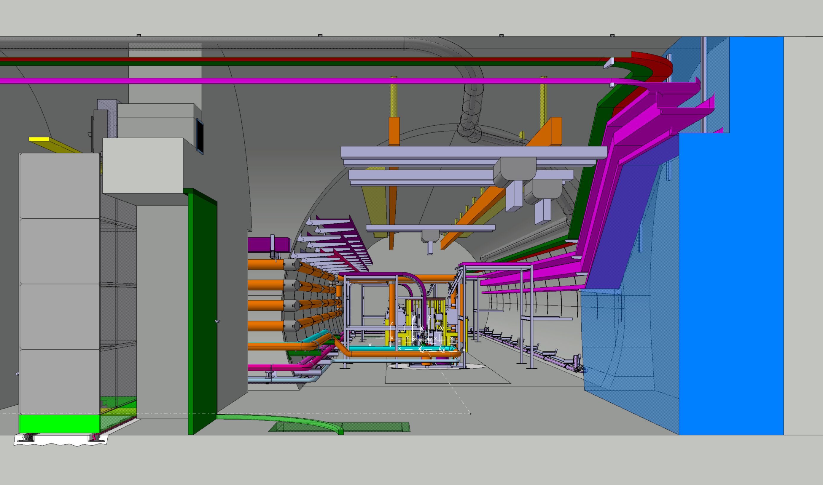
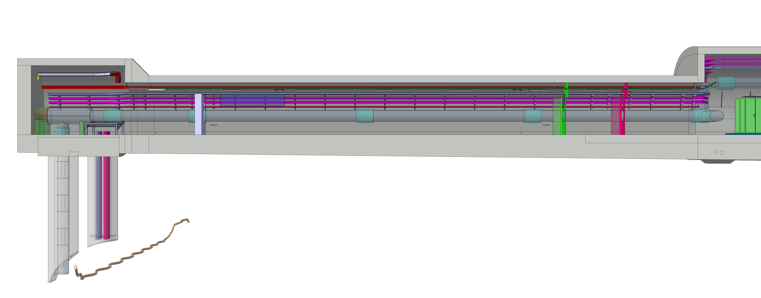
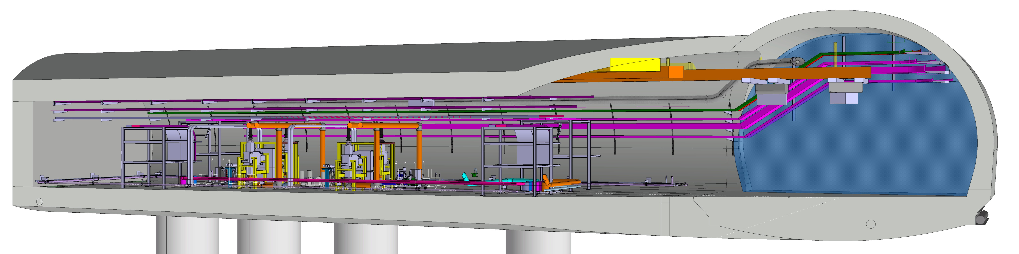
Strategic Patch Panel Placement
The patch panels will be located in two distinct areas: the UAs and the ULs.
Strategic Positioning of Patch Panels in the UAs
Strategic Positioning of Patch Panels in the ULs

Slide 4
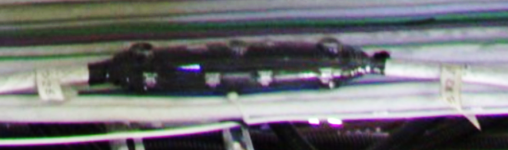
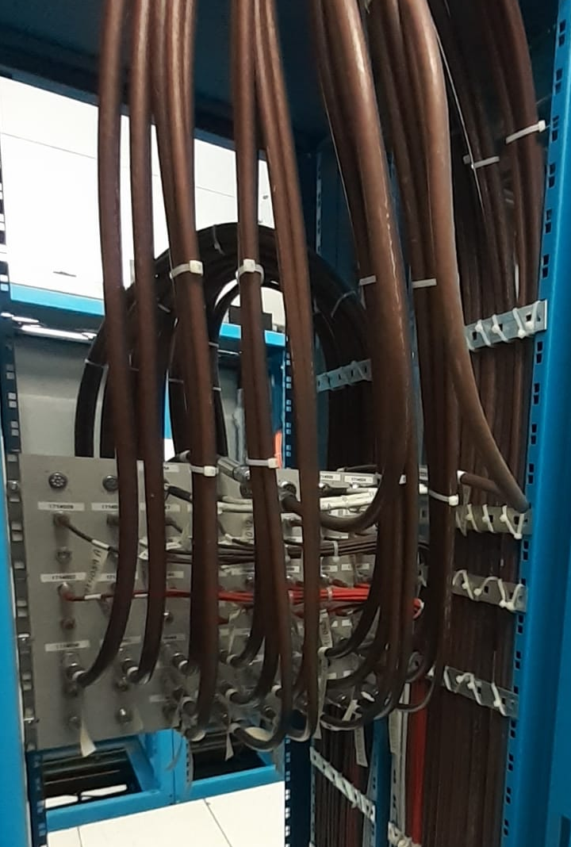
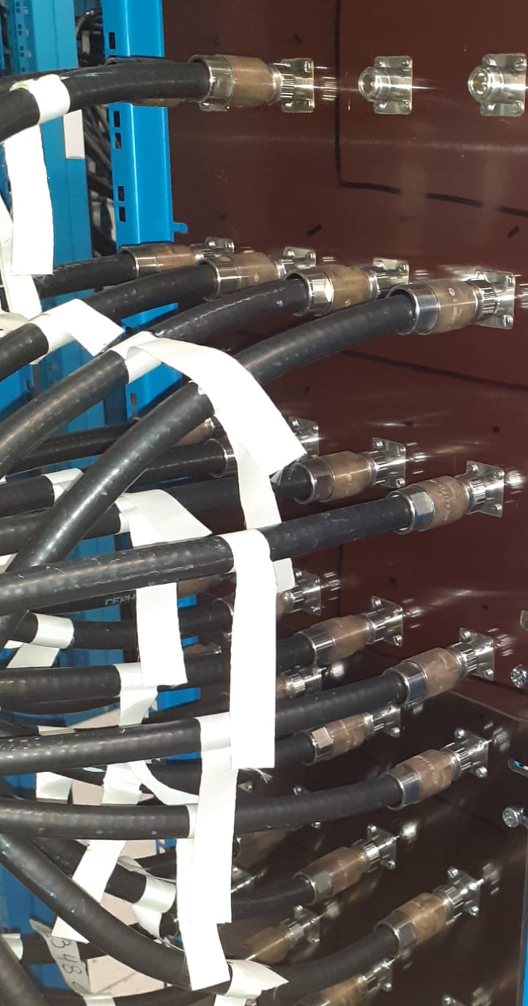
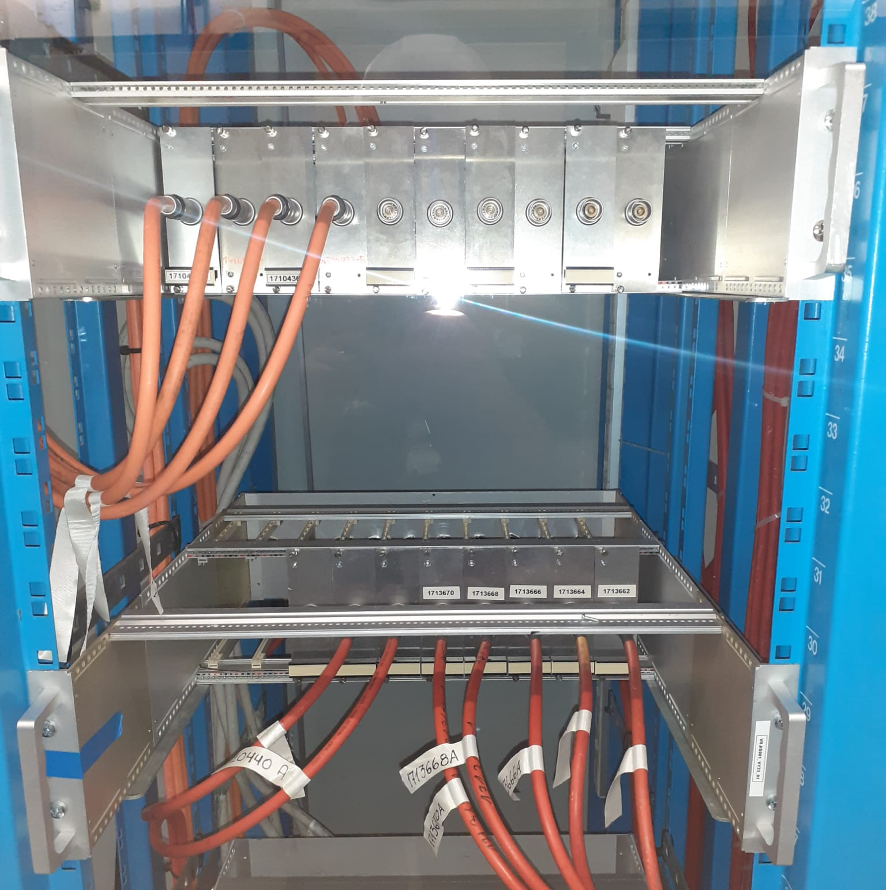
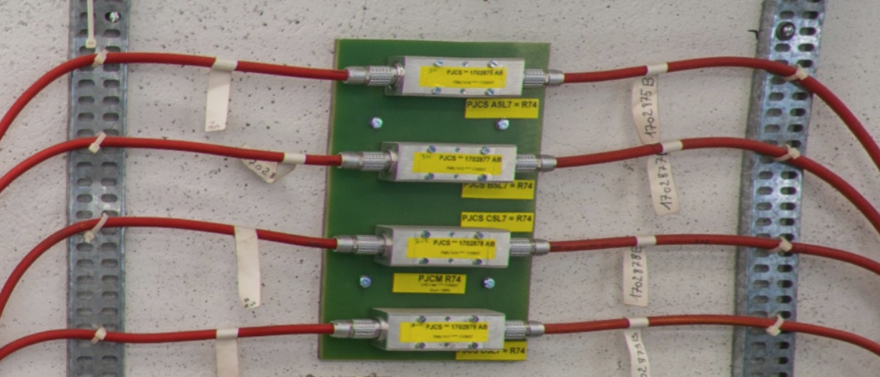
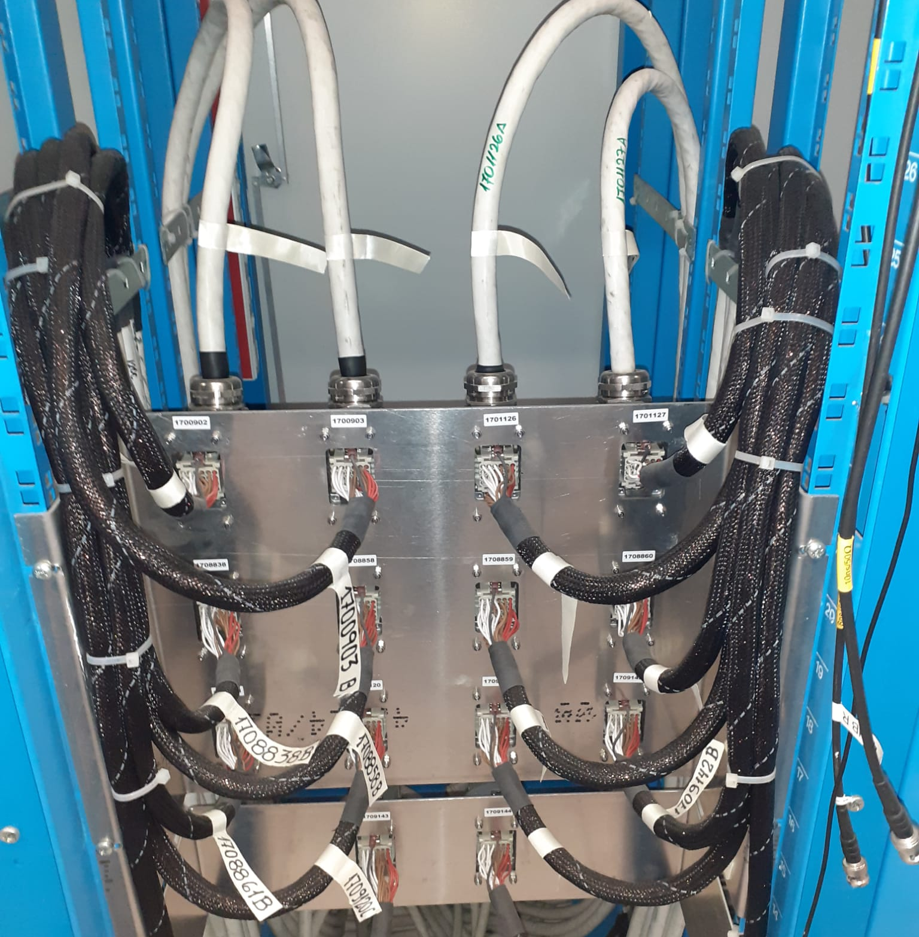
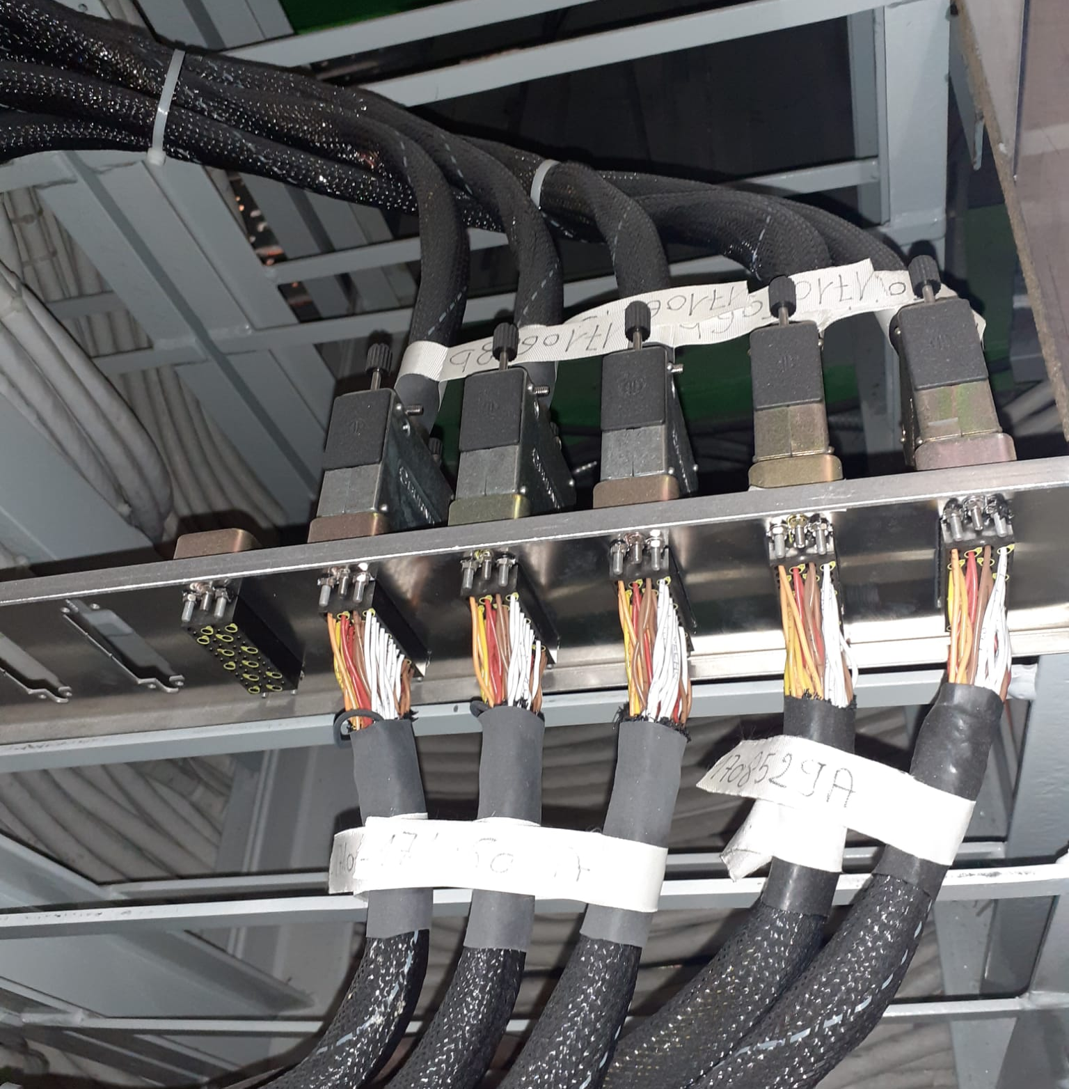
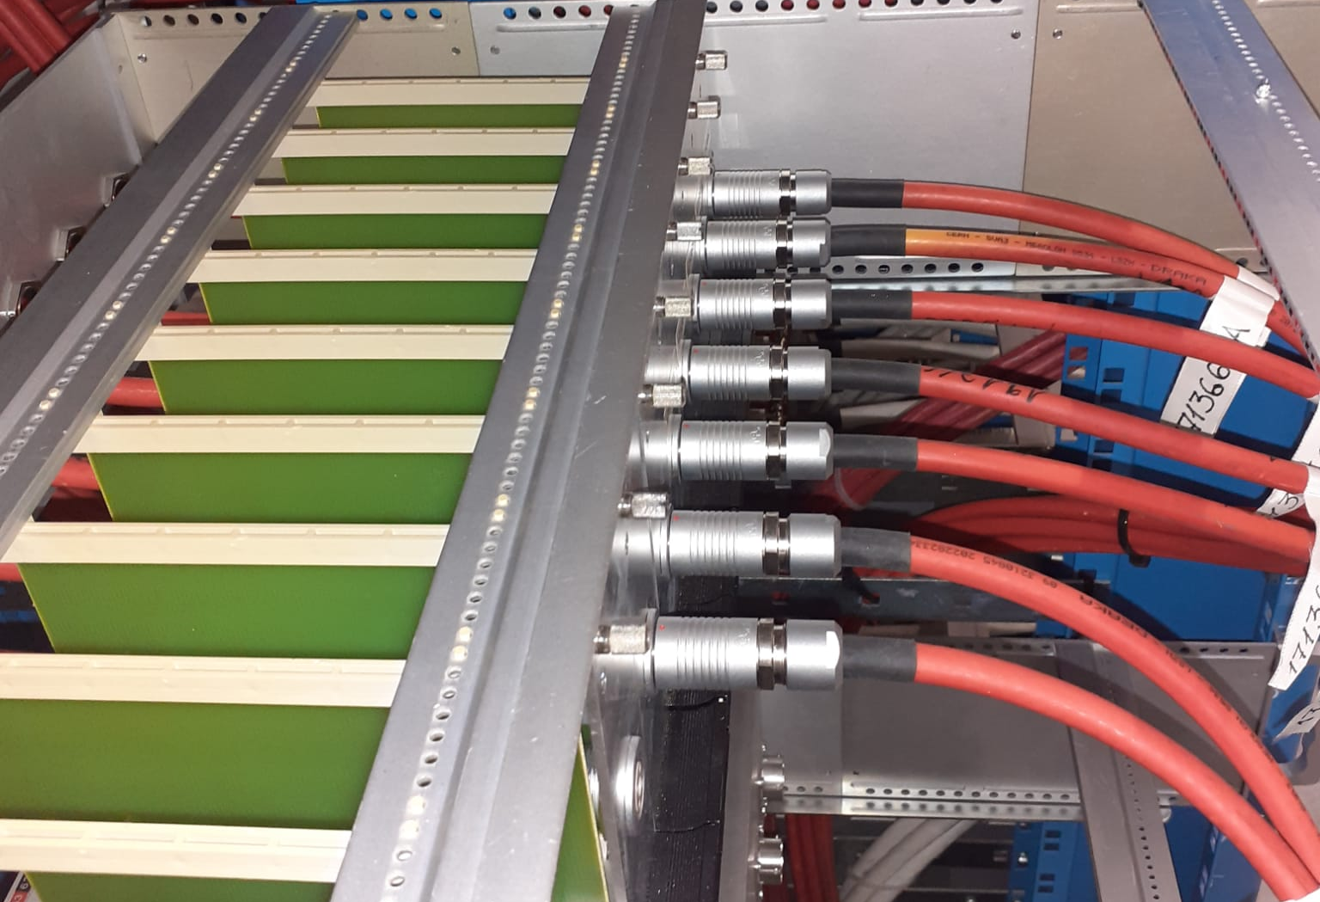
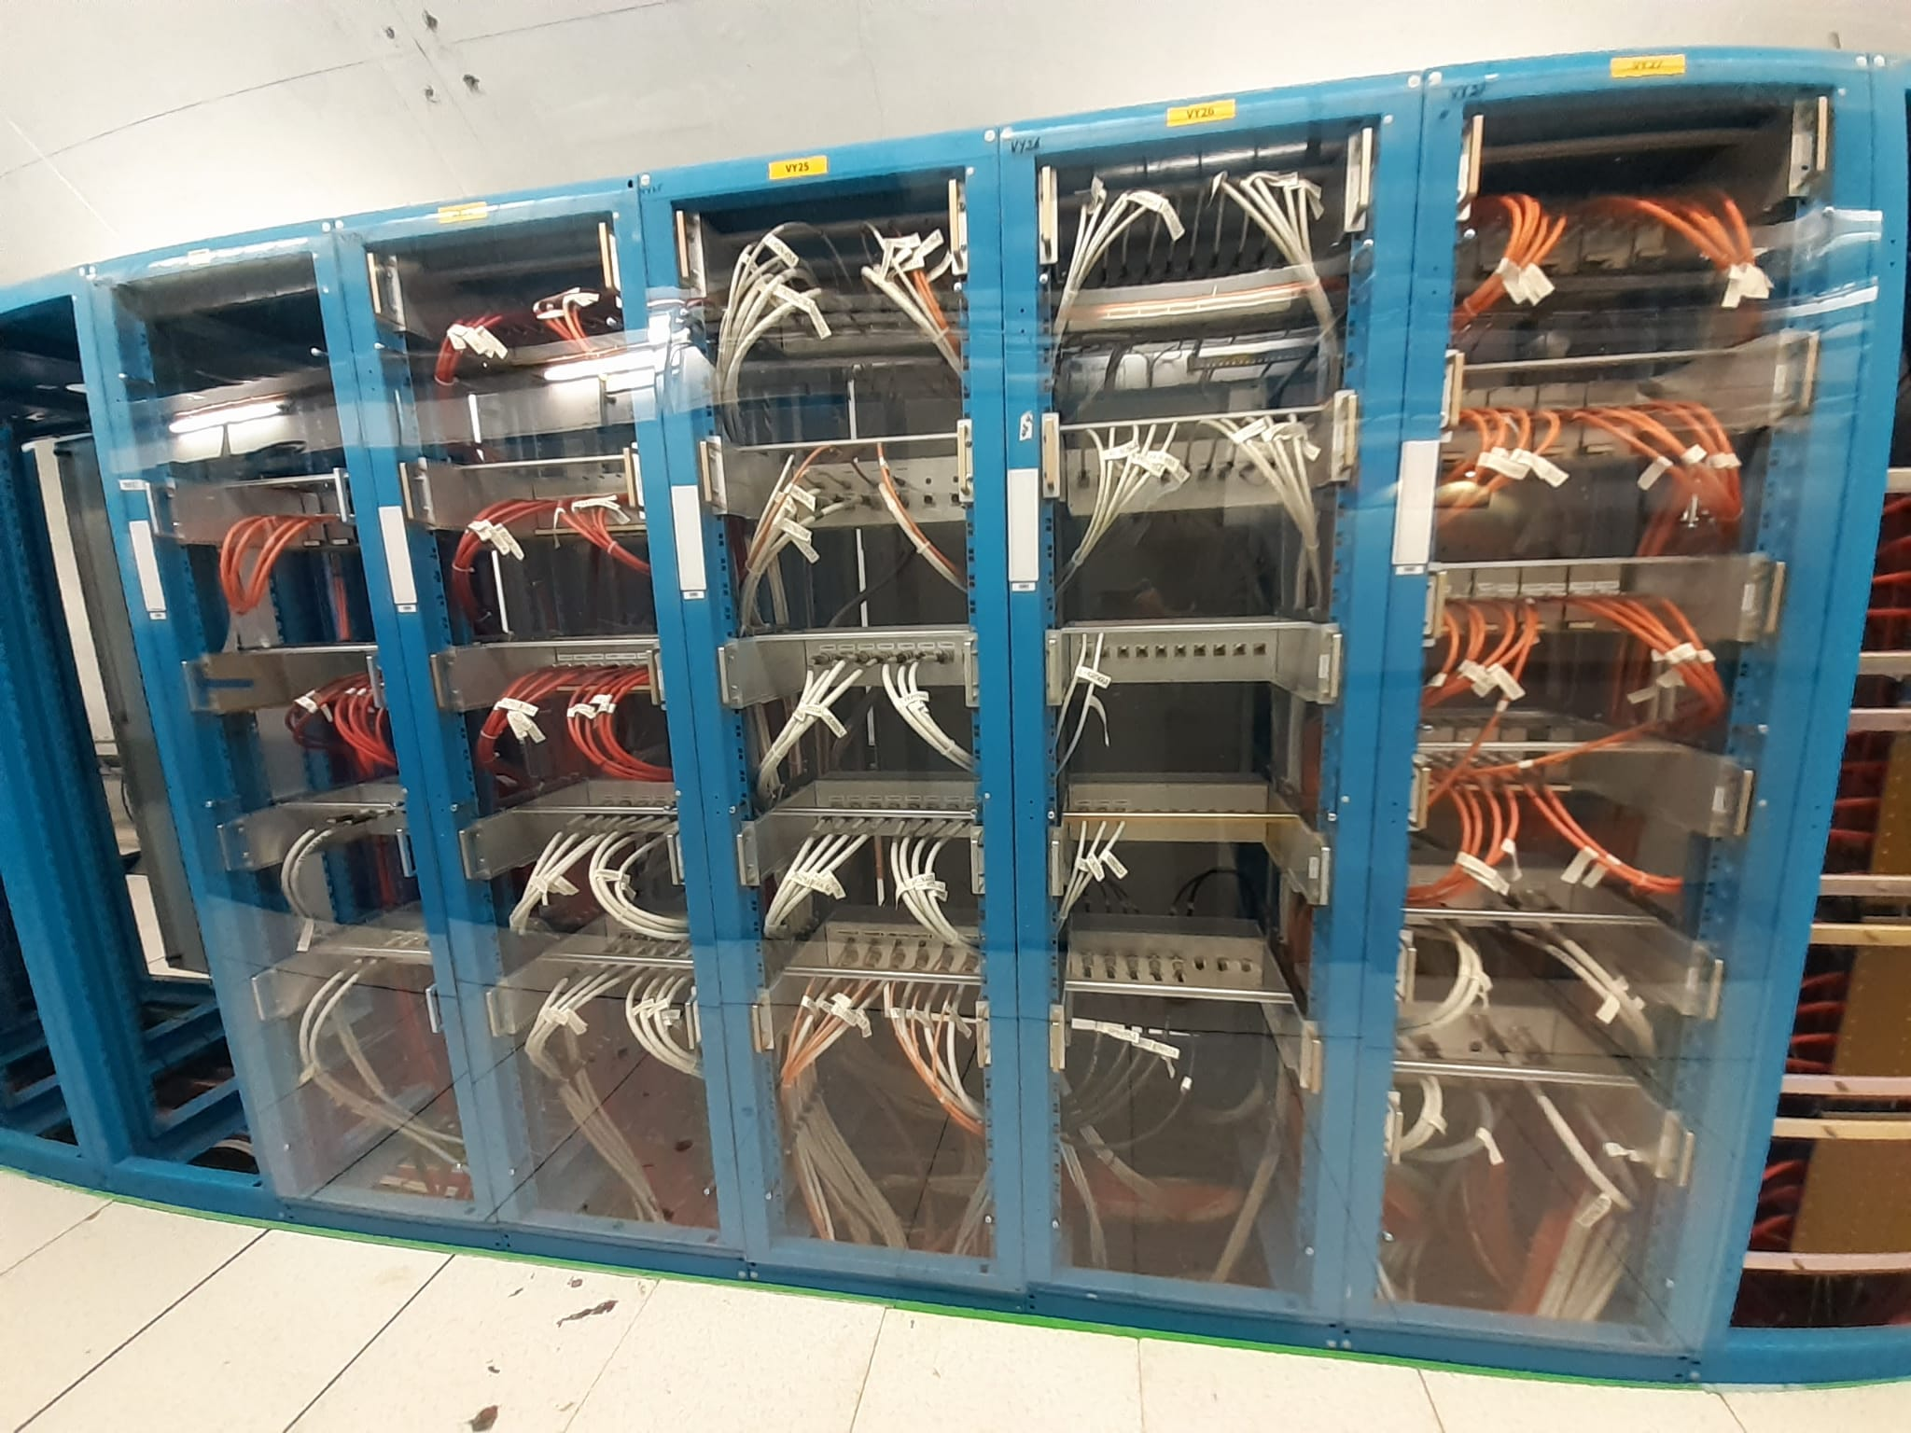
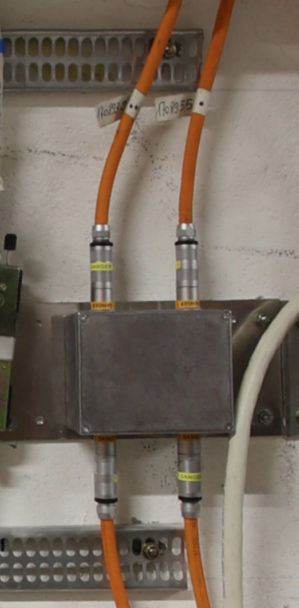
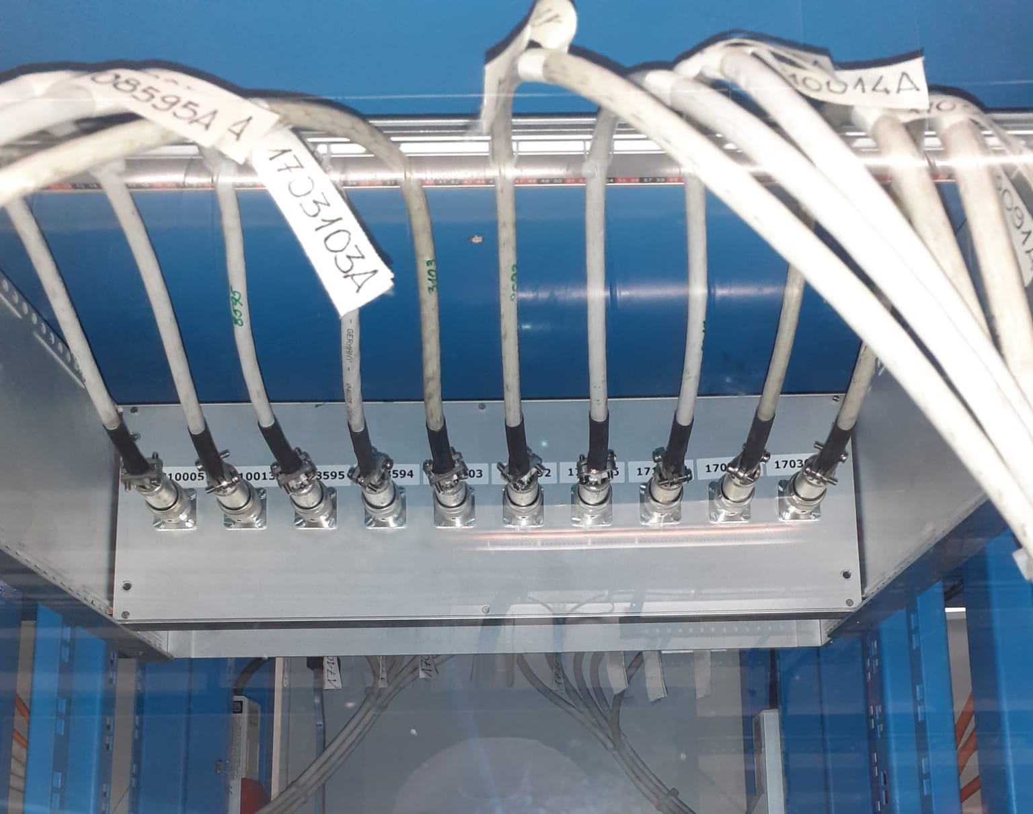
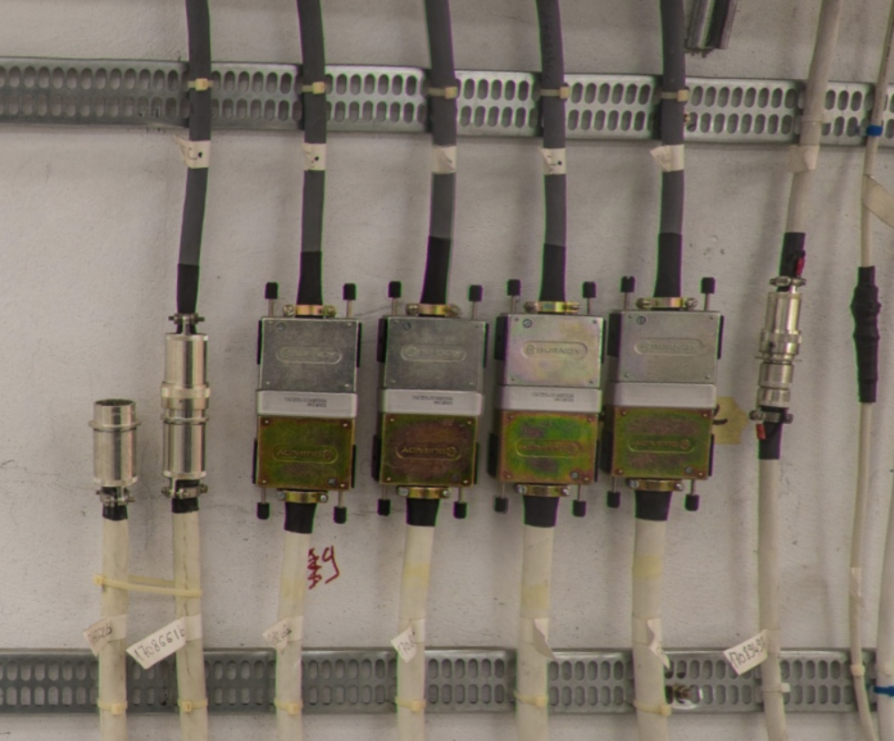
Our Expertise and Current Achievements at CERN
A large number of patch panels, with various configurations, are already placed at CERN and used for critical applications. For example, many are in place at LHC points 3 and 7 (R2E project).
Multiconductor Cables
Coaxial Cables
Special Cables

Slide 5
Patch Panel Design: Our Strategy
Groups define which cables can be patched
→ Excel file shared on the 19 March. Deadline 11 April.
Independent Patch Panel (if space constrain allow it):
  Per group
  and Per signal type
Use of the same connector types for the patch as the one defined in the DIC by the cable user
EN-EL supported by EMC Working Group
Patch panel design will be subject to the group's approval
The cable and patch will be tested by EL in three stages:
  Section A
  Section B
  Section A+B
Patch panels are owned by the users after EL test…. Nevertheless, EL will provide support in case of issue during hardware commissioning
… EN-EL may install patch panels built by Groups if they prefer
A
B
Patch Panel

Slide 6
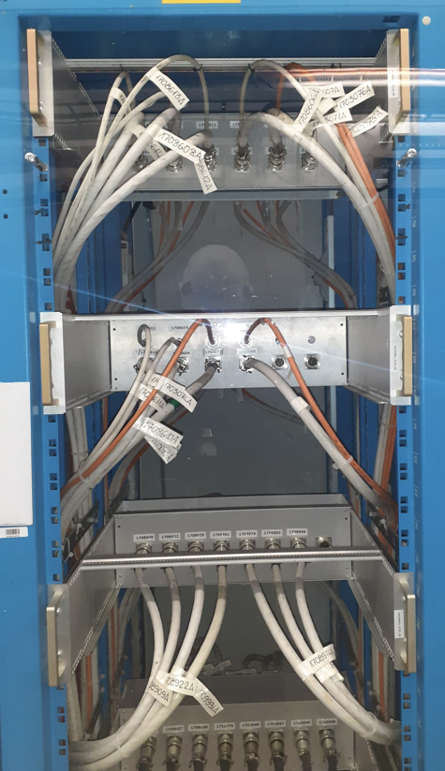
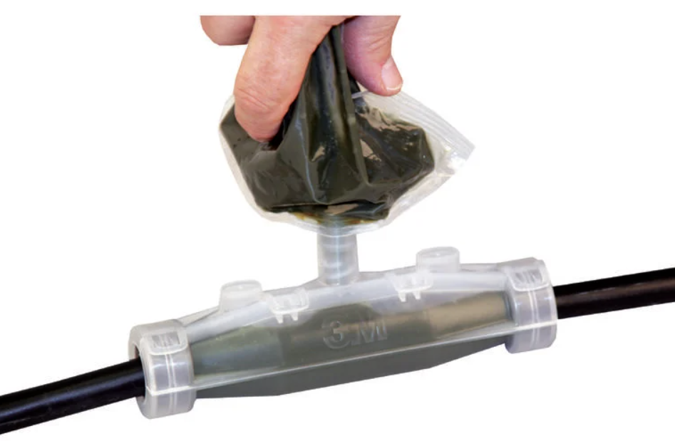
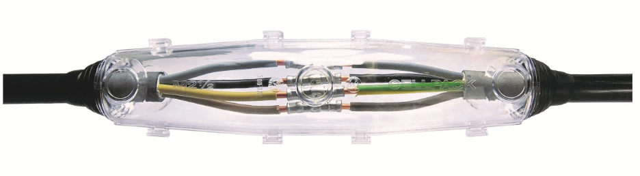
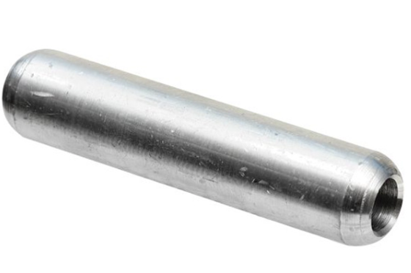
Patch Panel Design: Our Conception
Two configurations envisaged:
    Inside panel → Mainly used for UAs
      Any types of connector
    Along the wall → Mainly used for ULs
      Industrial connectors such as Harting
      (locking system, water resistant, dust resistant,…)
      Joint sealed with resin (but industrial connectors is preferred)
      “manchon” for power cable (included CLIQ cables)
    Patch designed to not alter the signals
    Shielding continuity ensured
    No grounding loop induced by the patch
    …
Inside Panel
Wall fixation

Slide 7
Roadmap
11 April: Confirmation received form Groups on patchable cables list
11 April - 30 May: EN-EL Feasibility Study
30 May - 15 June: Approval by the Groups of the preliminary design proposal
15 Aug. - 30 Aug.: Approval by the groups of the final design proposal is necessary so that work can begin in January 2026
Jan 2026: Patch installation

Slide 8
Conclusion
The large use of Patch Panels is mandatory to deliver HL-LHC within the defined LS3 duration
Many Patch panels already used for critical applications
Confirmation from Groups on patchable cables list is expected on 11 April
Design
  Performed by EN-EL
  With support of EMC WG
  Considering input from Groups
  Approved by the Groups
    Preliminary design approval: Beginning of June
    Final design approval: End of August
The time gained must be confirmed to CERN management by 15/05

