Slide 1


12 June 2025
VELO U2 Workshop
https://indico.cern.ch/event/1535828/
Istituto Nazionale
di Fisica Nucleare
Sezione di Milano
FEA studies of max overhang and possibilities for passive cooling
…
Possible contributions for the VELO U2 Detector
Simone Coelli
INFN Milano
For the Milano group
Contact: simone.coellimi.infn.it

Slide 2
A personal introduction

Slide 3
Good morning everyone,
since I have just joined the Collaboration for the Upgrade-2 of the LHCb VELO detector, I think it is useful to briefly introduce myself and some of the works carried out, as a reference:
I coordinate the Design Service and Mechanical Workshop at INFN-Milano from 2003
we have FEA Ansys and CFD Fluent calculation capabilities
laboratory for mechanical construction
working in the construction of UHV components for research and with orbital welding for pressure systems
We perform pressurization tests up to 200 bar with gas and up to 500 bar with liquid
He leak detection
we have a TRACI CO2 cooling plant
we assembled and tested cooling systems on various facilities:
Lukasz, for LHCb UT tracker
Baby-Demo, for ATLAS Itk, qualifying CO2 system down to -40 ℃
above all I have colleagues who are technically prepared and with a long experience in the field of detector mechanics and cooling
in particular for Silicon trackers: Atlas Pixel Detector, Insertable B-Layer, LHCb UT tracker, and ITk Pixel Outer Endcap (under construction)

Slide 4
I would use all the potential that we have:
for FEA analyses
we have a new powerful machine dedicated to simulations
thermal simulations, taking into account the details of composite materials and thin layers (glues), for evaluation of design thermal performance
mechanical and thermo-mechanical calculation (also non-linear with visco-elasticity) for determining the deformations and stresses induced by cooling
static and dynamic structural calculation, in particular modal analysis and effect induced by vibrations, for example detector transport using power spectral density (PSD) approach.
One of the first item we can set up is “FEA studies of max overhang and possibilities for passive cooling”..

Slide 5
with Fluent we propose to try to optimize the microchannels
building silicon prototypes with microchannels costs time and money: an orientation basis is needed
to have a theoretical basis from which to start for the geometric sizing of the channels
the model requires correlations for the thermo-fluid dynamic behavior of CO2 in a two-phase state (boiling)
these are not easily found in literature, mainly due to the dimensions of the microchannels and are difficult to apply to our case
(I kindly ask if you know any useful reference)
the simulation may not give very realistic results but can give an indication of which direction it is best to take in the design choice..
the final word is given by prototype test in working conditions
..these are in turn subject to experimental errors..)

Slide 6
for the experimental part
I would suggest to ask for the support and the experience of Paolo Petagna and Bart Verlaat and their teams at Cern
Cross check the validation tests with the infrastructures available at Cern
we are equipped to make pressure test but we have to build the interface for the silicon modules
we are asking the company M-Pump for an offer for a new CO2 pump to be able to face cooling tests on the microchannels, with high pressure drops, using the TRACI (the cooling power would be sufficient)
for the measurement of the Thermal Figure of Merit there are difficulties due to the effect of the environment surrounding the cold module
must be made similar to the operating detector (high vacuum, controlled temperatures and heat exchange with the environment)

Slide 7
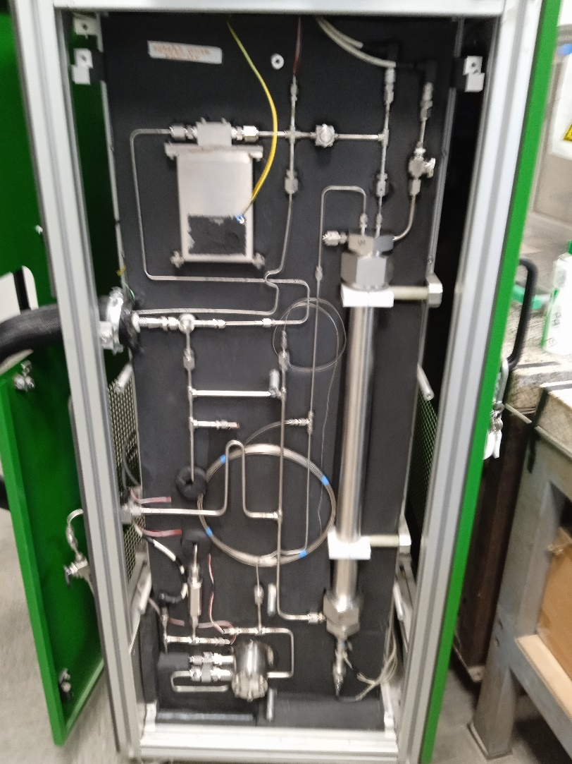
TRACI v.3 cooling unit
A picture of the 2PACL cooling circuit, opened for the proposed upgrade =>
There is a long by-pass that we plan to intercept – for the short time of the data taking on cooled prototypes - with a valve to push higher pressure in the test
It was implemented to better cool down the M-pump circulator, but limits the pressure output
It is possible to substitute the pump with a 4 stages, instead of 2 stages
We’d ask advise to Cern experts

Slide 8
Kripton cooling option
I would follow the evolution of the activities followed by Paolo Petagna, Luca Contiero and others
it would be useful to understand if the microchannels for CO2 would be fine without modifications also for this type of coolant, or what modifications would be needed
and try to carry out tests on prototype modules with Kripton cooling!
...I apologize if the following presentation does not provide answers yet
but provides a series of questions and some needed clarifications
to be able to proceed and address the various issues under discussion:
the VELO detector is truly complex
and requires an important investigation phase

Slide 9
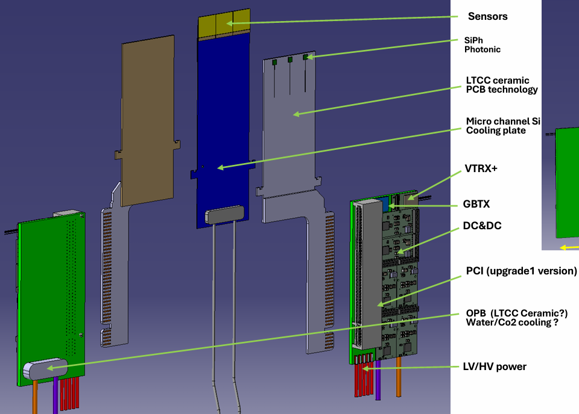
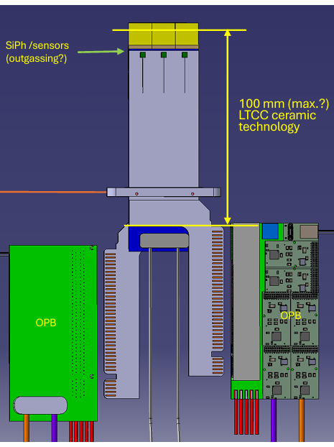
we are collaborating with FBK for the next production of prototypes:
an important piece of information, following yesterday's presentation by Raphael Dumps (Cern):
the maximum size of the silicon wafer that can be processed at FBK would be 6 inches (152.4mm)
which limits the size of the discussed model

Slide 10
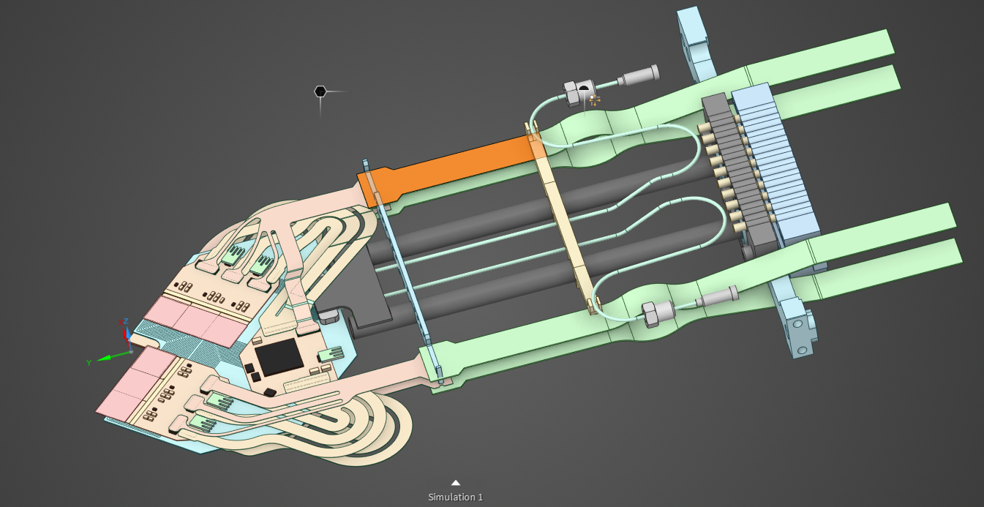
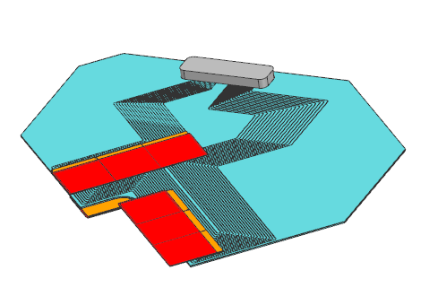
Open points regarding the models
Starting point:
Model of the current VELO module
Thanks to Oscar Augusto De Aguiar Francisco (UoM)
The tiles are represented by the objects in yellow (ASIC) and red (Sensor).
Microchannel cooling plate in light blue. The fluidic connector is at the bottom in light gray.
The microchannel is held by the back of the fluidic connector in place.

Slide 11
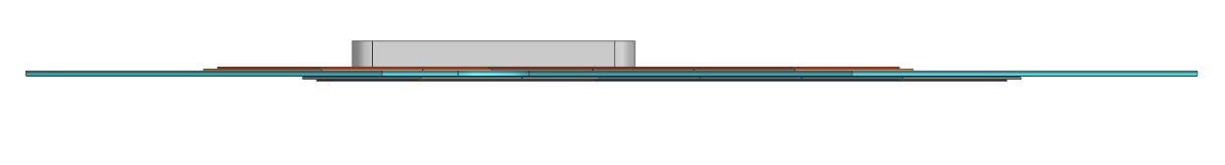
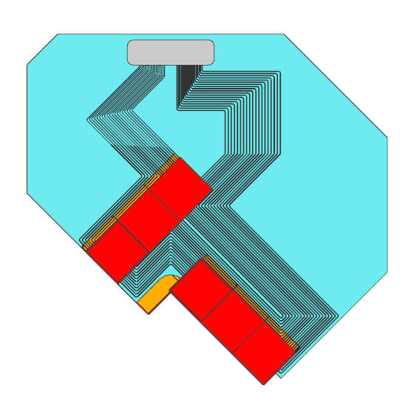
Model of the current VELO module
Details

Slide 12
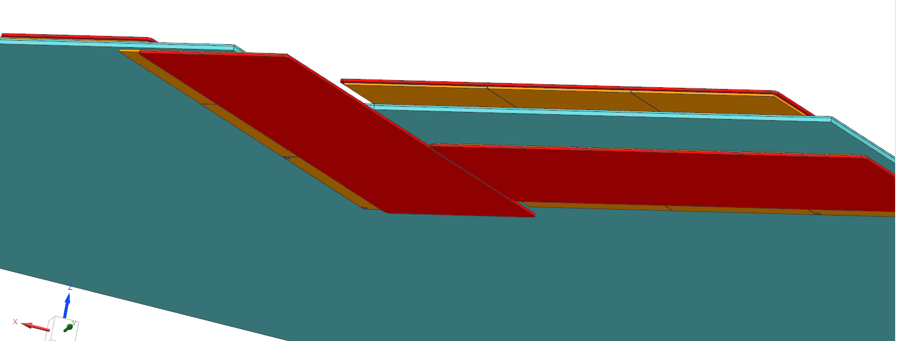
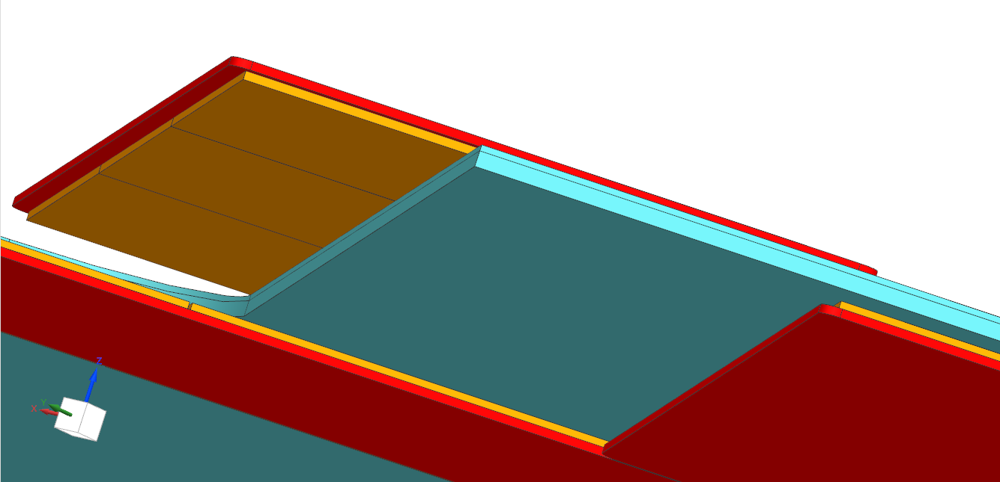
Model of the current VELO module
Details of the over-hanging
The sensors in the current velo module overhang the cooling plate by 5 mm.
This overhang while minimizing the material in the innermost area creates an additional variation of temperature compared to the coolant.
More information about this is indicated in my slides from the previous workshop (link, slide 9)
(Oscar Augusto)

Slide 13
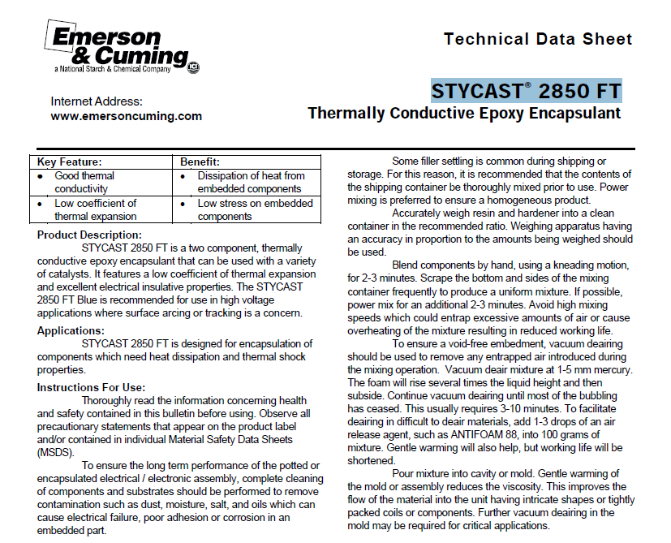
“FEA studies of max overhang and possibilities for passive cooling”
Work in progress
For you simulation, as a first step, I would simplify it and use
silicon for the cooling plate and sensor+asic stack.
For the glue layer, you can consider the same used for the VELO Upgrade I "Stycast 2850FT with catalyst 23LV"
STYCAST® 2850 FT
Thermally Conductive Epoxy Encapsulant
Thermal Conductivity ASTM-D-2214
Catalyst 9 1.25 W/m.K
Catalyst 23 LV 1.02 W/m.K
Catalyst 11 1.28 W/m.K

Slide 14
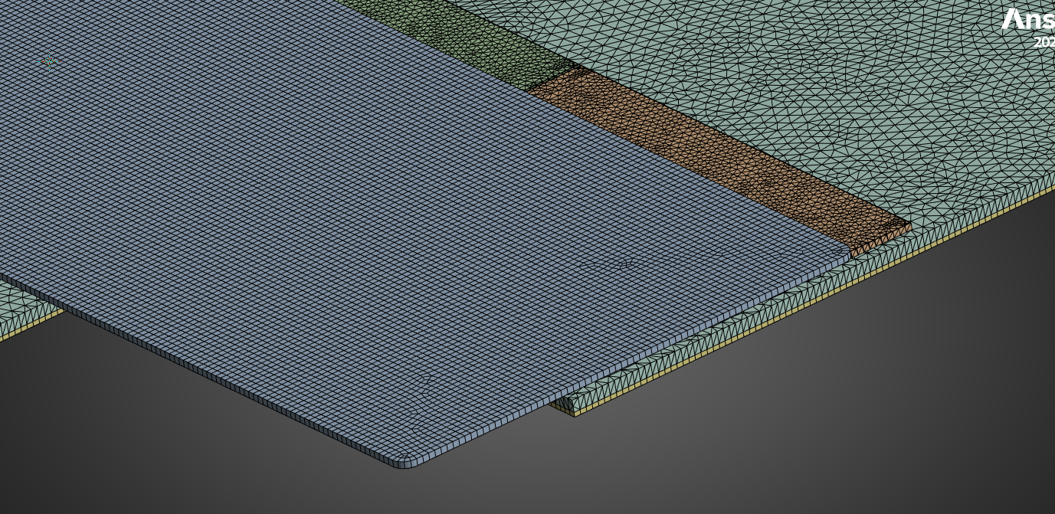
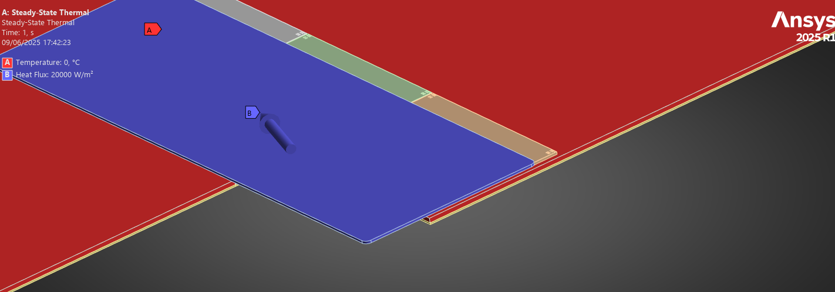
“FEA studies of max overhang and possibilities for passive cooling”
Work in progress, exercises with Ansys, fine mesh test

Slide 15
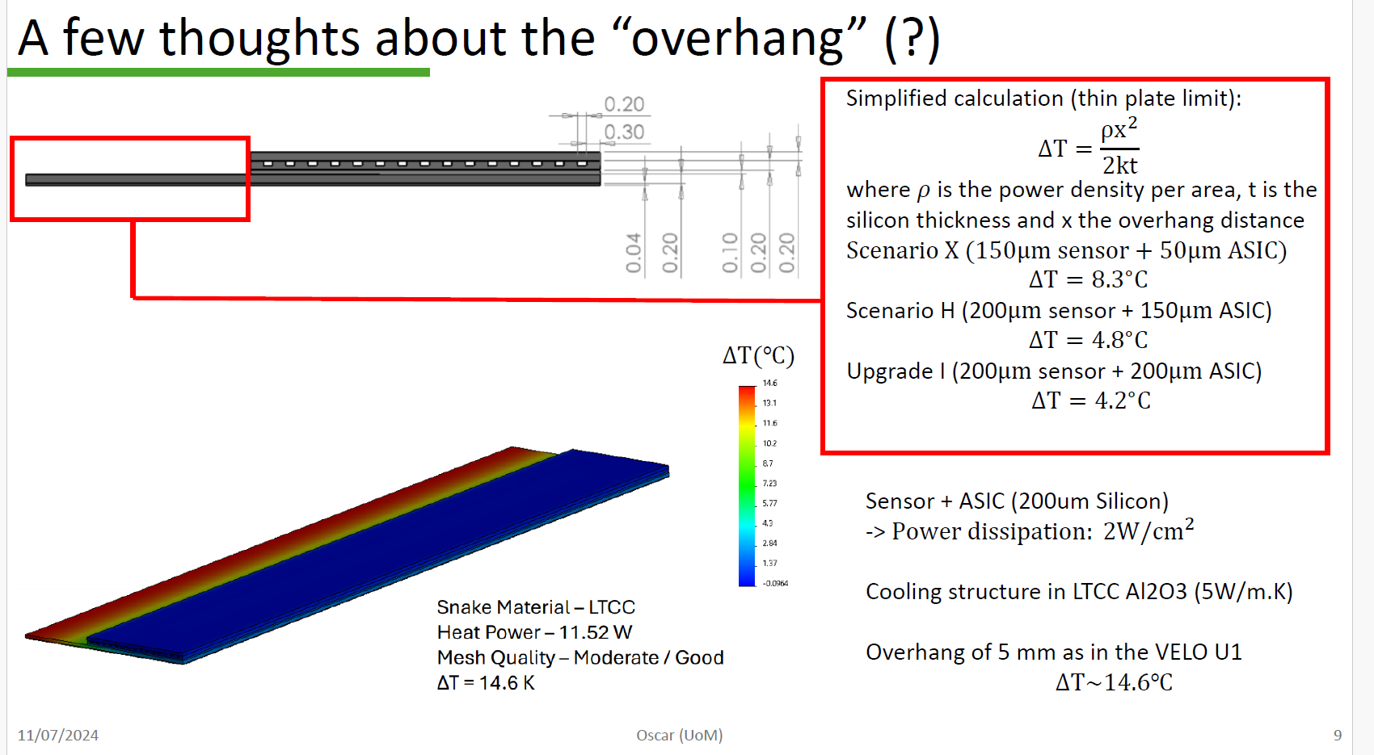
More information about this is indicated in my slides from the previous workshop (link, slide 9).
(Oscar Augusto)
Already a very useful extimation, I’d say..

Slide 16
Open points regarding the models
23/04/2025
The original design by Raphael (CERN) is more compact:
https://edms.cern.ch/ui/#!master/navigator/document?P:101675036:101704721:subDocs
(40 mm x 25 mm)
The microchannel cooling plate design adjusted by Yutaro (NIKHEF) for the timepix4 area including the wire-bonds area was uploaded to the EDMS link below:
https://edms.cern.ch/ui/#!master/navigator/document?P:101675036:101778315:subDocs
(40 mm x 36 mm)
To avoid any future confusion, I have listed both here and their links to EDMS for future reference. The original suggestion was to consider the NIKHEF design. We can revisit this if there is a sizeable budgetary difference per cooling plate. @kazu.akiba@nikhef.nl and @Victor Coco, if you disagree with this initial approach, please don't hesitate to share.
Best regards,
Oscar Augusto
The next slides shows many microchannel models that we need to classify, to understand what to do..

Slide 17
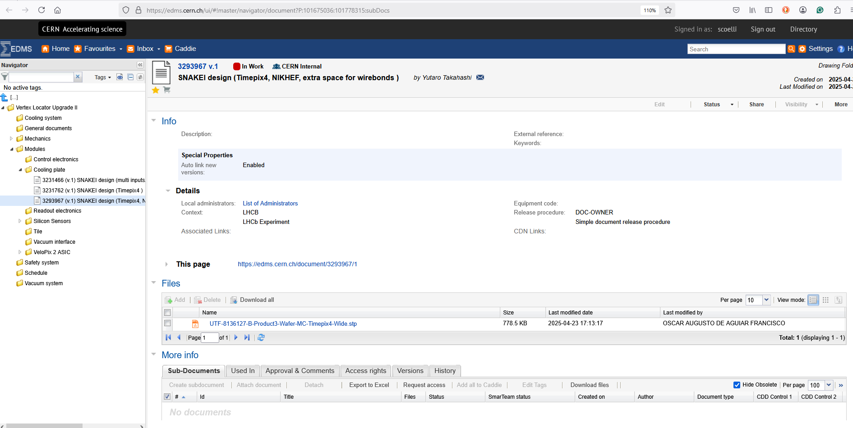
The microchannel cooling plate design adjusted by Yutaro (NIKHEF) for the timepix4 area including the wire-bonds area was uploaded to the EDMS link below:
https://edms.cern.ch/ui/#!master/navigator/document?P:101675036:101778315:subDocs
(40 mm x 36 mm)

Slide 18
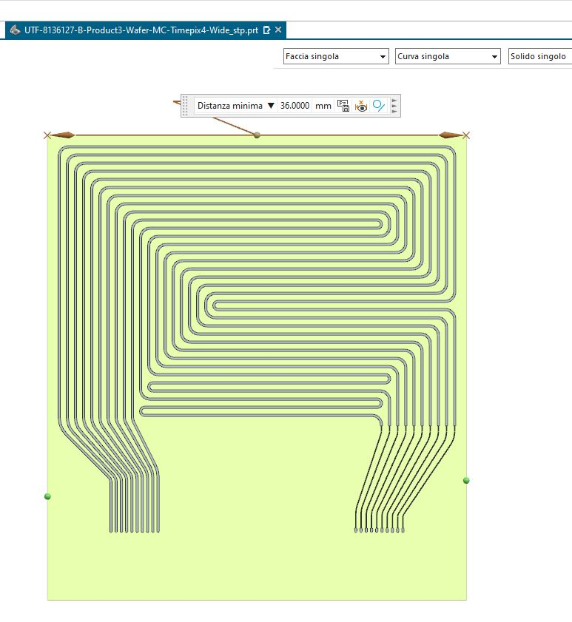
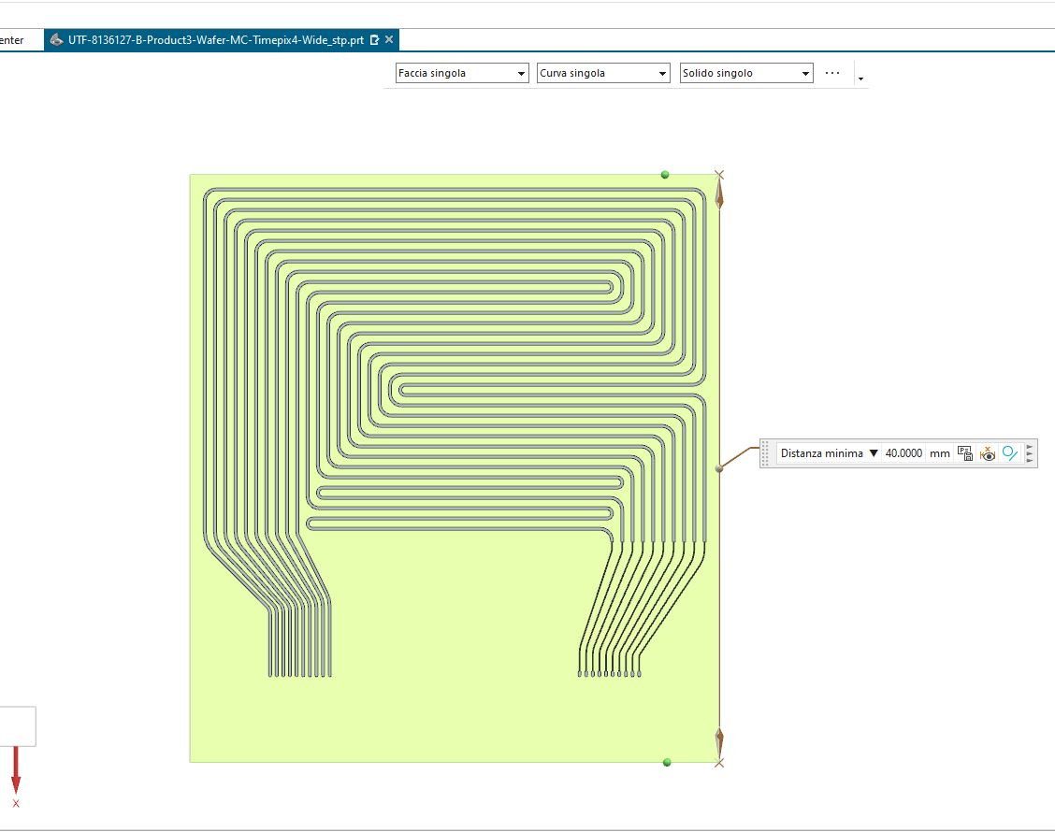
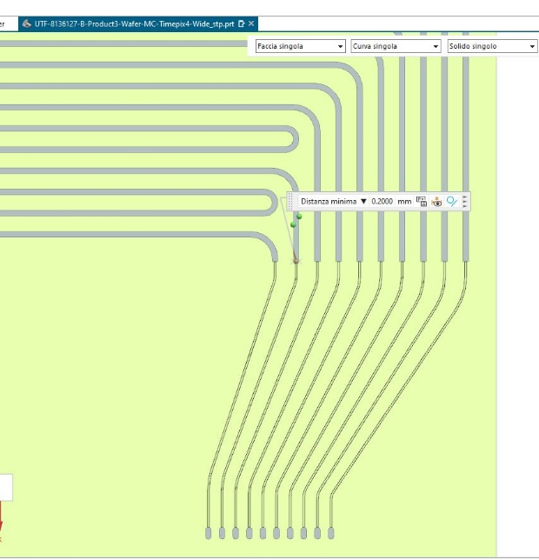
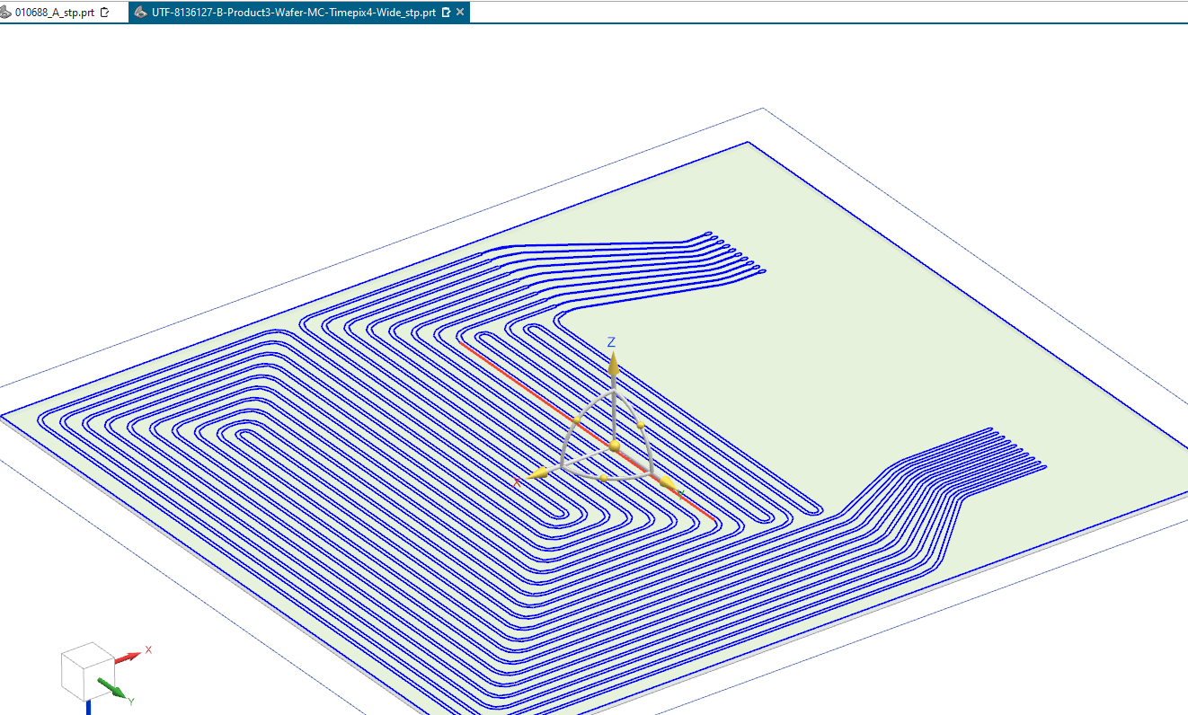

SNAKEI design (Timepix4, NIKHEF, extra spaceor wirebonds )
by Yutaro Takahashi
UTF-8136127-B-Product3-Wafer-MC-Timepix4-Wide.stp

Slide 19
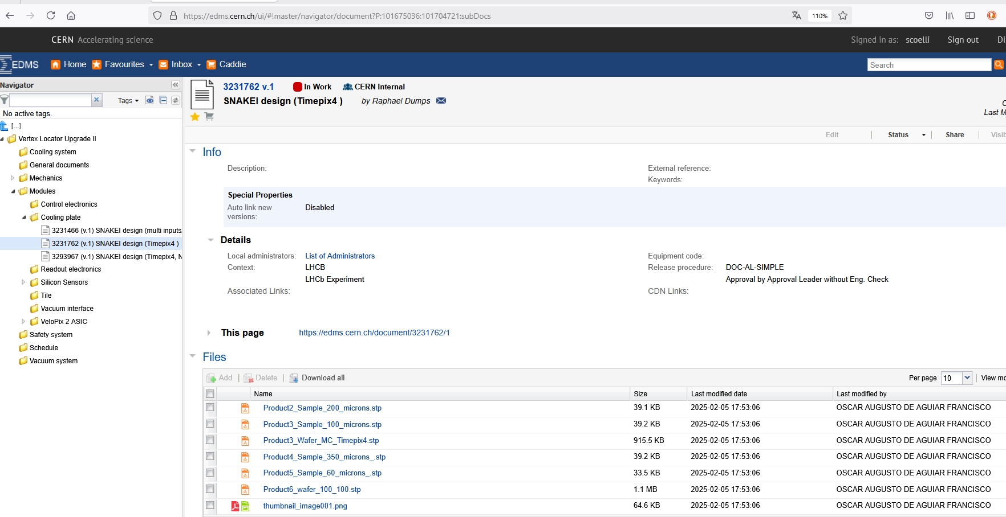
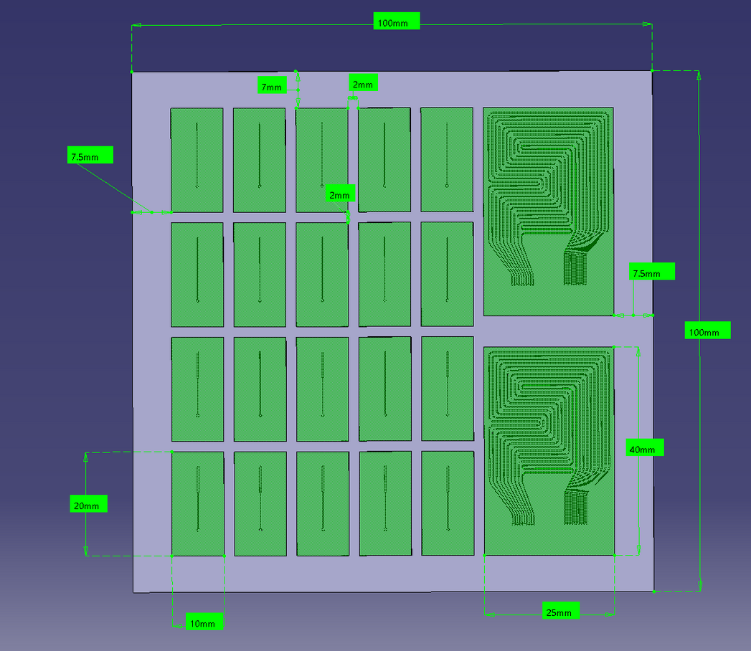
The original design by Raphael (CERN) is more compact:
https://edms.cern.ch/ui/#!master/navigator/document?P:101675036:101704721:subDocs
(40 mm x 25 mm)

Slide 20
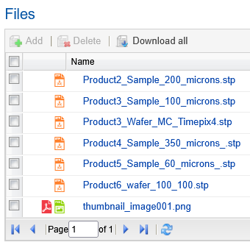

XXXXXXXXXXXXXXXXXXX

Slide 21

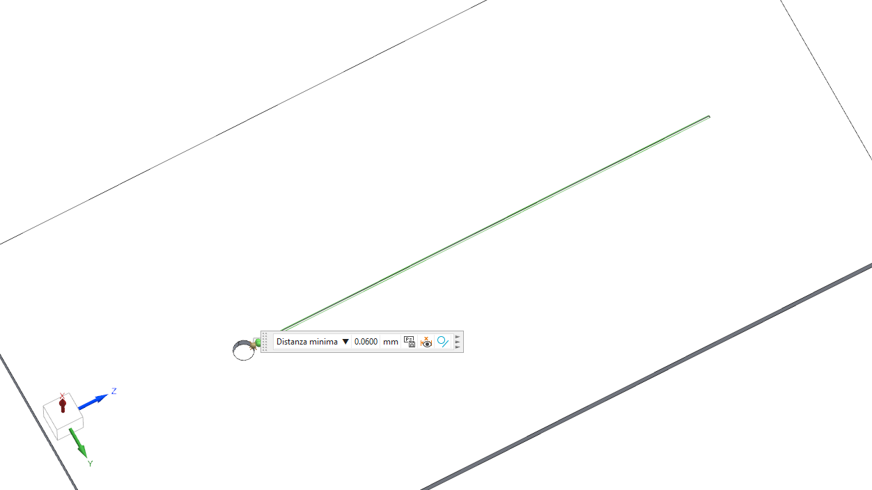

Slide 22

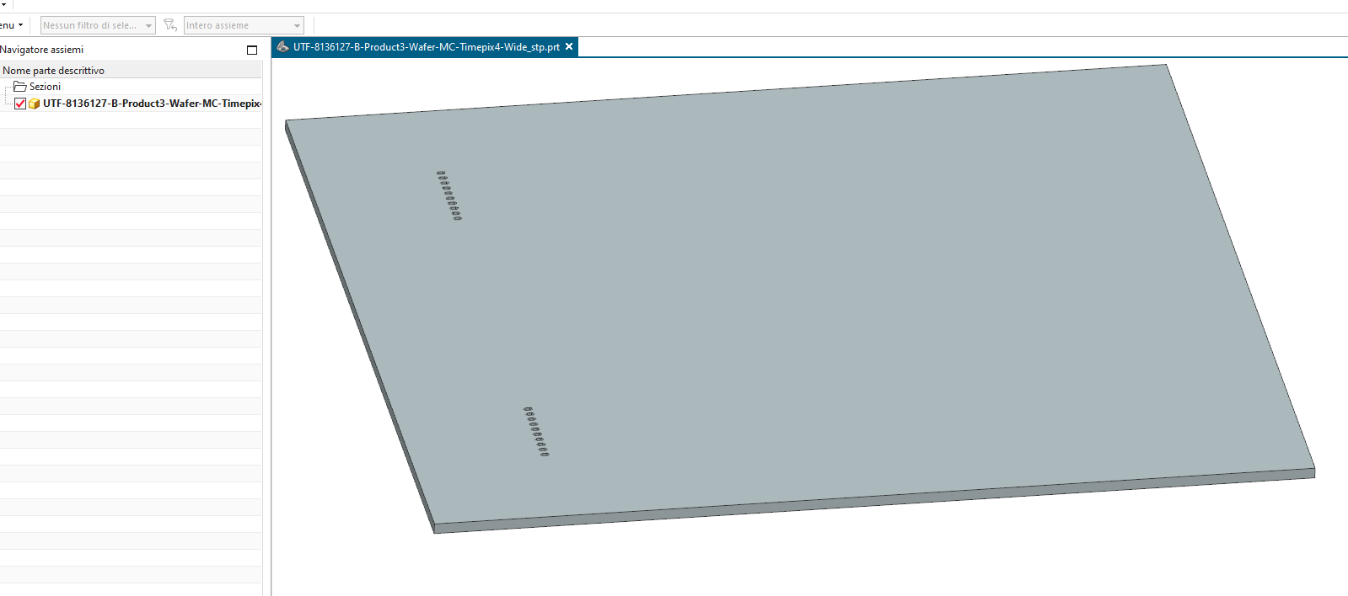
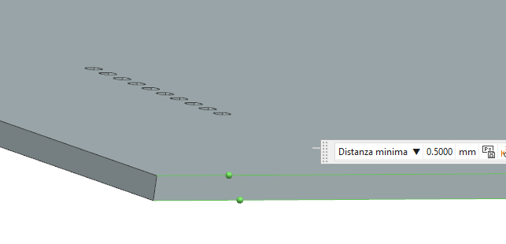
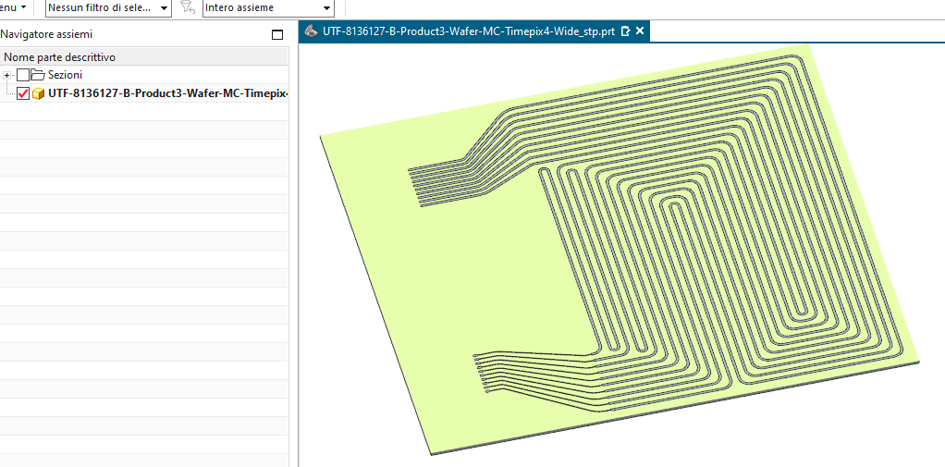

Slide 23
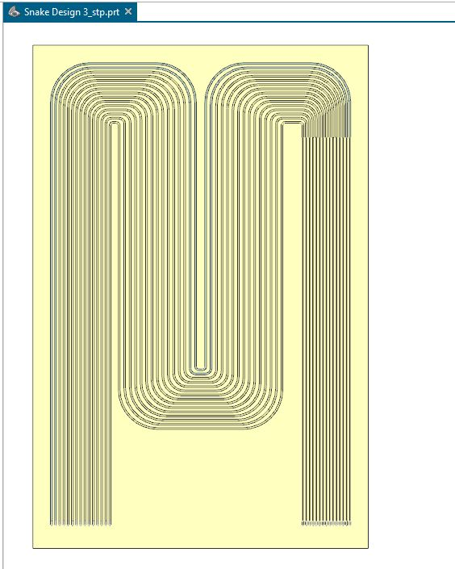
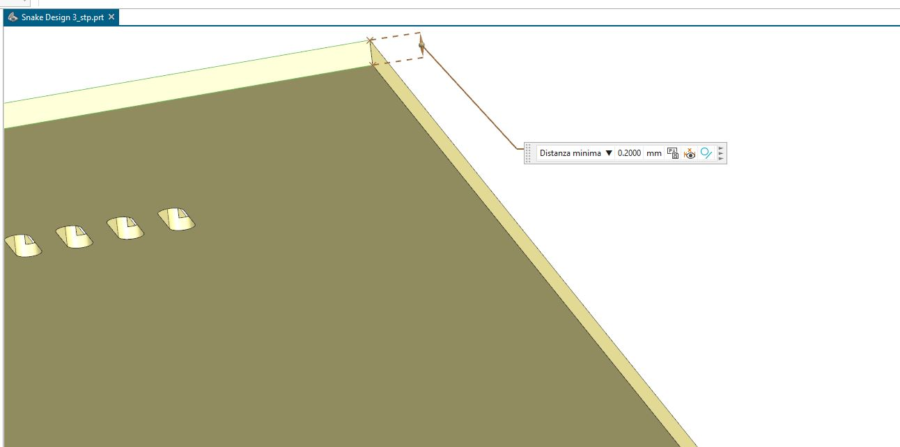
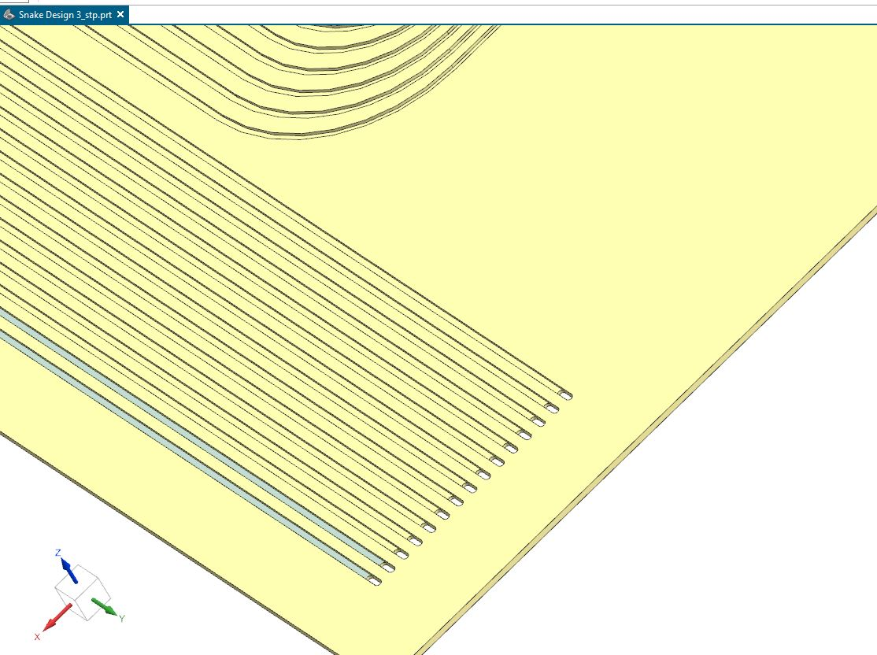

Slide 24
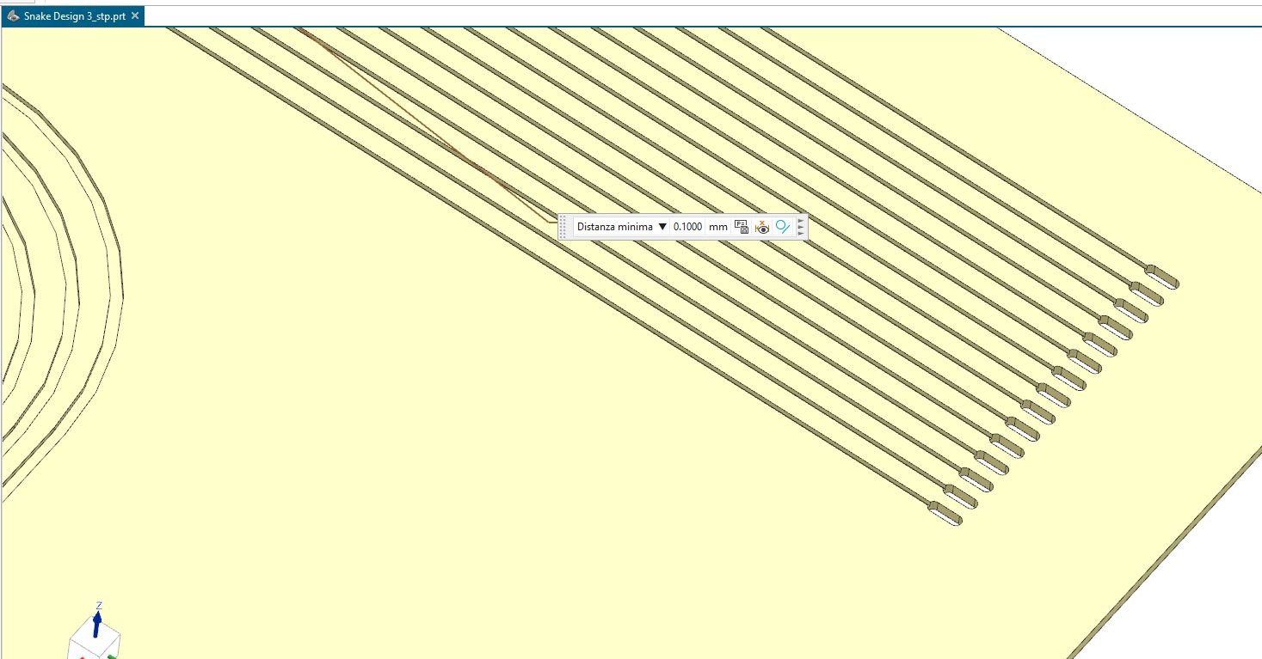

Slide 25
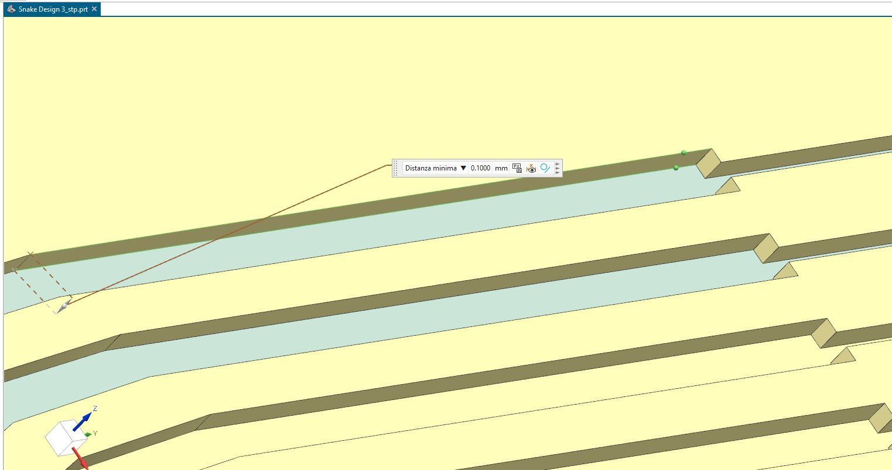

Slide 26
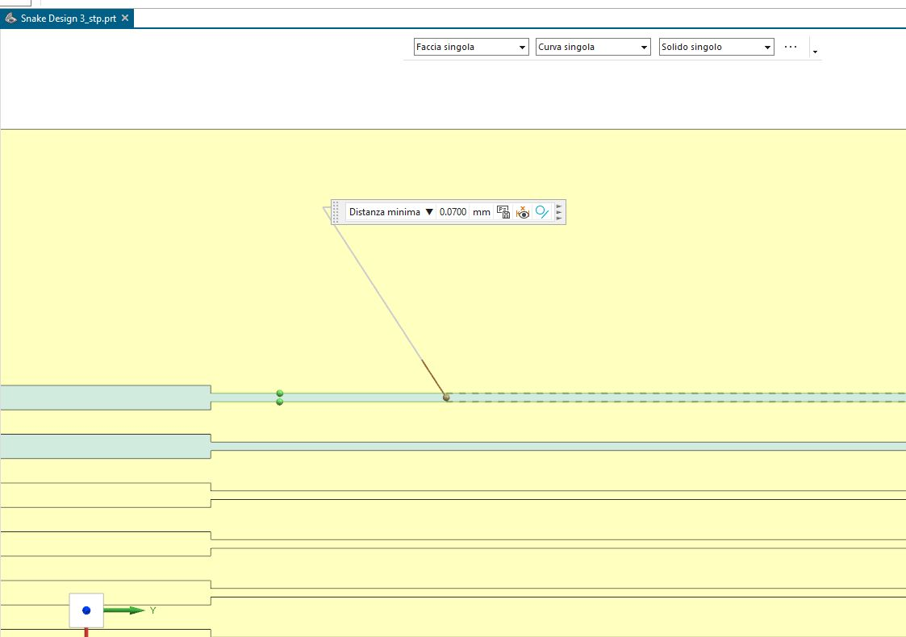
XXXXXXXXXXXXXXXXXXX

Slide 27
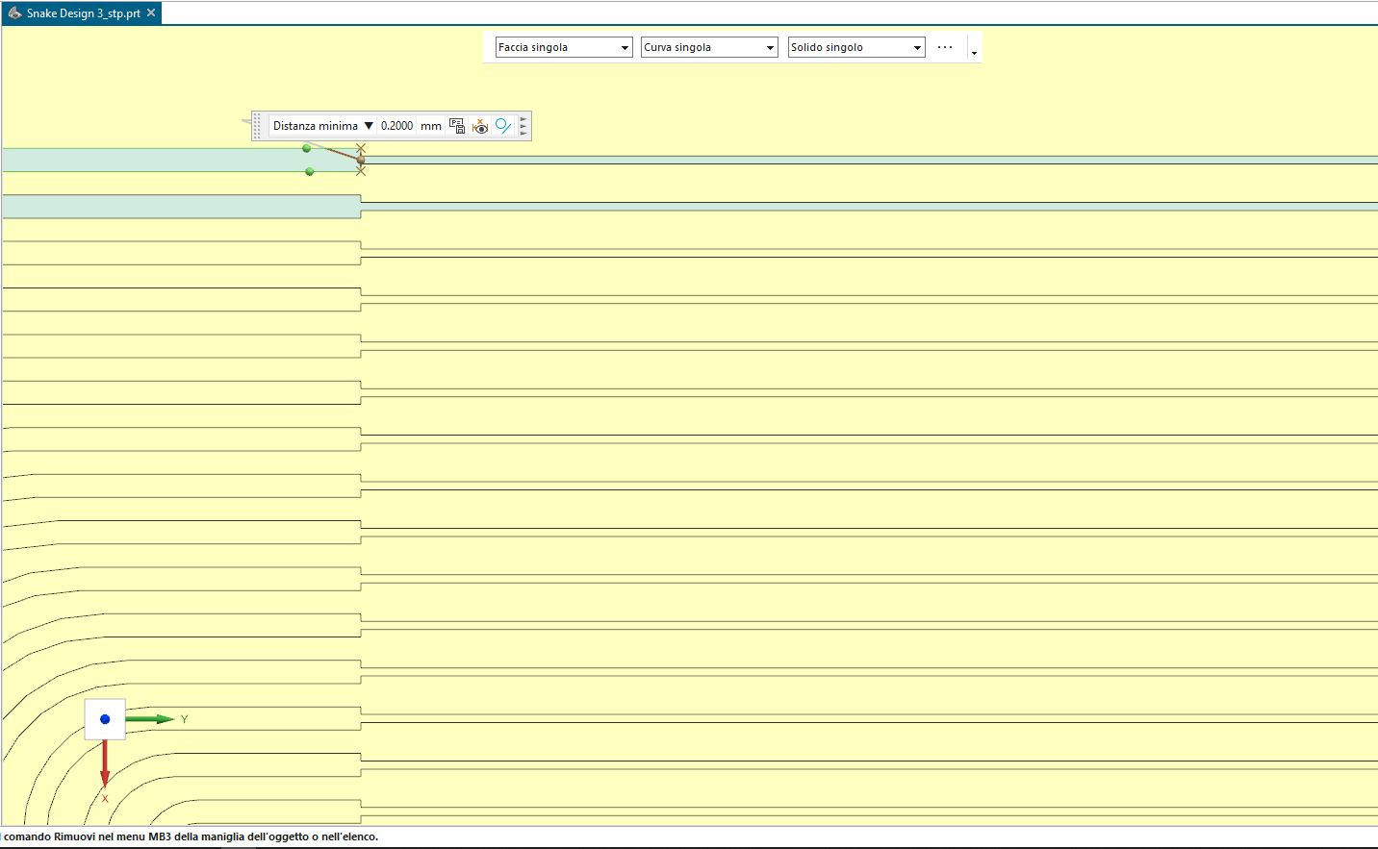

Slide 28
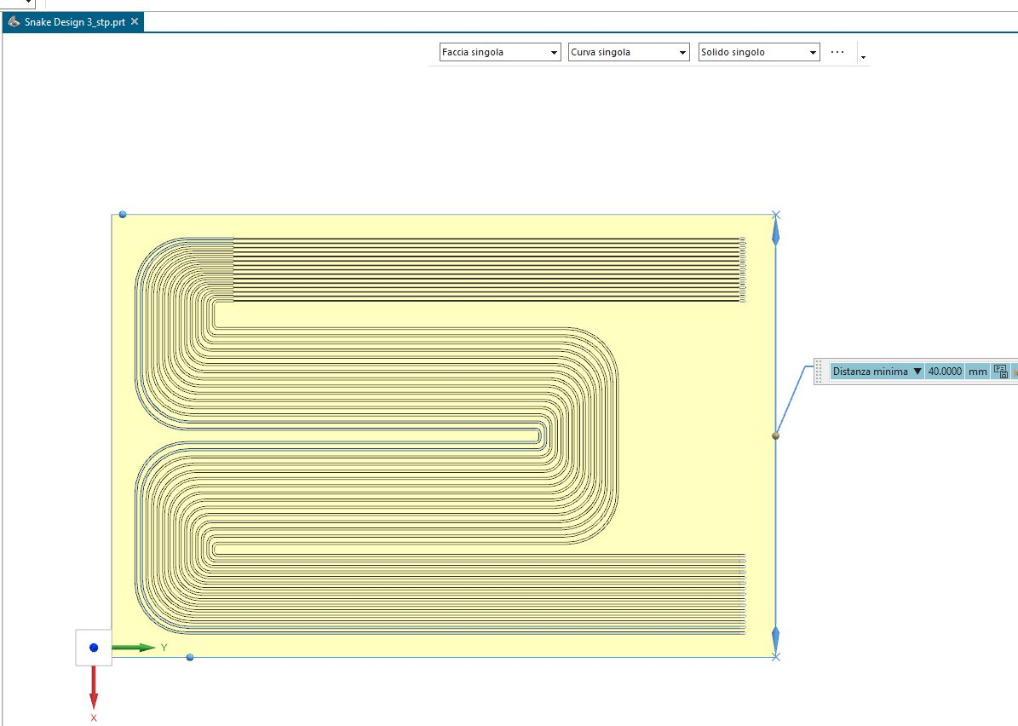

Slide 29
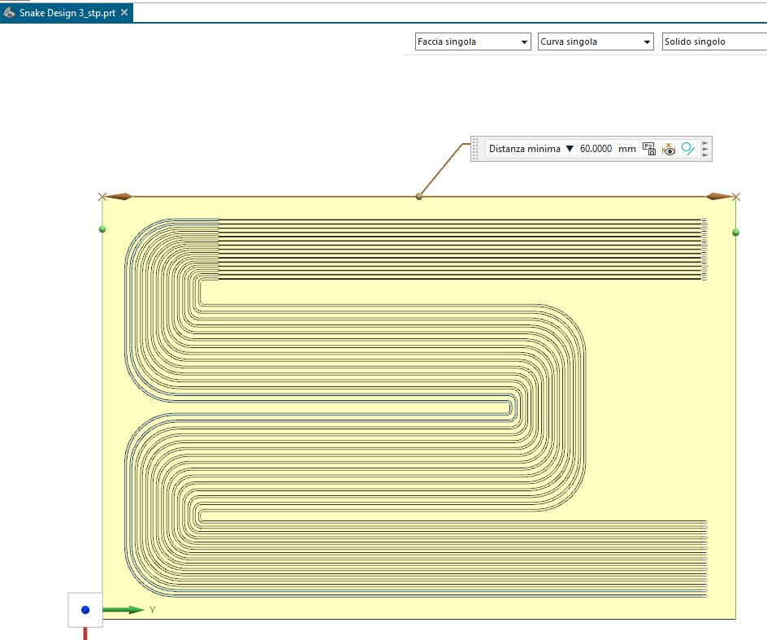
XXXXXXXXXXXXXXXXXXX

Slide 30
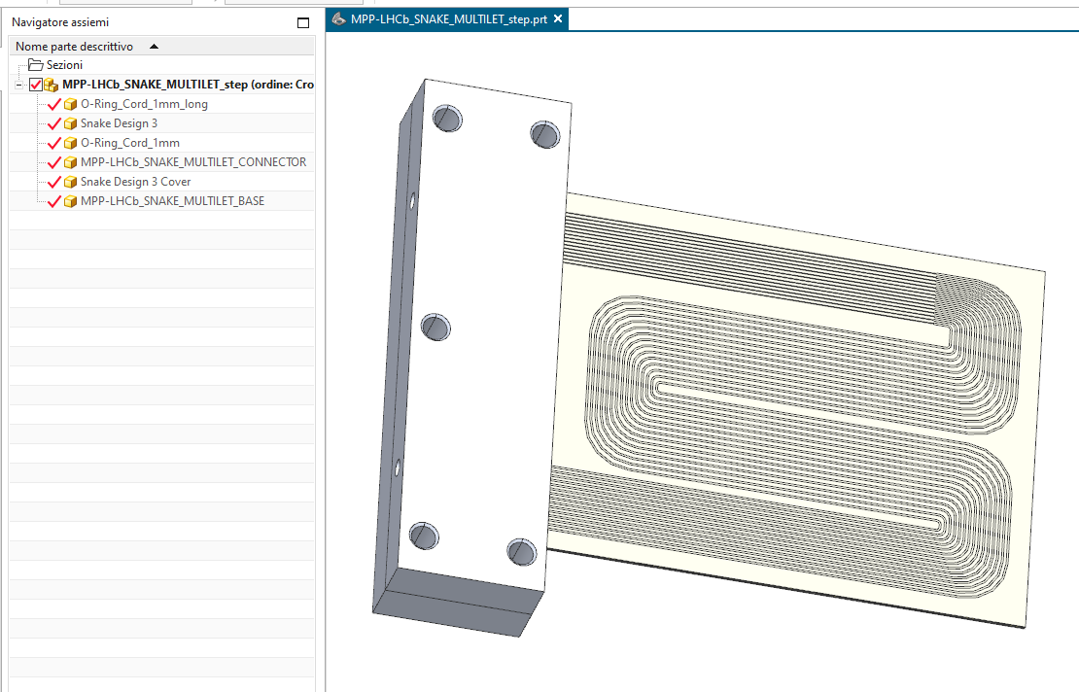

Slide 31
Back up

Slide 32
…we would like to invite you to give a talk on the cooling performance of the modules using FEA focusing on the distance of the coolant compared to the innermost sensor part.
The second talk is a status update of the silicon microchannels developments for the VELO Upgrade 2 where you can also indicate yours plans on developing cooling plates with FBK.

Slide 33
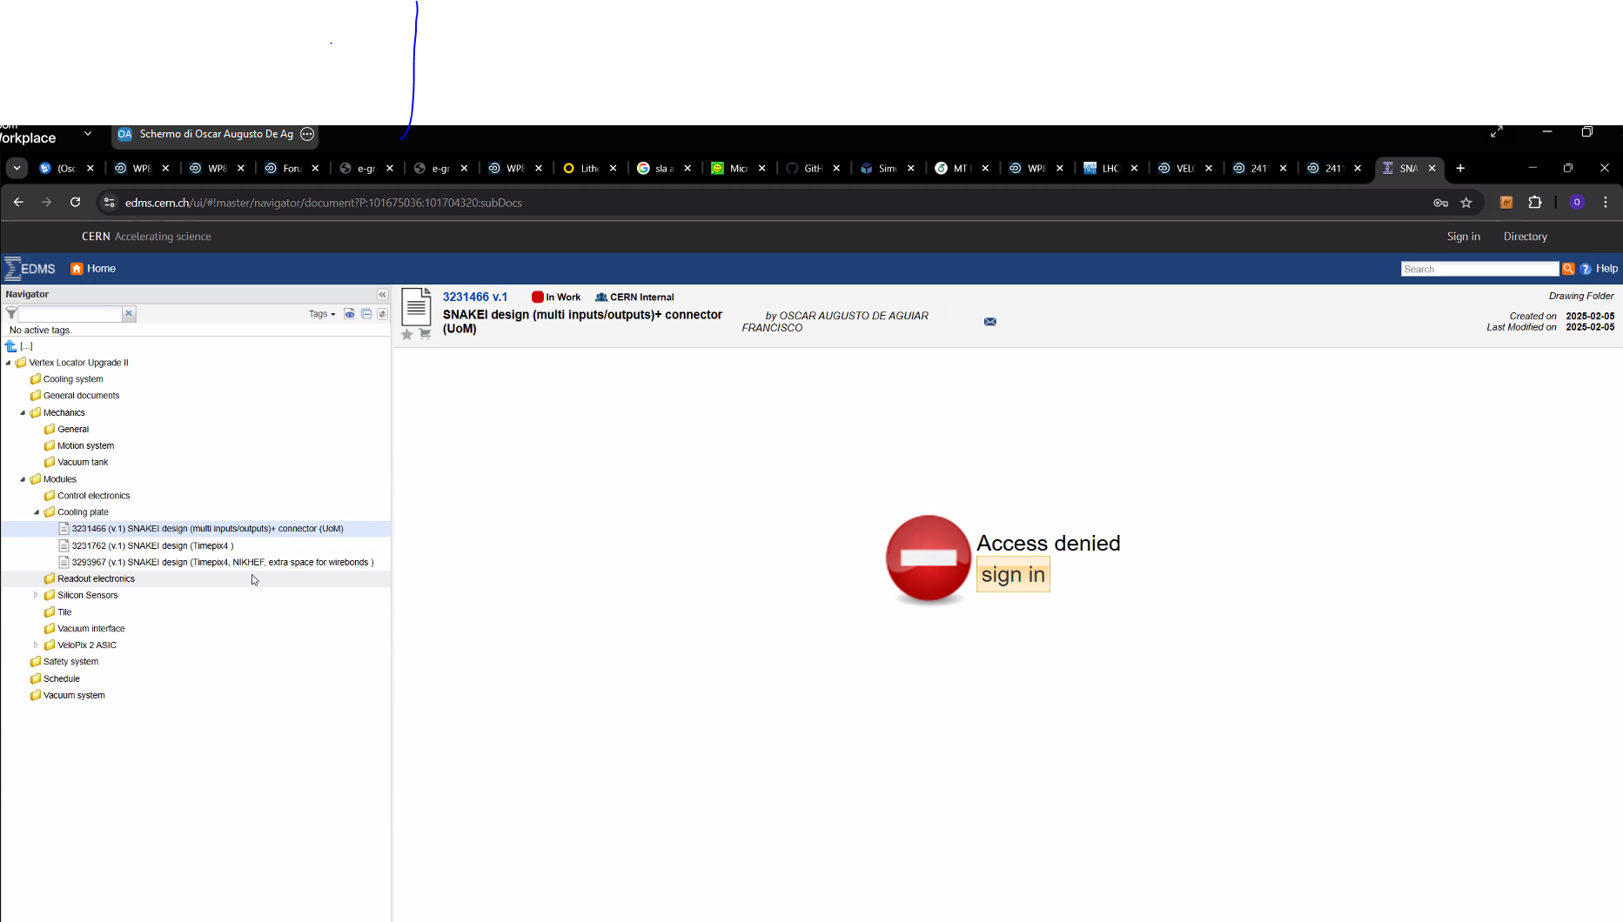

Slide 34
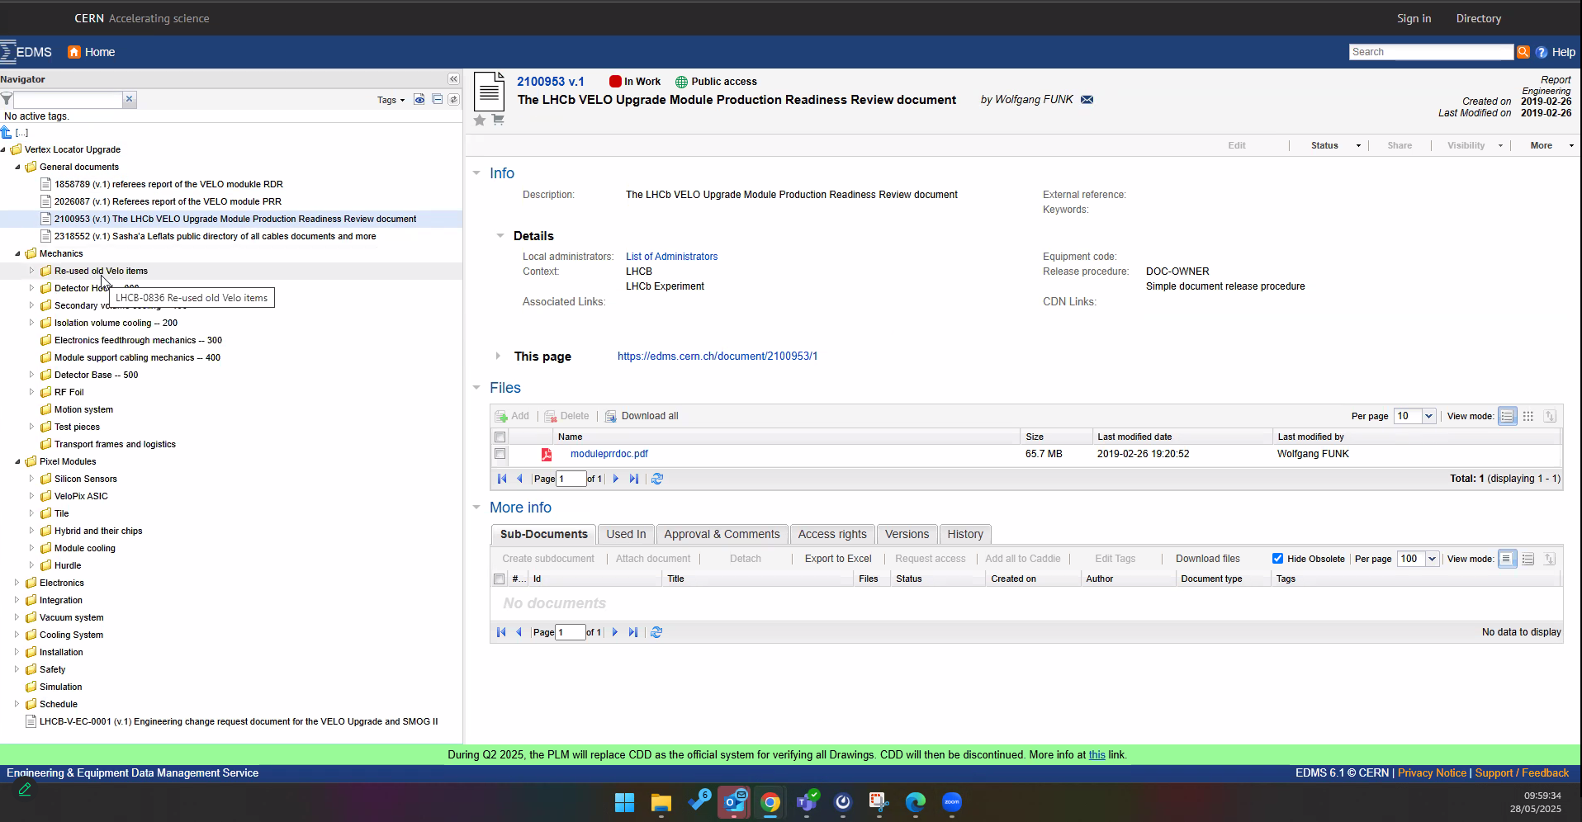

Slide 35
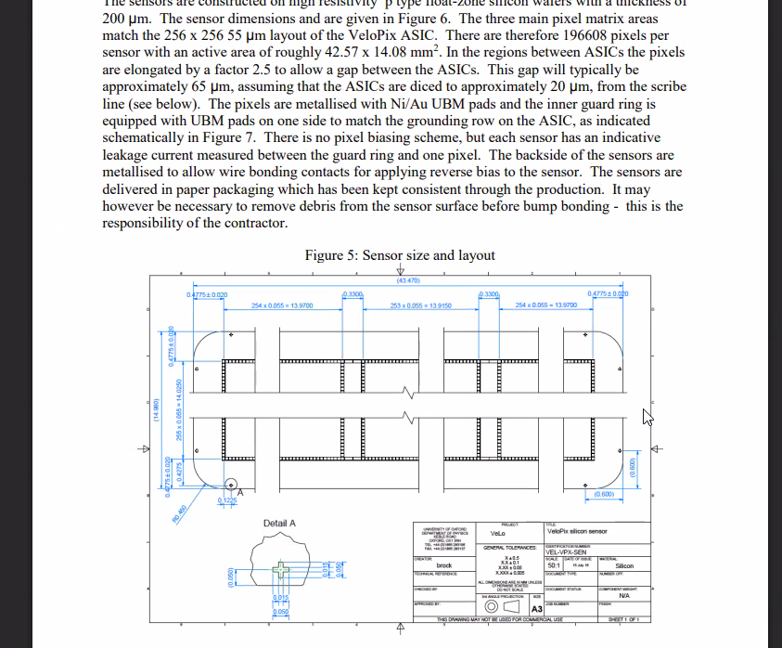

Slide 36
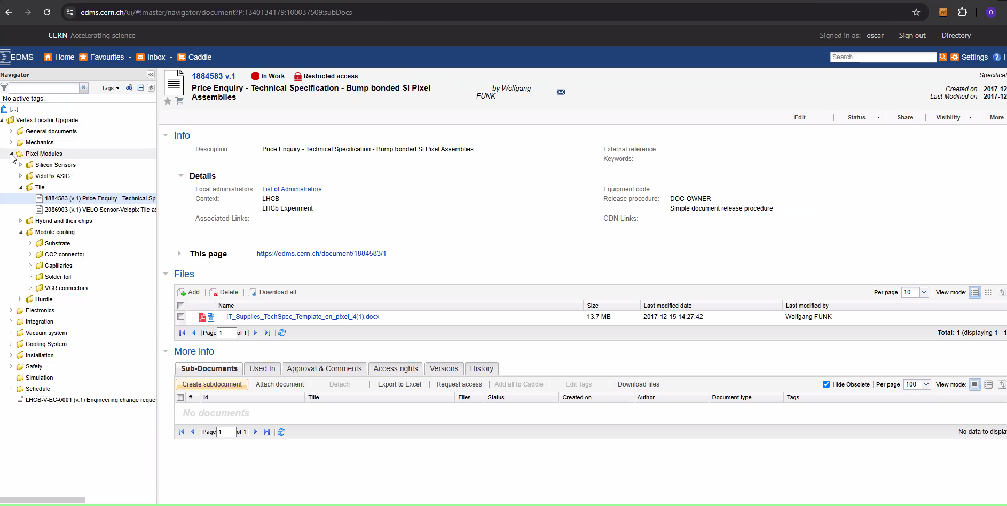

Slide 37
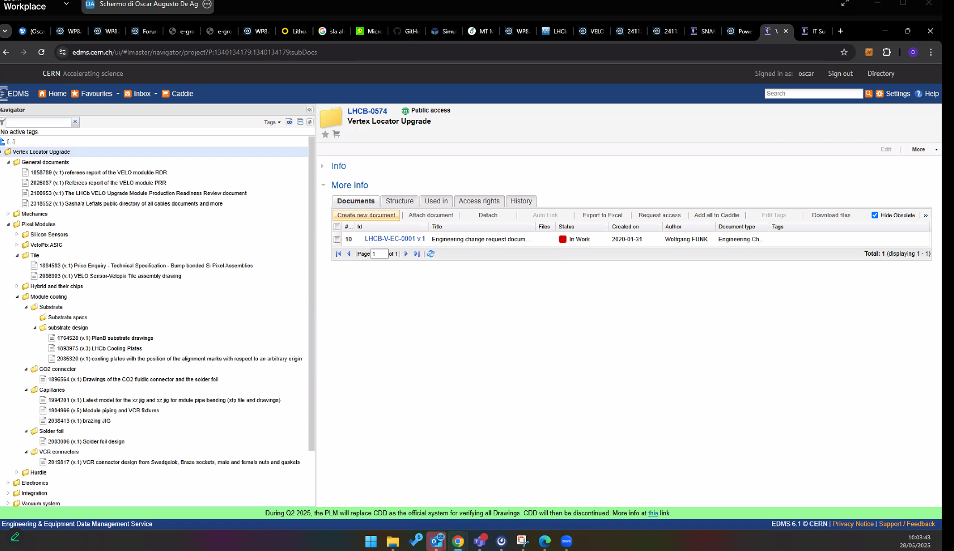

Slide 38
https://indico.cern.ch/event/1530995/
https://indico.cern.ch/event/695767/contributions/3014925/attachments/1674339/2687417/FOTDM2018_Byczynski_v3.pdf
https://indico.cern.ch/event/695767/contributions/3014925/attachments/1674339/2687417/FOTDM2018_Byczynski_v3.pdf

Slide 39
Back up

Slide 40
Experiences on evaporative cooling systems (list):
Thermal and structural FEAs, R&D and manufacturing of the detector cooling systems and the coolant distribution systems for Cern detectors:
Working: Atlas Pixel detector – evaporative fluorocarbon (C₃F₈)
Working: Atlas IBL (Insertable B-layer) – evaporative CO₂
Cancelled project: SuperB Vertex Locator – evaporative CO₂
Working: LHCb UT tracker – evaporative CO₂
Under construction: Atlas Itk (Inner Tracker) Pixel Outer Endcap – evaporative CO₂
FEA:
we are equipped with Ansys software, academic licence with unlimited node number, dedicated hardware with large RAM and CPU (optimized for detailed structural analysis)
Cooling tests:
we are equipped with a TRACI cooling unit, when needed we collaborate with Cern to use larger cooling units (Lukasz, Baby-demo, etc)
flow, pressure, temperature and pressure drop measurement instrumentation
CompactRIO system monitoring and acquisition

Slide 41
INFN Institute interests for the VELO upgrade:
Optimization of the detector structure and integrated cooling system
Finite Element Analysis with high professional experience and hardware capabilities
now devoted to Atlas ITk detector studies and applicable to the VELO R&D
Thermal performance simulations with detailed parametrization studies
comparison of alternative solutions
Thermo-mechanical deformation analysis
Structural stress analysis
Dynamic studies (modal, analysis of stress due to transport vibration)
Realization of prototype circuits with realistic components
Pressurization (up to 500 bar) and He leak-rate measurements for the qualification of the proposed designs
thermo-fluidic characterization in real cooling operation conditions
Thermal performance assessment
Circuit flow-pressure and power dependencies characterization
Destructive test and Quality Assessment of the design

Slide 42
Possible contributions:
Extensive FEA design analysis for the detector optimization
Realization of prototypes
in collaboration with FBK Institute, other interested VELO groups and Cern
our proposed baseline for the VELO cooling R&D is based on:
Silicon micro-channel technology (anodic bonding with transparent glass for visual test and direct bonding for the real detector)
Evaporative CO2 as baseline, with studies using the Krypton alternative
starting from the current cooling configuration of the installed VELO
studying the cooling system with fluid distribution configurations in micro-channels and alternative microstructures (fluid diodes) with 1:1 scale tests at operating flow, temperature and pressure
Quality assessment, structural integrity test (mainly of the pressure system)
Studies for CO₂ optimized cooling flow and heat-transfer
Assessment ‘in opera’ of relevant instabilities control mechanisms
Trying to realize the more affordable, stable, robust and best performant cooling system

