Slide 1
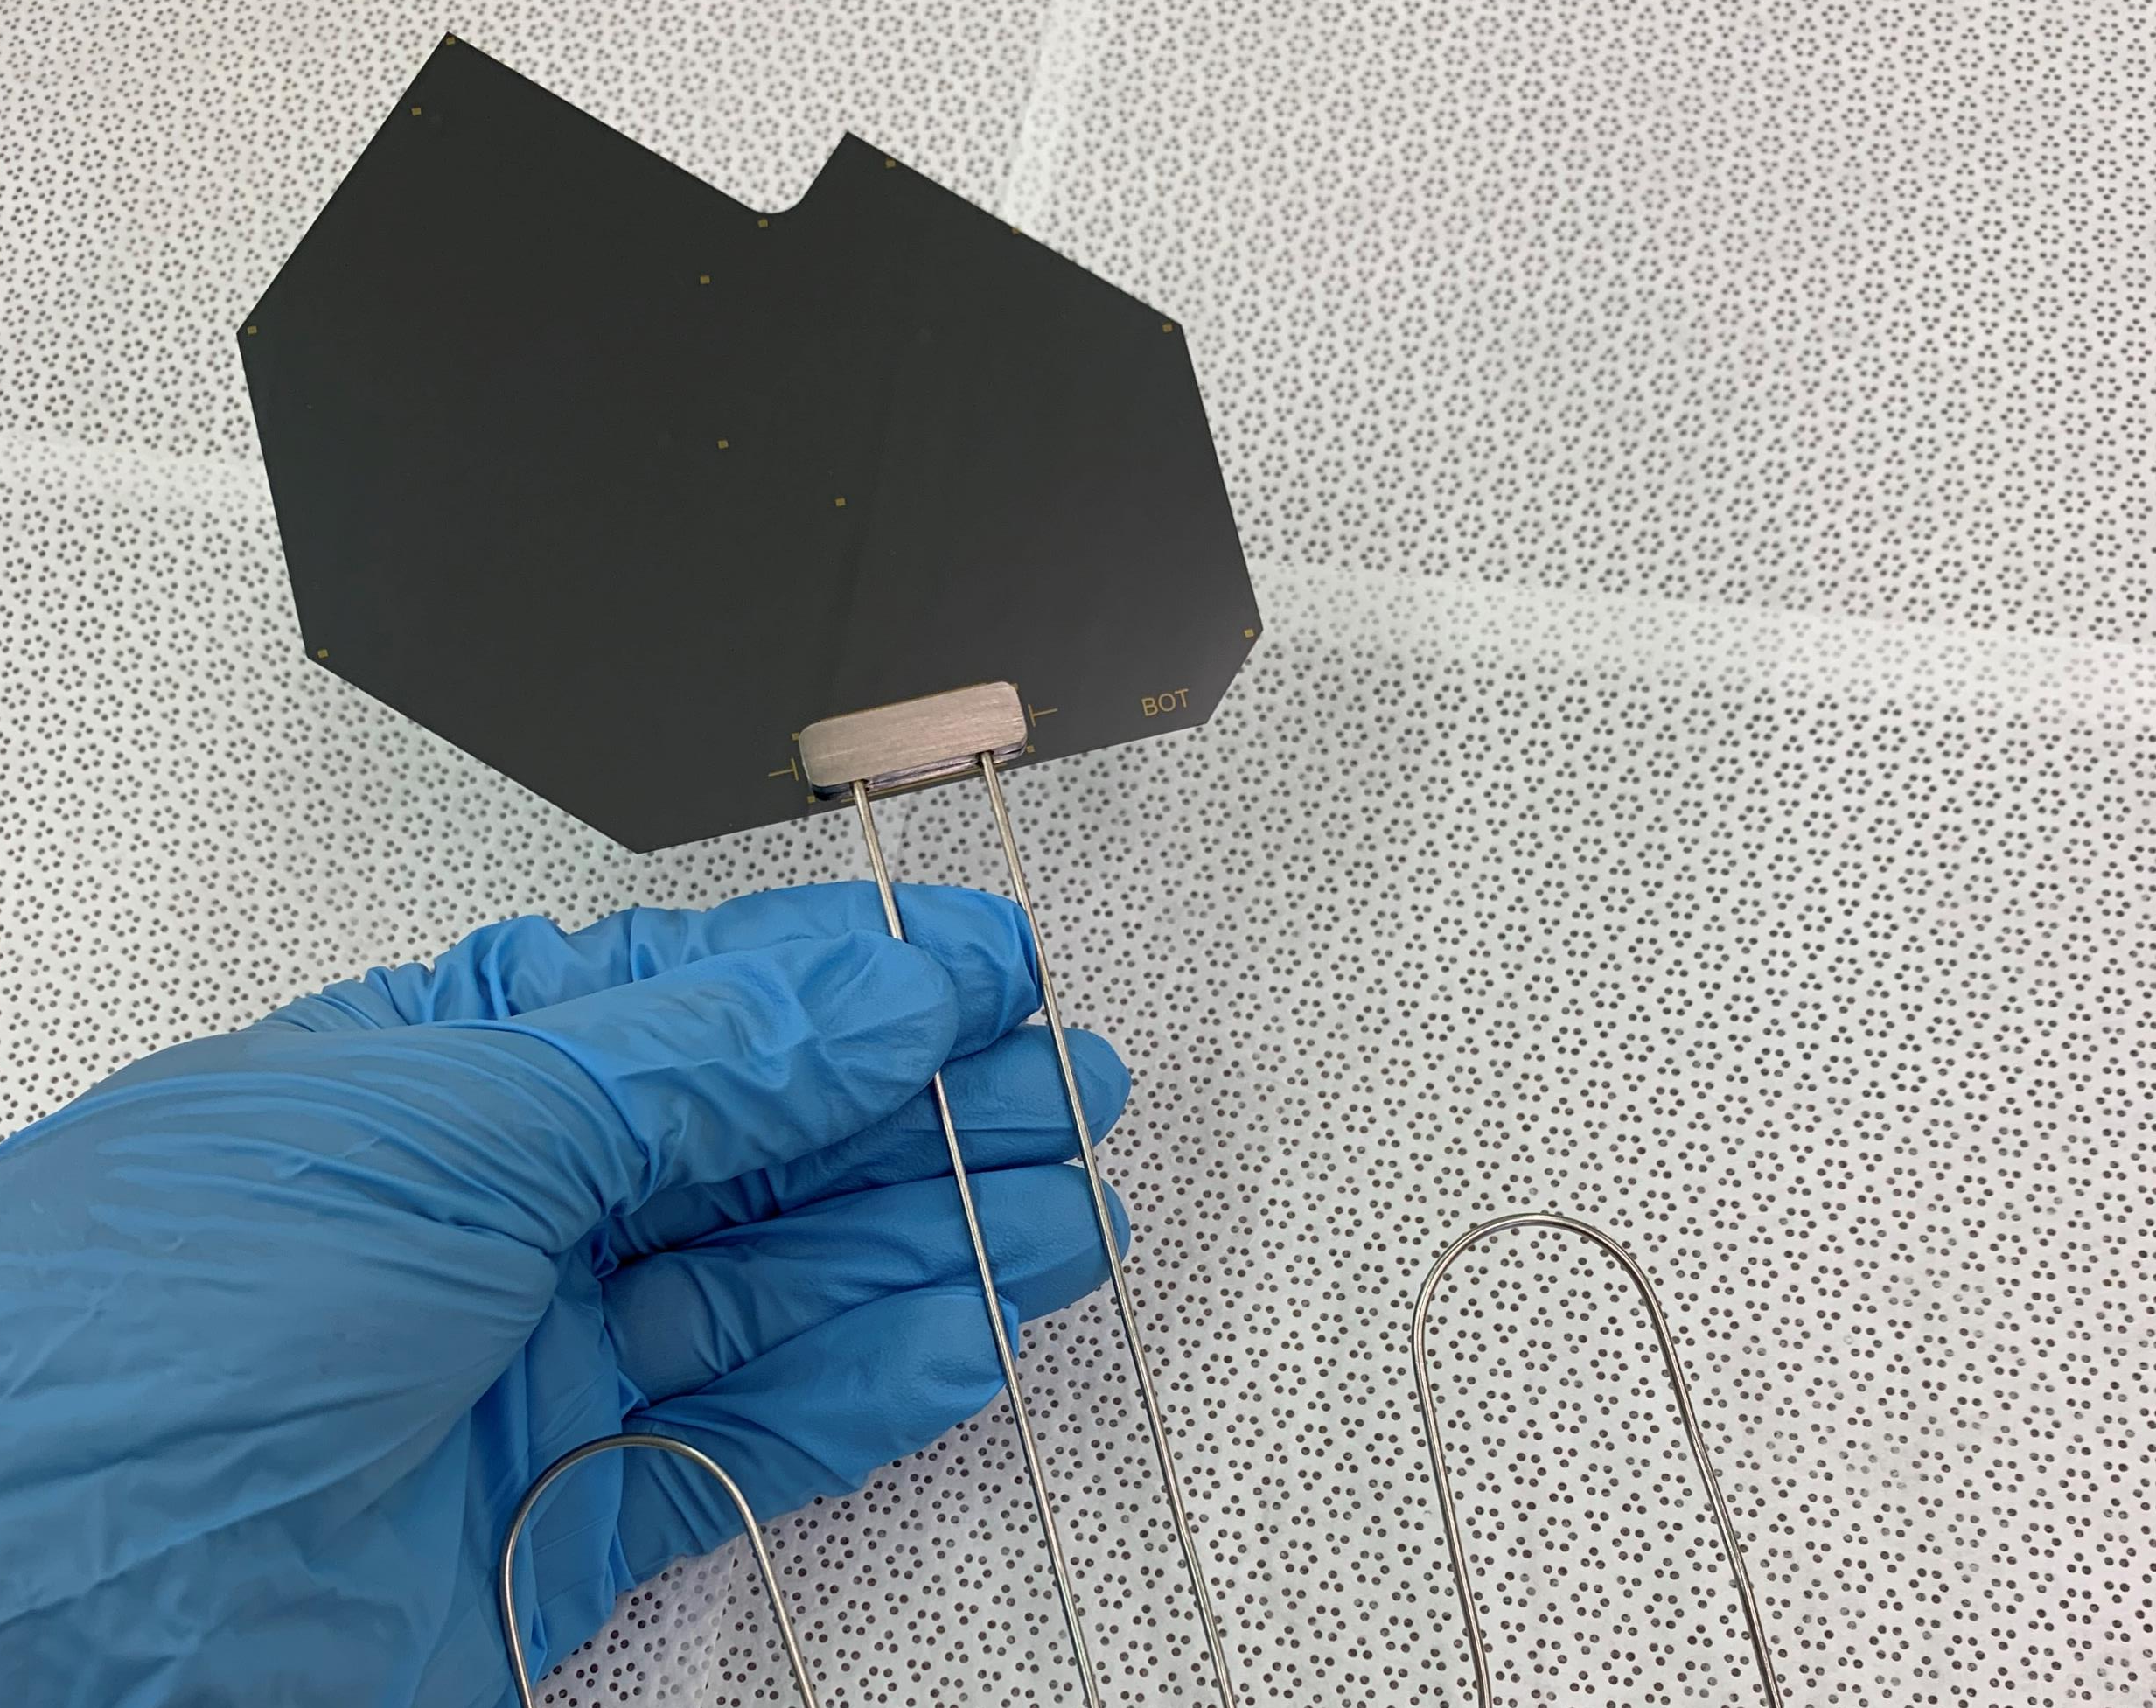
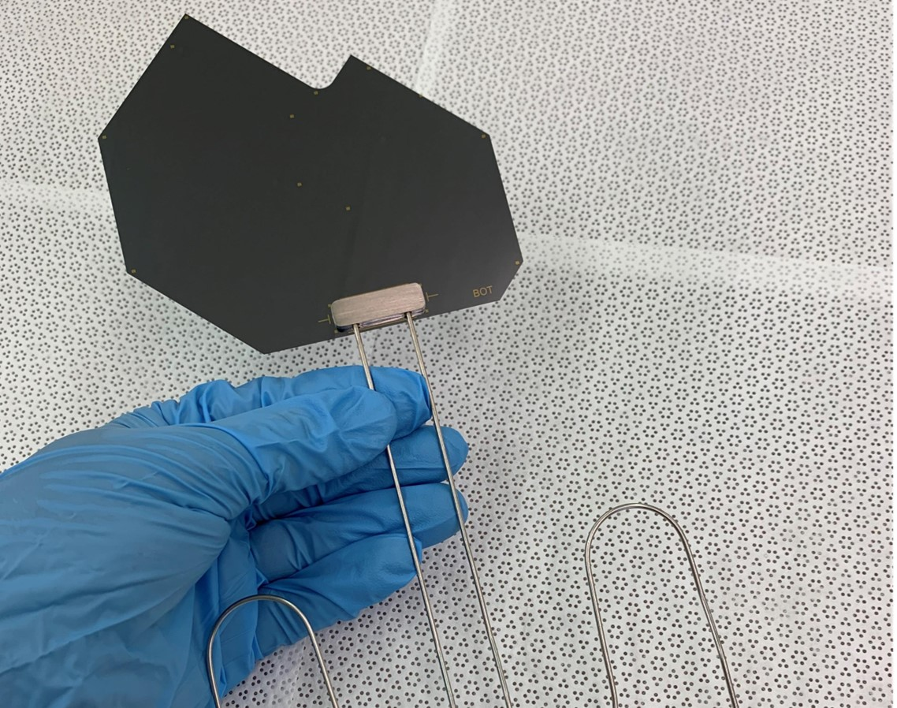
Cooling Substrates Qualification
VELO U2 Workshop
Wiktor Byczynski

Slide 2

Quality Control Objectives
Maintaining System Safety
Ensuring Cooling efficiency

Slide 3
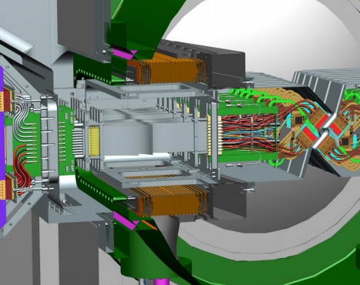
Maintaining System
Safety
Direct / indirect interface with the LHC require demonstrating system reliability
Ensure operational safety for personnel interacting with the system

Slide 4
Maintaining System
Safety
Direct / indirect interface with the LHC require demonstrating system reliability
Ensure operational safety for personnel interacting with the system
Assure - no Leaks!

Slide 5
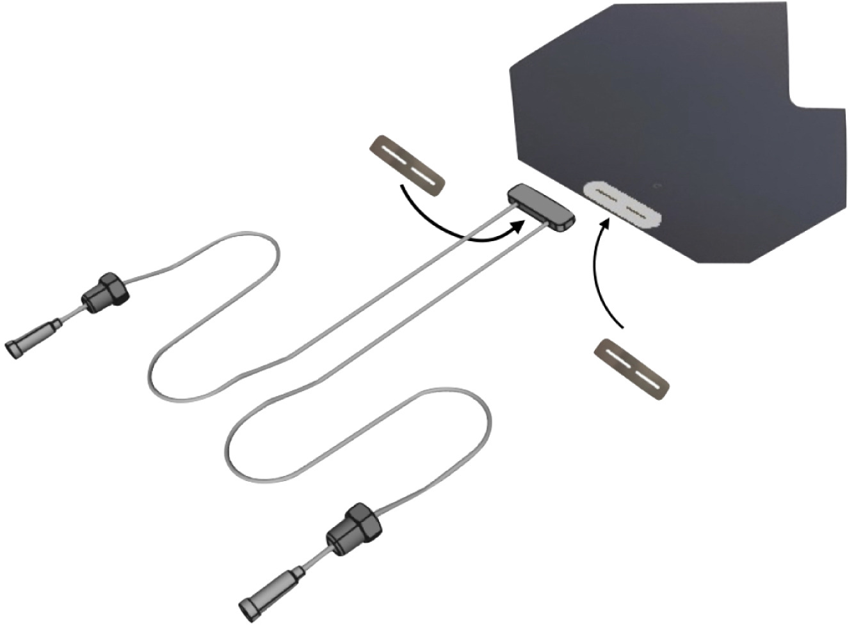
Reliability assurance
for silicon cooling substrates
Silicon
Fluidic Connector
Solder joint
Cooling Substrate

Slide 6
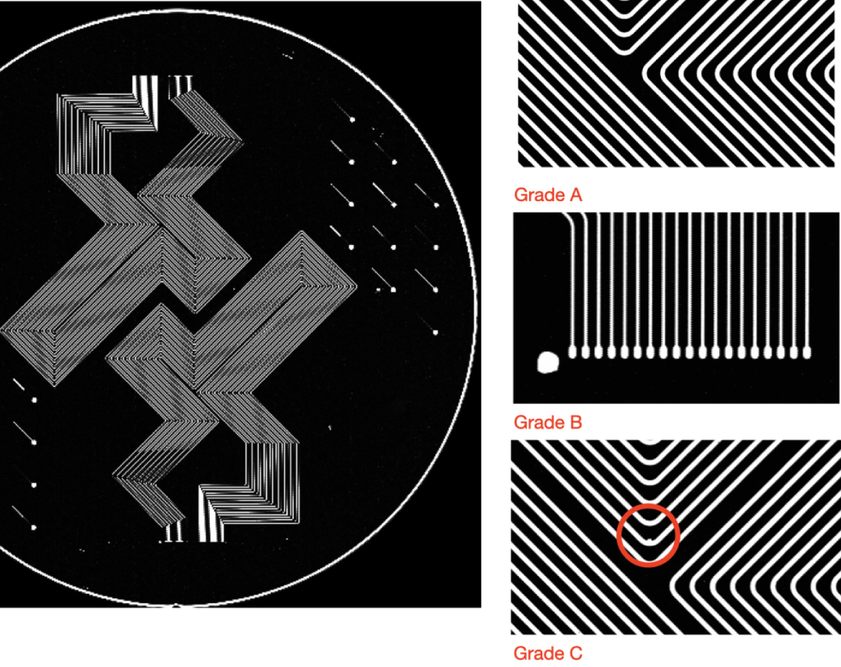
Reliability assurance Silicon
Scanning Acoustic Microscope images
Allow for the detection of bonding imperfections and enable classification of wafers based on void size and position

Slide 7
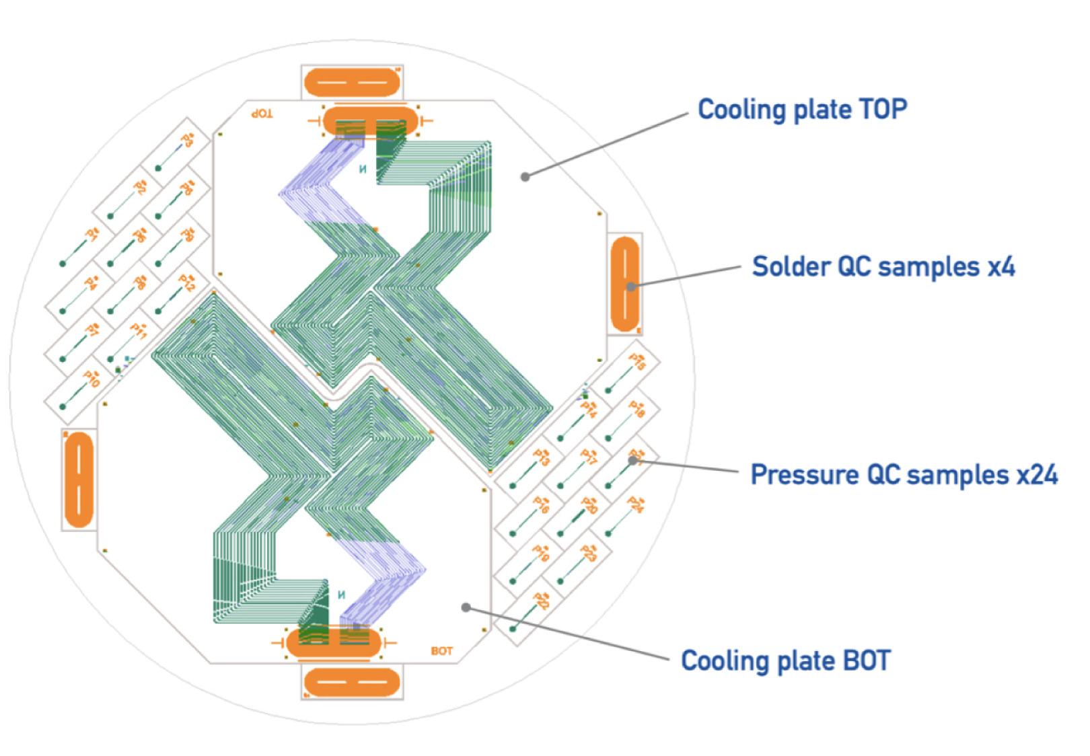
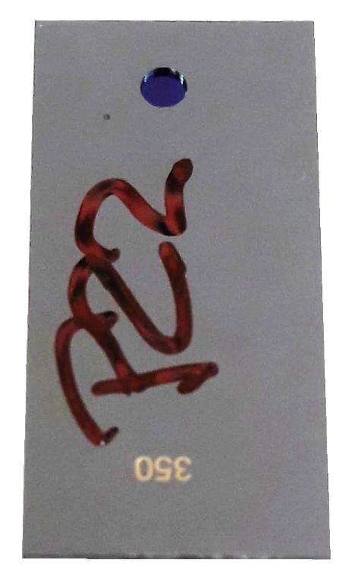
Reliability assurance Silicon
Bonding quality – high pressure test
Using small samples allows for the detection of wafer bonding issues and supports building statistics on the endurance of structures of varying sizes.

Slide 8
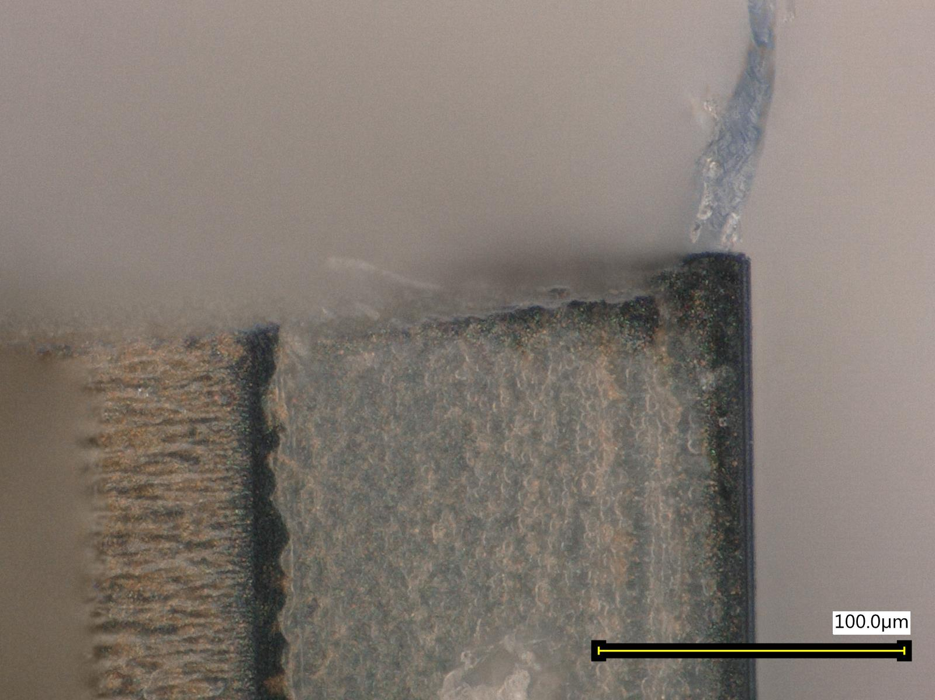
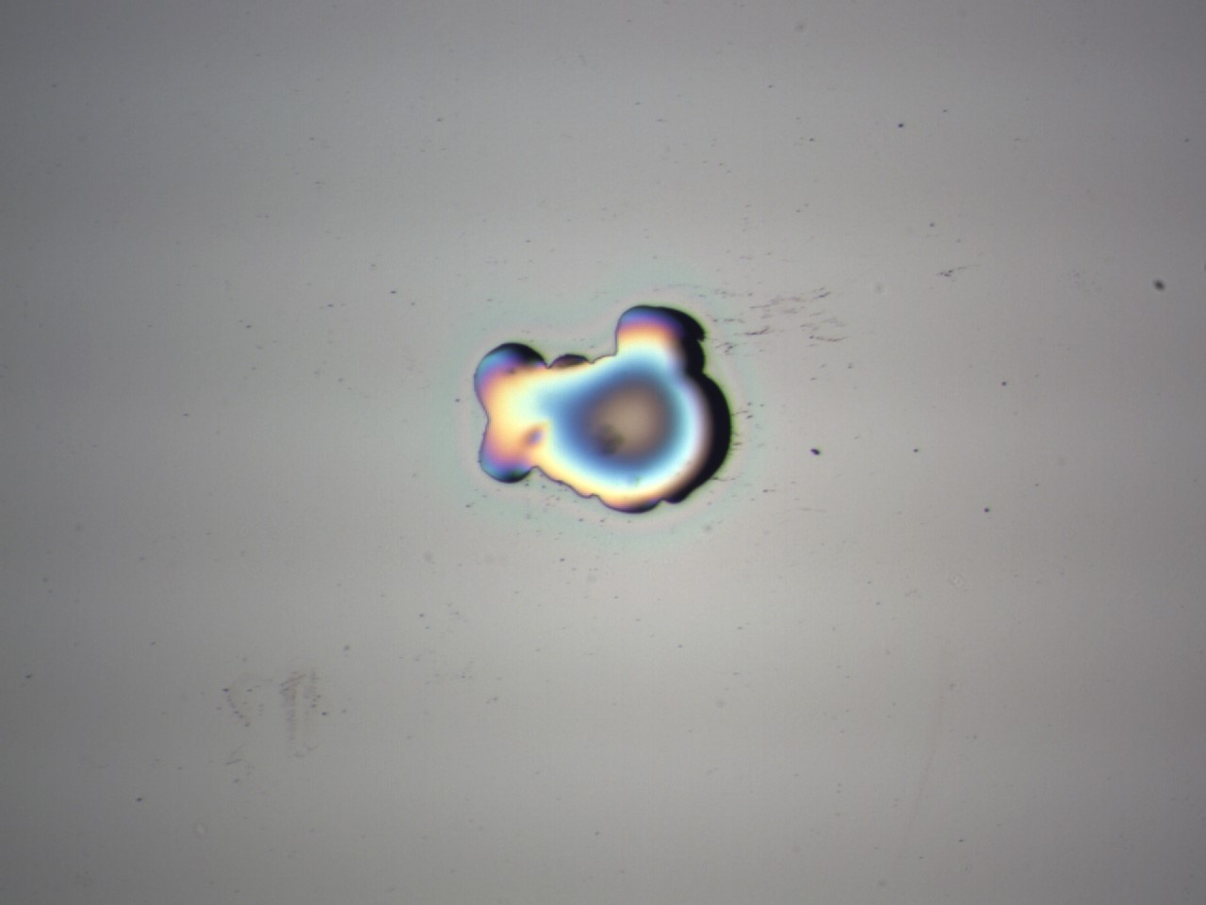
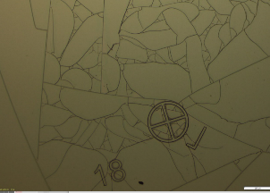
Reliability assurance Silicon
Visual inspections
Different methods (SEM, optical microscopy, UV exposure, etc.) allow evaluation of surface quality and cutting precision.

Slide 9
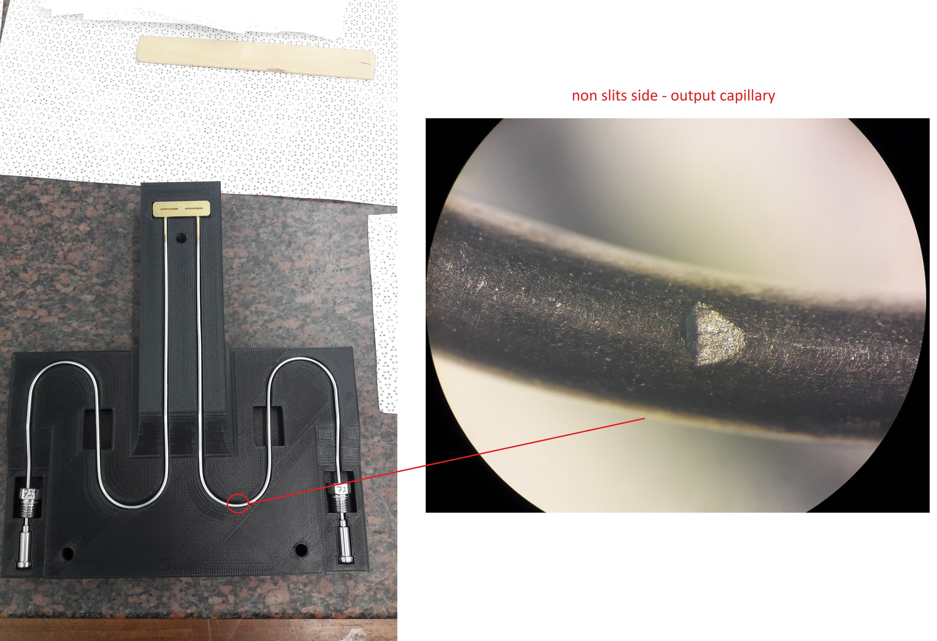
Reliability assurance Fluidic connector
Visual Inspection
Allows for the evaluation of surface quality and detection of mechanical damage.

Slide 10
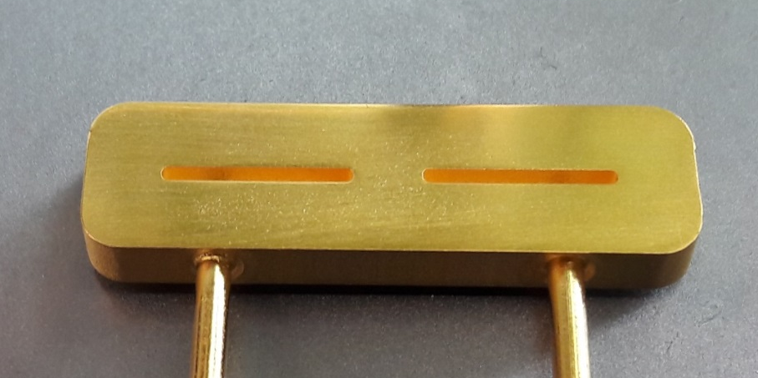
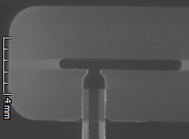
Reliability assurance Fluidic connector
X-Ray / Tomography
Allow for non-destructive inspection of joints and evaluation of internal material quality, helping to identify hidden defects and structural inconsistencies.

Slide 11
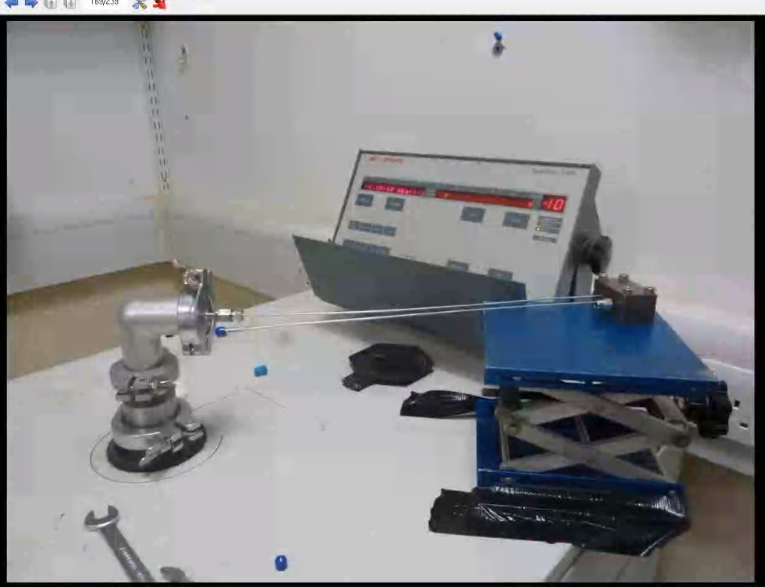
Reliability assurance Fluidic connector
Leak check
Allows for the detection of leaks and ensures the integrity of the assembly

Slide 12
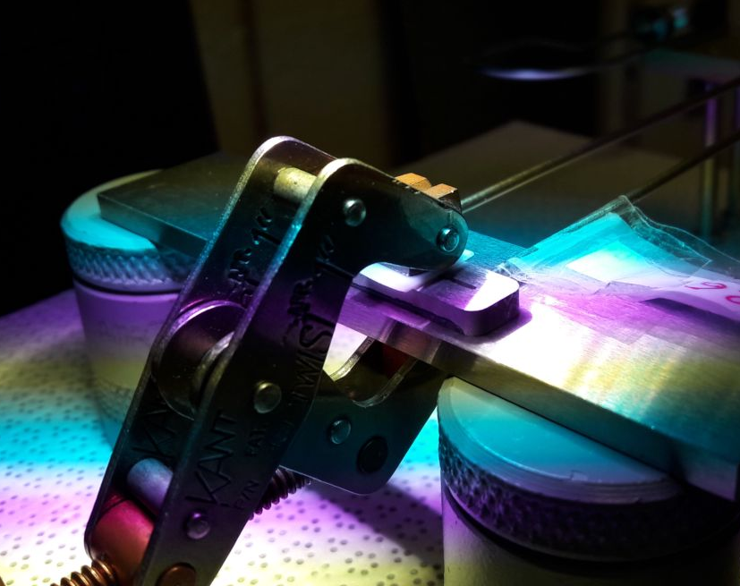
Reliability assurance Fluidic connector
Dimensional Metrology
Allows for the evaluation of geometrical dimensions, planarity, flatness, and parallelism to verify conformity with design requirements..

Slide 13
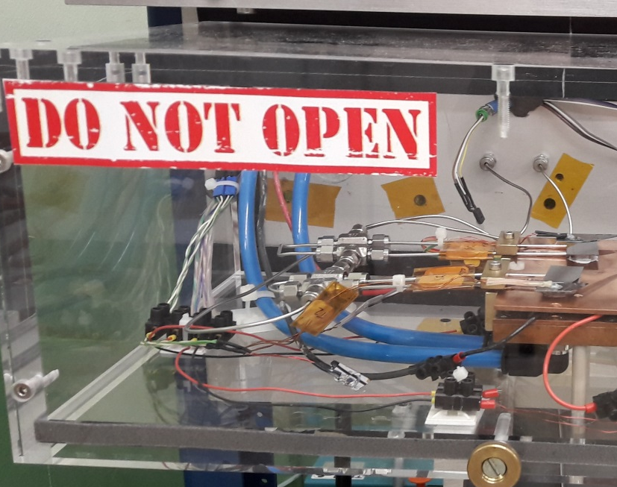
Reliability assurance Solder Joint
Joint Robustness Test
Allows testing of resistance to accumulated stress caused by accelerated creep and fatigue effects, such as pressure and temperature cycling.

Slide 14
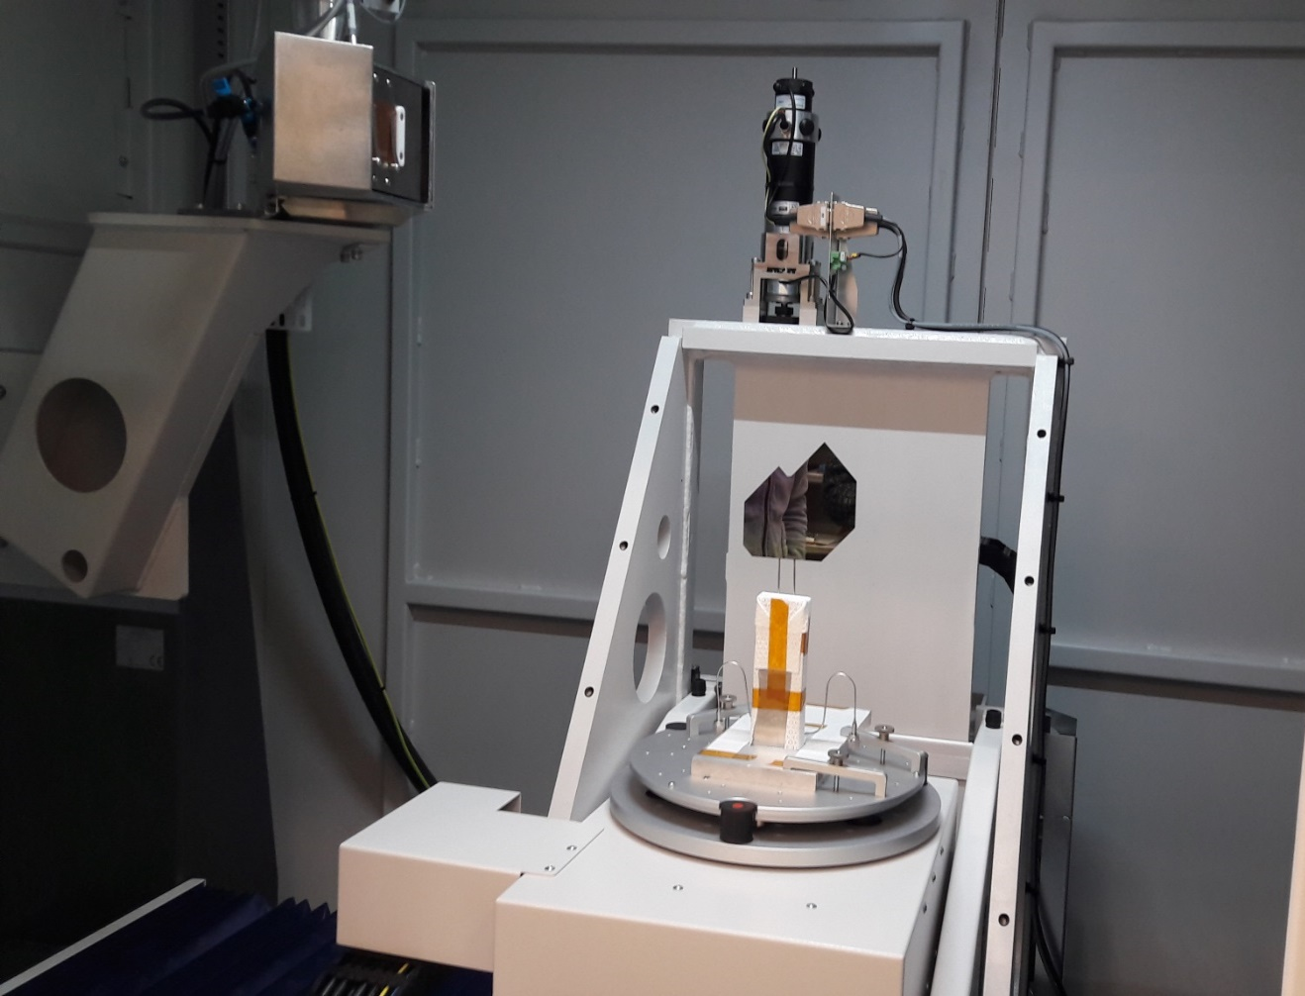

Reliability assurance Cooling Substrate
X-Ray / Tomography
Allow non-destructive inspection of joints, enabling the identification of hidden defects and structural inconsistencies.

Slide 15
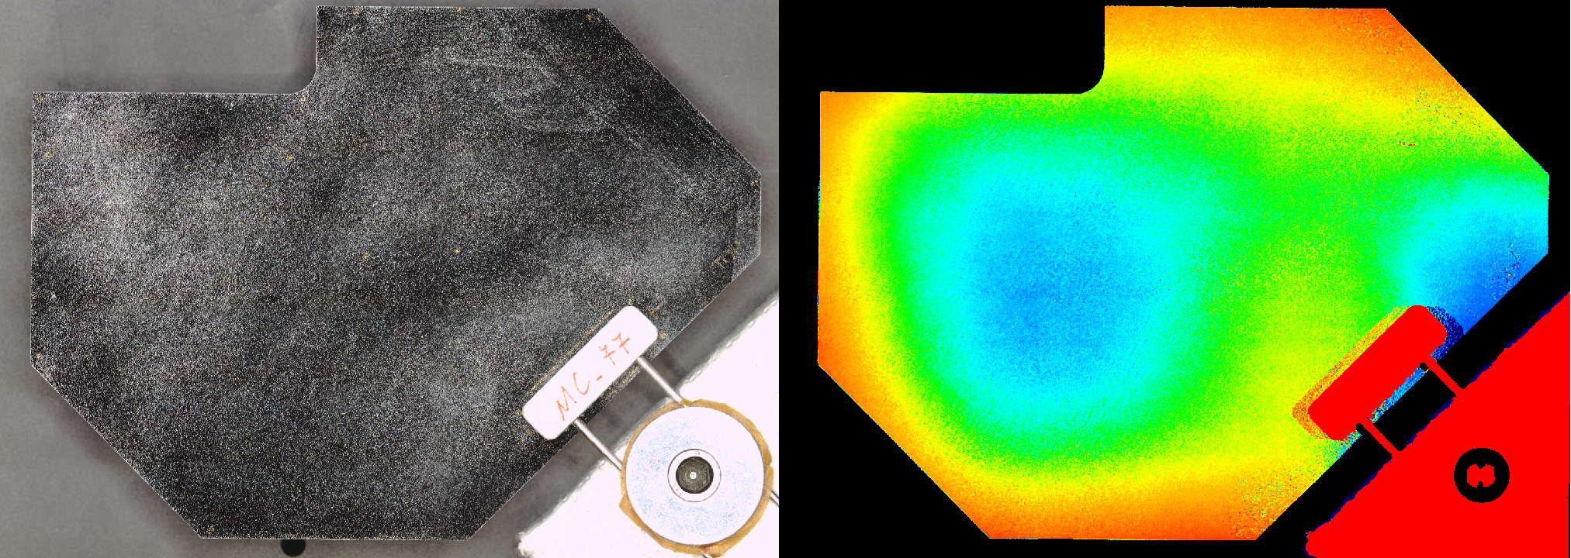
Reliability assurance Cooling Substrate
Dimensional Metrology
Allows for the evaluation of geometrical dimensions, planarity, flatness, and parallelism to verify conformity with design requirements..

Slide 16
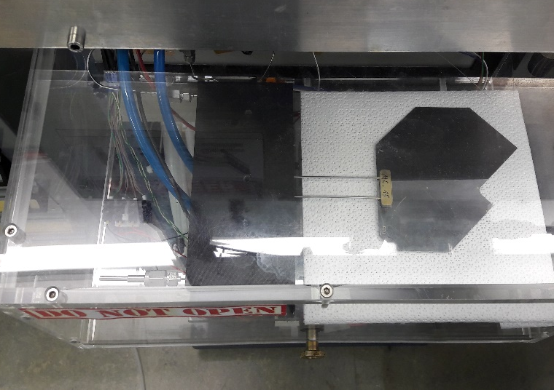
Reliability assurance Cooling Substrate
Substrate robustness proof test
Allows for assessing the final product’s quality by testing the substrate’s durability under stress conditions.

Slide 17
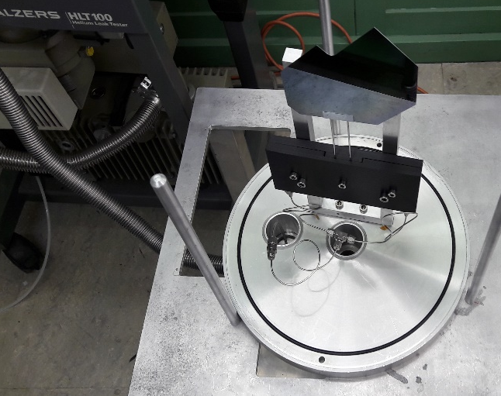
Reliability assurance Cooling Substrate
Substrate leak test
Allows for the evaluation of the final product’s quality by detecting leaks and verifying seal integrity after initial stress induced by the robustness test.

Slide 18
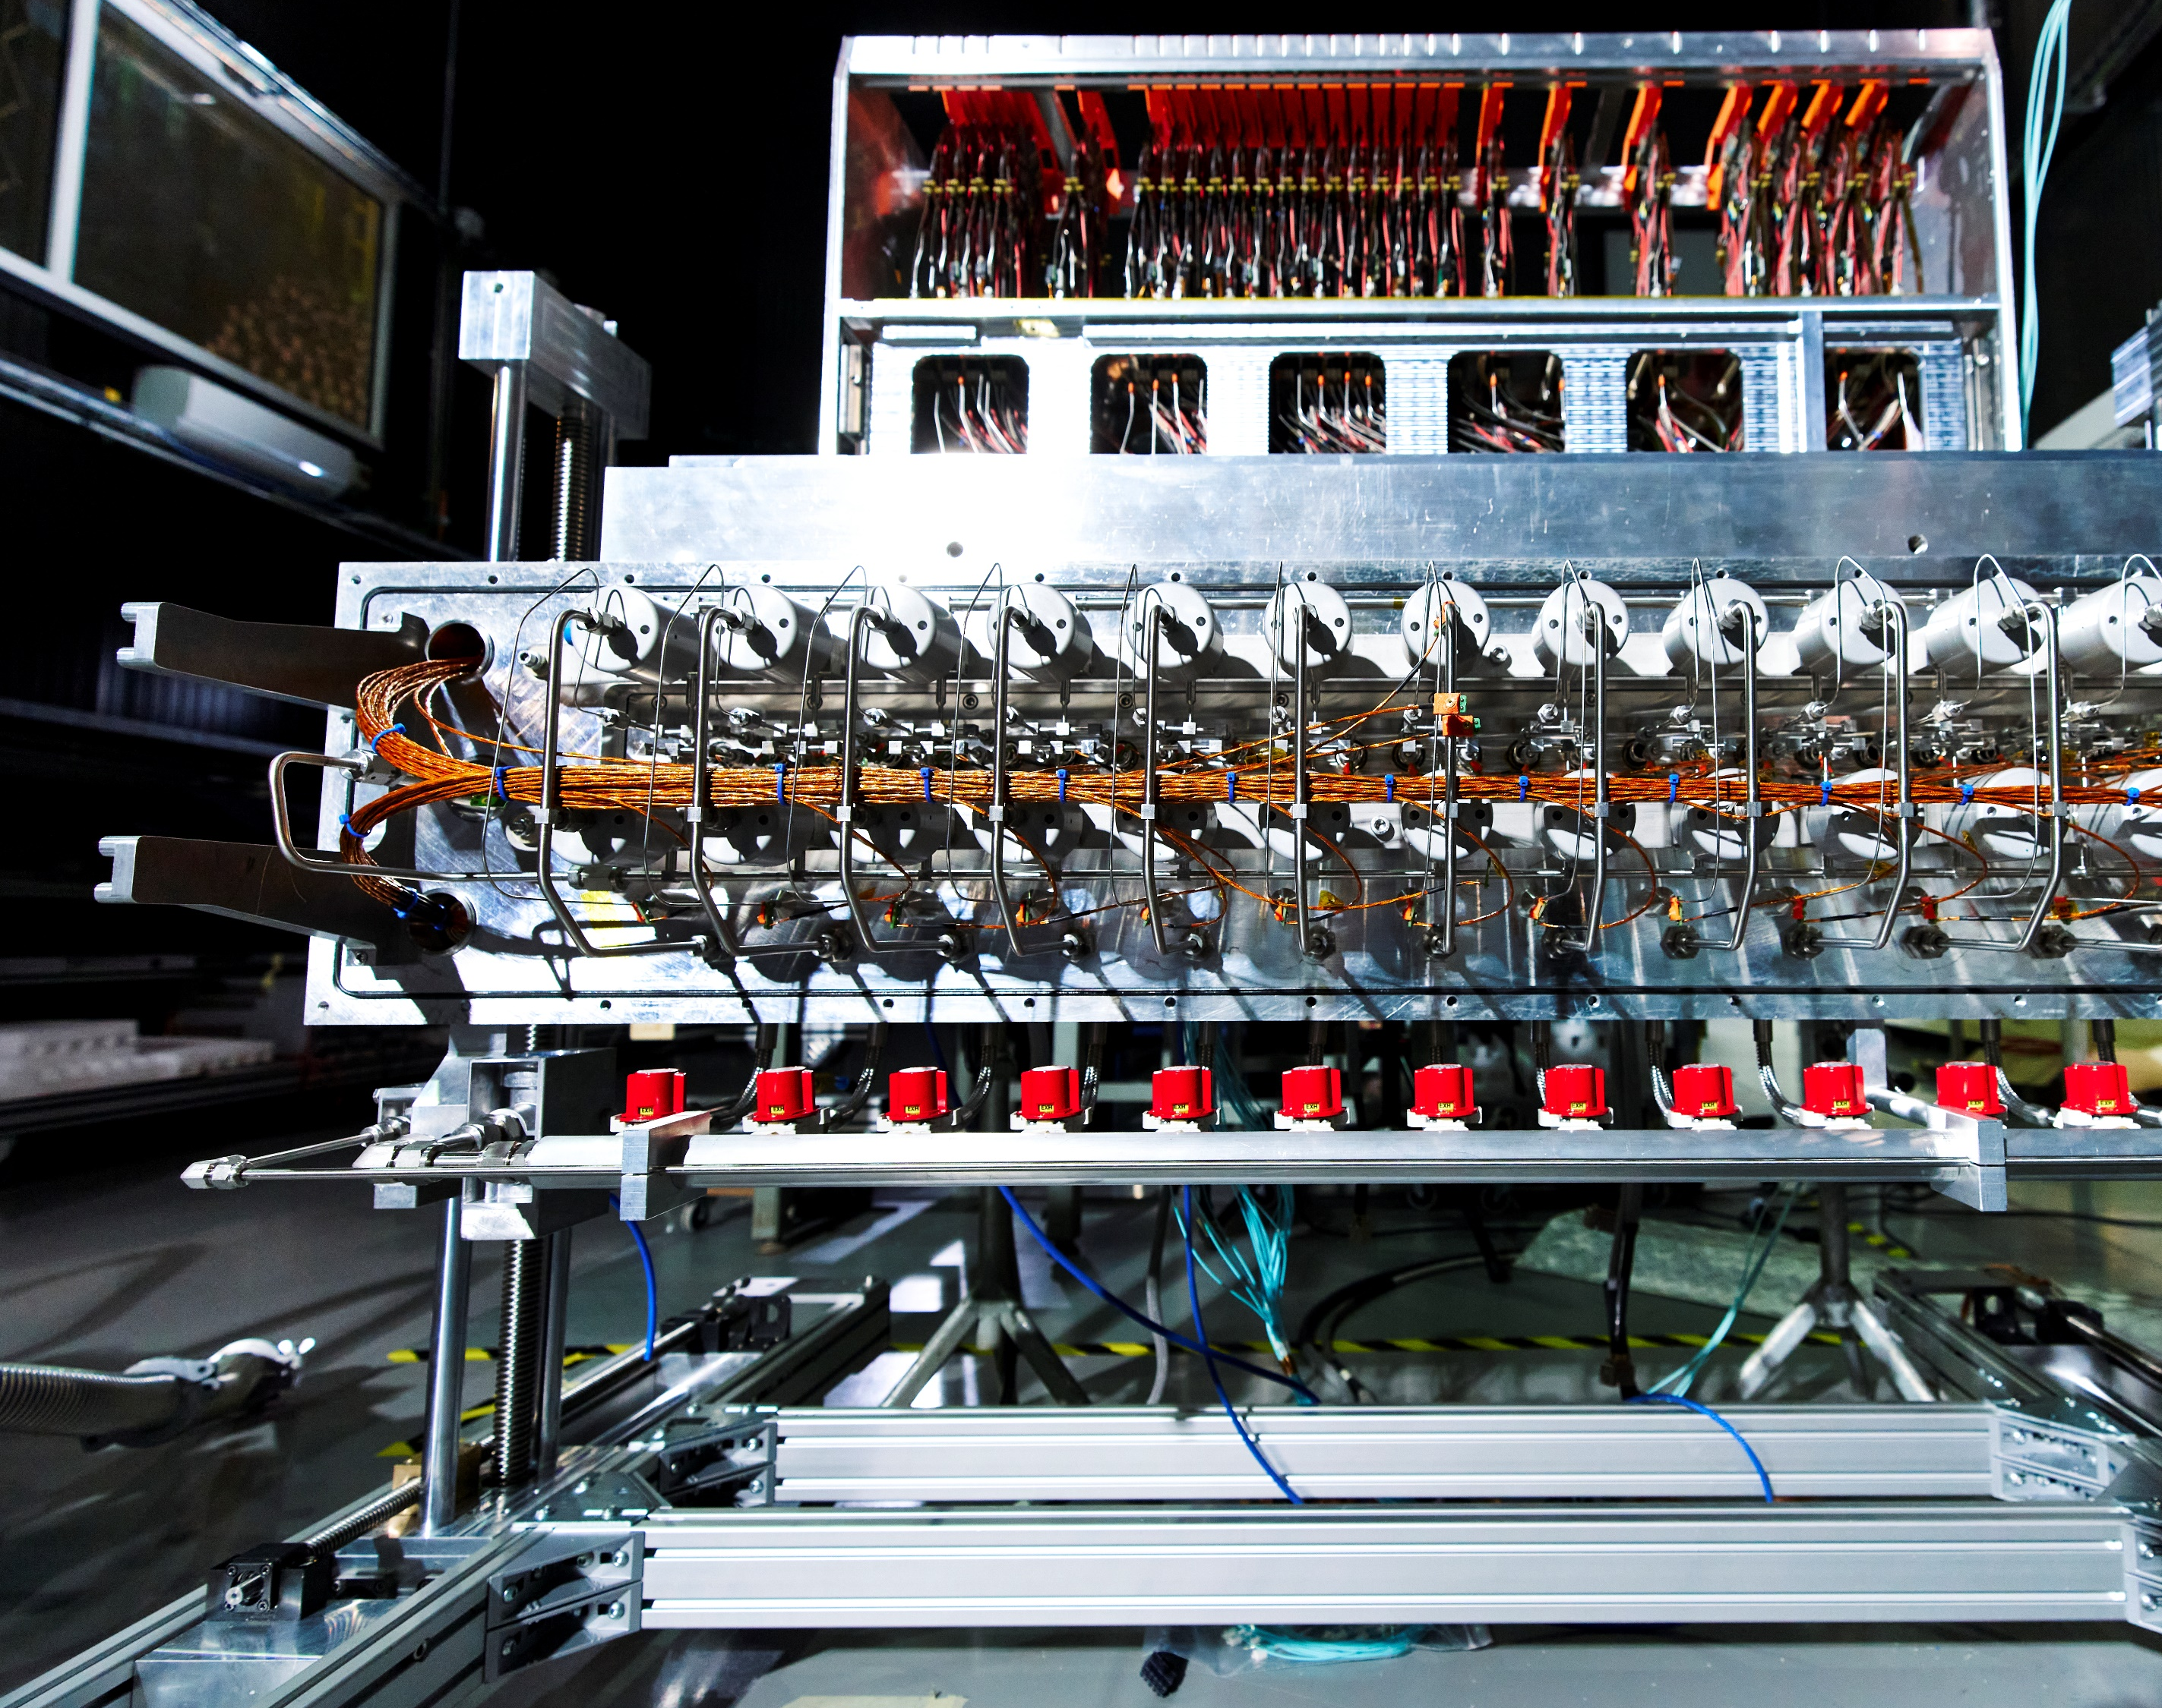
Ensuring Cooling efficiency
Maintains proper sensor temperature
Ensures stable cooling performance

Slide 19
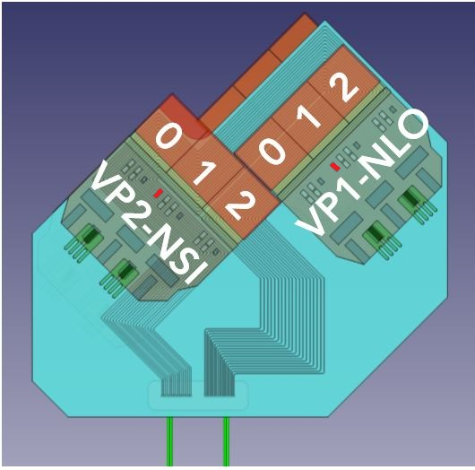
Cooling Substrate Performance Assessment
Evaluation of Boiling Behaviour
Fluidic Characterization
Substrates Parallel Operation
Thermal Figure of Merit

Slide 20
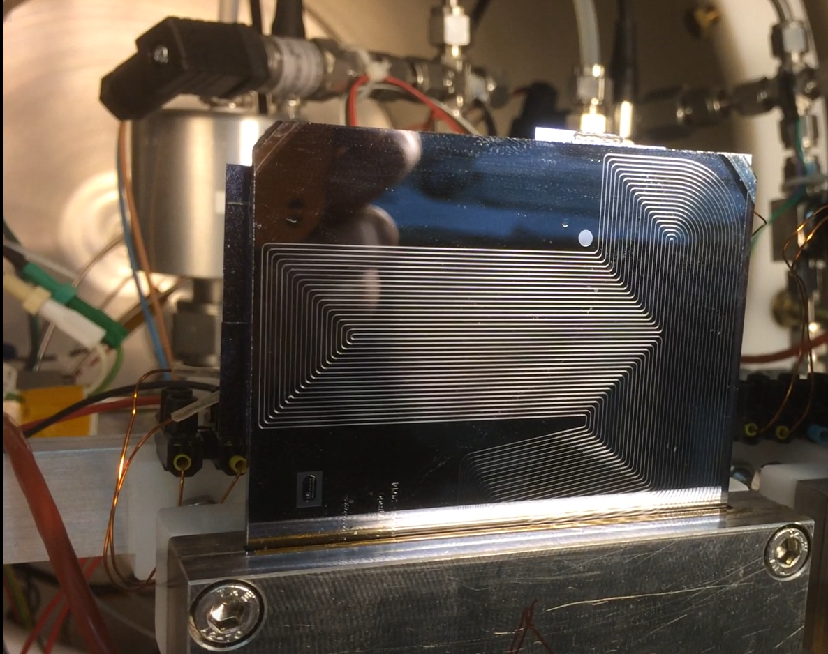
Evaluation
of Boiling Behavior
Allows assessment of the proper initiation of boiling within the restriction region in different system conditions

Slide 21
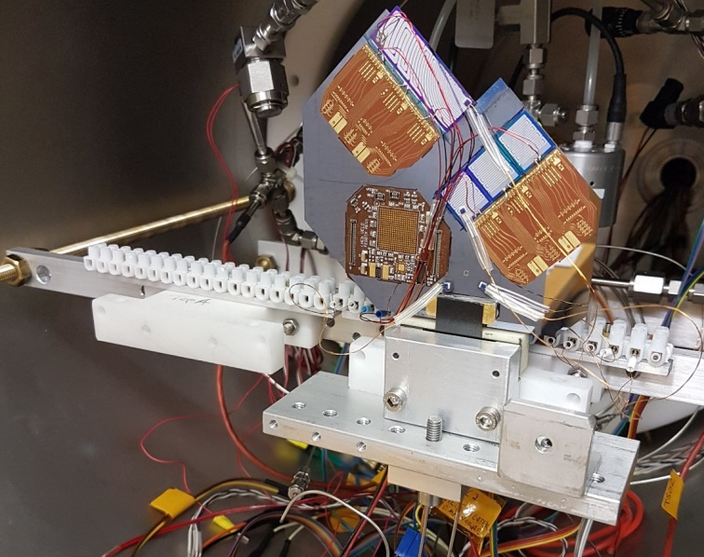
Fluidic characterization
Enables the measurement of system parameters across different flow rates, temperatures, and thermal load conditions, providing essential input for the design of the cooling plant.

Slide 22
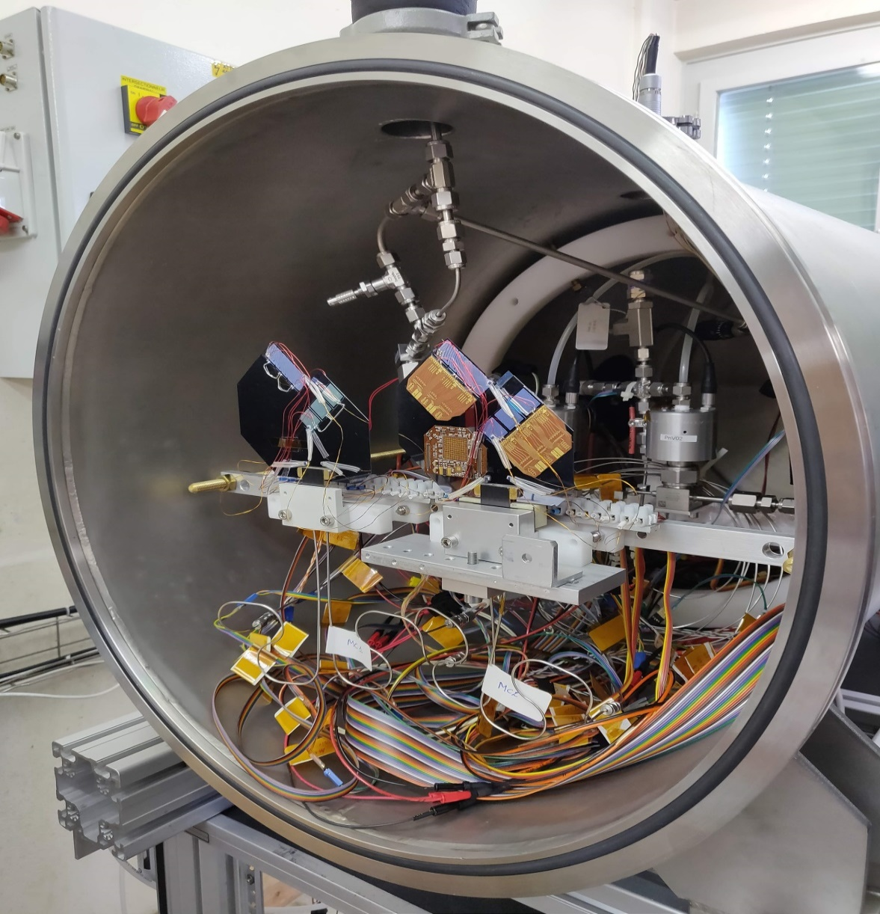
Substrates Parallel Operation
Enables evaluation of multi-module operation to verify uniform and effective coolant distribution.

Slide 23
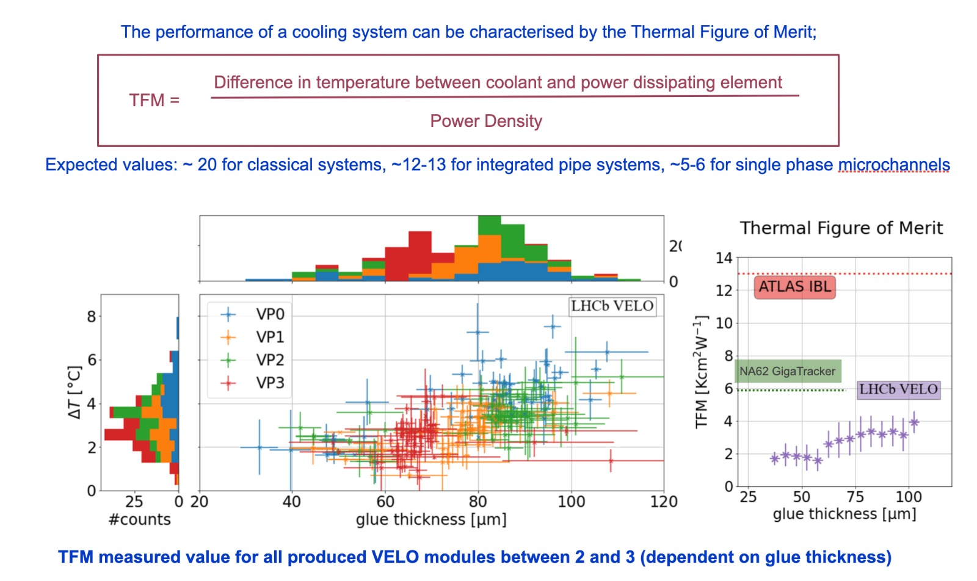
Thermal Figure of Merit
Allows assessment of the final module’s quality and verification of effective cooling performance.

Slide 24
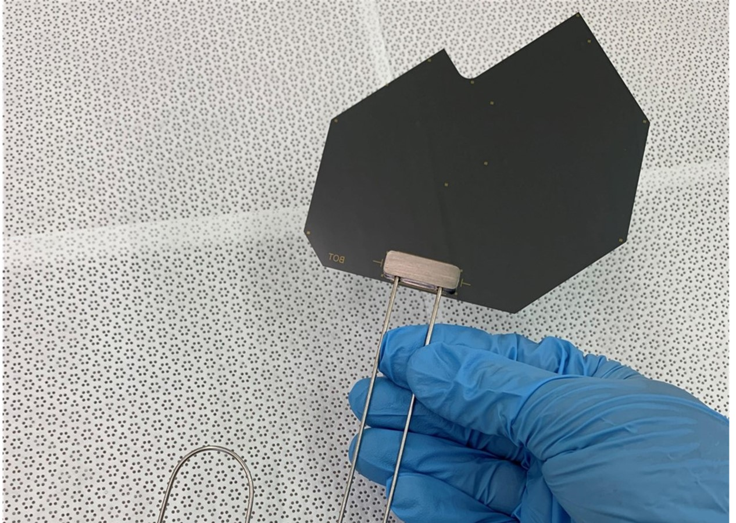
Summary
Cooling substrates must be designed to ensure safety during operation.
Leak prevention is critical to maintain system integrity and reliability.
Qualification tests vary depending on the selected cooling technology.
Testing protocols vary between R&D, focusing on design validation, and production, prioritizing process control and product reliability

Slide 25
Thank You!

