Slide 1


Ceramics microchannels
Oscar Augusto on behalf of The University of Manchester and CERN

Slide 2
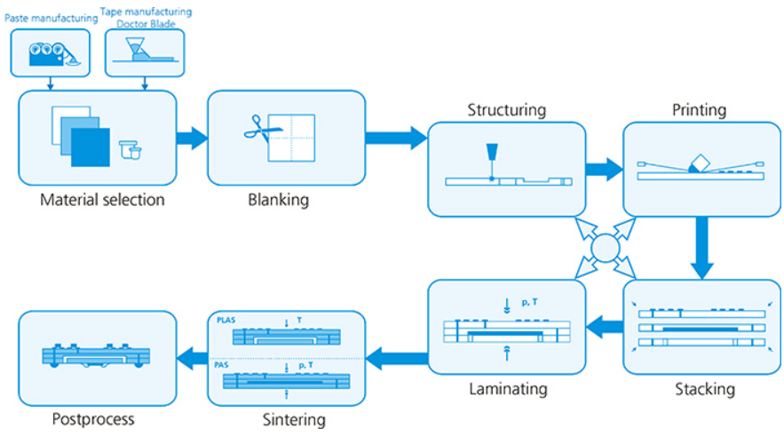
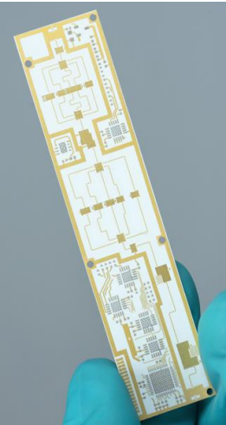
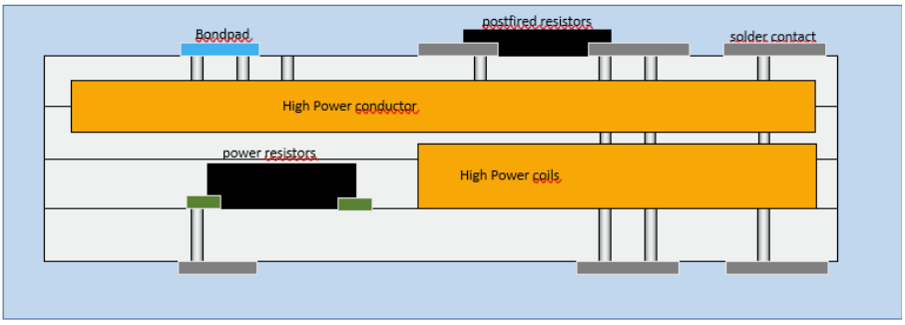
Ceramics LTCC
Why?
Robustness and reliability
Manufacturing at IKTS Fraunhofer (Germany) and Micro-Epsilon
Possible to embed conductive layers in between ceramics layers and metalize the surface
Potential to integrate electronics or high conductivity elements
Mechanically robust and compatible with high ultra vacuum
Different base materials: Al2O3/Glass (LTCC), YSZ, $Al_{2}O_{3}$ and further options
Different base materials: Al2O3/Glass (LTCC), YSZ, Al_2 O_3 and further options
Manufacturing based on several layers
Cooling structure is empty by construction
Development in collaboration with CERN
©Fraunhofer IKTS

Slide 3
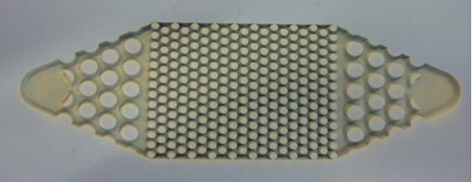

Ceramics (IKTS)
Experience with fluidic applications
First prototype based on the early VELO Upgrade I CERN design
Initial channel with $70μm$ width (restrictions)
Initial channel with 70μm width (restrictions)
Channels height $100μm$
Channels height 100𝜇𝑚
Overall dimensions: $40×60mm^{2}$
Overall dimensions: 40×60mm^2
Based on LTCC
$Al_{2}O_{3}/Glass$ $\sim 1:1$ (20W/m.K)
Al_2 O_3/Glass ~1:1 (20W/m.K)
HTCC at a later stage ($Al_{2}O_{3}$ $\sim 96\%$)?
HTCC at a later stage (Al_2 O_3 ~96%)?
©Fraunhofer IKTS
Restrictions
Input
Output
40 mm
Main
channels
60 mm

Slide 4
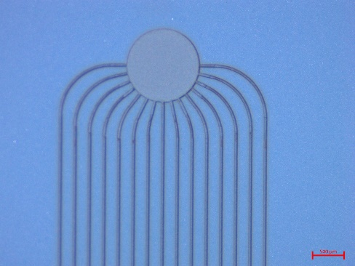
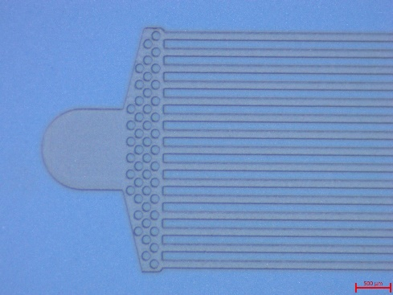
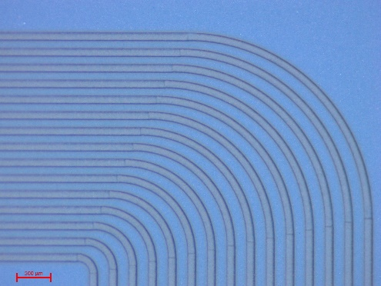
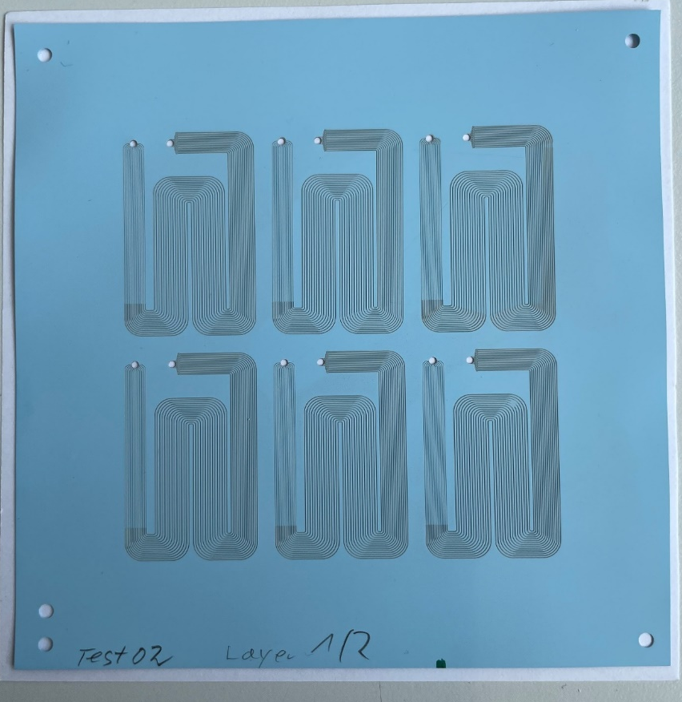
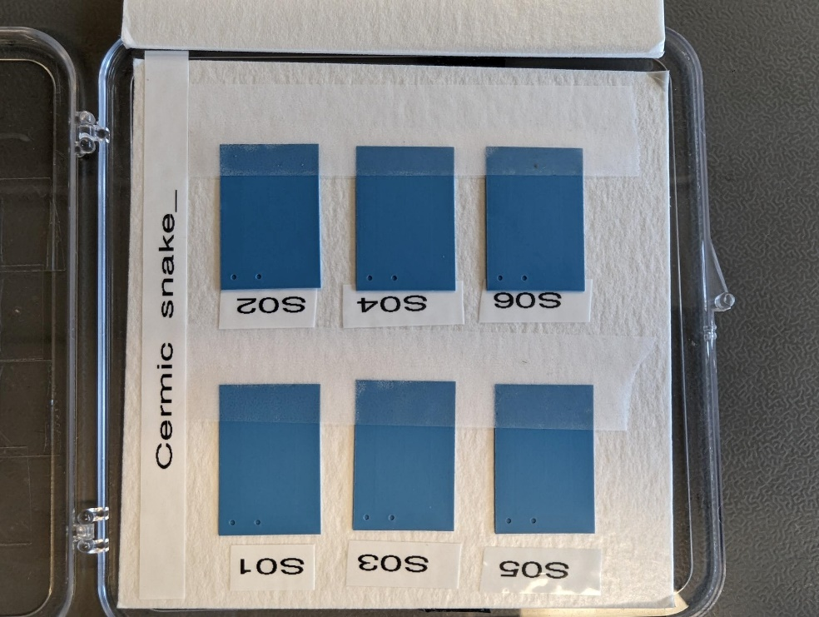
Ceramics: Goal and status
Recap:
Manufactured first samples (IKTS)
Nominal samples received
Validate initial prototypes to CO2 pressure level, leak tightness and cooling performance
Miniaturized version (2x smaller in-plane)
Expected 35um and 100um width restrictions and main channels respectively!
IKTS Fraunhoffer ©
IKTS Fraunhoffer ©
IKTS Fraunhoffer ©
Fraunhoffer ©

Slide 5
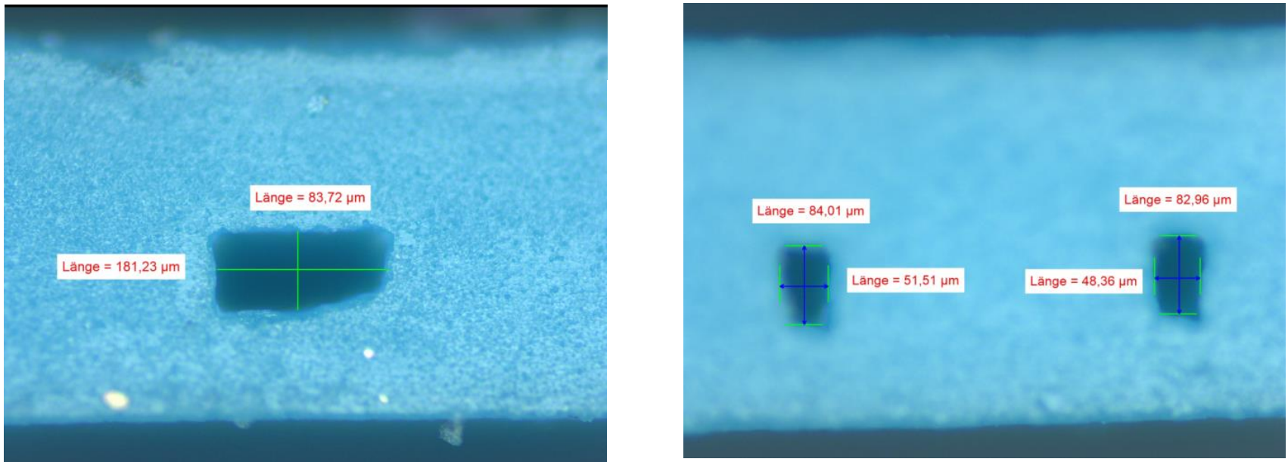
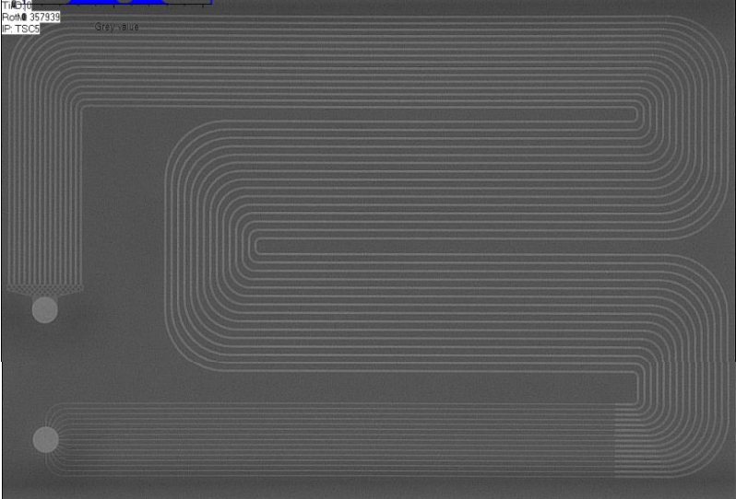
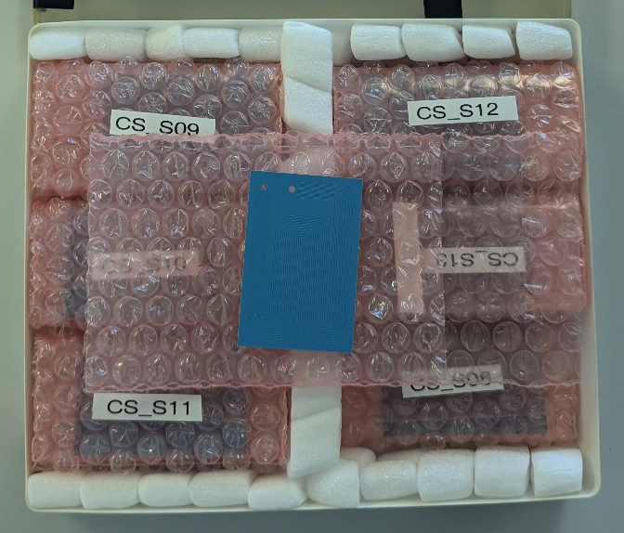
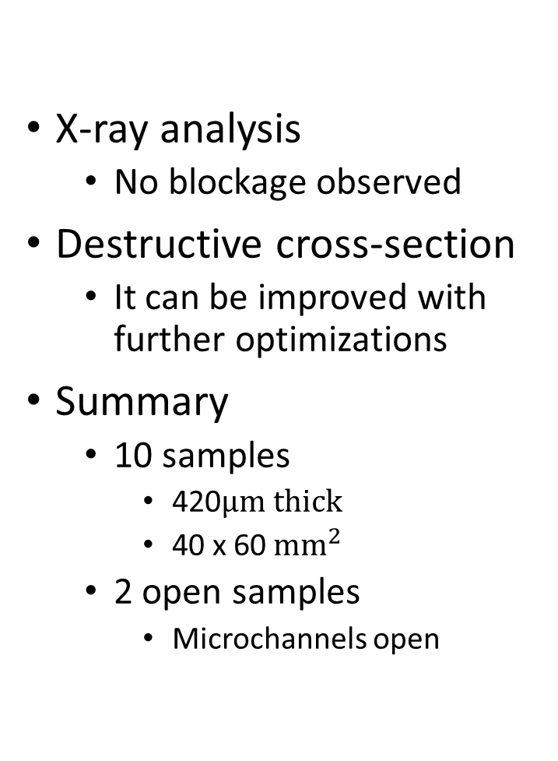
Nominal samples
Sample destructive cross section measurement
X-ray analysis
  No blockage observed
Destructive cross-section
  It can be improved with further optimizations
Summary
  10 samples
    420$μm thick$
    40 x 60 $mm^{2}$
  2 open samples
    Microchannels open
X-ray analysis
Samples at UoM

Slide 6
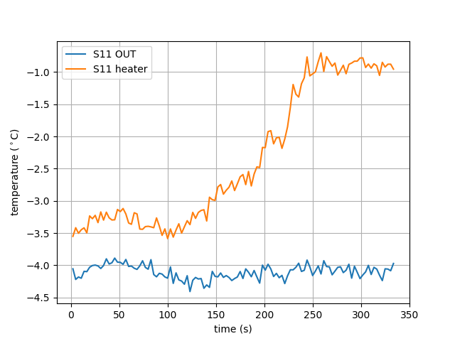
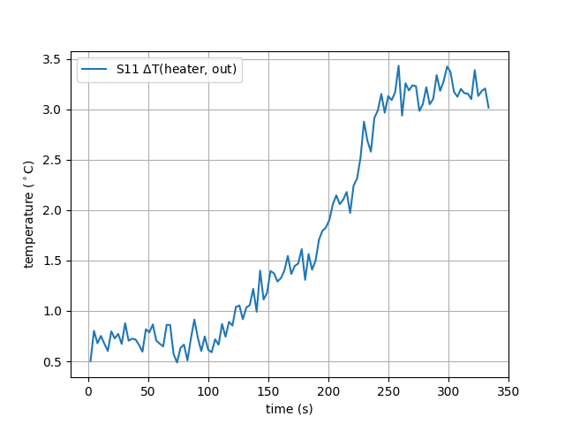
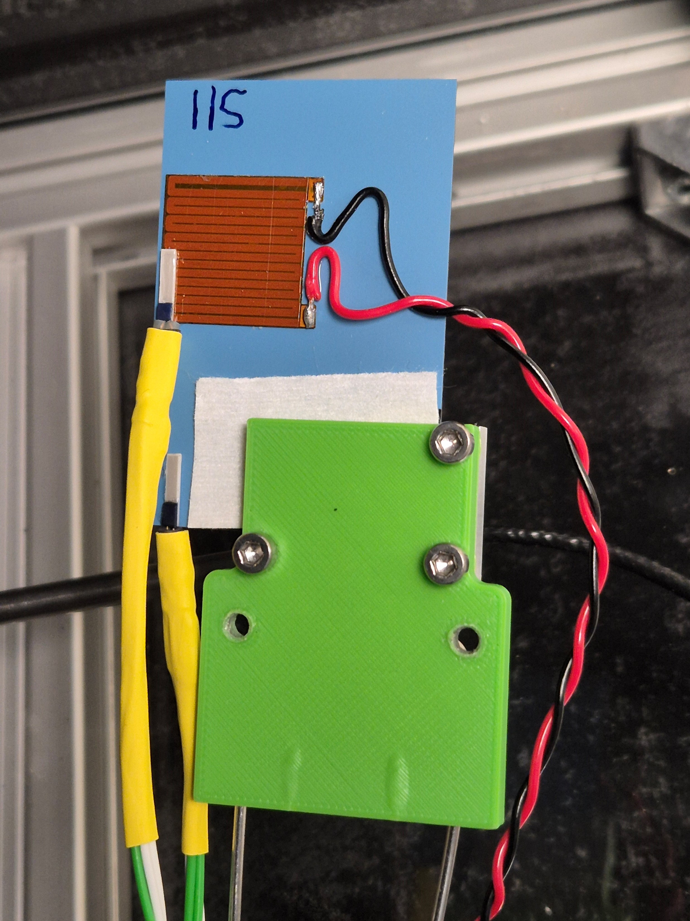
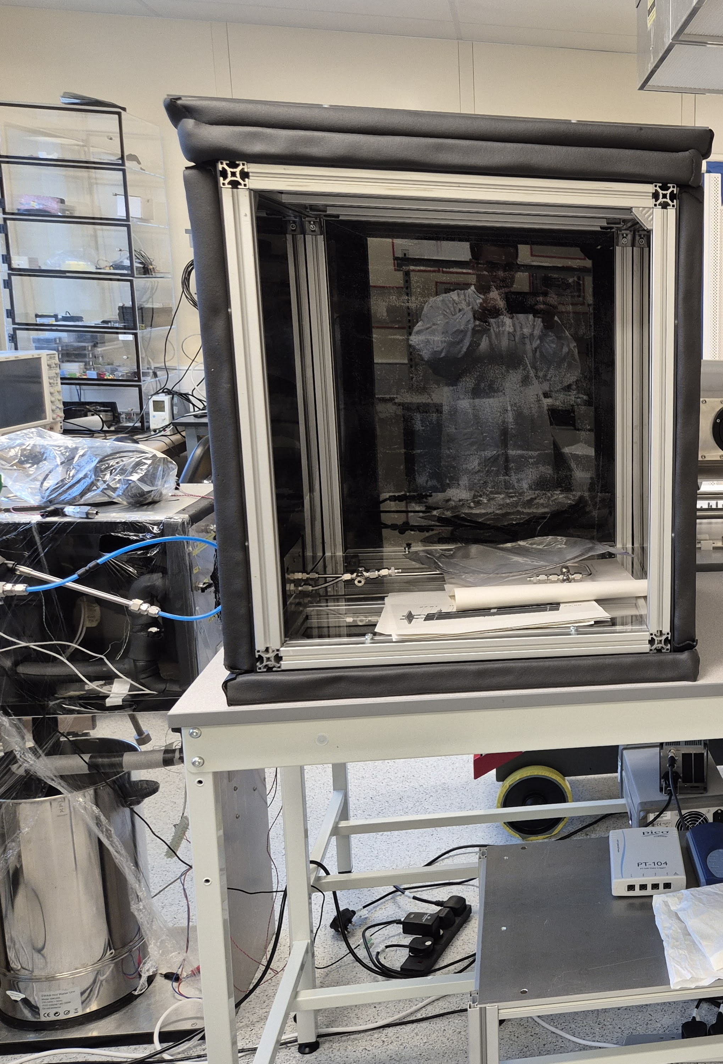
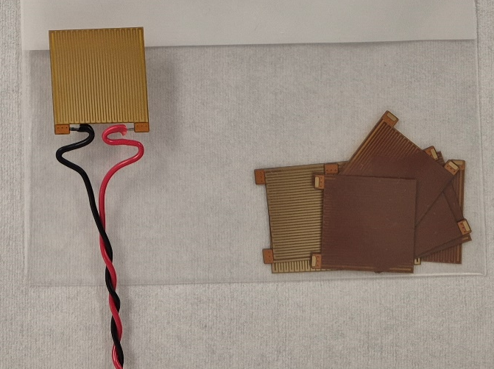


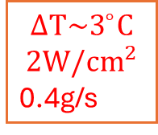

VELO Upgrade II
Disclaimer: Test done in a dry air box. To be repeated in vacuum.
No overhang!
$CO_{2}$ circulation!!!
$$ΔT\sim 3^{∘}C$$
$$2W/cm^{2}$$
0.4g/s
$2W/cm^{2}$ -> $ΔT∼{3.4}^{∘}C$
Custom-made heater for cooling tests
kapton
copper
glue
Si (200$μm$)
Dry air box

Slide 7
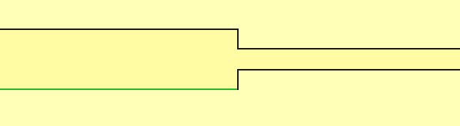
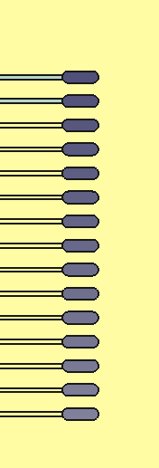

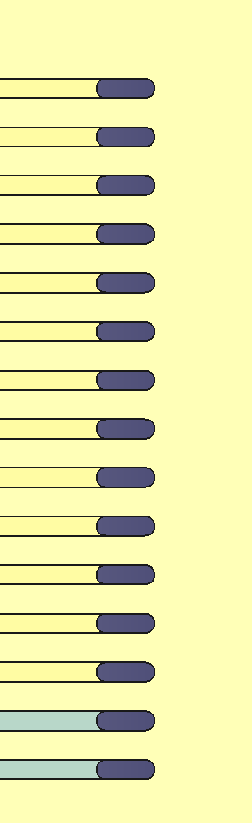

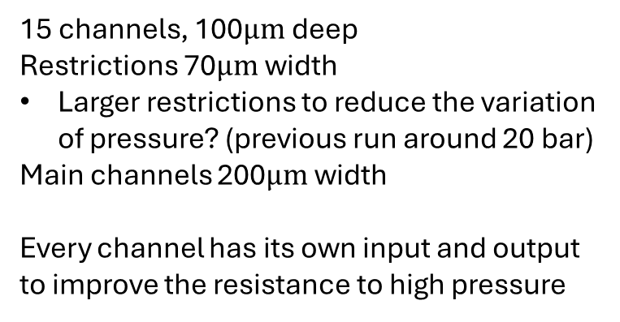


New design for the ceramics
600 x 200$μm^{2}$
70$μm$
200$μm$
Inputs
15 channels, 100$μm$deep
Restrictions 70$μm$ width
Larger restrictions to reduce the variation of pressure? (previous run around 20 bar)
Main channels 200$μm$ width
Every channel has its own input and output to improve the resistance to high pressure
40mm
Outputs
60mm

Slide 8
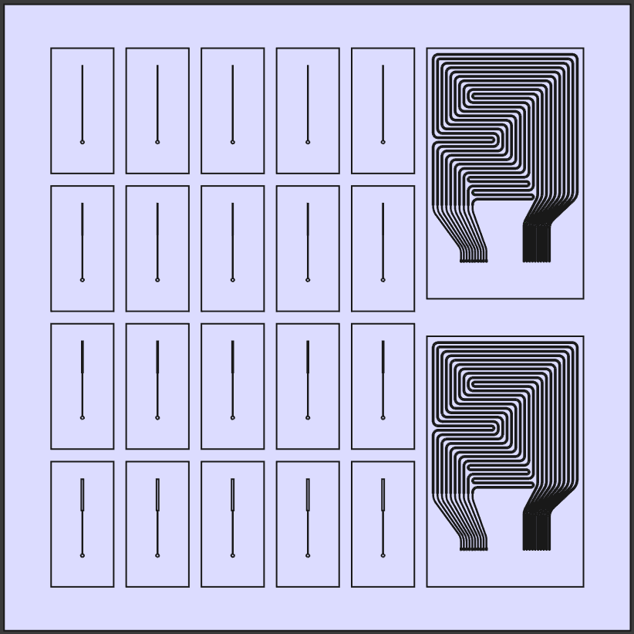
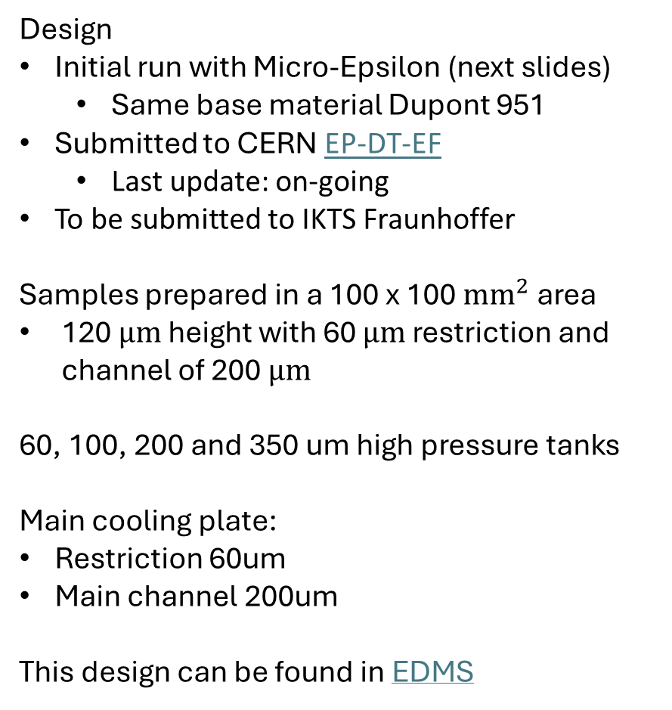
New round of samples: Cooling plates (Ceramics)
link
Design
Initial run with Micro-Epsilon (next slides)
  Same base material Dupont 951
Submitted to CERN EP-DT-EF
  Last update: on-going
To be submitted to IKTS Fraunhoffer
Samples prepared in a 100 x 100 $mm^{2}$ area
120 $μm$ height with 60 $μm$ restriction and channel of 200 $μm$
60, 100, 200 and 350 um high pressure tanks
Main cooling plate:
Restriction 60um
Main channel 200um
This design can be found in EDMS

Slide 9
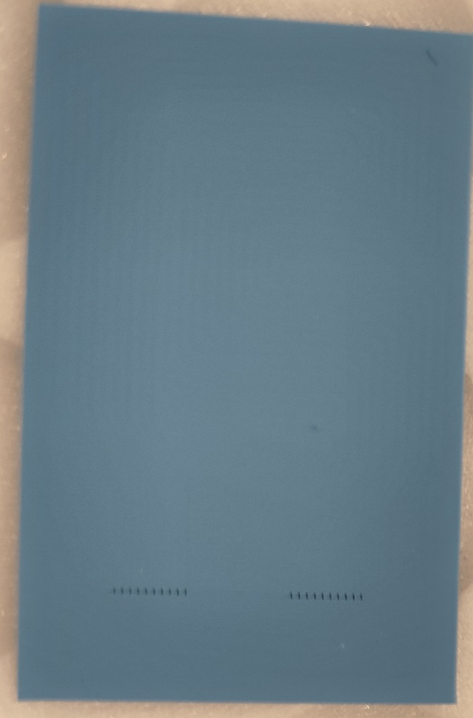
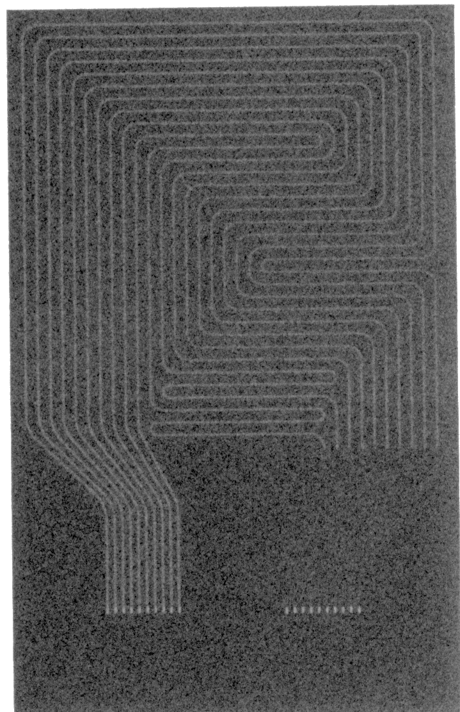
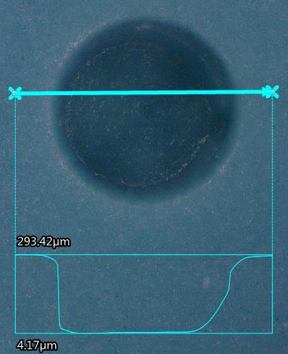
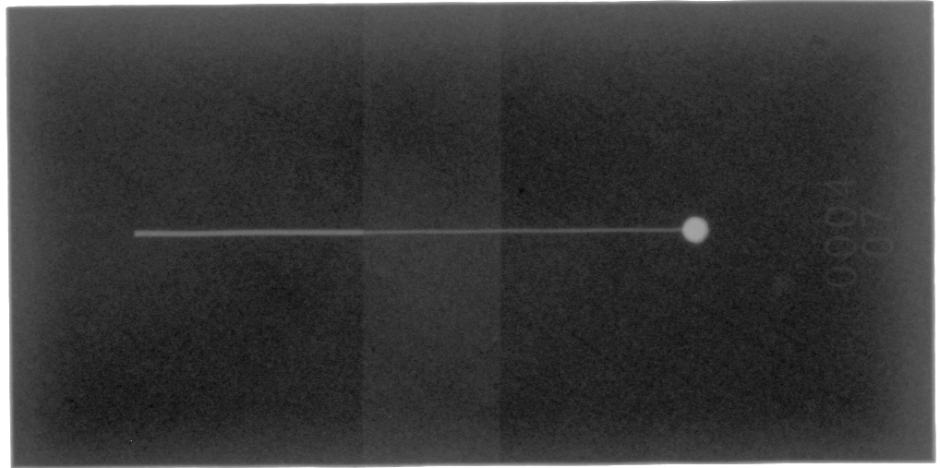
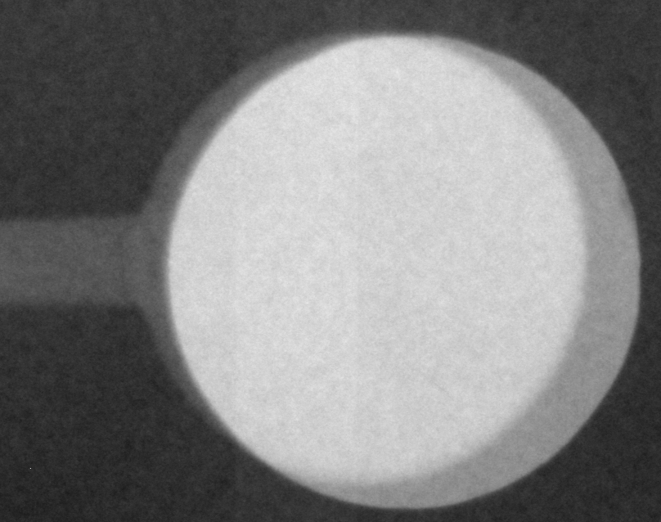
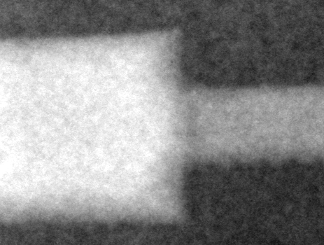
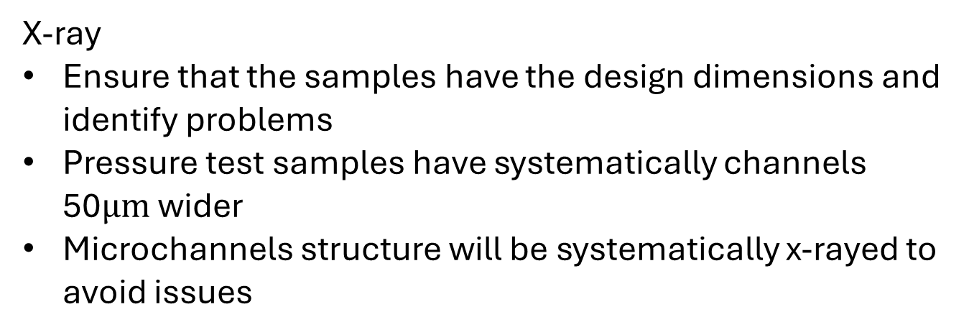
First run with Micro-Epsilon
link
X-ray
Ensure that the samples have the design dimensions and identify problems
Pressure test samples have systematically channels 50$μm$ wider
Microchannels structure will be systematically x-rayed to avoid issues
Sample
Size change
Input hole

Slide 10
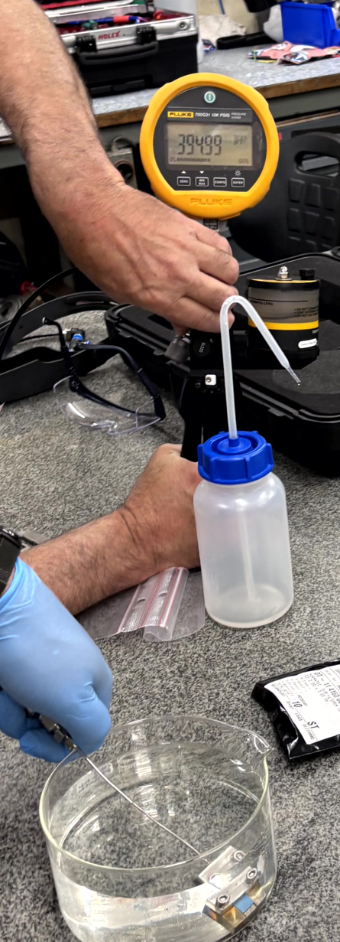
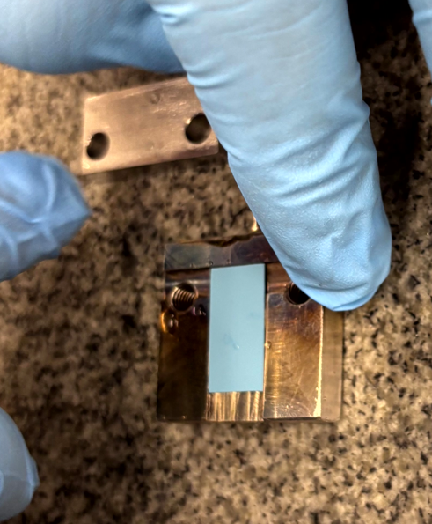
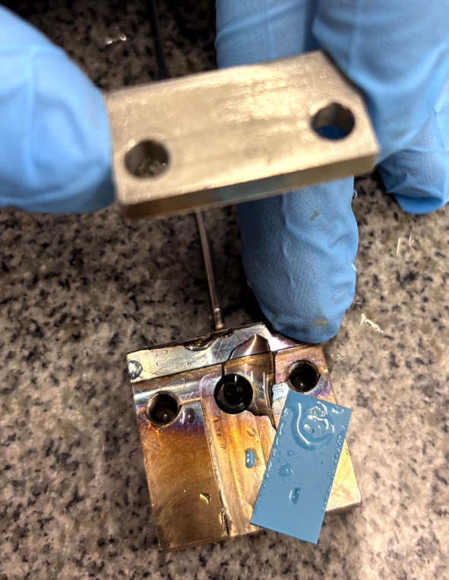
First run with Micro-Epsilon
High pressure test
Tested the samples with real channel size of 400 um and 250 um.
Results:
  400 um samples:
    One broke at 296 bar, one broke at 341 bar and one we tested it up to 186 bar (not broken).
  250 um samples:
    All of them (5) tested up to 400 bar waiting there for 1 min without break.

Slide 11
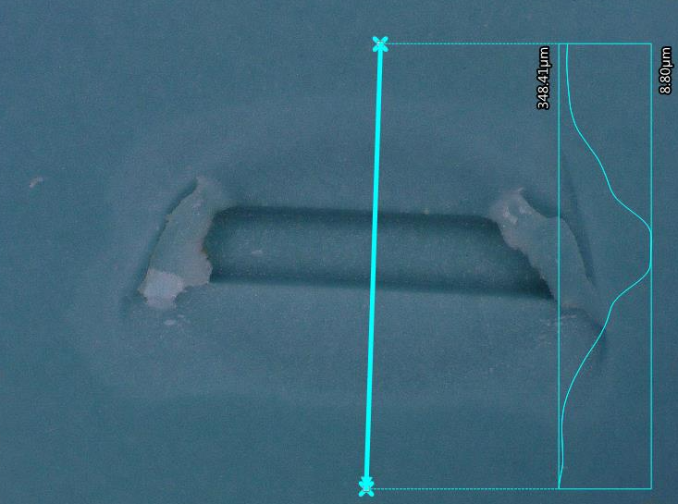
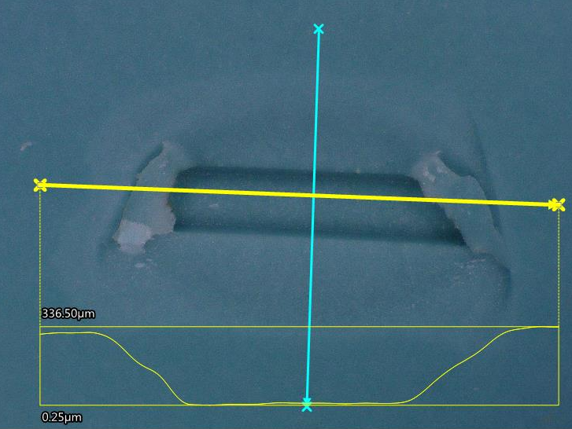
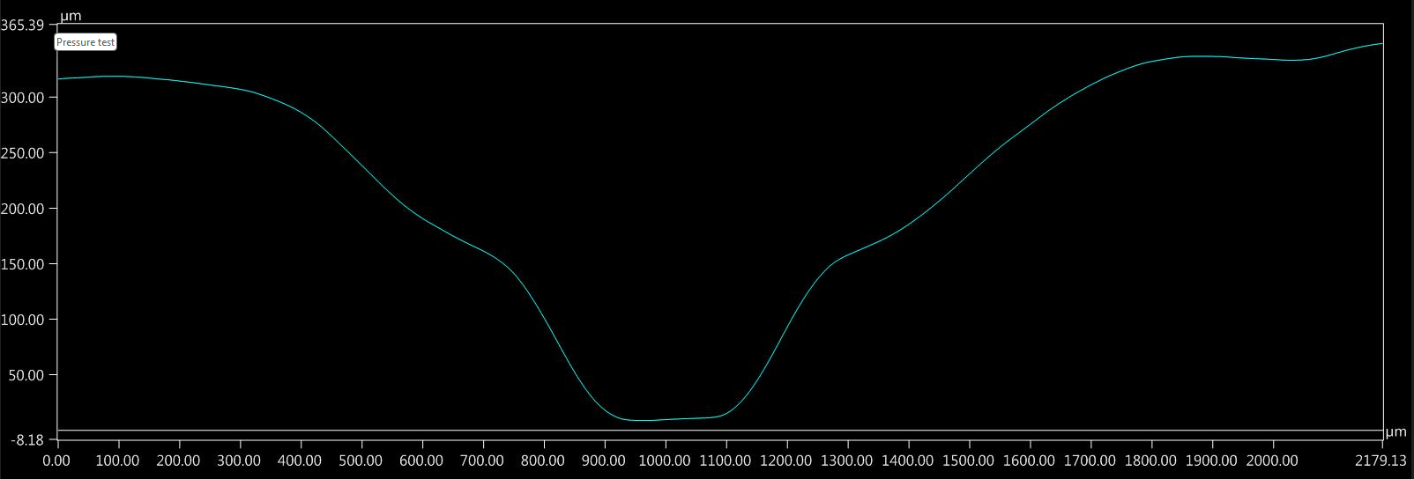
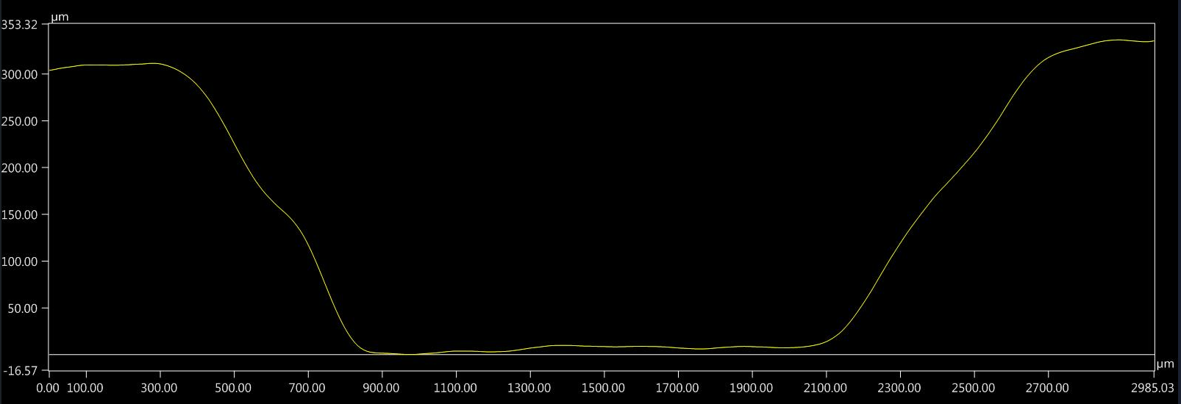
First run with Micro-Epsilon
High pressure test: one broken sample

Slide 12
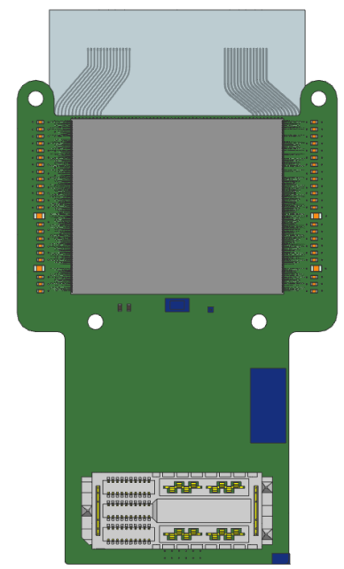
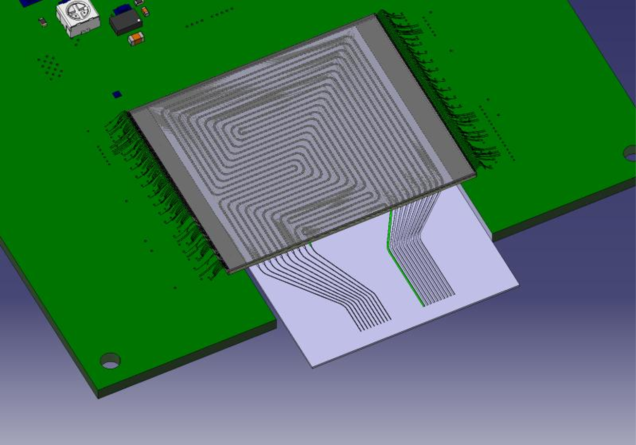
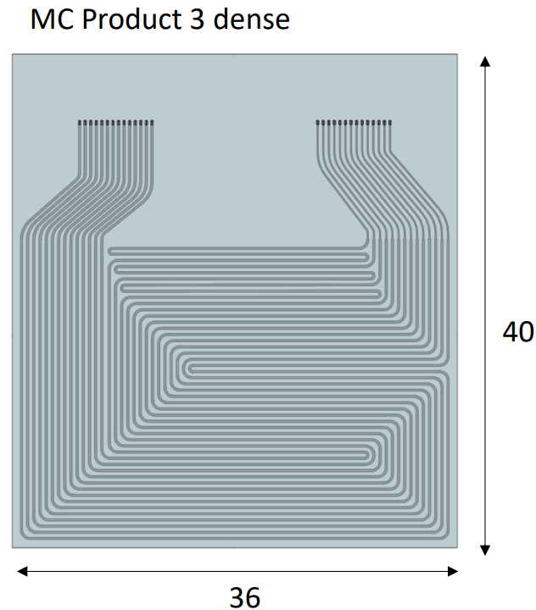
Towards M0: timepix4 compatible
Cooling plate footprint larger than the timepix4
CERN design
NIKHEF design
Cooling plate footprint smaller than the timepix4 to allow it to be fixed to the PCB for wire-bonding
EDMS
EDMS
Yutaro talk

Slide 13
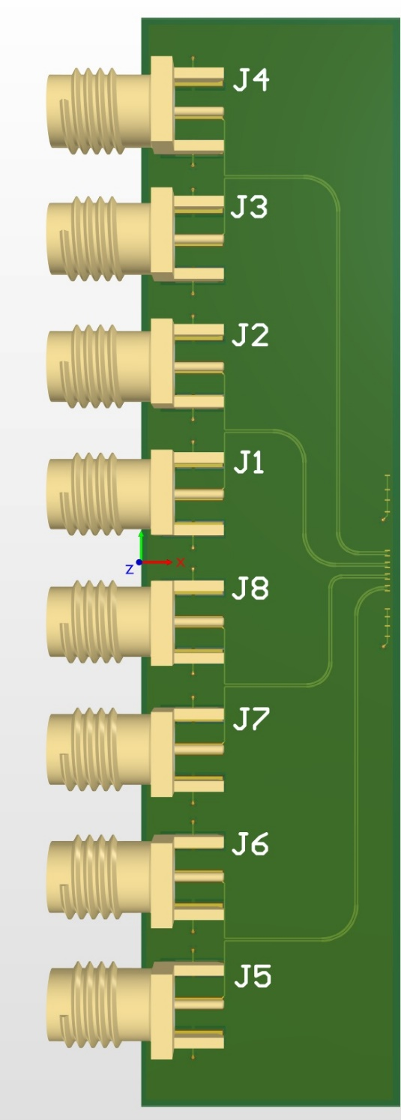
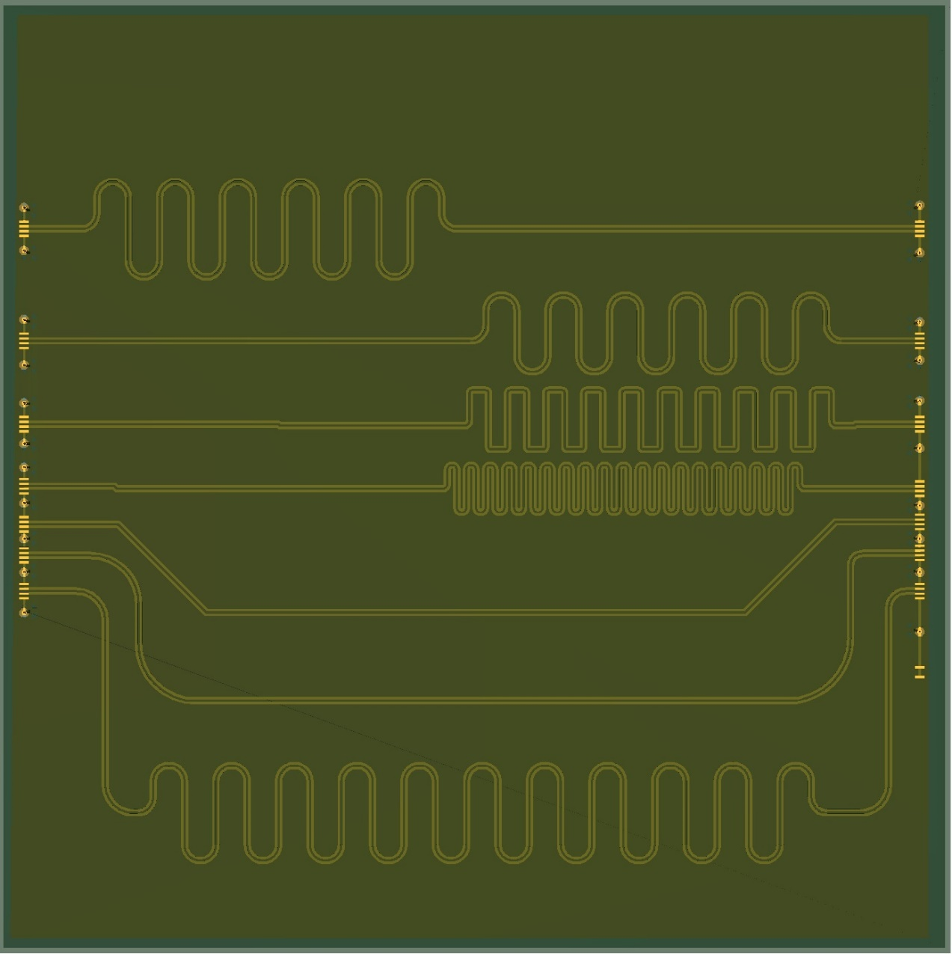
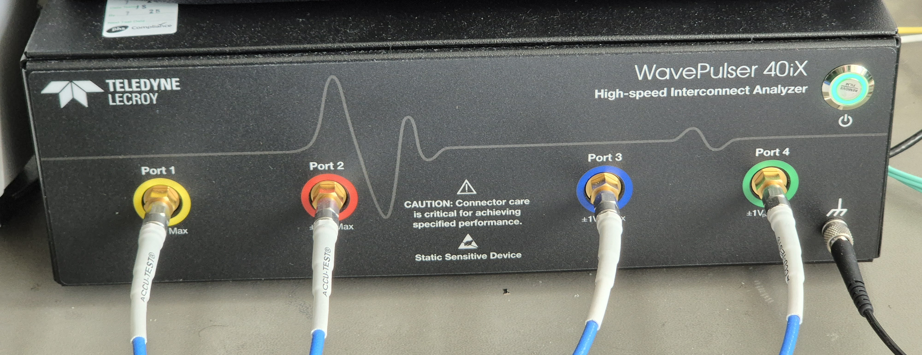
First electrical test: in preparation
Adapter board
Green tape under test
Adapter board
In-preparation
Evaluate simple structures before a more complex full design
Plan to test the different structures up to 40GHz with a passive element analyser
We are still open for comments/suggestions
Wire bonds

Slide 14
AIDA proposal: ceramics microchannels

Slide 15
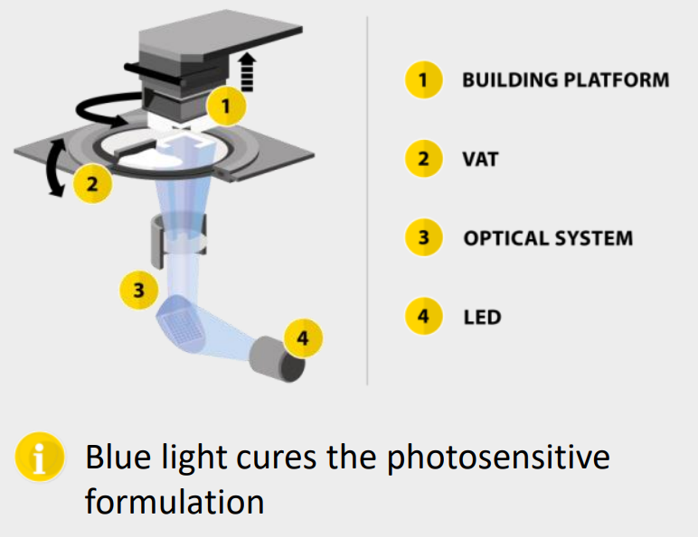
Lithoz
AlN
Higher thermal conductivity
212 W/m.K (10x higher than LTCC Al2O3/Glass, link)
Thermal expansion coefficient similar to silicon (4.5 ppm/K vs 2.6 ppm/K)
Manufacturing based LCM (LED + LCD mask)
Faster than stereolithography (SLA)
Most information collected from the AIDA meetings (2025, 2024 and 2023)
More cost effective
Printing dimensions: 190 mm diameter by 300 mm (height)
video

Slide 16
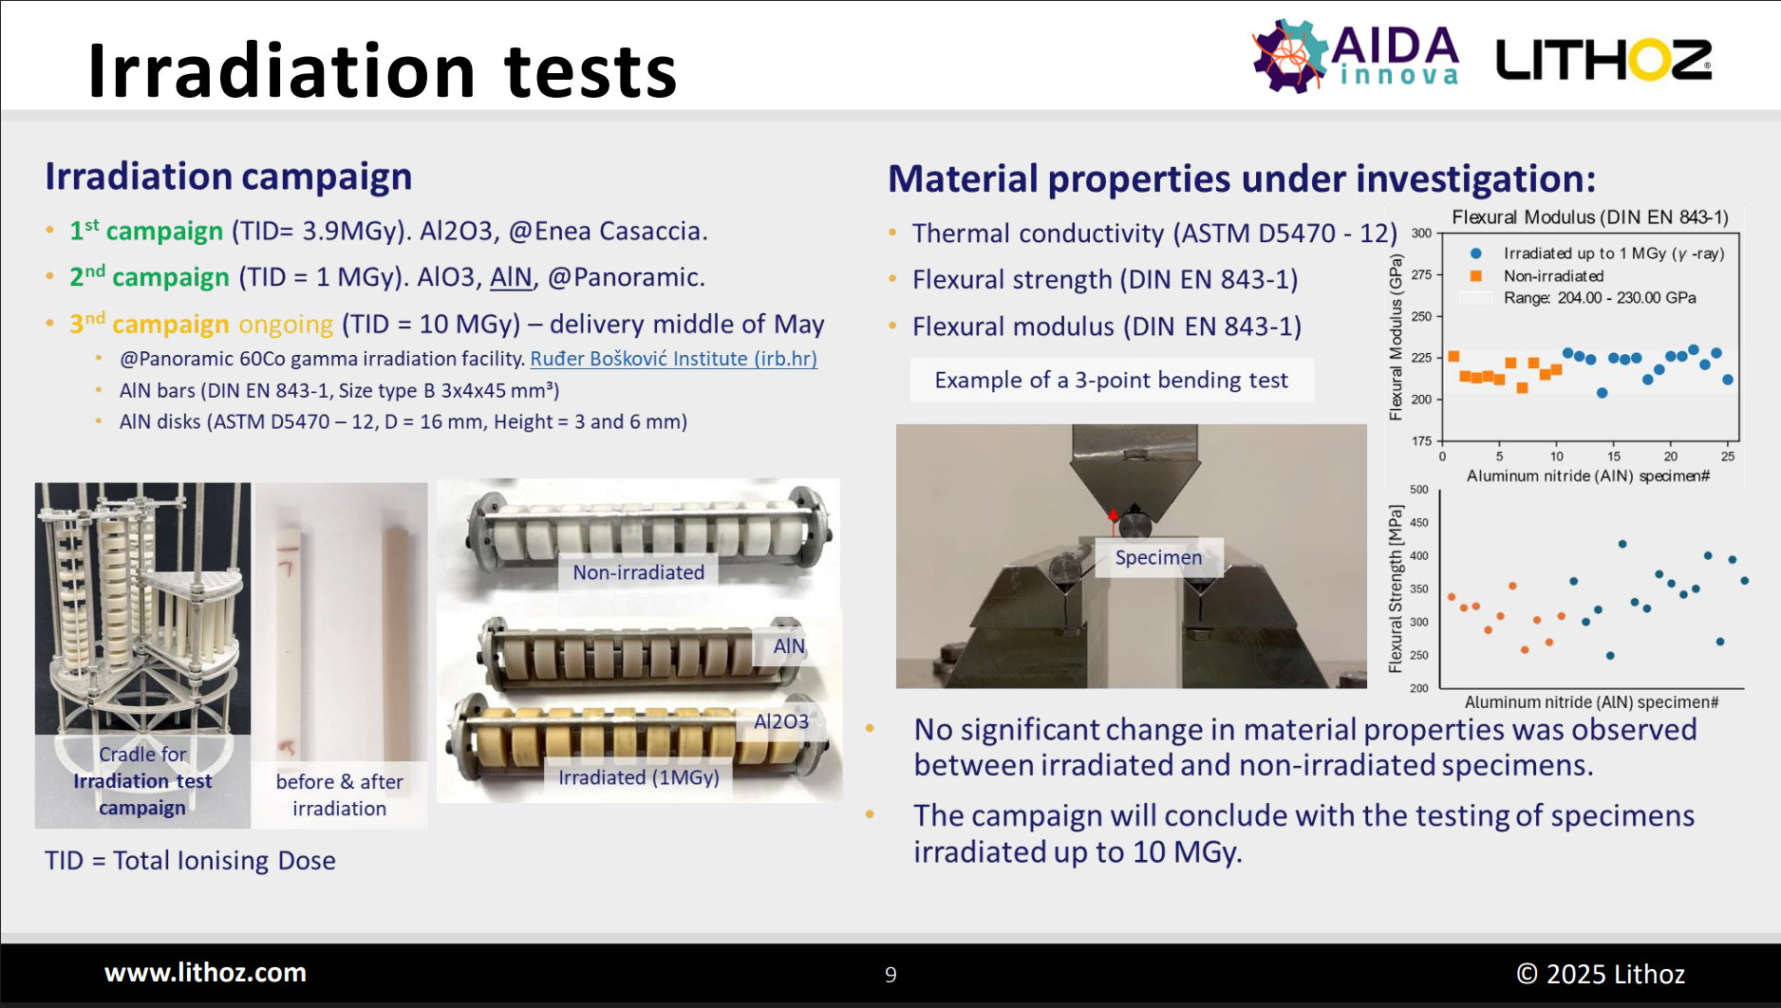
Lithoz

Slide 17
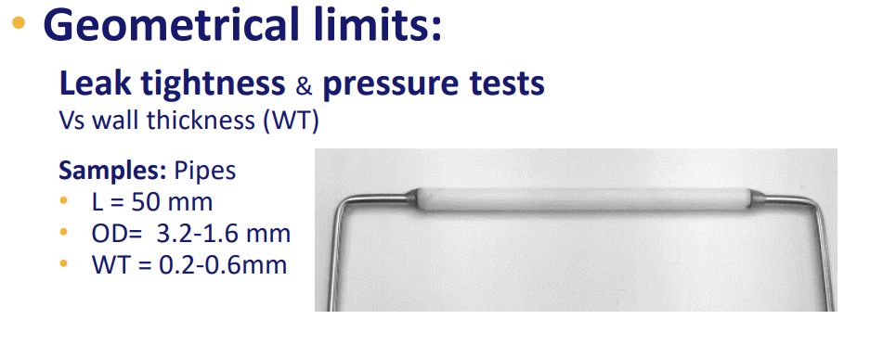
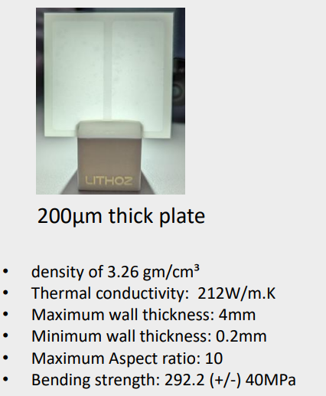
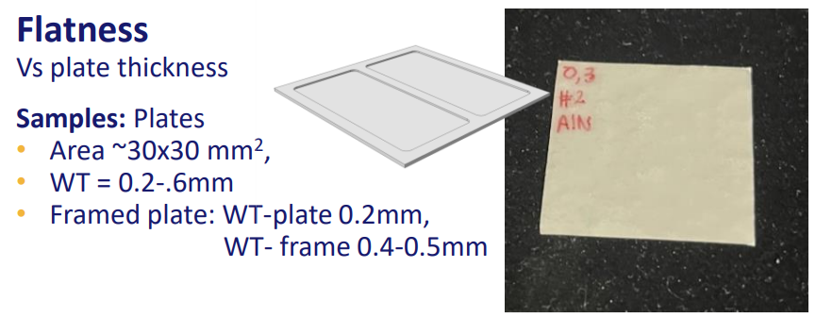
Lithoz

Slide 18

Lithoz

Slide 19


Slide 20
Main goal: Demonstrator
Monolithic-like approach
(Electronics integrated in the same ceramics base material)
Integration of ceramics based front-end electronics
Sensor+asic
Front-end electronics
Sensor+asic
glue
Front-end electronics
glue
glue
LV supply
LTCC ceramics (Al2O3/Glass)
LTCC ceramics (AL2O3/Glass) or LCM ceramics (AlN)
LTCC ceramics (Al2O3/Glass)
Better integration including low voltage (LV)
Potentially less material
Better CTE matching between sensor and AlN ceramics

Slide 21
Final remarks
Micro-epsilon
Very promising high pressure test resistance
Channel precision to be discussed
Yellow spot on the sample after close up X-ray inspection. Irradiation campaign on-going.
Ultra high vacuum tests under discussion with the vacuum group
Xray(tomography), pressure test, CO2 circulation and thermal performance in the pipeline
AIDA proposal
Expand the program to include AlN via LCM process for the cooling plate (Lithoz)
Minimize CTE mismatch with silicon and improve thermal performance
IKTS Fraunhoffer
Best experience so far with the LTCC process
Proof-of-concept microchannels achieved but further design optimizations are needed (increase high pressure tolerance, reduce variation of pressure, …)
Co-funding to accelerate all activities related to ceramics
Next steps: first electronics tests with simple lines for high speed

