Slide 1
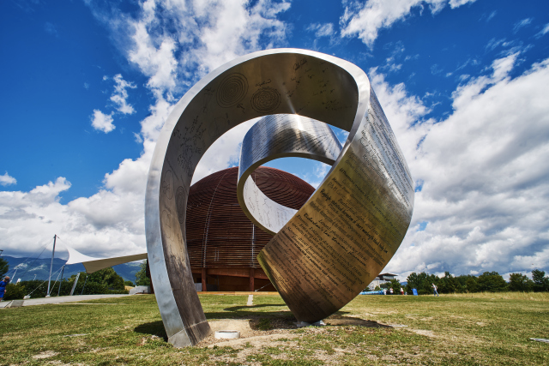
Tackling the Computing Challenges @ CERN
CERN OpenLab Summer Student lecture
1 July 2025
Alessandro Di Girolamo - CERN IT

Slide 2

… a brief “random walk” through CERN

Slide 3
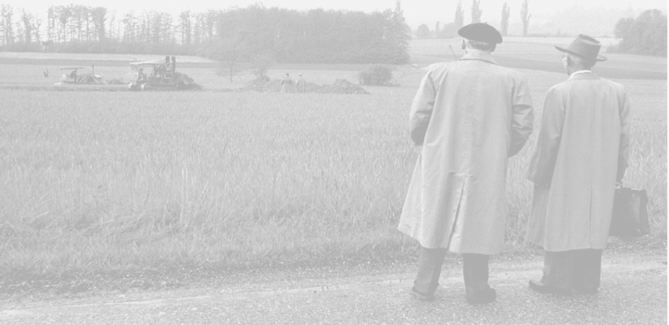

What does CERN stand for?
Conseil
Européen pour la
Recherche
Nucléaire
Notes:
https://home.cern/about

Slide 4



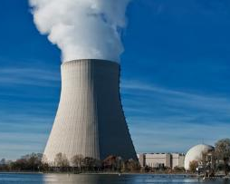
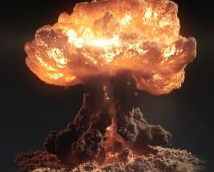
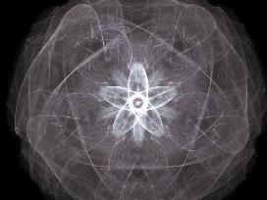
Nuclear?
European laboratory for particle physics
Notes:
https://home.cern/about/who-we-are/our-history
The word «Nuclear» should not be misunderstood:
- CERN does not produce electricity (but consumes a lot)
- CERN does not produce military applications out of nuclear power (forbidden by CERN convention, and, anyway, all research results are made publicly available and there are scientists from many countries in each experiment… therefore no risk that exclusive military applications are developed).
- CERN studies the structure of matter. In the 50’s, the nucleus is the main object of study about matter. The word «Nuclear» comes from that.
Nowadays CERN is studying the components of the components of the nucleus. Therefore CERN can use (after being allowed by the Council) an alternative «branding» which is more accurate and less open to interpretation: « European laboratory for particle physics »

Slide 5
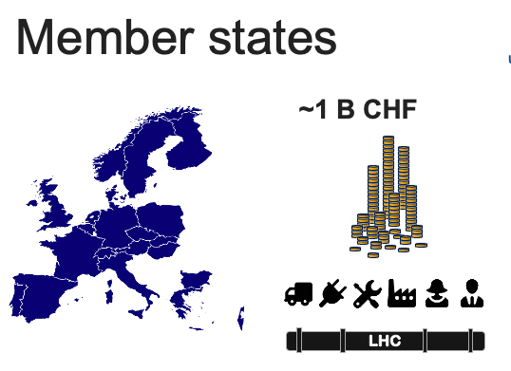
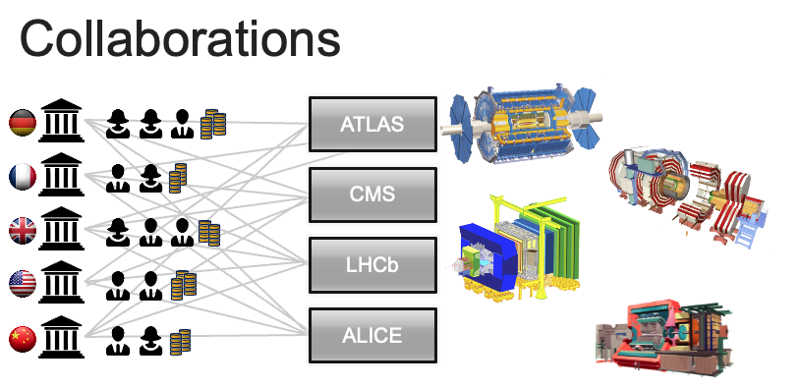
CERN
Who is it?
The Council
  Member states
The Collaborations
  experiments
Notes:
https://home.cern/about/who-we-are/our-governance/member-states

Slide 6




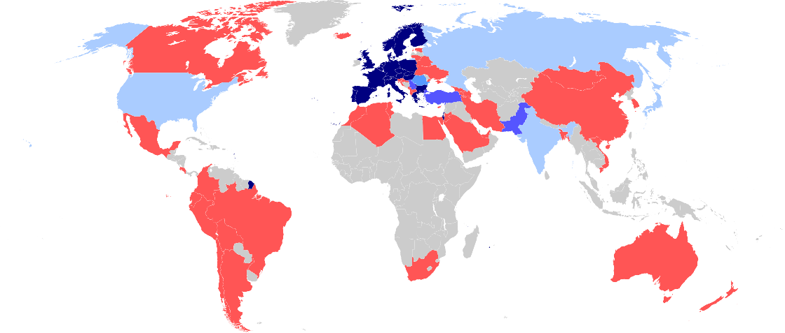

CERN: a worldwide collaboration
25 member states
+ Associates
+ Observers
Cooperation agreements
Scientific contacts
Notes:
Even though the «E» in CERN stands for European, CERN became a WORLD actor in the particle physics community.
In fact, half of the world particle physicists ARE connected with CERN at some point. No other scientific domain has reached this level of integration.
https://home.cern/about/who-we-are/our-governance/member-states
https://council.web.cern.ch/en/content/member-and-associate-states-observers

Slide 7










How many persons?
15000+!
2500 staff
600 fellows & apprentices
500 students
10000+ users
2000 external companies
Notes:
CERN employs «only» 2500 persons. In which there are «only» 70 research physicists (you can ask the audience if they can guess this).
As Fellows and Apprentices are here for a first employement experiences.
The number of students can vary from 300 to 600 depending of the time of the year. It’s mostly university students.
The core population of CERN is made of about 11’000 «users», called like that because they are here to «use» CERN’s facilities.
They are NOT employed by CERN and come in the frame of the collaborations.
They are not all the time at CERN. Some spend 5% of their time at CERN (a few days a year), some spend 100% of their time. It really depends on their function in the collaboration, on the need for them to be on site, or, on the other hand, the possibility for them to work remotely.
Given the size for CERN’s population, many services are externalized (mail, transport, restaurants, etc) to firms.

Slide 8
Our Mission
The CERN Mission
perform world-class research in fundamental physics.
provide a unique range of particle accelerator facilities that enable research at the forefront of human knowledge, in an environmentally responsible and sustainable way.
unite people from all over the world to push the frontiers of science and technology, for the benefit of all.
train new generations of physicists, engineers and technicians, and engage all citizens in research and in the values of science

Slide 9

CERN
How does it work ?
Notes:
Now we have many questions to answer. But how are we going to proceed?

Slide 10

Accelerating and colliding
Notes:
Most of CERN’s experiments are made of collisions. We take 2 objects and smash them together at very high speed.
Let’s take 2 apples. What happens if we smash them together?
At very low speed, not much. They will stop each other. That’s a «Level 1» collision.
At higher speed, they will damage each other, change direction, slow down. That’s a «Level 2» collision.
At very high speed (imagine we use apple cannons), they will explode. That’s a «Level 3» collision.
We have all experienced such collisions: with cars, bikes, ourselves (not «Level 3» hopefully).
At CERN we want to produce «Level 4» Collisions… This level is so high in energy, that out of the collisions will come… pears, bananas, strawberries, kiwis and… of course apples. Sound strange?

Slide 11
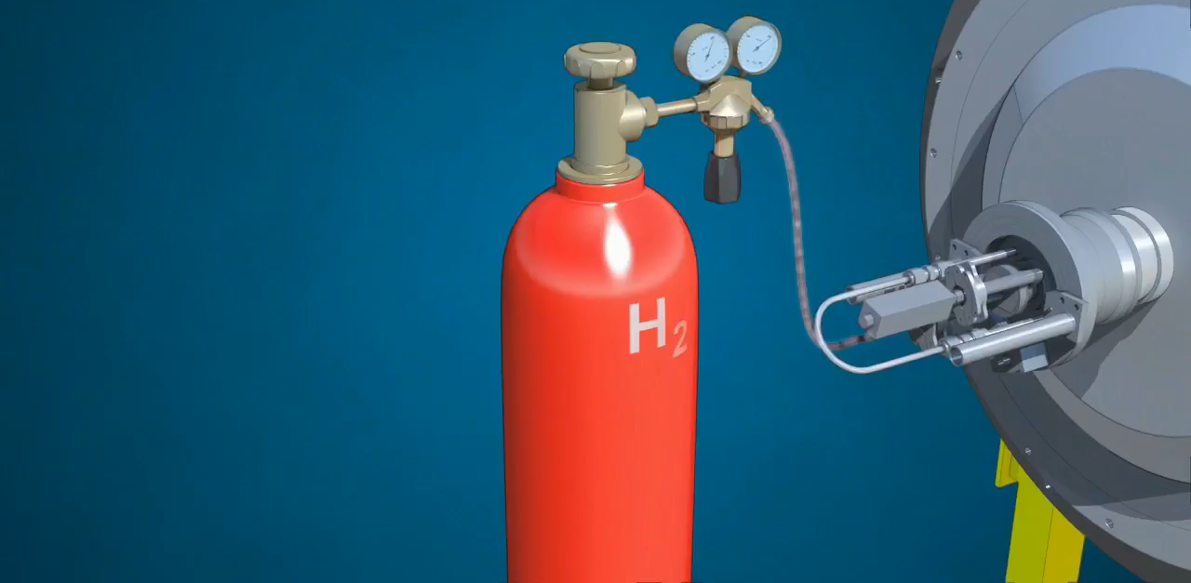
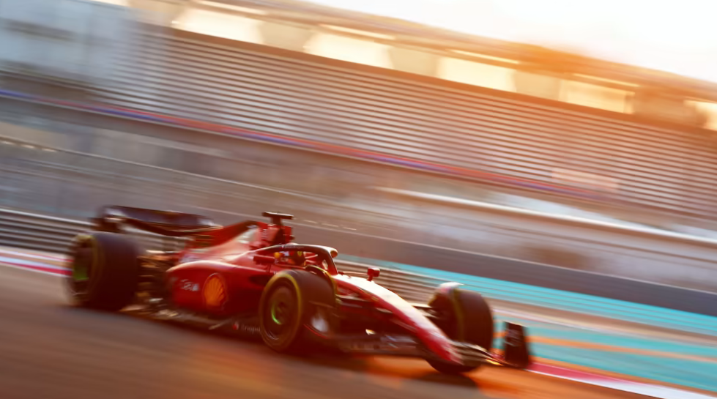
Accelerator
chain
Notes:
But how do we produce protons and grant them the energy of a flying mosquito?
First we start with a bottle of hydrogen gas.
Hydrogen is quite close to what we want. It’s made of protons. With one electron orbitting around.
We send hydrogen gas through an electric field. Proton which has a positive charge goes through. Electron whic has negative charges bounces back and it removed. We are then left only with protons.
They are sent through the LINAC (LINear Accelerator) which uses alternating electric fields to either attract or push the protons. It is so efficient that after only 45m they have been accelerated to a 1/3 of the speed of light, that is 100’000 km per second. Needless to say that continuing in straight lines will be impractical.
We then send the protons to the Booster which will prepare bunches of protons in 4 superposed rings.
They are then sent in the PS (Proton Synchrotron). This machine is 600m circumference, was built in 1959 and is still in use! In 1.2 seconds it accelerate protons to 99% of the speed of light. Very efficient. But cannot go faster. We then need to transfer protons to the «2nd gear of our accelerator complex».
The SPS (Super Proton Synchrotron) build in 1976 and of 7km curcumference. In 3 seconds, it accelerate particle to 99.9% of the speed of light. Once again cannot go faster.
Then half of the particles are sent clockwise and half anti-clockwise into the LHC (Large Hadron Collider). This machine is the largest machine on Earth: 27 km circumference. It will take about 20 minutes to reach our maximum velocity: 99.9999991% of the speed of light which correspond to 7 TeV energy.

Slide 12

Incredible levels of energy
7+7 TeV
100’000’000’000’000’000’000’000
u
u
d
Notes:
Each proton we accelerate at CERN will eventually reach an energy of 7 TeV (Tera electron-Volt).
Does that sound familiar to you? Can explain what level of energy it represents in everyday life? (ask the audience)
This is the incredible energy of a… flying mosquito!
OK… For you and me of course this is insignificant. But remember that we grant this energy to ONE proton.
A normally well-fed mosquito is made of about 10^23 protons! It’s like we are trasnsferring the energy of ALL these protons to ONE if them.
So, at the proton level, this is very very energetic. Remember, it’s the amount of energy proportional to the size of the accelerated object which counts!

Slide 13
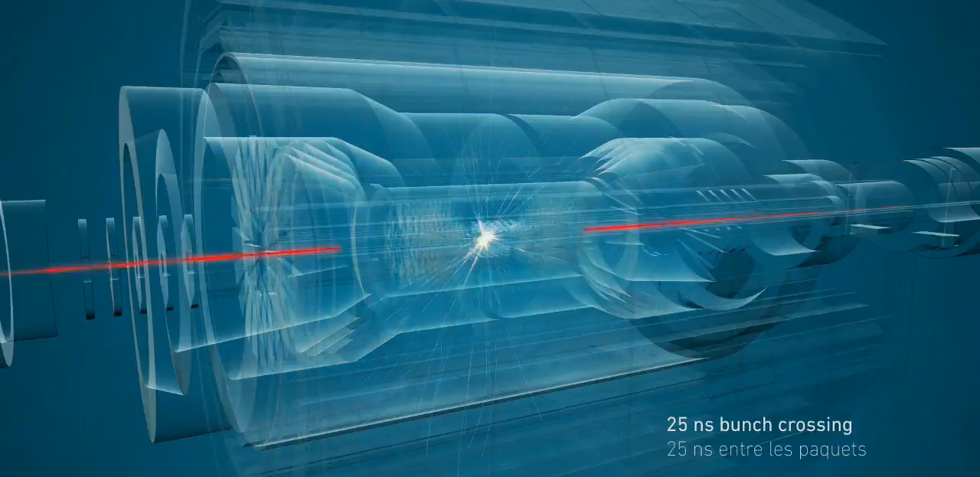
Millions of collisions per second
Notes:
The 2 beams are circulating in separate pipes and in 4 places we cross the 2 pipes over so that collision occur there and only there.
We have built particle detectors which will observe and record the traces of new particles created in the collision.
There are so many protons and they go so fast that around 600 million collisions will occur every SECOND in each of the 4 detectors.
These detectors are a bit like huge digital cameras of about 100 Megapixel resolution. Guess the size of the SD card to store the LHC’s pictures?

Slide 14
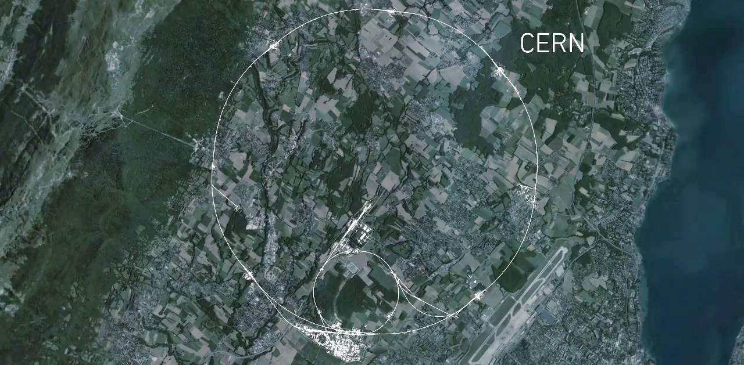
CMS
Largest
accelerator machine
on earth: LargeHadronCollider
ALICE
ATLAS
LHCb
Notes:
This is a map of the complex of main accelerators of CERN.
The dotted line is the French-Swiss border.
The 2 main CERN sites are Meyrin and Prévessin (as big, but not as built nor populated)
The PS is the tiny 600m ring on the Meyrin site, the SPS goes accross the border and the LHC takes all the space between Geneva airport and the Jura (dark green on the left).
The 4 red dots represent where the 4 detectors are located.

Slide 15
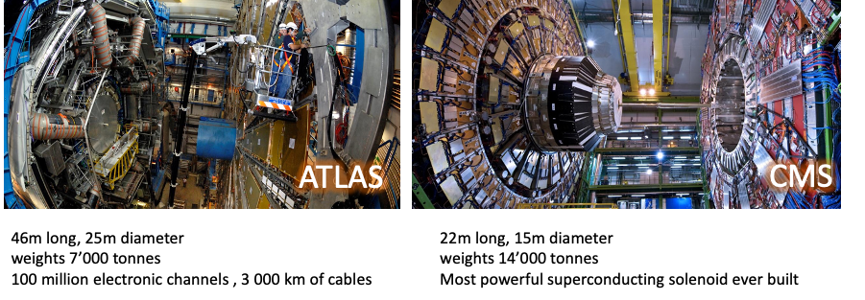
ATLAS and CMS
Two general-purpose detectors cross-confirm discoveries, such as the Higgs boson.

Slide 16
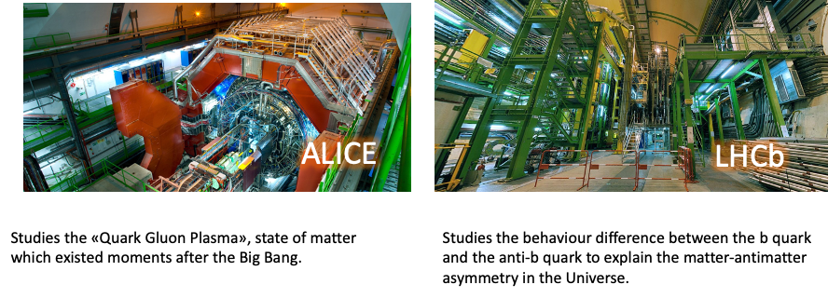
ALICE and LHCb
ALICE and LHCb experiments have detectors specialised on studying specific phenomena.

Slide 17
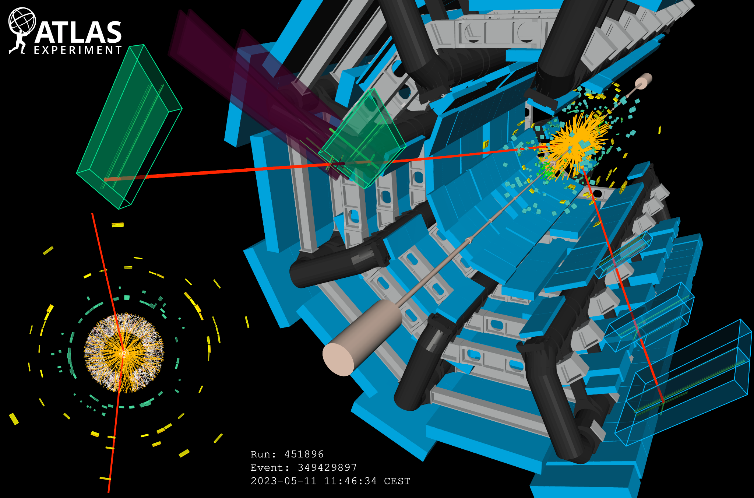
Millions of collisions per seconds generate particles that decay in complex ways – into even more particles
Notes:
An event display of a collision event (Run 451896, Event 349429897) recorded in ATLAS on 11 May 2023, when stable beams of 2400 bunches of protons at the energy of 6.8 TeV per beam were delivered to ATLAS for the first time in 2023 by the LHC. The figure on the right shows a cut-out view of the ATLAS detector; starting from the center of the detector, the image shows the reconstructed tracks of charged particles (orange lines), the energy deposits in the LAr (squares in different hues of green) and Tile (yellow/orange squares) calorimeters, as well as the reconstructed muon tracks (red lines) and their associated hits (green lines) inside the MDT and TGC chambers (green/blue and purple boxes, respectively). The bottom view on the left shows a zoomed-in projection of the same event on the transversal plane, with a focus on the inner detectors; starting from the center, the image shows the hits in the Pixel (white dots), SCT (yellow strips), and TRT (white/red dots) detectors, the reconstructed tracks of charged particles (orange lines), the reconstructed muon tracks (red lines), as well as the energy deposits in the barrel electromagnetic region of the LAr calorimeter (green squares) and in the Tile hadronic calorimeter (yellow/orange squares).

Slide 18
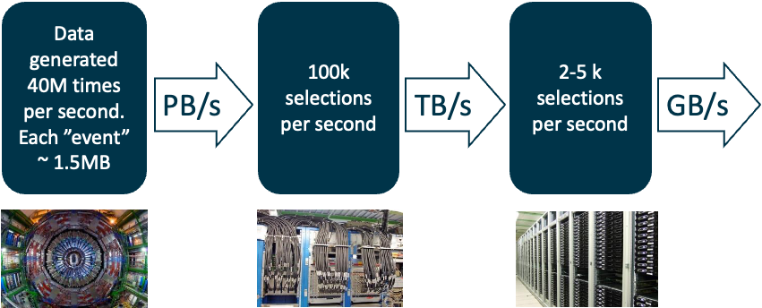
Data filtering (Trigger)
PetaBytes of data per second:
The “trigger” is filtering data in real time, selecting potentially interesting events

Slide 19
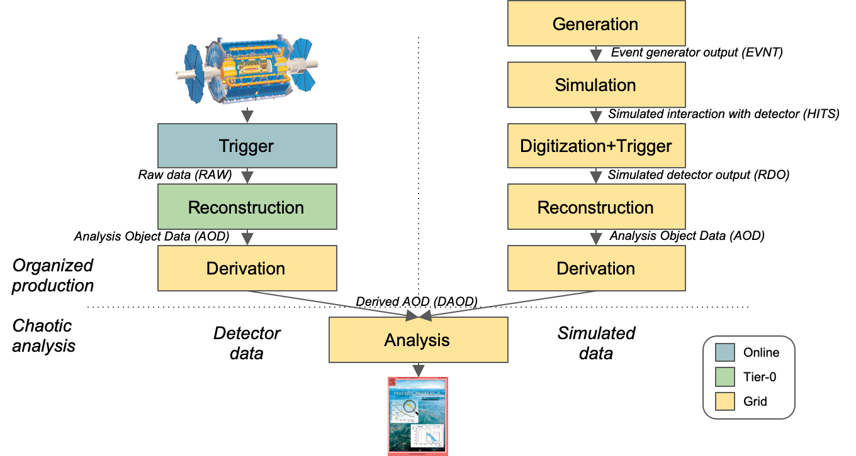
From Data to Paper(s): data processing chain
Notes:
Thks Fernando!

Slide 20

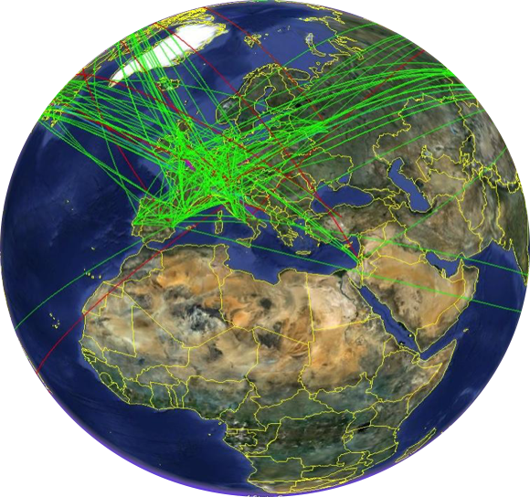
The Worldwide LHC Computing Grid - WLCG
International collaboration to distribute and analyse LHC data
Integrates computing centres worldwide that provide computing and storage resource
into a single infrastructure accessible by all LHC physicists
Global network connectivity
  Tier-0 (at CERN): Large resource, recording and
  custodial archival of collision data, prompt reconstruction
  Tier-1s: Memory and CPU intensive tasks second
  tape copy of detector data, occasional Tier-0 overspilling
  Tier-2s: Processing centres, nowadays many are
  similar to the Tier-1s
Around 1.5 million CPU cores fully occupied 24/7
Around 1.5 EB data (~600 PB on disk and >800 PB on tape)
More than 100 PB moved every month, accessed by 10k users

Slide 21
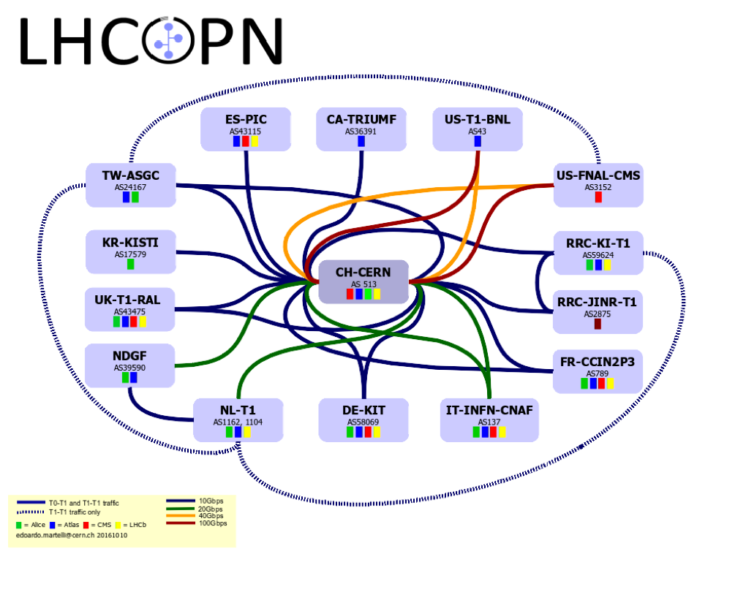
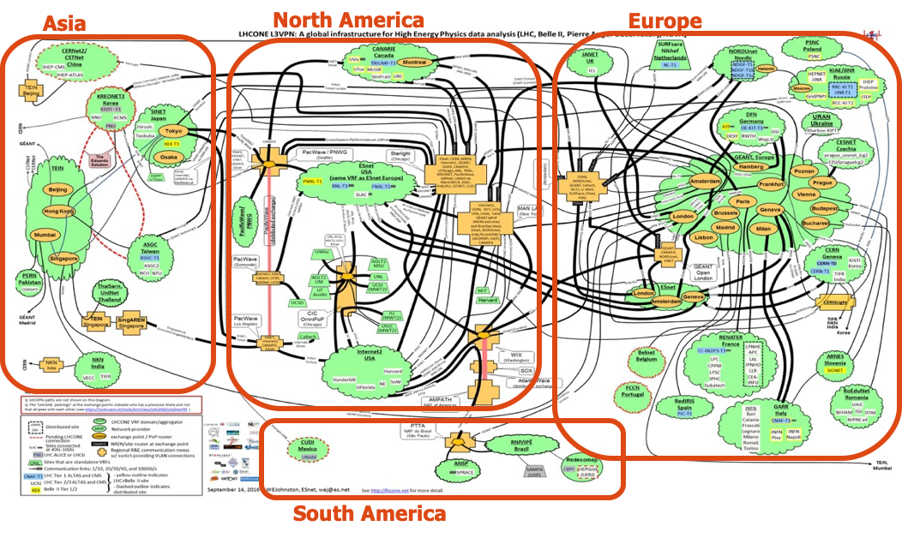
Worldwide Networking
WLCG relies on powerful network infrastructure which connects the whole Grid
LHCOne: overlay network
  Enable NREN to manage general public network for HEP scientific computing
LHCOPN: LHC Optical Private Network
  For Tier0 ↔ Tier1s traffic,
  managed by Tier0 and Tier1s

Slide 22
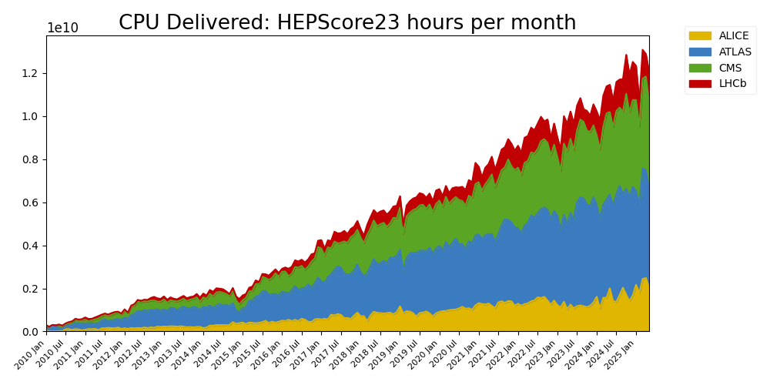
WLCG resources: compute
Notes:
Robust resource growth of resources:
Average +20% CPU and disk yearly growth
https://wlcg.web.cern.ch/using-wlcg/monitoring-visualisation/monthly-stats
Consistent with a ‘flat budget’ funding for computing centres, the de-facto adopted model across all Funding Agencies for the past 10 years

Slide 23
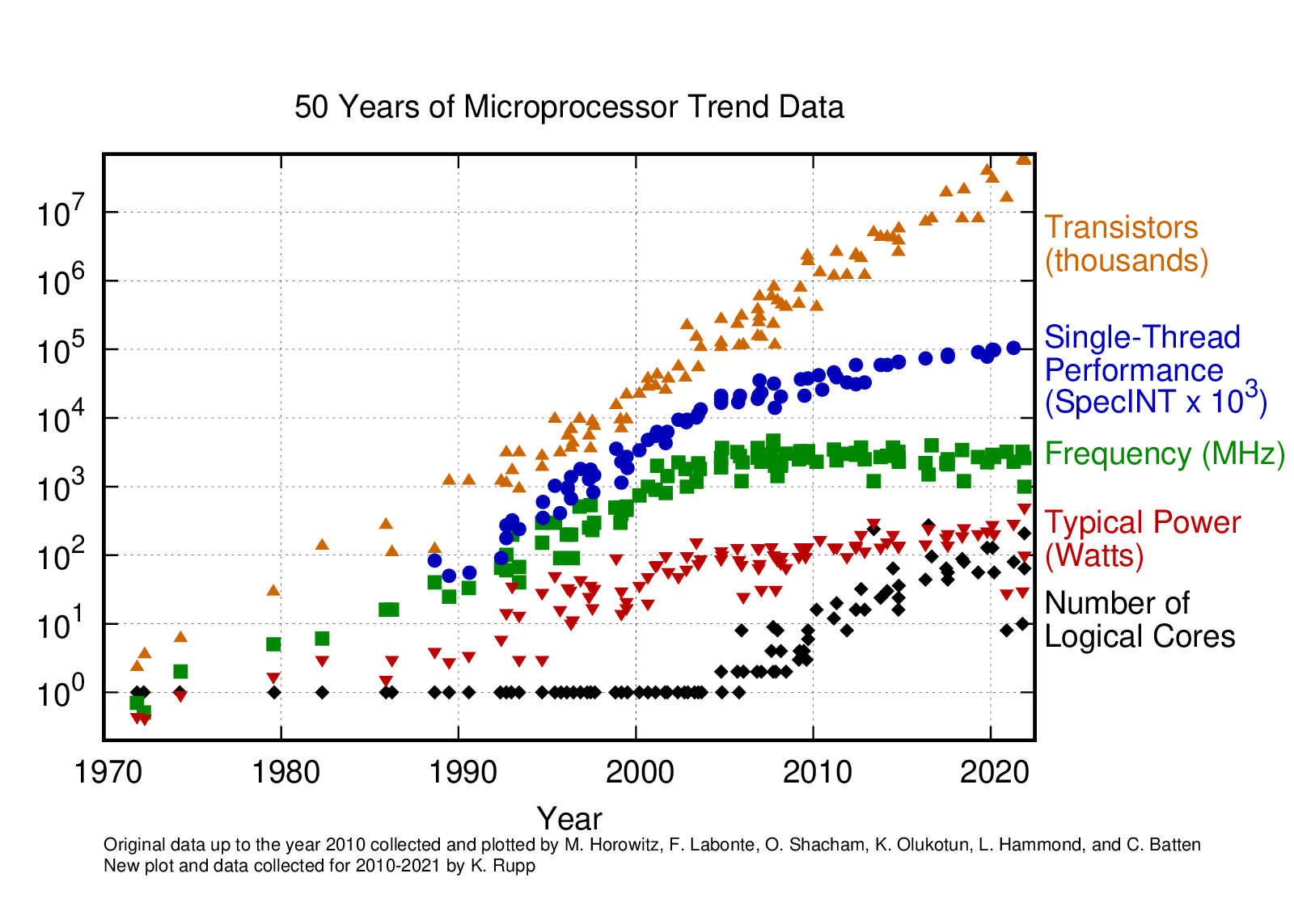
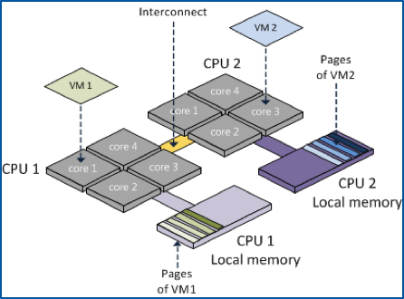
Hardware evolution
A challenge not only for the HEP computing:
  Transistors go into many cores, co-processors, vector units...
  Clock speed stalled since ~2005
    Single core performance is essentially also stalled
  Mobile devices and data centres are the key volume markets
  Memory consumption is a huge driver now
  Memory access and I/O paths also become problematic
Modernizing code will play a vital role for the upgrades of experiments and LHC
Increase software performance by adopting modern coding techniques and tools
Fully exploit the features offered by modern HW architectures
  Many-cores GPU platforms, acceleration co-processors and innovative hybrid combinations of CPUs and FPGAs
Getting performant software requires significant investment in programming skills
  Also, it does not happen overnight...

Slide 24
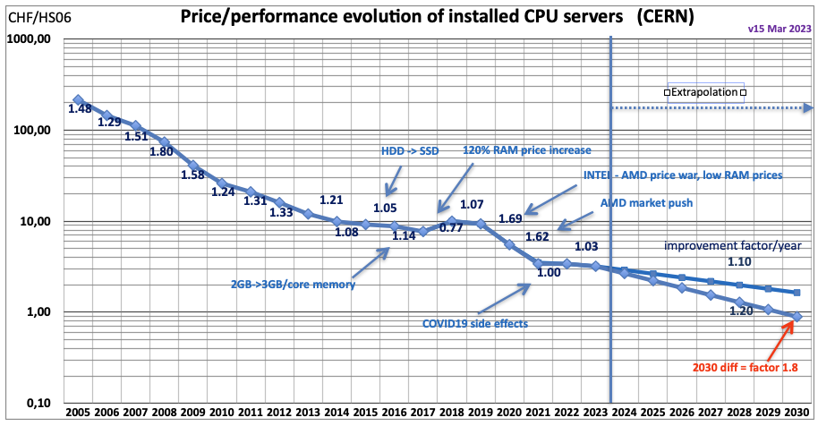
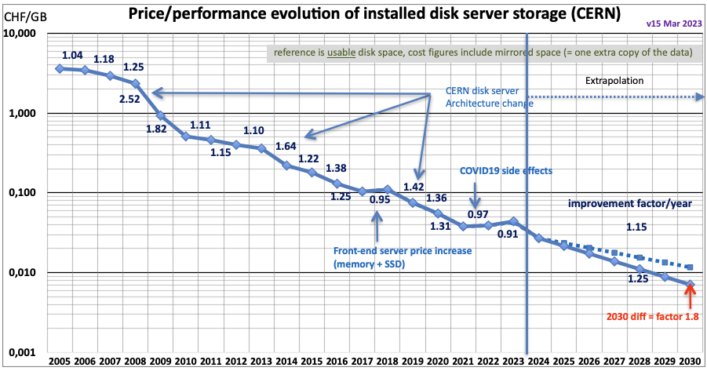
Hardware cost evolution
Hardware cost is more and more dominated by market trends rather than technology
  science has no influence on these markets!
For the budget we have been assuming +20%/year in storage and CPU capacity, but we have to deal with large fluctuations and a “flat” budget constraint

Slide 25

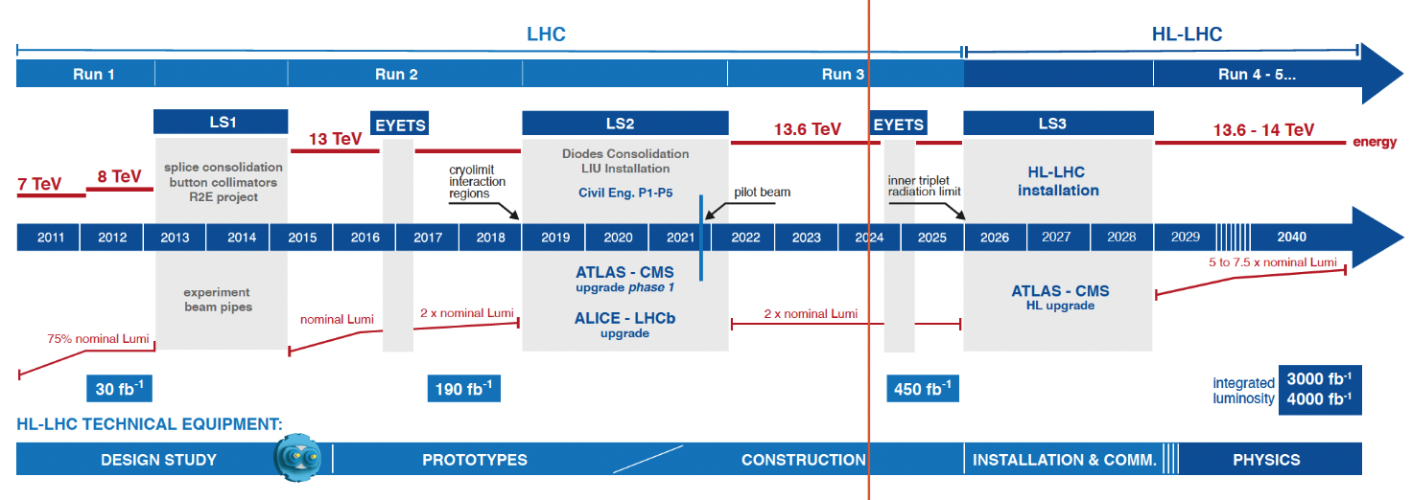
HL-LHC plans
Expected to be operational from 2029
  Objective is to increase the integrated luminosity by a factor of 10
ATLAS and CMS will face several challenges wrt Run3 (now): ~3x instantaneous luminosity, 3-4x pileup (mu ~60 -> 200)
Notes:
Link to the image??
https://hilumilhc.web.cern.ch/content/hl-lhc-project

Slide 26
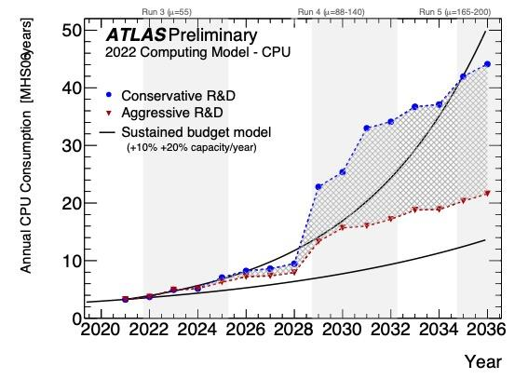
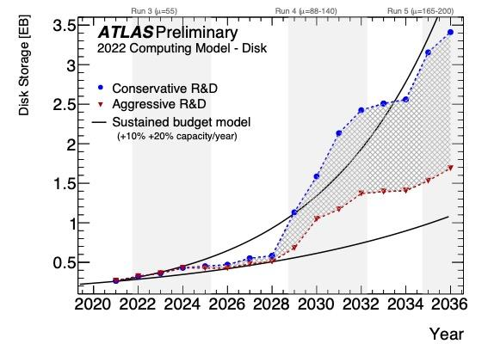
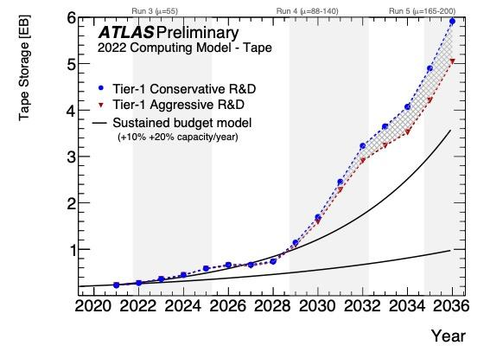
HL-LHC Software and Computing Challenges
Computing Resource Estimates show need for major R&D (or budgetary) effort to achieve HL-LHC physics potential.
  We have defined Conservative R&D and Aggressive R&D scenarios
    Conservative should be achieved with today’s effort and people
    Aggressive requires more people, more R&D projects bringing resource savings
  The black lines indicate the “flat budget” of 10% (lower line) and 20% (upper line).
Investing in brainpower is paramount!
Notes:
projected evolution of disk (top) and tape (bottom) usage from 2020 until 2036, under the conservative (blue) and aggressive (red) R&D scenarios. The grey hatched shading between the red and blue lines illustrates the range of resources consumption if the aggressive scenario is only partially achieved. The black lines indicate the impact of sustained year-on-year budget increases, and improvements in new hardware, that together amount to a capacity increase of 10% (lower line) and 20% (upper line). The vertical shaded bands indicate periods during which ATLAS will be taking data.

Slide 27

Tackling the HL-LHC Computing Challenges
Compute..
  Optimize the usage of al the available resources, including new HW technologies and facilities
  Make physics choices that save computation without sacrificing the physics reach
Storage
  Optimize data format
  Evolve the computing models to make use of different (cheaper) storage technologies
Sustainability
  Environmental sustainability (Use - not waste!)
  New technologies!
  Boomers, GenX/Y/Z: we are all different, different times different challenges!

Slide 28

Time to act: NOW
Experiments defined their roadmaps toward HL-LHC:
ATLAS S&C HL-LHC Roadmap ; CMS Phase 2 Computing Model
Based on the HL-LHC schedule, it is clear that R&D projects need to start now
  from R&D to demonstrators, with measurable impact
  We see already lot of engagement!
Integration and validation will require lot of time
  Late arriving R&D is risky

Slide 29
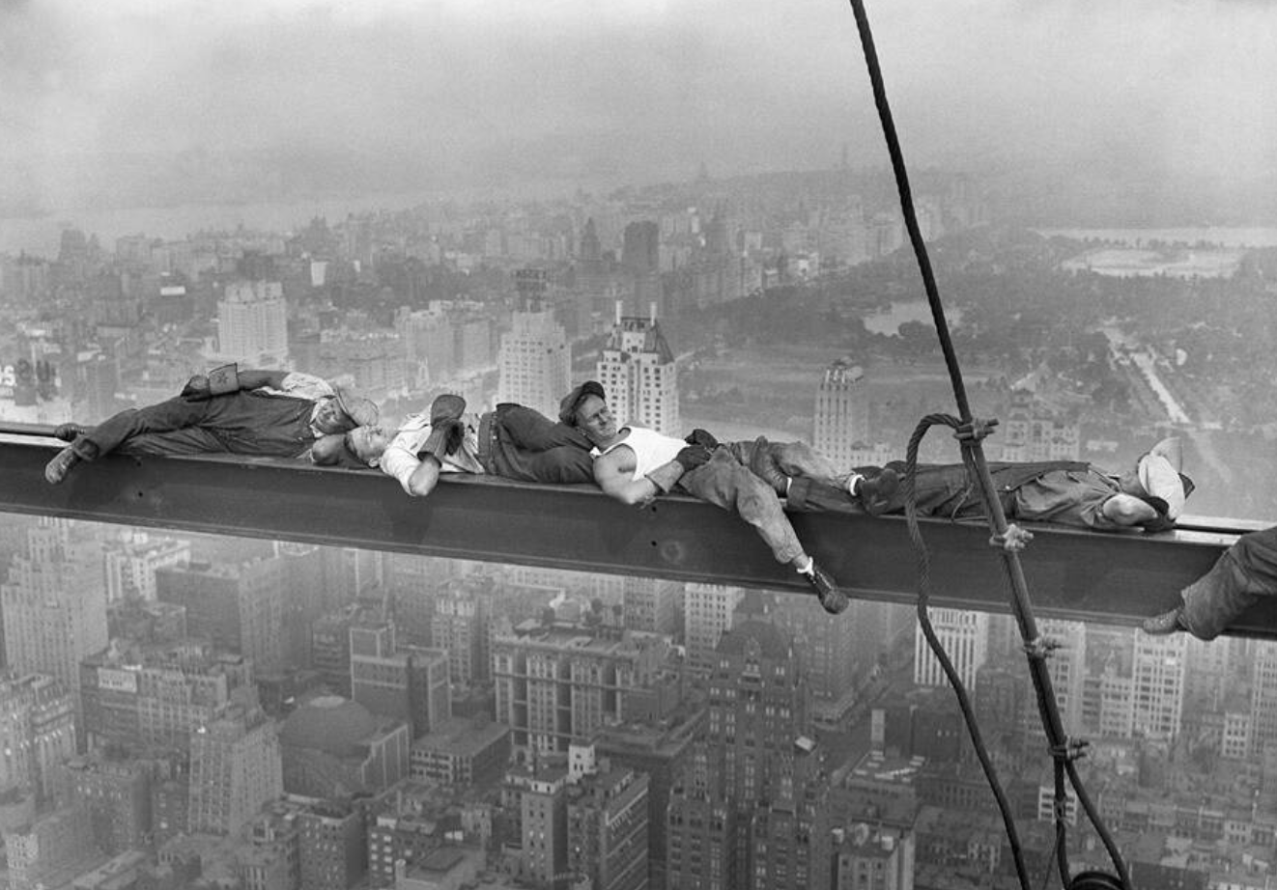
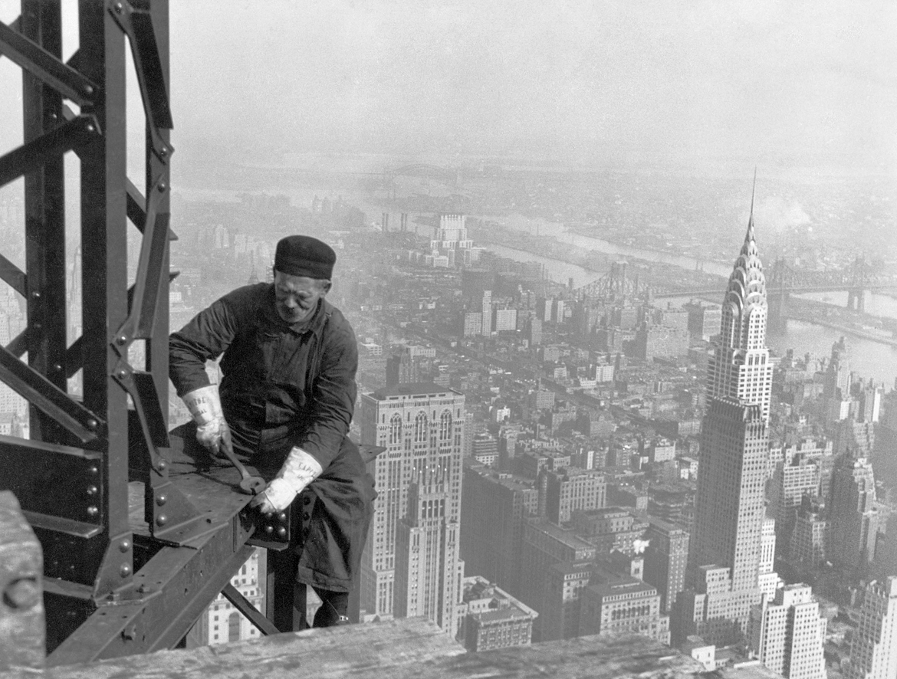
Some caveats: lots of “business as usual”
We have to keep on running the experiments while we are planning for major upgrades
  “we are building a new ATLAS while we are running ATLAS” (Karl Jakobs, ex ATLAS spokesperson)
  Failing is not an option
Lot of efforts that need to go into non-R&D work (or at the boundaries)
  Maintaining our current software
  Updates to the distributed computing infrastructure
  Upgrade geometry, digitization, re-tuning simulation…
  SW performance improvements
R&D projects are on top of this:
  balance (between R&D and “business as usual”) is key
  We need a strong focus on “impact”

Slide 30
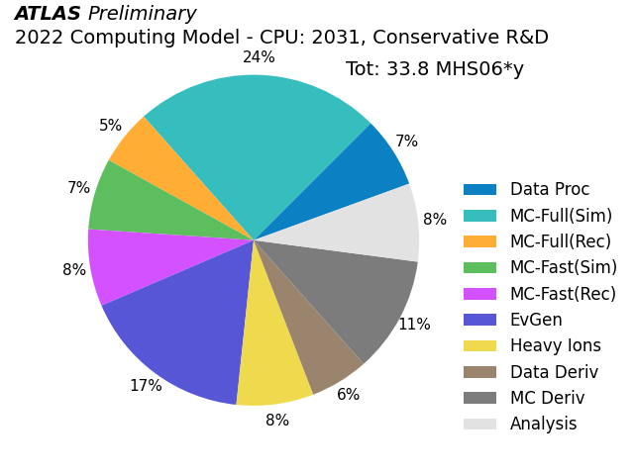
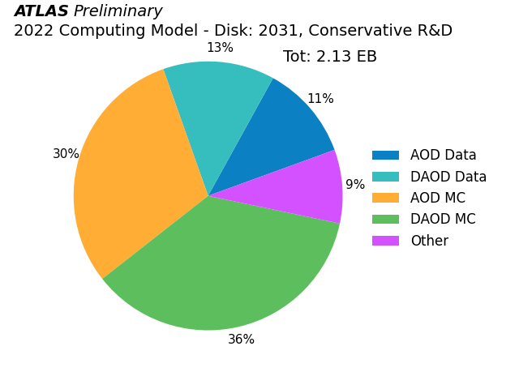
HL-LHC - Resource Estimates for 2031
There is no “silver bullet”:
  it’s not that we do have 1 (one) single problem and if we solve that “we are done”.
we need to work on each and every part of our system
The opportunities are “everywhere”: we need to work hard to scavenge a few % here and there
  An “evergreen” motivational speech, Any Given Sunday : true we do not play *against* anyone, but we still want to bring out the best from ourselves - while having fun!

Slide 31
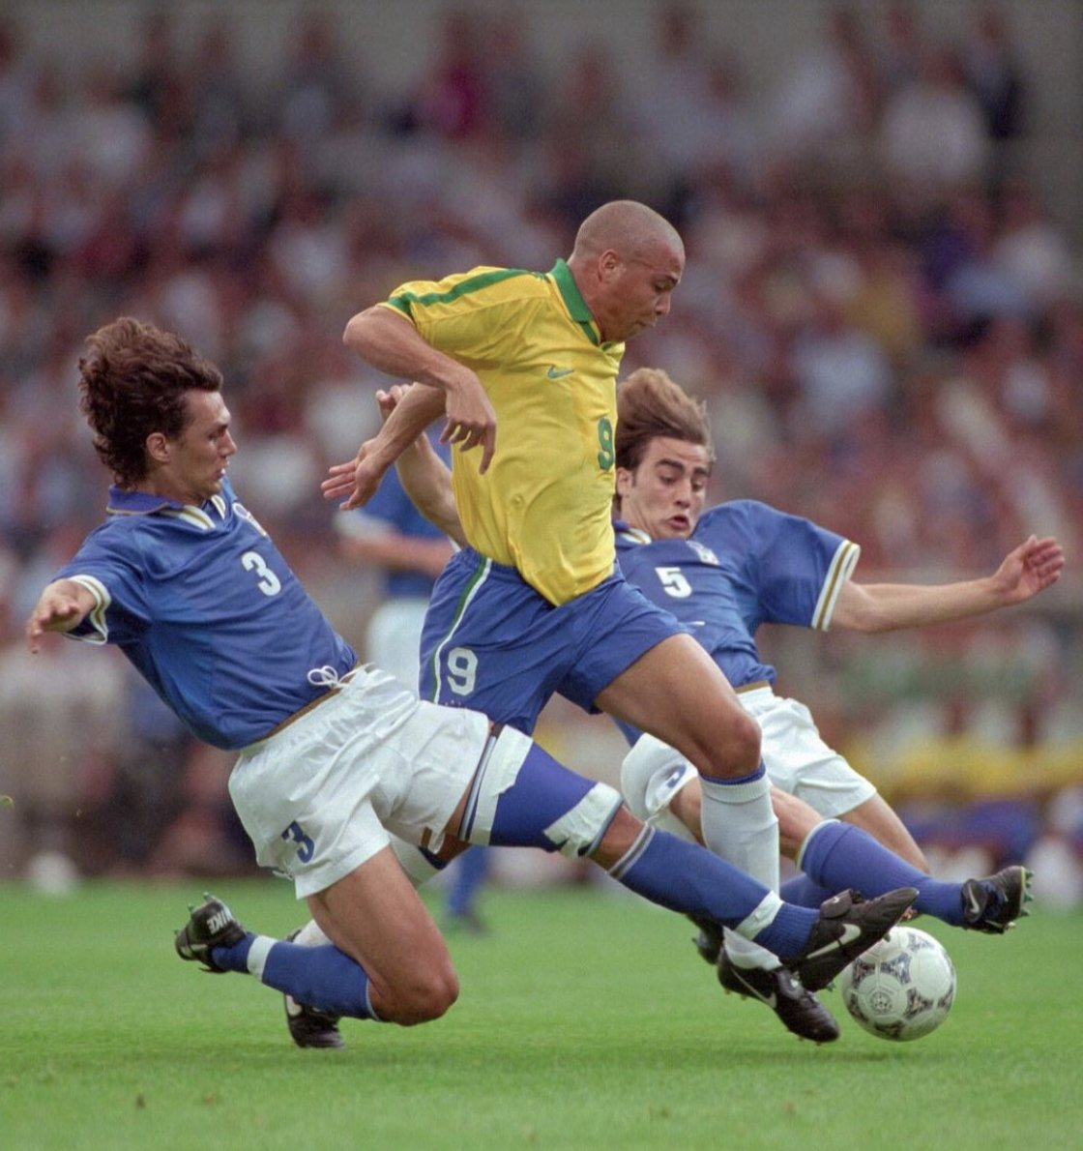
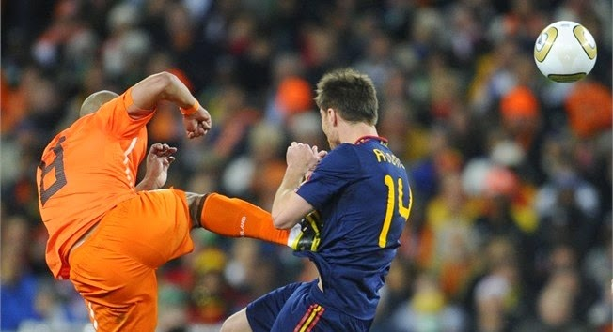

Tackling the challenges
There is nothing bad in being “two” in tackling difficult challenges!
  Important we work together and we organize ourselves
  We don’t compete
There are no shortcuts and not so many “low hanging fruits”
  It requires disciplines from all of us
  Others might suffer from our “being late”
Expectations management is paramount
  We do not dictate! We do bring people onboard, we (try to) motivate them (and people motivate us!)
  Crucial to clearly define our commitments taking into account all the “other” stuff we have to do
  It is critical that we are able to estimate by when “that something” will be done.

Slide 32
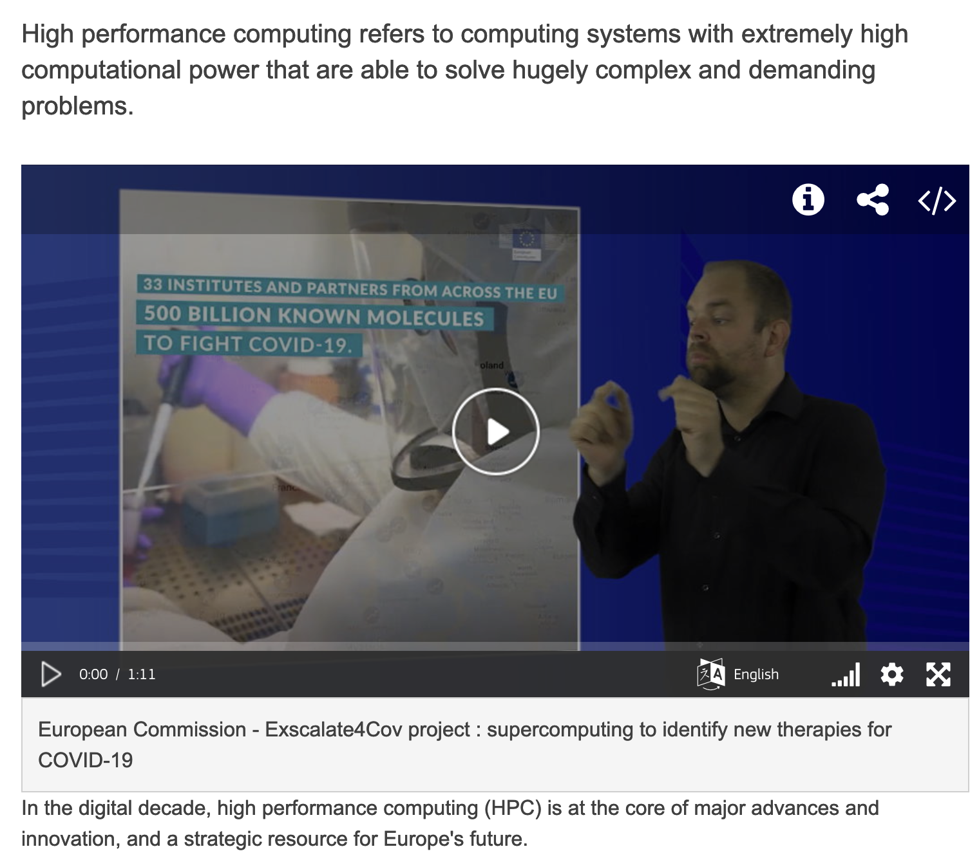
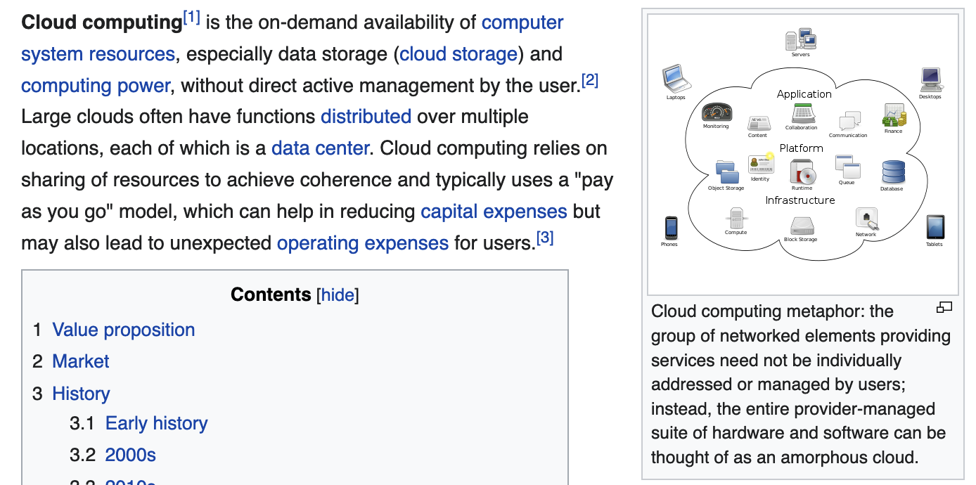
Tackling the challenges: infrastructure evolution
HPC and Clouds (and Industrial partners)
  More and more often we are seeing them discussed together
  Not really much overlap, except that they “both” are not standard Grid sites.
They really deserve two different “set of slides” → next

Slide 33
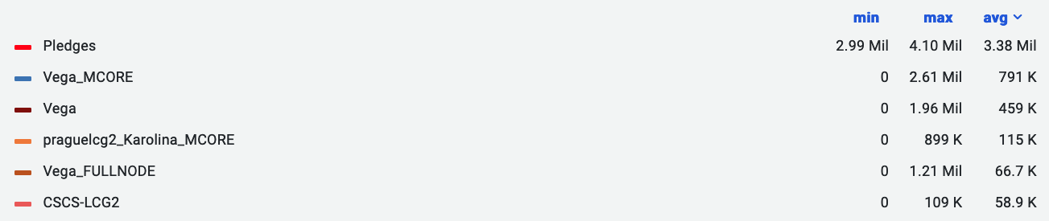
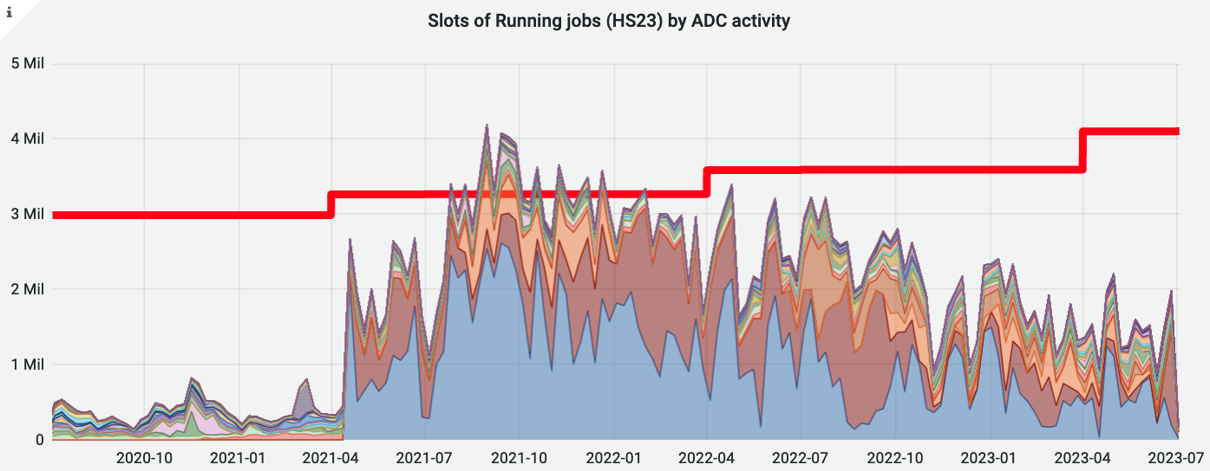
HPC and ATLAS - last 3 years - HPC only
A few HPCs make a big difference
  But still it’s important to highlight that many HPCs are integrated!
  Looking forward to Leonardo(n4) and Perlmutter(n8)
Notes:
https://monit-grafana.cern.ch/d/000000696/job-accounting-historical-data?from=1609459200000&orgId=17&to=now&var-bin=1d&var-cloud=All&var-computingsite=All&var-container_name=All&var-cores=All&var-country=All&var-error_category=All&var-es_division_factor=24&var-eventservice=All&var-federation=All&var-groupby=resource_type&var-groups=All&var-gshare=All&var-inputdatatypes=All&var-inputprojects=All&var-job_resource_type=All&var-jobstatus=All&var-jobtype=All&var-nucleus=All&var-outputproject=All&var-pledges=CPU&var-processingtype=All&var-prodsourcelabel=All&var-resources=GRID&var-resources=cloud&var-resources=hpc&var-resourcesreporting=All&var-site=All&var-tier=All&viewPanel=159

Slide 34
A strategy towards opportunistic HPC
Investment in proportion to opportunity
  At the moment, e.g., we see ARM as a higher priority than Power
  Not trying to get in on every machine!!
    We don’t need to – getting the easy/with internal good support ones gives ample CPU.
  All the “easy” HPCs transparently integrated, running all workflows, are much welcome!
We have a good (and growing) toolkit for edge services
  With several available solutions, one is likely to fit a new machine
Work towards several big HPCs is ongoing
  E.g. Perlmutter, Fugaku(2)/CSCS, Toubkal …
The details can make the difference:
  HPC are not easy, need expertise on I/O, shared file systems, scheduling, AAI…
Without forgetting:
  The risk that the opportunistic CPU resources will disappear at any time is very real
  The main physics program of the experiment should be supported through pledged resources
  A constant yearly increment for both CPU and Disk is reasonable to minimize the risks that, if these resources disappear, the computing centers providing pledged resources won’t be able to provide what is needed

Slide 35
R&D Projects with Industry
The experiments and the labs are engaging with industrial partners on R&D projects, e.g.:
  SEAL, a decentralized cloud storage start-up
  Google Cloud and Amazon Web Services
Opportunities to evaluate technologies and to define a resilient long term strategy
  Use of cloud compute for all workflows, and a comparison to traditional resources of the total cost of ownership (TCO)
    Google already used for interactive analysis
  Evaluation of test technologies (e.g. TPU, ARM) using cloud resources without requiring large-scale purchases
    AWS extensively used in setup and validation of ARM Athena nightlies builds
  Evaluation of remote cold storage as a complement / supplement to tape systems
These projects also present great connections with strong partners
  Amazon and Google are major players that many groups already collaborate with
  Being able to speak the same language and learn how they operate is invaluable

Slide 36
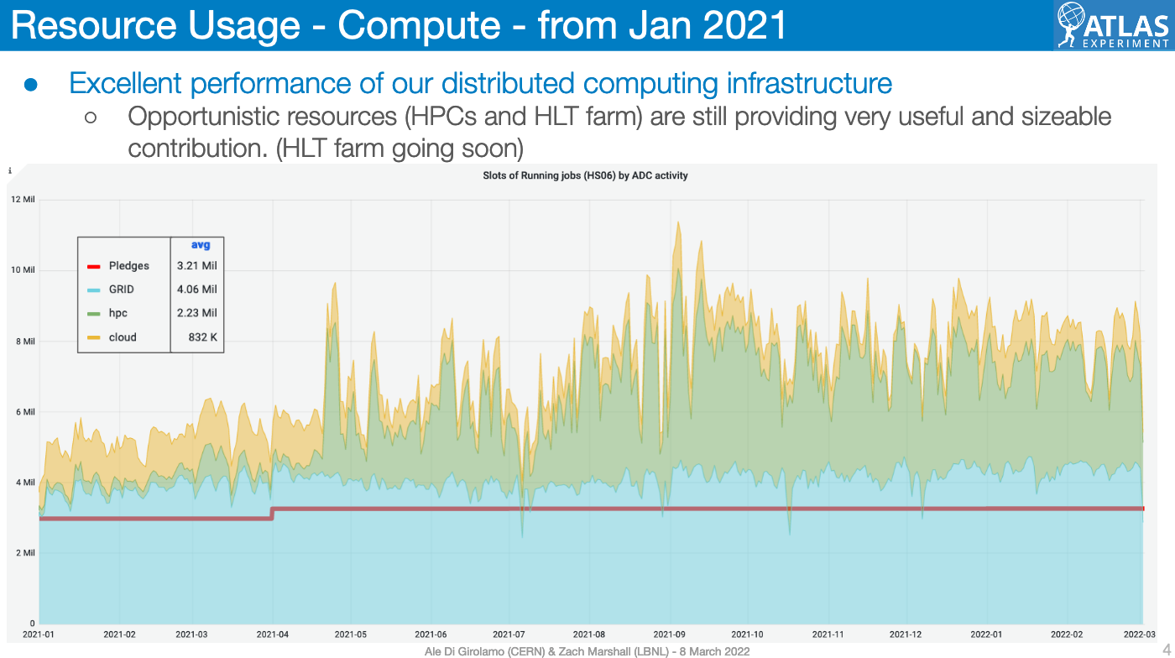
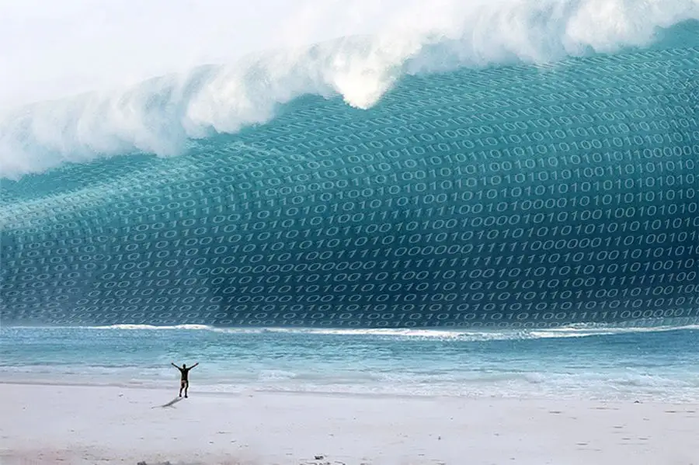
Opportunistic CPU but NO opportunistic Disk
Resources extremely useful for the physics community
  We have developed a detailed programme for secondary MC simulation samples
  E.g.: large number of diphoton background events simulated → significant reduction of spurious signal systematic uncertainty → enabled a low diphoton-mass analysis; V+jets w both new Sherpa and MadGraph → primary setup for upcoming V+jets modelling pub, used in Z+jets measurements paper
Still, they produce a huge challenge for our storage: we need to store all these data!

Slide 37
Storage challenges
Our data sample is going to be 10x bigger!
  today trigger rate is ~4kHz, will be 10kHz in HL-LHC,
  RAW size from 1.5MB/event to ~4MB in HL-LHC
  MC simulated events from 30B/year to 150B/year
We are working on several R&D (and lots of “business as usual”) to make sure we make the best use of our Disk and Tape:
New analysis models: smaller data types
Data Carousel: trading Tape (cheaper, but slower) for Disk
Constant review of the content and the objects stored in each datatypes

Slide 38
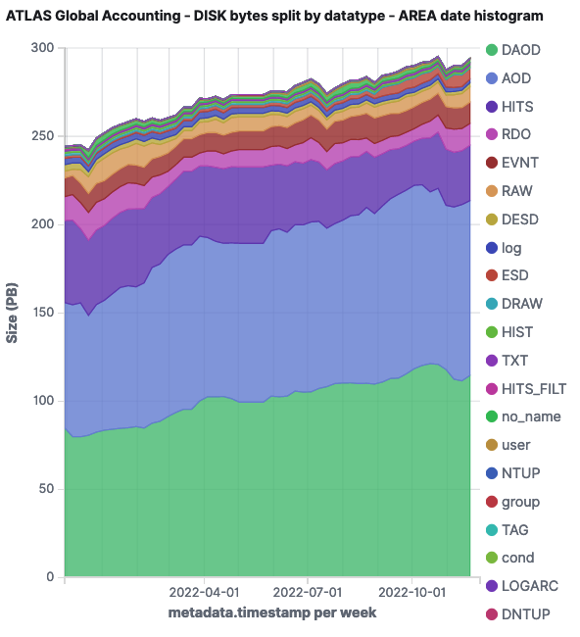
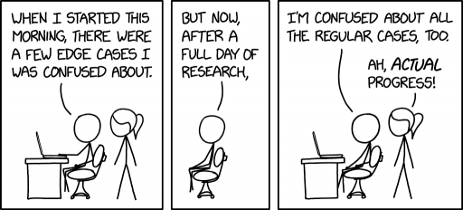

Storage challenges: more
Lot of analytics:
  Too much, never enough - and always complicated to keep all the chain working! - help welcome!
  understand what we use, how often, how many replicas …
Some more blue-sky R&D are fascinating, e.g.:
fastchain: trading CPU for Disk
  A fast end-2-end simulation, we could choose to save less (or zero) intermediate data - potentially important impact on disk and tape savings
More aggressive deletion - and recreation on demand
  Again trading CPU for Disk, one of the complexity is on the timely reproduction (with proper metadata)
Data Scientists:

Slide 39
Tackling challenges: considerations
HPCs are very useful to mitigate the risk of being short in CPU resource
  With some caveats - as we discussed
Clouds and in general project with industry help us in improving our frameworks, make it more sustainable and “community standard”
  Some interesting “opportunistic storage” R&D
  And TCO evaluation is important
Many more R&D to mitigate the HL-LHC not-enough-CPU risks:
  We are following with great interest the Geant4 collaboration (+Adept and Celeritas) and Event Generator groups’ R&D efforts
Many R&D to mitigate the storage challenges’ risks:
  Our systems are complex: need lots of brains and analytics expertise to take the right informed decisions
Note that not all our R&D will reduce our resource consumption!
  We want to do *great* physics, some of the R&D will help us on this too
  And some others will push us to rewrite our (reco and tracking) code, to be able to be accelerators (e.g. GPU) friendly
    → independently on the usage or not of accelerators, we will for sure gain having better written code: sustainability and capability to engage more people

Slide 40
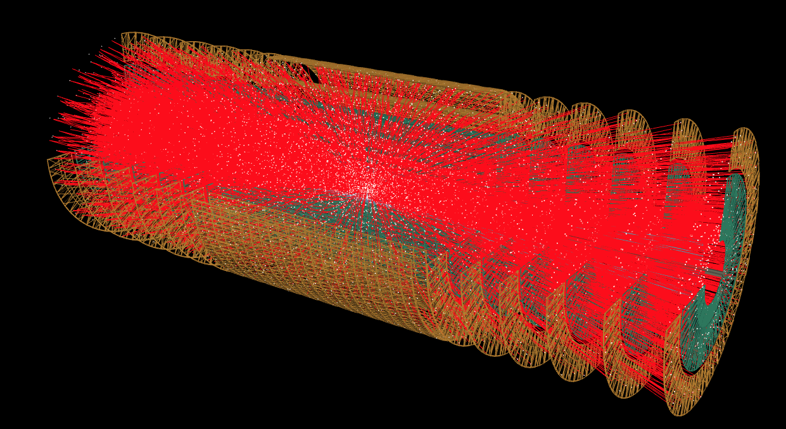
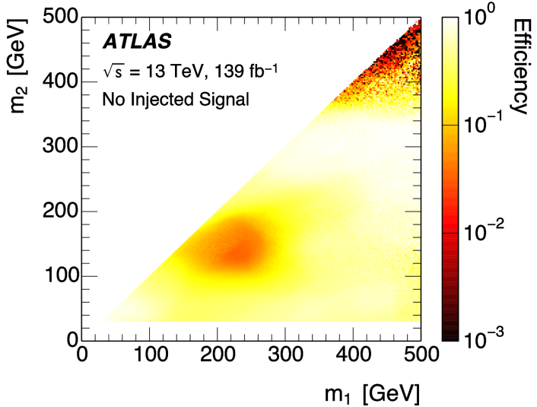
ML, AI, and more
Machine Learning (and AI) is pervasive in the experiments
  For trigger, reconstruction (e.g. pixel clusters, electrons and hadrons), analysis (e.g. signal/background discrimination), fast detector simulation (e.g. generative networks for calorimeter simulation). NextGenerationTrigger (agendas)
  Not only inside the experiments, but also work in collaboration with external machine learning experts (e.g. TrackML challenge, Higgs ML challenge)
AI for computing
Quantum Computing and Algorithms
Notes:
..
For trigger, reconstruction (e.g. pixel clusters, electrons and hadrons), analysis (e.g. signal/background discrimination), fast detector simulation (e.g. generative networks for calorimeter simulation)

Slide 41
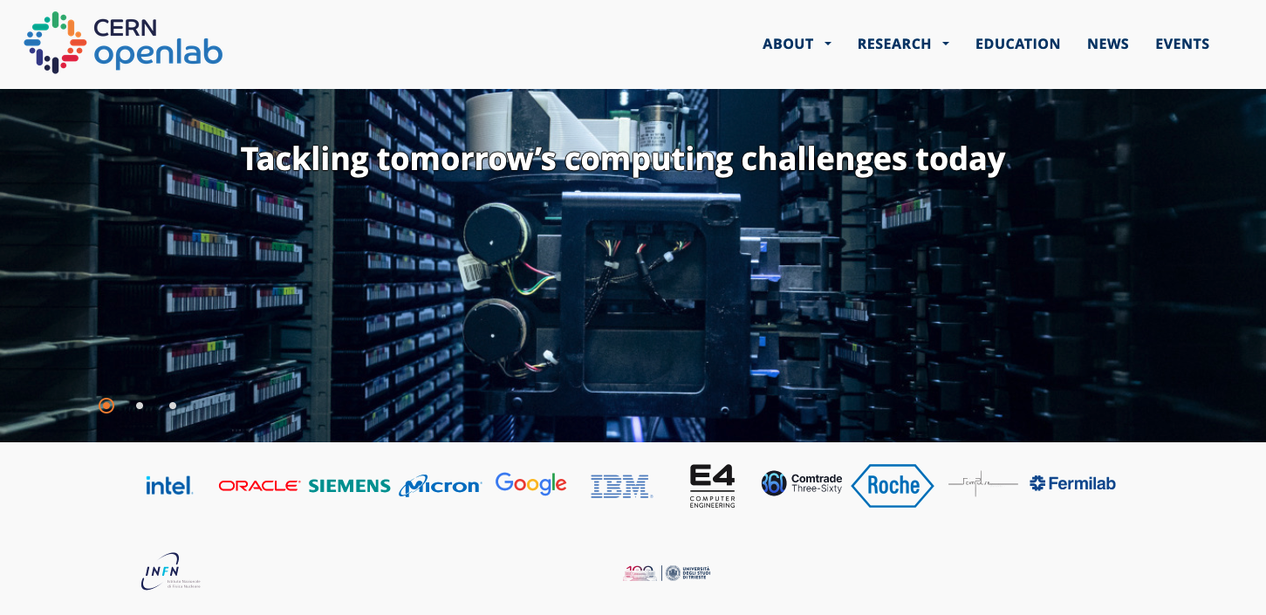
CERN OpenLab

Slide 42

.… The Role of Computing in Society
… in the scientific community actually… but also in the society at large.
What do YOU think?
What’s YOUR forecast?
https://www.menti.com/alty7843vbq9 or
https://www.menti.com/ 8272 6353
Live results

Slide 43
The road ahead: “Welcome”!
Exciting Challenges:
  The experiments at CERN are facing interesting, difficult, but solvable software and computing challenges for the HL-LHC.
Critical Need for Talents:
  One of the biggest challenges not mentioned here is engaging, supporting and retaining skilled developers – YOU!!
Unified Goals:
  Focusing our efforts on common shared objectives is paramount.
Impactful Collaboration:
  The way in which we work can make the difference between success and failure!
Time to act is now!
  Ad Augusta per angusta!
We are part of a team. We are all unique. We can make a difference.

Slide 44
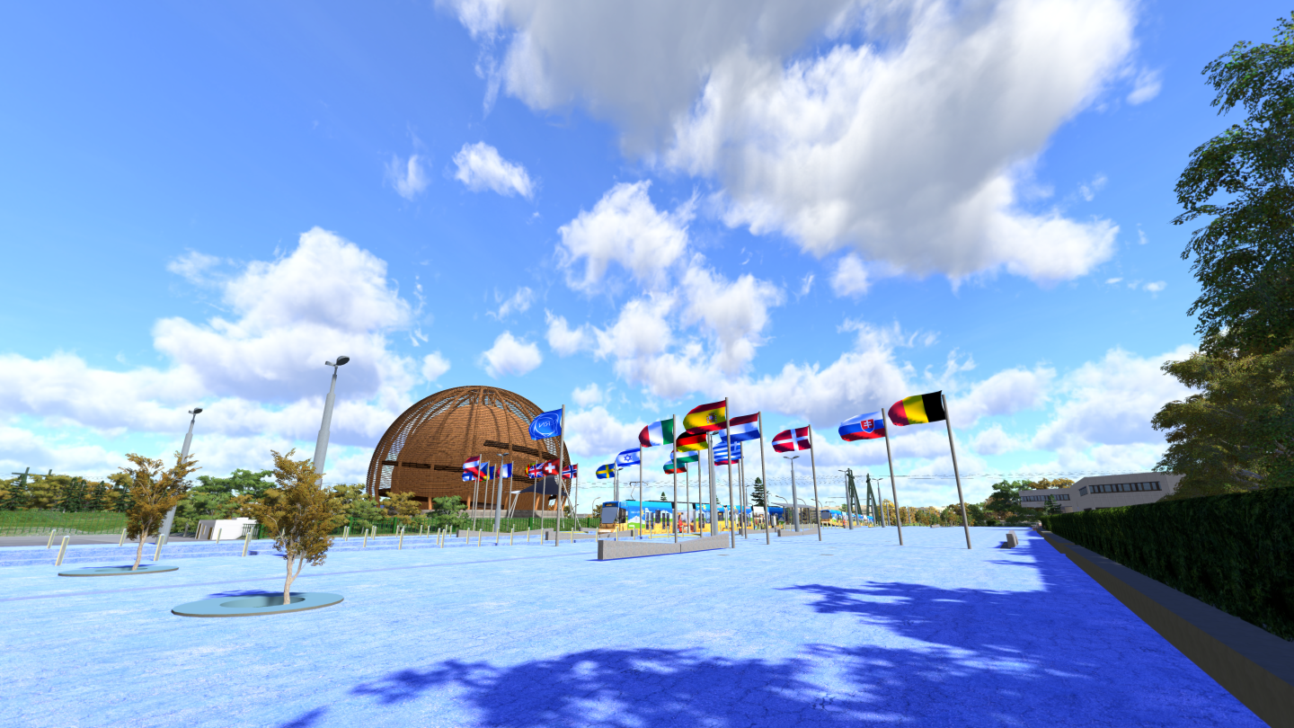
…
Thank you
….
….
  ...
….
… a special thanks for the many very useful discussions and providing material for this talk, to: Antonella Del Rosso, Zach Marshall, David South, Concezio Bozzi, Stefano Piano, Fernando Barreiro Megino, Maria Girone and many more!

Slide 45
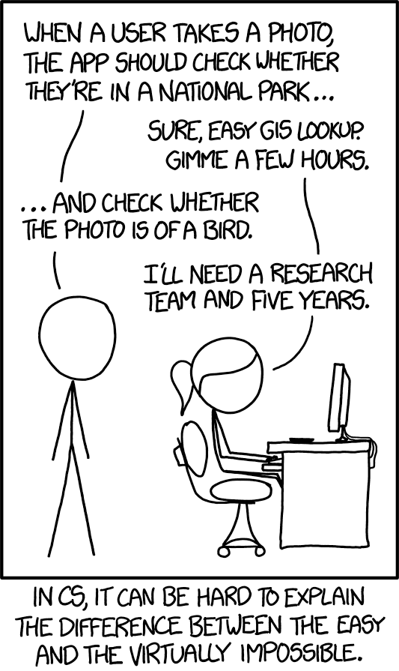
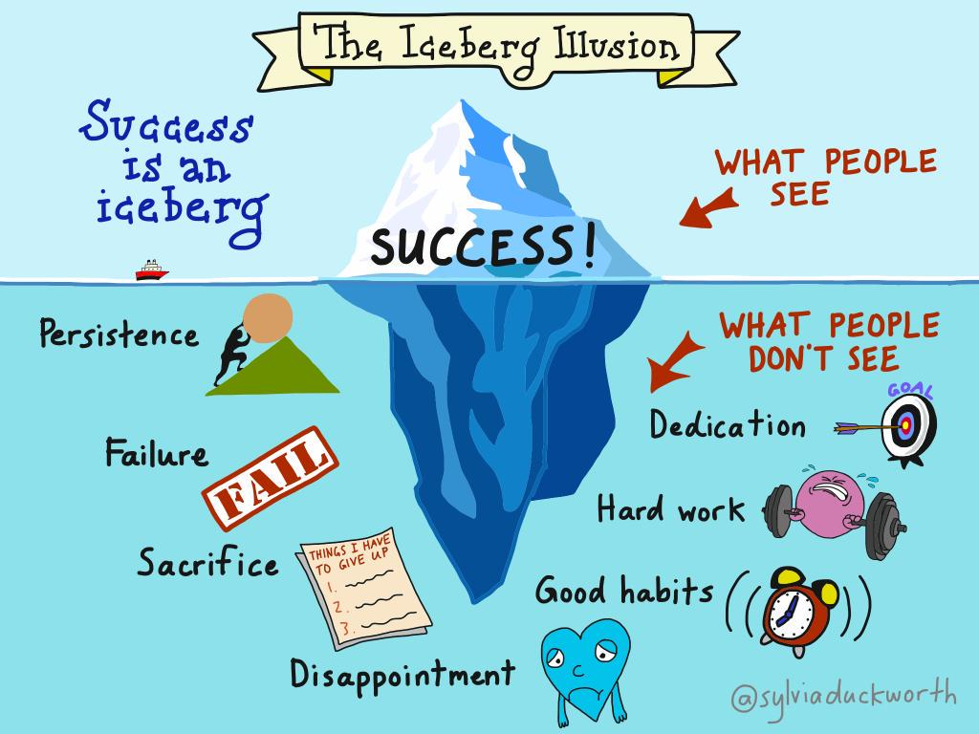


Slide 46

Plan B

