Slide 1

How to navigate inside openlab servers
Joaquim Santos (CERN)
Albane Carcenac (CERN)
Luca Atzori (CERN)
Jessy Sobreiro (CERN)
Notes:
Alternative title: "Resource access"

Slide 2
Contents
Access Request (submit a ticket to us)
How to connect to the server (from CERN or outside)
Personal space and different filesystems available
Documentation
How to contact us
23/06/2025
How to navigate inside openlab servers
2
Notes:
Do we say more/ present the hardware we have like you did in the march workshop? (slide: Some numbers)

Slide 3
Our servers
The environment
Shared Bare metal access only
RHEL/ALMA 8 and 9
CERN’s filesystems available
The hardware
Different CPU architectures
Different GPUs
23/06/2025
How to navigate inside openlab servers
3
Notes:
Bare metal / system wide / RHEL/ALMA 8 or 9
no root access / if you need to install packages you need to contact us with the list of packages you want to install
Exception for the python packages, you can create a virtual environment and install them by yourself in there
Hardware inside (might be useful if they don't really know about it) : CPUs, GPUs, Memory (RAM), Disks (Storage), different architectures, x86-64, ARM, power 8/9

Slide 4
How to request access
Explain the project you're in
Which are your requirements:
CPU,GPU, FPGA, memory, disks...
Open a ticket to us
on service-now
Specify the anticipated end date of the access
Add your supervisor on the watchlist (after submitting)
ServiceNow - Request access to an openlab machine
23/06/2025
How to navigate inside openlab servers
4
Notes:
Or live show:
Go on the CERN servicenow page
Search for Openlab-systems and go on our page
Create a request for a machine
Complete everything and explain in the same time
Submit, and add the supervisor in the watchlist
Maybe tell them that they will receive an email when we answer them?
And maybe explain the 3 different types of requests (machine, requests and incidents)
Change the screenshot, it got mangled when uploaded through the web editor

Slide 5
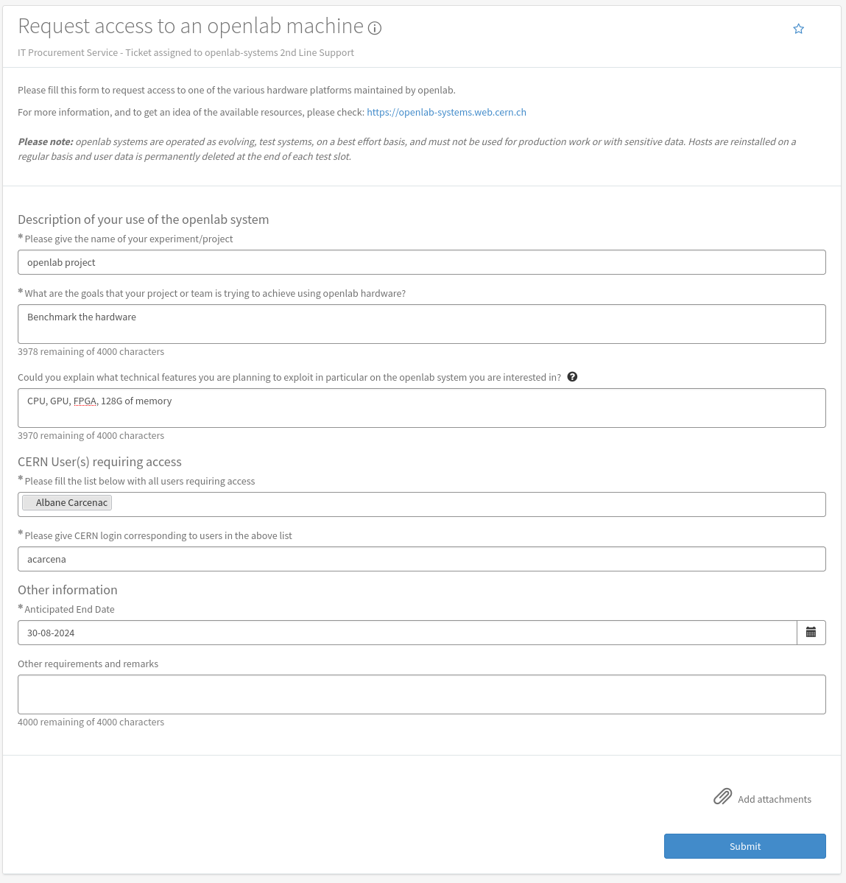

Slide 6
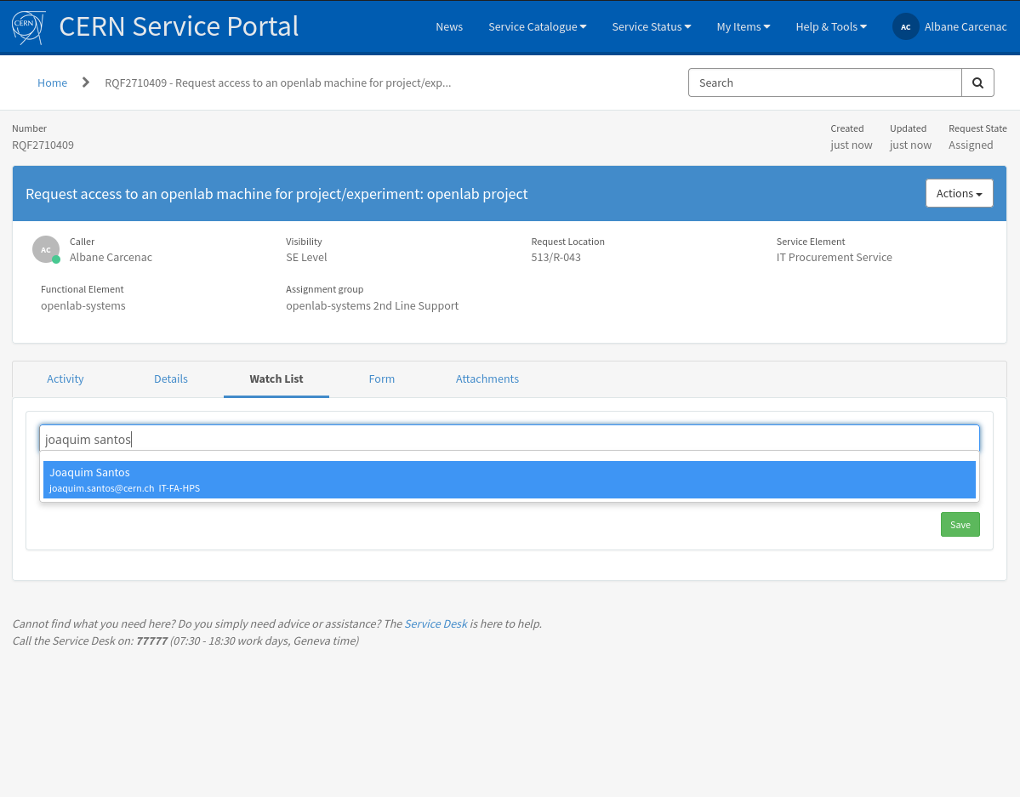

Slide 7
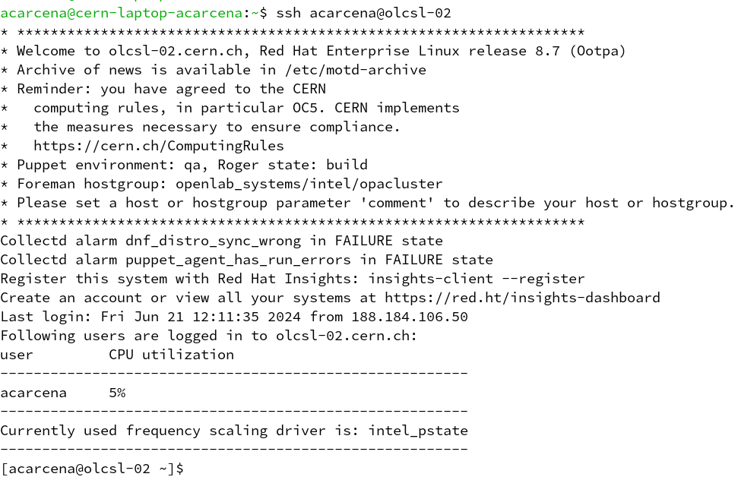
How to connect to the openlab machines
SSH connection
Inside CERN’s Network
You can connect directly from your computer with
your CERN username:
local_user@user-pc-name:~$ ssh cern_user@openlab-node-name
Managing personal user space - SSH connection
23/06/2025
How to navigate inside openlab servers
7

Slide 8
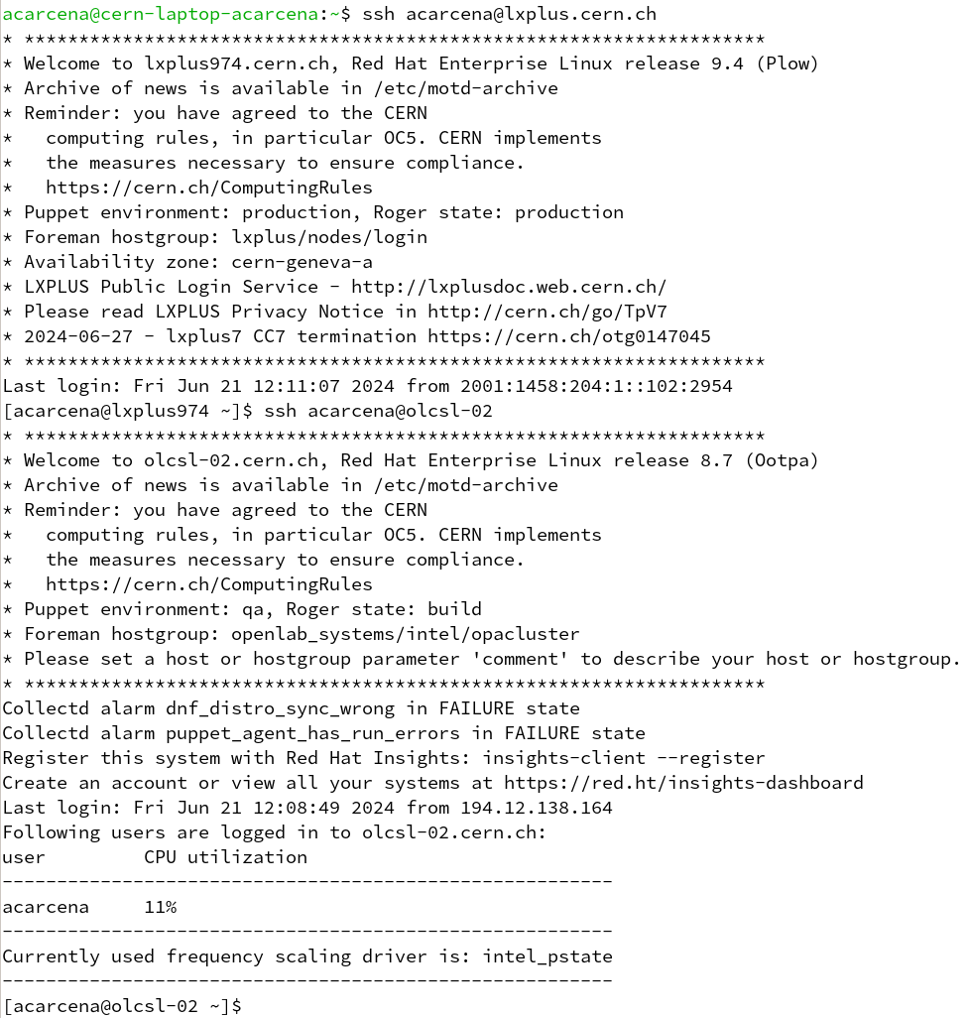
How to connect to the openlab machines
SSH connection
Outside CERN’s Network
You first need to connect to lxplus.cern.ch with
your CERN username:
[local_user@user-pc-name]:~$ ssh cern_user@lxplus.cern.ch
From there, you can access to the node:
[cern_user@lxplus ~]$ ssh cern_user@openlab-node-name
23/06/2025
How to navigate inside openlab servers
8

Slide 9
Space to use
Preferred working & storage space
/data/<username> (local)
Your personal local directory in each server
Where you arrive when you log in, your home folder
~/ or /afs/cern.ch/user/<1st letter of the CERN username>/username/
AFS (not local)
You can access your EOS folder, as well
/eos/home-<1st letter of the CERN username>/username/
EOS (not local)
Managing personal user space - User personal directories
23/06/2025
How to navigate inside openlab servers
9
Notes:
When you login you will be in your afs folder
However you have dedicated space inside each machine
/data/<username>

Slide 10

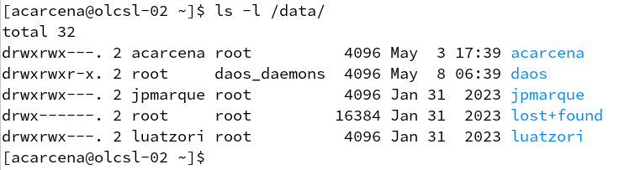
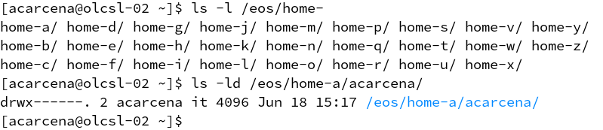
AFS
/data/
EOS

Slide 11
Documentation
openlab-systems.web.cern.ch
Procedure to request access
Managing personal user space
Using Jupyter notebooks
Install Python3 packages in your own environment
Hardware portfolio
23/06/2025
How to navigate inside openlab servers
11

Slide 12
How to contact us
Where to open request / incident tickets
https://cern.service-now.com/service-portal?id=functional_element&name=openlab-systems
Our email address
openlab-systems@cern.ch
23/06/2025
How to navigate inside openlab servers
12

Slide 13
Thank you!
Questions?

