Slide 1
Test Plan – New Interlayer Materials
Javier Osuna – TE-MSC-SMT

Slide 2
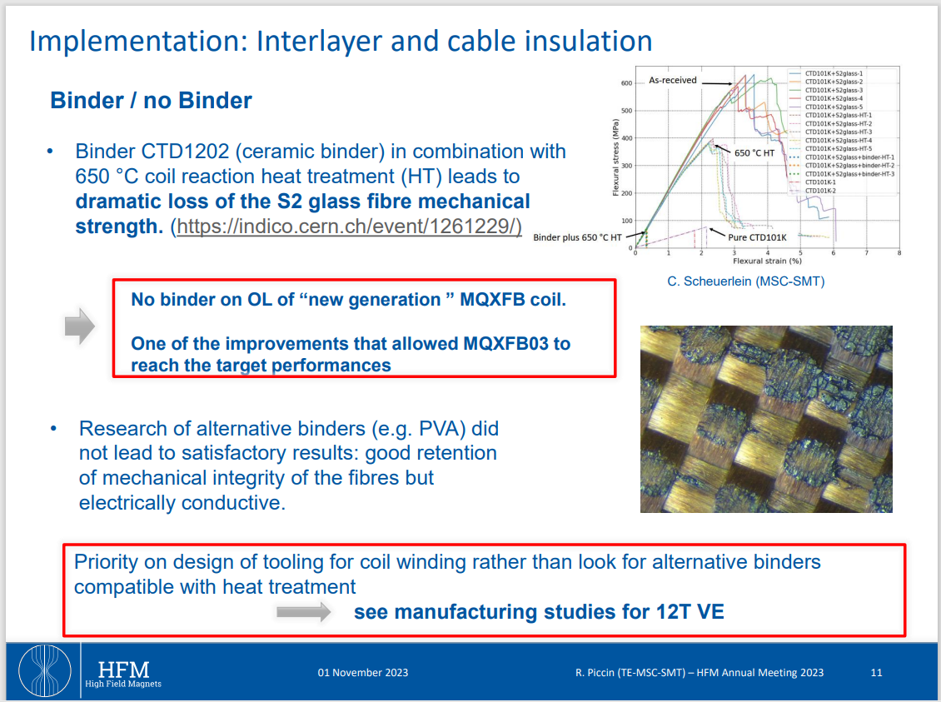
Interlayer Study in 2023 (Slide by R.Piccin)

Slide 3
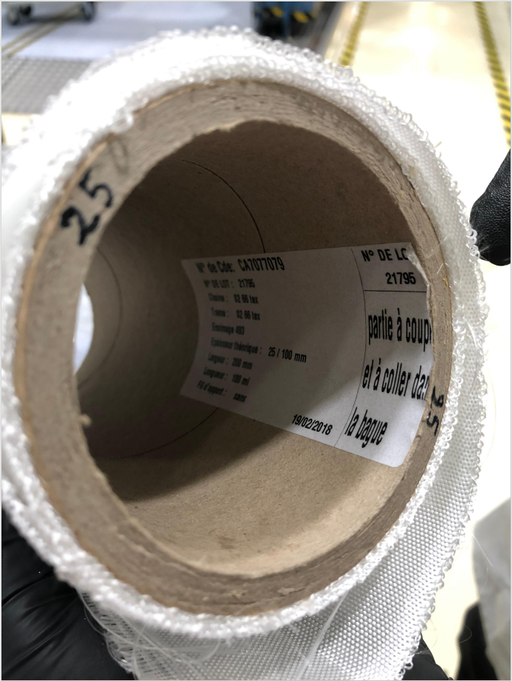
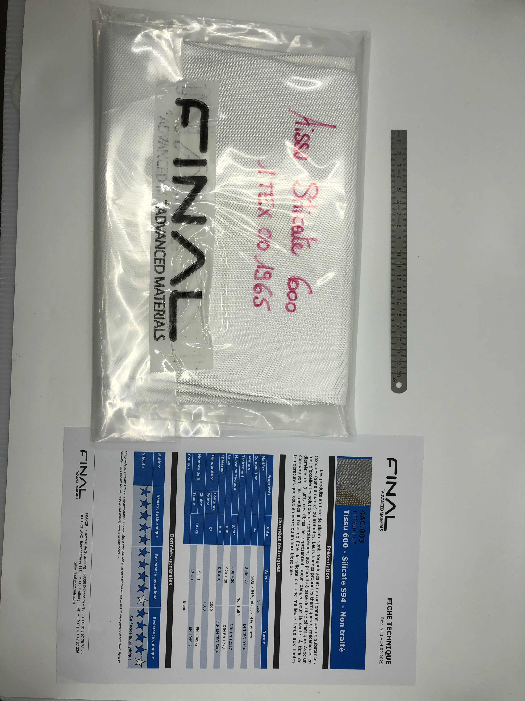
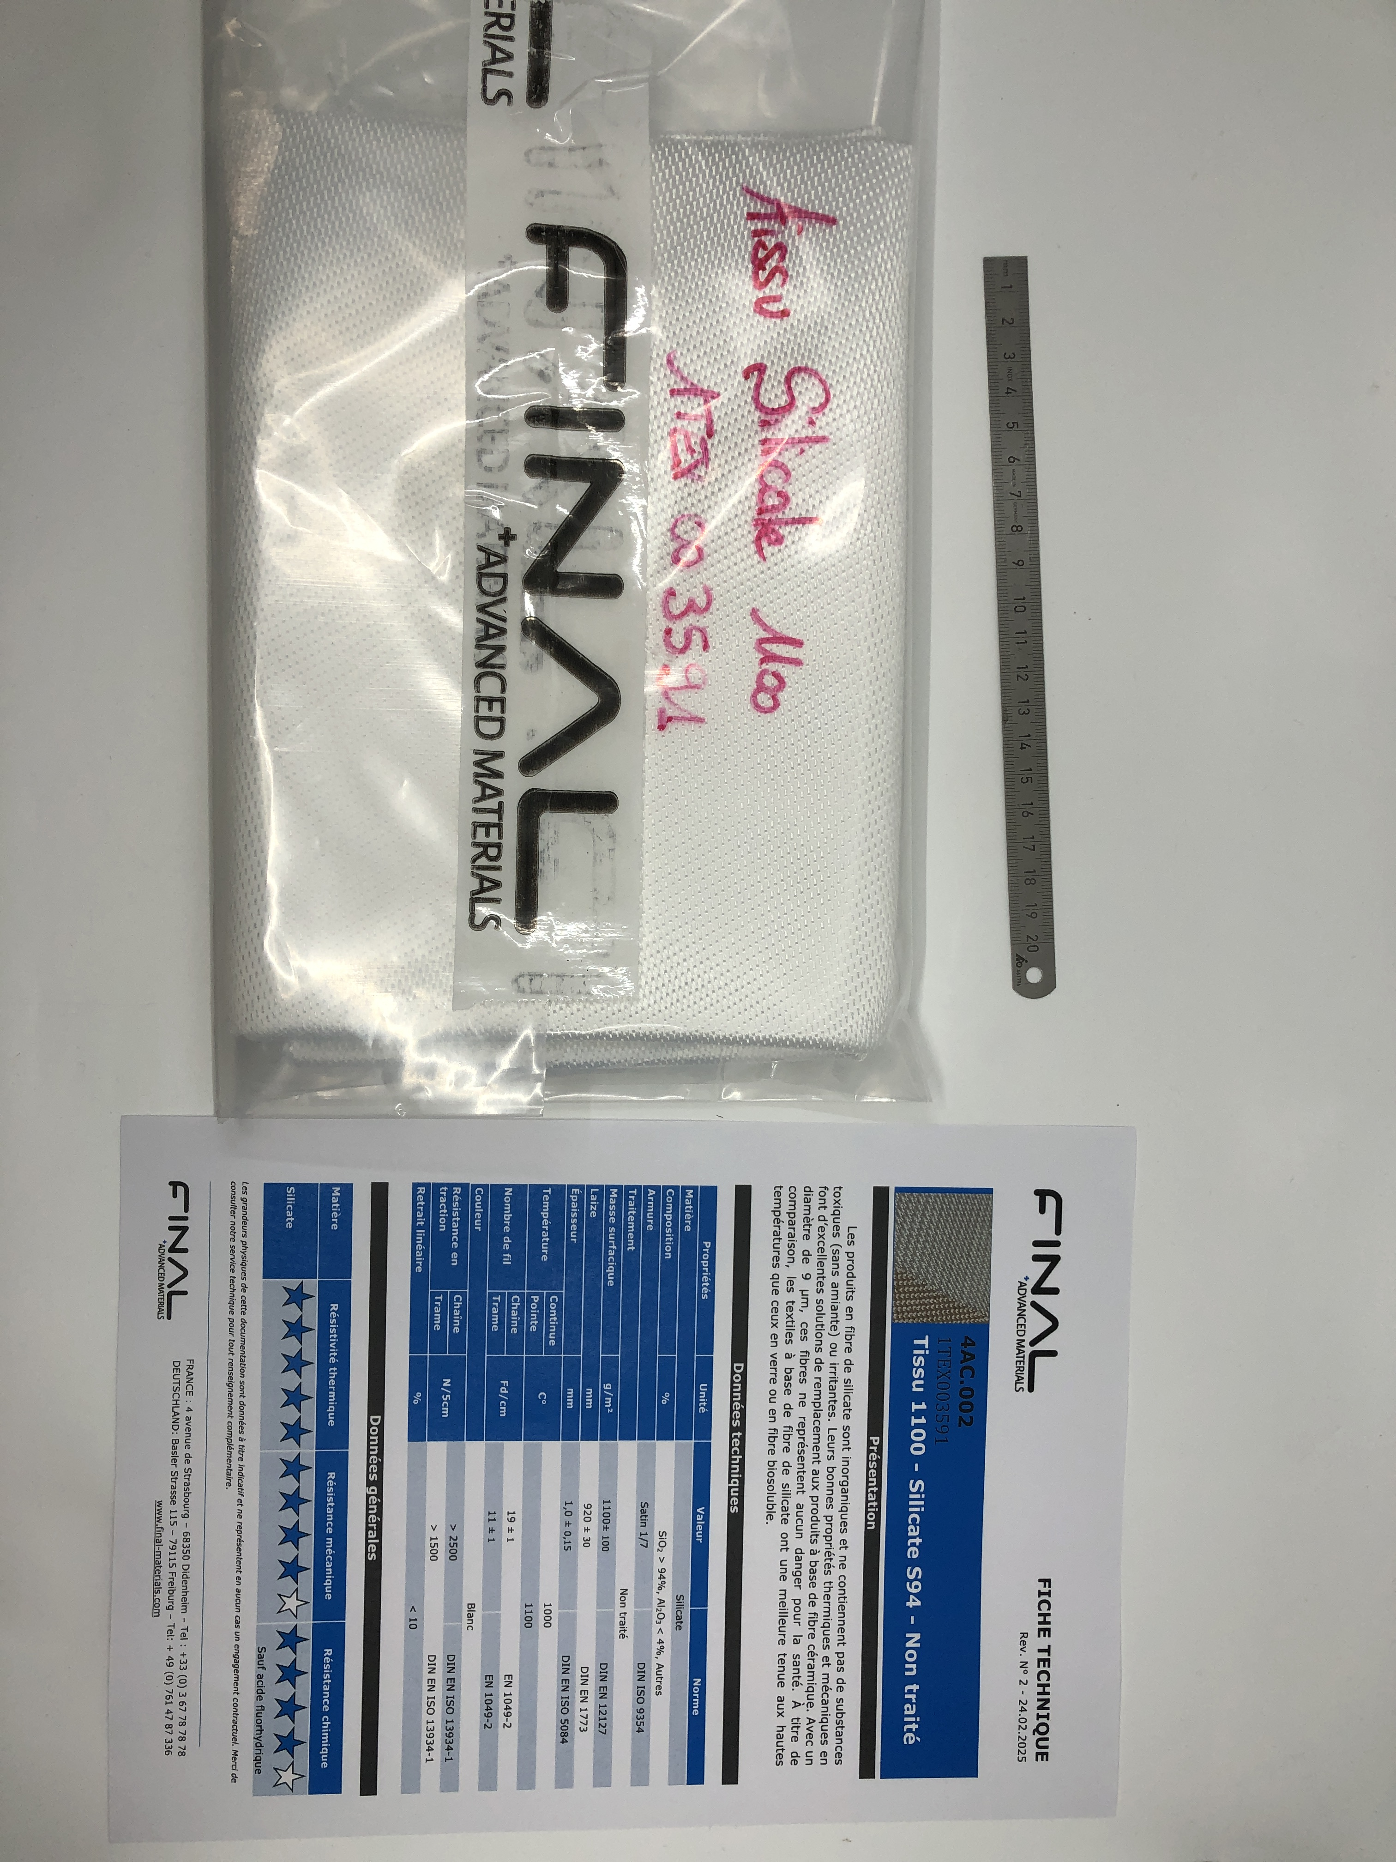
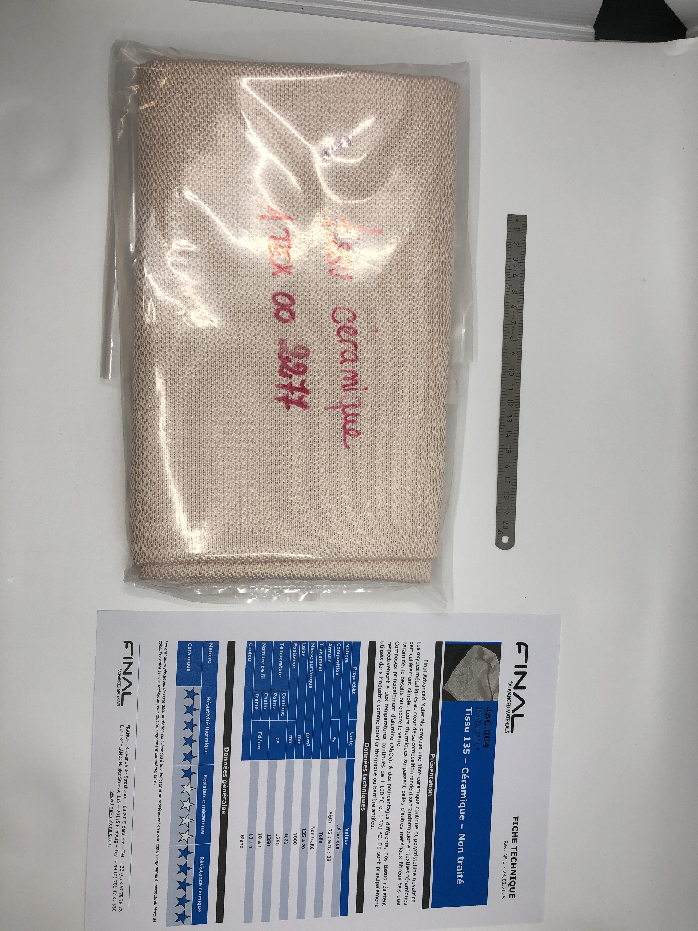
New Interlayer Materials
S2-Glass 493
65% SiO_{2 ,} 25% Al₂O_{3,} 10% MgO
0.25, 0.175 mm thick
258, 212 g/m²
Plain Weave
Silicate 600
>94% SiO₂, <4% Al₂O₃
0.6 mm thick
600 g/m²
Satin 1/7 Weave
Silicate 1100
>94% SiO₂, <4% Al₂O₃
1 mm thick
1100 g/m²
Satin 1/7 Weave
Ceramic 135
28% SiO₂, 72% Al₂O₃
0.21 mm thick
135 g/m²
«Toile» (Satin) Weave

Slide 4
New Interlayer Materials
S2-Glass
65% SiO_{2 ,} 25% Al₂O_{3,} 10% MgO
0.25, 0.175 mm thick
258, 212 g/m²
Plain Weave
Silicate 600
>94% SiO₂, <4% Al₂O₃
0.6 mm thick
600 g/m²
Satin 1/7 Weave
Silicate 1100
>94% SiO₂, <4% Al₂O₃
1 mm thick
1100 g/m²
Satin 1/7 Weave
Ceramic 135
28% SiO₂, 72% Al₂O₃
0.21 mm thick
135 g/m²
«Toile» (Satin) Weave

Slide 5
New Interlayer Materials
S2-Glass
65% SiO_{2 ,} 25% Al₂O_{3,} 10% MgO
0.25, 0.175 mm thick
258, 212 g/m²
Plain Weave
Silicate 600
>94% SiO₂, <4% Al₂O₃
0.6 mm thick
600 g/m²
Satin 1/7 Weave
Silicate 1100
>94% SiO₂, <4% Al₂O₃
1 mm thick
1100 g/m²
Satin 1/7 Weave
Ceramic 135
28% SiO₂, 72% Al₂O₃
0.21 mm thick
135 g/m²
«Toile» (Satin) Weave

Slide 6
New Interlayer Materials
S2-Glass
65% SiO_{2 ,} 25% Al₂O_{3,} 10% MgO
0.25, 0.175 mm thick
258, 212 g/m²
Plain Weave
Silicate 600
>94% SiO₂, <4% Al₂O₃
0.6 mm thick
600 g/m²
Satin 1/7 Weave
Silicate 1100
>94% SiO₂, <4% Al₂O₃
1 mm thick
1100 g/m²
Satin 1/7 Weave
Ceramic 135
28% SiO₂, 72% Al₂O₃
0.21 mm thick
135 g/m²
«Toile» (Satin) Weave

Slide 7
New Interlayer Materials
S2-Glass
65% SiO_{2 ,} 25% Al₂O_{3,} 10% MgO
0.25, 0.175 mm thick
258, 212 g/m²
Plain Weave
Silicate 600
>94% SiO₂, <4% Al₂O₃
0.6 mm thick
600 g/m²
Satin 1/7 Weave
Silicate 1100
>94% SiO₂, <4% Al₂O₃
1 mm thick
1100 g/m²
Satin 1/7 Weave
Ceramic 135
28% SiO₂, 72% Al₂O₃
0.21 mm thick
135 g/m²
«Toile» (Satin) Weave

Slide 8
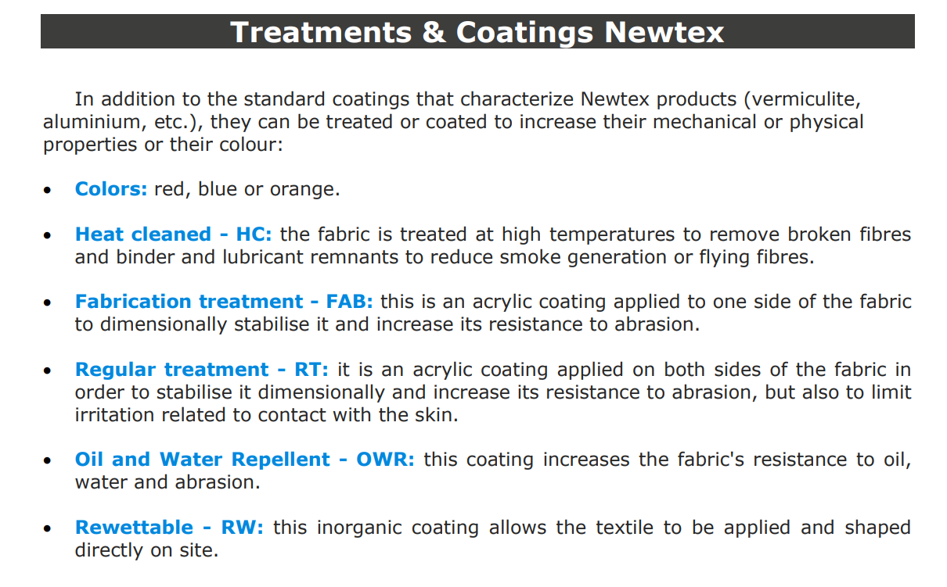
About the Silicate/Ceramic Fibres

Slide 9
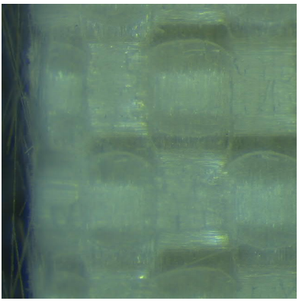
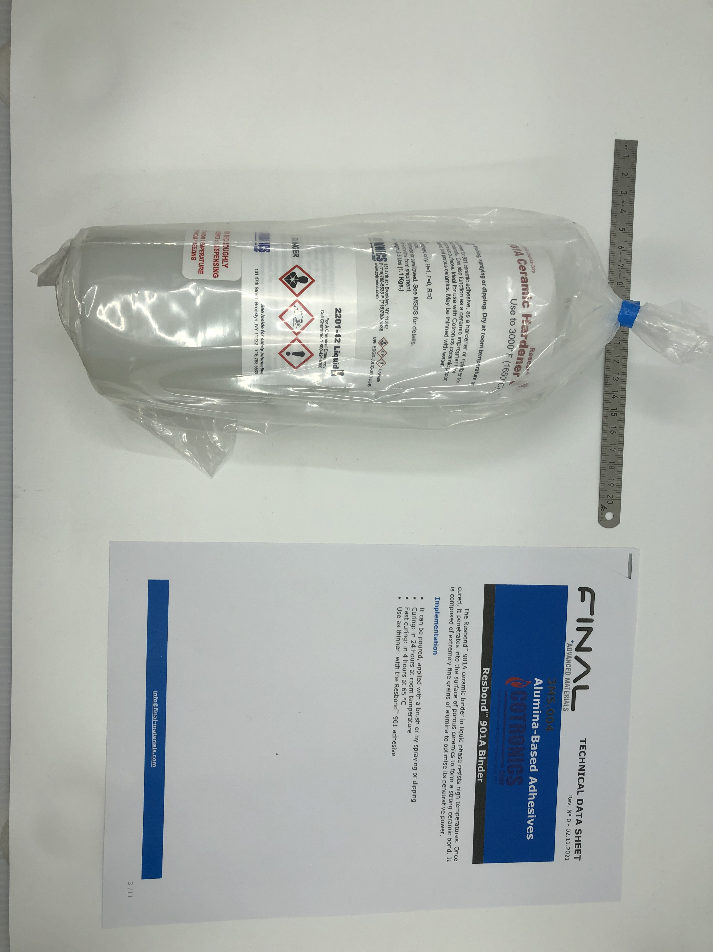
New Binder Material
CTD1202
Cyclosiloxanes + Polymethylsiloxane
Initial Cure 1h 80 °C
Post Cure 2h 150 °C
Heat Treat >550 °C
Resbond Binder
Ethylene Glycol + Al₂O₃ particles
24h RT Curing or 4h at 65 °C

Slide 10
New Binder Material
CTD1202
Cyclosiloxanes + Polymethylsiloxane
Initial Cure 1h 80 °C
Post Cure 2h 150 °C
Heat Treat >550 °C
Resbond Binder
Ethylene Glycol + Al₂O₃ particles
24h RT Curing or 4h at 65 °C

Slide 11
New Binder Material
CTD1202
Cyclosiloxanes + Polymethylsiloxane
Initial Cure 1h 80 °C
Post Cure 2h 150 °C
Heat Treat >550 °C
Resbond Binder
Ethylene Glycol + Al₂O₃ particles
24h RT Curing or 4h at 65 °C

Slide 12
Questions to Answer
Does Resbond ‘bind’ the fibre tissues? (priority) before moving on.
Does Resbond also produce a brittle, low-strength phase after reaction HT?
Do we obtain a better-performing interlayer with ceramic fibres?
  Young’s Modulus
  Flexural Strength
  DC Breakdown
Does Alumina ceramic behave differently to Silicate?

Slide 13
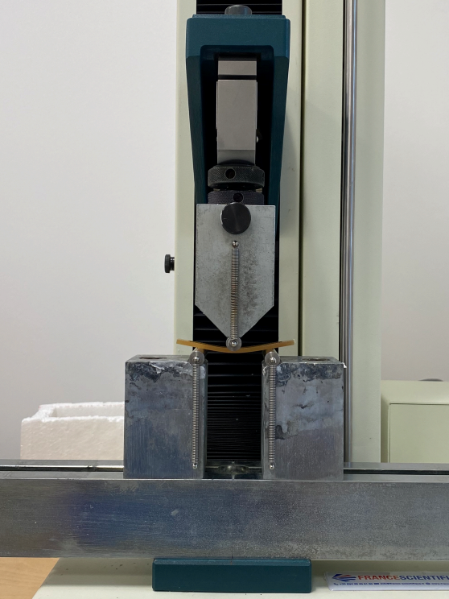
Flexural Properties - Test Matrix
3mm Cured Stack | S2 Glass (Desized) | Silicate 600 | Silicate 1100 | Ceramic
Binder – No Impregnation | X | X |  | X
Interlayer performance during winding. (does it bind?) (keep note of binder amount)
Initial rough test, visual to see if it stays together at least.
3mm Plates | S2 Glass (Desized) | Silicate 600 | Silicate 1100 | Ceramic
Binder + HT | X | X |  | X
No Binder + No HT |  | X |  | X
No Binder + HT |  | X |  | X
Ceramic vs glass fibres, effects of reaction on binder and fibres.
Flexural Test

Slide 14
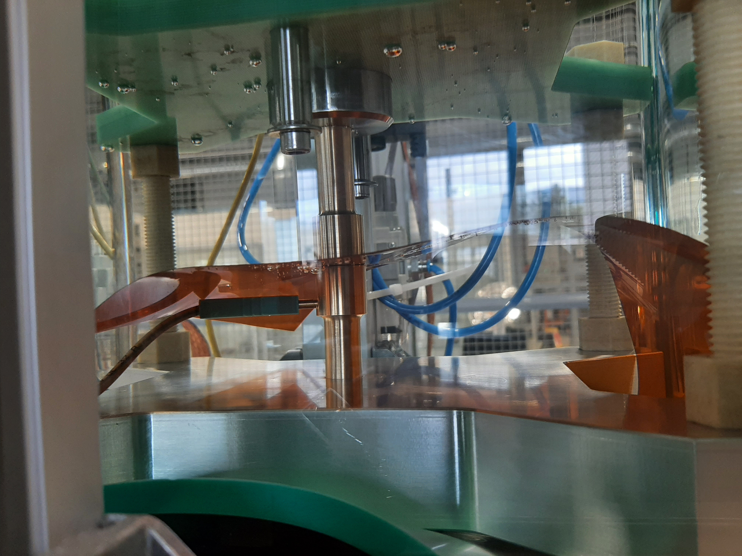
Electrical Properties - Test Matrix
0.5mm Plates | S2 Glass (Desized) | Silicate 600 | Silicate 1100 | Ceramic
No Binder + HT |  | X |  | X
Binder + HT | X | X |  | X
Ceramic vs glass fibres, effects of reaction on binder and fibres.
DC Breakdown Test in Oil

Slide 15
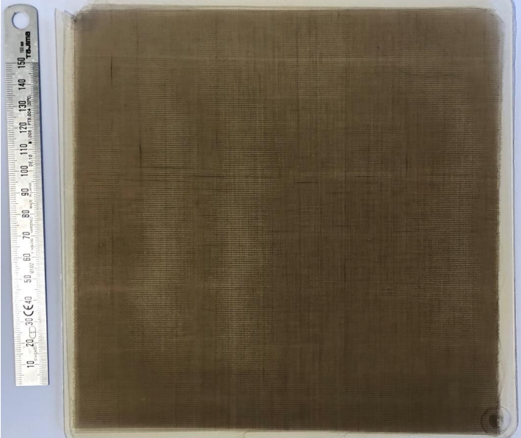
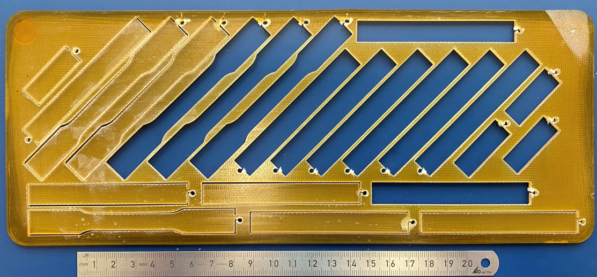
Summary of Test Samples
3mm composite plates for flexural tests, x7
3mm cured stack for interlayer winding test, x3
0.5mm composite plates for DC breakdown test, x5
Minimum number of impregnations: 7
0.5mm composite plate for electrical tests
3mm composite plate for mechanical tests

Slide 16
Additional Slides

