Slide 1
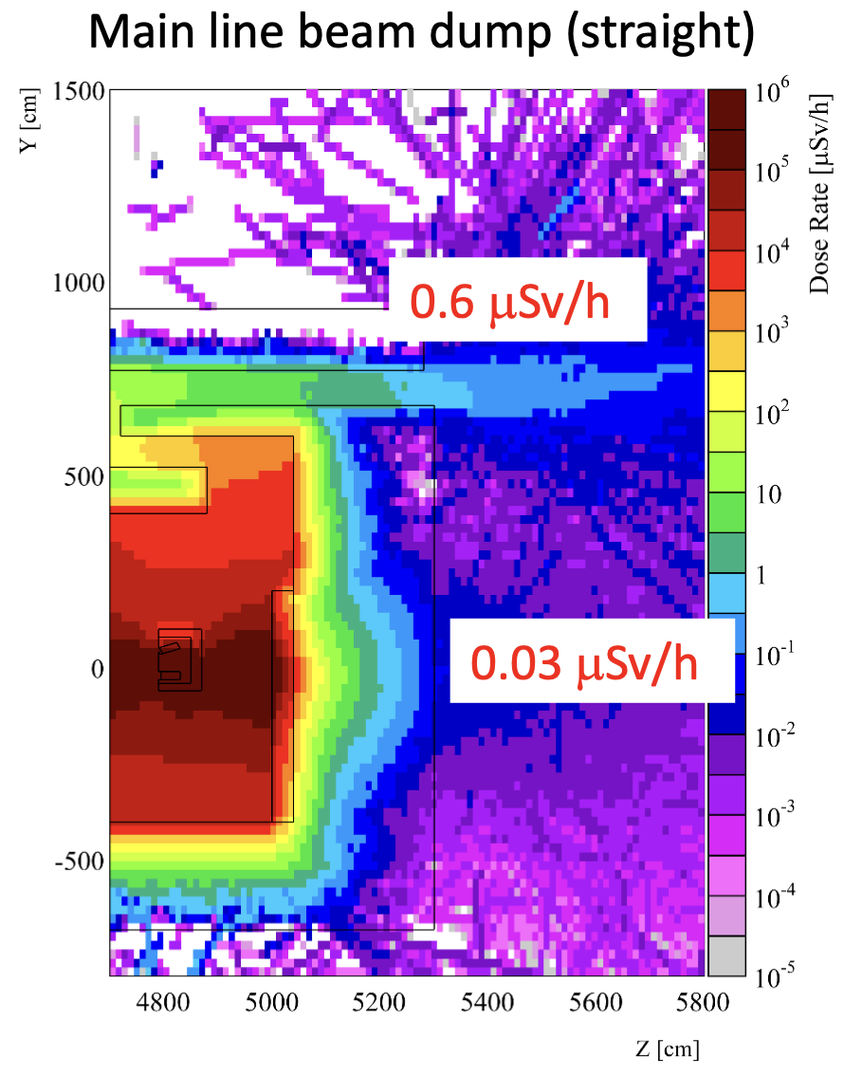
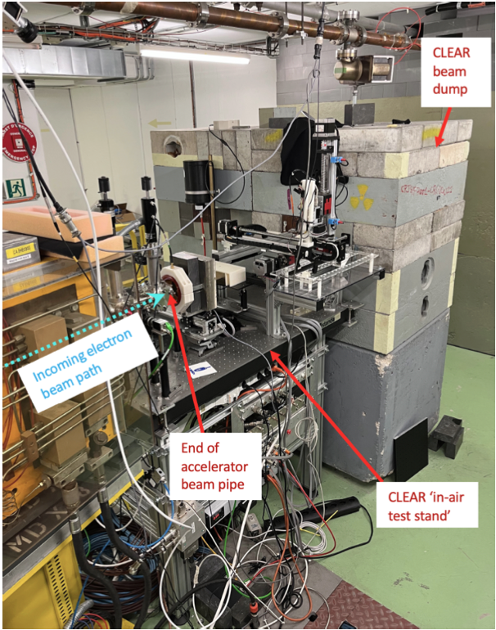
Present CLEAR dump
Original design/RP simulation by Joachim EDMS #2920943
Was built as in EDMS #3012301
Dump as built (central layer)
Dump as built
Dose rate with 3.9x1012 e -/s at 220 MeV

Slide 2
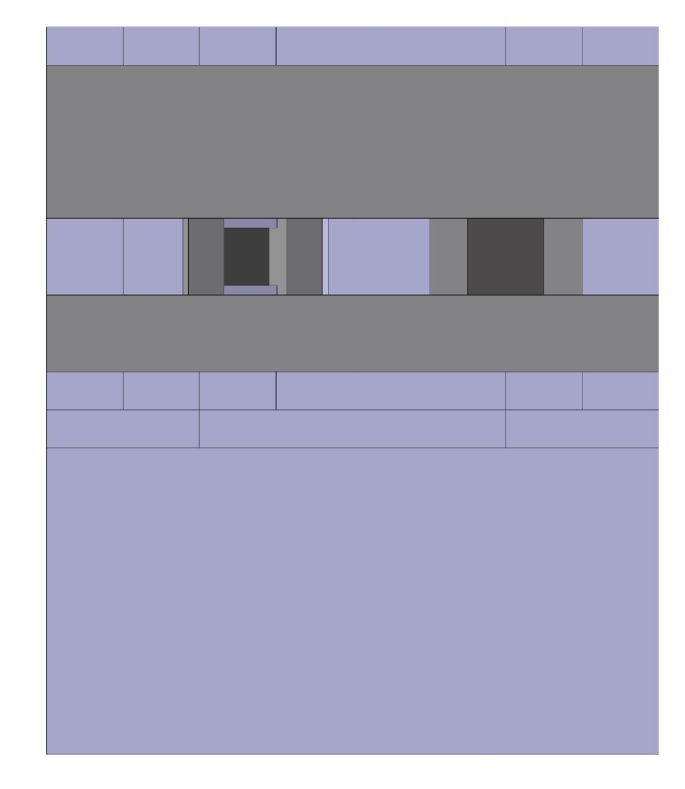
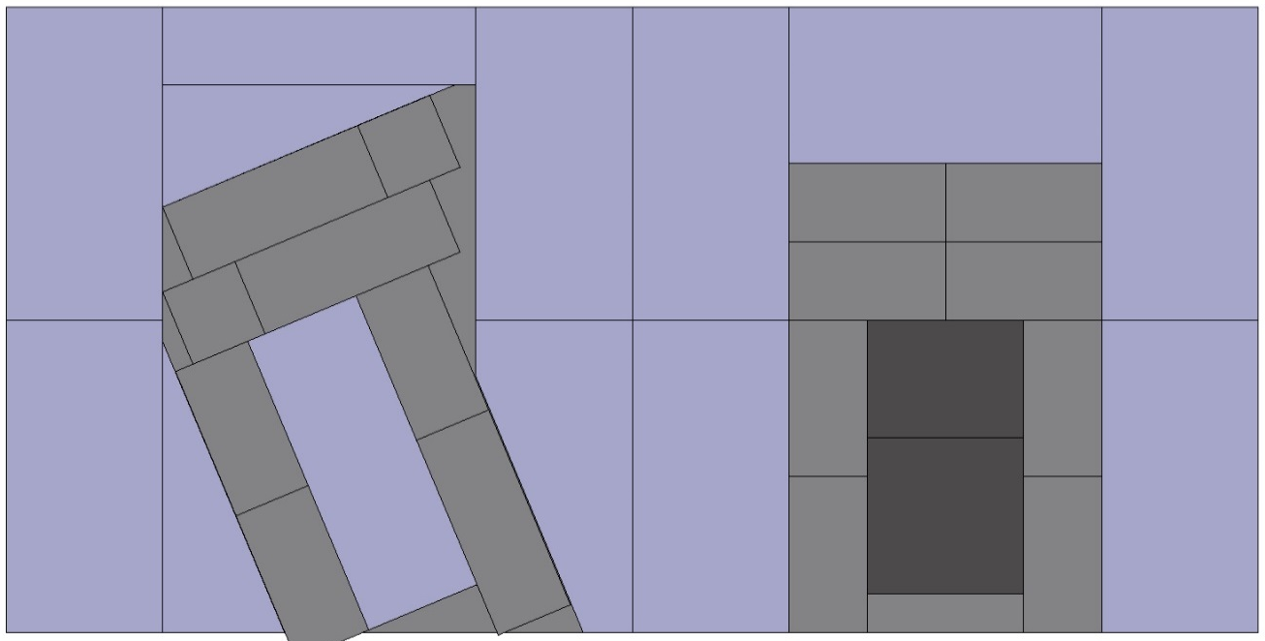
New dump second beamline for CLEAR (with respect to the present main CLEAR dump)
Only the “straight” dump part needed, as no spectrometer will be installed
Not needed
24xCB
400x200x100
Not needed
(5)
IB
400x400x200
IB
800x800x200
CB
CB
(5)
CB
CB
CB
CB
IB 2
IB 1
IB 1
IB
800x800x200
IB 2
IB 1
IB 1
IB
800x200x200
IB
800x200x200
IB
800x800x200
(5)
IB 1
G
200^3
CB
800x800x800
CB
IB 1
(5)
IB 1
CB
IB 1
CB
CB
2 x IB
400x100x100
2 x IB
400x100x100
CB
IB 2
(5)
IB 1
IB 1
IB 1
Resume :
- 1 Concrete block 800x800x800 (to be found!!!)
- 24 Concrete blocks 400x200x100 (to be found!!!)
- 3 Iron blocks 800x800x200 (from TL2’ dump)
- 1 Iron block1 400x400x200 (from TL2’ dump)
- 2 Iron blocks 800x200x200 (from TL2’ dump)
- 4 iron blocks 400x100x100 (already in CLEAR)
- 1 graphite block 200x200x200 (from storage CLEAR storage in bld.150)
(if needed, we can add another block 200x200x150, already in CLEAR)
CB -> Concrete blocks
IB-> Iron blocks
G -> Graphite

Slide 3
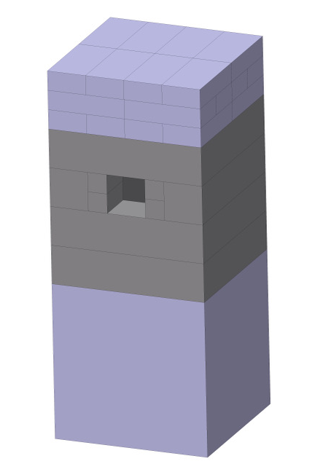
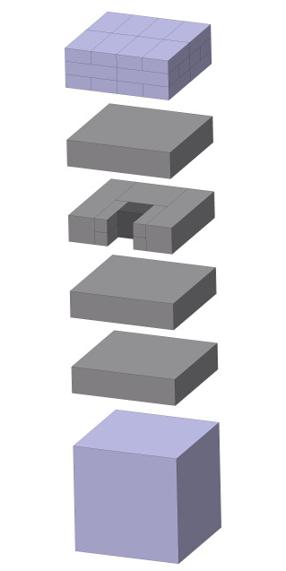
First Draft
Preliminary drawings by C. Capelli based on previous inputs
All components in principle available
20 cm
Graphite
Iron blocks
Concrete blocks

Slide 4
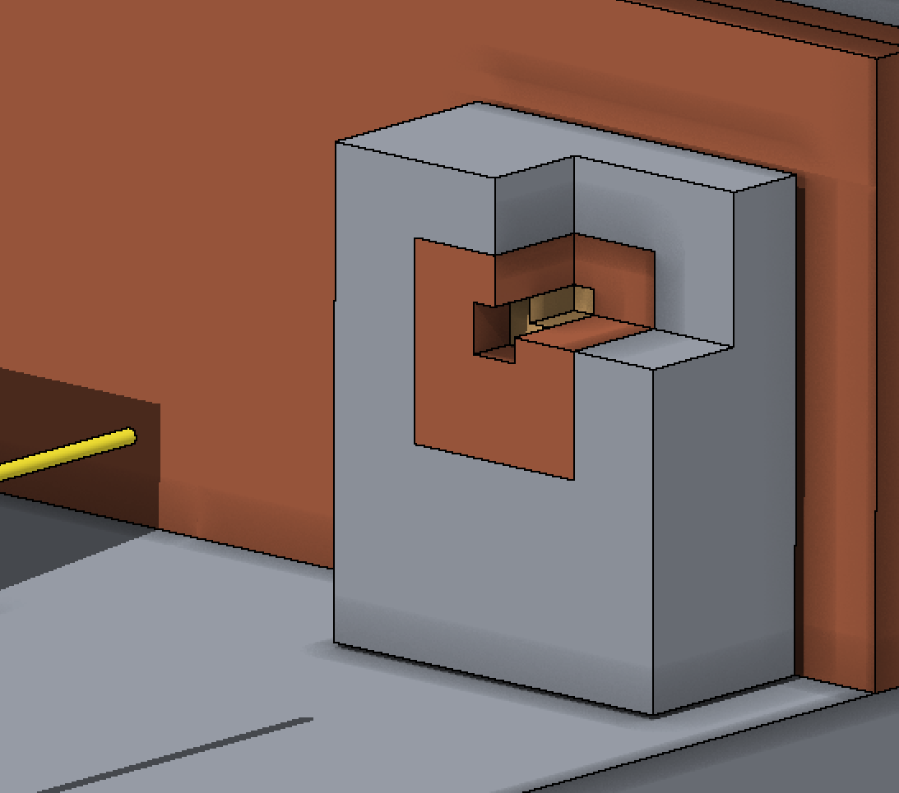
Second Draft
Based on EDMS 3056100 V1, a new (2x larger) design has to be made:
Propose solution:
  Note, all iron blocks presently available are NOT painted, and they must be before installation
48xCB
400x200x100
IB
800x400x200
IB
400x400x200
IB
800x400x200
IB
800x400x200
IB
800x800x200
IB
800x400x200
IB
800x400x200
IB
800x
200²
G
IB
800x
200²
IB
800x400x200
IB
800x200x200
IB
800x200x200
IB
800x400x200
IB
800x800x200
IB
800x400x200
G
200^3
(5)
IB
800x800x200
IB
800x800x200
2 x IB
400x100x100
2 x IB
400x100x100
(5)
CB
800x800x800
CB
800x800x800
G
200^2
x150
Resume :
- 2 Concrete block 800x800x800 or 1 Concrete blockk 1600x800x800 (to be found!!!)
48 Concrete blocks 400x200x100 (to be found!!!)
6 Iron blocks 800x400x200 (1 from TL2’ dump, 5 to be found)
- 4 Iron blocks 800x800x200 (from TL2’ dump, now in bld.150)
- 1 Iron block1 400x400x200 (from TL2’ dump, now in bld.150)
- 2 Iron blocks 800x200x200 (from TL2’ dump, now in bld.150)
- 4 iron blocks 400x100x100 (already in CLEAR)
- 1 graphite block 200x200x200 (from storage CLEAR storage in bld.150)
- 1 graphite block 200x200x150, (already in CLEAR)
CB -> Concrete blocks
IB-> Iron blocks
G -> Graphite

Slide 5
Second Draft - alternative
Based on EDMS 3056100 V1, a new (2x larger) design has to be made:
Propose solution:
  Note, all iron blocks presently available are NOT painted, and they must be before installation
48xCB
400x200x100
CB
800x800x400
IB
400x400x200
CB
800x800x400
CB
800
x800
x400
IB
800x800x200
CB
800
x800
x400
IB
800x
200²
G
IB
800x
200²
IB
800x200x200
IB
800x200x200
IB
800x800x200
option
G
200^3
(5)
IB
800x800x200
CB [cm]
80x40x20
2 x IB
400x100x100
2 x IB
400x100x100
(5)
CB
800x800x800
CB
800x800x800
CB [cm]
80x40x20
G
200^2
x150
CB [cm]
80x40x20
CB [cm]
80x40x20
Resume :
- 2 Concrete block 800x800x800 or 1 Concrete blockk 1600x800x800 (to be found!!!)
- 2 Concrete blocks 800x800x400 (to be found!!!)
48 Concrete blocks 400x200x100 (to be found!!!)
- 3 Iron blocks 800x800x200 (from TL2’ dump, now in bld.150)
- 1 Iron block1 400x400x200 (from TL2’ dump, now in bld.150)
- 2 Iron blocks 800x200x200 (from TL2’ dump, now in bld.150)
- 4 iron blocks 400x100x100 (already in CLEAR)
- 1 graphite block 200x200x200 (from storage CLEAR storage in bld.150)
- 1 graphite block 200x200x150, (already in CLEAR)
CB -> Concrete blocks
IB-> Iron blocks
G -> Graphite

Slide 6
Second Draft – alternative 2
Based on EDMS 3056100 V1, a new (2x larger) design has to be made:
Propose solution:
  Note, all iron blocks presently available are NOT painted, and they must be before installation
48xCB
400x200x100
CB
800x800x400
IB
400x400x200
CB
800x800x400
CB
800
x800
x400
IB
800x400x200
CB
800
x800
x400
CB
800x400x200
CB
800x400x200
G
CB
800x400x200
CB
800x400x200
IB
800x400x200
option
G
200^3
CB
800x400x200
CB
800x400x200
(5)
CB
800x400x200
CB [cm]
80x40x20
2 x IB
400x100x100
2 x IB
400x100x100
(5)
CB
800x800x800
CB
800x800x800
CB [cm]
80x40x20
G
200^2
x150
CB [cm]
80x40x20
CB [cm]
80x40x20
Resume :
- 2 Concrete block 800x800x800 or 1 Concrete blockk 1600x800x800 (to be found!!!)
- 2 Concrete blocks 800x800x400 (to be found!!!)
48 Concrete blocks 400x200x100 (to be found!!!)
- 5 Concrete blocks 800x400x200 (to be found!!!)
- 1 Iron block1 400x400x200 (from TL2’ dump, now in bld.150)
- 2 Iron blocks 800x400x200 (to be found!!!)
- 4 iron blocks 400x100x100 (already in CLEAR)
- 1 graphite block 200x200x200 (from storage CLEAR storage in bld.150)
- 1 graphite block 200x200x150, (already in CLEAR)
CB -> Concrete blocks
IB-> Iron blocks
G -> Graphite

Slide 7
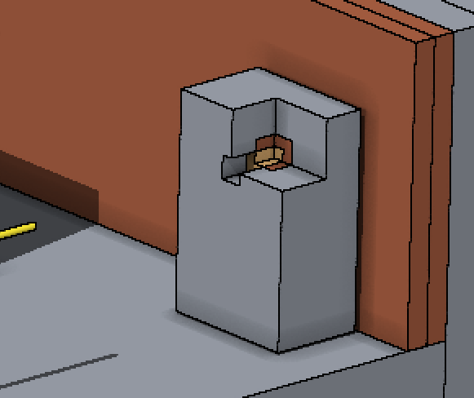
Third Draft
OK
Based on new inputs from Markus (20/6/2024)
Might be difficult to install those latest 2 concrete blocks as just under the cable tray
CB
800x800x400
2 x IB
200x100
x100
2 x IB
200x100
x100
CB
800x800x400
30 cm
36 (or 34) x CB
400x200x100
2 x IB
200x100
x100
2 x IB
200x100
x100
CB
800
x800
x400
IB
800x400x200
CB
800
x800
x400
G
200^3
G
2 x IB
400x100x100
2 x IB
400x100x100
G
200^2
x150
IB
800x400x200
option
(5)
CB
800x400x200
CB [cm]
80x40x20
(5)
CB
800x800x800
CB
800
x800
x400
CB [cm]
80x40x20
2 x IB
200x100
x100
2 x IB
200x100
x100
CB [cm]
80x40x20
Resume :
- 1 Concrete block 800x800x800 (to be found!!!)
- 3 Concrete blocks 800x800x400 (to be found!!!)
36 Concrete blocks 400x200x100 (to be found!!!)
1 (+4 for option) Concrete blocks 800x400x200 (to be found!!!)
2 Iron blocks 800x400x200 (to be found!!!. Note: 2 Iron blocks 400x400x200 from TL2’ dump, now in bld.150)
4 iron blocks 400x100x100 (already in CLEAR)
4 iron blocks 200x100x100 (already in CLEAR? – to check)
- 1 graphite block 200x200x200 (from storage CLEAR storage in bld.150)
- 1 graphite block 200x200x150, (already in CLEAR)
CB [cm]
80x40x20
CB -> Concrete blocks
IB-> Iron blocks
G -> Graphite

Slide 8
Costs and lead times
Standard Blocks
To give an idea, total volume is about 5 times 800x800x800 blocks:
  The whole dump in concrete would cost about 2 kCHF
  The whole dump in iron would cost about 65 kCHF
We aim at reusing most iron we already have, so hopefully cost will be <5 kCHF.
Lead times for bocks is <1 week
Painting of iron blocks is typically done <1 month
Item | Type | Weight(Kg) | Dimensions(mm)
 | 1688 | 7500 | 1600x800x800
 | 1684 | 3700 | 1600x800x400
 | 1682 | 1850 | 1600x800x200
 | 884 | 1850 | 800x800x400
Cast Iron blocks | 882 | 925 | 800x800x200
 | 844 | 925 | 800x400x400
 | 842 | 465 | 800x400x200
 | 822 | 230 | 800x200x200
 | 442 | 230 | 400x400x200
 | 211 | 16 | 200x100x100
Item | Type | Weight(Kg) | Dimensions(mm)
 | 24168 | 7500 | 2400x1600x800
 | 23168 | 7200 | 2300x1600x800
 | 1688 | 2500 | 1600x800x800
 | 1684 | 1250 | 1600x800x400
Concrete blocks | 1682 | 630 | 1600x800x200
 | 888 | 1250 | 800x800x800
 | 884 | 630 | 800x800x400
 | 882 | 325 | 800x800x200
 | 842 | 160 | 800x400x200
 | 421 | 20 | 400x200x100

Slide 9
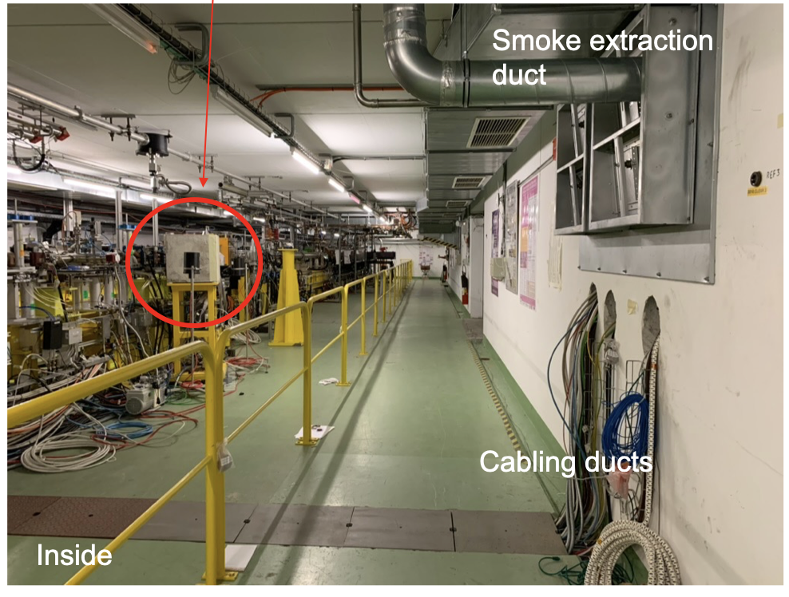
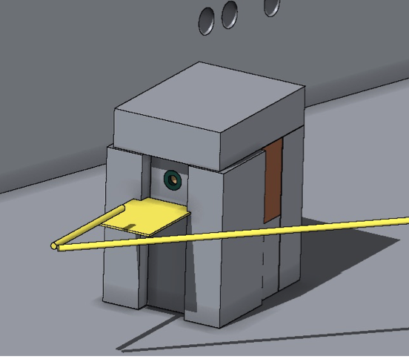
VESPER Beam Line Dump
Following RP investigations during heavy irradiation experiment in EDMS 3101594 and following studies by RP in EDMS 3102892, an upgrade of the VESPER dump is deemed necessary.
A dump like the previously proposed one for the the new beam line would still be too small
  Probably need at least 120 cm in length!
In any case, we miss all pieces...

Slide 10
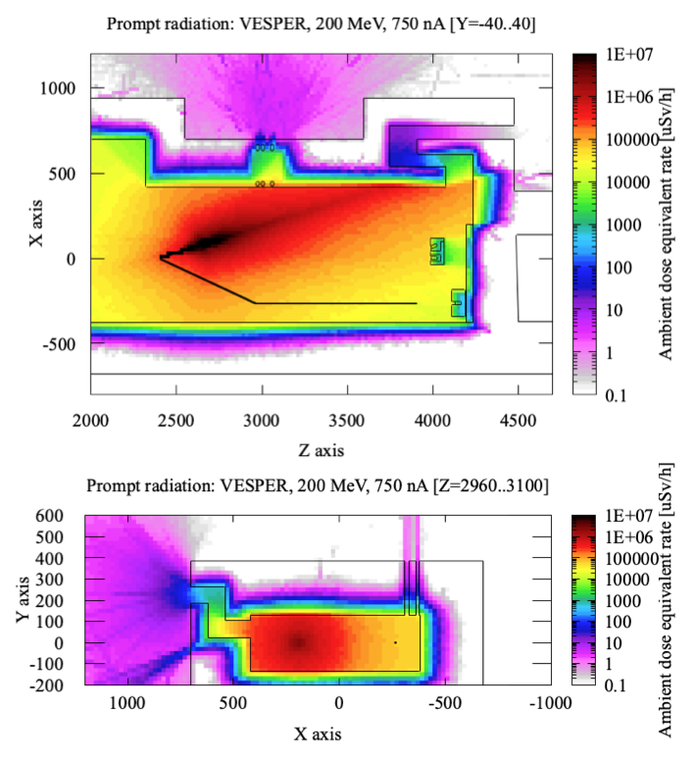
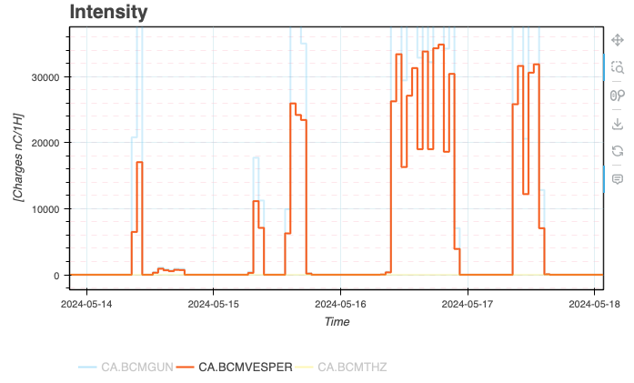
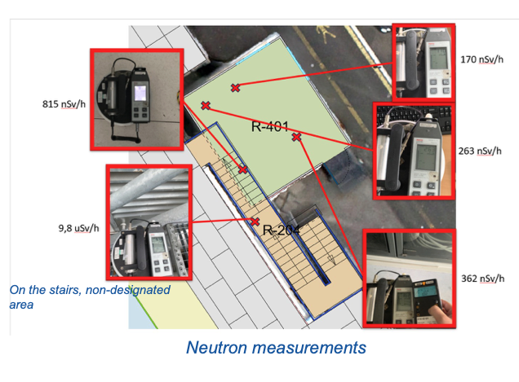
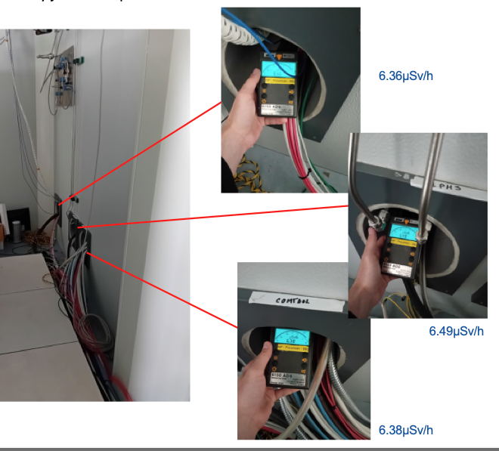
Summary of EDMS 3101594
Factor 6 higher than delivered
Scaling from 0.833 Hz to 10 Hz = ~120 nA
Simulations possibly a factor 2-3 pessimistic, but not too far off

Slide 11
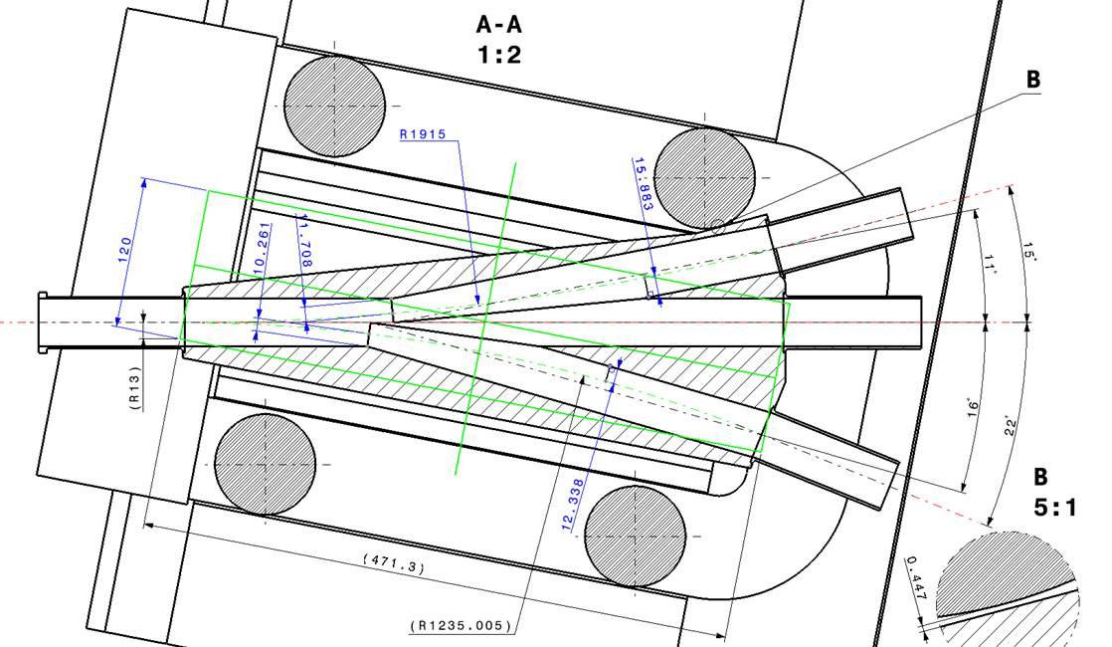
VESPER Line: new angle!
According to latest design, the new deflecting angle will be of the order of 15 deg instead of 17.5 deg of today’s configuration
  tan(15deg) = 0.268; tan(17.5deg) = 0.315 hence, for the same distance L along the straight line, we “loose” ~L*0.5 separation from straight line

Slide 12
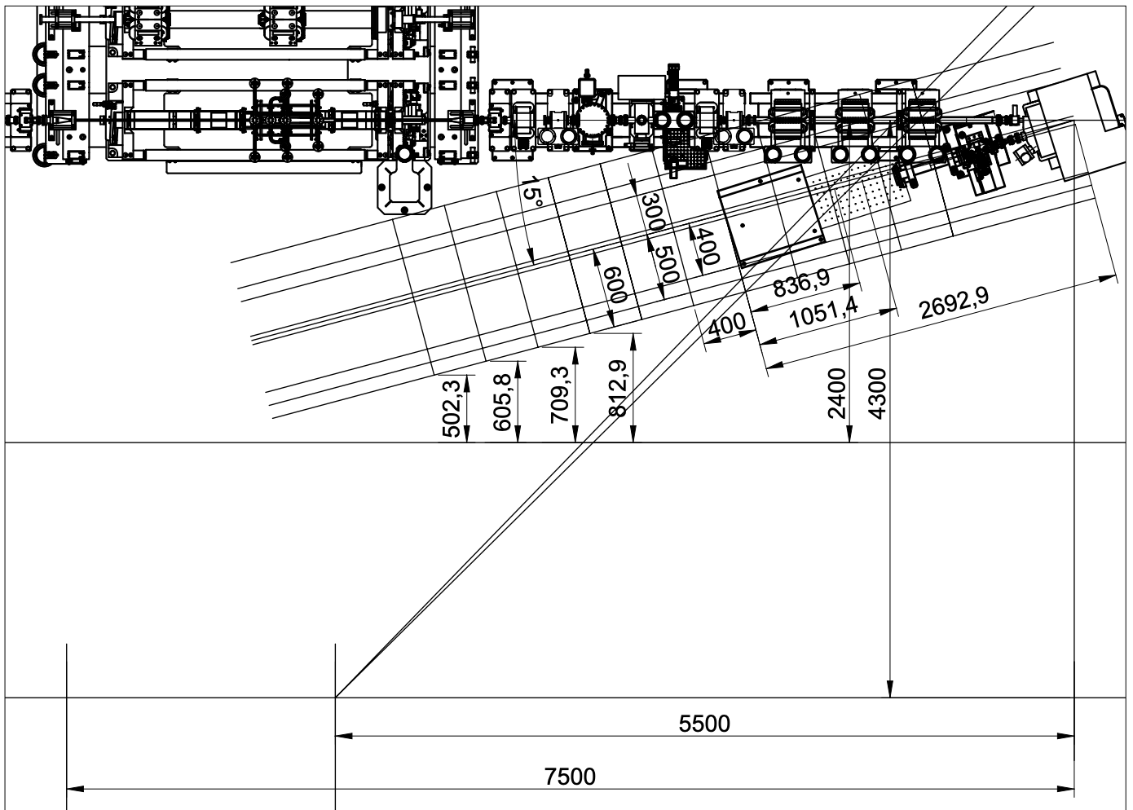
Now
turbo
Now BTV
57 cm
Must be free area
45 cm
bread
60 cm
77 cm
Cable duct
1 m
77 cm
65 cm
125 cm
Yellow barrier
270 cm
Min experimental area L 70 cm!
520 cm
35 cm
Ventilation duct
170 cm

Slide 13
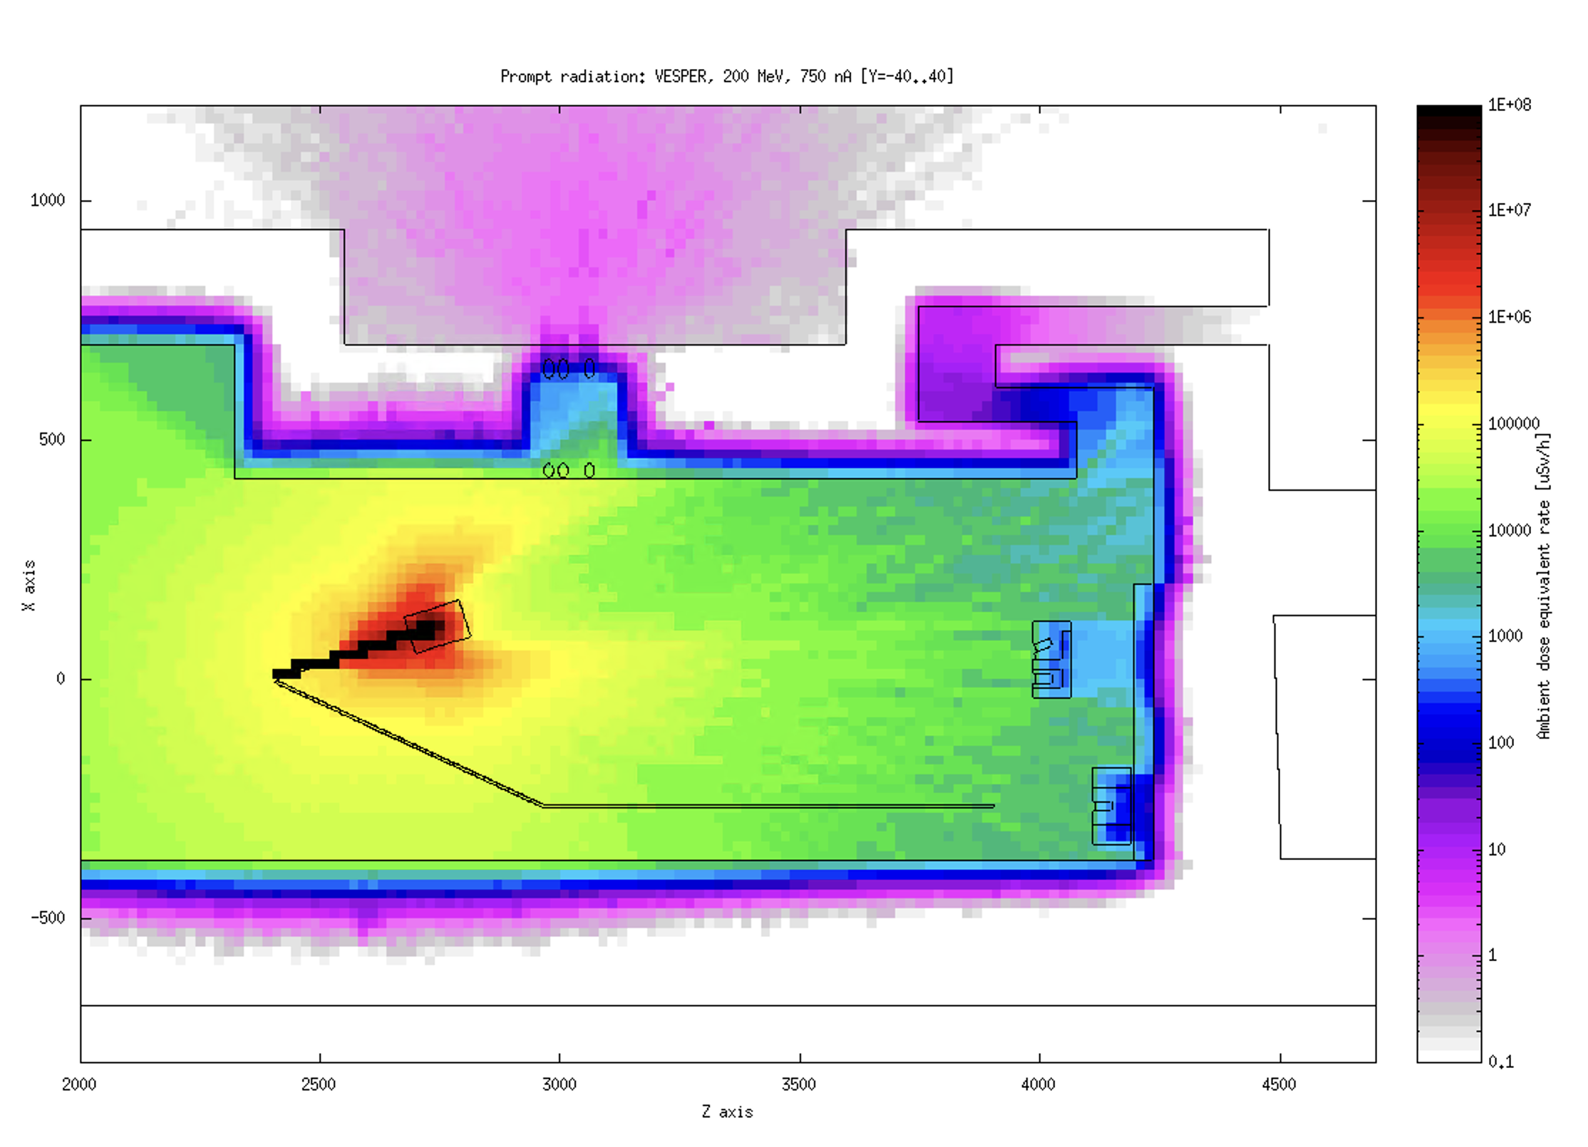
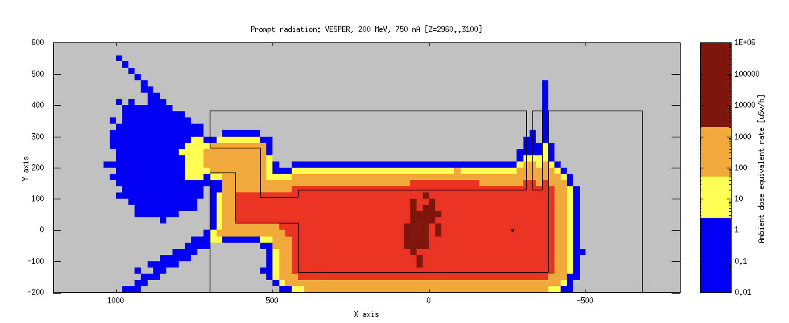
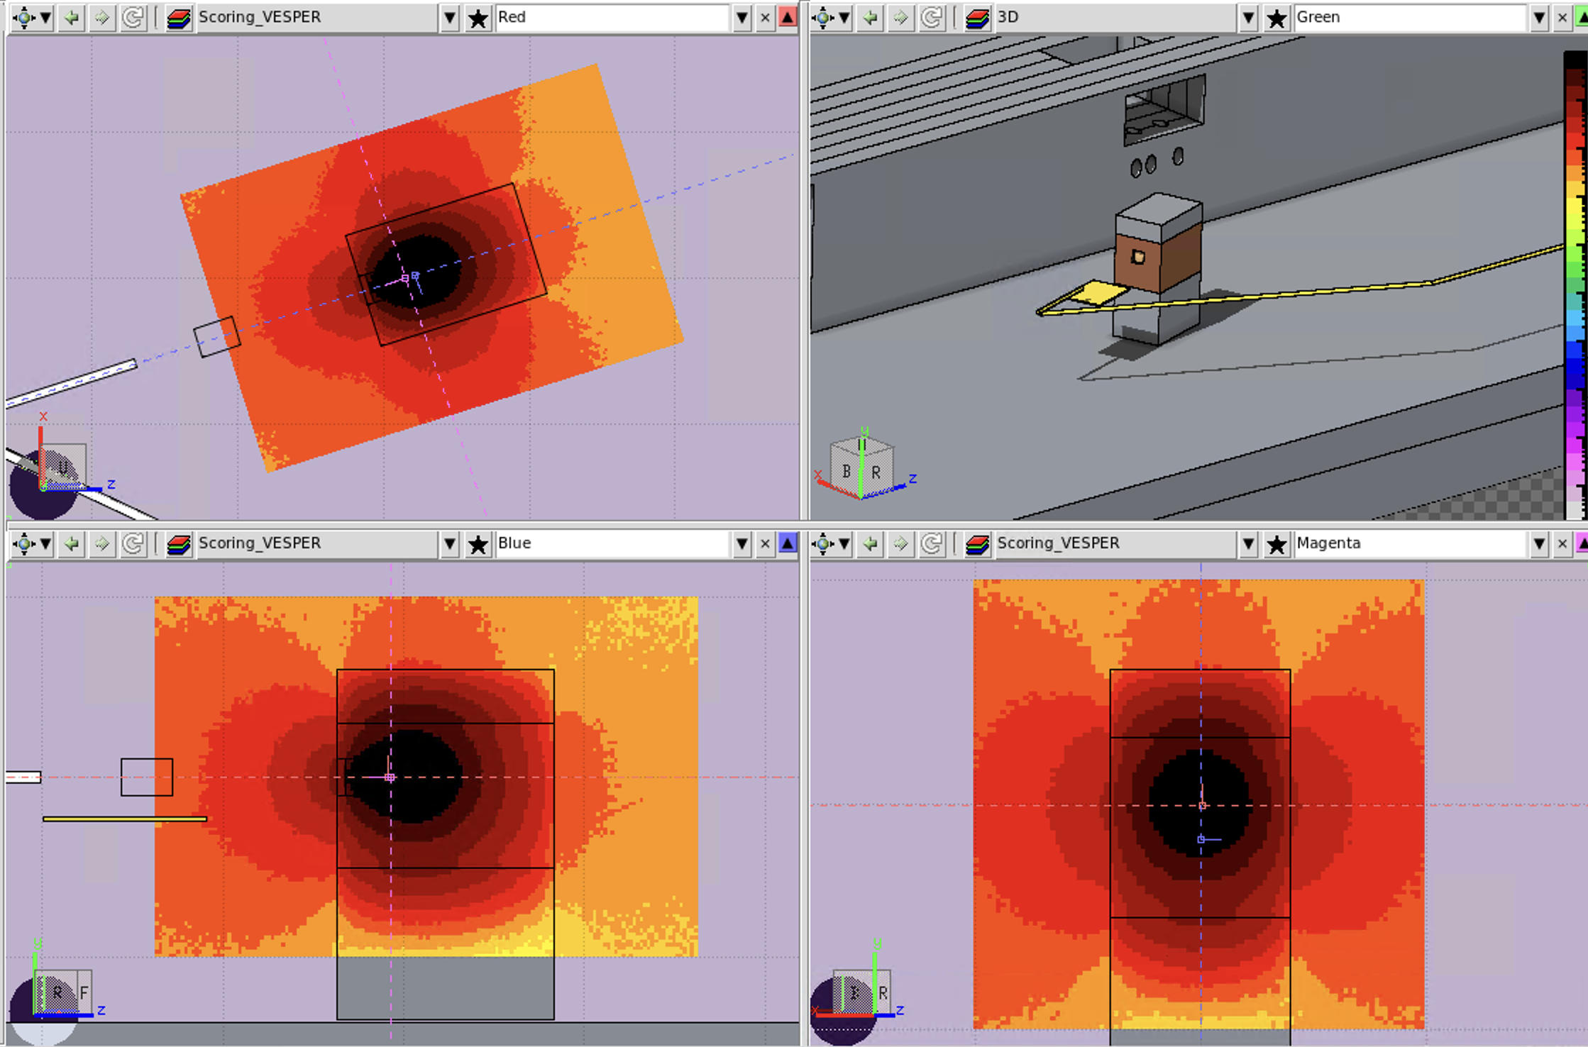
VESPER Beam Line Dump V2
Following on request that dump might need to be at least 1200 mm long (still to be verified by RP):
  Still not good enough!
IB
800x400x200
36xCB
400x200x100
IB
400x400x200
IB 800x800x200
+ IB 800x400x200
IB
800x
200²
G
IB
800x
200²
IB 800x800x200
+ IB 800x400x200
IB
800x200x200
IB
800x200x200
IB 800x800x200
+ IB 800x400x200
G
200^3
(5)
CB
800x800x800
+
800x800x400
2 x IB
400x100x100
2 x IB
400x100x100
(5)
G
200^2
x150
Resume :
- 1 Concrete block 800x800x800 (to be found)
- 1 Concrete block 800x800x400 (to be found!!!)
36 Concrete blocks 400x200x100 (to be found)
3 Iron blocks 800x400x200 (to be found)
- 3 Iron blocks 800x800x200 (to be found)
1 Iron block1 400x400x200 (from TL2’ dump, now in bld.150)
- 2 Iron blocks 800x200x200 (to be found)
- 4 iron blocks 400x100x100 (to be found)
- 1 graphite block 200x200x200 (to be found)
- 1 graphite block 200x200x150, (to be found)
CB -> Concrete blocks
IB-> Iron blocks
G -> Graphite

Slide 14
VESPER Beam Line Dump V3
Following on request that dump might need to be at least 1200 mm long (still to be verified by RP):
  Asymmetric?
IB
800x400x200
36xCB
400x200x100
IB
200^3?!
IB 800x800x200
+ IB 800x400x200
IB
800x4x200
G
IB
800x
200²
IB
800x200x200
G
200^3
IB 800x800x200
+ IB 800x400x200
IB
800x200x200
CB 800x800x200
+ CB 800x400x200
G
200^3
(5)
CB
800x800x800
+
800x800x400
(5)
CB -> Concrete blocks
IB-> Iron blocks
G -> Graphite

Slide 15
VESPER Beam Line Dump V4
Following on request that dump might need to be at least 1200 mm long (still to be verified by RP):
  Additional shoulder on one side?
IB
400x400x200
36xCB
400x200x100
2 x CB
400x200x100
2 x CB
400x200x100
CB 1600x
800x
400
CB 1600x
800x
400
IB 800x800x200
+ CB 800x400x200
CB
80x40x20
G
CB
80x40x20
4 x IB
400x100x100
IB 800x800x200
+ CB 800x400x200
CB 800x800x200
+ CB 800x400x200
G
200^3
CB
800x800x800
+
800x800x400
CB
800x400x200
CB
800x400x200
2 x IB
400x100x100
2 x IB
400x100x100
G
200^3
(5)
(5)
CB -> Concrete blocks
IB-> Iron blocks
G -> Graphite

Slide 16
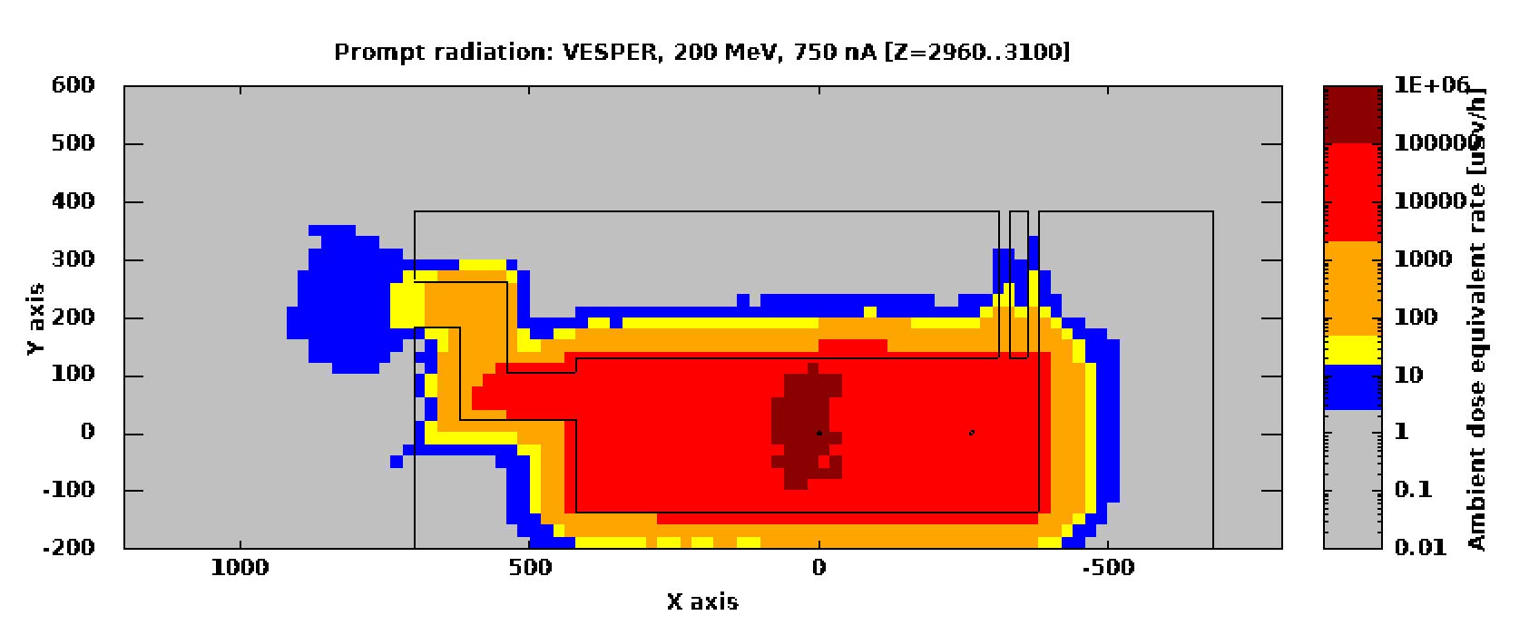
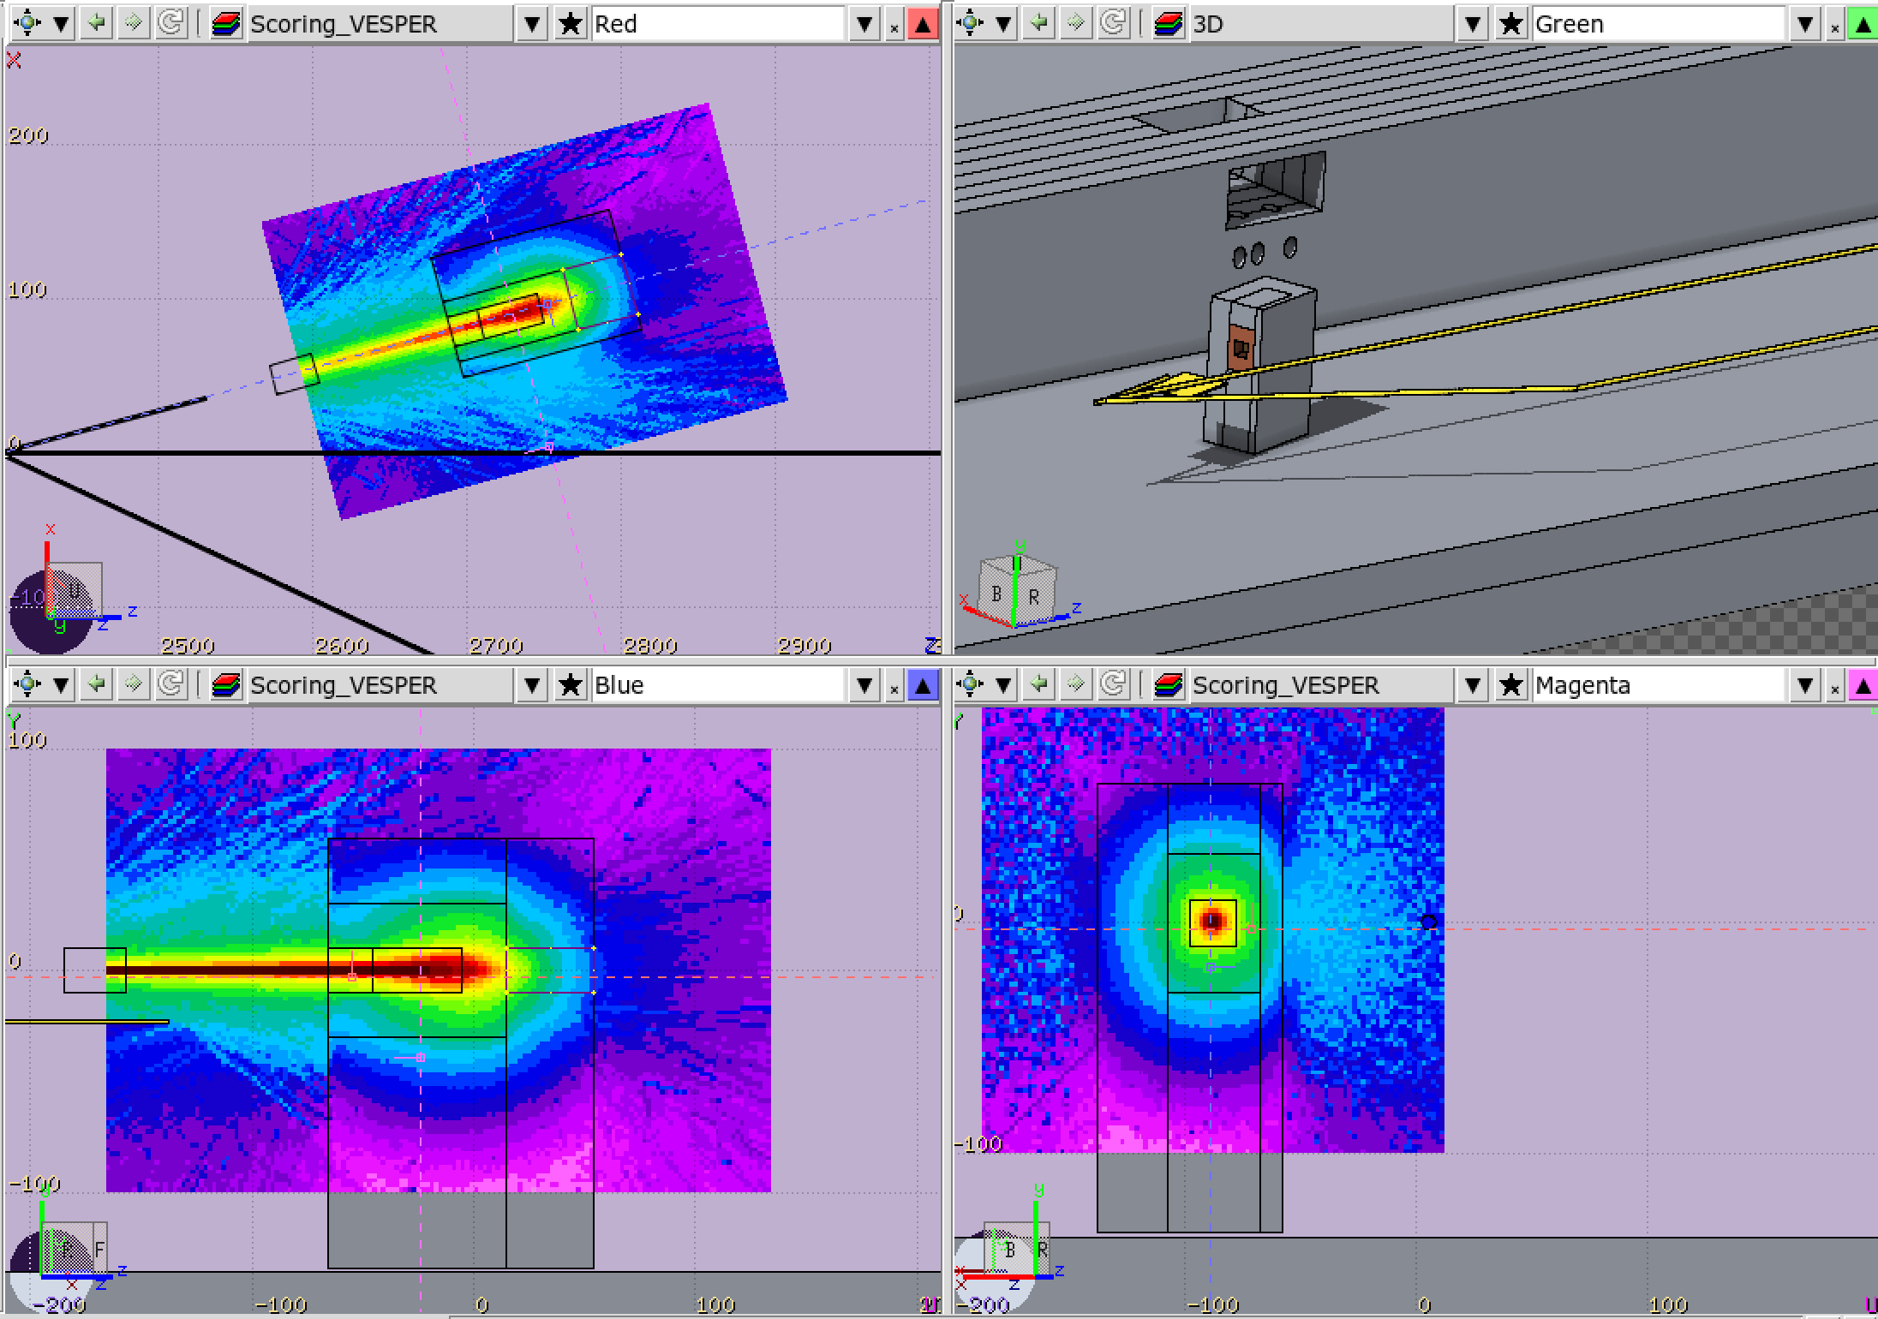
VESPER Beam Line Dump V5
Following on request that dump might need to be at least 1200 mm long
  Asymmetric + maximising concrete
Front view
Top views
36 x CB
400x200x100
IB
400x400x200
CB
800x400x200
2 x CB
400x200x100
IB
800x400x200
CB
400x200x100
CB
400x200x100
CB
80x40x20
G
IB
800x400x200
2 x IB
200x200x100
IB
400x400x200
CB 800x800x200
+ CB 800x400x200
CB
400x200x100
2 x IB
400x100x100
CB
400x200x100
CB
800x800x800
+
800x800x400
2 x IB
400x100x100
CB
400x200x100
CB
400x200x100
G
200^3
CB
800x400x200
CB
800x400x200
G
200^3
(5)
CB
400x200x100
CB
400x200x100
2 x IB
400x100x100
CB
400x200x100
CB
400x200x100
(5)
2 x IB
400x100x100
CB -> Concrete blocks
IB-> Iron blocks
G -> Graphite

Slide 17
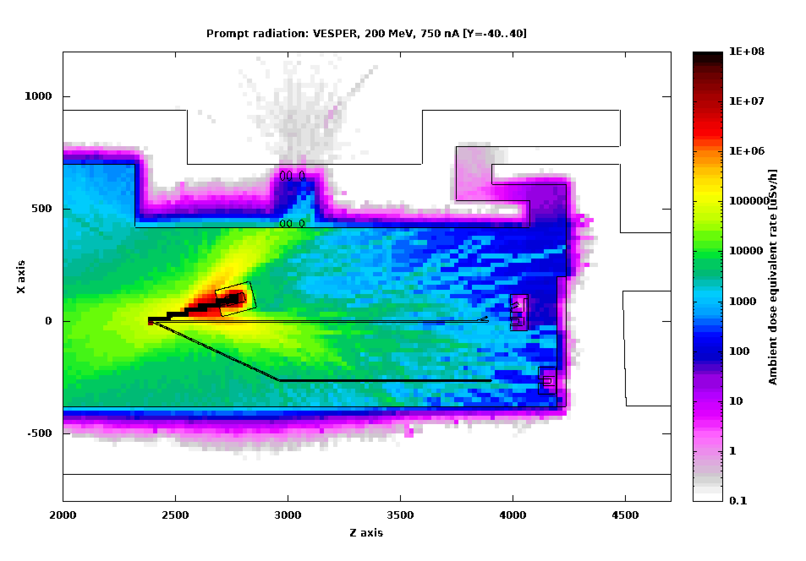
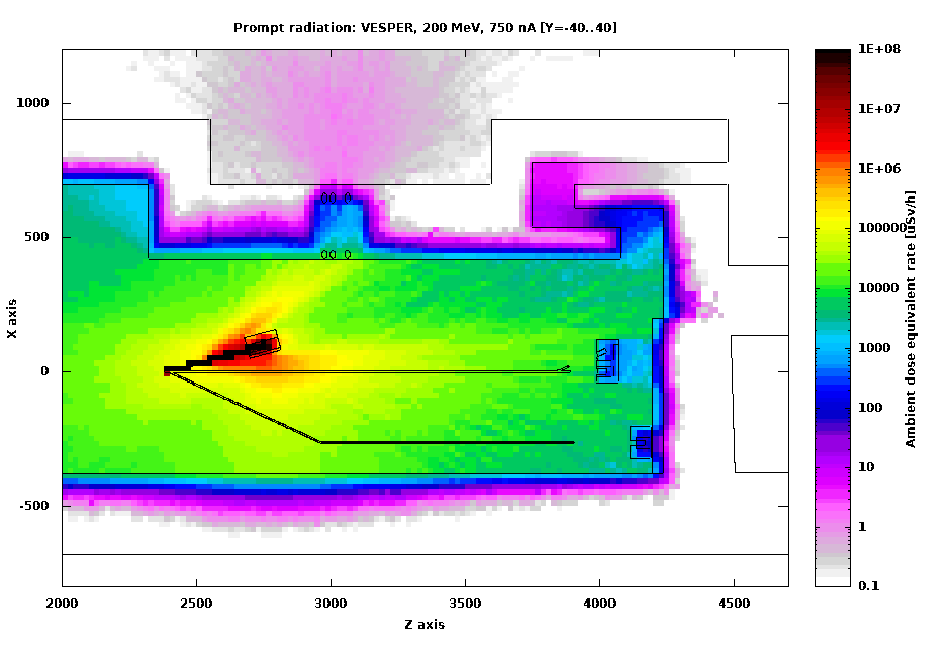

Slide 18
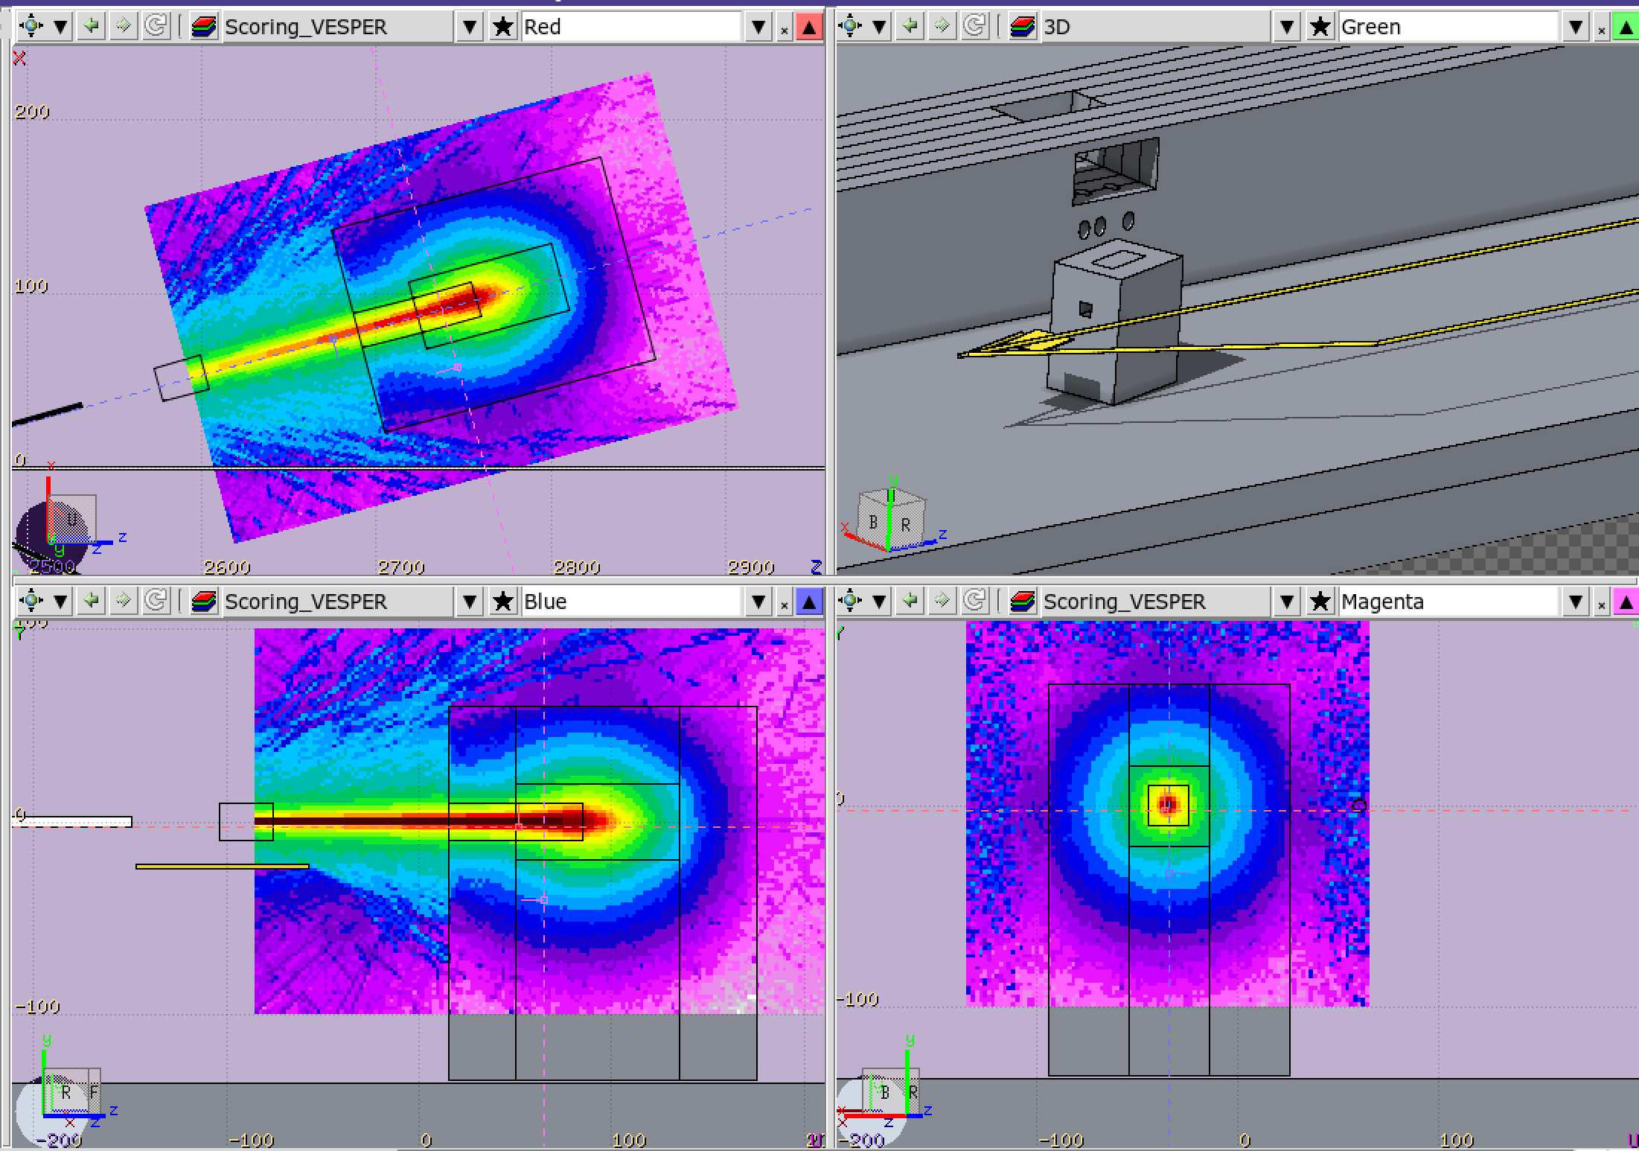
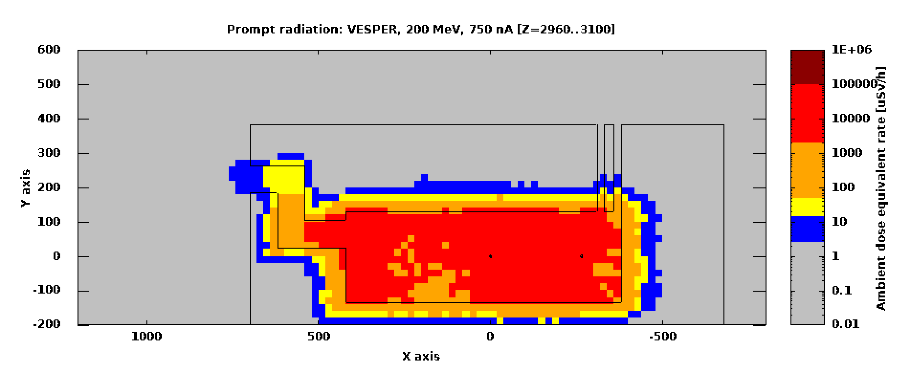
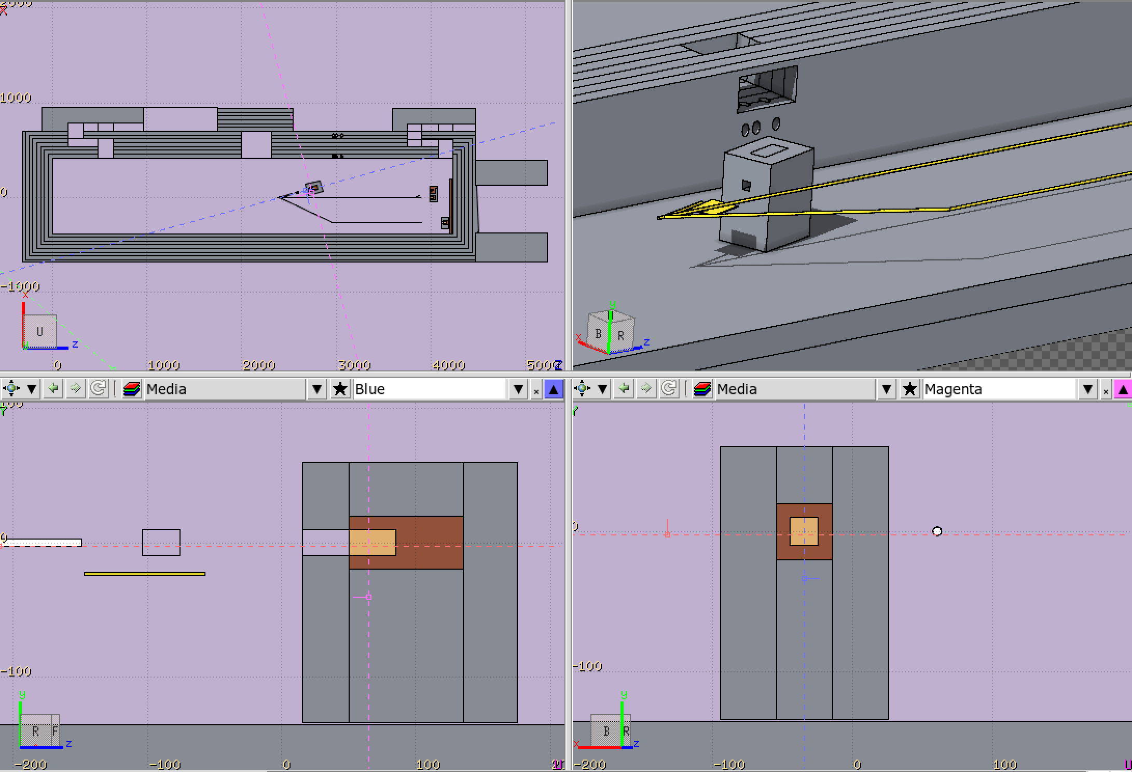
Version proposed by Markus (footprint 1600x1200)

Slide 19
VESPER Beam Line Dump V6
Following on request that dump might need to be at least 1200 mm long (still to be verified by RP):
  Asymmetric + maximising concrete+a bit more shielding one the “external” side
Front view
Top views
Not sure this layer will be stable…
36 x CB
400x200x100
IB
400x400x200
CB
800x800x400
2 x CB
400x200x100
CB
80x40x20
IB
800x400x200
CB
400x200x100
CB
400x200x100
CB
80x40x20
G
CB
80x40x20
IB
800x400x200
2 x IB
200x200x100
IB
400x400x200
CB 800x800x200
+ CB 800x400x200
2 x IB
400x100x100
CB
800x800x800
+
800x800x400
2 x IB
400x100x100
CB
400x200x100
CB
400x200x100
CB
800x400x200
G
200^3
CB
800x400x200
G
200^3
(5)
2 x IB
400x100x100
CB
400x200x100
CB
400x200x100
(5)
2 x IB
400x100x100
CB -> Concrete blocks
IB-> Iron blocks
G -> Graphite

Slide 20
VESPER Beam Line Dump V7
Following on request that dump might need to be at least 1200 mm long (still to be verified by RP):
  Asymmetric + maximising concrete+a bit more shielding one the “external” side+a bit more on the internal one (not sure it fits…)
Front view
Top views
36 x CB
400x200x100
IB
400x400x200
CB
800x800x400
2 x CB
400x200x100
2 x CB
400x200x100
IB
800x400x200
CB
800x8004200
G
CB
800x800x200
IB
800x400x200
2 x IB
200x200x100
IB
400x400x200
CB
800x400x200
CB
800x800x800
+
800x800x400
2 x IB
400x100x100
2 x IB
400x100x100
CB
800x400x200
G
200^3
CB
800x400x200
CB
800x800x200
CB
800x800x200
CB
800x800x200
G
200^3
(5)
2 x IB
400x100x100
2 x IB
400x100x100
(5)
CB -> Concrete blocks
IB-> Iron blocks
G -> Graphite

Slide 21
VESPER Beam Line Dump V8
Following on request that dump might need to be at least 1200 mm long (still to be verified by RP):
  Asymmetric + maximising concrete+a bit more shielding one the “external” side+a bit more on the internal one (not sure it fits…) + back single piece of concrete
Front view
Top views
36 x CB
400x200x100
CB
1600x800x400
CB
1600x800x400
IB
800x400x200
CB
800x8004200
G
CB
800x800x200
IB
800x400x200
3 x IB
200x200x100
IB
400x400x200
CB
800x400x200
CB
800x800x800
+
800x800x400
2 x IB
400x100x100
2 x IB
400x100x100
CB
800x400x200
CB
800x400x200
G
200^3
CB
800x800x200
CB
800x800x200
CB
800x800x200
(5)
G
200^3
2 x IB
400x100x100
2 x IB
400x100x100
(5)
CB -> Concrete blocks
IB-> Iron blocks
G -> Graphite

Slide 22
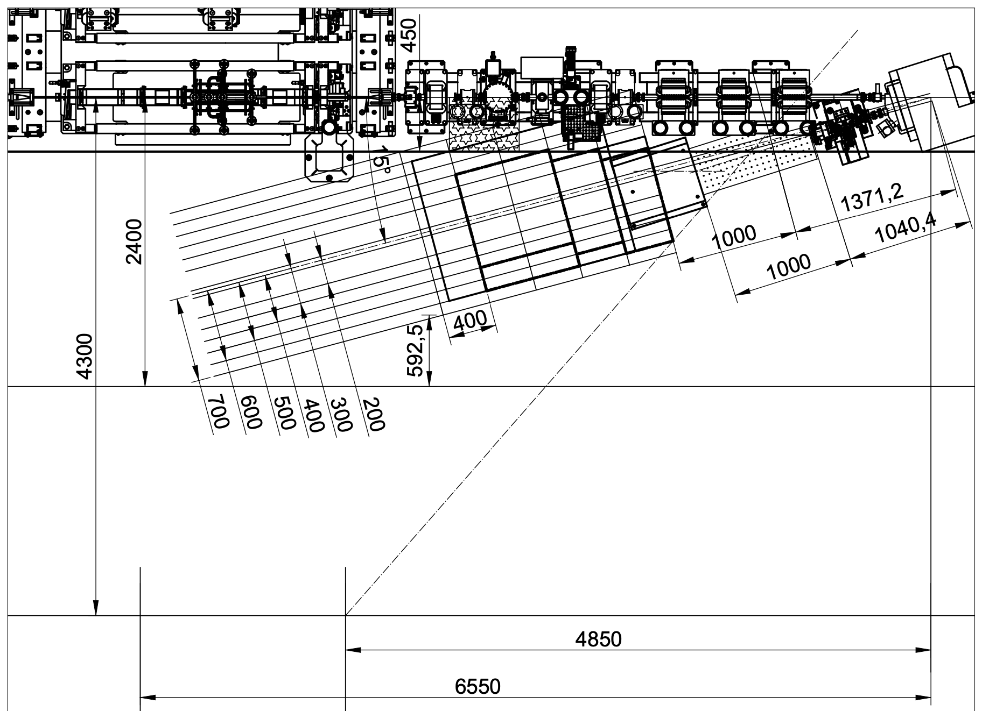
Region typically occupied by cables, etc.
(about +- 45 cm from beamline
Updated layout (10/7/24)
New proposal based on the following assumptions:
Trying to start the dump as soon as possible:
  Keep today’s max distance from the straight beamline (about 60 cm)
  Start of the dump at about 2.37 m from the centre of the dipole
Trying to make the in-vacuum part as long as possible
  Keep today 1 m of path in air, i.e. vacuum window at 1.37 m from the centre of the dipole
  Note: the in-air path can possibly be reduced by another 20 cm at most (i.e. window at 1.57 m from the centre of the dipole)
Have the footprint as close as possible to Markus’ design
BI exp. area
New Turbo
Pump
Screen breadboard
(can be modified)
New proposal “fitting” in the area
“OK” dump proposed by Markus
Cable duct
Yellow barrier limit
Wall limit
Ventilation duct
area

Slide 23
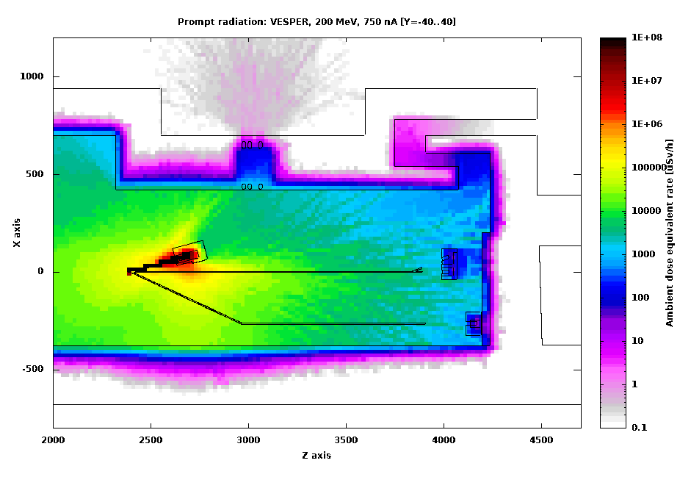
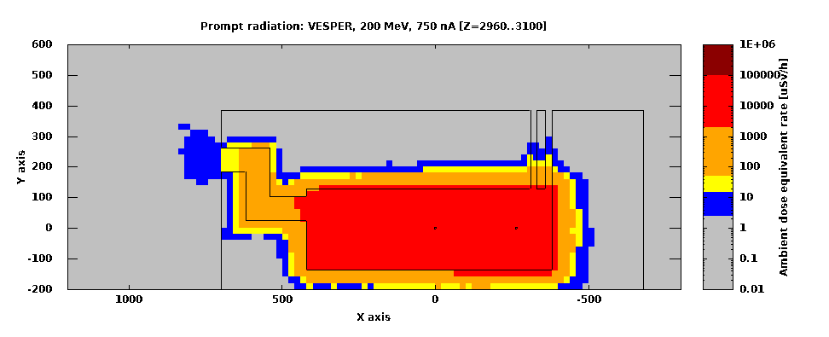
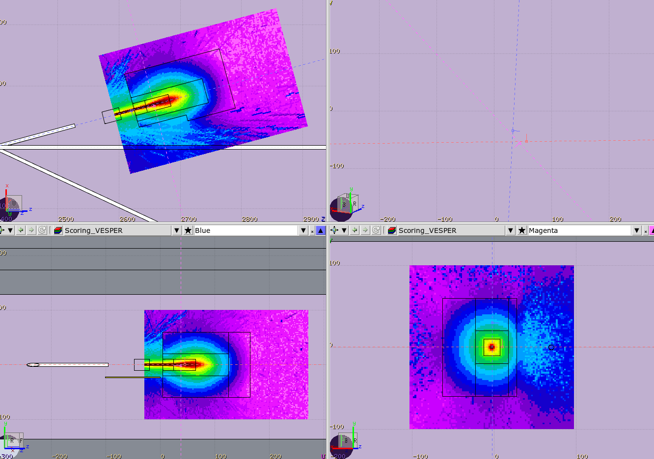
VESPER Beam Line Dump V9
Total 1000
2 x CB
400x200x100
2 x CB
400x200x100
2 x CB
400x200x100
Front view
Not sure this layer will be stable…
CB
800x400x200
Several CB 400x200x100
Item | Type | Weight(Kg) | Dimensions(mm)
 | 24168 | 7500 | 2400x1600x800
 | 23168 | 7200 | 2300x1600x800
 | 1688 | 2500 | 1600x800x800
 | 1684 | 1250 | 1600x800x400
Concrete blocks | 1682 | 630 | 1600x800x200
 | 888 | 1250 | 800x800x800
 | 884 | 630 | 800x800x400
 | 882 | 325 | 800x800x200
 | 842 | 160 | 800x400x200
 | 421 | 20 | 400x200x100
CB
800x8004200
IB
800x400x200
IB
400x400x200
2 x CB
400x200x100
G
IB
800x400x200
CB 800x800x200
+ CB 800x400x200
Total 1600
2 x IB
200x200x100
CB
800x800x400
+
800x800x400
+
800x800x800+ 200x800x800
2 x IB
400x100x100
2 x IB
400x100x100
CB
400x200x100
CB
800x400x200
G
200^3
G
200^3
(5)
2 x IB
400x100x100
CB
400x200x100
(5)
2 x IB
400x100x100
CB -> Concrete blocks
IB-> Iron blocks
G -> Graphite
Total 900

Slide 24
2025 - April

Slide 25
Region typically occupied by cables, etc.
(about +- 45 cm from beamline
Assumptions:
Trying to make the in-vacuum part as long as possible
  Keep today 1 m of path in air, i.e. vacuum window at 1.37 m from the centre of the dipole
Reducing maximum allowed current to VESPER by x10:
Possible soft-interlock implementation:
  SIS interlock that prevents negative dipole current for rep.rate higher than 0.83 Hz
BI exp. area
New Turbo
Pump
Screen breadboard
(can be modified)
RP-simulated conditions in 2024:
200 MeV, 750 nA average current
  i.e. 75 nC trains, at 10 Hz
New proposal for 75 nA current (2025)
“OK” dump proposed by Markus Summer-2024
New allowed conditions for VESPER:
200 MeV, 75 nA average current
  i.e. <90 nC train, at 0.83 Hz
  i.e. 7.5 nC trains, at 10 Hz
Cable duct
Yellow barrier limit
Wall limit
Ventilation duct
area

Slide 26
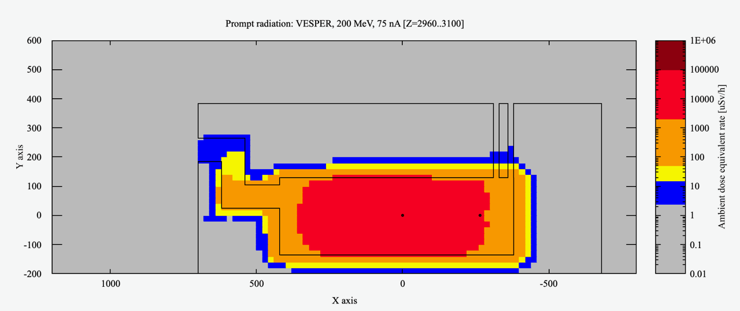
VESPER Beam Line Dump V10
Based on V5 version, but with back in concrete instead of iron
!!! 75 nA average current !!!
Front view
36 x CB
400x200x100
CB
800x800x400
CB
800x800x400
Top views
IB
800x400x200
CB
80x40x20
G
IB
800x400x200
2 x IB
200x200x100
IB
400x400x200
CB 800x800x200
+ CB 800x400x200
CB
400x200x100
2 x IB
400x100x100
CB
400x200x100
CB
800x800x800
+
800x800x400
2 x IB
400x100x100
CB
400x200x100
CB
400x200x100
G
200^3
CB
800x400x200
CB
800x400x200
G
200^3
(5)
CB
400x200x100
CB
400x200x100
2 x IB
400x100x100
CB
400x200x100
CB
400x200x100
(5)
2 x IB
400x100x100
CB -> Concrete blocks
IB-> Iron blocks
G -> Graphite

Slide 27
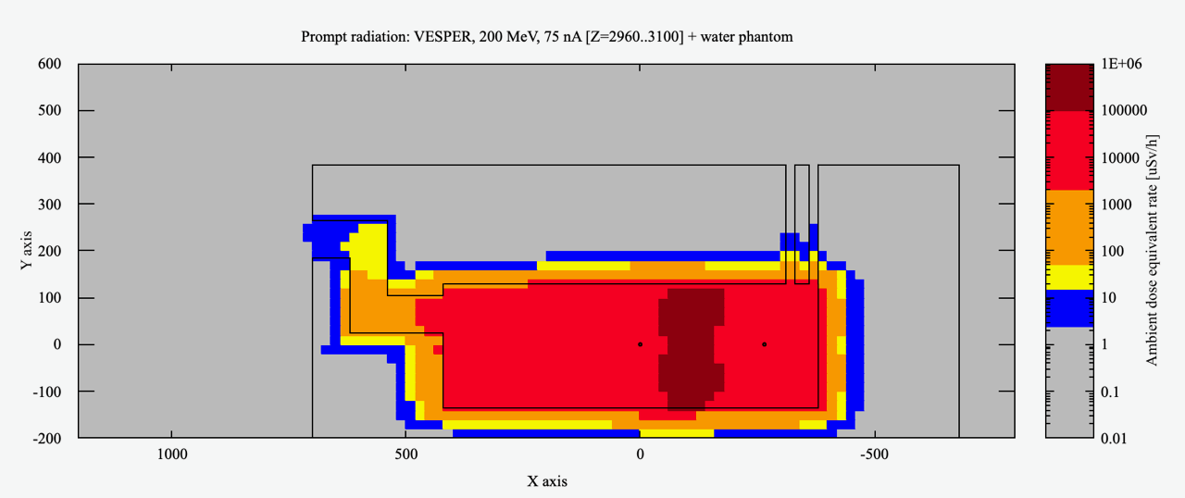
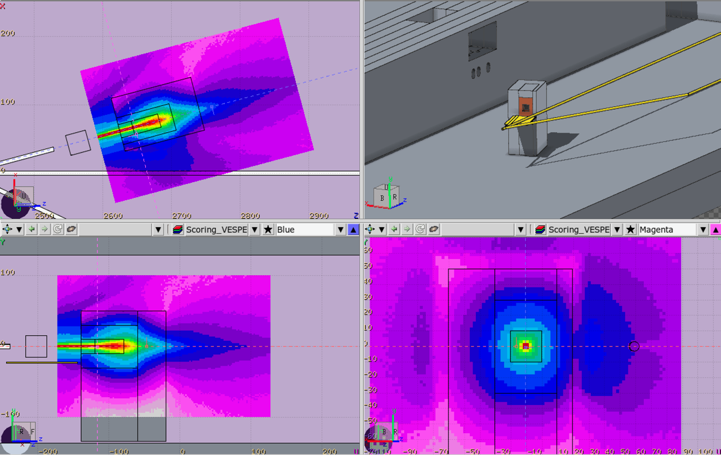
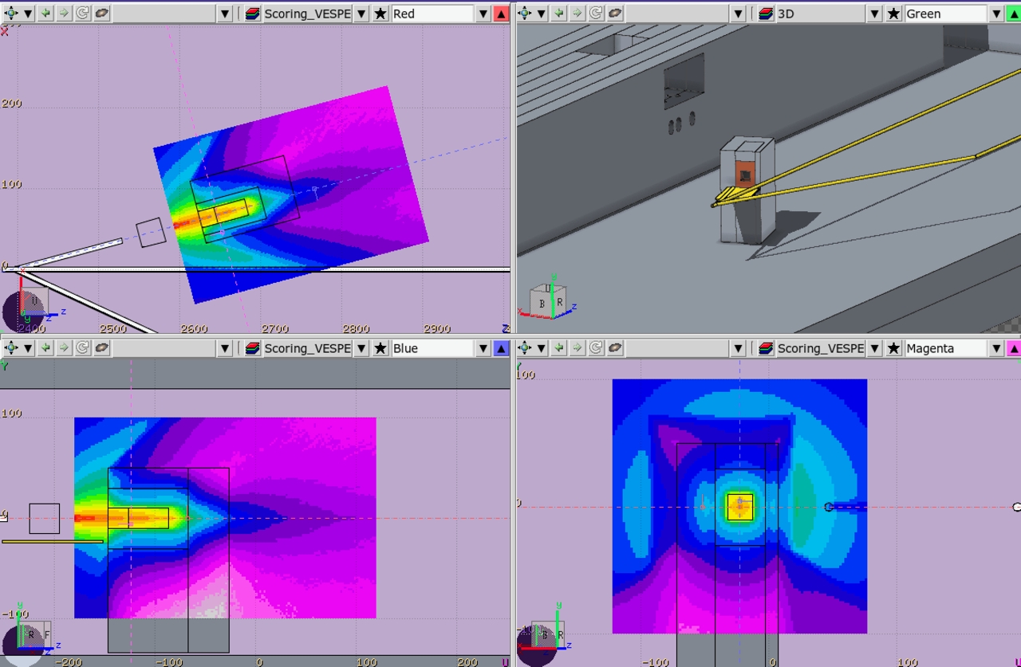
!!! 75 nA average current, without water phantom !!!
!!! 75 nA average current, with 30 cm long water phantom !!!

