Slide 1





Liquid lead target calculations
Silvio Candido (CERN-SY-STI-TCD) et al.
10/04/2025
CERN – Systems Department, Sources Targets Interaction (STI), Targets Collimators Dumps (TCD)
Notes:
CERN – Systems Department, Sources Targets Interaction (STI), Targets Collimators Dumps (TCD)

Slide 2
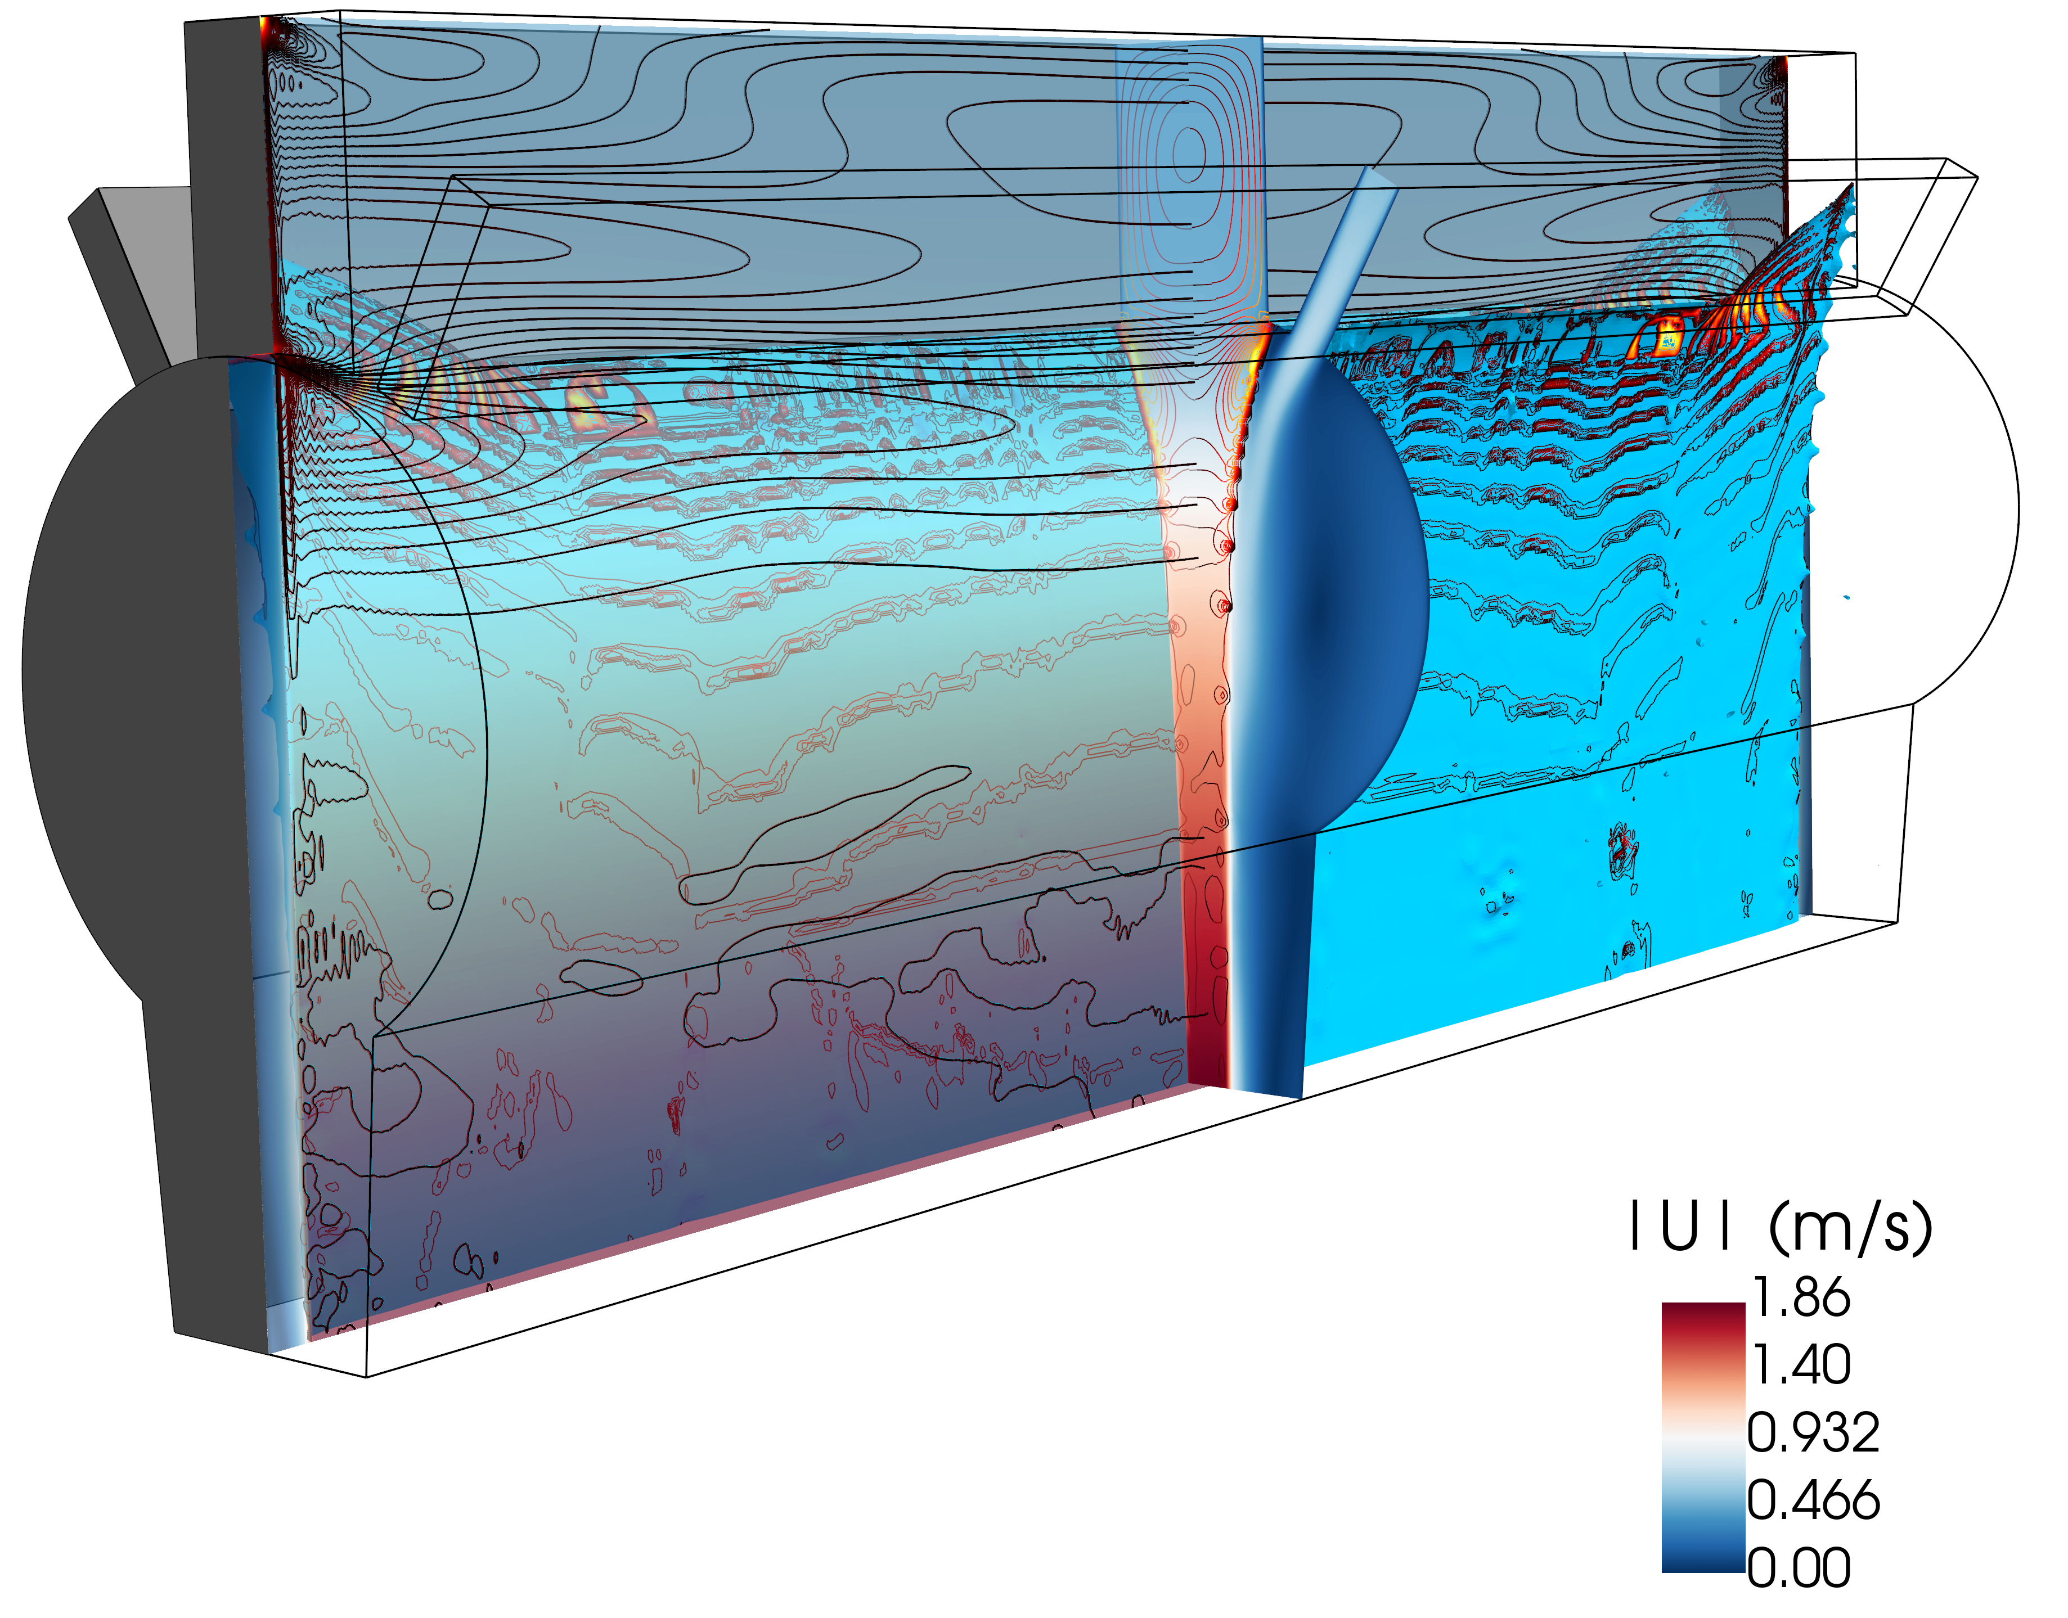
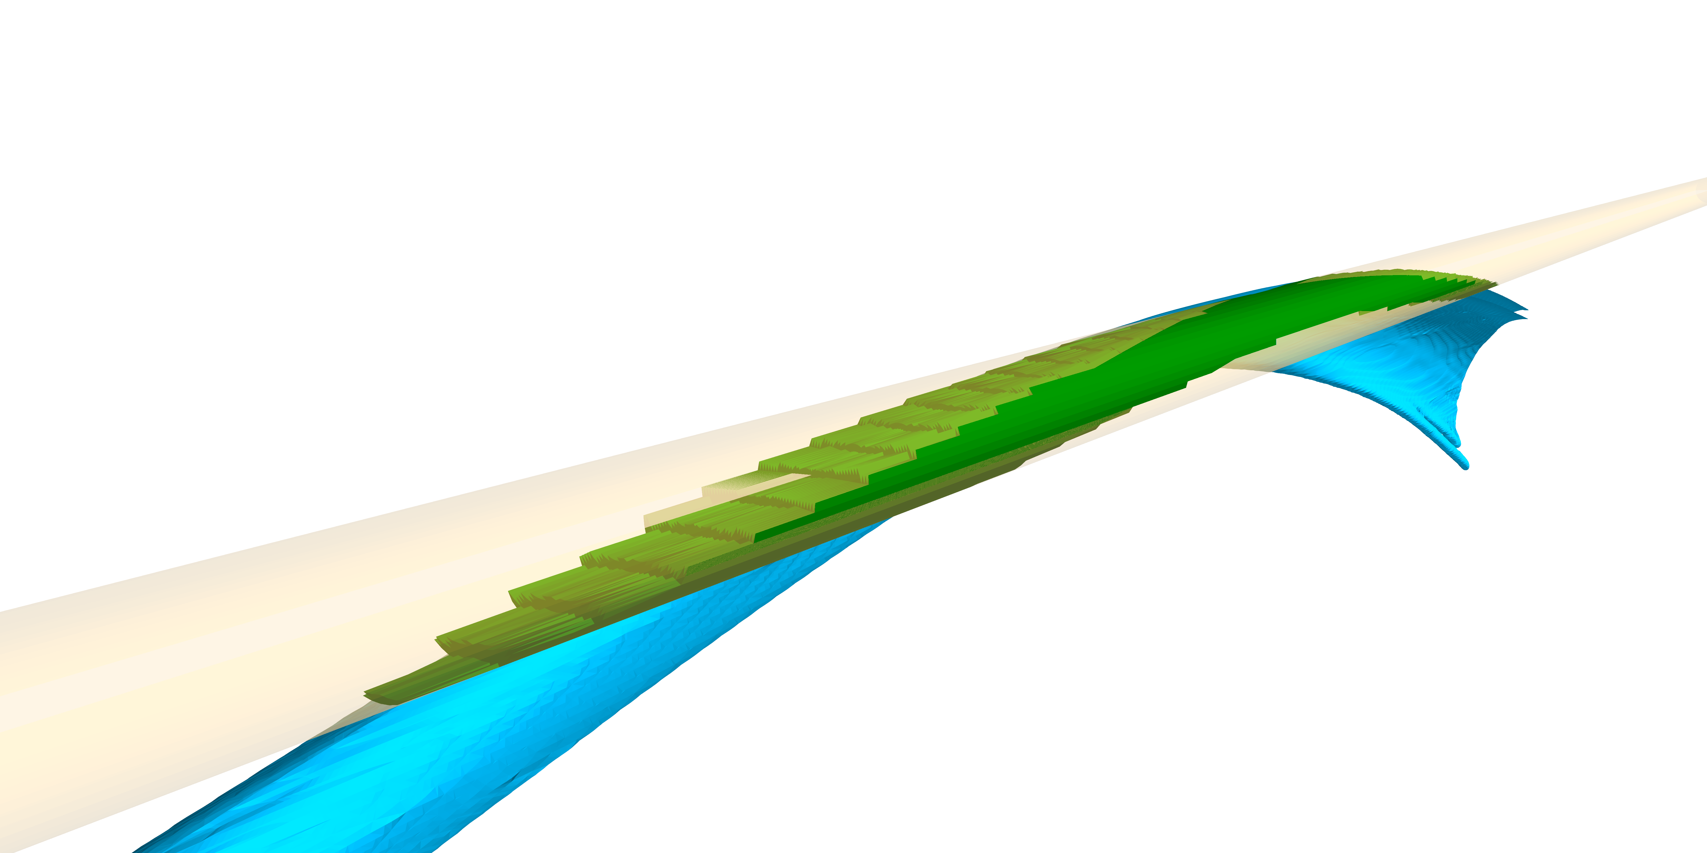
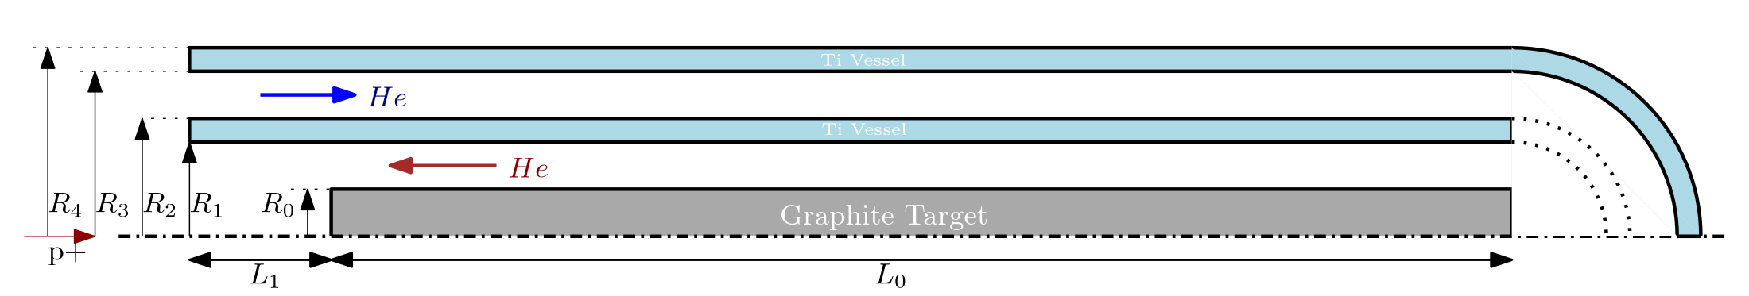
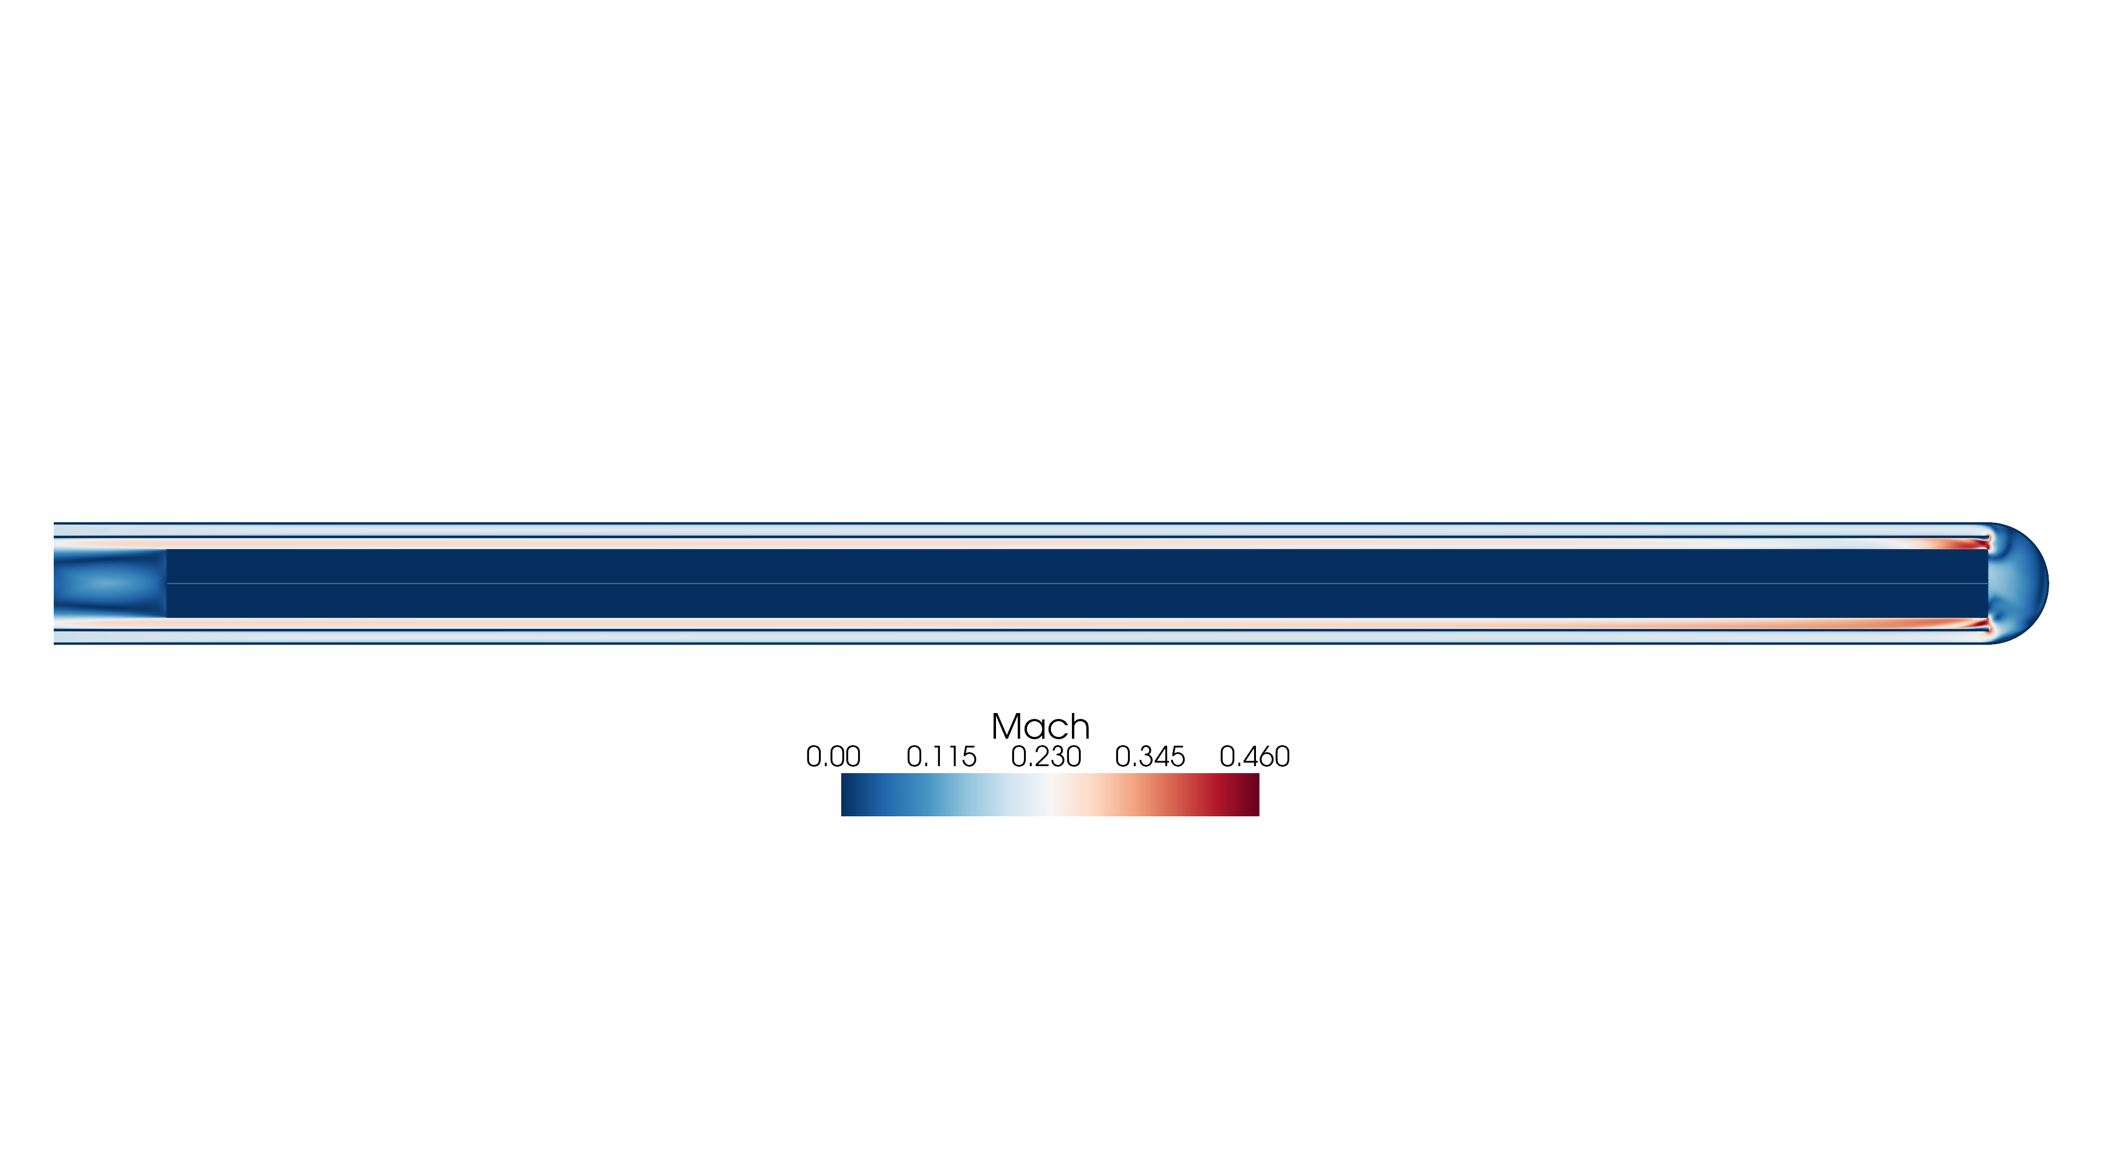
Target Concepts
Static Concept
Liquid Pb Concept
Option a: Free Falling Curtain
Option b: Liquid Jet
Graphite Solid Target (10 GeV 5mm)
Pressurized He flow for active colling
Mass for rate He ~ 0.2 kg/s @ 10 bar
Required Flow optimization
Flow rate around 100-150 kg/s
Flow perpendicular to the Magnetic Field: MHD instabilities Lorenz Force not negligible
Vertical height necessary to maintain the curtain isn’t good for physics
Higher velocity on the nozzle
Higher probability of stabilization due to the strong 2 phase interaction

Slide 3
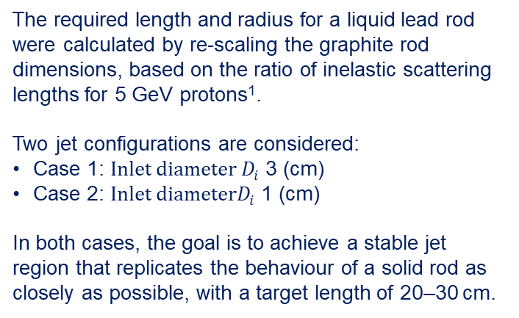
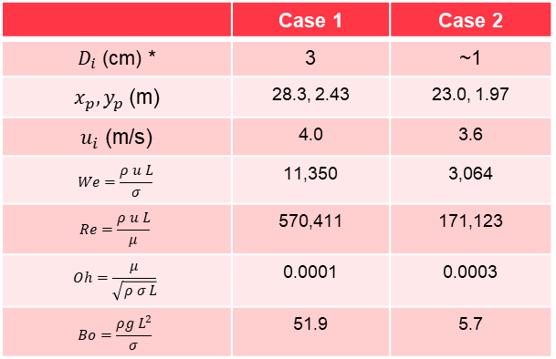
Liquid Jet Concept
The required length and radius for a liquid lead rod were calculated by re-scaling the graphite rod dimensions, based on the ratio of inelastic scattering lengths for 5 GeV protons¹.
Two jet configurations are considered:
Case 1: $Inlet diameter D_{i}$ 3 (cm)
Case 2: $Inlet diameterD_{i}$ 1 (cm)
In both cases, the goal is to achieve a stable jet region that replicates the behaviour of a solid rod as closely as possible, with a target length of 20–30 cm.
 | Case 1 | Case 2
$D_{i}$ (cm) * | 3 | ~1
$x_{p}, y_{p}$ (m) | 28.3, 2.43 | 23.0, 1.97
$u_{i}$ (m/s) | 4.0 | 3.6
$$We=\frac{ρ u L}{σ}$$ | 11,350 | 3,064
$$Re=\frac{ρ u L}{μ}$$ | 570,411 | 171,123
$$Oh=\frac{μ}{\sqrt{ρ σ L}}$$ | 0.0001 | 0.0003
$$Bo=\frac{ρg L^{2}}{σ}$$ | 51.9 | 5.7
¹J. Manczak, https://indico.cern.ch/event/1508888/]

Slide 4

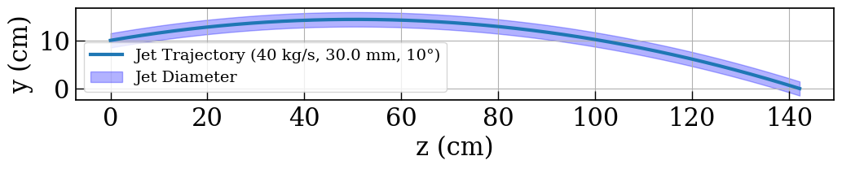


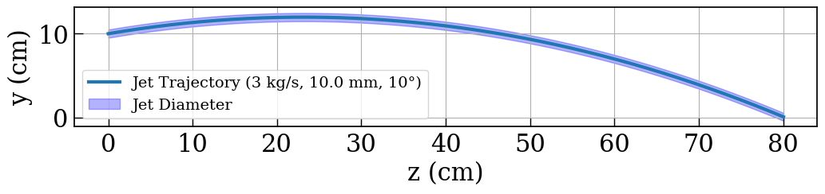
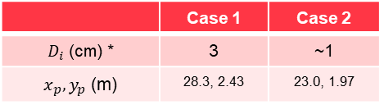
Liquid Jet Analytical Prediction
Considering a Ballistic Trajectory, based on Newtonian motion equations:
Case 1
Case 2
 | Case 1 | Case 2
$D_{i}$ (cm) * | 3 | ~1
$x_{p}, y_{p}$ (m) | 28.3, 2.43 | 23.0, 1.97

Slide 5
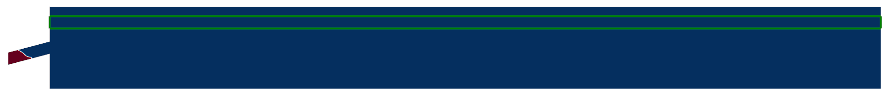
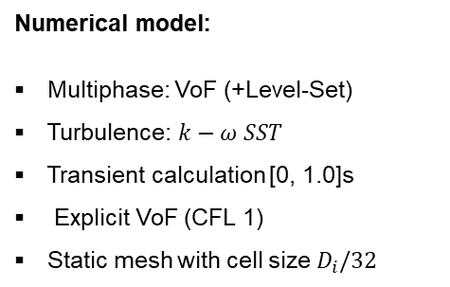
CFD calculations
xplat: [50.44812508]
yplat: [4.34904262]
uin: 5.348124882273928
We: 20178.504975324697
Re: 760549.2589597242
L_breakup: 5.893260671581403
Numerical model:
Multiphase: VoF (+Level-Set)​
Turbulence: $k−ω SST$
Transient calculation [0, 1.0]s
Explicit VoF (CFL 1)
Static mesh with cell size $D_{i}/32$
Region D=3cm
Argon @1bar
Pb
~130 cm
$$20cm$$
$$200cm$$

Slide 6
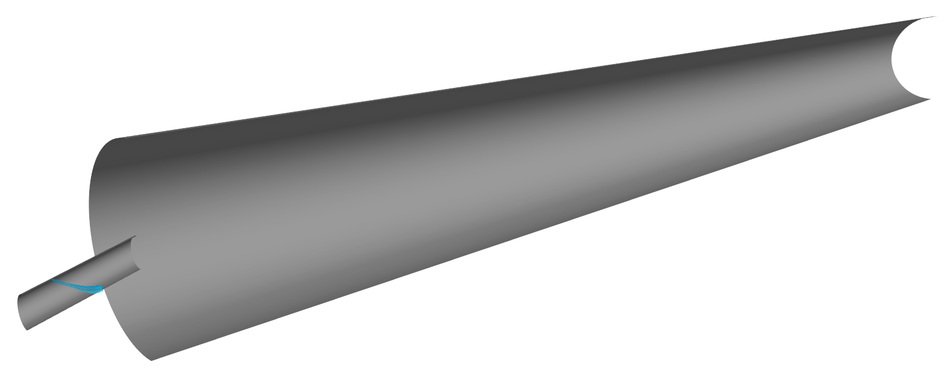
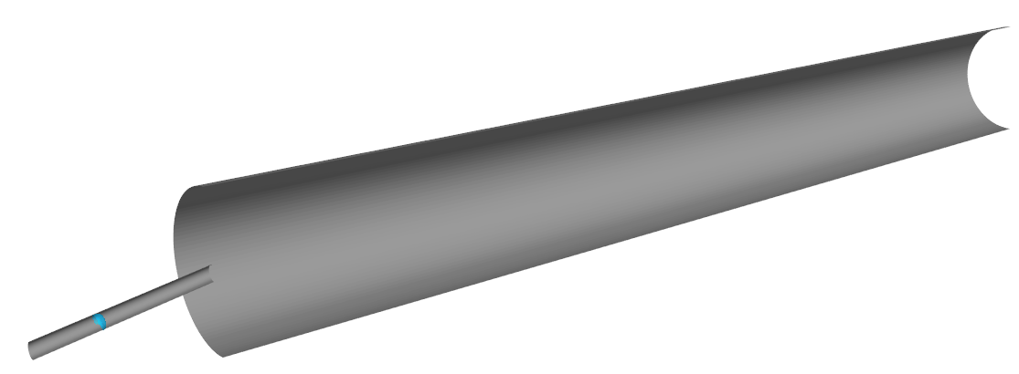
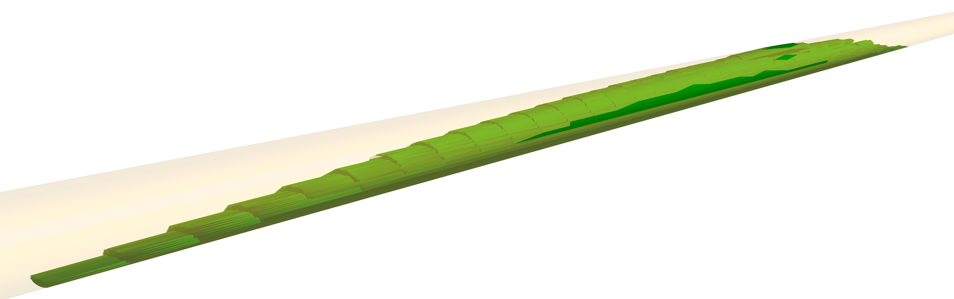
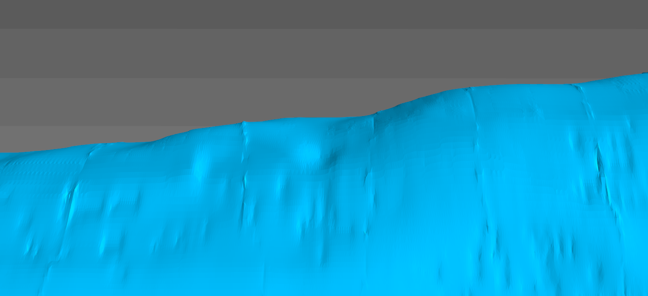











3D CFD Liquid Jet
Test Case 1
Test Case 2
${ u}_{i}=4$ m/s
${ D}_{i}=3$ cm
$D_{o}=20$ cm
${ u}_{i}=3.6$ m/s
$D_{i}=1$ cm
$D_{o}=20$ cm
$$L_{f}=200cm$$
$$L_{f}=100cm$$
$$D_{o}$$
0.16s
0.36s
$$33cm$$
Kelvin-Helmholtz instability can be addressed by reducing the relative velocity liquid-argon

Slide 7
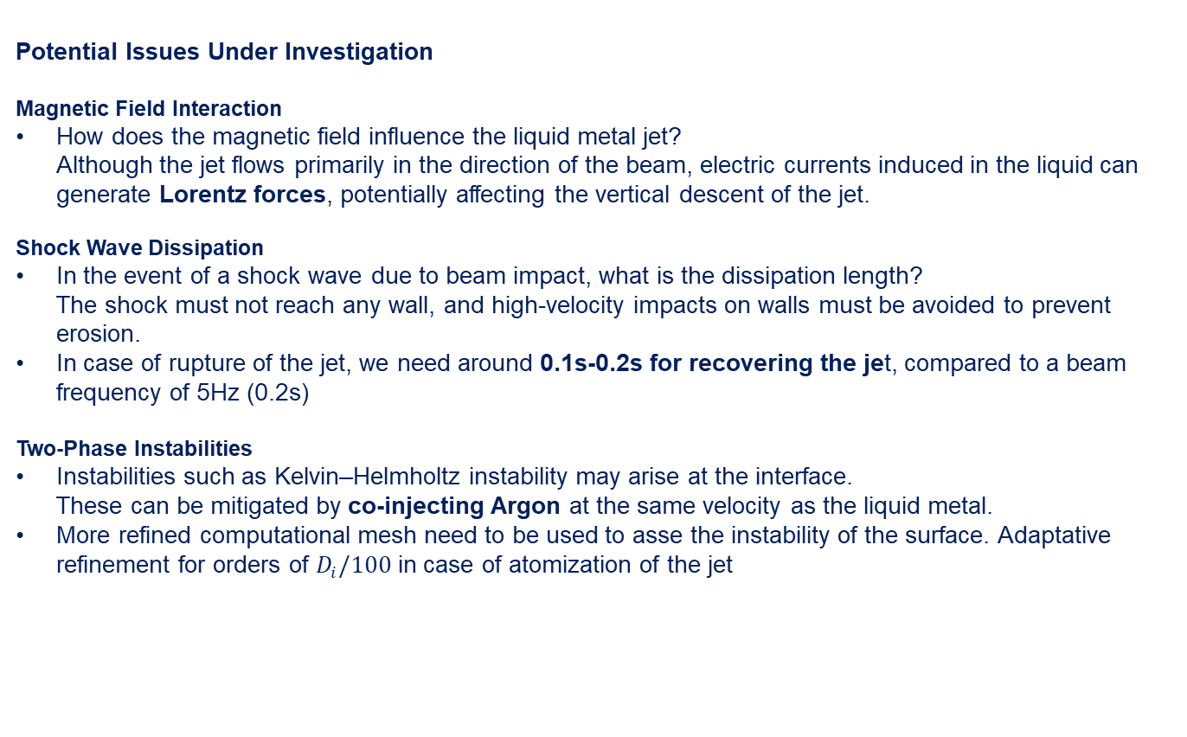
Final considerations
Potential Issues Under Investigation
Magnetic Field Interaction
How does the magnetic field influence the liquid metal jet?
Although the jet flows primarily in the direction of the beam, electric currents induced in the liquid can generate Lorentz forces, potentially affecting the vertical descent of the jet.
Shock Wave Dissipation
In the event of a shock wave due to beam impact, what is the dissipation length?
The shock must not reach any wall, and high-velocity impacts on walls must be avoided to prevent erosion.
In case of rupture of the jet, we need around 0.1s-0.2s for recovering the jet, compared to a beam frequency of 5Hz (0.2s)
Two-Phase Instabilities
Instabilities such as Kelvin–Helmholtz instability may arise at the interface.
These can be mitigated by co-injecting Argon at the same velocity as the liquid metal.
More refined computational mesh need to be used to asse the instability of the surface. Adaptative refinement for orders of $D_{i}/100$ in case of atomization of the jet

