Slide 1
BDF target cooling concepts
BDF Targetry Systems Advisory Committee - TSAC
F. Dragoni
04/03/2025
https://hiecn3.web.cern.ch

Slide 2
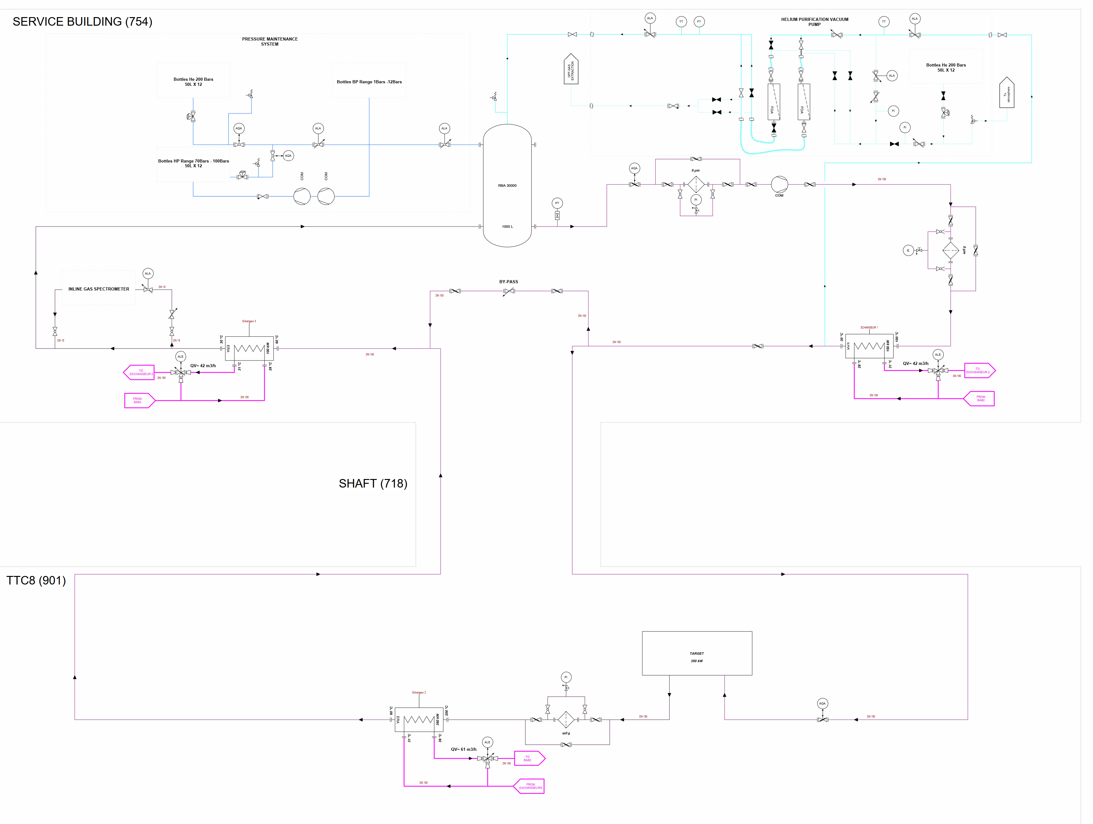
Helium Cooling – Technical Solution – P&ID
1 cooling circuit for target
Compressor skids - 13/16 bar(a)
3 heat exchangers (Water/He_{(g)})
  Shell and tube construction – safety type
  Demineralised water on primary side
Filtration
  HEPA gas filters
  Chemical getters for impurities absorption
Filling and pressure maintenance system
  Helium bottle racks with precision pressure reducers
Inline gas spectrometer
  Continuous sampling machine
Vacuum pumps
  To remove air from the circuit for subsequent filling

Slide 3
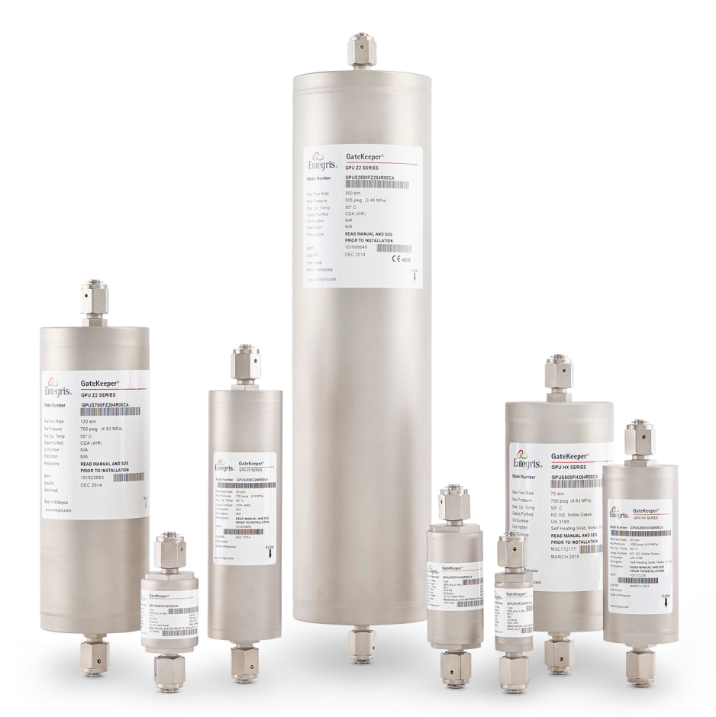
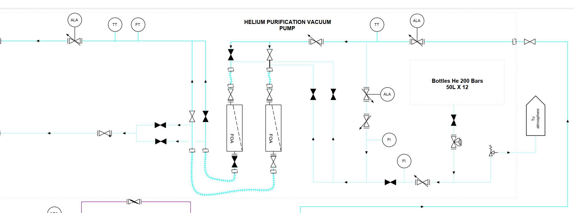
Helium purification – chemical getters
Gas purifier IX Media – same solution used at ESS
Technology
  Absorption by chemical media
  Impurities permanently trapped
  Achieved purity: H₂O, O₂, CO, CO₂, H₂ (<100 pptV each), Sulfur Compounds (<1 ppbV)
2% overall flow rate circulated through them
  Manufacturer: Entegris®

Slide 4
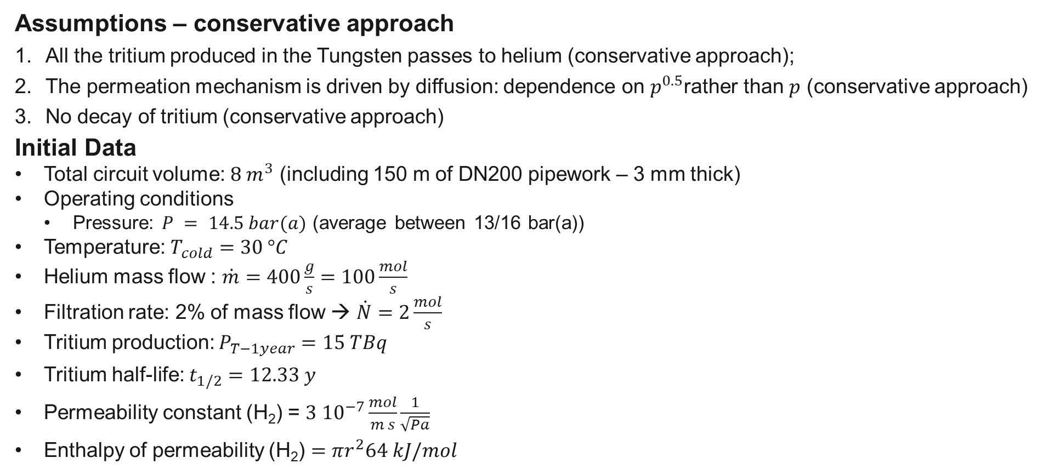
Tritium Permeation through 304L SS
Assumptions – conservative approach
  All the tritium produced in the Tungsten passes to helium (conservative approach);
  The permeation mechanism is driven by diffusion: dependence on $p^{0.5}$rather than $p$ (conservative approach)
  No decay of tritium (conservative approach)
Initial Data
  Total circuit volume: $8 m^{3}$ (including 150 m of DN200 pipework – 3 mm thick)
  Operating conditions
    Pressure: $P = 14.5 bar(a)$ (average between 13/16 bar(a))
  Temperature: $T_{cold}=30 °C$
  Helium mass flow : $\dot{m}=400\frac{g}{s}=100\frac{mol}{s}$
  Filtration rate: 2% of mass flow → $\dot{N}=2\frac{mol}{s}$
  Tritium production: $P_{T−1year}=15 TBq$
  Tritium half-life: $t_{1/2}=12.33 y$
  Permeability constant (H₂) = $3 {10}^{−7}\frac{mol}{m s}\frac{1}{\sqrt{Pa}}$
  Enthalpy of permeability (H₂) $=πr^{2}64 kJ/mol$

Slide 5

Tritium concentration in Circuit
Tritium concentration in circuit
  Number of moles of Tritium: $n_{T}= \frac{P_{T−1year }t_{1/2}}{\ln\left(2\right) N_{A}}=0.014 mol$ in 1 year
  Production rate of Tritium: $P_{T−1s }=4.44 ∙ {10}^{−10}mol/s$
  Filtration rate = $\dot{N}=2\frac{mol}{s}$
  Tritium concentration in steady state: $C_{ss}= \frac{P_{T−1s }}{\dot{N}}+C_{min}=322 pptV$ → $p_{T}=4.73∙{10}^{−4}Pa$

Slide 6
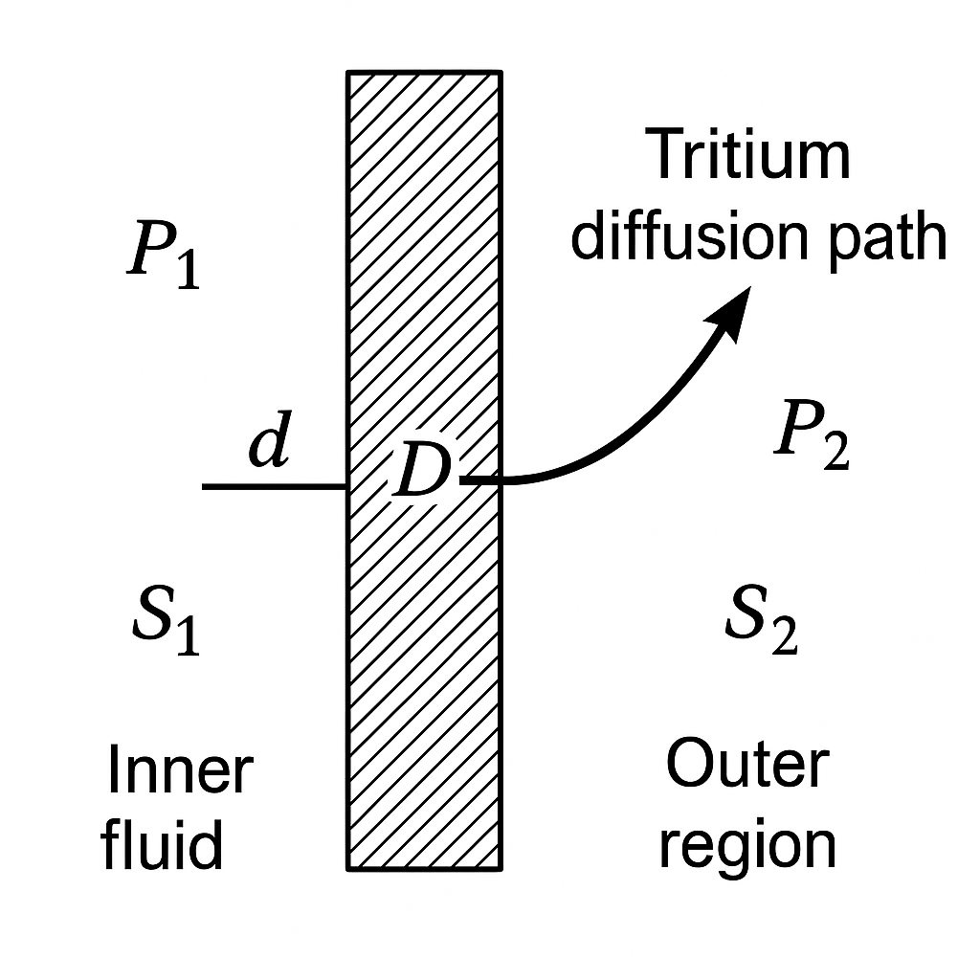
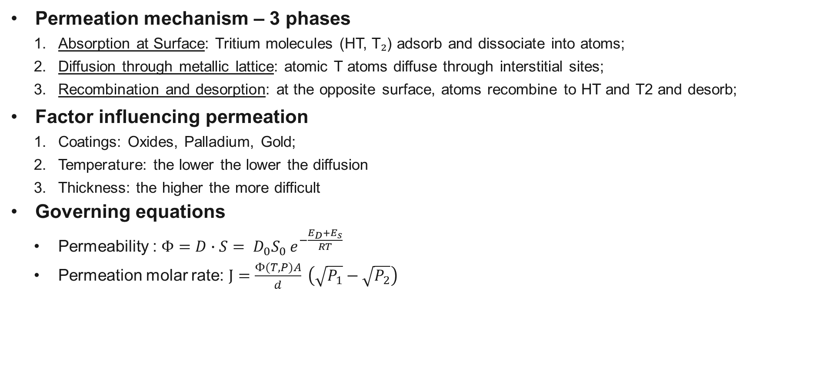
Tritium Permeation through 304L SS
Permeation mechanism – 3 phases
    Absorption at Surface: Tritium molecules (HT, T₂) adsorb and dissociate into atoms;
    Diffusion through metallic lattice: atomic T atoms diffuse through interstitial sites;
    Recombination and desorption: at the opposite surface, atoms recombine to HT and T2 and desorb;
Factor influencing permeation
    Coatings: Oxides, Palladium, Gold;
    Temperature: the lower the lower the diffusion
    Thickness: the higher the more difficult
Governing equations
  Permeability : $Φ=D∙S= D_{0}S_{0} e^{−\frac{E_{D}+E_{s}}{RT}}$
  Permeation molar rate: $J=\frac{Φ(T,P)A}{d} \left(\sqrt{P_{1}}−\sqrt{P_{2}}\right)$

Slide 7
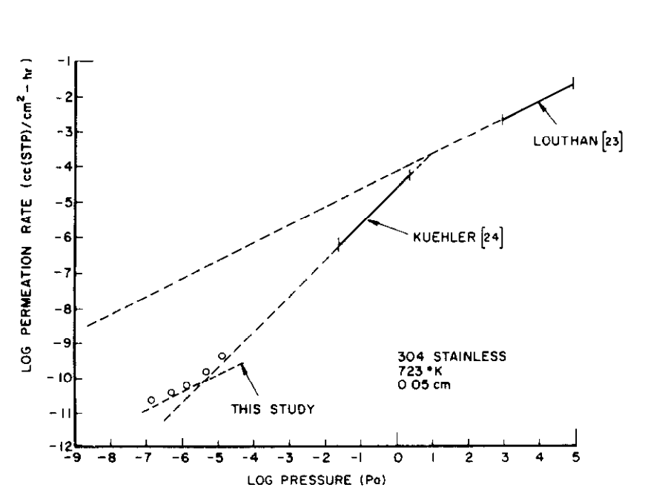
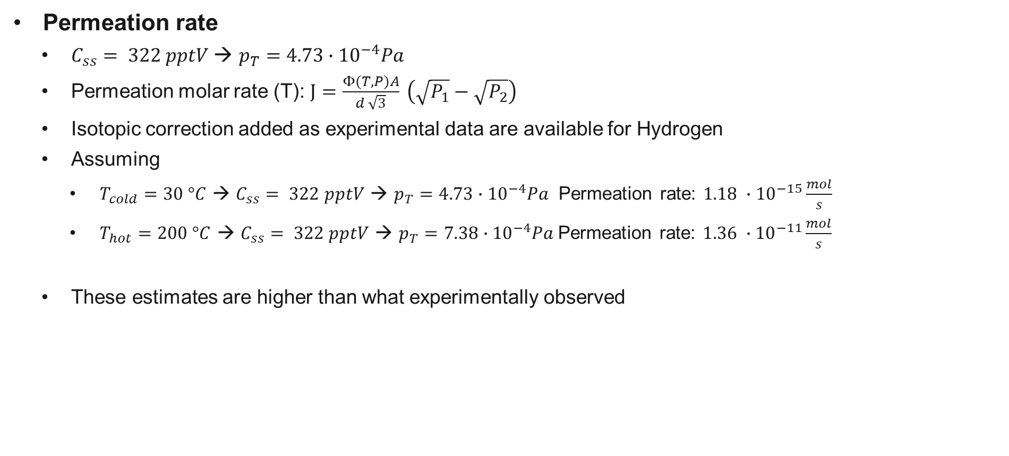
Tritium Permeation through 304L SS
Permeation rate
  $C_{ss}= 322 pptV$ → $p_{T}=4.73∙{10}^{−4}Pa$
  Permeation molar rate (T): $J=\frac{Φ(T,P)A}{d \sqrt{3}} \left(\sqrt{P_{1}}−\sqrt{P_{2}}\right)$
  Isotopic correction added as experimental data are available for Hydrogen
  Assuming
    $T_{cold}=30 °C$ → $C_{ss}= 322 pptV$ → $p_{T}=4.73∙{10}^{−4}Pa$ Permeation rate: $1.18 ∙{10}^{−15}\frac{mol}{s}$
    $T_{hot}=200 °C$ → $C_{ss}= 322 pptV$ → $p_{T}=7.38∙{10}^{−4}Pa$Permeation rate: $1.36 ∙{10}^{−11}\frac{mol}{s}$
  These estimates are higher than what experimentally observed

