Slide 1

Outgassing estimation for W target
HI-ECN3 WP3
Serdar Usta (SY-STI-RBS)
April 23rd 2025

Slide 2
Radionuclide inventory of W target based on simulation results
Isotopes
H-3
Co-60
Ba-133
Pm-145
Eu-146
Gd-148
Eu-150
Tb-157
Yb-169
Lu-172
Hf-172
Lu-173
Lu-174
Hf-175
Ta-178
W-178
m-Hf-178
Ta-179
W-181
Ta-182
Ta-183
m-Re-184
W-185
W-187
Elements (Z)
H
Co
Ba
Pm
Eu
Gd
Tb
Yb
Lu
Hf
Ta
W
Re
Chemical properties are accepted as same between isotopes of interest.
https://edms.cern.ch/document/3153059/1/approvalAndComments

Slide 3
Summary- 1 h, 1 day and 1 month of cooling ( based on W-LA list)
75 elements have been analyzed based on the simulation results. 57 of them have potential to form volatile species if the extended list is considered.
(Exceptions from periodic table Li, Fr, Ra, He, B, Pt, Au, Hg, Pb, Tl, Bi, Po, Rn, actinides and synthetic elements)
Table 1. Partial representation of outgassing estimations
Elements (Z) | Volatile Elements (Z) | Possible radioactive volatile chemicals | Reason of volatility
H | H | H2, H2O, H2O2, NH3, HNO3 | boiling
Co | Co | Co | sublimation (773 K)
Ba | W | WO3 | sublimation (823 K-wet conditions)
Pm | Re | Re2O7 | sublimation (523 K)
Eu | Zn | Zn | sublimation (619 K)
Gd | Sn | Sn, SnI4 | sublimation (633 K)/boiling
Tb | Rb | Rb | sublimation (330 K)
Yb | Cd | Cd | sublimation (773 K)
Lu | Se | SeO2 | boiling (588 K)
Hf | m-Tc | Tc2O7 | boiling (583 K)
Ta | Na | Na | sublimation (370 K)
W | Te | Te | sublimation (673 K)
Re | Ru | RuO4 | boiling (402 K)
Y | I | I2, IO,IO2 and etc. | boiling
Ce | As | As2O3, AsI3 | boiling (738 K, 676 K)
Sc | Os | OsO4 | boiling (403 K)
Mn | Ga | GaI3 | boiling (618 K)
Zn | Ge | GeI4 | boiling (713 K)
Sn | Cs | Cs | sublimation (400 K)

Slide 4
1 hour cooling, 5 years irradiation
Isotopes | Elements | Possible radioactive volatile chemicals | Reason of volatility | Contribution | Effective contribution
m-Hf-178 | m-Hf | - | - | 47.7% | 0.0%
Gd-148 | Gd | GdI3 | - | 17.1% | 0.1%
W-187 | W | WO3 | sublimation (823 K-wet conditions) | 12.6% | 12.6%
W-185 | W | WO3 | sublimation (823 K-wet conditions) | 7.4% | 7.4%
Hf-172 | Hf | - | - | 6.1% | 0.0%
Ta-182 | Ta | - | - | 1.5% | 0.0%
Ta-183 | Ta | - | - | 0.7% | 0.0%
Yb-169 | Yb | YbI2 | sublimation (773 K) | 0.7% | 0.1%
Hf-175 | Hf | - | - | 0.5% | 0.0%
Lu-171 | Lu | LuI3 | sublimation (773 K) | 0.5% | 0.1%
Lu-170 | Lu | LuI3 | sublimation (773 K) | 0.4% | 0.1%
Ta-176 | Ta | - | - | 0.3% | 0.0%
Lu-173 | Lu | LuI3 | sublimation (773 K) | 0.3% | 0.1%
W-178 | W | WO3 | sublimation (823 K-wet conditions) | 0.3% | 0.3%
Lu-172 | Lu | LuI3 | sublimation (773 K) | 0.2% | 0.1%
Tm-167 | Tm | TmI2 | sublimation (773 K) | 0.2% | 0.1%
Ta-177 | Ta | - | - | 0.2% | 0.0%
Yb-166 | Yb | YbI2 | sublimation (773 K) | 0.2% | 0.1%
Gd-146 | Gd | GdI3 | sublimation (773 K) | 0.2% | 0.1%
Ta-179 | Ta | - | - | 0.2% | 0.0%
W-181 | W | WO3 | sublimation (823 K-wet conditions) | 0.2% | 0.2%
Hf-170 | Hf | - | - | 0.2% | 0.0%
Hf-173 | Hf | - | - | 0.2% | 0.0%
Lu-169 | Lu | LuI3 | sublimation (773 K) | 0.2% | 0.1%
Ta-175 | Ta | - | - | 0.2% | 0.0%
Ta-184 | Ta | - | - | 0.1% | 0.0%
Tb-149 | Tb | TbI3 | sublimation (773 K) | 0.1% | 0.1%
Hf-181 | Hf | - | - | 0.1% | 0.0%
Ta-173 | Ta | - | - | 0.1% | 0.0%
I-125 | I | I2, IO,IO2 and etc. | boiling | 0.1% | 0.1%
Re-182 | Re | Re2O7 | sublimation (523 K) | 0.1% | 0.1%
Re-183 | Re | Re2O7 | sublimation (523 K) | 0.1% | 0.1%
Eu-146 | Eu | EuI2 | sublimation (773 K) | 0.1% | 0.1%

Slide 5
Estimation of volatile chemical compounds
Plan of action
Classifying the elements from simulated radionuclide inventory and identify the reactive atmosphere components at given conditions.
Exploiting thermochemical database of HSC Chemistry 9 by searching elements from the inventory and determine all possible combinations of known chemical compounds (reliability class 1) based known compound classes.
Searching literature for found compounds and their possible lower & higher oxidation states.
Sorting them based on boiling/sublimation point to determine volatile radioactive species at given conditions.

Slide 6
Main components of air- as residual atmosphere
N₂ | 78-75%
O₂ | 21-20%
H₂O | 4-1%
Ar | 0.92%
CO₂ | 0.04%
Why do we consider N₂, H₂O and CO₂ as well in addition to O₂?
N₂ can be catalyzed on metallic surfaces. (ppm level of activity)
H₂O can be preferred over O₂ as in the hydroxide form or as an oxygen source at lower temperatures and even may decrease the sublimation temperature.
  Ex.
  La + Humid air La(OH)₃
  La₂O₃ + Humid air La(OH)₃
  UC_{x} + H₂O UO₂ , UC_{x} + O₂ UO₂
  WO_{3(s)} WO_{3(g)} in humid air
CO₂ can further stabilize an oxide.
  CaO + CO₂ CaCO₃
25 ºC
25 ºC
100 ºC
215 ºC
550 ºC
25 ºC

Slide 7
Simple classification of elements from the inventory
Metalloid | Ametal | Noble gas | Earth Metal | Tr. Metal | Noble Metal | Lanthanides
- | H | - | Ba | Co | Re | Pm
 |  |  |  | Hf |  | Eu
 |  |  |  | Ta |  | Gd
 |  |  |  | W |  | Tb
 |  |  |  |  |  | Yb
 |  |  |  |  |  | Lu
These elements’ interactions among themselves and with N, O, C and H atoms are under investigation (except organics) like in the class of oxide, nitrate, nitride, hydroxide, hydride, carbonate.
Note: Most of the carbonate and oxalate transforms itself to oxide after thermal treatment, they can be omitted. Additionally, salts containing metalate anion tends to decompose at elevated temperatures to oxide forms, therefore metal elements are considered only in possible cations.

Slide 8
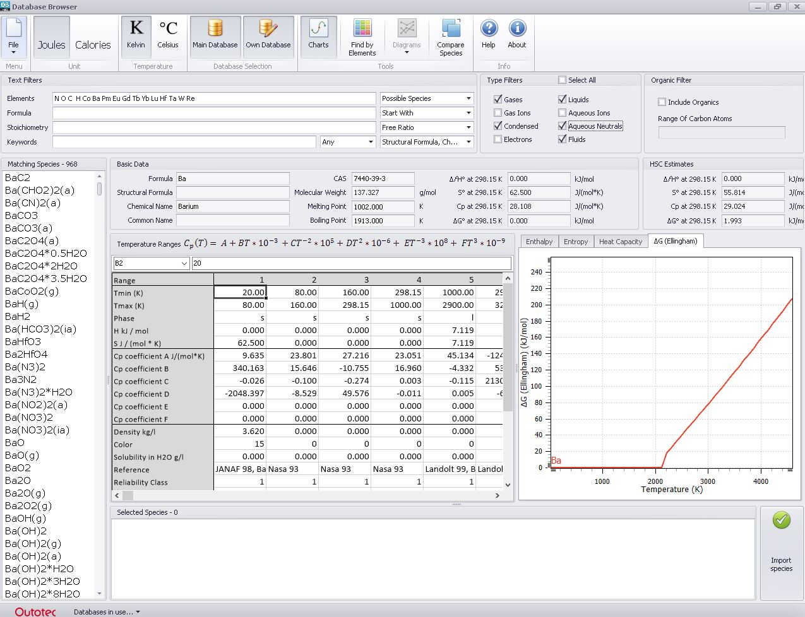
968 species excluding organics

Slide 9
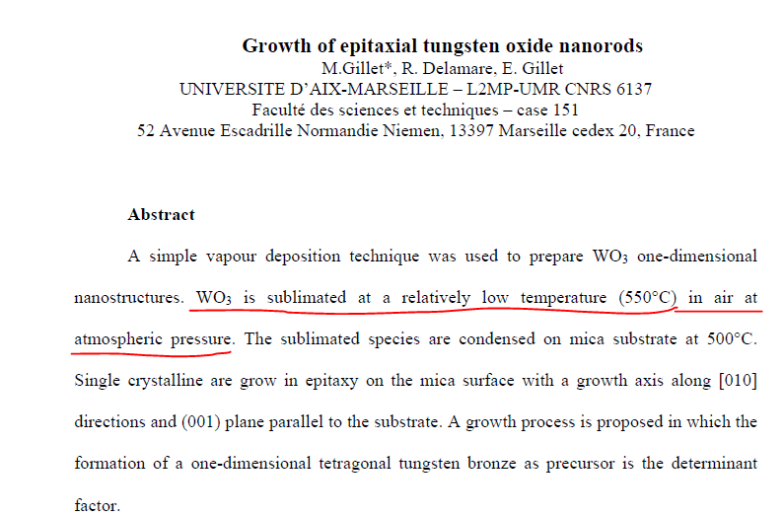
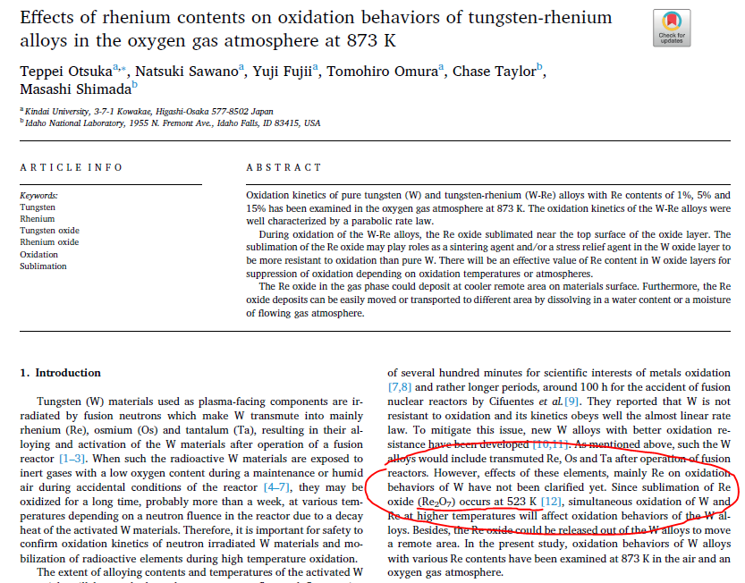
Literature comparisons
WO₃ Re₂O₇
Access to the key publications:
(https://cernbox.cern.ch/s/VN3dDnPiMfyhtpL)

Slide 10
Remarks!
Limited by HSC Thermochemical Database and literature (i.e. Lanthanide’s chemistry and uncharacterized/unknown phases)
Hard to claim that all related literature has been covered!
In most studies, ppm/ppb level of sublimation/vaporization or chemical activity are not under investigation and considered negligible including lower oxidation states (i.e. Ta₂O₅ most stable but the oxidation starts from Ta₄O).
Pay attention to the all reactants within the atmosphere of interest (i.e. water content).
This study can only be complementary to experimental investigations.

