Slide 1
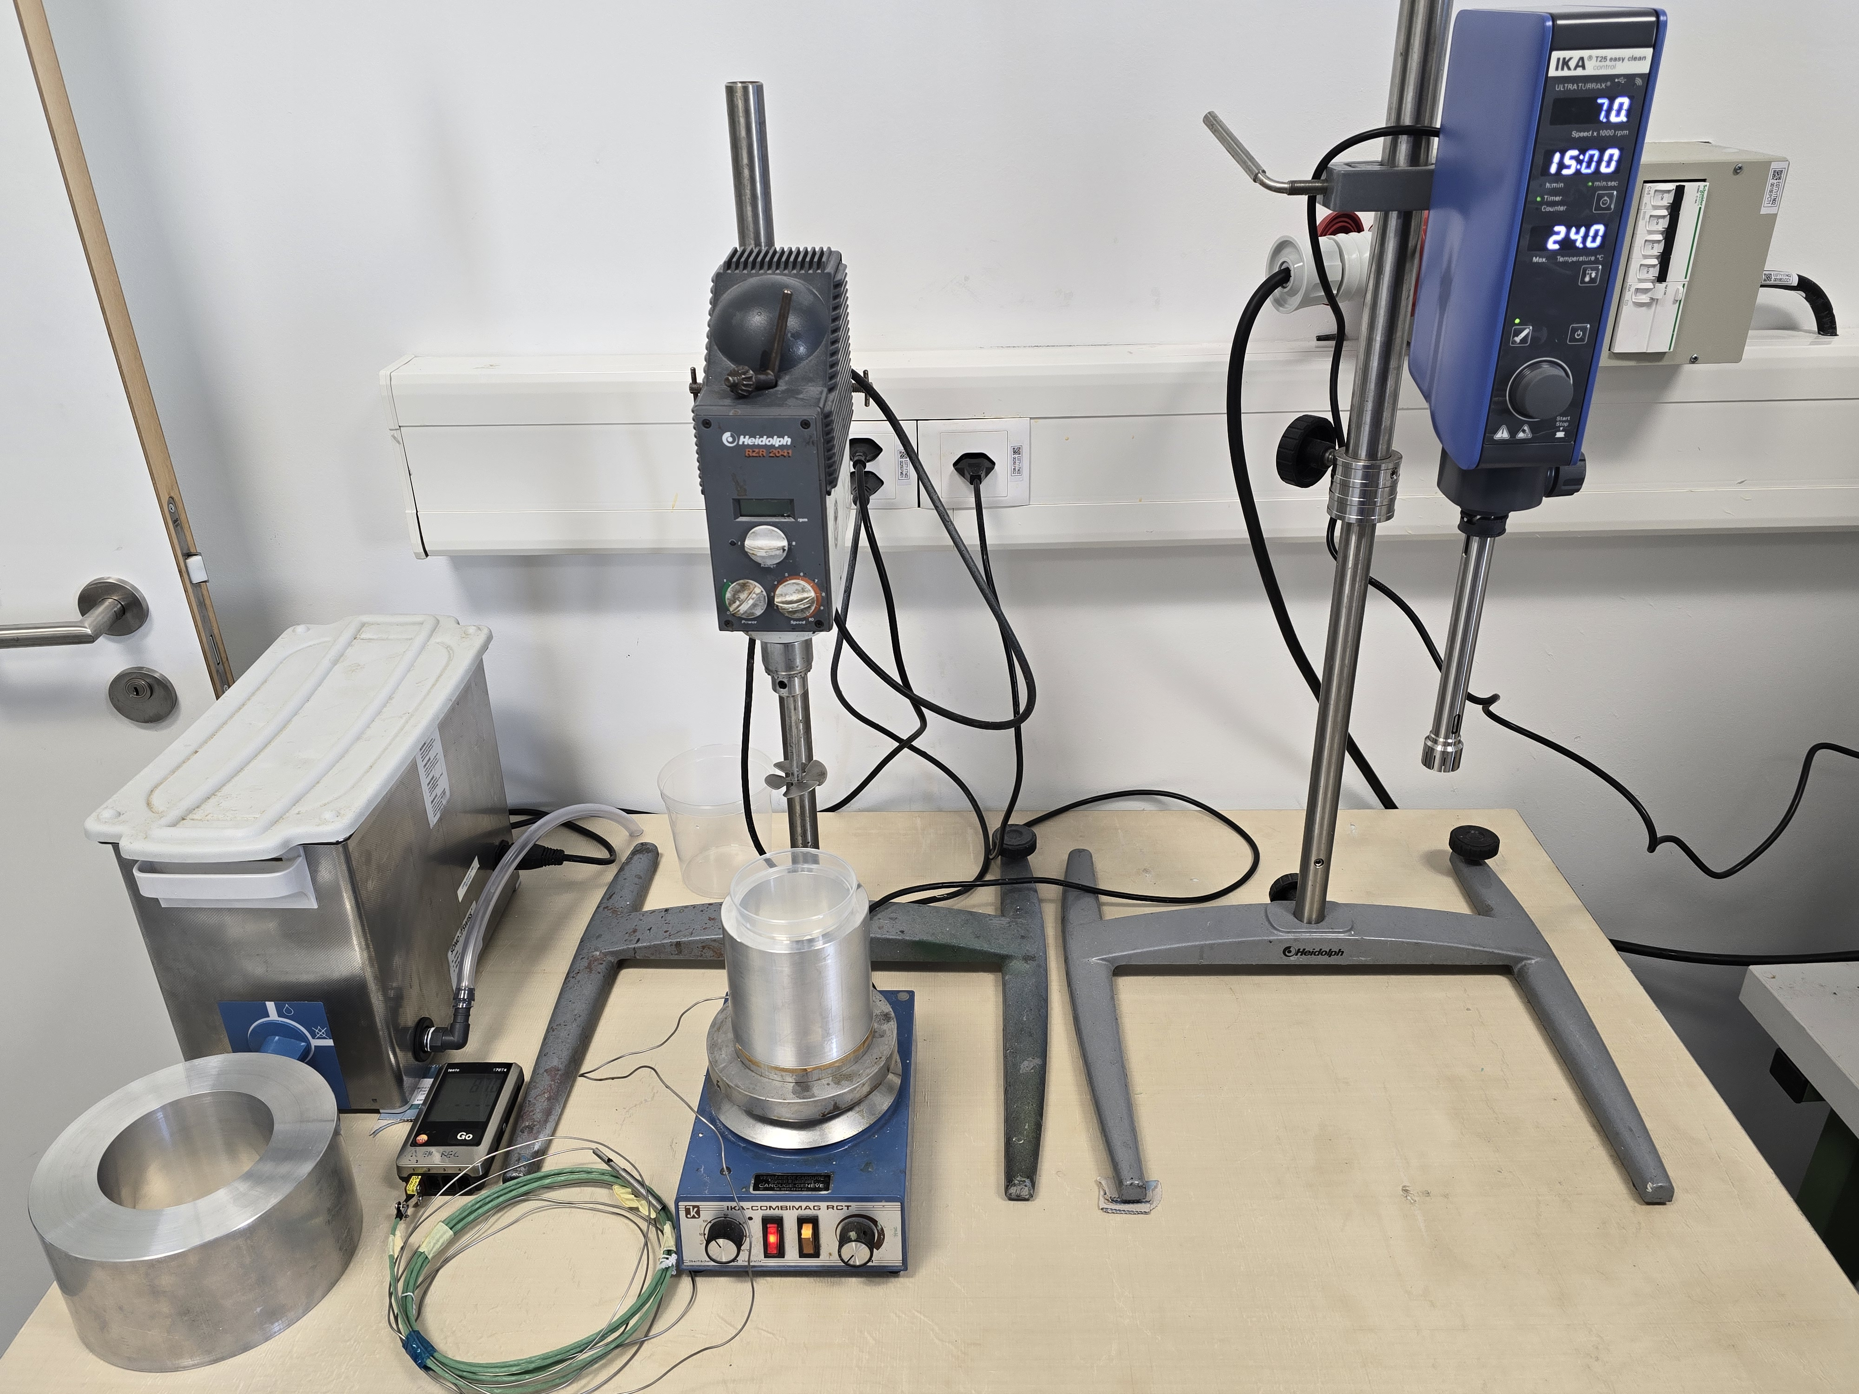
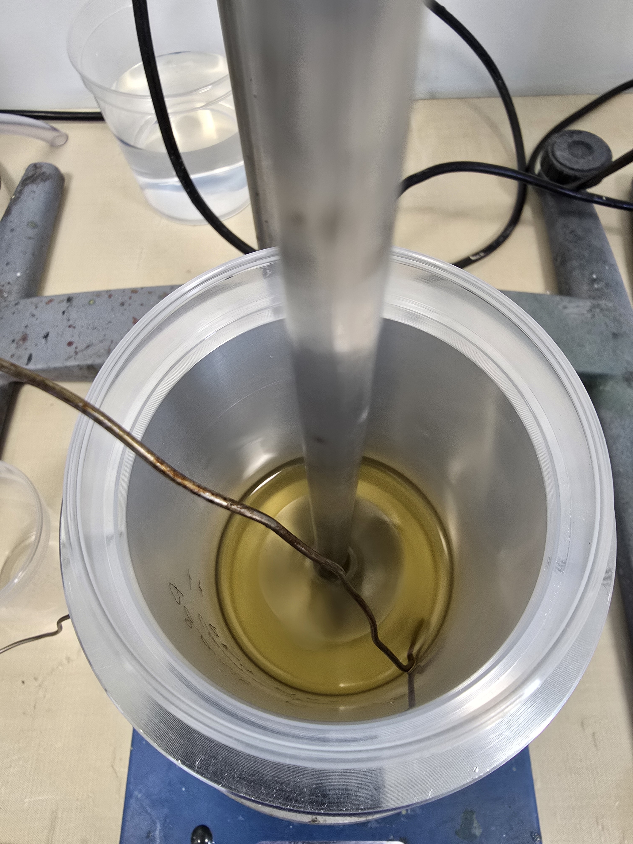
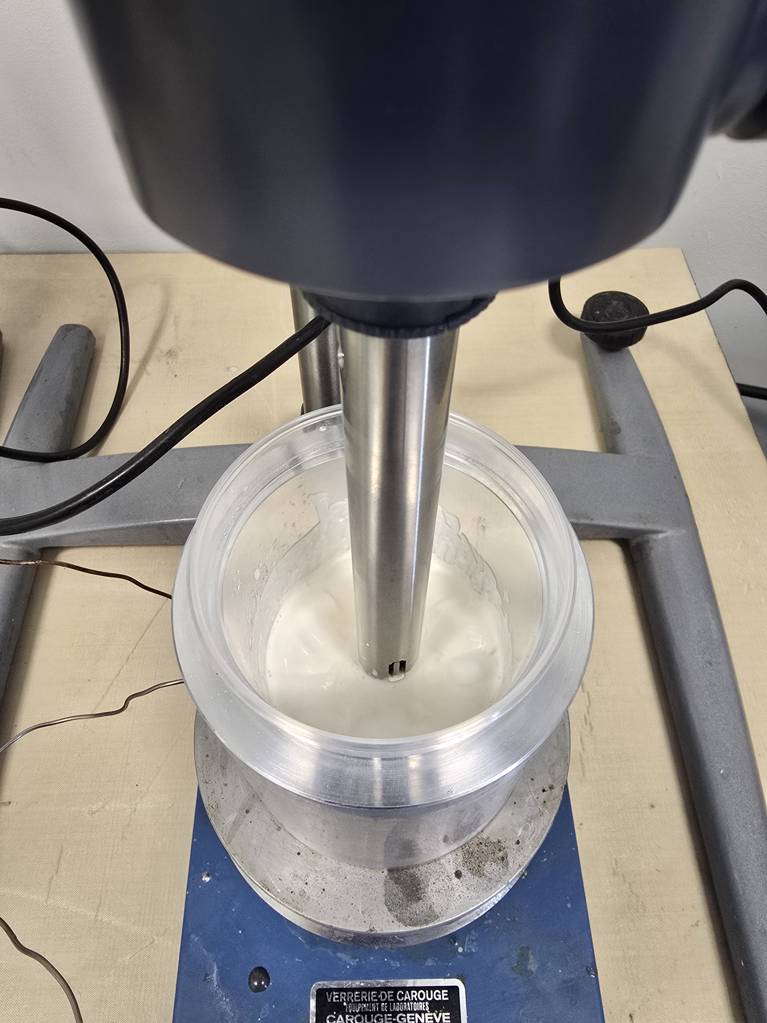
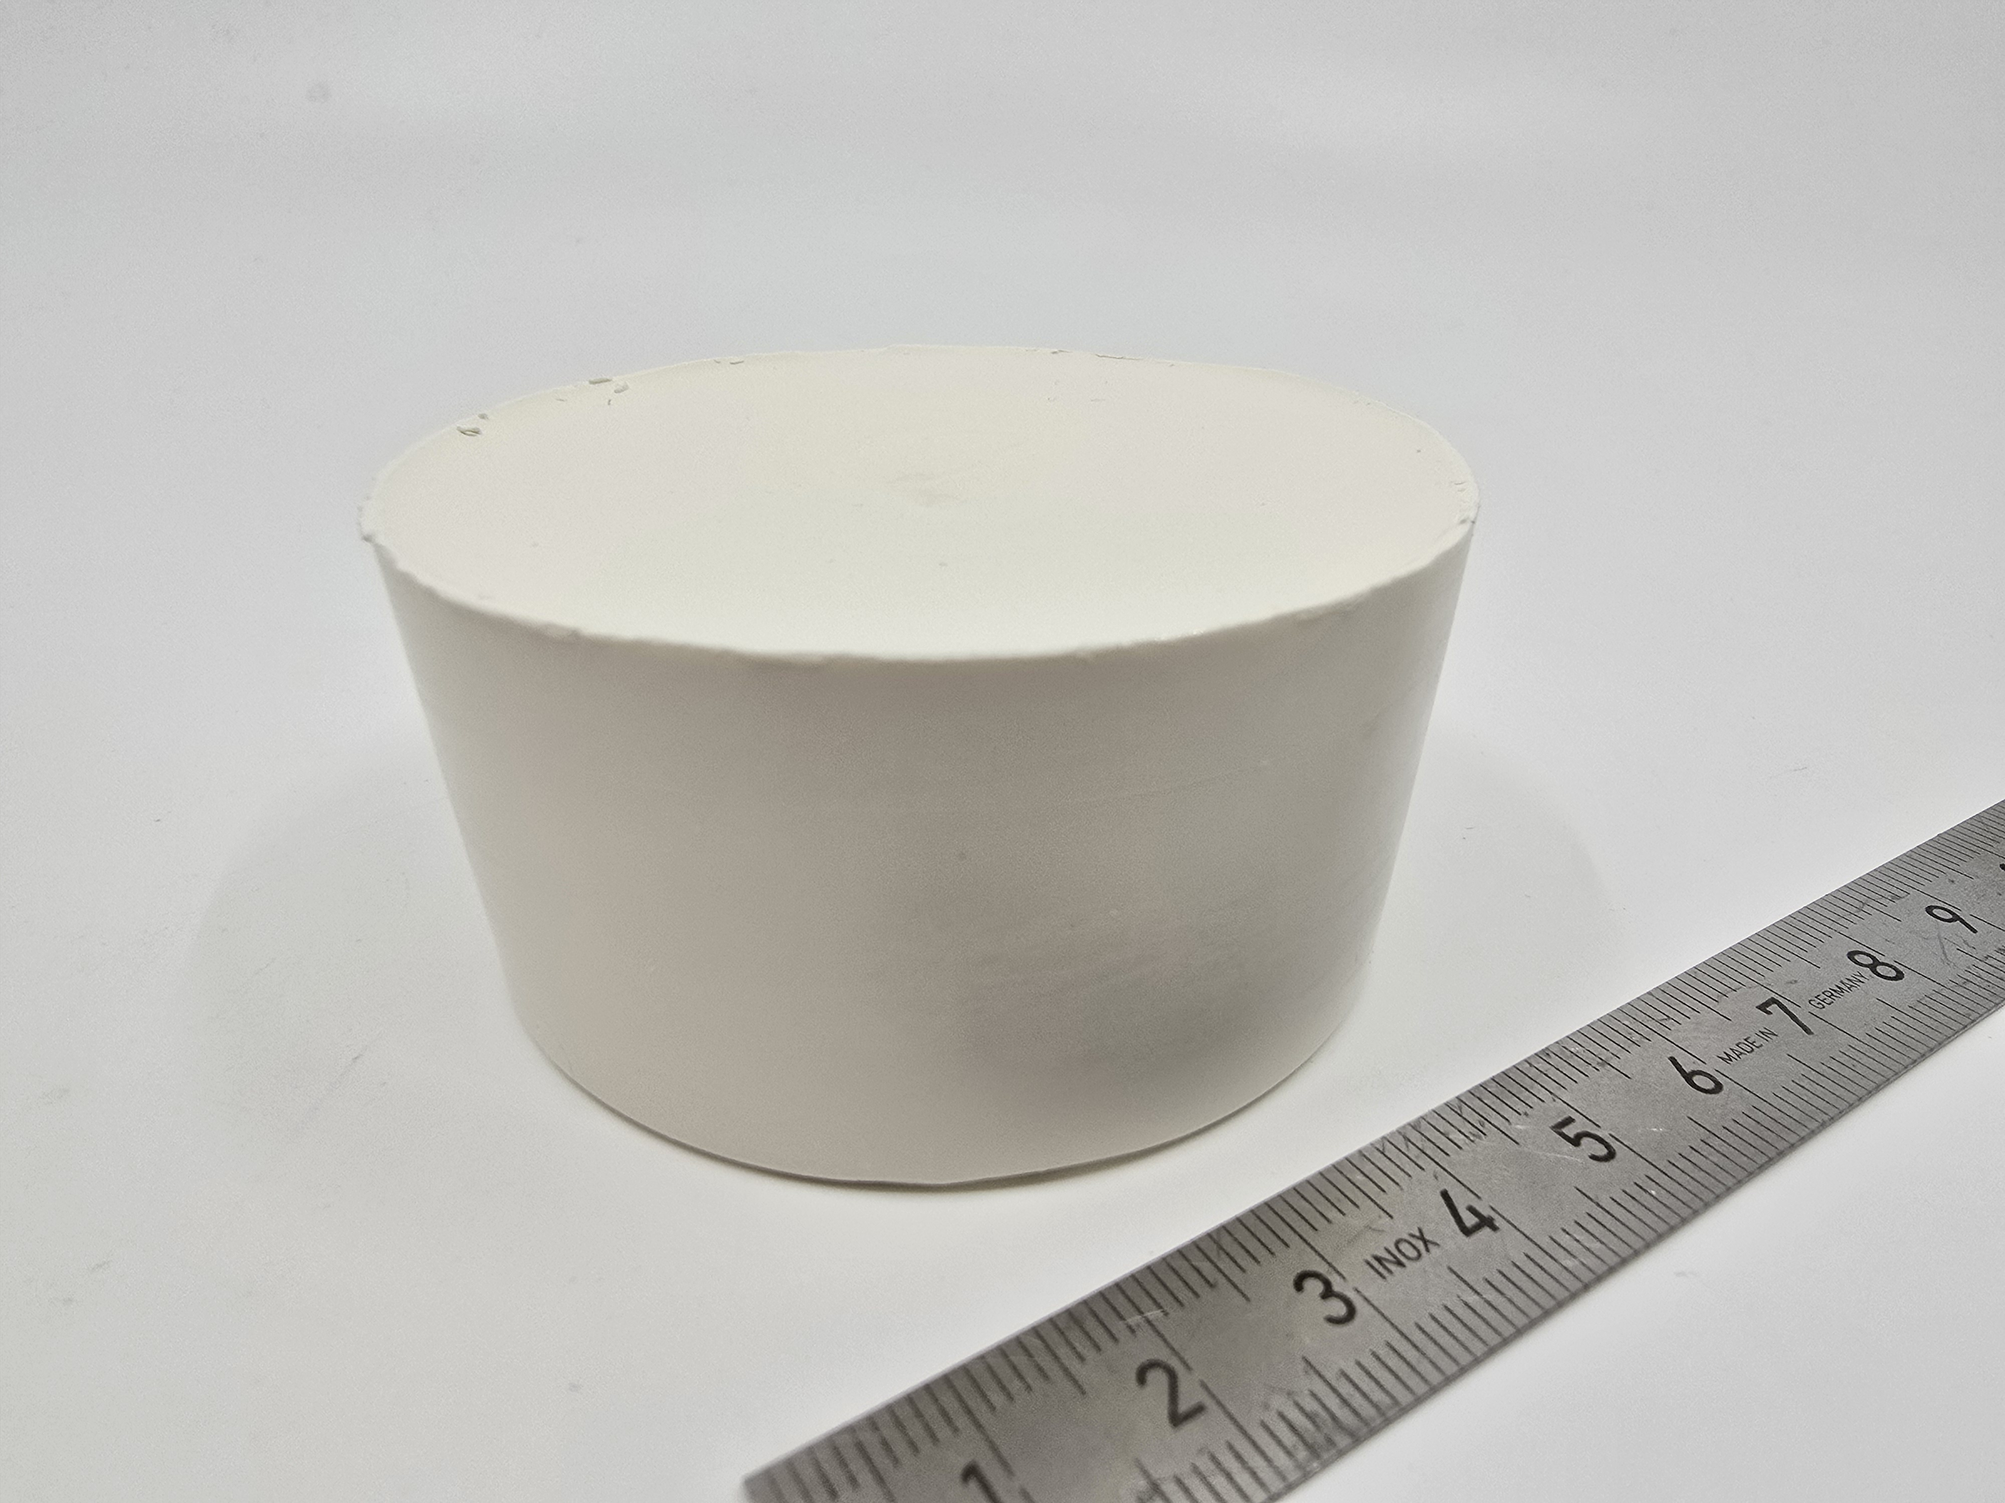
Filled wax dispersion test
  Materials:
  Polarit G54/56: 45.5 g
  Carnauba (dispersant): 5 g
  PB4 MAR Alumina particles (~ 700 nm): 180 g (45 %vol)
  Procedure:
  Polarit + Carnauba at 90 °C then stirred at 150 rpm
  Degassed at 1 mbar and 90 °C
  PB4 MAR preheated at 90 °C
  Fillers added to the wax + dispersant
  Ultrasonic bath for 15 min at 80 °C
  Ultraturrax at 15 000 rpm for 5 min
  Ultrasonic bath for 15 min at 80 °C
  Degassed at 1 mbar and 90 °C
Wax + carnauba
Wax + carnauba + fillers
Wax + carnauba + fillers after cooling

Slide 2
Next steps toward SMC impregnation
Degassing pressure at 1mbar, then impregnation at 1 mbar or higher (TBD)
Impregnation in horizontal position (with the horizontal vacuum chamber)
Design and machine parts to modify impregnator and SMC impregnation moulds
Define the right procedure for scraping the excess of wax after impregnation
Target date of SMC wax impregnation: 3rd of June

