Slide 1
Dynamic aperture and beam lifetime

Slide 2
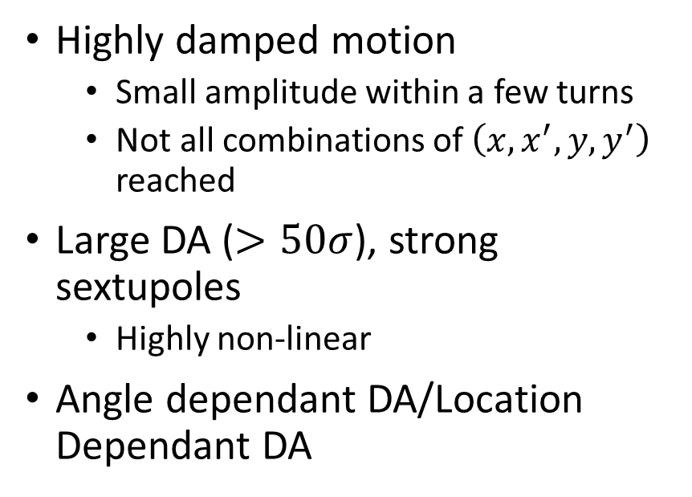
Dynamic Aperture Simulation
Simulation setup
Quantifying DA/MA
Highly damped motion
  Small amplitude within a few turns
  Not all combinations of $\left(x,x^{′},y,y^{′}\right)$ reached
Large DA ($>50σ$), strong sextupoles
  Highly non-linear
Angle dependant DA/Location Dependant DA
DA interpretation often by eye
  Not suitable for scans/optimisation
  Require a quantity defining size of DA
Large DA =/= large lifetime (necessarily)
  DA quantification should capture lifetime ideally

Slide 3


Angle Scan
$$N_{y}σ_{y}$$
$$N_{x}σ_{x}$$

Slide 4



Angle Scan
$$x_{N}′$$
$$x_{N}$$
$$N_{x}ε_{x}$$
$$N_{y}σ_{y}$$
$$N_{x}σ_{x}$$

Slide 5



Angle Scan
$$x_{N}′$$
$$x_{N}$$
$$N_{x}ε_{x}$$
$$N_{y}σ_{y}$$
$$y_{N}′$$
$$N_{y}ε_{y}$$
$$N_{x}σ_{x}$$
$$y_{N}$$

Slide 6
Angle Scan
$$x_{N}′$$
$$x_{N}$$
$$N_{x}ε_{x}$$
$$N_{y}σ_{y}$$
$$y_{N}′$$
$$N_{y}ε_{y}$$
$$N_{x}σ_{x}$$
$$y_{N}$$

Slide 7


Angle Scan
$$x_{N}′$$
$$x_{N}$$
$$N_{x}ε_{x}$$
$$N_{y}σ_{y}$$
$$N_{y}σ_{y}$$
$$y_{N}′$$
$$N_{y}ε_{y}$$
$$N_{x}σ_{x}$$
$$N_{x}σ_{x}$$
$$y_{N}$$

Slide 8
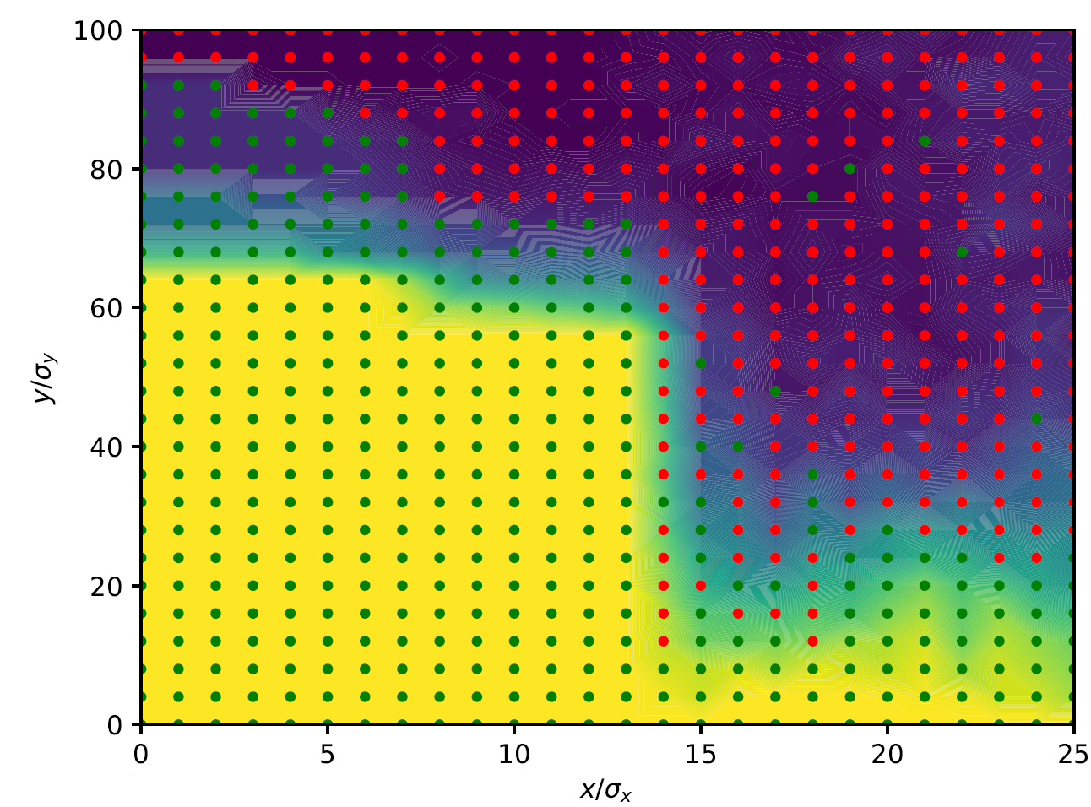
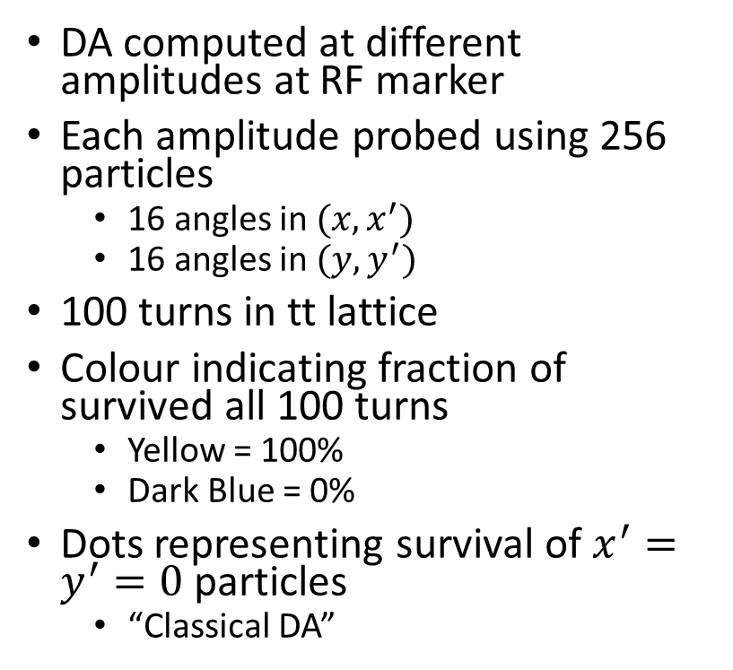
DA Angle Scan
No Radiation
DA computed at different amplitudes at RF marker
Each amplitude probed using 256 particles
  16 angles in $(x,x^{′})$
  16 angles in $(y,y^{′})$
100 turns in tt lattice
Colour indicating fraction of survived all 100 turns
  Yellow = 100%
  Dark Blue = 0%
Dots representing survival of $x^{′}=y^{′}=0$ particles
  “Classical DA”

Slide 9
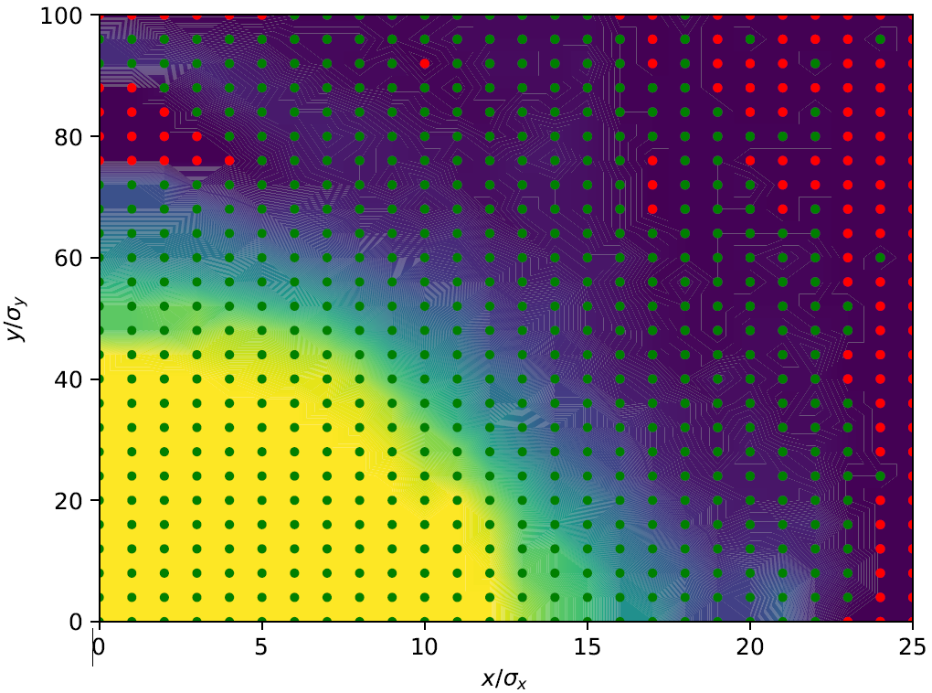
DA Angle Scan
Radiation
DA computed at different amplitudes at RF marker
Each amplitude probed using 256 particles
  16 angles in $(x,x^{′})$
  16 angles in $(y,y^{′})$
100 turns in tt lattice
Colour indicating fraction of survived all 100 turns
  Yellow = 100%
  Dark Blue = 0%
Dots representing survival of $x^{′}=y^{′}=0$ particles
  “Classical DA”

Slide 10
Dynamic Aperture Simulation
Simulation setup
Quantifying DA/MA
Highly damped motion
  Small amplitude within a few turns
  Not all combinations of $\left(x,x^{′},y,y^{′}\right)$ reached
Large DA ($>50σ$), strong sextupoles
  Highly non-linear
Angle dependant DA/Location Dependant DA
DA interpretation often by eye
  Not suitable for scans/optimisation
  Require a quantity defining size of DA
Large DA =/= large lifetime (necessarily)
  DA quantification should capture lifetime ideally

Slide 11








Projection of DA
$$s_{0}$$
$$s_{1}$$
$$x_{N}′$$
$$x_{N}′$$
Track
$$x_{N}$$
$$x_{N}$$
$$N_{x}ε_{x}$$
$$N_{x}ε_{x}$$

Slide 12




Projection of DA
$$s_{0}$$
$$s_{1}$$
$$s_{1}$$
$$x_{N}′$$
$$x_{N}′$$
$$x′$$
Track
$$x_{N}$$
$$x_{N}$$
$$x$$
$$N_{x}ε_{x}$$
$$N_{x}ε_{x}$$
$$N_{x}ε_{x}$$

Slide 13
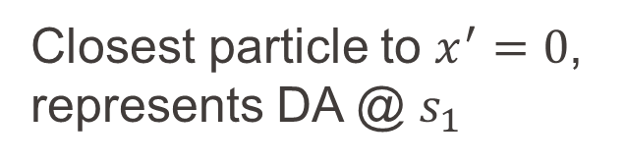
Projection of DA
$$s_{0}$$
$$s_{1}$$
$$s_{1}$$
$$x_{N}′$$
$$x_{N}′$$
$$x′$$
Track
$$x_{N}$$
$$x_{N}$$
$$x$$
$$N_{x}ε_{x}$$
$$N_{x}ε_{x}$$
$$N_{x}ε_{x}$$
Closest particle to $x^{′}=0$, represents DA @ $s_{1}$

Slide 14
Projection of DA
$$s_{0}$$
$$s_{1}$$
$$s_{1}$$
$$x_{N}′$$
$$x_{N}′$$
$$x′$$
Track
$$x_{N}$$
$$x_{N}$$
$$x$$
$$N_{x}ε_{x}$$
$$N_{x}ε_{x}$$
Closest particle to $x^{′}=0$, represents DA @ $s_{1}$

Slide 15

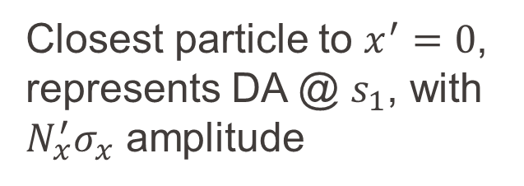
Projection of DA
$$s_{0}$$
$$s_{1}$$
$$s_{1}$$
$$x_{N}′$$
$$x_{N}′$$
$$x′$$
Track
$$x_{N}$$
$$x_{N}$$
$$x$$
$$N_{x}ε_{x}$$
$$N_{x}ε_{x}$$
$${N′}_{x}ε_{x}$$
Closest particle to $x^{′}=0$, represents DA @ $s_{1}$, with $N_{x}^{′}σ_{x}$ amplitude

Slide 16
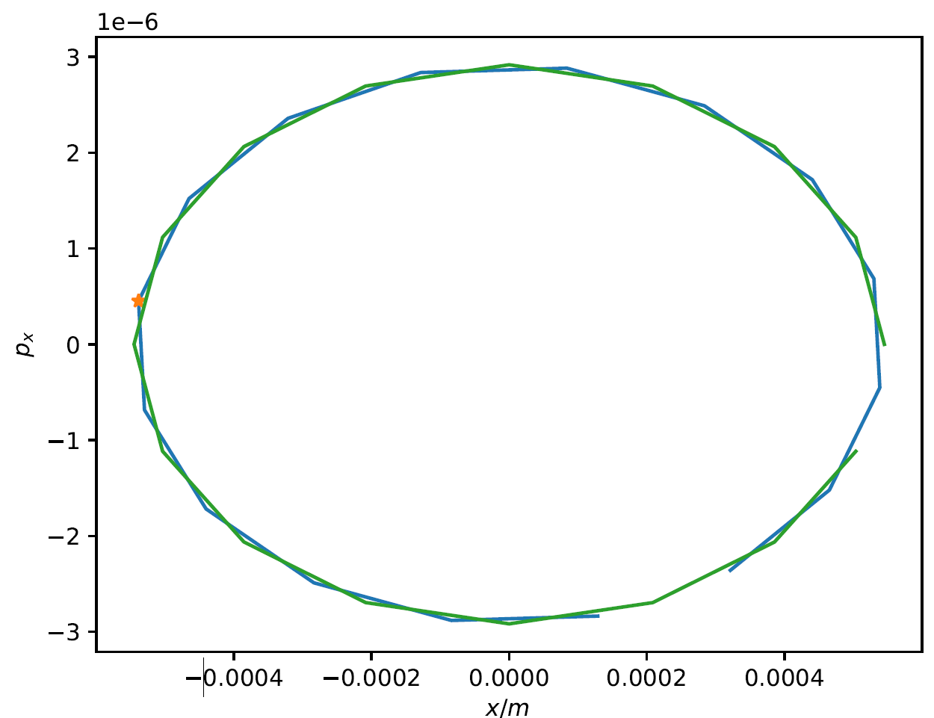
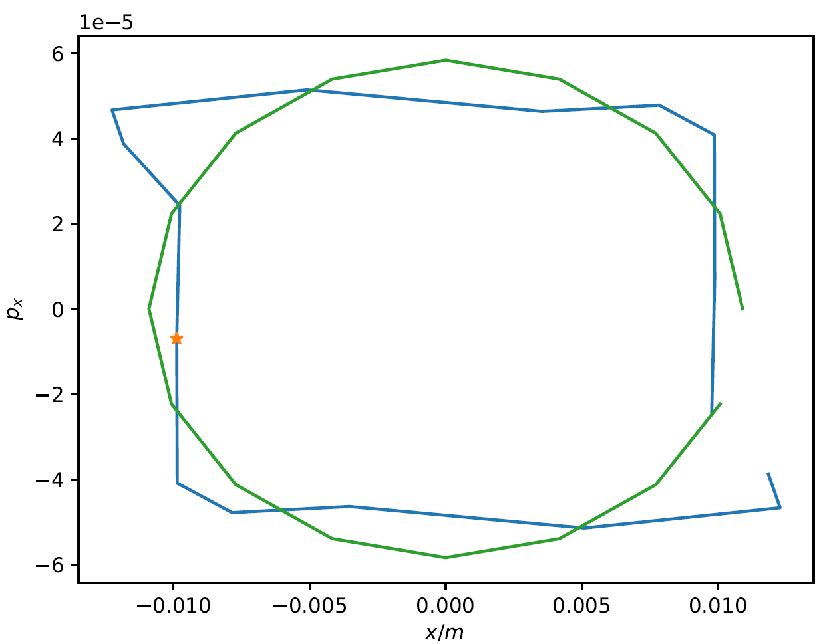
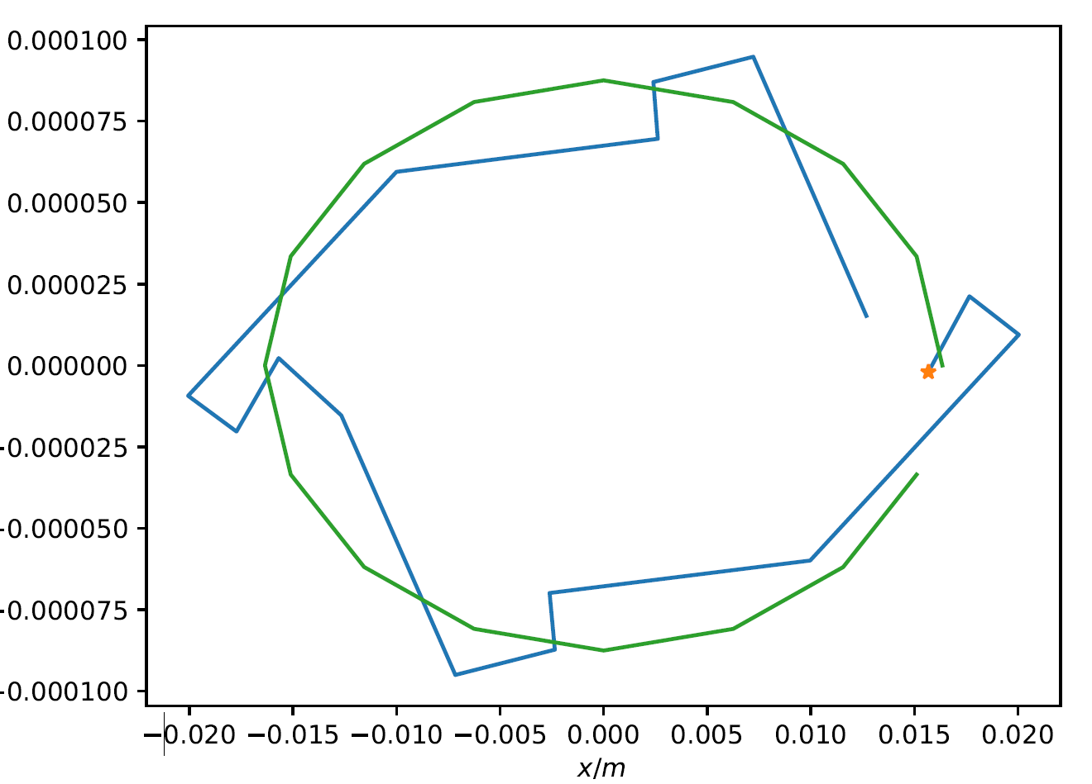



Particle projection – Drift Downstream
Green = particles initiated at RF marker
Blue = Particles downstream
Orange = Closest particle to x’ = 0
$$1σ_{x}$$
$$20σ_{x}$$
$$25σ_{x}$$

Slide 17
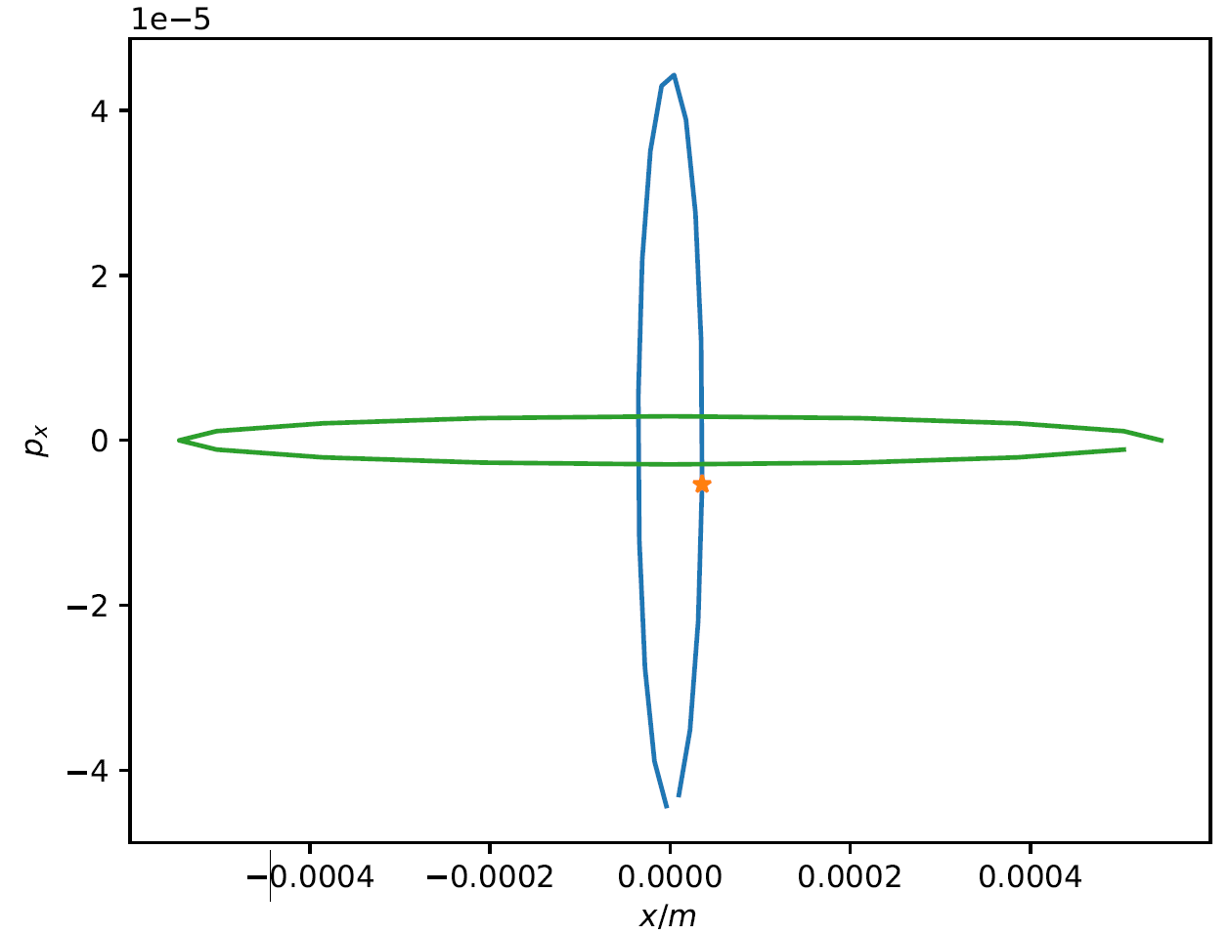
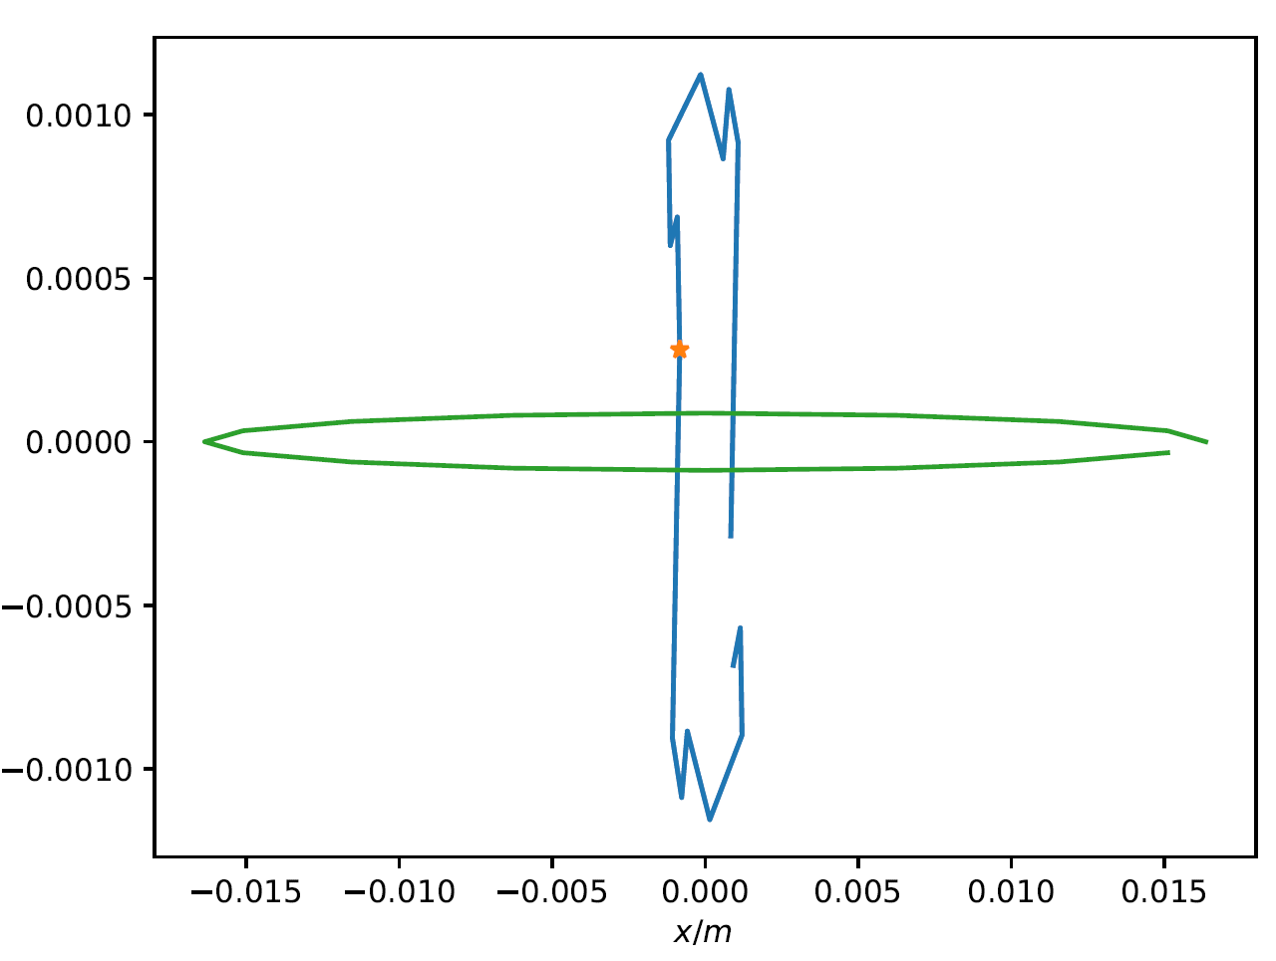


Particle projection – IP
Green = particles initiated at RF marker
Blue = Particles downstream
Orange = Closest particle to x’ = 0
$$1σ_{x}$$
$$20σ_{x}$$

Slide 18
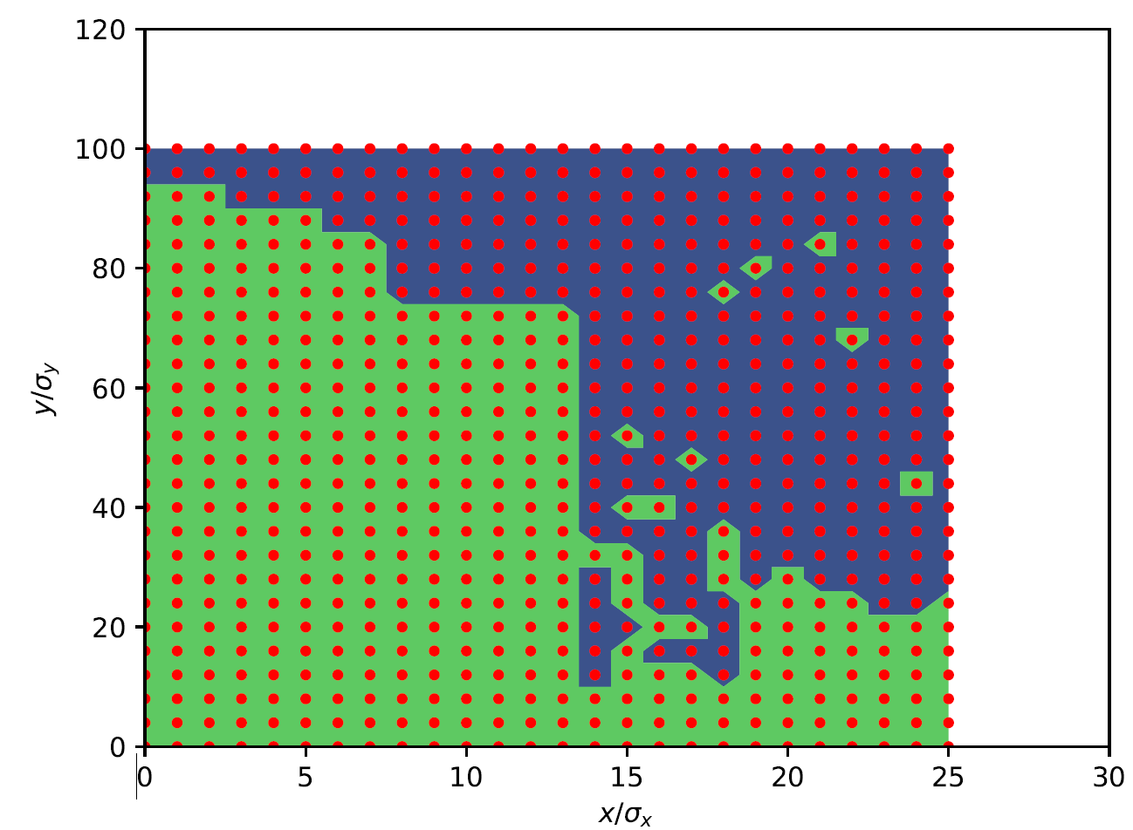
Same location 1 turn later…

Slide 19
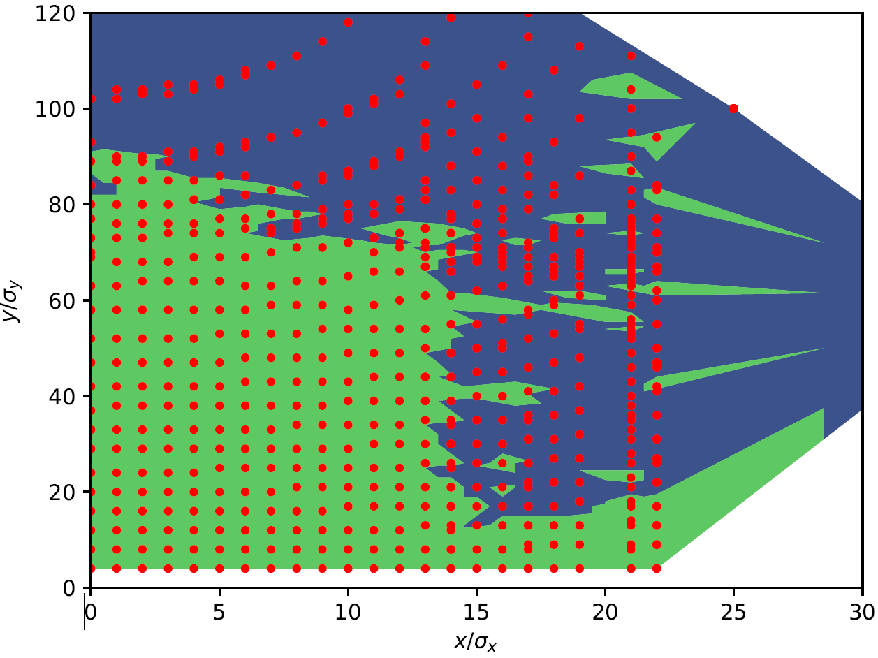
Same location 1 turn later…

Slide 20
Same location 1 turn later…

Slide 21
Dynamic Aperture Simulation
Simulation setup
Quantifying DA/MA
Highly damped motion
  Small amplitude within a few turns
  Not all combinations of $\left(x,x^{′},y,y^{′}\right)$ reached
Large DA ($>50σ$), strong sextupoles
  Highly non-linear
Angle dependant DA/Location Dependant DA
DA interpretation often by eye
  Not suitable for scans/optimisation
  Require a quantity defining size of DA
Large DA =/= large lifetime (necessarily)
  DA quantification should capture lifetime ideally

Slide 22


DA Quantification
Classical DA quantified by:
  Area of stable region
  Largest ellipse containing only stable particles
New method:
  Redefine “green points”
    All particles survived
    Fraction of particles survived
  Other quantification?
$$b$$
$$a$$

Slide 23
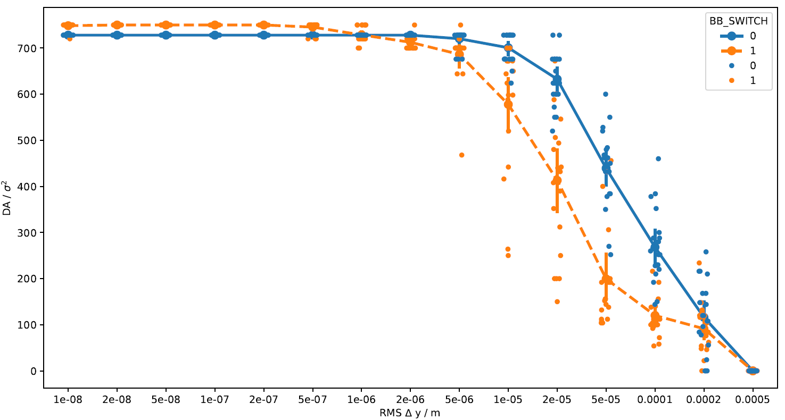
DA Quantification
Classical DA quantified by:
  Area of stable region
  Largest ellipse containing only stable particles
New method:
  Redefine “green points”
    All particles survived
    Fraction of particles survived
  Other quantification?

Slide 24

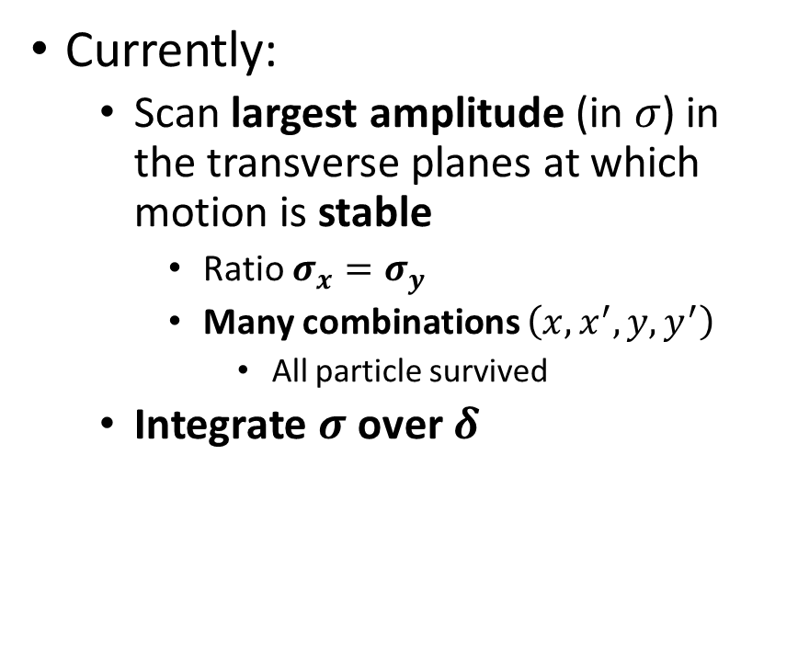


MA Quantification
Currently:
  Scan largest amplitude (in $σ$) in the transverse planes at which motion is stable
    Ratio $σ_{x}=σ_{y}$
    Many combinations $\left(x,x^{′},y,y^{′}\right)$
      All particle survived
  Integrate $σ$ over $δ$
$$x,y [σ]$$
$$δ$$
$$σ$$

Slide 25
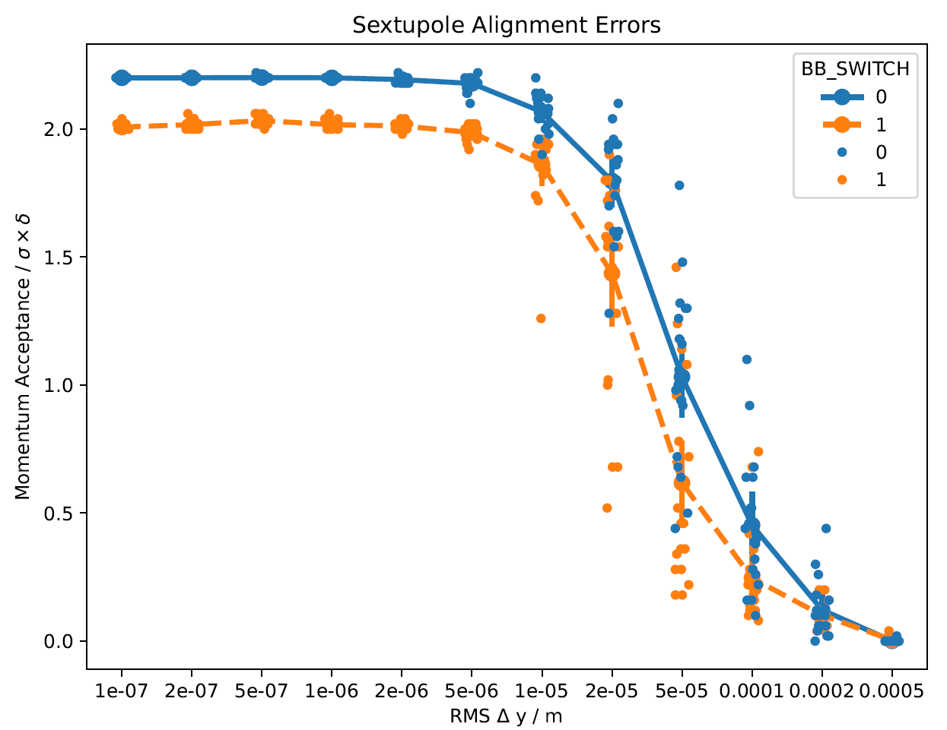
MA Quantification
Currently:
  Scan largest amplitude (in $σ$) in the transverse planes at which motion is stable
    Ratio $σ_{x}=σ_{y}$
    Many combinations $\left(x,x^{′},y,y^{′}\right)$
      All particle survived
  Integrate $σ$ over $δ$

Slide 26

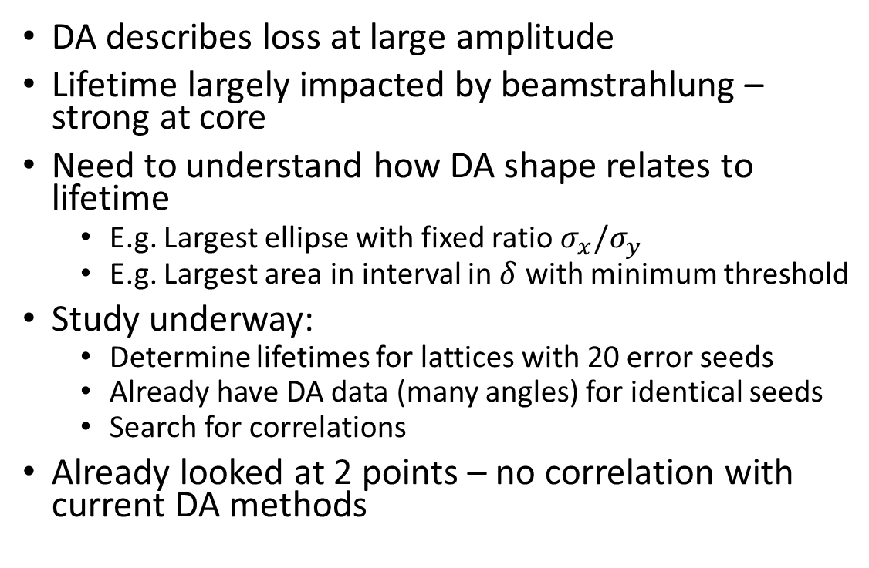



Correlation with Lifetime
$$x,y [σ]$$
$$δ$$
DA describes loss at large amplitude
Lifetime largely impacted by beamstrahlung – strong at core
Need to understand how DA shape relates to lifetime
  E.g. Largest ellipse with fixed ratio $σ_{x}/σ_{y}$
  E.g. Largest area in interval in $δ$ with minimum threshold
Study underway:
  Determine lifetimes for lattices with 20 error seeds
  Already have DA data (many angles) for identical seeds
  Search for correlations
Already looked at 2 points – no correlation with current DA methods
$$x,y [σ]$$
$$δ$$

