Slide 1

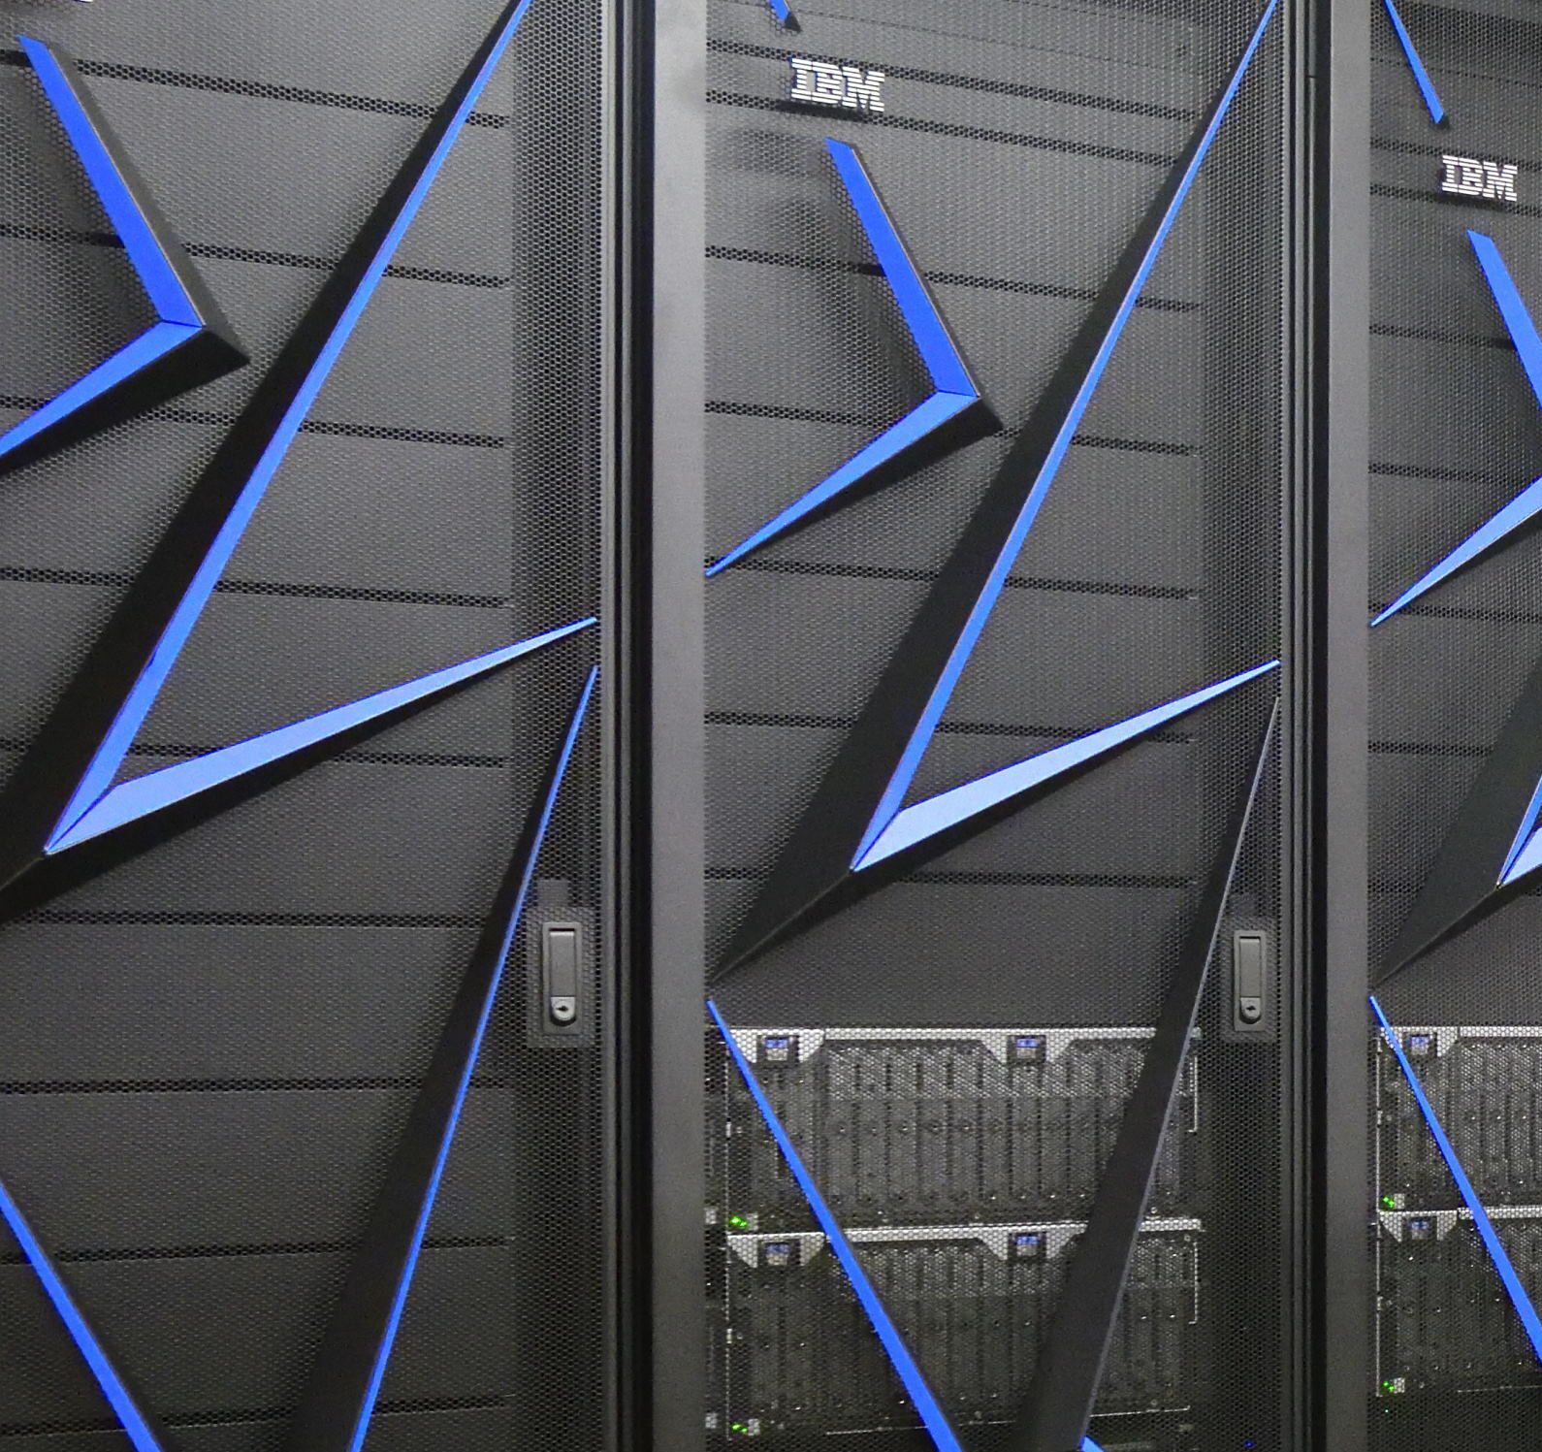
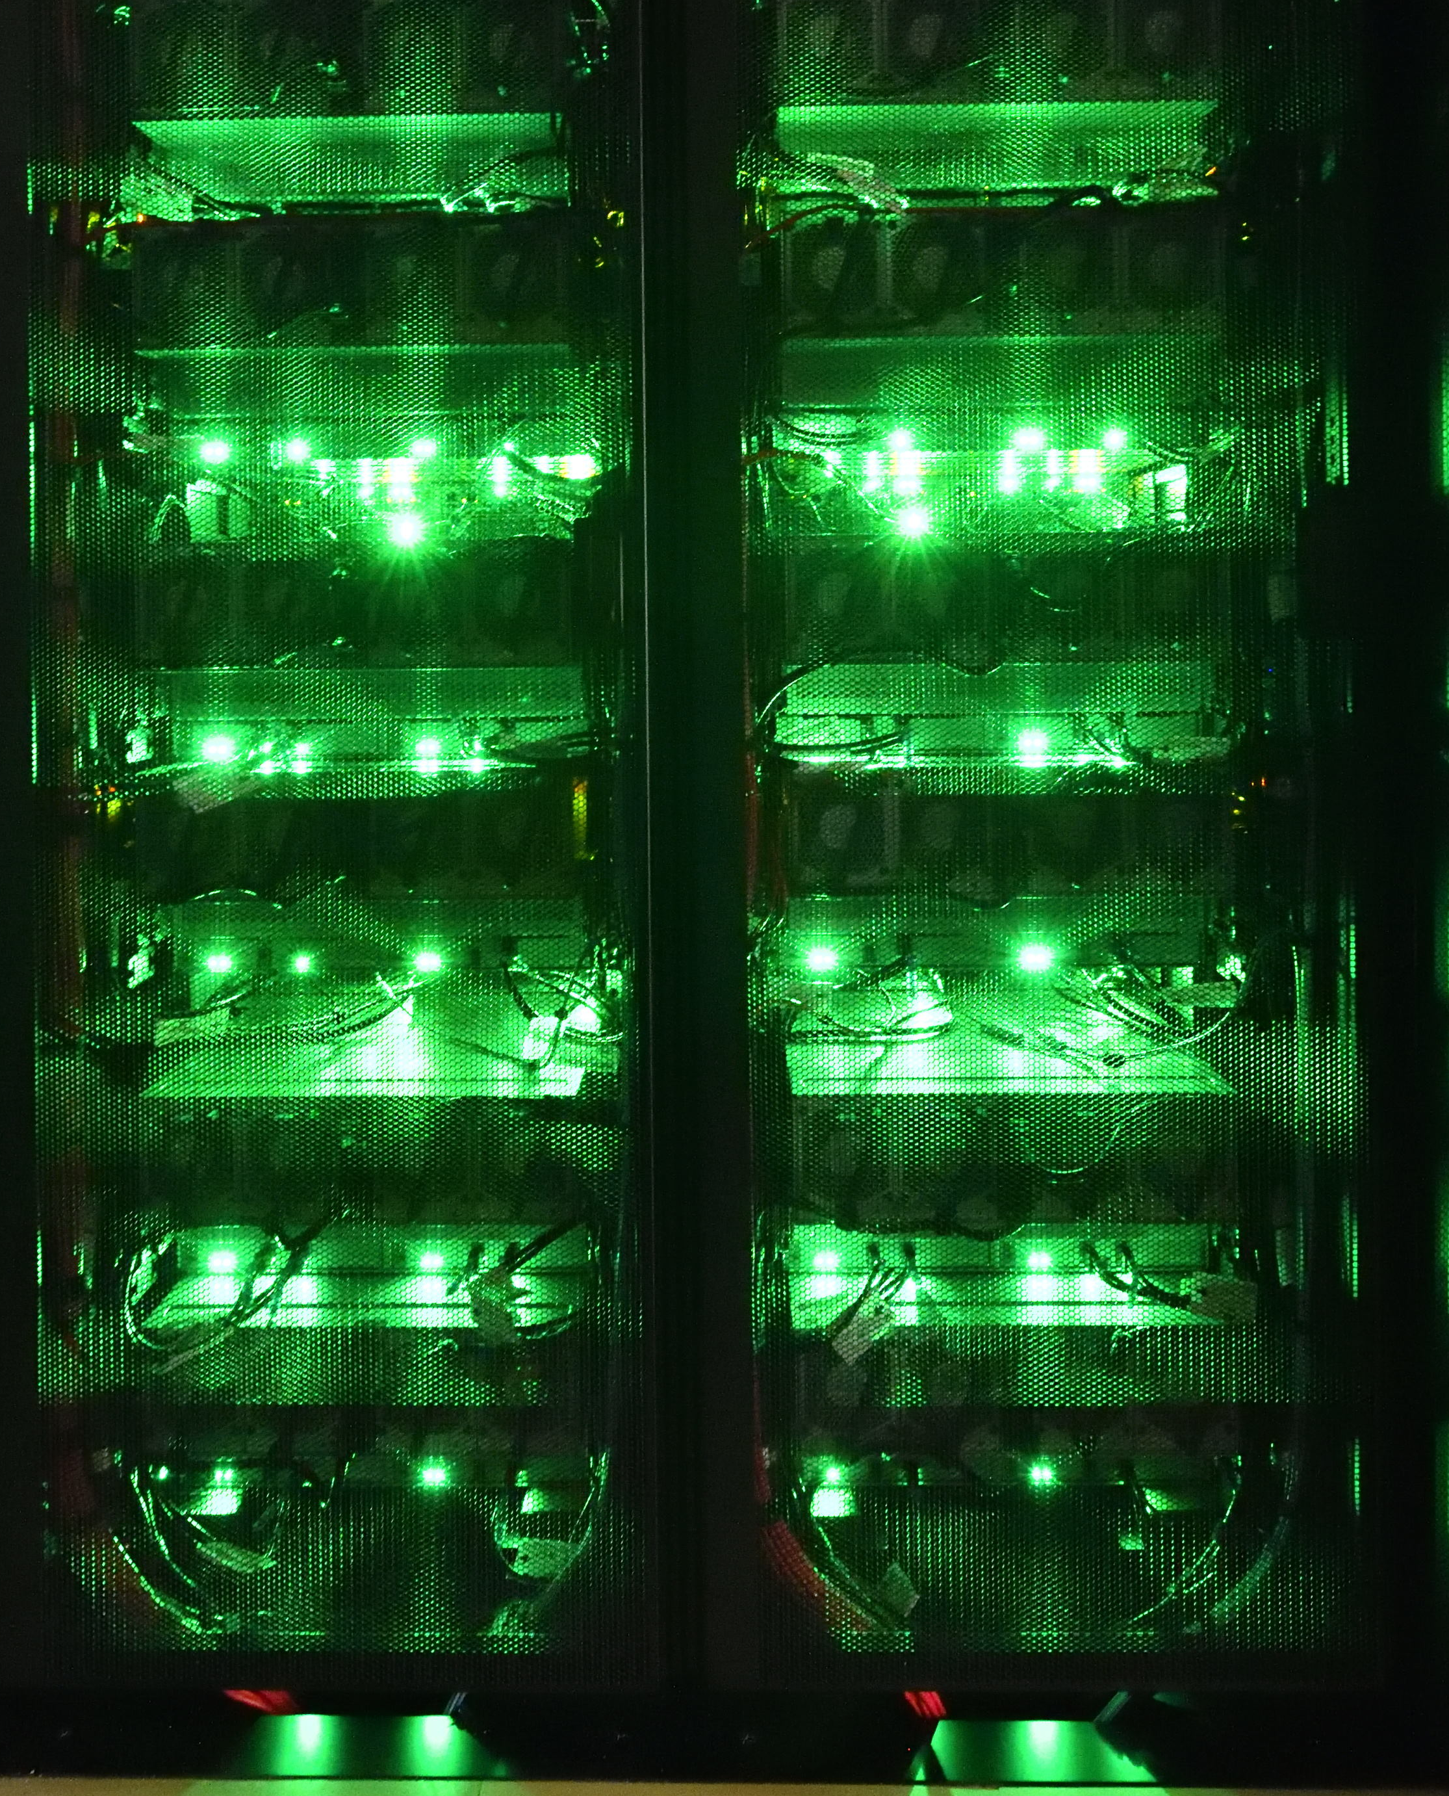



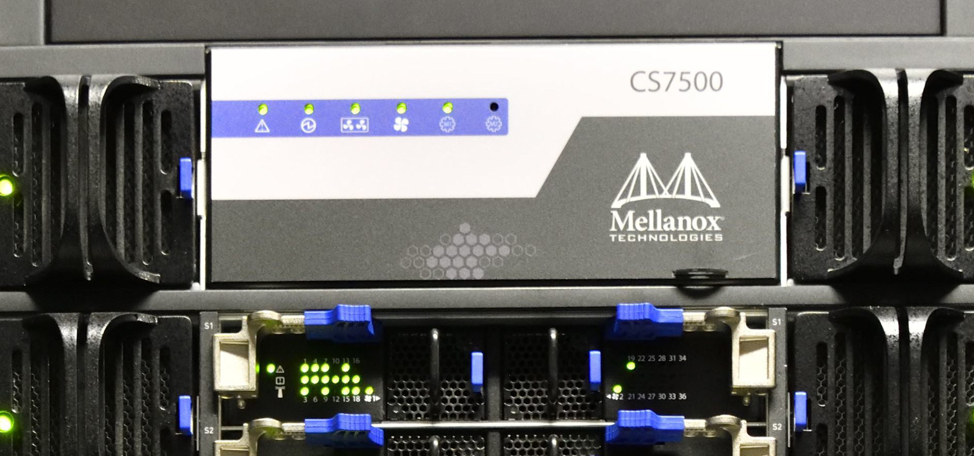

KEK Site Report
Go Iwai, T. Kishimoto, K. Murakami, T. Nakamura, and S. Suzuki
High Energy Accelerator Research Organization (KEK)
Computing Research Center (CRC)

Slide 2

KEKCC: A Largest Computer System
2024
Linux Cluster + Storage System (GPFS/HSM)
  Accommodate multiple experiments in a single system
In production since September 2024
CPU: 12,096 cores
  AMD EPYC 9654, 2.4 GHz (Base clock, up to 3.7 GHz)
  192 cores/node (2 CPU/node, 96 cores/node)
  63 calculation nodes
  382K HS23 (6K HS23/node @3.5 GHz Measured w/o SMT)
    LINPACK: R_{max}: 0.52 / R_{peak}: 0.45 (PFlop/s)
Memory: 56 TB
  4 GB/job
Disk: 30 PB
  20 PB: GPFS for experimental groups
  10 PB: GPFS-HPSS-Interface (GHI) as an HSM cache
Tape: 120 PB as maximum capacity
Grid instances are running in KEKCC

Slide 3

Site Scale Evolution
Resource History (Last 4-Gen)
+40% HEPScore
-20% cores
~382K HEPScore / 12K cores
48 PB in use as of Sep 2025
273K HEPscore / 15K cores
x1.4
x1.2
x4.0
Disk: 30 PB
+20%

Slide 4

More power with less energy
KEKCC-2020
KEKCC-2024
KEKCC-2024 | Upgrade Factor
Lenovo SR645v3
AMD EPYC 9654 (96cx2/node)
192 cores/server x 63 servers
RedHat EL9
Mellanox HDR100
IBM Elastic Storage System
30 PB (10 PB for HSM) | +20%
IBM TS1160 x70
20TB/vol, 400 MB/s
120 PB | +20%
-15%
KEKCC-2024: 40% more HS23 with 15% less power consumption than KEKCC-2020

Slide 5
Runtime in the Entire System
CPU time version is in backup slides
Low utilisation 6 months after system replacement
Almost fully utilised since March
Local batch jobs
Nearly 100% of jobs for Belle2

Slide 6

CPU efficiency (Only for Grid Jobs)
Runtime
CPU time
10% of KEKCC for 100% availability
50% efficiency

Slide 7

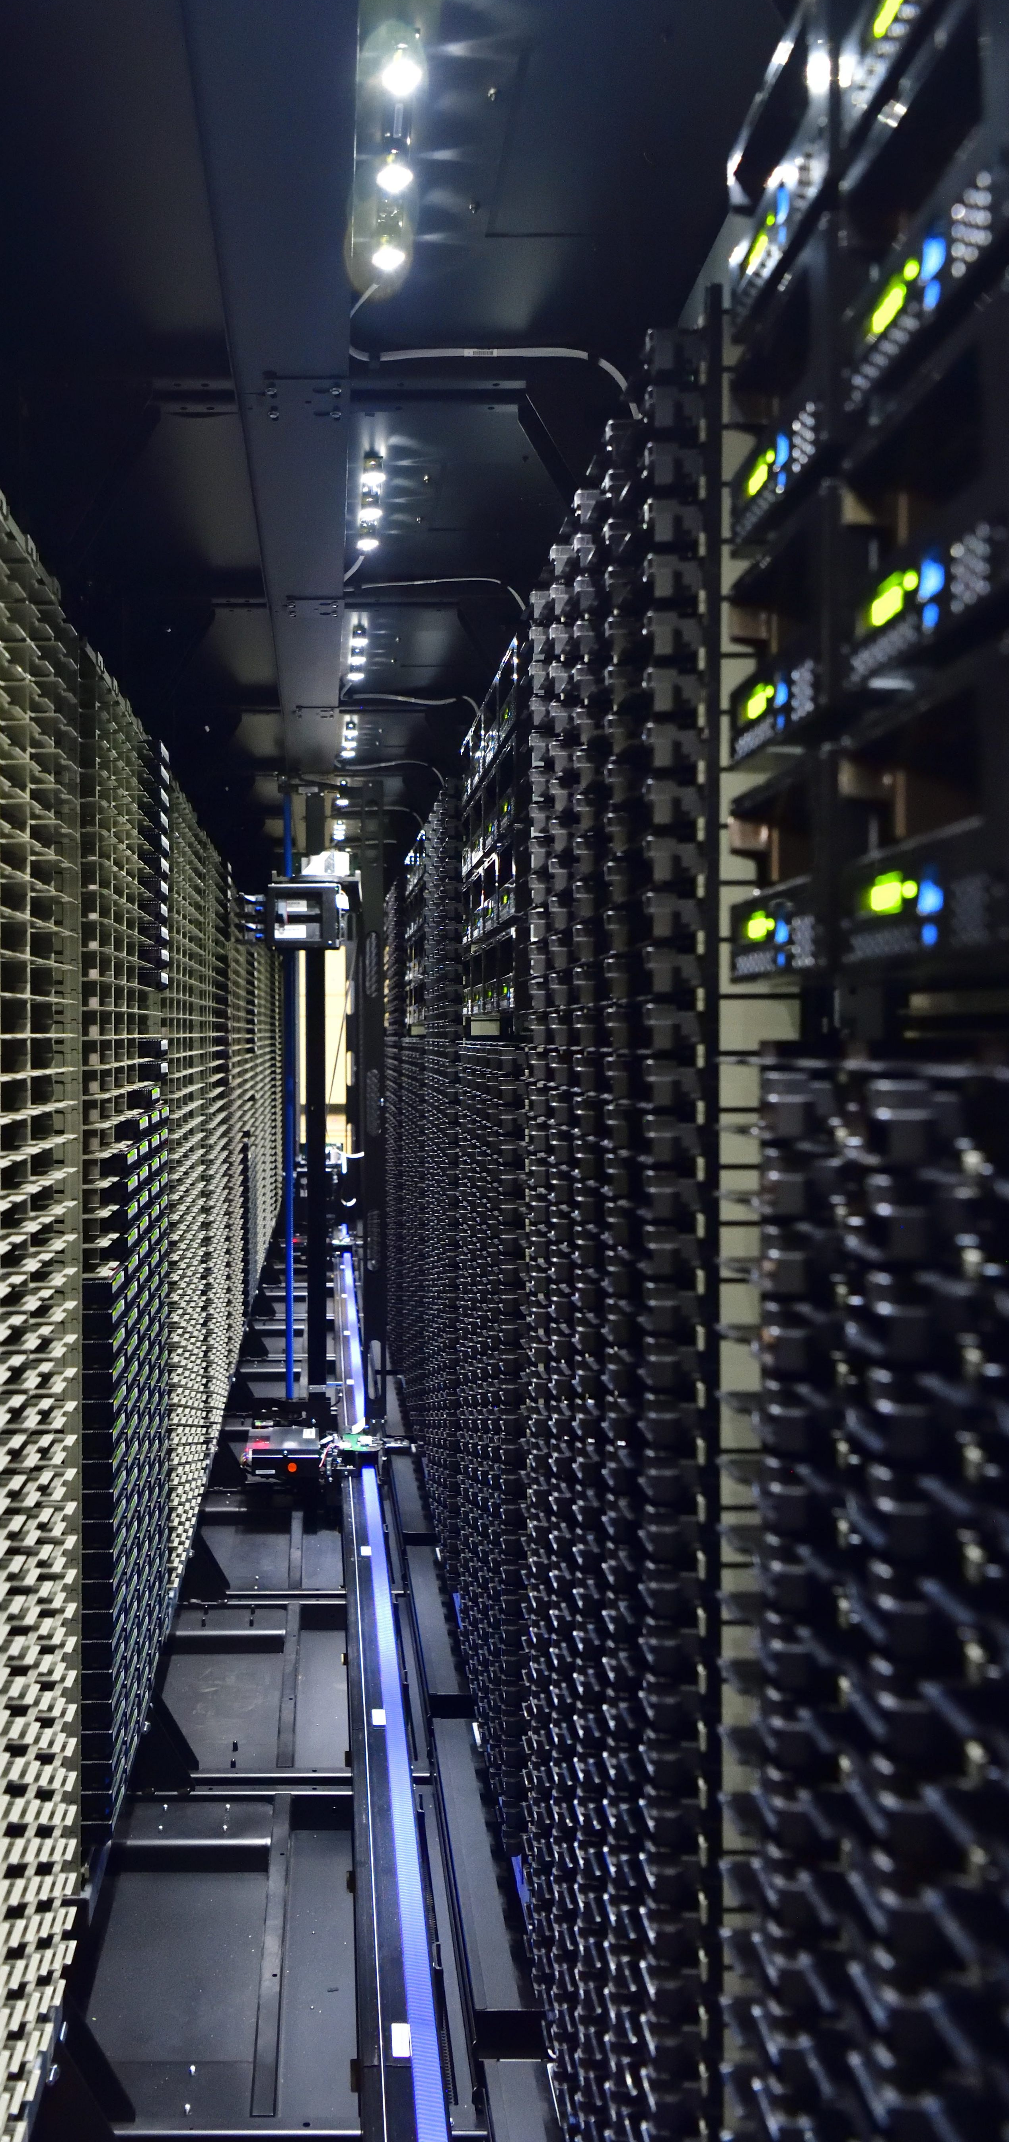

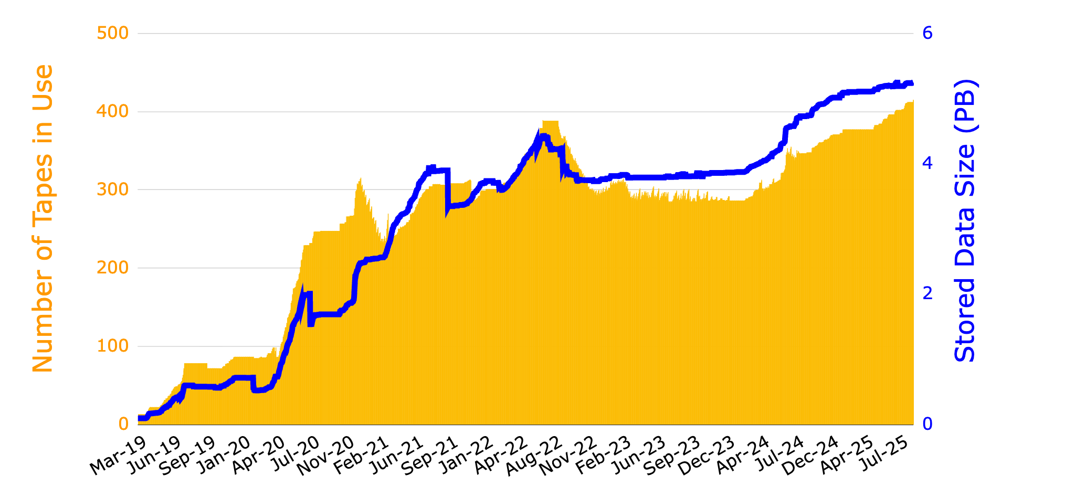
5 PB of Belle2 RAW data for 0.5 ab⁻¹ of total int. luminosity
* Belle2 RAW data centres: BNL, UVic, CNAF, DESY, KIT, and CCIN2P3
w/ HLT
Contributes 50%+ spatial reduction
Int. L: 0.5 ab⁻¹
2019a-b
0.5 PB
6 fb⁻¹
2019c
0.1 PB
4 fb⁻¹
2020a-b
1.5 PB
64 fb⁻¹
2020c
0.8 PB
16 fb⁻¹
2021a-b
1.4 PB
122 fb⁻¹
2021c
0.3 PB
54 fb⁻¹
2022a-b
0.8 PB
160 fb⁻¹
LS1
1.5 Years
2024a-b
0.8 PB
106 fb⁻¹
2024c
1.2 PB
45 fb⁻¹
5.3
415
Garbage Collection
at the sharp drop-off
w/o SROOT-ROOT conversion
Replaced rsync with xrootd

Slide 8
Networking
Network hardware replacement in summer 2025
International network backbone

Slide 9



SINET
Sep 2024
XPDR
Ciena 6500
10G-SR
100G-SR4
10G-SR
KEKCC
FW SRX4100
Outer SW 2
ARISTA 7280
MLAG
Outer SW 1
ARISTA 7280
100G-SR4
10G-SR
KEK
SINET
J-PARC SW
Ethernet2/48
Ethernet3/48
Ethernet6/45
Ethernet7/45
Ethernet12/23
10G-LR
10G-LR
10G-SR
KEKCC SW
Nexus 9516
KEK FW 2
PA
KEK FW 1
PA
LHCONE
J-PARC
Ethernet1/22
Ethernet6/47
Ethernet7/47
Ethernet12/22
Ethernet2/51
J-PARC Router
Core SW 2
N9K
vPC
Core SW 1
N9K
Grid System
KEK Campus Network
J-PARC Campus Network
Replaced in summer 2025!

Slide 10
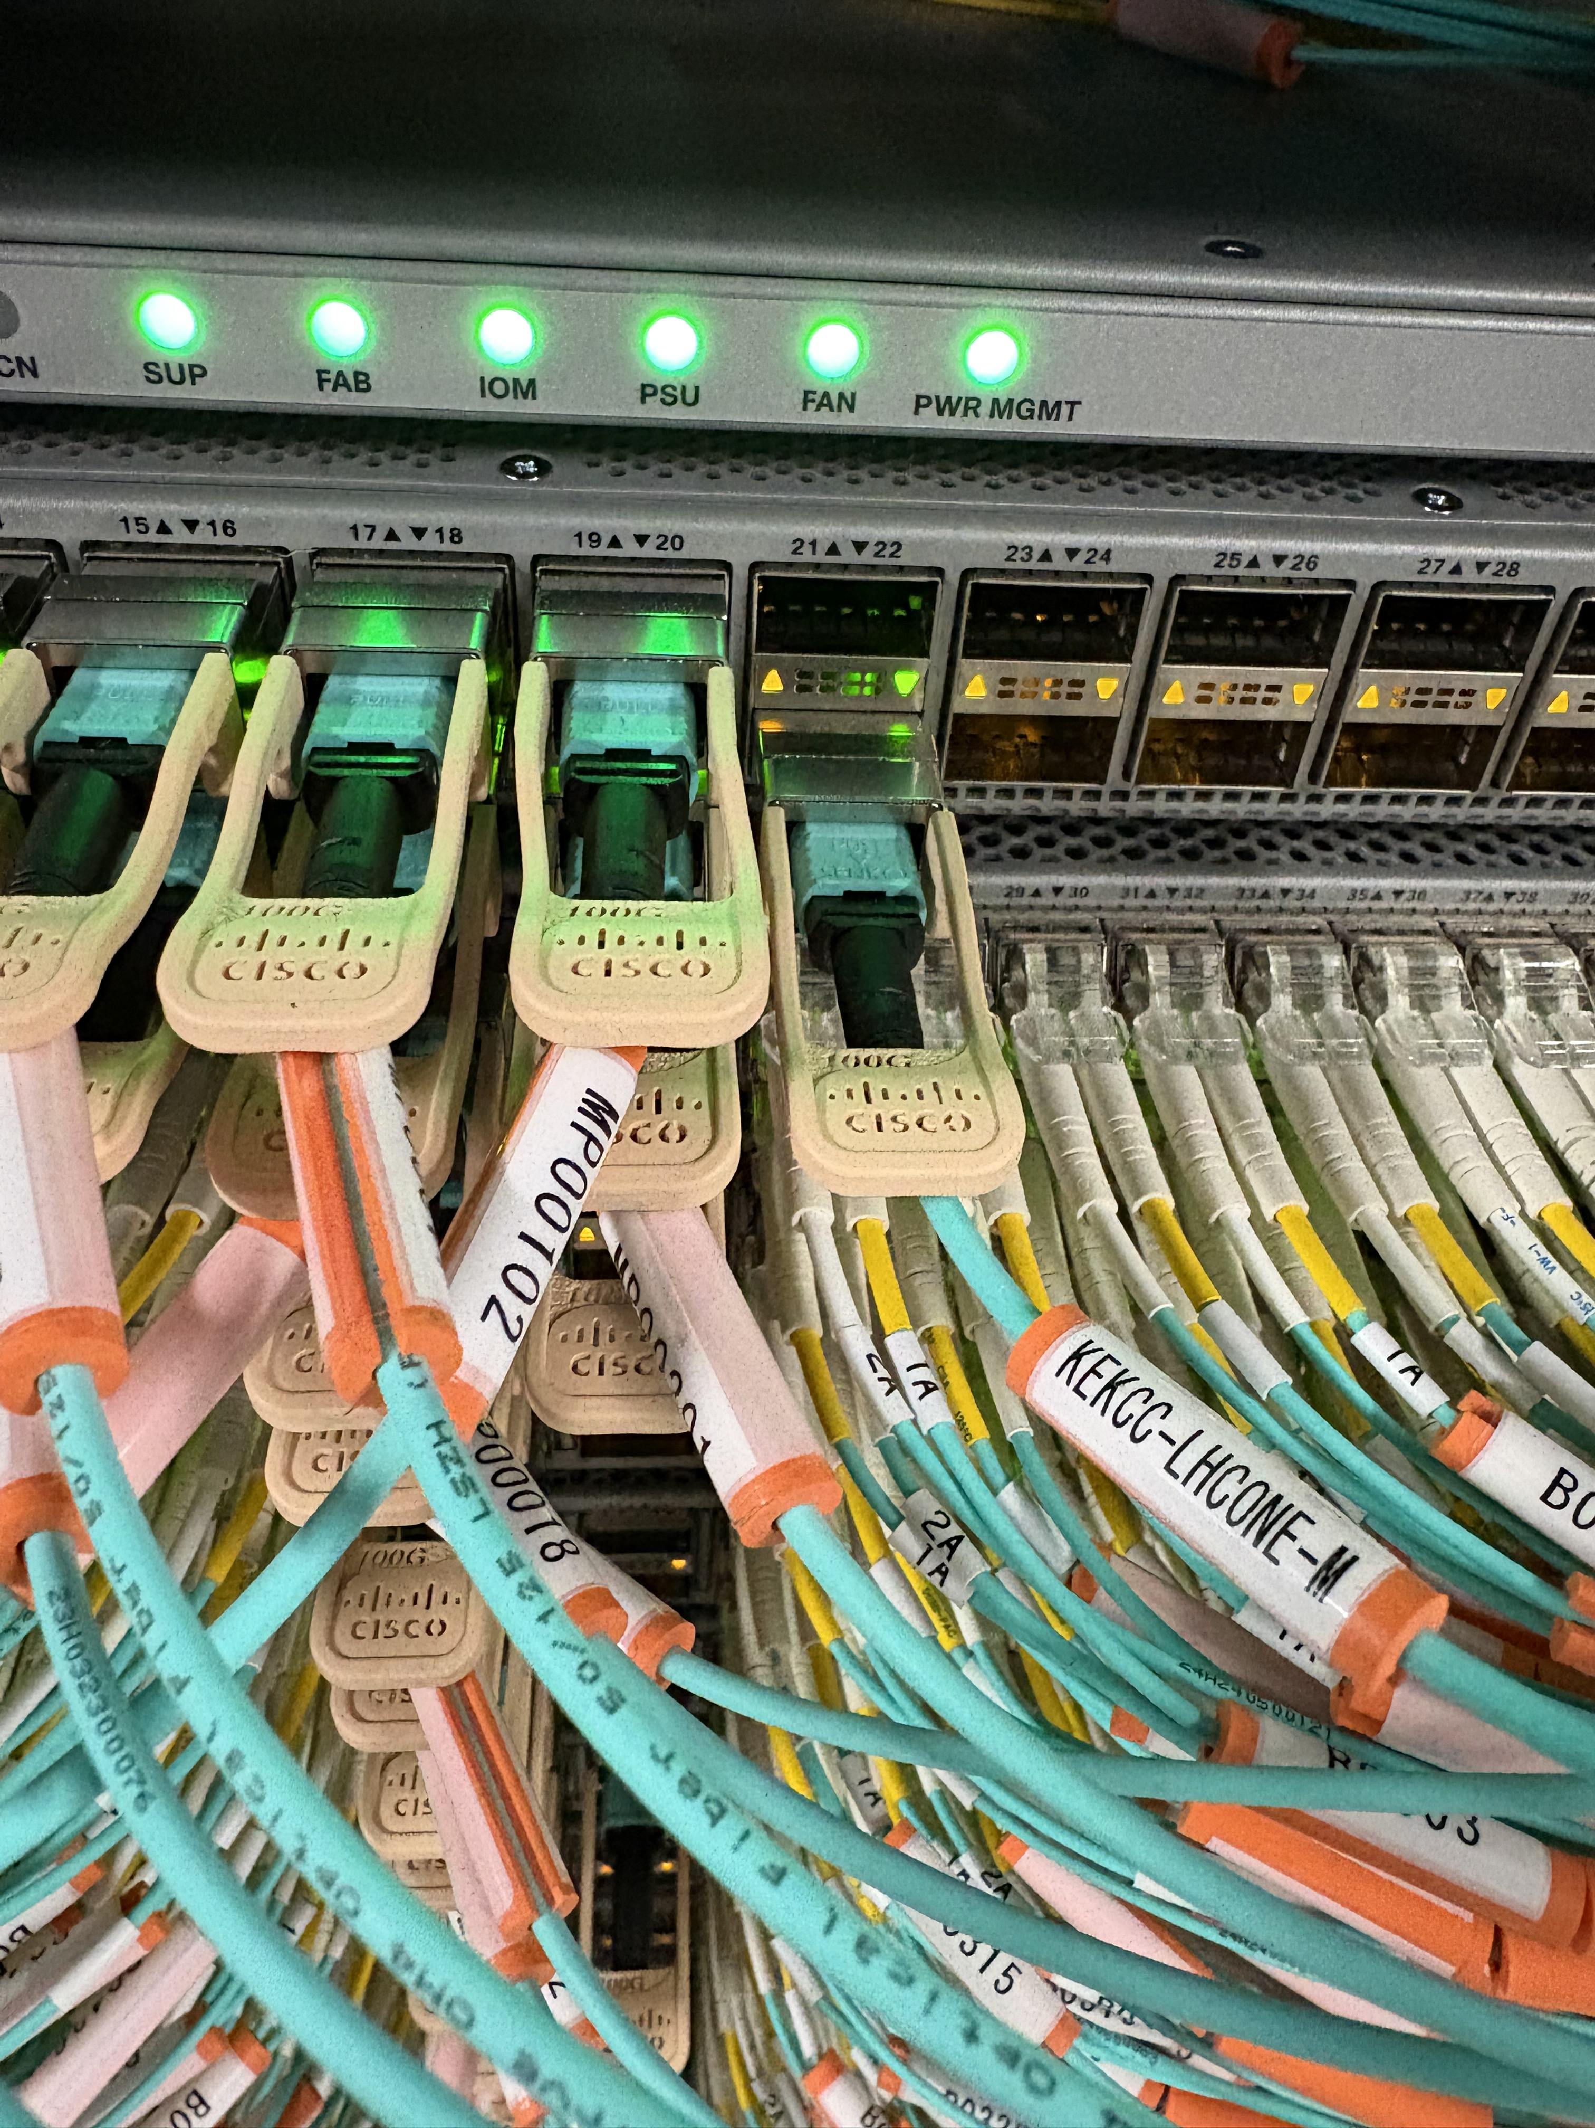
SINET
Aug 2025
No change in total bandwidth before and after update (100G for LHCONE, 10G for Non-LHCONE traffic).
XPDR
Ciena 6500
LHCONE
ARISTA 7280
100G-SR4
10G-SR
10G-SR
KEKCC
FW SRX4100
Outer SW 1
Catalyst 9500
Outer SW 2
Catalyst 9500
100G-SR4
Stack
10G-SR
KEK
SINET
J-PARC SW
Ethernet2/48
Ethernet3/48
Ethernet6/45
Ethernet7/45
Ethernet12/23
10G-LR
10G-LR
10G-SR
KEKCC SW
Nexus 9516
KEK FW 1
PA5410
KEK FW 2
PA5410
LHCONE
J-PARC
Ethernet1/22
Ethernet6/47
Ethernet7/47
Ethernet12/22
Ethernet2/51
J-PARC Router
Core SW 1
C9K
vPC
Core SW 2
C9K
Grid System
KEK Campus Network
J-PARC Campus Network
Bandwidth Bottleneck

Slide 11
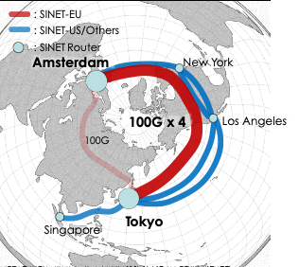
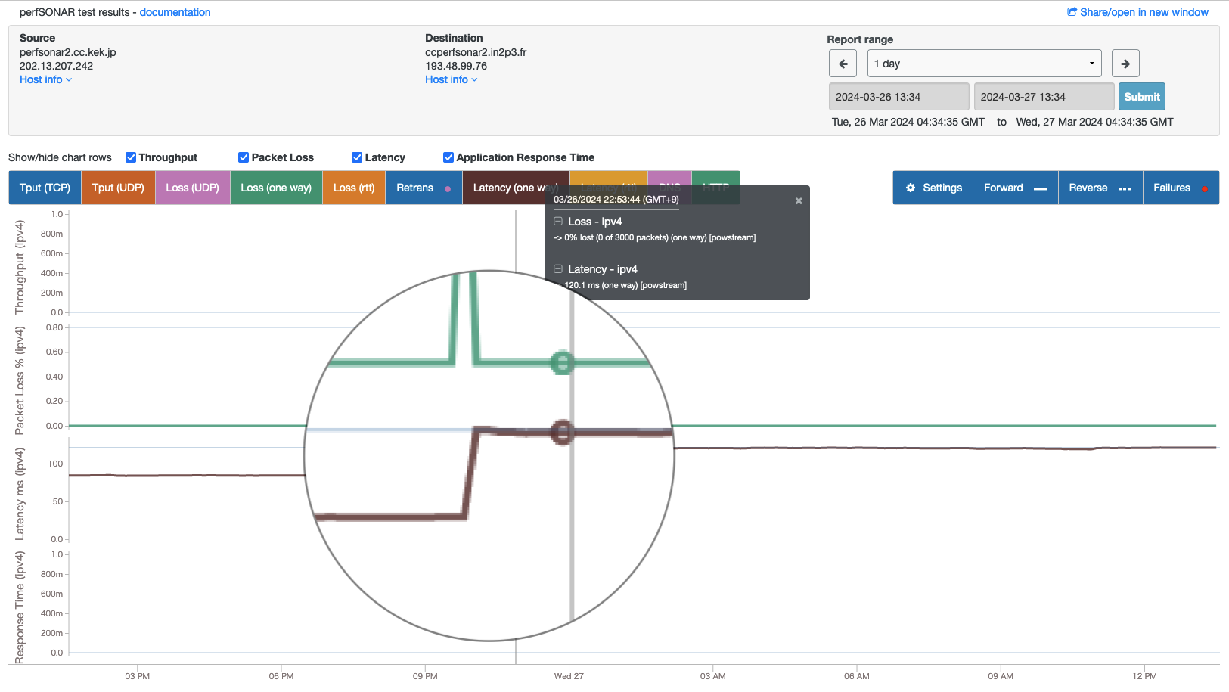
Recap: International Network Route Transatlantic Back Again
March 2024
Siberian 100G route for Euro has been upgraded to the transatlantic route with 100G x4 lines
Dedicated line for the traffic between Japan and Euro, not shared with traffic for the US
To minimise the latency:
  traffic passes through fewer routers on the shortest route close to the Arctic
Upgraded Feb 2019
Planned 100G x2+
84 ms to 120 ms for CC-IN2P3, Lyon, Fr
+50% longer
Topic Today!
Changed on 26th March, 2024

Slide 12
JGN: Tokyo Hong Kong Line
Japan Gigabit Network (JGN) has been another LHCONE traffic backbone between Tokyo and Hong Kong for specific Asian sites, e.g., KISTI, ASGC, and IHEP, for a decade
  JGN is operated by NICT (MIC) but not NII (MEXT), our primary NREN provider
Decommissioned in December 2025
  Thank JGN for long-standing stable operation!

Slide 13

S. Suzuki @ATCF9

Slide 14
Grid Service Deployment Status
OS migration RHEL7 to RHEL9
Data transfer test in summer 2025

Slide 15

Service Deployment as of Sep 2024
RHEL7 with ELS running a lot
as Belle2 dedicated
Service | Service | OS | VM/Bare metal | Ethernet | IPv6 | HA | UPS
 | StoRM | RHEL7 + ELS | Bare metal | 10GE | ✅ | ✅
 | VOMS | RHEL7 + ELS | VM | 10GE | ✅ | ✅ | ✅
 | IAM | RHEL9 | Bare metal | 10GE | ✅ | ✅ | ✅
 | AMGA | RHEL7 + ELS | Bare metal | 10GE | ✅ | ✅ | ✅
 | Top BDII | RHEL9 | VM | 10GE | ✅ | ✅ | ✅
 | Site BDII | RHEL9 | VM | 10GE | ✅ | ✅ | ✅
 | FTS3 | RHEL9 | VM | 10GE | ✅ | ✅ | ✅
 | ARC-CE | RHEL7 + ELS | Bare metal | 10GE | ✅ | ✅
 | CVMFS Stratum Zero | RHEL9 | Bare metal | 10GE | ✅ | ✅
 | CVMFS Stratum One | RHEL7 + ELS | Bare metal | 10GE | ✅ | ✅
 | CVMFS publisher | RHEL9 | VM | 10GE | ✅
 | Frontier Squid HTTP Proxy | RHEL9 | VM | 10GE | ✅ | ✅ | ✅

Slide 16


Decommissioning GridFTP, then SRM
As of March 2025
Turned off GridFTP in January, SRM in March
as Belle2 dedicated
Service | Service | OS | VM/Bare metal | Ethernet | IPv6 | HA | UPS
 | StoRM | RHEL7 + ELS | Bare metal | 10GE | ✅ | ✅
 | VOMS | RHEL7 + ELS | VM | 10GE | ✅ | ✅ | ✅
 | IAM | RHEL9 | Bare metal | 10GE | ✅ | ✅ | ✅
 | AMGA | RHEL7 + ELS | Bare metal | 10GE | ✅ | ✅ | ✅
 | Top BDII | RHEL9 | VM | 10GE | ✅ | ✅ | ✅
 | Site BDII | RHEL9 | VM | 10GE | ✅ | ✅ | ✅
 | FTS3 | RHEL9 | VM | 10GE | ✅ | ✅ | ✅
 | ARC-CE | RHEL7 + ELS | Bare metal | 10GE | ✅ | ✅
 | CVMFS Stratum Zero | RHEL9 | Bare metal | 10GE | ✅ | ✅
 | CVMFS Stratum One | RHEL9 (Mar ‘25) | Bare metal | 10GE | ✅ | ✅
 | CVMFS publisher | RHEL9 | VM | 10GE | ✅
 | Frontier Squid HTTP Proxy | RHEL9 (Minor fix) | VM | 10GE | ✅ | ✅ | ✅

Slide 17
Ongoing migration campaign to RHEL9
As of September 2025
as Belle2 dedicated
Migrated to SciTags-enabled DTNs on RHEL9
Service | Service | OS | VM/Bare metal | Ethernet | IPv6 | HA | UPS
 | StoRM | RHEL9 (Sep ‘25) | Bare metal | 10GE | ✅ | ✅
 | VOMS | RHEL7 + ELS | VM | 10GE | ✅ | ✅ | ✅
 | IAM | RHEL9 | Bare metal | 10GE | ✅ | ✅ | ✅
 | AMGA | RHEL7 + ELS | Bare metal | 10GE | ✅ | ✅ | ✅
 | Top BDII | RHEL9 | VM | 10GE | ✅ | ✅ | ✅
 | Site BDII | RHEL9 | VM | 10GE | ✅ | ✅ | ✅
 | FTS3 | RHEL9 | VM | 10GE | ✅ | ✅ | ✅
 | ARC-CE | RHEL7 + ELS | Bare metal | 10GE | ✅ | ✅
 | CVMFS Stratum Zero | RHEL9 | Bare metal | 10GE | ✅ | ✅
 | CVMFS Stratum One | RHEL9 | Bare metal | 10GE | ✅ | ✅
 | CVMFS publisher | RHEL9 | VM | 10GE | ✅
 | Frontier Squid HTTP Proxy | RHEL9 | VM | 10GE | ✅ | ✅ | ✅

Slide 18
Transfer Volume from/to StoRM
(Not Including Internal Data Transfer)
Data transfer test several times before OS migration
Regularly a few 100 TB in a month
5 PB
4 PB

Slide 19
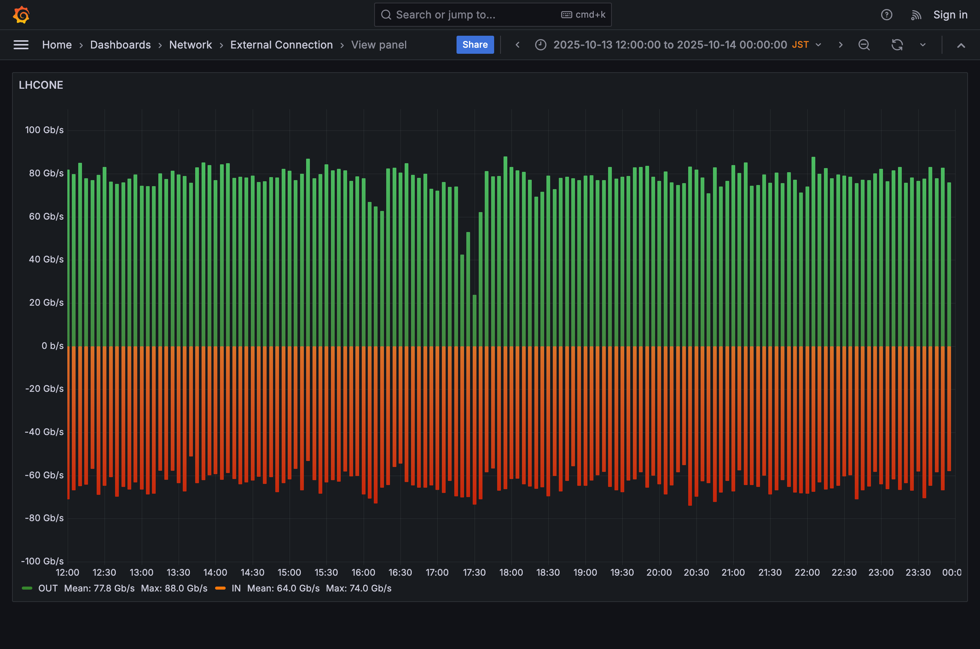
Half a day data transfer test between KEK and Belle2 RDCs (BNL, UVic, CNAF, DESY, KIT, and CCIN2P3)
Average throughput: 80 Gbps in both directions
The bottleneck at 100G
Most likely saturated at FTS optimisation limit (could be improved)
KEK→RDCs: 77.8 Gb/s Max: 88.0 Gb/s
80 Gbps
80 Gbps
RDCs→KEK: Mean: 64.0 Gb/s Max: 74.0 Gb/s

Slide 20
Authentication and Authorisation
New CA is in production
Migrating X.509/VOMS to JWT/IAM

Slide 21
KEK Grid CA and beyond
20 years operation
3.8K user certs
4.5K host certs
Initially only for domestic users, then extend the service for specific experiment members outside Japan, e.g.: Belle2
CA’s root certificate will expire soon (in this month)
Expected to migrate from X.509 to JWT authentication by the date – Unfortunately not!
Launched a new CA (KEK Grid CA 2024) in September 2025 to continue X.509-based auth. for the next few years
  Accredited and included in the latest EGI Trust Anchor v1.137 (Sep 15, 2025)
  New root certificate has longer validity and a signature signed by a more secure algorithm, i.e.: SHA-2
  The current root certificate is signed by SHA-1, which NIST has disallowed 10+ years ago

Slide 22

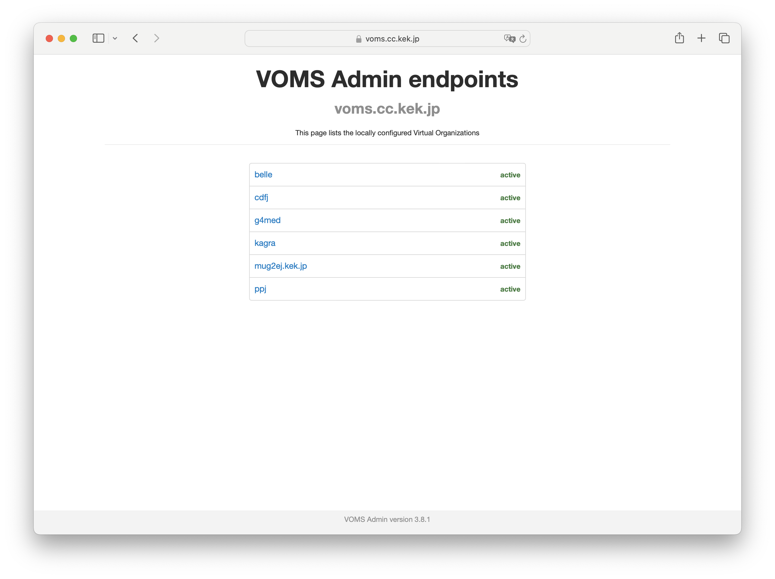



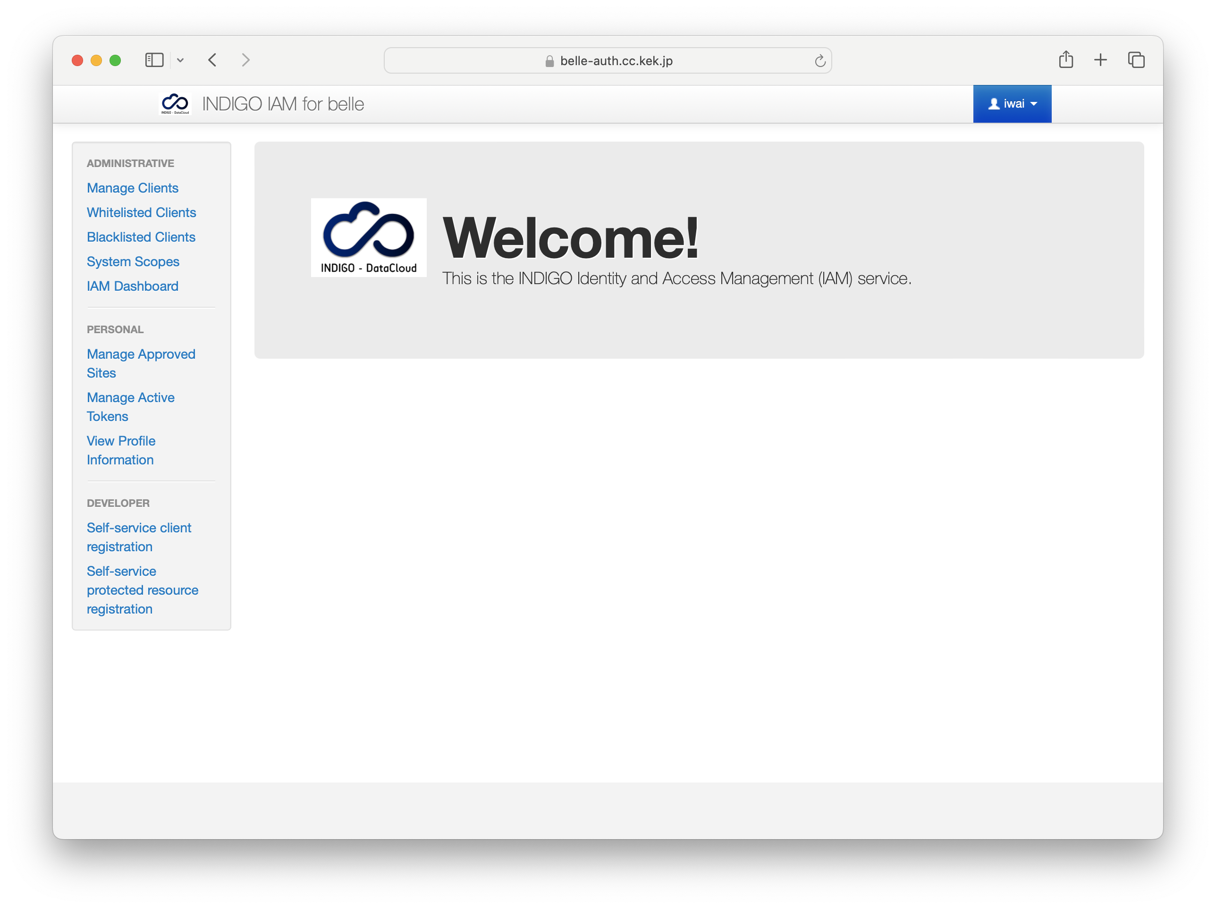

Migrating X.509/VOMS to JWT/IAM
User registration process, co-working with IAM
Registration Service
Personal identification with X.509
IAM instances have been deployed for Belle2
  Verified some basic use cases (TPC with FTS) using token-based authentication
  Will have mini-DC using JWT to be ready for co-operated Data Challenge between Belle2 and Hyper-K in 2027
In transition phase toward Token-only AuthNZ:
  Currently, VOMS registration service for personal identification with X.509, then synchronise to IAM
  Started IAM as VOMS (with VOMS AA) authentication in September 2025
  Still highly rely on X.509 (CA)
Need to replace CA’s functions such as: in-person personal identifiy verification
  Developing KEK’s institutional IdP to federate with GakuNin – the academic ID federation, lead by NII, (and eduGain)
  Plan to upgrade IAL2 (Identity Assurance Level 2)
  Then, move forward decommissioning VOMS and CA
VOMS
X.509 proxy cert issuer
Periodic sync.
Request tokens, or VOMS cert
IAM
Token provider

Slide 23
Summary
KEKCC has been in production in September 2024
  Just completed the first year of four-year contract
  ☺ Well utilised (~90%)
OS migration campaign to RHEL9 is ongoing
  Completed: CVMFS and StoRM DTNs
  Achieved 80+ Gbps throughput between KEK and B2RDCs
    Belle II HL scenario: 40 TB/day (3.7 Gbps)
APAN-JP (AS7660) will take over operating the Tokyo-HKIX link from JGN in 2026
A new CA (KEK Grid CA 2024) has been successfully launched in September 2025!
  Ongoing to deploy IdP for migrating to JWT/IAM

Slide 24

Thank you for your attention!

