Slide 1
HEPiX IPv6 WG - status report
Bruno Hoeft
Karlsruhe Institute of Technology

Slide 2
On behalf of all members of the HEPiX
IPv6 working group - (many thanks all!)
G Attebury (UNL), M Babik (CERN), M Bly (RAL), N Buraglio (ESnet), D Carder (ESnet), T Chown (Jisc), J Chudoba (FZU Prague), P DeMar (FNAL), A Fernandez Casani (IFIC/LHCb), J Flix Molina (PIC), A Forti (Manchester, ATLAS),C Grigoras (CERN/ALICE), B Hoeft (KIT), H Ito (BNL), D P Kelsey (RAL), E Martelli (CERN), S McKee (U Michigan), C Misa Moreira (CERN), K Ohrenberg (DESY), F Prelz (INFN), D Rand (Imperial), A Sciabà (CERN/CMS), T Skirvin (FNAL), M Wadenstein (NDGF), C J Walker (Jisc), S Zeng (IHEP)
Many more in the past, and members join/leave from time to time
many thanks also to WLCG operations, WLCG sites, LHC experiments, networking teams, monitoring groups, storage developers…

Slide 3
Outline
The HEPiX IPv6 working group and WLCG
Short report on IPv6 at data storage
Ongoing IPv6 on CPU & worker nodes GGus campaign
Still issue: Identifying and removing use of IPv4
Plans for IPv6-only WLCG
Summary

Slide 4
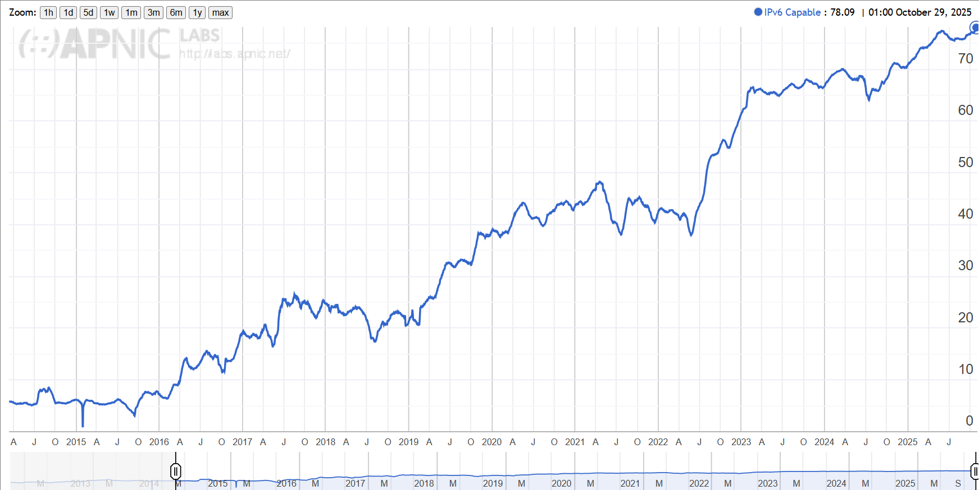
Use of IPv6 on Internet - (from APNIC)
A general plot - not HEP/WLCG etc
Use of IPv6 for France (FR)

Slide 5
HEPiX IPv6 working group History and drivers for use of IPv6
2011-2016 - analysis, investigations, testbed, fix storage
2017-2023 - deploy IPv6 on WLCG data storage
2023 onwards - deploy IPv6 on CPU services and WLCG clients
Sites running out of routable IPv4 addresses
To be ready to support use of IPv6-only CPU clients
Other drivers for IPv6:
scitags.org – packet marking (in header of IPv6 packets)
USA Federal Government – directive on “IPv6-only” (Nov 2020)
Global Research Networking - single protocol easier to manage

Slide 6
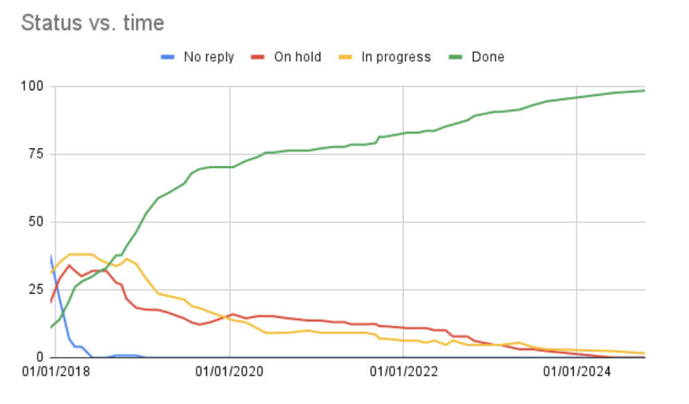
IPv6 on WLCG Storage (Tier2s)
“IPv6 on storage services”
2017 to 2023
Goal to support IPv6-only WNs
Now complete
But took lots of time!
Status always visible from a twiki page

Slide 7
IPv6 on CPU services and Worker Nodes
https://twiki.cern.ch/twiki/bin/view/LCG/WlcgIpv6

Slide 8
CPU - GGUS support ticket campaign
Eliminate IPv4 data transfers - between WNs and remote storage
Approved by WLCG MB in October 2023
“Please deploy dual-stack connectivity (IPv4+IPv6) on your computing services (computing elements and worker nodes) as soon as possible and by 30 June 2024 at the latest”
Reasons for delay include
New data centres, new hardware, OS updates
Other priorities - AuthZ Tokens, End of life CentOS 7
Nvidia Skyway Infiniband gateway - no support yet for IPv6

Slide 9
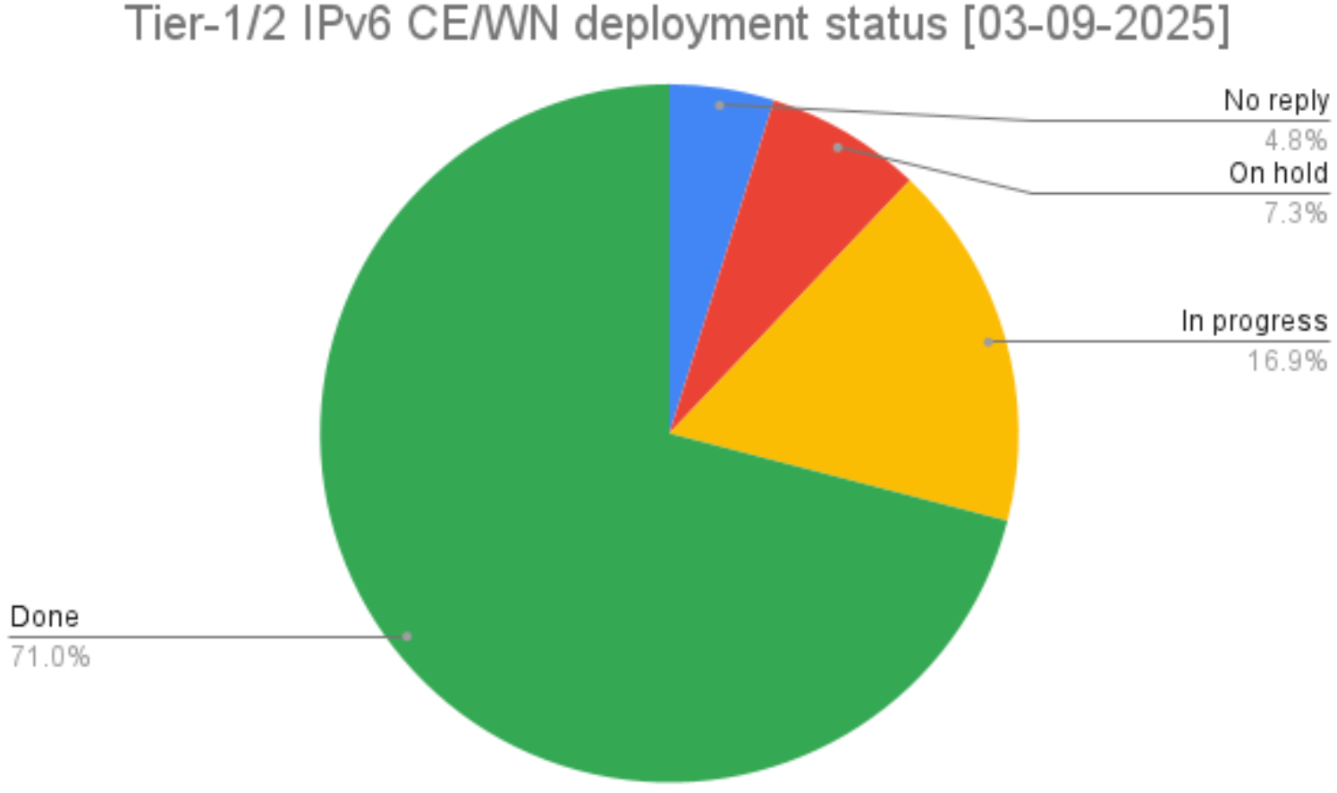
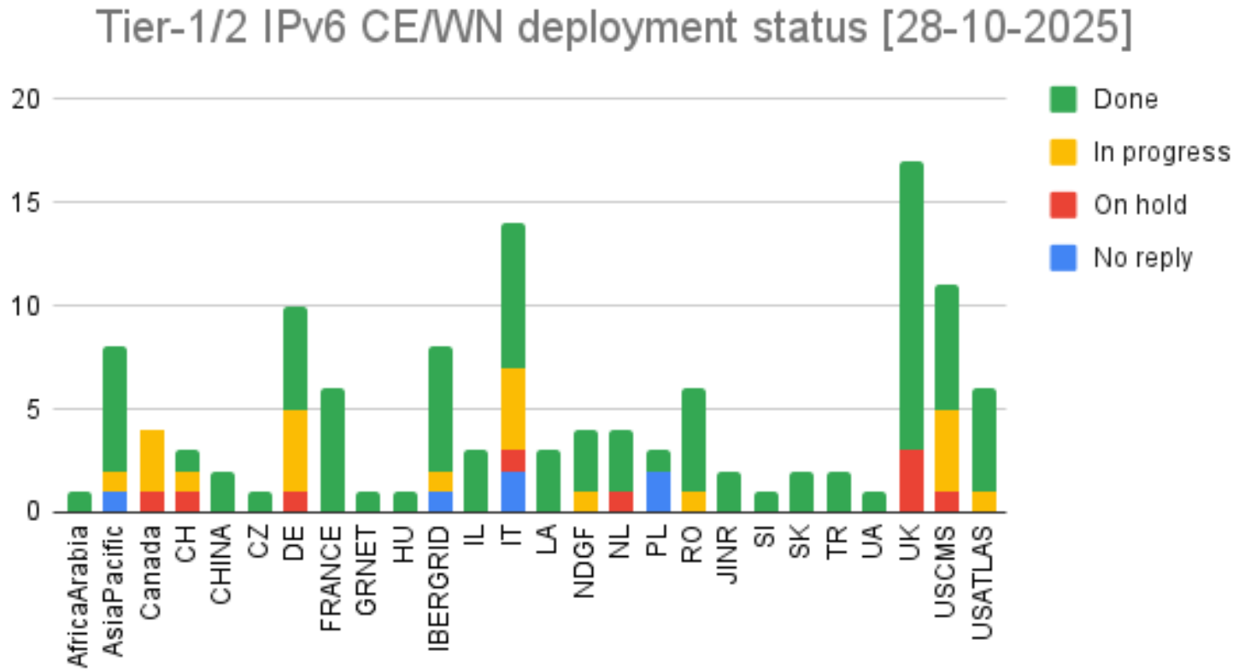
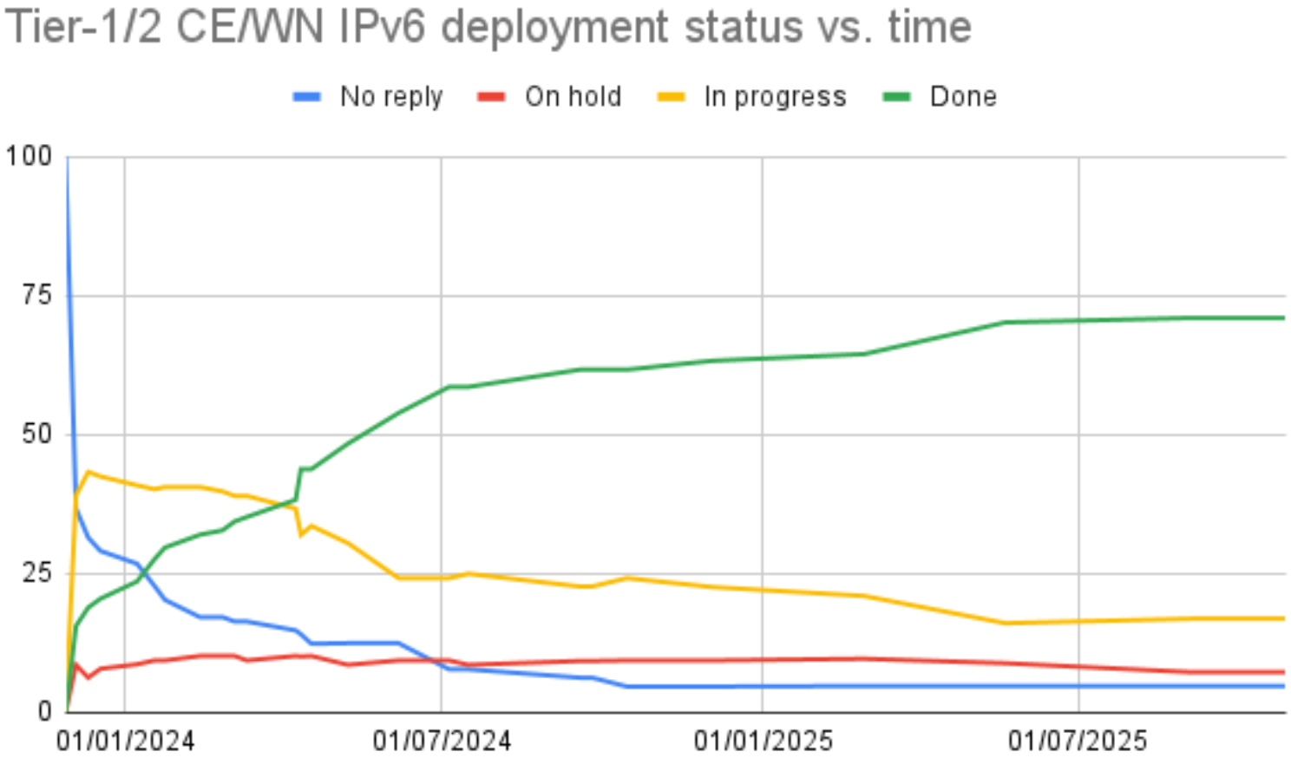
CPU/WN IPv6 status
last report: 65% sites are done
>70% sites done Status always visible from a twiki page

Slide 10
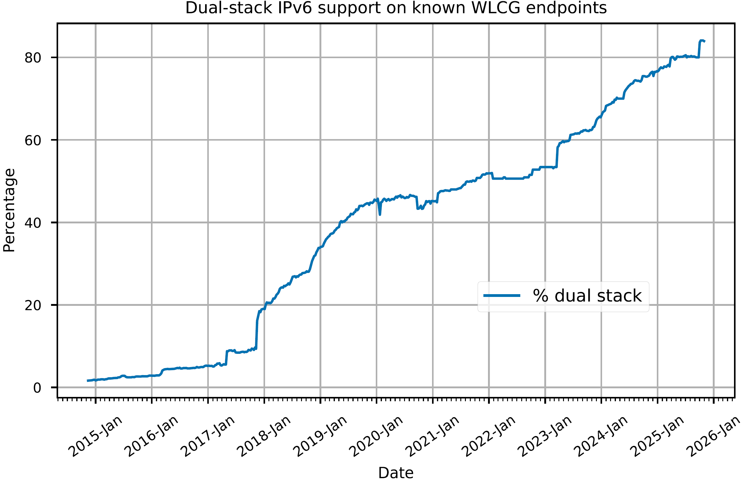
*All* WLCG services - “VOfeeds” https://orsone.mi.infn.it/~prelz/ipv6_vofeed/
30 Oct 2025:
~85% IPv6/IPv4
~16% IPv4

Slide 11
WLCG Data Transfers - % IPv6
And Identifying/fixing use of IPv4

Slide 12
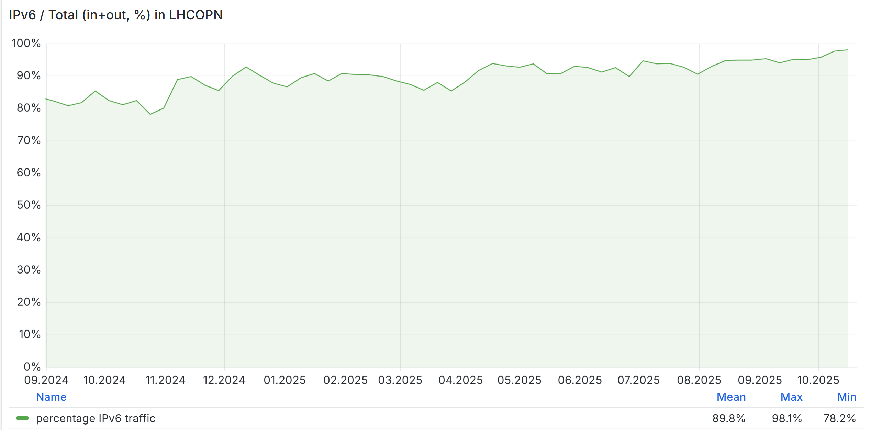
LHCOPN - CERN/Tier1 % IPv6 - last year
90%
95%
80%
98%

Slide 13
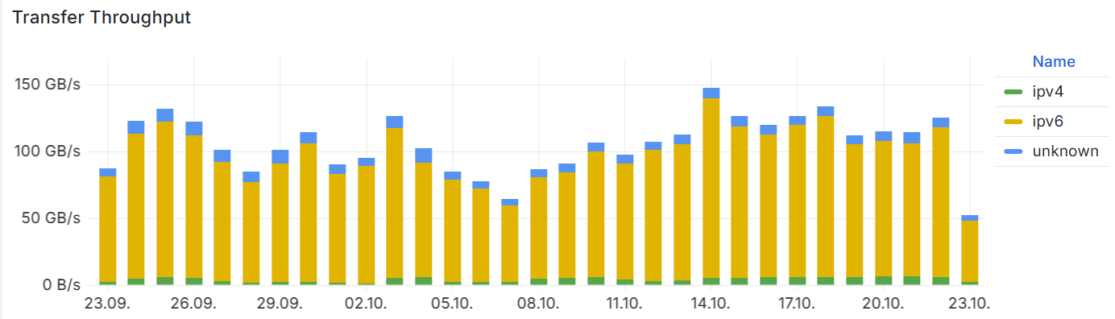
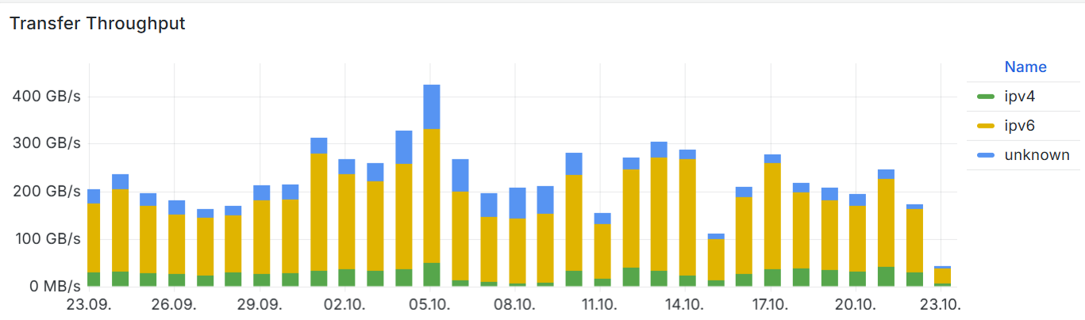
WLCG FTS and XRootD - Last 30 days transfers Mostly over IPv6
← FTS
XRootD →

Slide 14
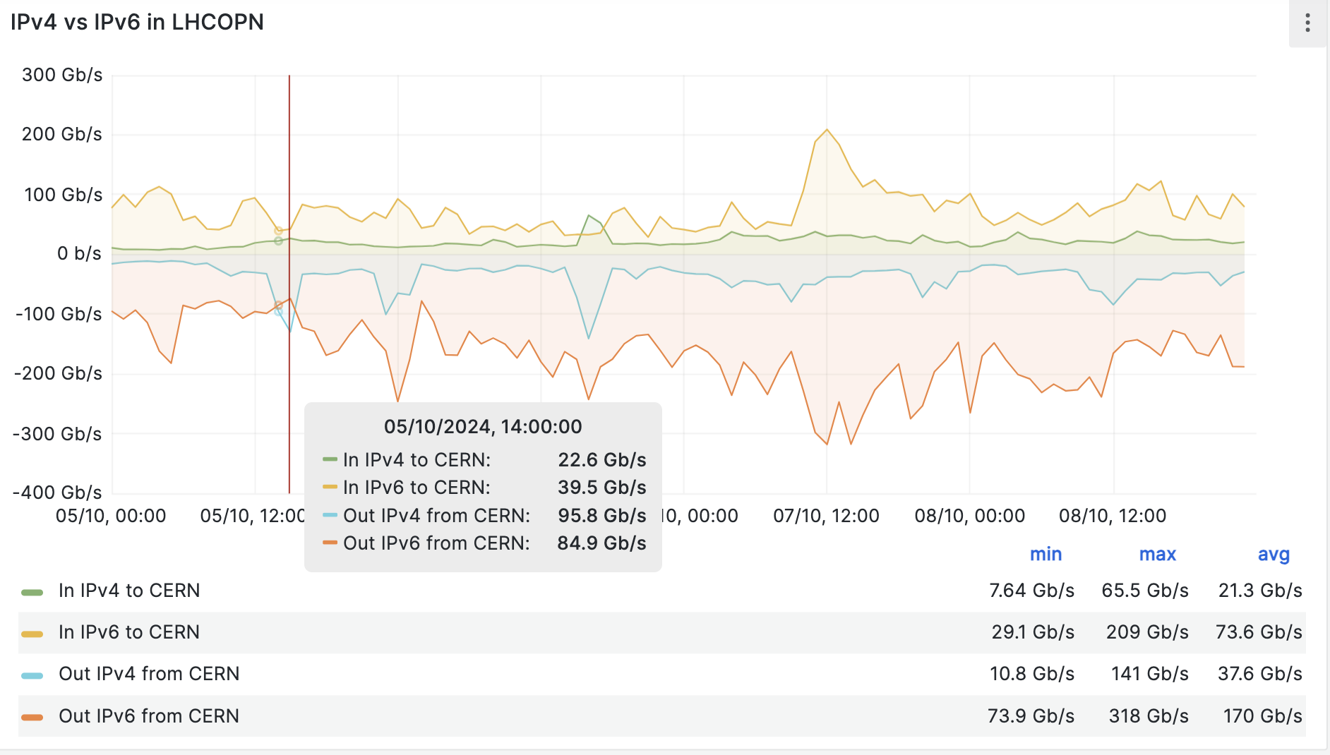
LHCOPN total traffic, split IPv4 & IPv6 (as seen at CERN)
https://monit-grafana-open.cern.ch/d/cumEJJb4z/lhcopn-one-ipv6-vs-ipv4?orgId=16&from=1728079200000&to=1728424799000
Old data - shown at CHEP2024
5 to 9 Oct 2024
IPv6 Out of CERN
Avg 170 Gbps
IPv4 Out of CERN
Avg 37.6 Gbps
BUT
Large IPv4 peaks, e.g.
5/10 @ 14:00
Out 95.8 Gbps

Slide 15
Identifying and fixing use of legacy IPv4
Not easy to identify/understand use of IPv4
Need monitoring both by the network and by the site/experiment
We often see use of IPv4 between two endpoints that are already enabled to use IPv6 (dual-stack)
Preference for IPv4 can be requested in many different config files
We (the IPv6 WG) together with experiments and networks
Have been working on this for more than 2 years
An early observation was data transfers requested by IPv4-only CPU/worker nodes (WLCG clients)
Hence the start of the campaign to deploy IPv6 on all CPU services and worker nodes (from end of 2023)
java.net.preferIPv6Addresses (default: false)
was a dCache problem
See our CHEP Papers in 2023 and 2024 for more details

Slide 16
Use of legacy IPv4 when site IPv6-capable
A site with hardware-related issues
Wrong info in config file gai.conf
Localhost configuration issues
Frontier/CVMFS/Squid configuration issues
The investigations in the lead up to removal of IPv4 on USA LHCOPN links
Identified several issues all of which were fixed to use IPv6
ATLAS, CMS & DUNE
DE-KIT IPv6 testbed
Alice: still loopback address software hardcoded : IPv4 address (127.0.0.1)
Solved in 1,5 days → now protocol independent
Missing home directories
IPv6 at NFS server “mis-”configured

Slide 17
LHCOPN → IPv6 only
₁₇

Slide 18
enable IPv6 only at LHCOPN (1)
MB meeting July 2025:
BNL and FNAL LHCOPN → IPv6 only
For a test of one week (from 2 Sept. 2025)
IPv4 traffic should fall back to LHCONE
Before IPv4 rate of both site less than 10% transfer volumen
₁₈

Slide 19
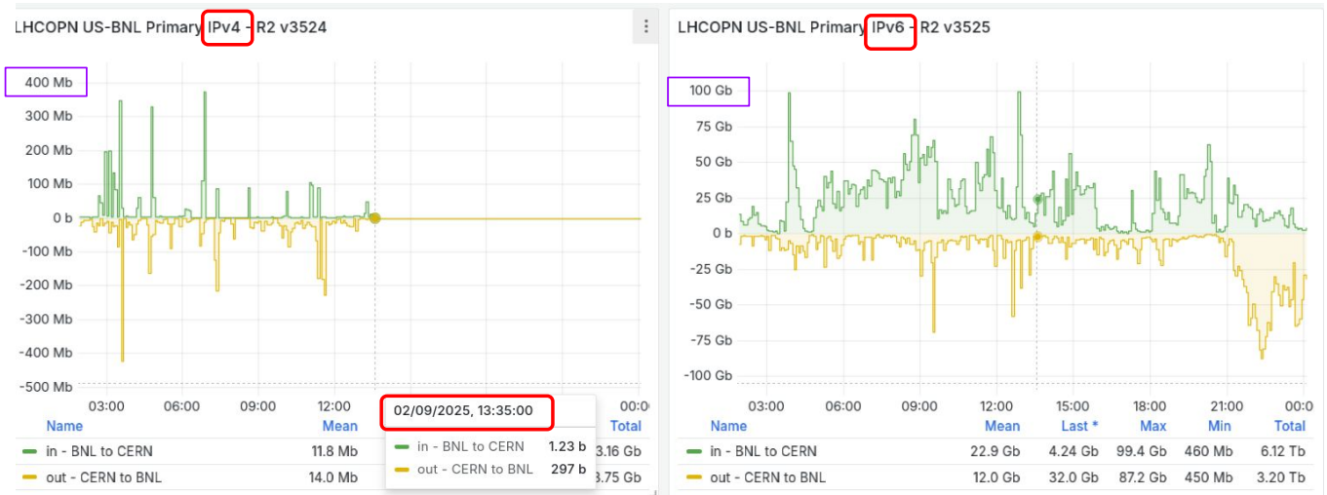
enable IPv6 only at LHCOPN (2)
₁₉

Slide 20
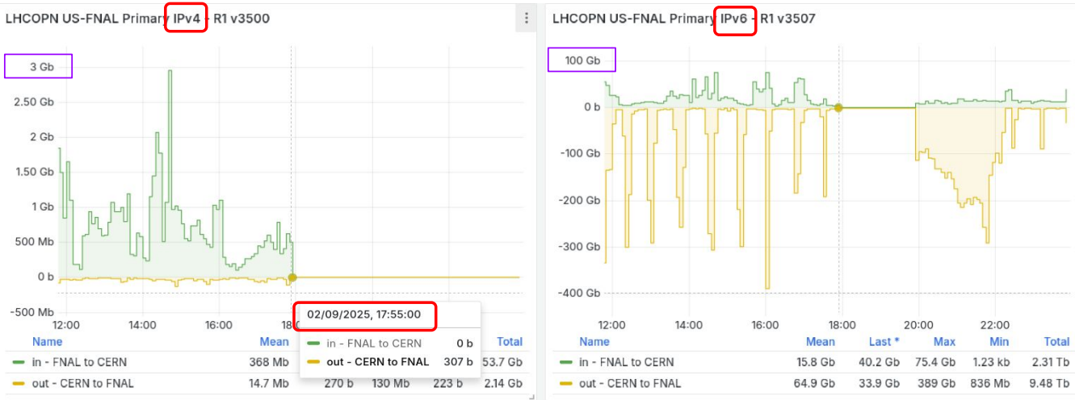
enable IPv6 only at LHCOPN (2)
₂₀

Slide 21
enable IPv6 only at LHCOPN (2)
Report of ATLAS and CMS
No impact
At BNL
And FNAL
Traffic moved seamlessly to LHCONE
option of reenabling IPv4 kept open
experiments are happy to stay with LHCOPN IPv6 only deployment
Results of Removal of IPv4 on LHCOPN in U.S. → Edoardo Martelli, Shawn McKee https://indico.cern.ch/event/1562124/contributions/6680944/attachments/3133036/5558340/Results%20of%20Removal%20of%20IPv4%20Peering%20on%20US%20LHCOPN.pdf
₂₁

Slide 22
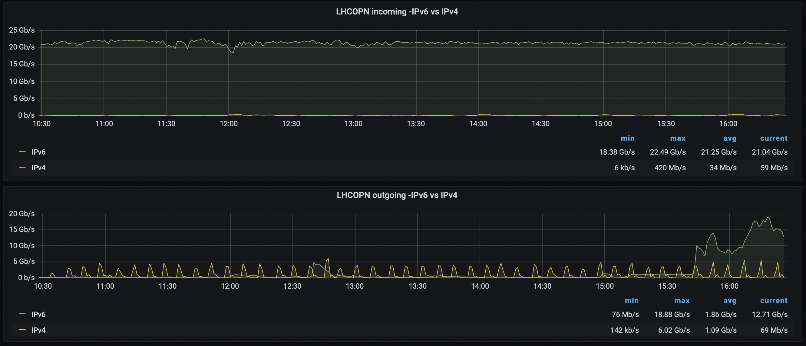
Draft Plans and ideas of IPv6-only LHCOPN at IHEP
Be inspired by Edoardo’s report and David’s report in LHCOPN-LHCONE meeting #55 at KIT
IHEP is willing to do some test in implementing IPv6-only for LHCOPN
So many preparations need to be done, the draft plan is:
Analyze the details of LHCOPN IPv4 traffic to identify the affected scope
Enhance the network monitoring
Comprehensive monitoring and analytics
Scitags？
Communicate with LHCb experiment
identify the advantages for IPv6-only
Reiterate that there is no impact on network performance, which of course based on the test results we will done in the near future
₂₂

Slide 23
Plans for IPv6-only WLCG

Slide 24
IPv6-only on WLCG (CHEP2019) https://doi.org/10.1051/epjconf/202024507045
The end point of the transition from IPv4 is an IPv6-only WLCG core network - already agreed by WLCG MB - not a dual-stack network!
LHCOPN and LHCONE in particular
To simplify operations
Dual-stack infrastructure is the most complex
Reduced complexity reduces chance of making security errors
And dual-stack does not reduce pressure on IPv4 address space
Large infrastructures (e.g. Facebook, Microsoft,...) use IPv6-only internally
The goal is still: all Wide-area data transfers over IPv6

Slide 25
IPv6-only plans and testing
Some sites are keen to move to IPv6-only services
Including USATLAS (AGLT2, NET2, …)
NDGF are planning on IPv6 only
PL Tier1 NCBJ (provide some IPv6-only storage to CMS)
others
Some sites have been testing IPv6-only clusters for some years
CERN, Brunel (UK), KIT, others….
CMS has recently (re) tested at KIT and CERN
CMS confirms - they are perfectly able to work with IPv6-only sites

Slide 26
Plans for “IPv6-only” WLCG data transfers
For discussion with all stakeholders
LHCOPN (the easiest - just Tier 0/1)
By end Run 3 encourage the deployment of IPv6 on *all* WLCG services (today ~80%)
Need to continue to identify/remove IPv4 on LHCOPN
Propose IPv4 peering removed from LHCOPN as soon as possible/sensible
Before Data Challenge DC27 (should test what we plan to use) - my personal view
USA test removal of IPv4 on LHCOPN
For transfers over LHCONE:
Identify/remove ongoing use of IPv4 on LHCONE network (WLCG traffic)
Move the WLCG LHCONE to be IPv6-only
End point of the IPv6 work:
Well before start HL-LHC Run 4 - exact date still to be agreed with the WLCG MB

Slide 27
Global Networking Challenges for the Coming Decade
Tony Cass - CHEP 2024 Networking Plenary talk
Tony Cass, CHEP 2024, 23rd October 2024
With thanks to Carmen Misa Moreira, Edoardo Martelli, Marian Babik, Enzo Capone, Bruno Hoeft, Lars Fischer, Pepe Flix, David Kelsey & Shawn McKee

Slide 28
Summary (Tony Cass CHEP2024)
Wide area networking will continue to deliver quality services for the HEP community into the HL-LHC era.
But
we need to (re)learn how to transfer data efficiently,
we need to understand and perhaps manage traffic flows,
IPv4 has to go, and
life will be more complicated in a multi-science world.
And he said … “Before HL-LHC”

Slide 29
Summary
WLCG already supports use of IPv6-only clients
Majority of WLCG data transfers already use IPv6
Campaign for IPv6 on CPU and WN’s - underway but slow
We still observe ongoing use of legacy IPv4 on LHCOPN/ONE
We continue to chase “preference of IPv6” in service configuration
We should complete the move to IPv6-only data transfers
LHCOPN before DC27, LHCONE before Run 4
Compliant with this approach at LHC[OPN/ONE] meeting at KIT
As shown: smoothly enabling IPv6 only at LHCOPN
before start HL-LHC Run 4
Message to all WLCG sites & LHC experiments:
Please deploy IPv6 on all services & clients and prefer its use
And monitor and check/fix

Slide 30
More information
The HEPiX IPv6 Working Group meets regularly
https://indico.cern.ch/category/3538/
WLCG IPv6 task force information
https://twiki.cern.ch/twiki/bin/view/LCG/WlcgIpv6
CHEP2023 paper “Overcoming obstacles to IPv6 on WLCG”
https://doi.org/10.1051/epjconf/202429507036

Slide 31
Questions, Discussion?
Notes:
test

Slide 32
Backup slides

Slide 33
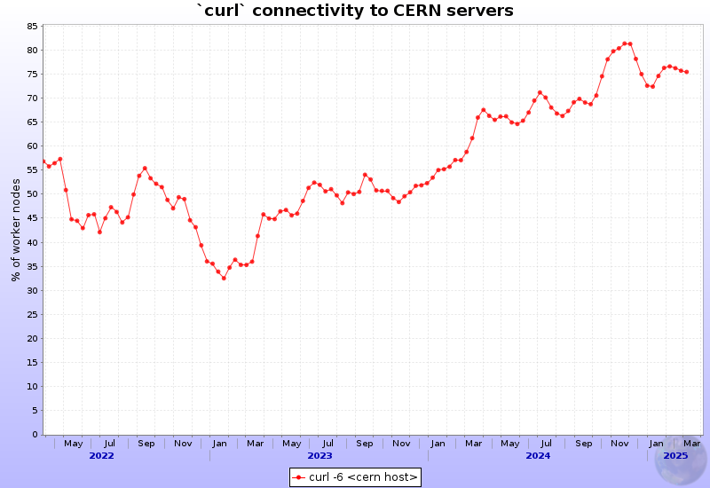
ALICE experiment monitoring
% IPv6 WNs
since May 2022

Slide 34
“Obstacles” to IPv6
There are many reasons stopping the full use of IPv6/IPv4
Dual stack is an essential step on the journey to IPv6-only
The Obstacles that we have been addressing:
WLCG Sites not yet deployed IPv6 networking
Sites have IPv6 but Tier-2 has no dual-stack storage
IPv6 monitoring not available or broken
Monitoring is essential
Service is dual-stack but IPv4 still being used
We continue to chase these problems

Slide 35
Obstacles to IPv6 - being addressed
Non-storage services not yet dual-stack
~80% of all WLCG services are dual-stack today, we need 100%
WLCG client CPU (worker nodes, VMs, containers) some IPv4-only
GGUS ticket campaign well underway
Services/clients outside of WLCG Tier-1/Tier-2 not yet addressed
Tier-3, Public/Commercial Clouds, Analysis facilities, Experiment portals…
Use of new or evolving technologies not yet tested or tracked
New CPU architectures (GPU, non-x86, …), container orchestration, …
Staffing issues can be an obstacle
Lack of effort, lack of IPv6 training/knowledge, pressure of other work

