Slide 1

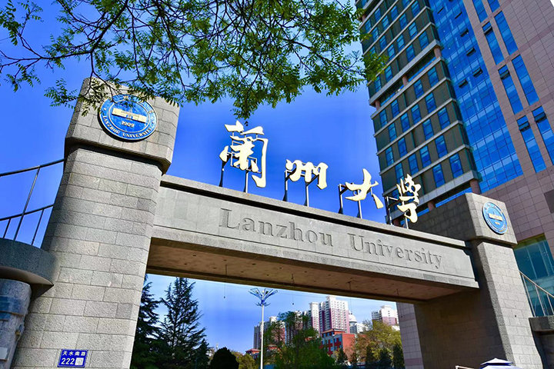
An update on the Web landscape at CERN
Sebastian Lopienski, CERN IT Department
HEPiX Fall 2025 November 3-7, Lanzhou, China
Notes:
My first HEPIX: in Vancouver, Canada in 2003 – 22 years ago

Slide 2
Acknowledgements
This presentation covers the work and achievements of many of my colleagues: Alberto Pimpo, Aleksandra Wardzinska, Alexandre Lossent, Andreas Wagner, Carina Antunes, Chrysoula Dikonimaki, Francisco Borges Aurindo Barros, Igor Jakovljevic, Ismael Posada Trobo, Joachim Yde, Juan Breinlinger, Katharina Borsig, Lorenzo Del Pianta, Luis Pelaez Bover, Mario Rey, Rudraksh Pareek, Vasvi Sharma
… and many others who worked on Web hosting at CERN in the past.

Slide 3
Agenda
CERN: the place where the Web was born
Web governance at CERN
.cern top-level domain (TLD)
Web hosting at CERN
Content Management Systems: Drupal → WordPress
Web hosting platforms and their evolution
Upgrades and migrations: lessons learned
Conclusions and open questions

Slide 4

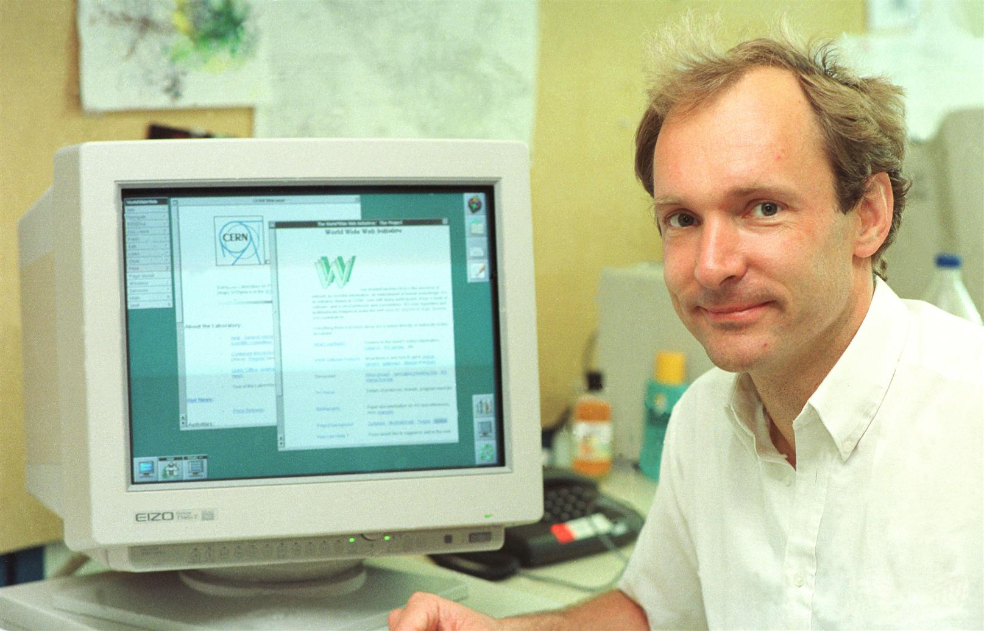
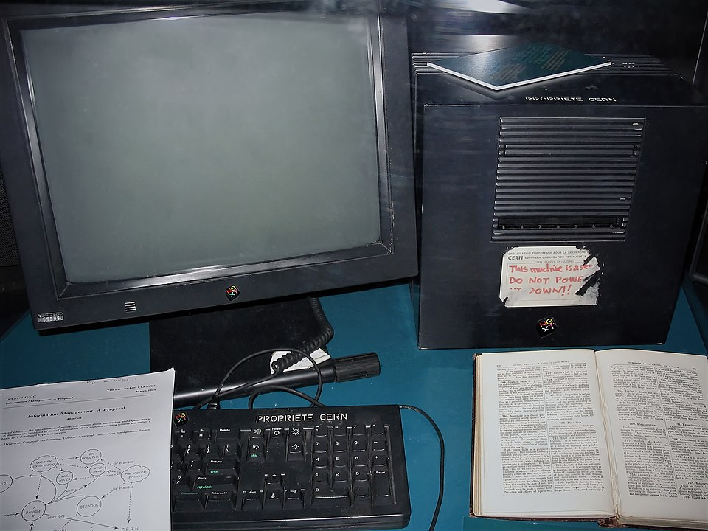
CERN: the place where the Web was born in 1989
Tim Berners-Lee, inventor of the World Wide Web
The first Web server (Tim’s desktop computer)
Notes:
The Web was invented by English computer scientist Tim Berners-Lee while at CERN in 1989 and opened to the public in 1993
Photos:
By Coolcaesar at the English-language Wikipedia, CC BY-SA 3.0, https://commons.wikimedia.org/w/index.php?curid=395096

Slide 5
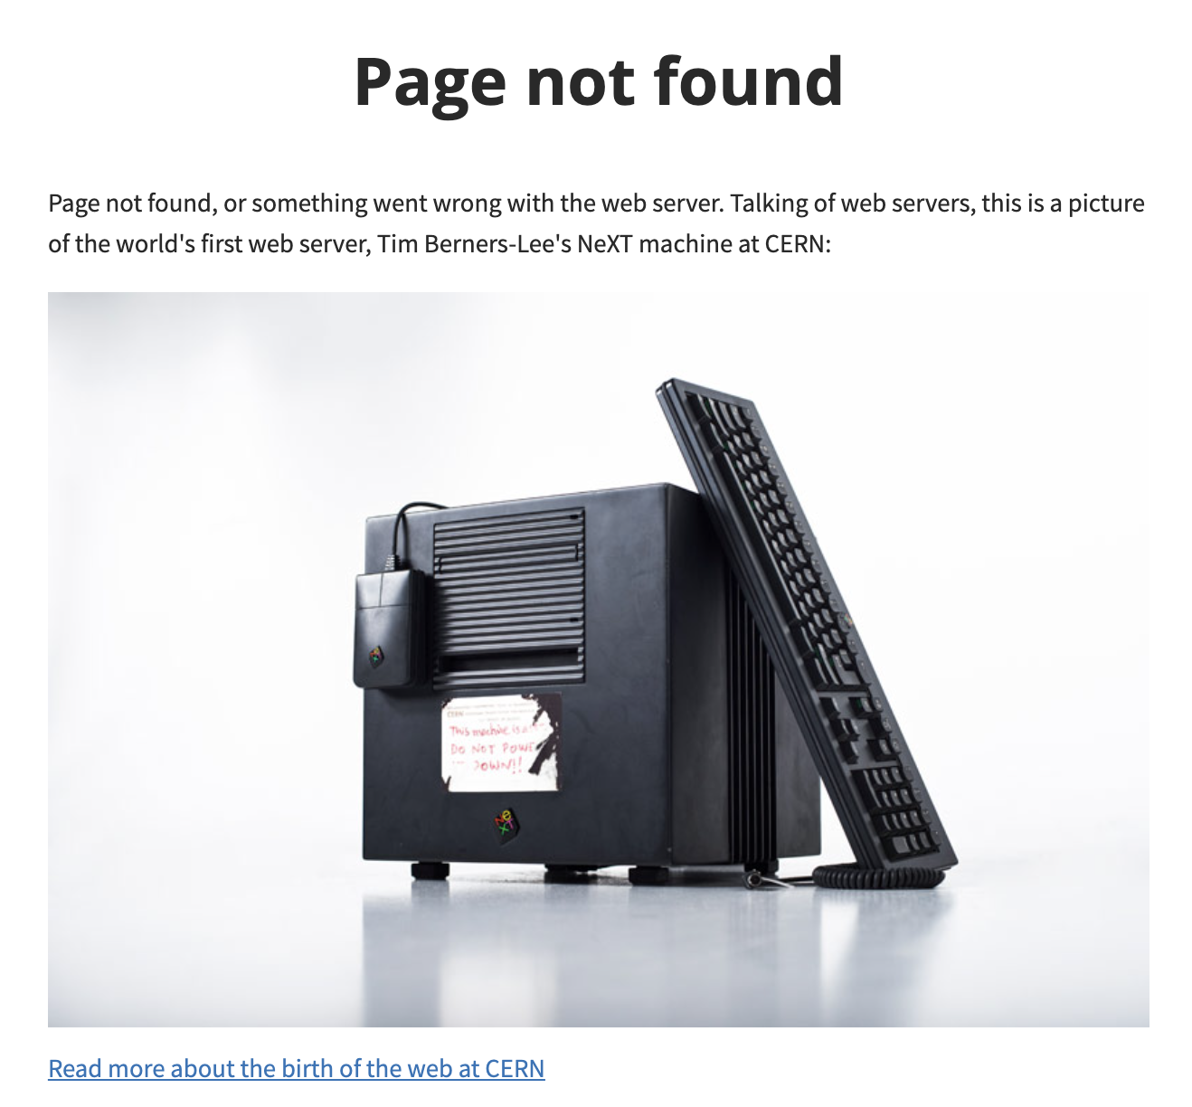
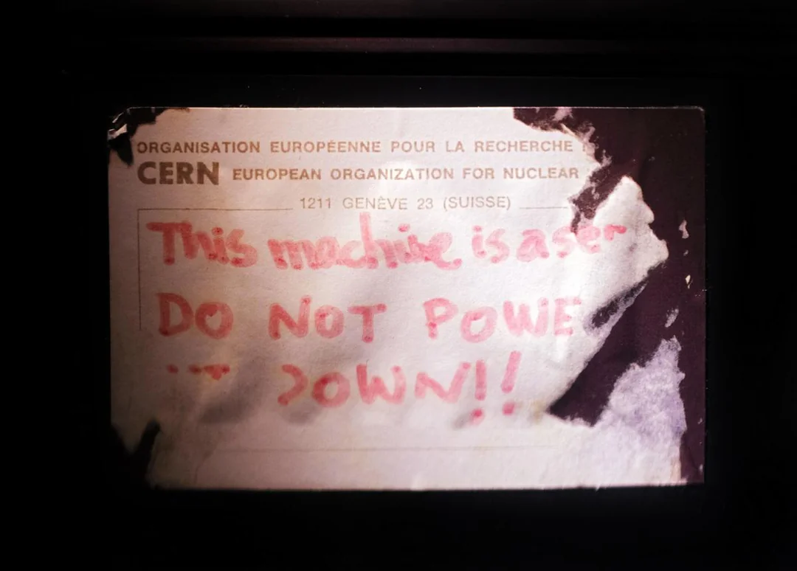
CERN’s “404 Not Found” page

Slide 6

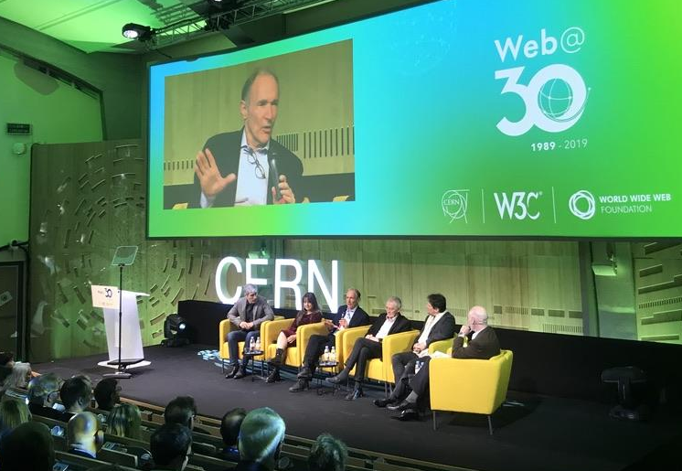
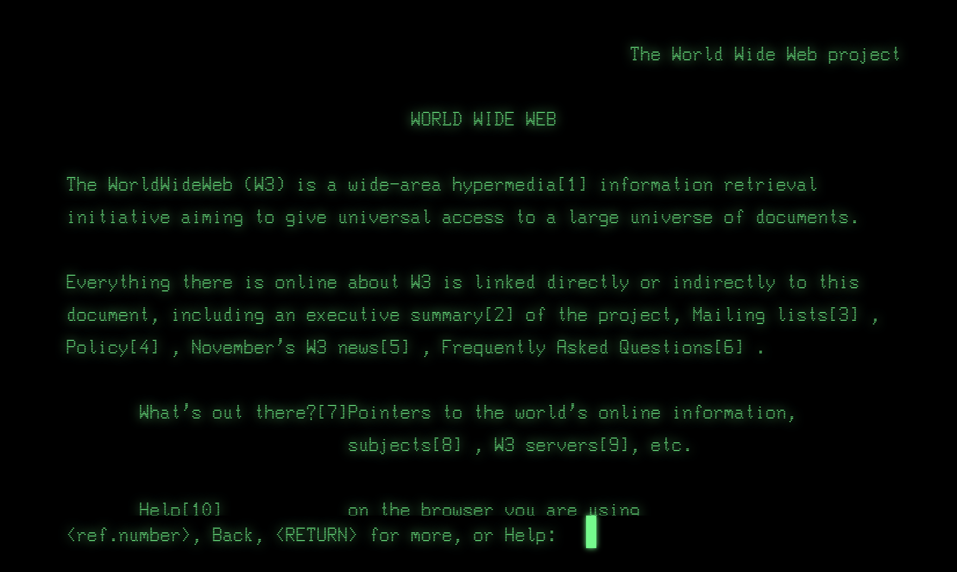
Web’s 30th anniversary at CERN in 2019

Slide 7
Web governance at CERN (since 2023)
Tier 1: CERN Web Governance Board
Mandate: Ensure alignment of CERN’s web presence with the organizational strategy
Members: Director for International Relations (co-chair), IT Department Head (co-chair), Sector Representatives, and co-chairs of the CERN Web Presence Committee
Tier 2: CERN Web Presence Committee
Mandate: Ensure alignment of CERN’s web presence with the communications strategy and with existing web & IT technology
Members: IR-ECO Head of Media and Digital Communication (co-chair), IR-ECO Web Manager, IR-ECO Digital Editor, Head of IT-PW (co-chair), IT-PW Web Infrastructure Team Manager
Departmental Web Representatives
Mandated by Heads of Department to provide support for the implementation of the web governance
Notes:
Ensure alignment of CERN's web presence with the organisational strategy; make recommendations;
implement decisions and ensure two-way information flow between central governance and departments
https://governance.web.cern.ch/mandate

Slide 8
.cern top-level domain (TLD)
CERN owns .cern TLD since 2015
Used by CERN home page (https://home.cern) and other highly-visible websites
E.g. cms.cern, careers.cern, visits.cern, beams.cern etc.
At the same time, most CERN websites / webservers are at .cern.ch
Governed by the .cern Top Level Domain Board
In particular, the Board reviews and approves requests for new .cern domain, as described at https://nic.cern/registration-policy/
More information at https://nic.cern

Slide 9
Web hosting at CERN
Various platforms, hosting thousands of websites, for different purposes:
static web pages (often used for service documentation)
dynamic web applications
Content Management Systems
User can request and manage websites in the Web Services Portal
Authentication to websites is done with the CERN SSO
Authorization (roles) for websites is managed in the Application Portal
Ownership and lifecycle is managed according to the website category:
Official → get automatically re-assigned to the supervisor when the owner leaves
Personal → get deleted when owner leaves, cannot be assigned to another person
Test → get blocked and then deleted after 6 months (but can be extended) get deleted when owner leaves (but can be re-assigned to another person)
NB: web servers managed directly by their owners are not covered here.

Slide 10
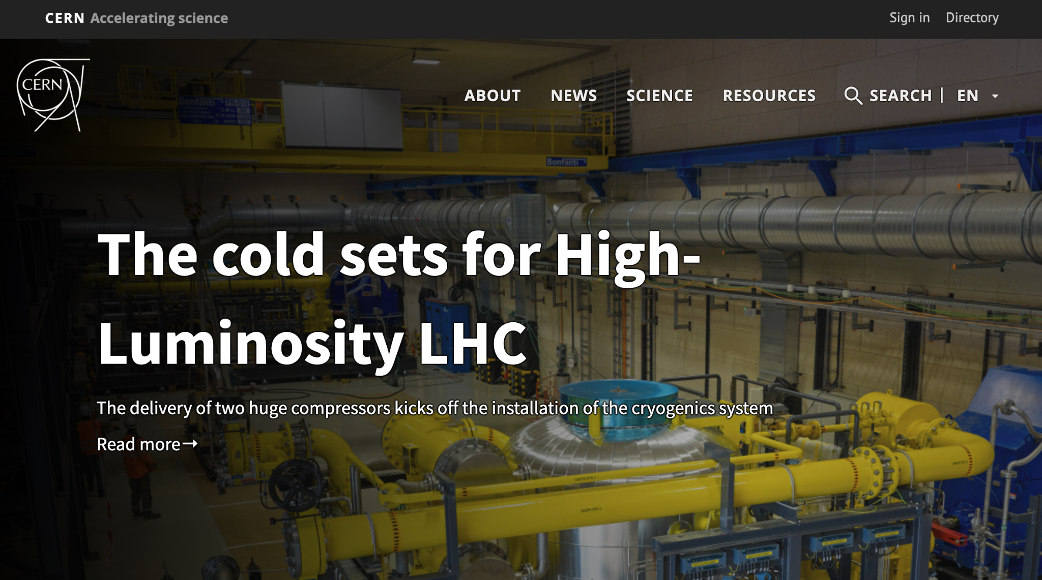
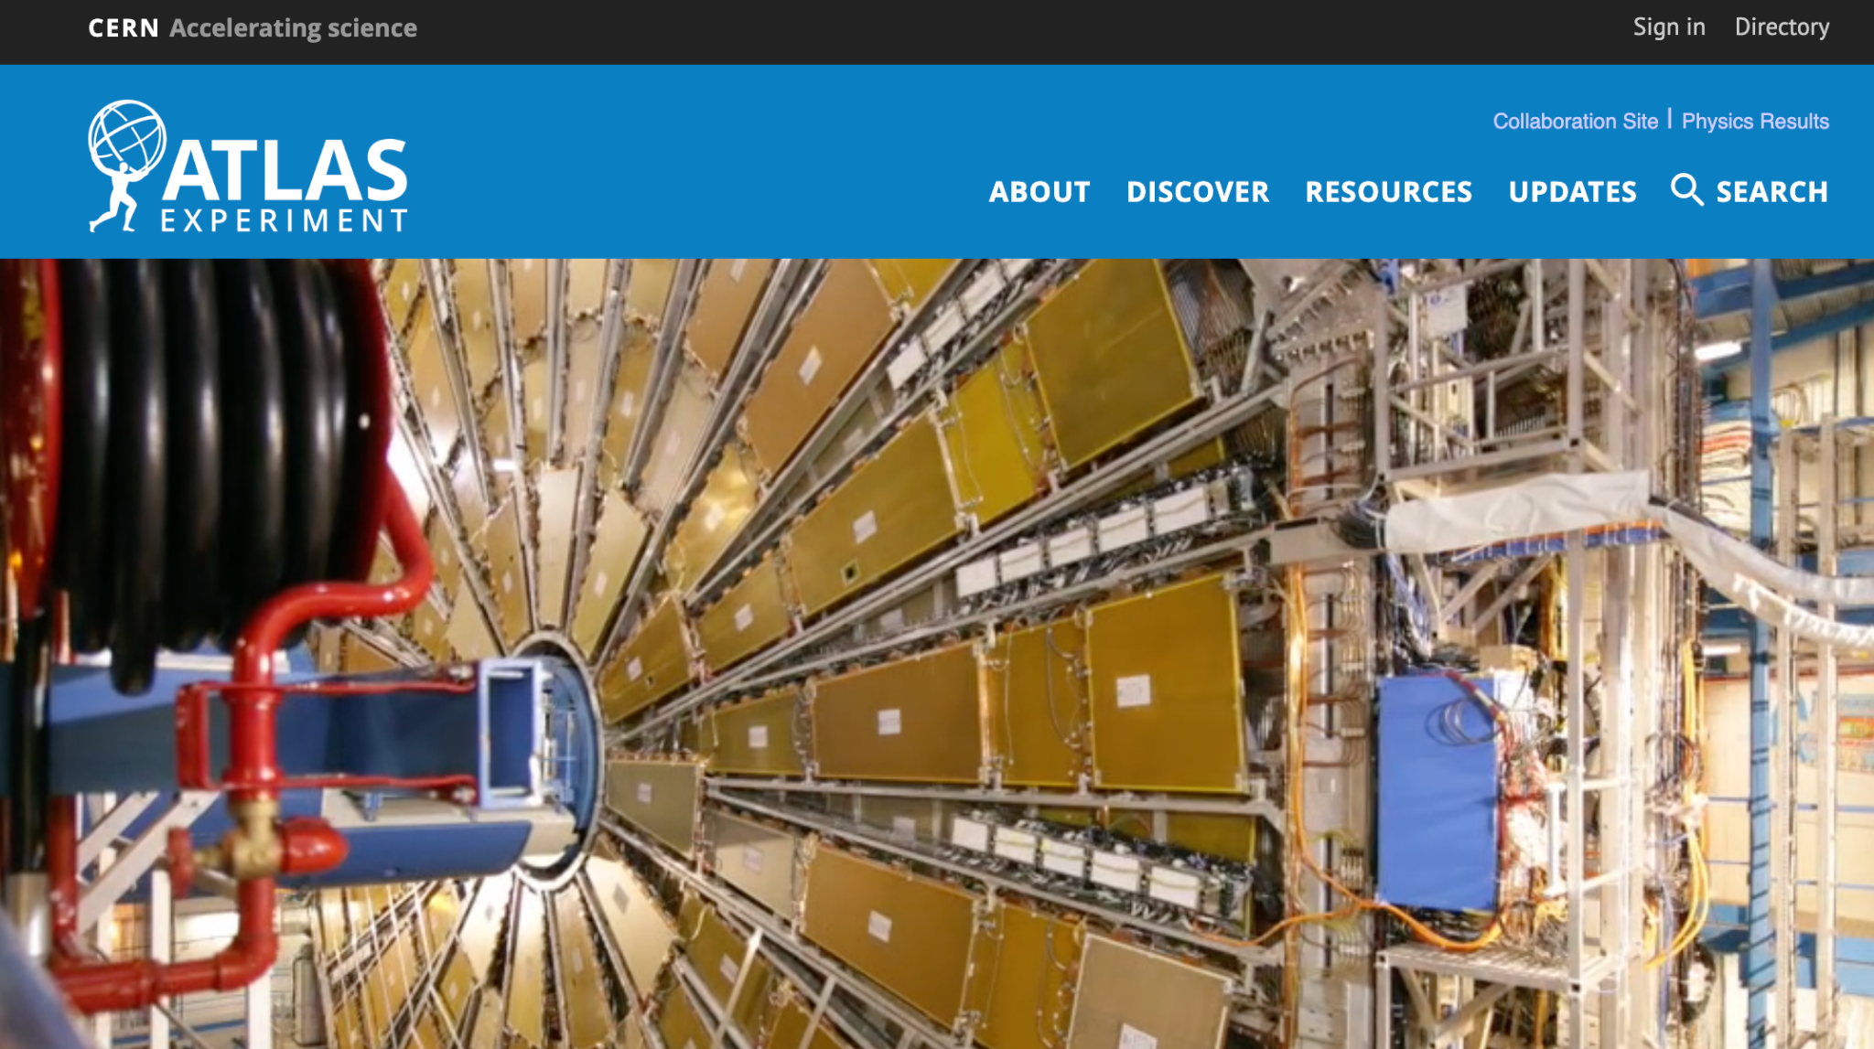
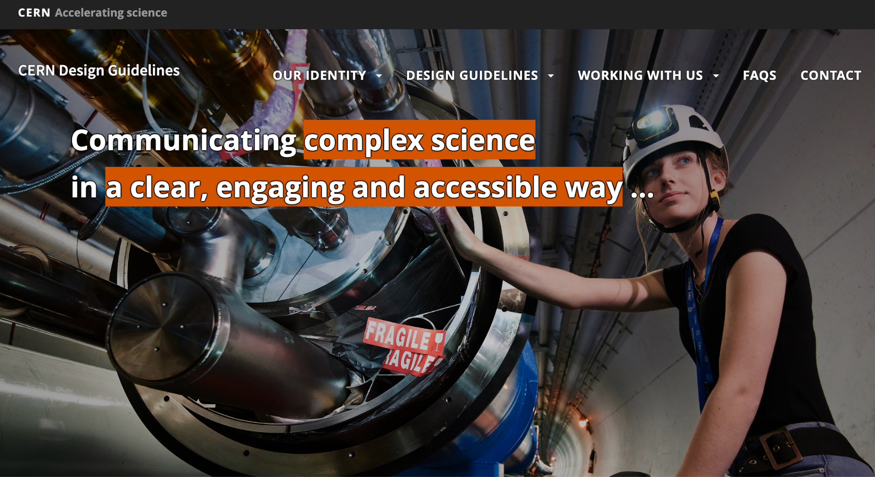
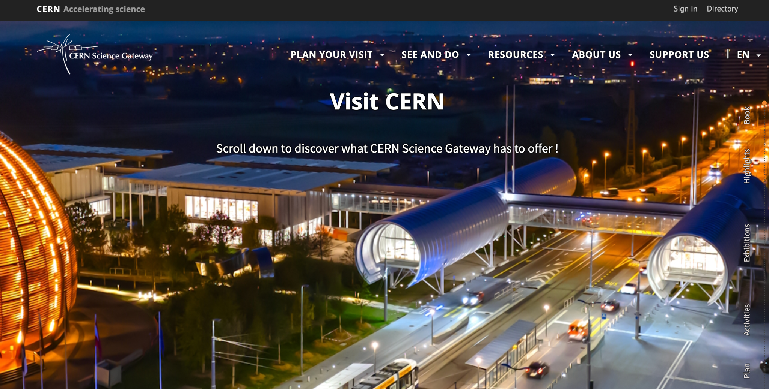
Official websites 🤩

Slide 11
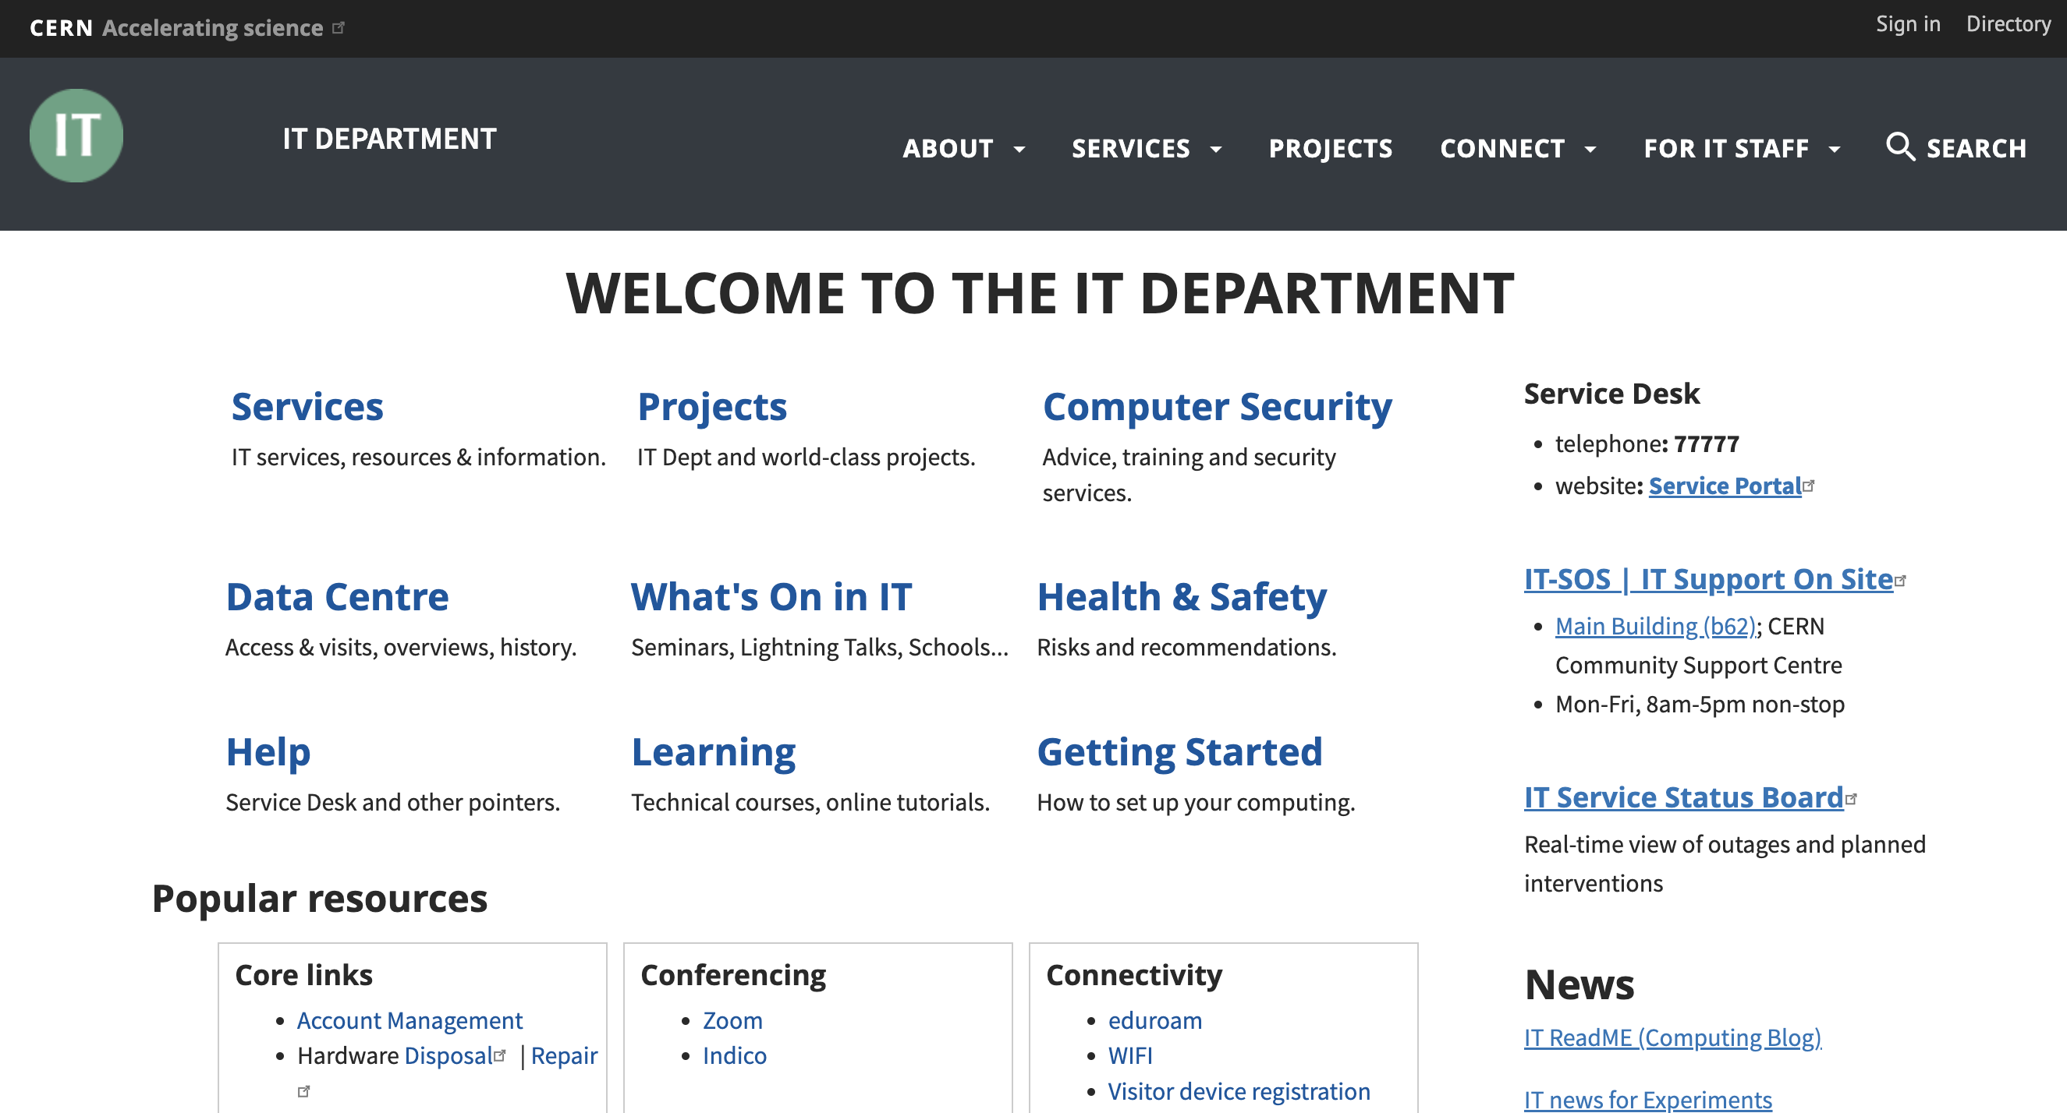
Official websites 👍

Slide 12
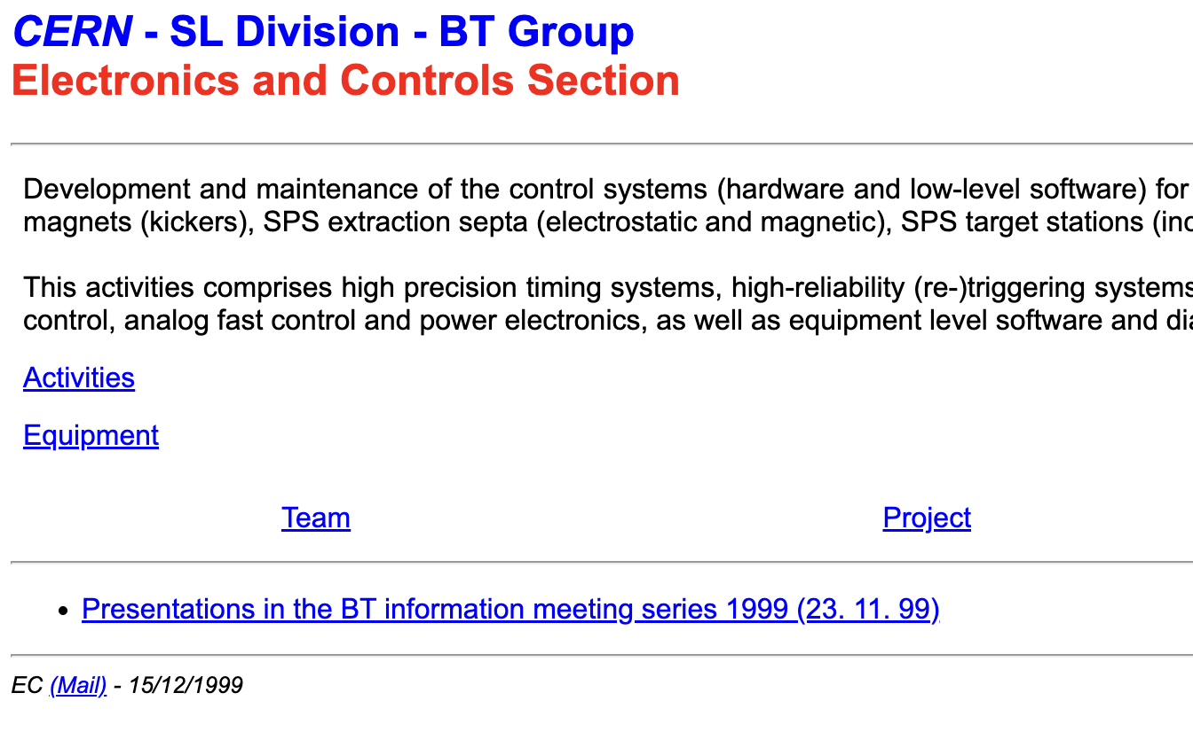

Official websites 😬
Notes:
https://service-dns.web.cern.ch/
https://it-div-events.web.cern.ch/
https://sl-div-bt-tl.web.cern.ch/
https://ab-ws-llrf05.web.cern.ch/

Slide 13
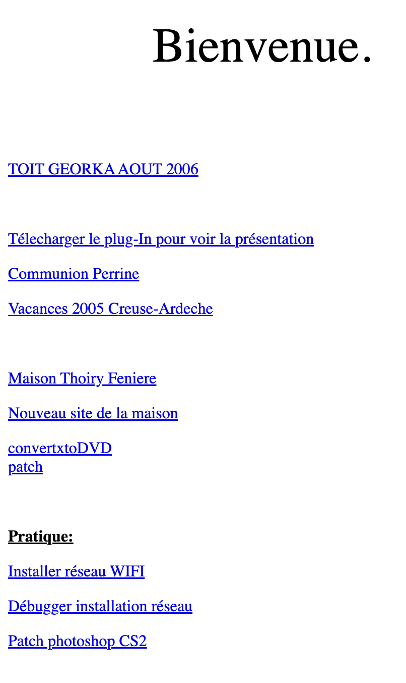
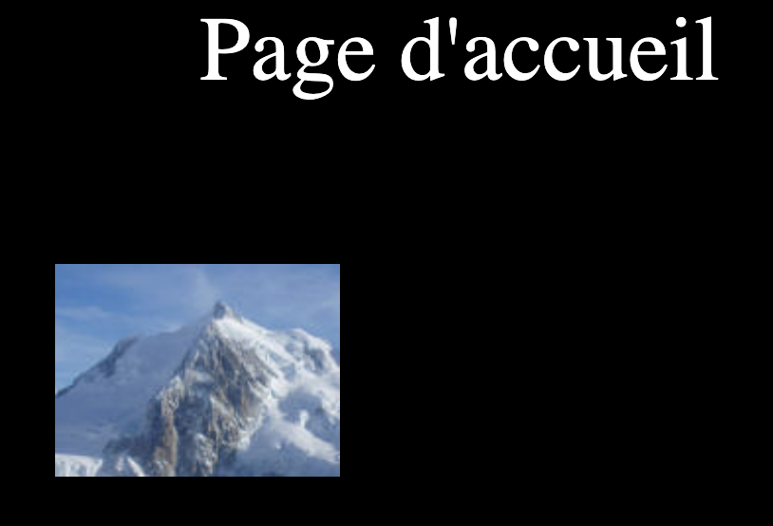
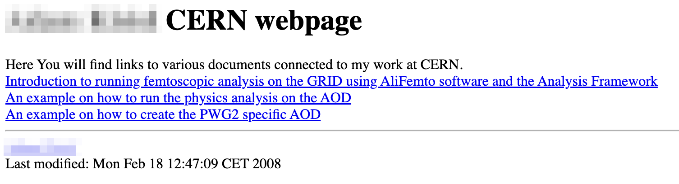
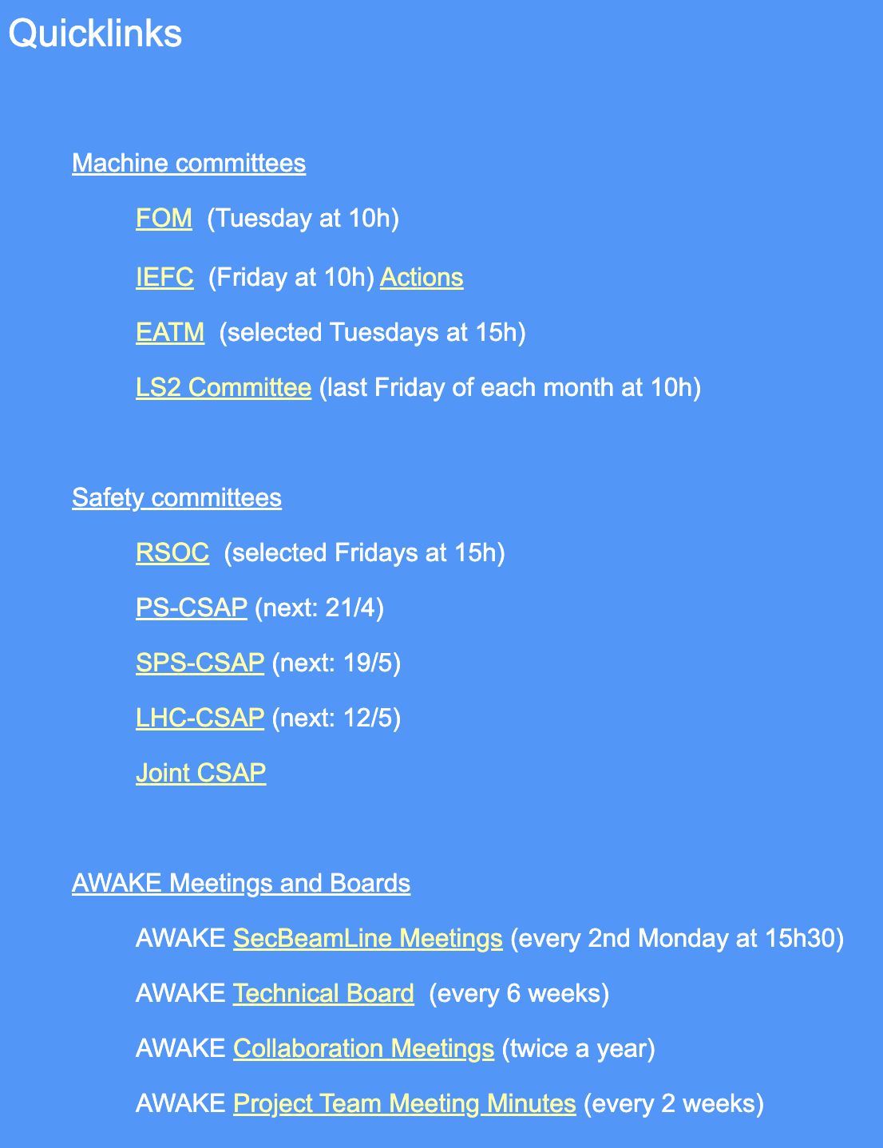
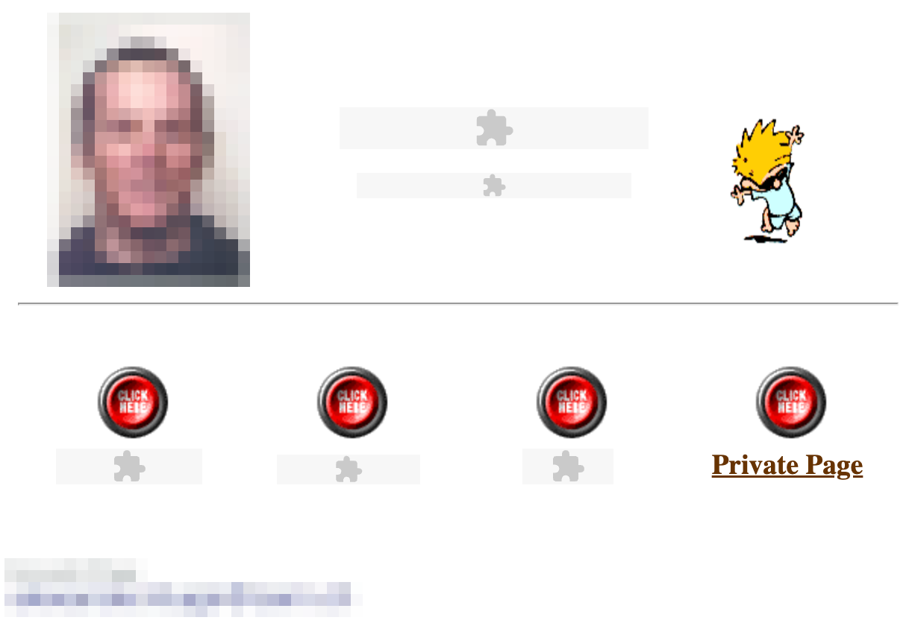
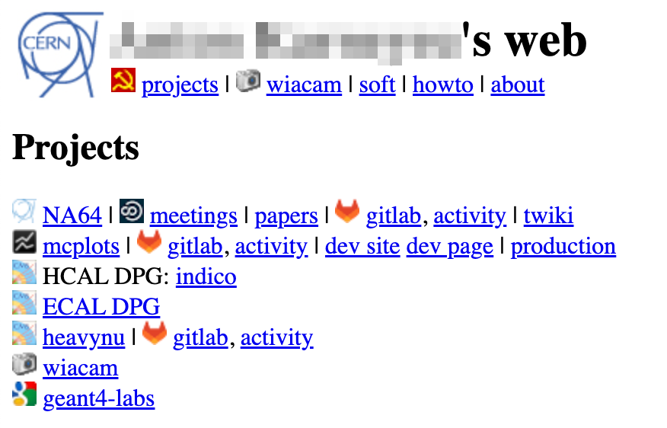

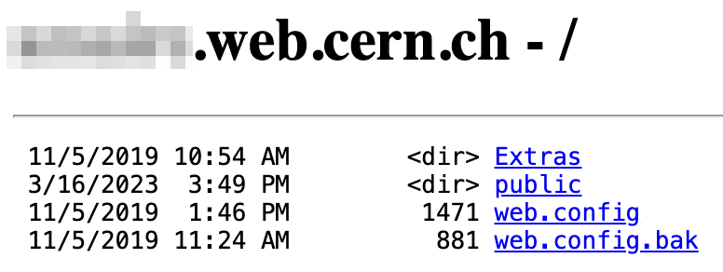
Personal websites 🤦‍♂️
Notes:
http://ajunique.web.cern.ch/ -> just a mountain picture
https://akisiel.web.cern.ch/ -> a few links, last modified 2008
http://akluge.web.cern.ch/ -> embedded Shockwave Flash content -> technology obsolete since 10+ years, dead since 5 years
http://akorneev.web.cern.ch/ -> soviet symbols next to CERN logo…
http://alberton.web.cern.ch/ -> just random private stuff
https://amaire.web.cern.ch/ -> file listing
https://apardons.web.cern.ch/ -> just links for personal use, last update 2016

Slide 14
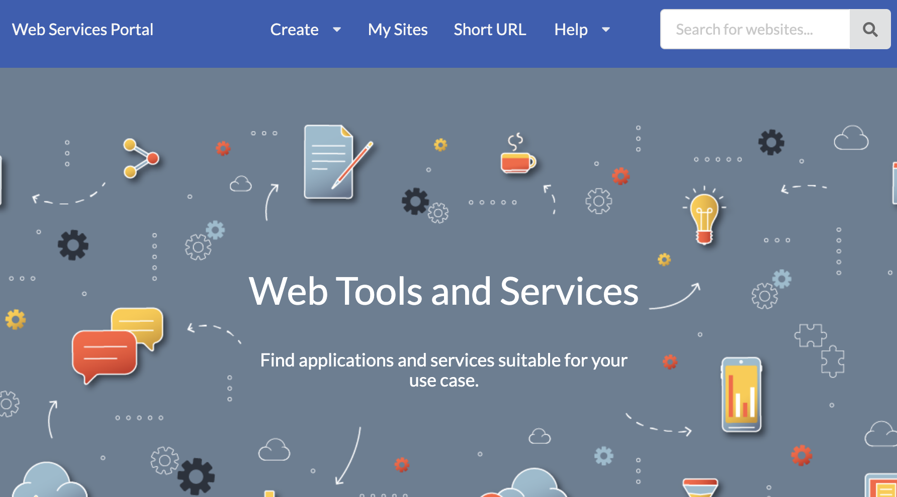
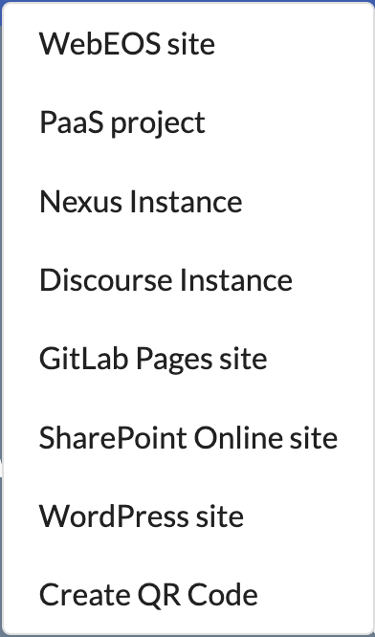
Web Services Portal

Slide 15

Content Management Systems: Drupal
Drupal is an open-source Content Management System
CERN Drupal hosting service established in 2012, successfully running since
The service includes a set of standard modules, and the CERN theme
Hundreds of Drupal websites (more than a thousand, at some point)
Some websites include custom modules / themes, or even custom PHP code
Several websites are highly-visible / critical – including https://home.cern
Multiple upgrades (Drupal 6 → 10, PHP 7 → 8) throughout the years
Major efforts both for owners of (customised) websites, and for service managers

Slide 16

Moving from Drupal to WordPress
WordPress is also an open-source Content Management System
In spring 2024, CERN has decided to move from Drupal to WordPress
Drupal has a steep learning curve, making website development and maintenance difficult
Drupal 10 EOL in December 2026 – foreseeing a heavy upgrade to Drupal 11
WordPress is much more popular, much bigger ecosystem; Drupal marked share decreased
WordPress was becoming increasingly popular at CERN
… and to change the hosting model at the same time:
Customisation no longer allowed (except if specifically approved)
Web site owners become content creators, rather than developers (as in Drupal)
This will make future upgrades much simpler – however it limits websites’ functionality
CERN central WordPress Service started in May 2025
Including CERN WordPress theme
Existing Drupal websites will be migrated to WordPress
Non-customized Drupal websites: semi-automated migration
Customized Drupal websites: manual migration, or rebuilding in WordPress from scratch
Drupal service to be decommissioned in 2026

Slide 17
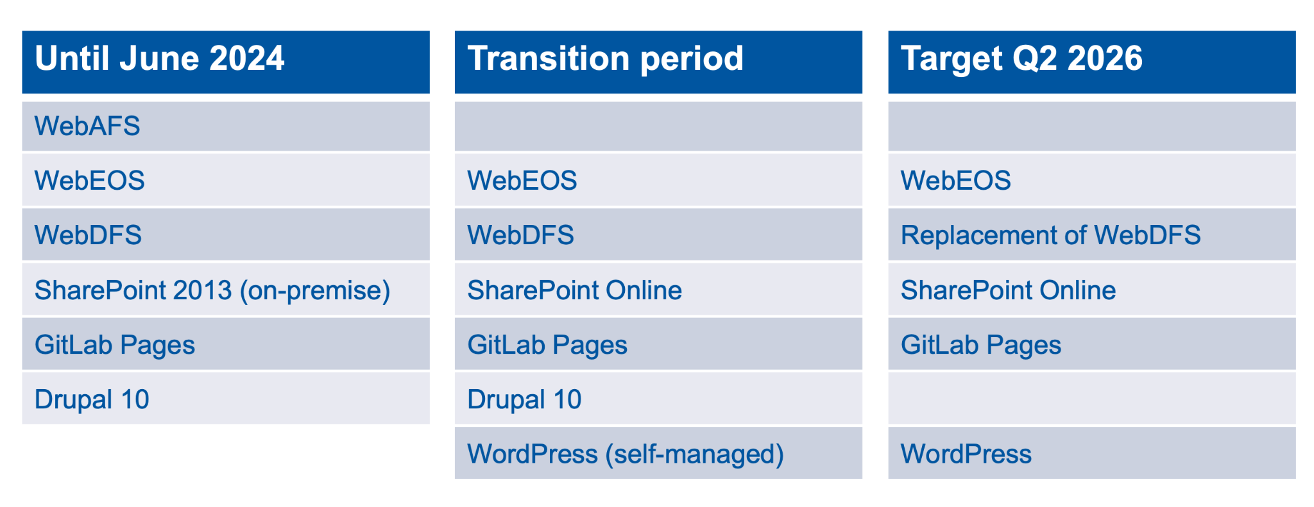
Website hosting platforms
Apache, Linux, AFS filesystem – PHP, Python, Perl etc.
Apache, Linux, EOS filesystem – PHP, Python, Perl etc.
IIS, Windows, DFS filesystem – .NET, ASP, PHP, Perl
SharePoint, Windows – content management system
Apache, Linux, GitLab repository – static pages hosting
Drupal, Linux – content management system, PHP

Slide 18
Web hosting platforms - evolution in the recent years
*
* WebEOS upgrade of OS from CC7 to Alma9 → PHP 5 to PHP 8, Python 2 to Python 3

Slide 19
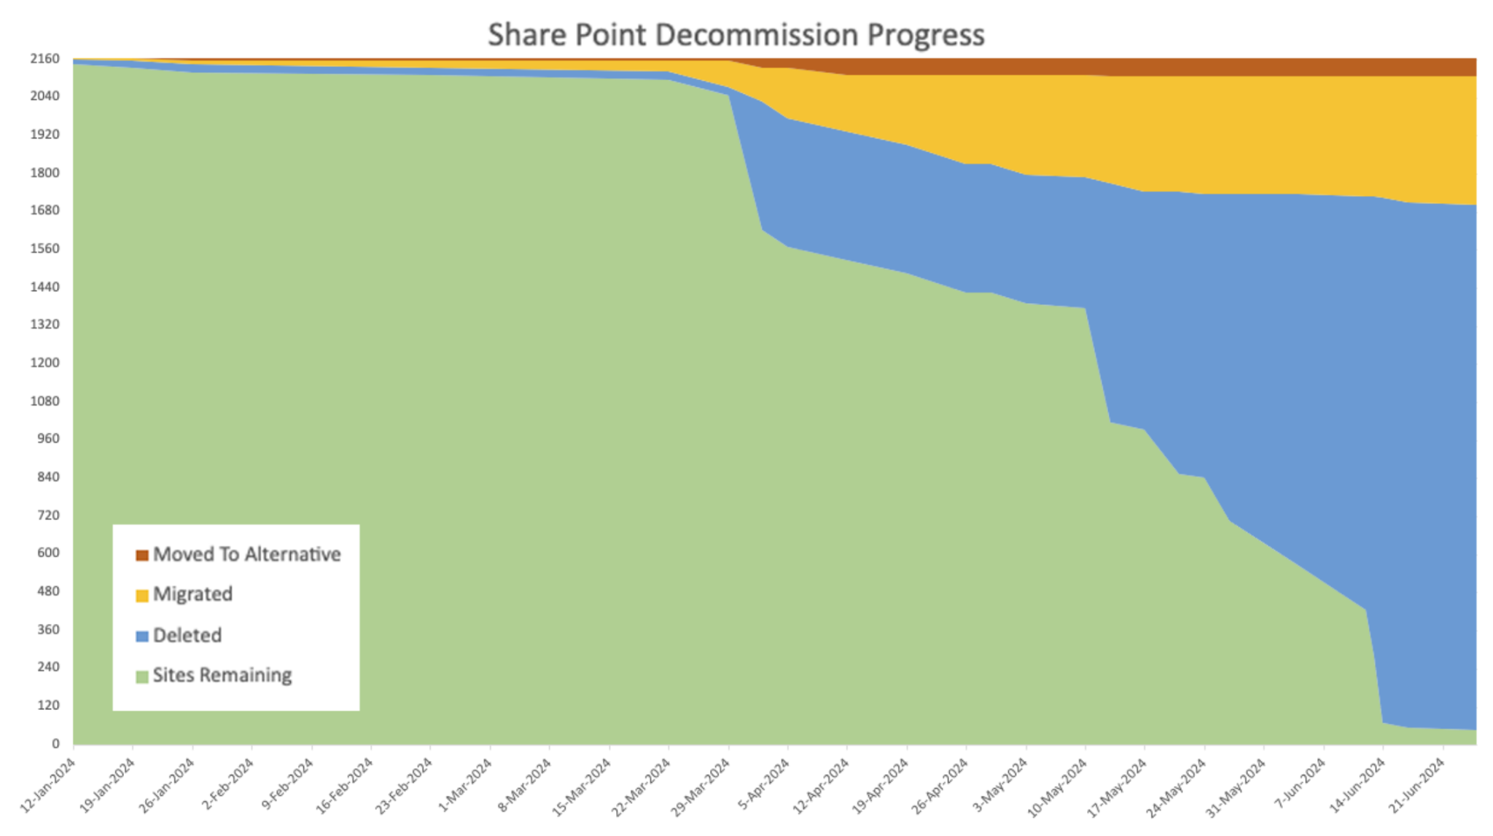
Upgrades and migrations: lessons learned
Several campaigns in the recent years
Actions required from website owners / moderators
Breaking changes cannot be avoided
Users are busy, and often lack expertise
Communication must be concise, detailed for technical users, clear and simple for non-technical users
Some users are not even aware of the computing resources (websites etc.) that they own
As a result:
Users are overwhelmed with multiple campaigns at the same time → plan carefully
Notifications to website owners are not understood (or even not read) → adapt the language
Actions are delayed until the very last moment → multiple reminders needed
Many users require individual support → allocate support time
When the deadline comes, websites are automatically migrated (if possible), or soft-deleted
Some users “wake up” months afterwards, asking why their website is broken or gone
Notes:
https://indico.cern.ch/event/1464094/contributions/6164092/attachments/3138312/5569327/ITTF_SharePoint_Igor%20Jakovljevic.pdf#page=6

Slide 20
Summary and conclusions
Web presence of a big research organization requires proper governance
Various needs: static pages, content management systems, web applications
Computing resources (e.g. websites) are not free - they do have a cost!
For the current and future owners (maintenance, security, upgrades or migrations when technology or service changes require it, etc.)
For the service providers (operations, user support, lifecycle, handling special cases)
Customisations cost even more
Uncontrolled proliferation: ”create once, touch never”
Enforcing resource lifecycle is crucial
Occasional clean-up (e.g. asking owners to reconfirm their resources) is useful too
Migration/upgrade campaigns help getting rid of obsolete or abandoned sites

Slide 21
Open questions and ongoing discussions
Academic (and personal) freedom versus online reputation (and security)
A common visual identity versus varied needs of a diverse community
“One-size-fits-all” closed platforms versus maintenance-heavy customizable platforms
Centrally-hosted websites versus self-hosted web servers
Ensuring long-term maintenance and ownership of websites
Archiving historical websites

Slide 22
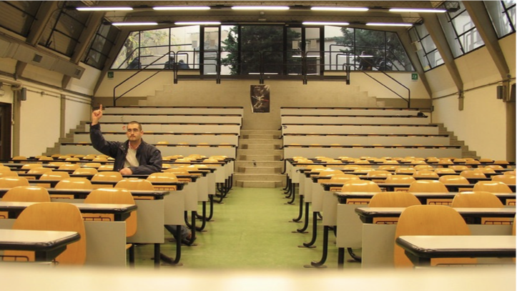
Thank you

