Slide 1

New Features Implementation of
Interactive aNalysis worKbench
Jingyan Shi
shijy@ihep.ac.cn
On Behalf of the INK Team
Hepix Fall 2025 Workshoph
Notes:
、

Slide 2
Outline
Interactive aNalysis worKbench (INK)
1
Brief Introduction of INK
2
New Features Implementation
3
Current Status and Next Steps
4
Summary

Slide 3
INK: Interactive aNalysis worKbench
Provide computing and storage resource of the “ closed Cluster” to be accessible anytime, anywhere
Visionary goal: Enable the Scientific research with just a network connection
  Shift backend / offline computing and storage resources to the frontend / interactive
  Enable flexible integration of resources and applications
  Provide customized interactive tools for HEP experiments
  Offer plus-and-play deployment solution for the HEP computing sites
Functions developed
  Scientific research with just a web page
  Provide web-based interactive analysis tool based on cluster (HTCondor/Slurm)
    Leverage web technologies : VSCode, Jupyter, Rootbrowse, VNC, Enode
    Run on the dedicated job slot : no interference each other
  Enable external file system access
    Files could be accessed via web page directly
    Upload / Download / View
  Provide API interfaces for cluster job submission and file access for the workflow of the experiment
  Containerized deployment

Slide 4













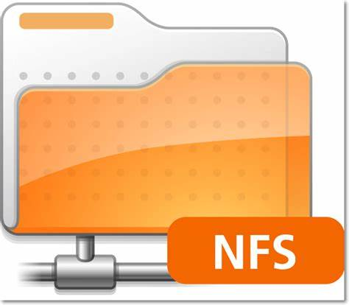





Loose and Flexible Architecture of INK
User Interface
Frontend
SSO
Viewer adaptor
Layer
Web page Template
User interactive module
Info / Parameter Configuration
User Permission DB
User Identity
Menu Template
Image/table display
Plugin template
Bussiness Layer
Password Access
File Access API
App. Running API
Computing Usage API
File System Adapter
App. Adapter
Computing Resource Adapter
Backend
Endpoint Conversion/Transfer
Resource Supply Layer
Storage / Computing Pool
INK Modular Architecture

Slide 5

Short Video of INK

Slide 6
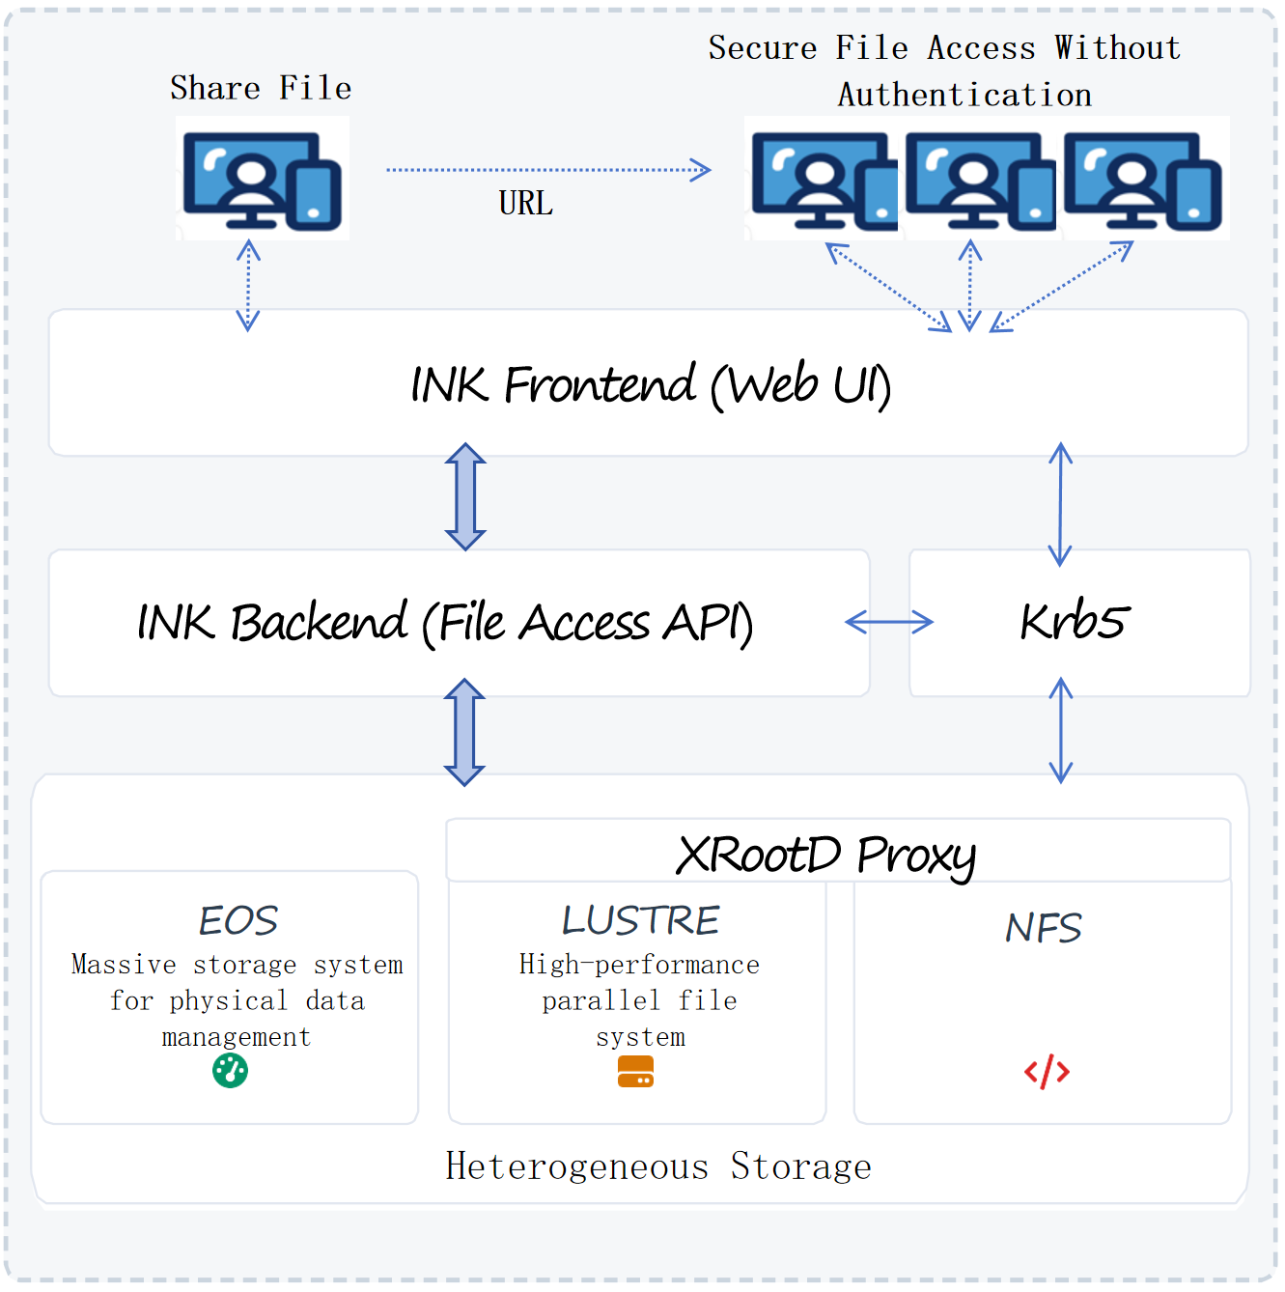
New Feature – Secure File Sharing
Unified Access via XRootD + Krb5 + JWT
Goal: Enable secure file sharing across EOS / Lustre / NFS
  without recipient authentication（no login required）
Core Components:
  INK Frontend: Web UI to create shareable links
  INK Backend: Permission control & JWT issuance
  FastAPI Gateway: Security validation & request proxy
  XRootD: Unified interface to diverse storage
Key Strengths:
  Storage abstraction | Temporary access | Stateless

Slide 7

Workflow of File Sharing
File Select
Link Generation
File Access
Validation
File Delivery
File Select: Users select file on the INK platform interface and request the generation of a sharing link.
Sharing Link Generation: The INK platform generates and encrypts the sharing link based on user permissions and sharing requirements.
Shared File Access: Recipients access the target file via a temporary URL. The website first verifies the link's validity; upon successful verification, it creates a JWT Token and sends the request to the FastAPI gateway for parsing and validation.
Validation: The FastAPI gateway parses the JWT Token and performs verification, including signature validity, timeliness, and permission scope.
File Delivery: Acting as a proxy, the FastAPI gateway interacts with the XRootD service and forwards the file data.
Notes:
Core Workflow – From Sharing to Secure Access
3-Step Closed Loop, Fully Controlled
1、User Initiates Share
Select file in INK → Set permissions & expiry → Generate encrypted link
2、Recipient Accesses Link
Access link → INK validates → Issues JWT token
3、Gateway Delivers File
FastAPI verifies JWT → Forwards via XRootD → Streams data back

Slide 8
Multi-Layer Security for File sharing
No Authentication ≠ No Security
Precision security through stateless validation, cryptographic protection, and comprehensive audit trails
Encrypted Share Links
One-Time JWT Tokens
Gateway Double Validation
Cryptographically signed URLs prevent guessing attacks and unauthorized enumeration. Links contain embedded parameters that cannot be modified without detection.
Stateless, short-lived tokens bound to specific file paths. Each access requires fresh validation, eliminating session hijacking risks and enabling precise access control.
FastAPI gateway verifies token signature integrity, validates expiration timestamps, and confirms ownership permissions before forwarding any request to storage backends.
Rotating Cryptographic Keys
Comprehensive Audit Logs
Automatic key rotation schedules ensure long-term security resilience. Compromised keys have limited blast radius due to temporal scope restrictions.
Full request traceability with immutable audit trails. Every access attempt, validation result, and file transfer is logged for compliance and forensic analysis.

Slide 9
New Feature: Token-based Frontend-Backend Security Communication
Allows frontend webpage users authenticated by different SSO credentials (e.g. Oauth, SAML, etc.).
In backend all the credentials need to be translated to backend resources token.
Backend needs to handle the credential-token mapping and create a valid token, stored in database and return to frontend.
Allows admin configure multi-type backend token, at present we have already supports:
  Kerberos credential
  Temporary key generated by Linux password.
  API key (ChatGPT style access key)
After the token generated, frontend only use token to access backend and no longer needs original user credentials.
Frontend Webpage
Login User
1. Request to create token by user credential
3. Return frontend a valid token
4. Resource operations with token
Backend User Mapping
2. Map user and create resource token
5. Access resources with token
Database
Store token
Computing and Storage Resources

Slide 10
Multiple User Credentials and Multiple Resource Token Translation
It bridges the frontend webpage and backend source.
It depends on backend resources authentication types, including Kerberos, Linux password, API key.
Solution for Kerberos usually is the hardest part:
  For Oauth/SAML types frontend logins, a small plugin, developed to create kerberos ticket for each user when user is login, needs to be installed on SSO side. (A plugin for SSO login workflow.)
  For Linux password types logins, username and password must be allowed to generate krb5 credential. A backend API is handling the krb5 ticket generation.
Solution for none kerberos cluster, usually Linux password type or GPU resources:
  For Linux password resource, backend will verify user with password once, and generate a temporary key (salted with a special uuid string and make username as payload) as the access token, return to frontend for future communication.
  For AI API key type resource, backend will verify user key to 3rd party API, and the key will be used as the access token, for future frontend-backend communication.
All the type of backend resource token type could be configured in configuration file.

Slide 11
Customized Application Control for Users and Groups
Each registered applications in INK has its own identity.
Each user and group has own applications permission identity list. Only allowed APPs could shown in the frontend webpage.
Permissions for Group:
  Rely on different experiment group, only experiment related APPs is permitted to this group.
Permissions for Single User:
  Additional permission list for single user, only allowed APPs could be shown in webpage.
Backend will compose the permission identity list from database when user is access APPs.
Allow the third party user group support. At present, IHEP’s User Group Service is the backend for composing user permission list.

Slide 12
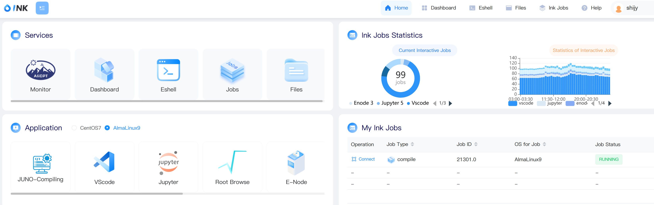
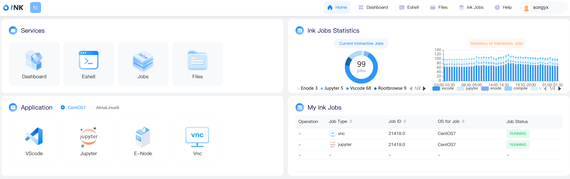
Customized Application Control for Users and Groups
JUNO User “shijy”
BES User “songyx”

Slide 13
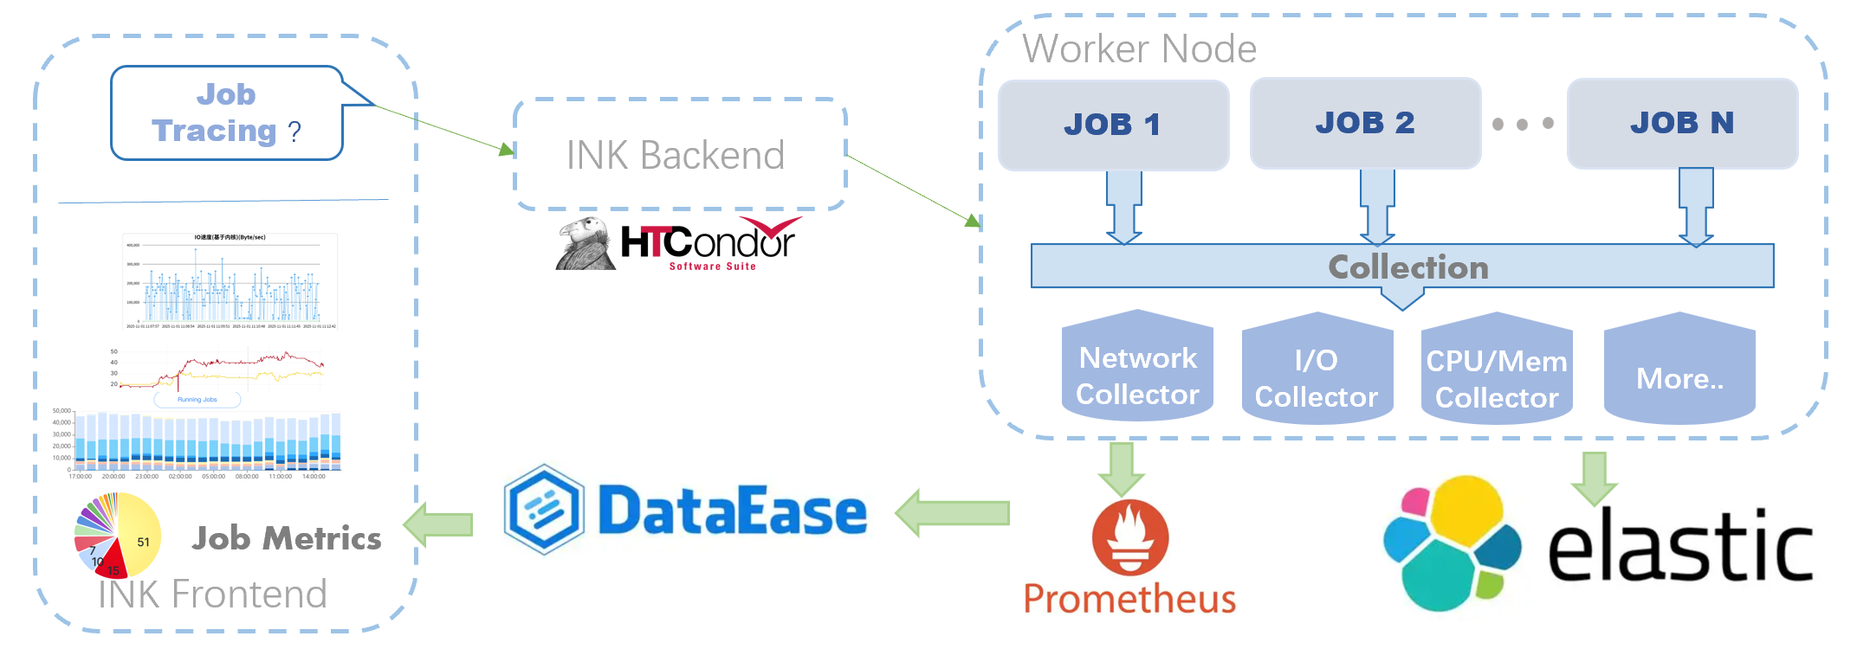
New features – Job Tracing (Undergoing)
Tracing jobs actions during the whole job life
  Resource (cpu, disk, memory, network etc) consuming in real time
  Further metrics: system calling from the job
​​Workflow of Job Tracing
  Job tracing query from User via INK web page
  Locate the operation node of the job provided by HTCondor by the INK backend
  Job tracing daemon collect the metrics and sends to ElasticSearcg/Prometheus/….
  Tracing plot generated based on DataEase and showed in INK web page

Slide 14
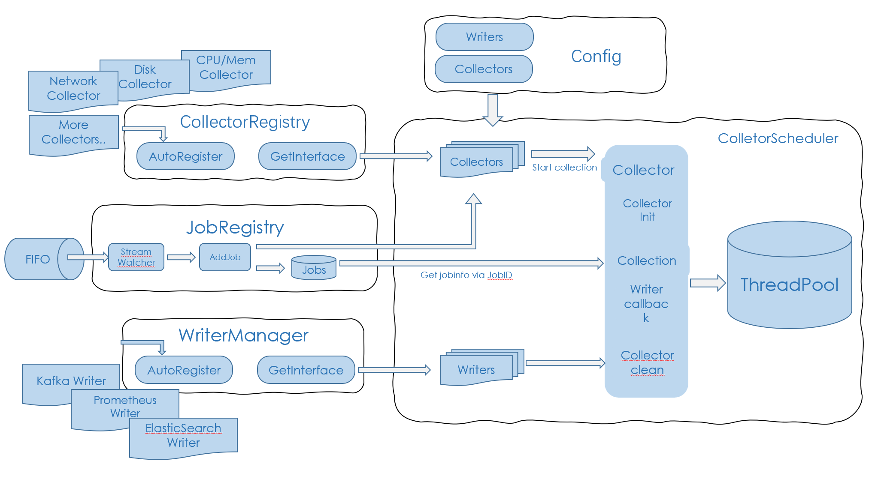
Design of Job Tracing in Details

Slide 15
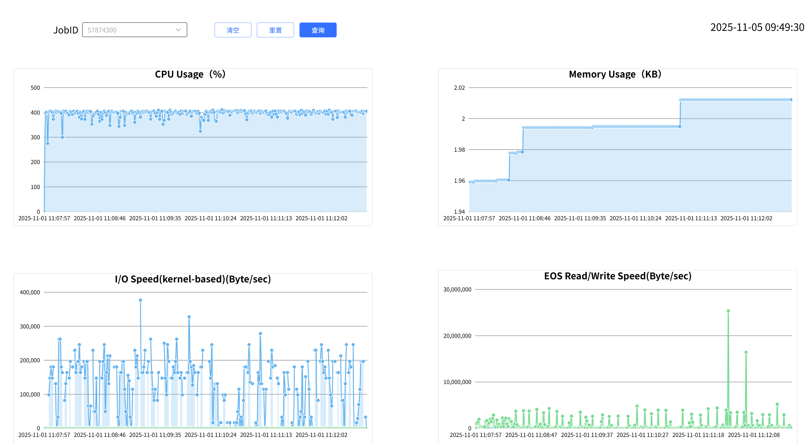
Test Example for JUNO Experiment
Tracing the JUNO analysis job

Slide 16
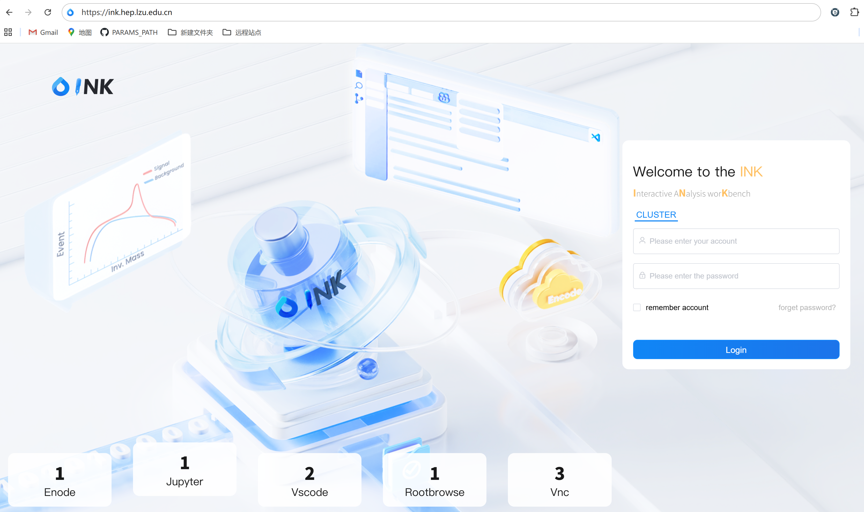
Current Status
Publicly accessible at IHEP https://ink.ihep.ac.cn
  First official release: Mar. 2025
  Total of 48 patch versions, 4 minor versions, and 2 major versions
Quite positive user feedback received!
Deployed at local cluster of Lanzhou Site in Nov. 2025
Open source in Oct. 2025
https://github.com/INK-IHEP/fastink-code
https://ink.hep.lzu.edu.cn

Slide 17
Next Steps
Performance optimization
More functions
  Job tracing
  Customization for the dedicated Experiment workflow (AliCPT)
  。。。。。

Slide 18
Summary
INK focus on providing an interactive usage of the cluster
  Provides users with a “frontend usage” for “backend resources”
  Received positive feedback from users since the first release published
New functions developed and further development is ongoing based on the HEP requirements
  Comments and suggestions are welcomed!

Slide 19
Acknowledgement
INK is supported by the key national research and development program
"Intelligent Data Transmission and Operation Monitoring System for the Primordial Gravitational Wave Telescope"

Slide 20
Thank You!
Questions?

