Slide 1

Data analysis and Software at LHAASO
L.Q. Yin(尹丽巧)
Institute of High Energy Physics, CAS, China
Nov 3 – 7, 2025 @ HEPiX Fall 2025 Workshop

Slide 2
Content
LHAASO Overview
Scientific Goals & Results
Data & Computing Resources
Future Prospects
Summary

Slide 3
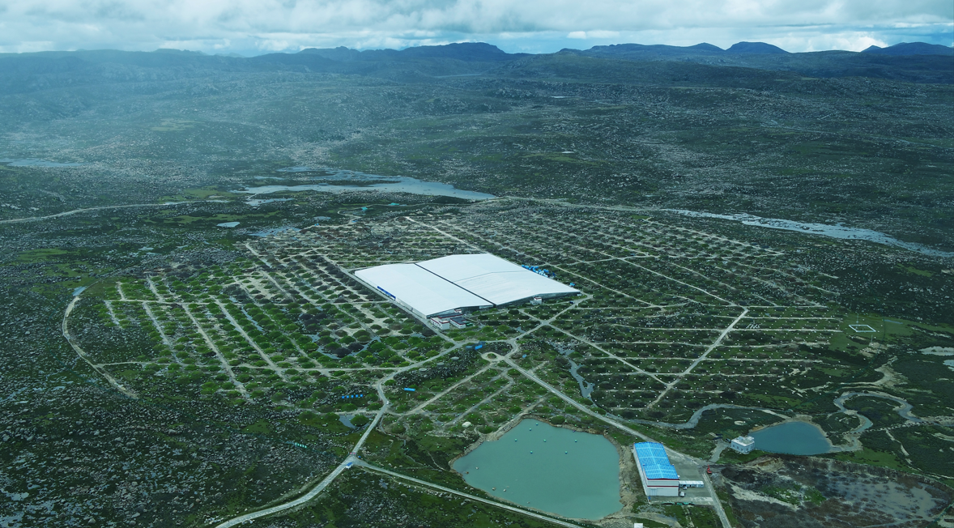
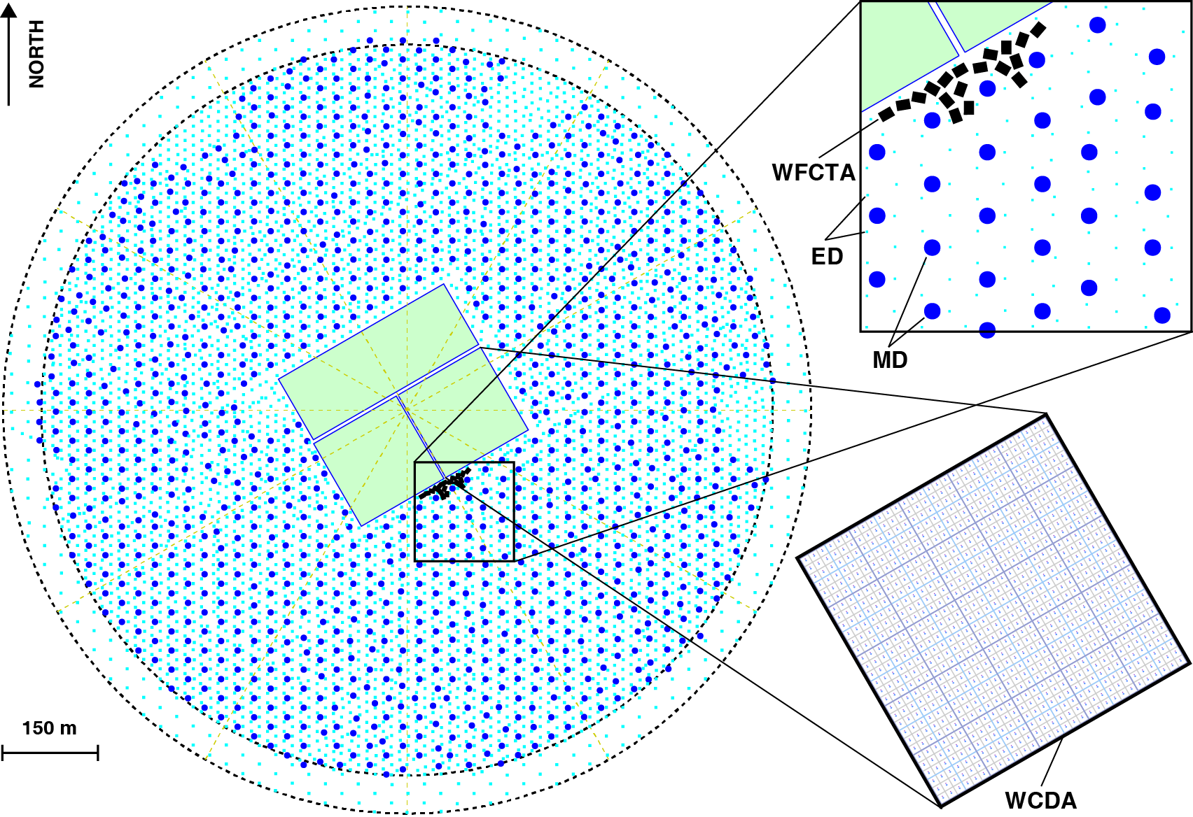
Large High Altitude Air Shower Observatory
Location：North 29º21’ 27.6” , East100º08’19.6”
Mt.Haizi, in Sichuan province, China.
Altitude：4410m a.s.l
Aera：1.3 km²
2009, first proposed
2017, construction began
2021, full array was completed

Slide 4

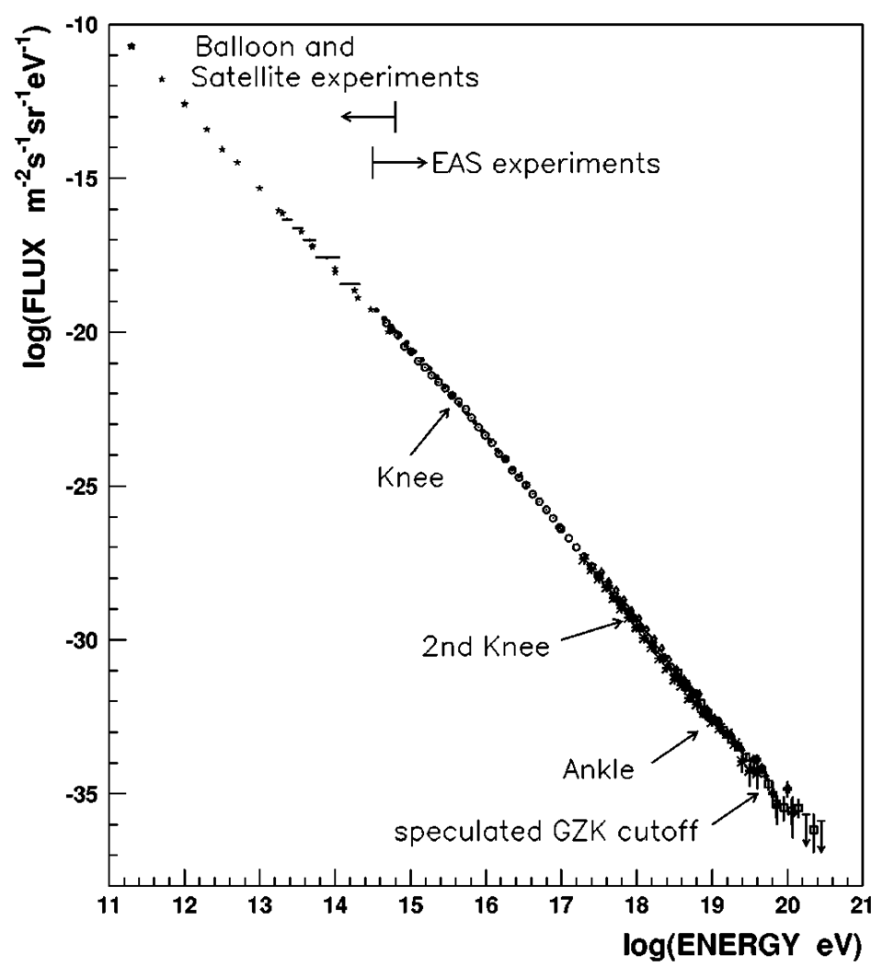
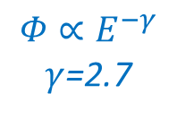
Cosmic ray
High-energy particles from outer space
Charged nuclei such as proton, helium, ... ;
gamma rays, electrons, and neutrinos.
Energy Spectrum
Power-law with index of -2.7；
Spanning 10 orders of magnitude in energy and 30 orders of magnitude in flux;
There are fine structures, which are closely related to their origin, acceleration, and propagation mechanisms.
Detection Techniques
Direct measurement in space using balloons, satellites, etc.
Indirect measurement on the ground through Extensive Air Showers (EAS).
1 particle / m² /year
$$Φ∝E^{−γ}$$
$γ$=2.7
1 particle / km² /year

Slide 5
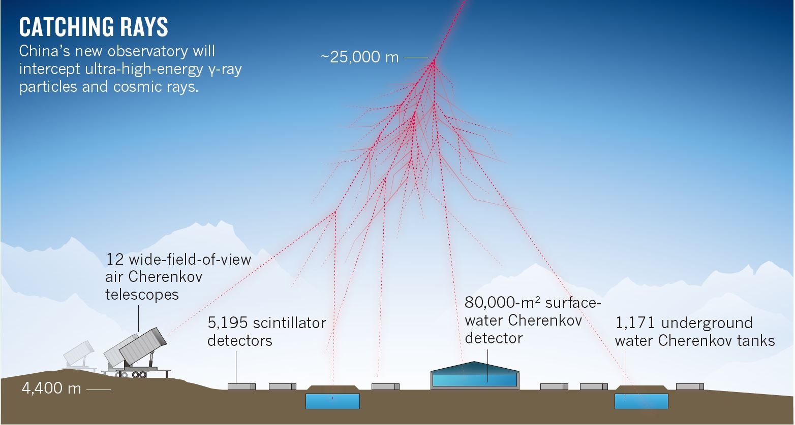
Extensive Air Shower
Primary cosmic rays interact with air nuclei, creating secondary particle showers.
Use different particle detectors to measure the arrival times & quantities.
Reconstruct the primary cosmic ray info (direction, energy, component).

Slide 6
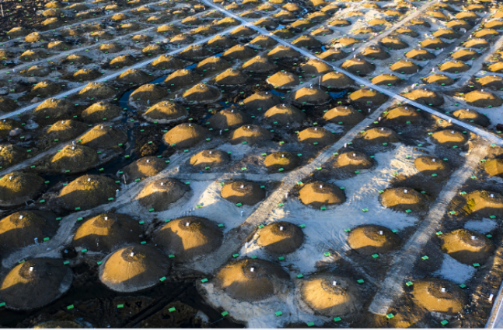
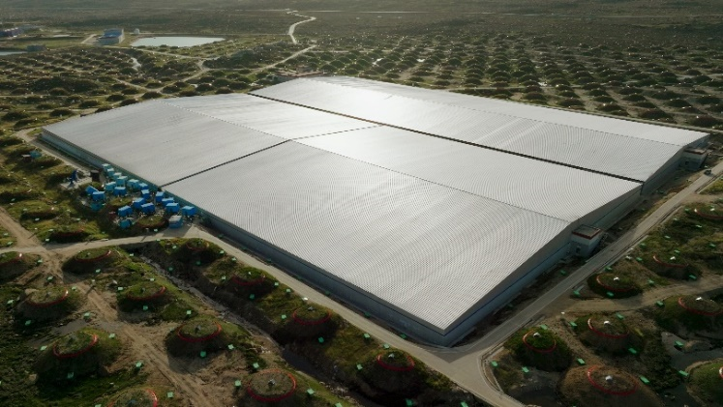
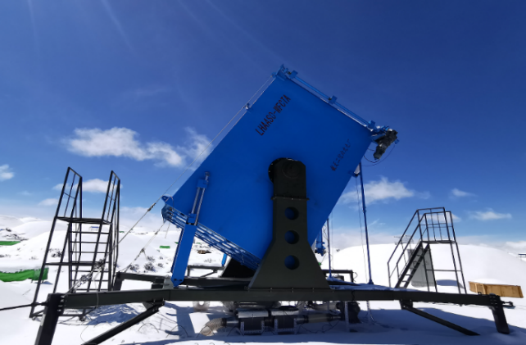
LHAASO Detector Arrays
square kilometer array
(KM2A)
Water Cherenkov Detector Array
(WCDA)
Wide FOV Cherenkov Telescope Array
(WFCTA)
Electromagnetic Particle Detectors (ED)
Muon Detectors
(MD)
5216 EDs
18 telescopes
3120 cells
1188 MDs
The most sensitive UHE gamma-ray detector
The most sensitive VHE gamma-ray detector
The highest degree of complexity cosmic ray detector with the broadest energy coverage

Slide 7
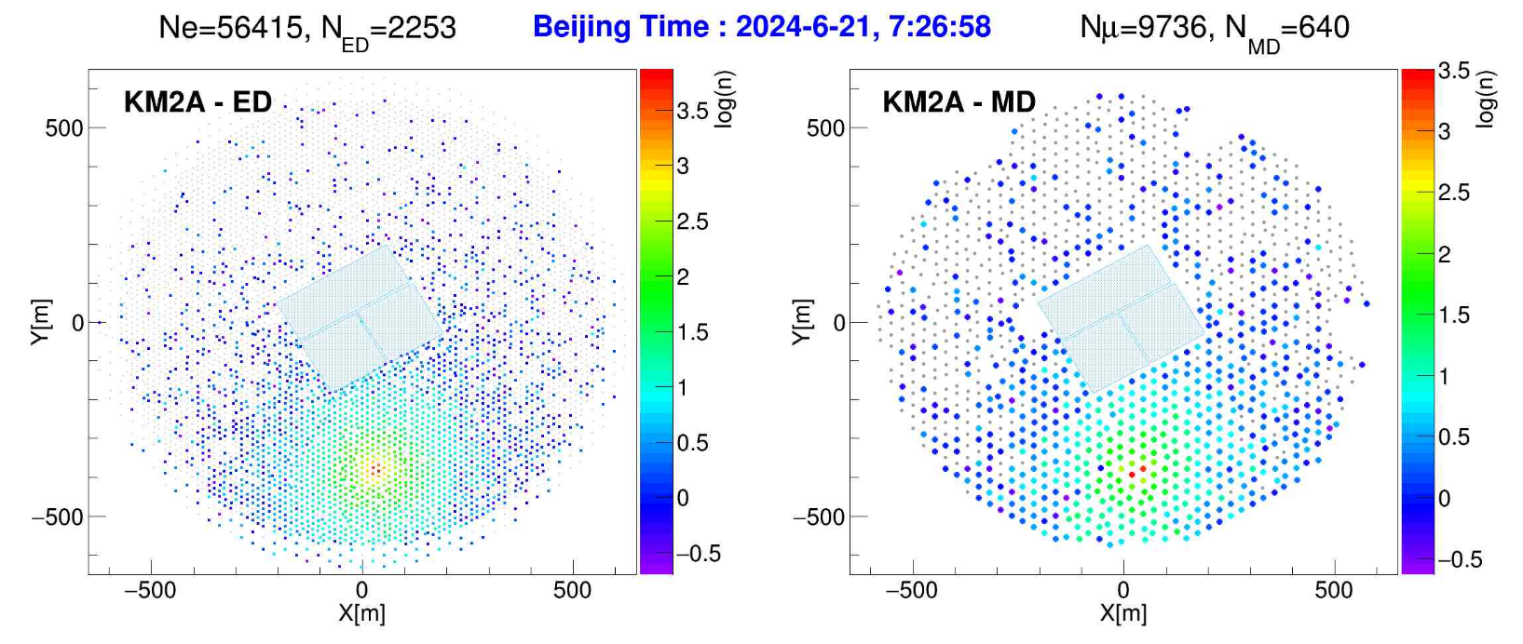
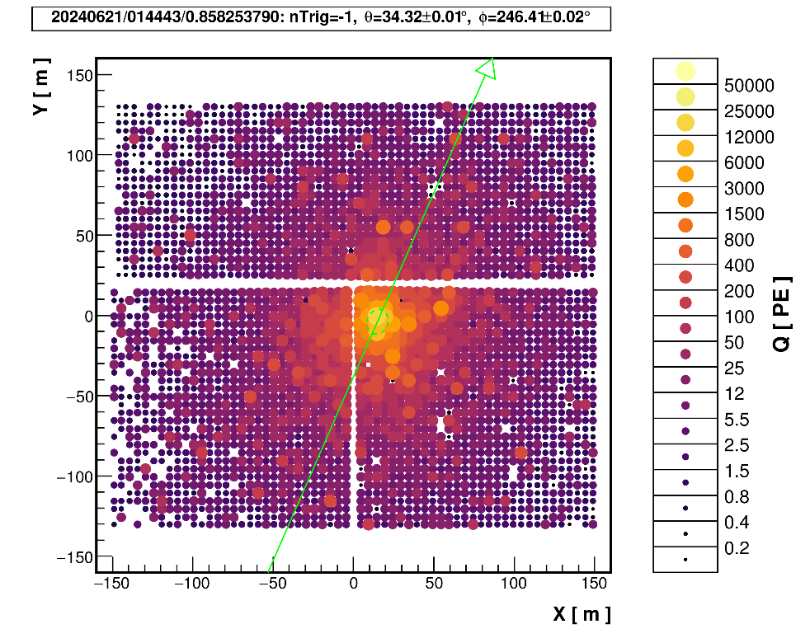
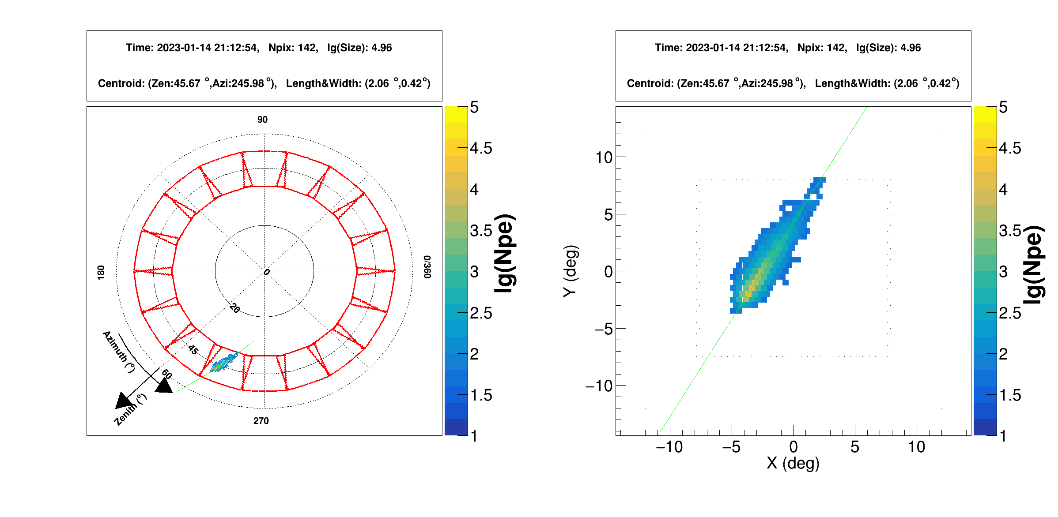
Images of shower events

Slide 8
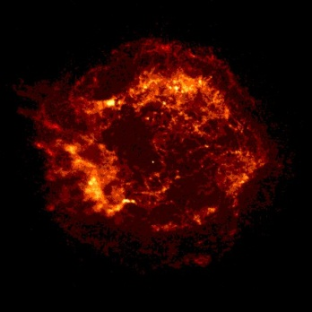
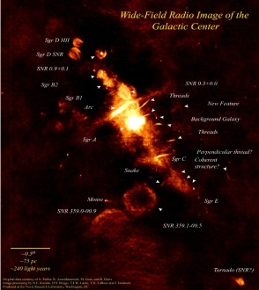
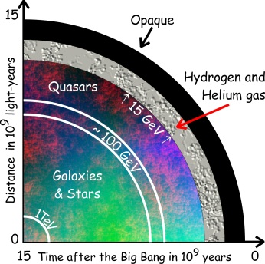
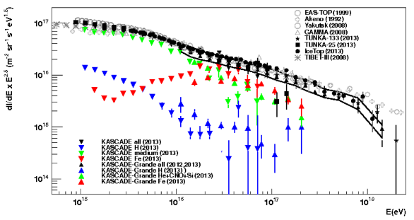
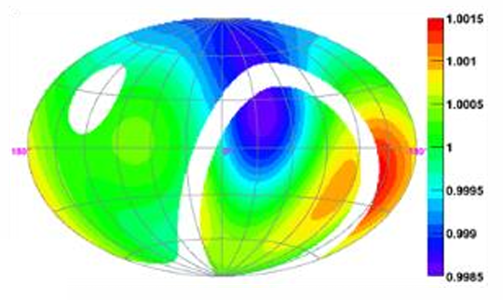
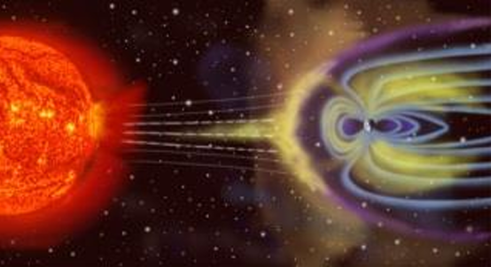
LHAASO Science -- Origin of Cosmic Rays
VHE / UHE Gamma-Ray Sky Survey (100 GeV-1 PeV):
Galactic sources;
Extragalactic sources and flares;
VHE radiation from gamma-ray bursts;
Diffuse gamma rays。
Energy Spectrum (TeV-EeV):
All particle spectrum & component spectra;
Anisotropy;
Cosmic electron energy spectrum.
Others:
dark matter;
Solar storms;
The interplanetary magnetic field (IMF).
SNR
WIMPs
EBL and Gamma-Ray Horizon
Component energy spectra
IMF
Anisotropy

Slide 9
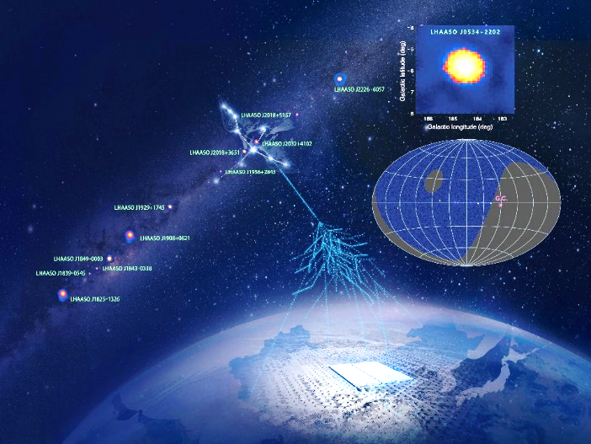
LHAASO Results (1)
Discovery of the First “PeVatron” and Highest-Energy Photons
Open UHE Gamma-Ray Sky
Revealed the widespread existence of “PeVatrons” within the Milky Way.
Challenged previous understanding of particle acceleration limits for celestial objects in our Galaxy.
Nature 594, 33 (2021)

Slide 10
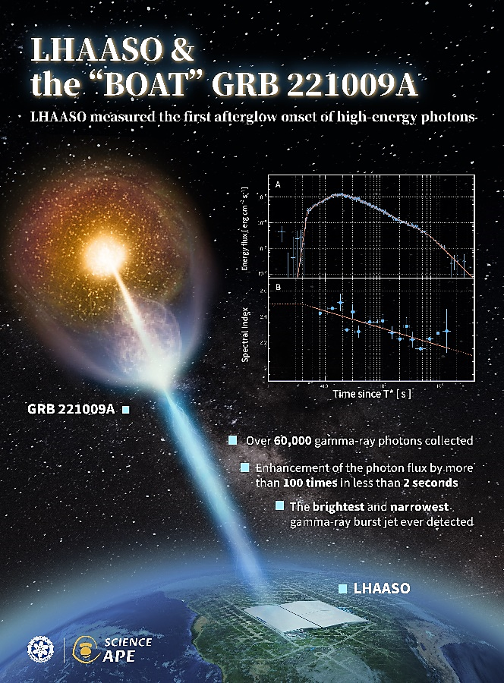
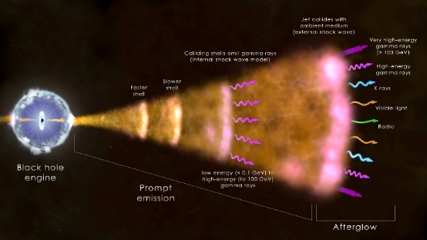
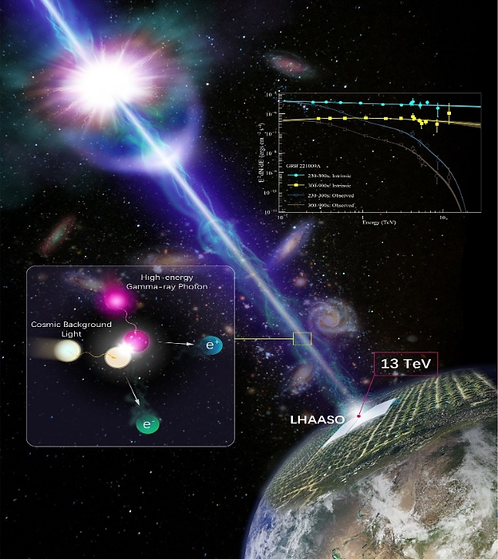
LHAASO Results (2)
TeV GRB Full Record (Science, 2023)
First complete documentation of a TeV GRB from massive star death.
Precisely measured entire high-energy photon burst.
First detection of rapid flux enhancement.
Record-breaking brightness explained.
Brightest GRB Spectrum (Science Advances, 2023)
First 10 TeV GRB observation window opened.
Spectrum extends to 13 TeV, challenging afterglow models.
Less absorption of 10 TeV gamma rays by infrared background light.
BOAT GRB: 221009A

Slide 11
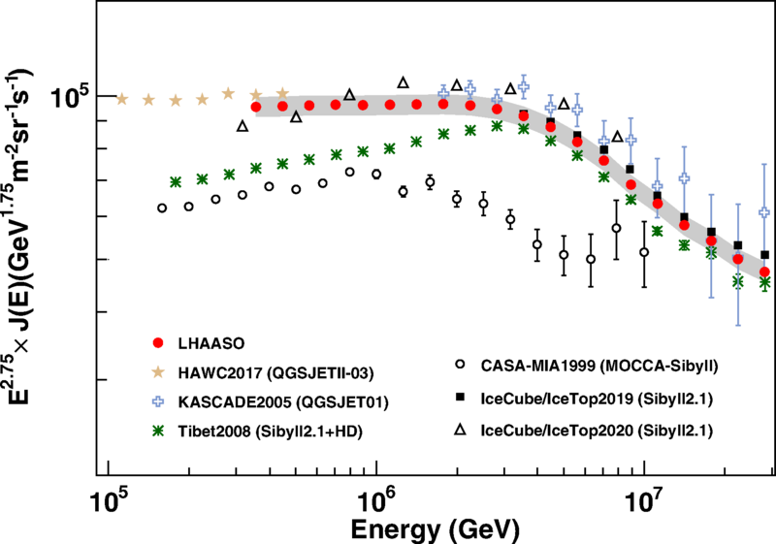
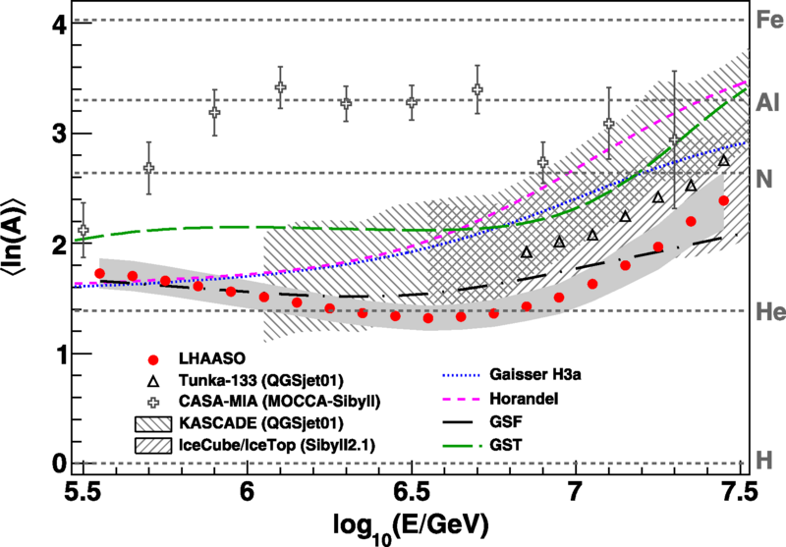
LHAASO Results (3)
Precise Measurement of Cosmic Ray All-Particle Spectrum and Average Mass Number (⟨lnA⟩)
Most precise measurement of the cosmic ray all-particle spectrum in the energy range 300 TeV – 3 PeV.
Most precise measurement of ⟨lnA⟩ in the energy range 300 TeV – 3 PeV.
The consistent trends of both measurements indicate an unknown change in cosmic ray composition within this energy range.
Highlighted Publication: Physical Review Letters 132, 131002 (2024)

Slide 12
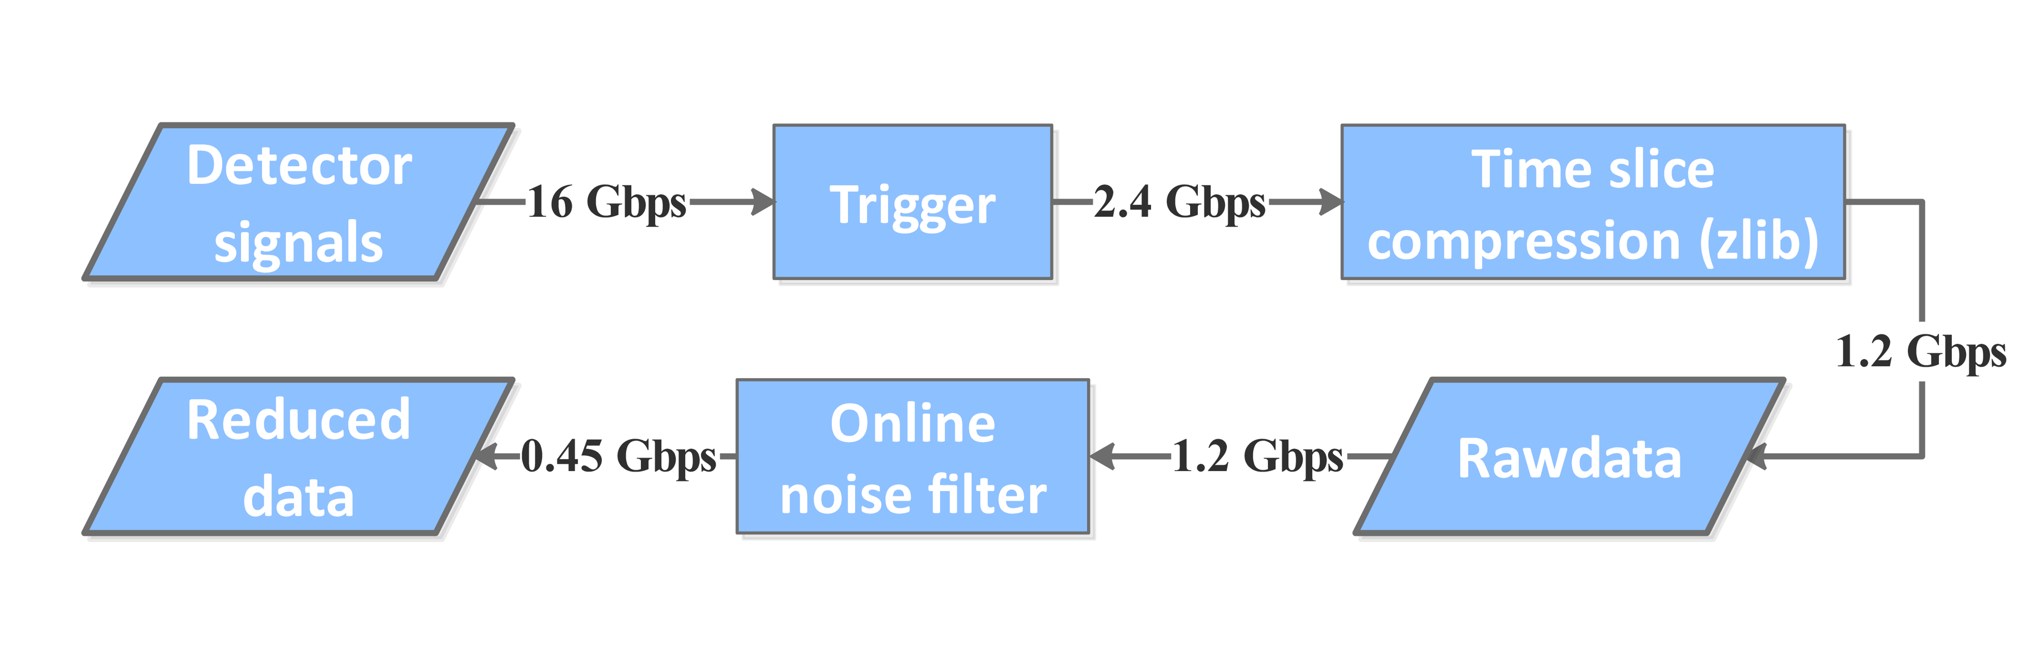
LHAASO Scientific Data Status - Annual Data Volume
Scientific Data Categories |  | events (billion) | storage (TB)
WCDA | trigger | 1000 | 2000
 | non-trigger | 100000 (hit) | 1500
 | simulation | 0.2 | 1000
KM2A | trigger | 145 | 800
 | simulation | 0.1 | 300
WFCTA | Observation | 0.1 | 150
 | simulation | 0.005 | 1500
Total |  |  | 7250
WCDA On-site Real-time Processing Flow for Triggered Data:：
Trigger：15%
Compression：50%
Noise Filtering：37%
Total Reduction Ratio：2.8%
WCDA On-site Real-time Processing Flow for Non-Triggered Data：
Receives GCN signals, ~2.5 per week
Each event retains 0.5 + 2.0 hours of data

Slide 13



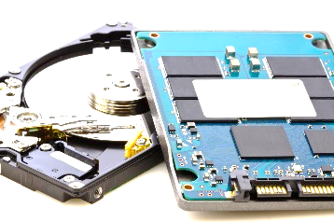

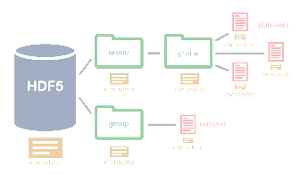
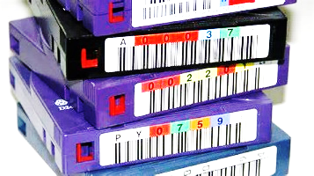
Data Formats & Storage Methods
Data Formats:
Raw, simulated, and various generated data:
ROOT（Particle Physics field）
Some data products (planned):
FITS（Astronomy field）
HDF5（For various types of complex big data）
Storage Methods:
Raw data：
Disk (majority)) + Tape (all)
Reconstructed Data：
Disk (majority)) + Tape (non)
Simulation Data：
Disk (majority)) + Tape (non)
Standard Data Format: HDF5 storing ROOT, or ROOT storing HDF5, or integrated interface programs

Slide 14




Data Transfer & Computing Resources
DAQ
(~24 Gpbs)
Detector
(~10000 channel)
Data transfer
(~3 Gbps)
Haizi Mountain Data Center
(~5000 CPU cores，~7 PB storage)
Beijing Data Center
(~15000 CPU Cores，~60 PB Disks，~80 PB tapes)
Dongguan Data Cetner（18000 ARM cores, 8000 x86 cores）
Job submit
User
(~200)
Login Nodes
Data Throughput：22 PB/Month

Slide 15
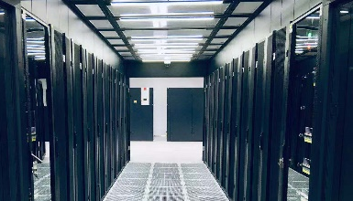
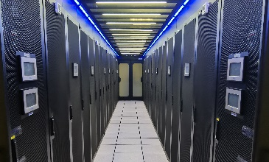
Computing Resources
Large scale, numerous users, complex systems, high service requirements, rapid data growth
Hardware: 314 blade servers; 69 disk arrays; Large-scale tape library; Network & security infrastructure
Locations/Resources: 3 primary data centers: Haizishan Observation Base, Daocheng Monitoring & Control Base, Beijing IHEP; plus resources like the Dongguan Big Science Data Center
Capacity
60 PB Disk
51 PB Tape
3 Gbps Network
20,000 CPU cores
18000 ARM cores, 8000 x86 cores from Dongguan Data Cetner
Systems
Computing system, Storage system, Tape library system, Network system, Data transfer, and Data center infrastructure
Annual New Data: ~11 PB
Platform Data Throughput Capacity: 22 PB/month

Slide 16








Data Processing Software
Collaboration Software
reconstruction, simulation, and analysis software:（~350k lines of custom code）
Data analysis and processing control software:，python（~50k lines of custom code, plus numerous external libraries; gradually expanding）
Data processing control software：Shell script（~50k lines of custom code）
External Libraries (ANYSW)：G++/GFORTRAN BOOST MYSQL POSTGRESQL CERNLIB CLHEP CASTOR COIN3D JAS SLALIB PAL ROOT CORSIKA GEANT4
BINUTILS CMAKE AUTOCONF AUTOMAKE READLINE ZLIB XZ SZIP LZ4 TAR OPENSSL SSH2 CURL LIBFFI SQLITE PYTHON2 PYTHON3 OPENJPEG TIFF XMLTO IMLIB2 XML2 XMLTOMAN GIF PNG FREETYPE AFTERIMAGE EXPAT GRAPHVIZ CPPUNIT XERCESC FFTW GSL CFITSIO XROOTD LIBAIO ODBC PYTHIA6 PYTHIA8 DAWN VRML PCRE2 PCRE MONALISA LIBDAEMON INTLTOOL CAIRO AVAHI GL2PS VECCORE VECGEOM HDF5 LAPACK HEPRAPP LIBPAPER GS VIM WT ZEROMQ JSONCPP XSD SPDLOG SOCI REDIS HIREDIS RE2 PROTOBUF LIBEVEN
OS Software
OS：
CENTOS7、AlmaLinux9
Job Control：
condor、slurm、Grid
File Systems, Tape Management:
EOS、luster、CTA
User Management, Computer Management, etc.：
......

Slide 17
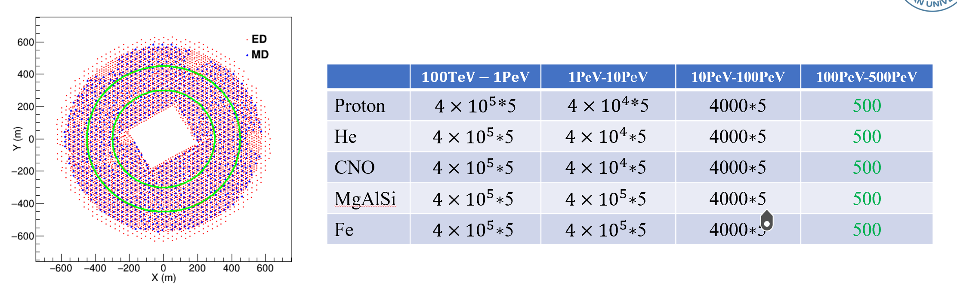
LHAASO Simulation Data Next
Energy @~50PeV, G4KM2A average runtime 6–7 hours; ~10% of events exceed 48 hours.
Energy @~200PeV,G4KM2A average runtime 50% of events require >100 hours of computation
Requires >10⁸ hours of total computing time.

Slide 18
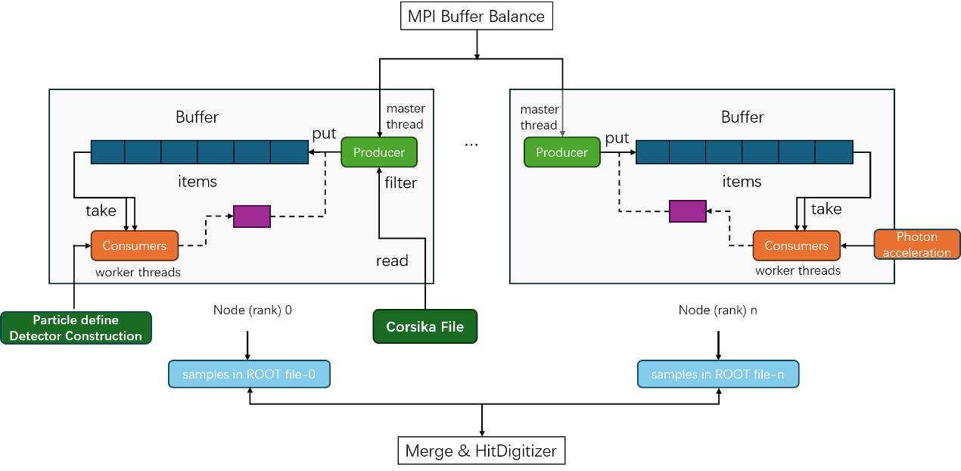
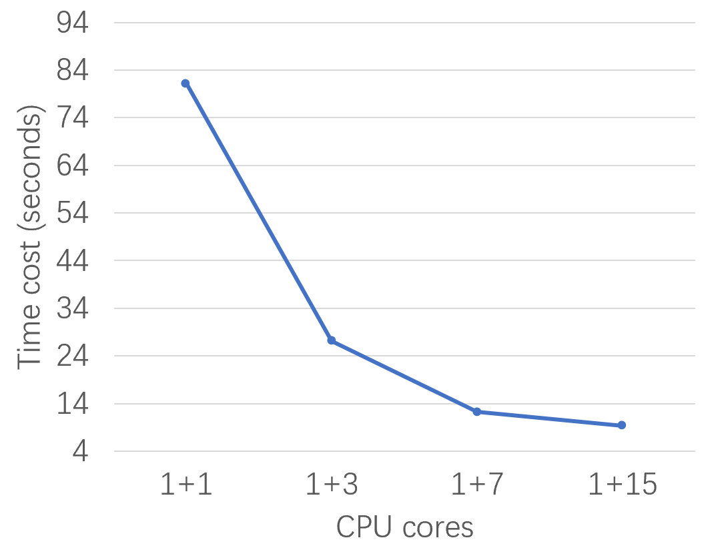
Parallel Optimization of G4KM2A on Tianhe Supercomputer
By Shun Xu (CNIC)
Performance Comparison:
Original G4KM2A (Single-Core Serial Version): 122.78 s
G4DMT-KM2A (16-Core Parallel Version): 9.2 s
Speedup: 13.34×
Parallel Efficiency: 83.3%
The parallel program is under optimization;
Plan to run on Tianhe supercomputer.
Significantly enhances the simulation efficiency of cosmic rays above 100 PeV.

Slide 19
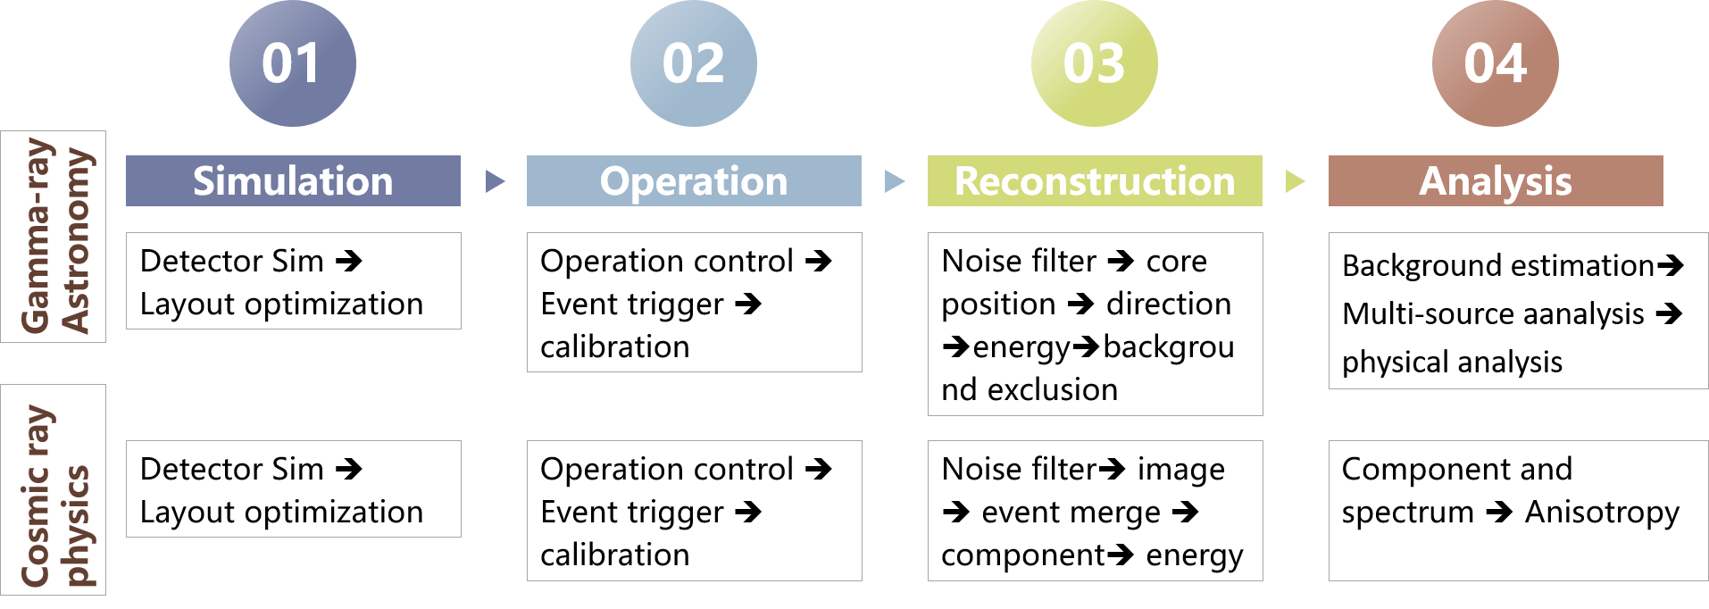
LHAASO Intelligent Upgrading Project
AI boosts LHAASO’s performance across all four modules！

Slide 20
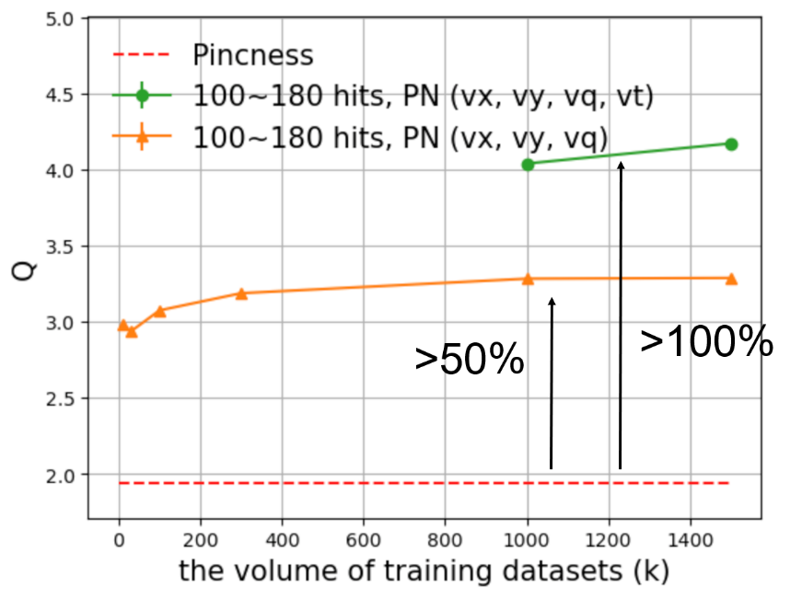
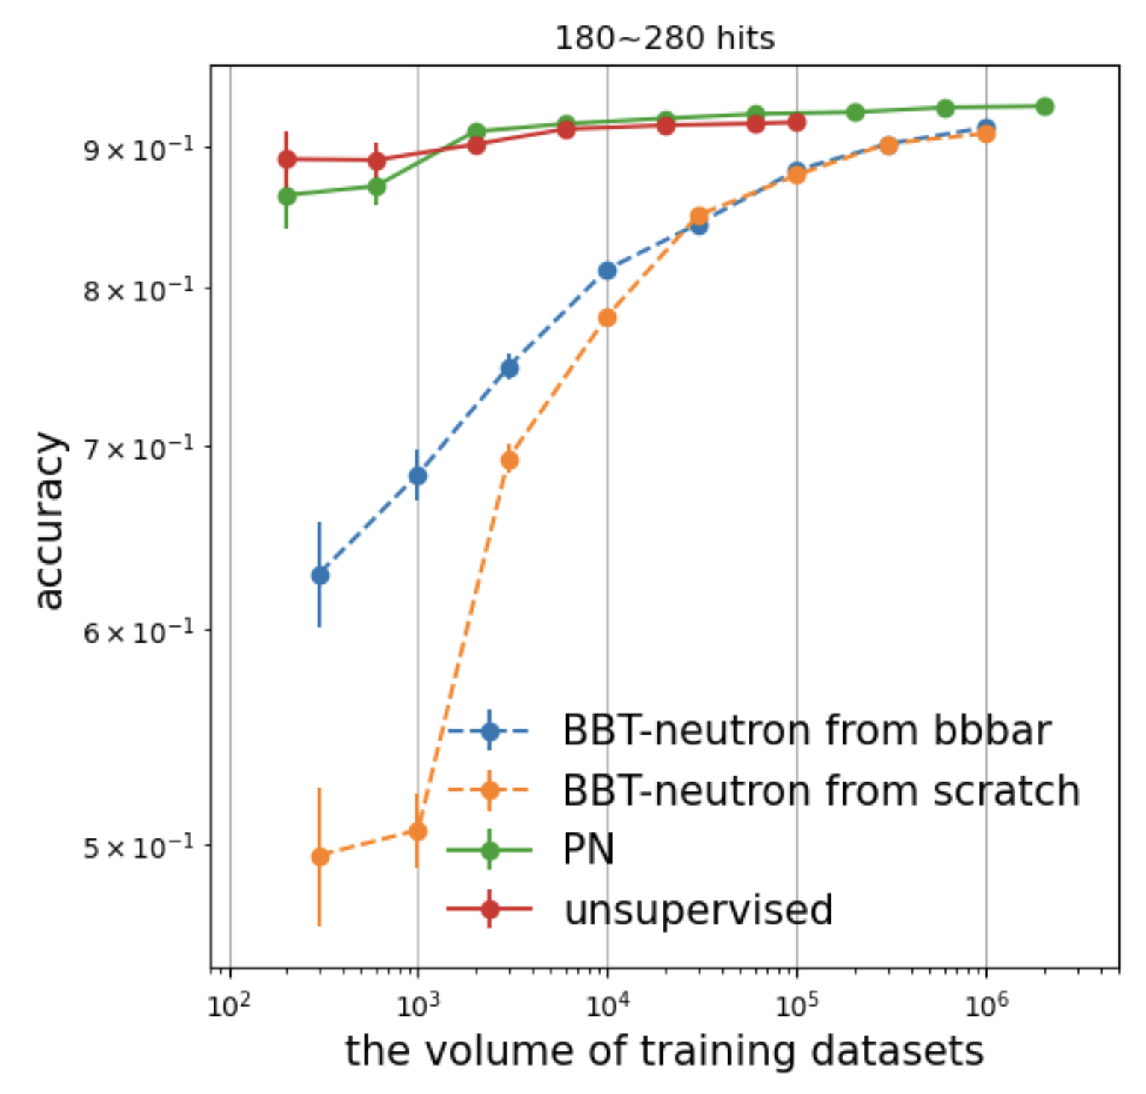
ParticleNet for particle identification
By Yongfeng Zhu, Shicong Hu, et.al(IHEP)
PNN method
Model Impact: Significantly improve γ/p discrimination performance.
Validation Requirement: Data-simulation validation studies are essential
Method Comparison:
Supervised Learning
Unsupervised Learning
Large Language Models (Transfer Learning)

Slide 21
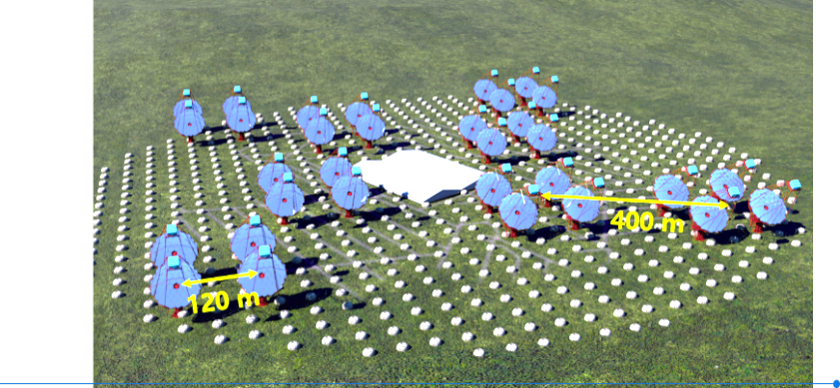
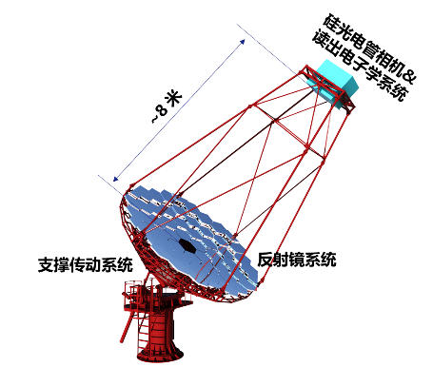
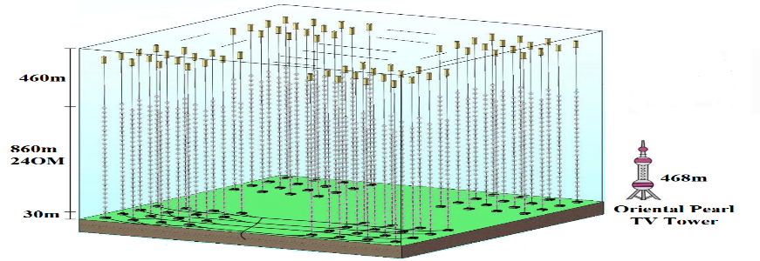
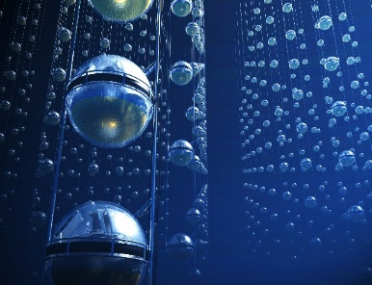
Upcoming/Planned New Facilities
Large Array of imaging atmospheric Cherenkov Telescope（LACT）
Objective: Enhance cosmic-ray accelerator identification by mapping fine structures of spatially extended gamma-ray sources.
Location: Within LHAASO site.
Configuration: 32 Cherenkov telescopes (6m diameter each).
High-energy Underwater Neutrino Telescope （HUNT）
Context: Building on LHAASO's discovery of numerous UHE gamma-ray sources, HUNT aims to achieve the first hadronic confirmation of high-energy neutrino sources.
Expected Sites: Lake Baikal, Russia / South China Sea.
Scale: ~40,000 optical modules distributed across 36 km³ volume.

Slide 22
Summary and Prospects
LHAASO has been in full-array operation since July 2021. Over the next 20 years, it will measure gamma rays and cosmic rays from high-energy celestial bodies in the northern sky.
LHAASO offers broad potential for multi-disciplinary research, not only in particle astrophysics but also in computational sciences.
Aiming at the original of cosmic ray, LHAASO, LACT and HUNT are expected to make significant contributions and discoveries in the future!

Slide 23
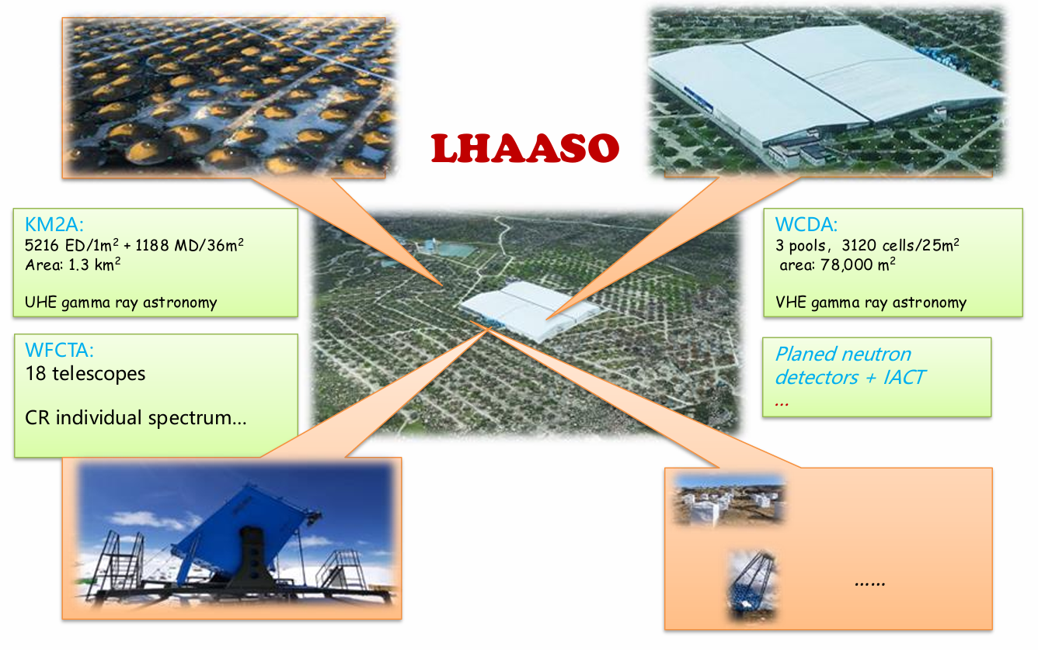

Slide 24
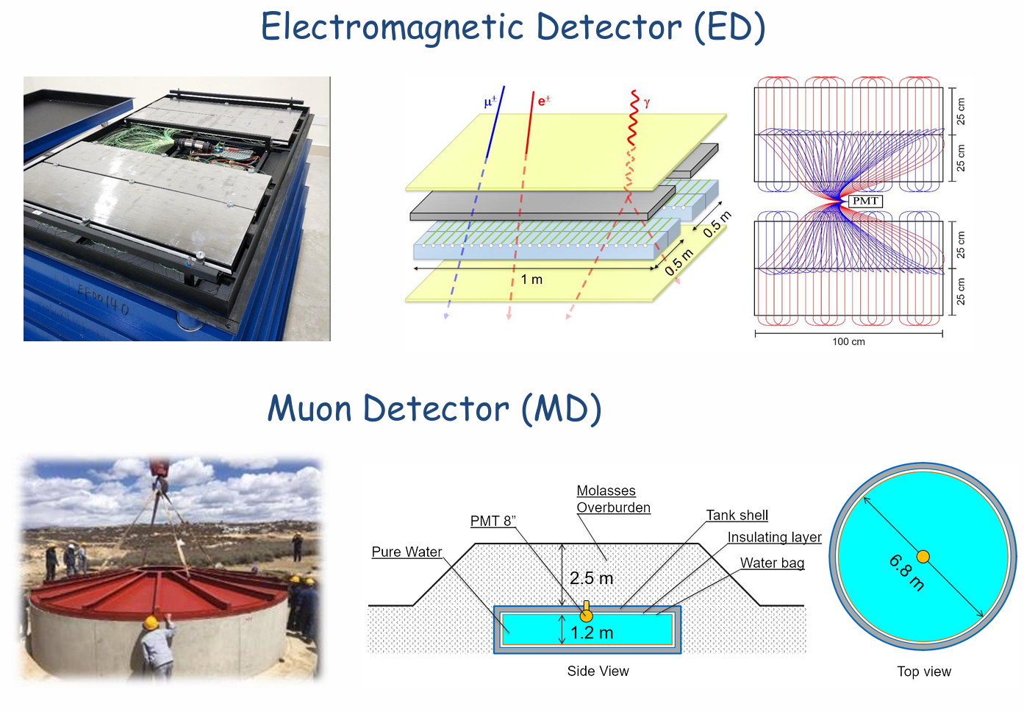
电磁粒子探测器（ED）
缪子探测器（MD）

Slide 25
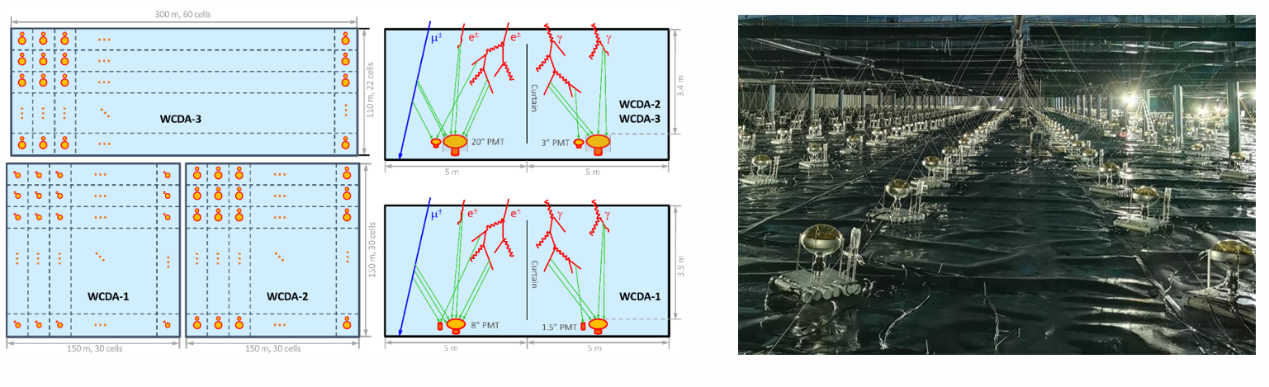

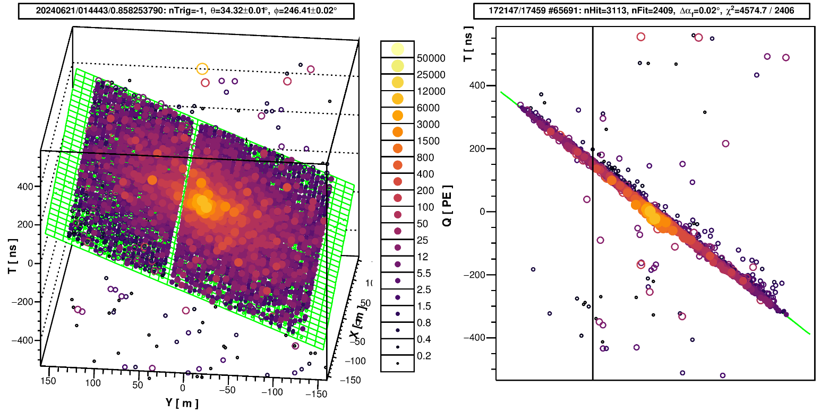

Slide 26
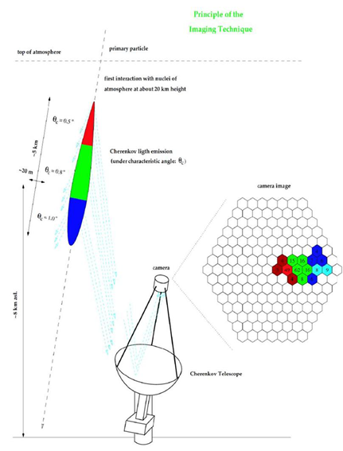
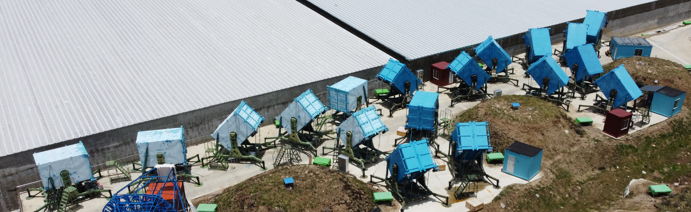

Slide 27
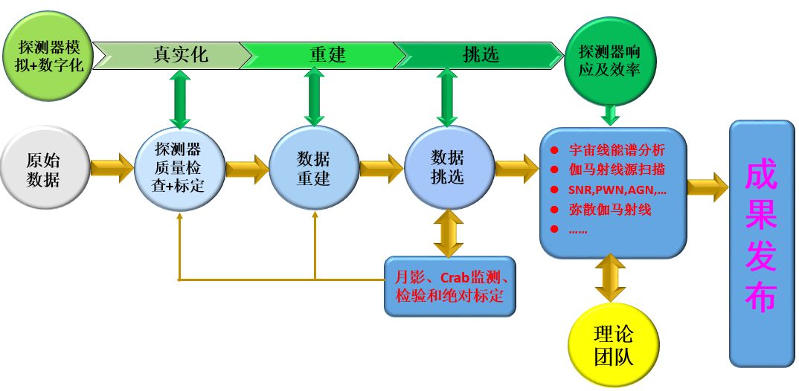

Slide 28
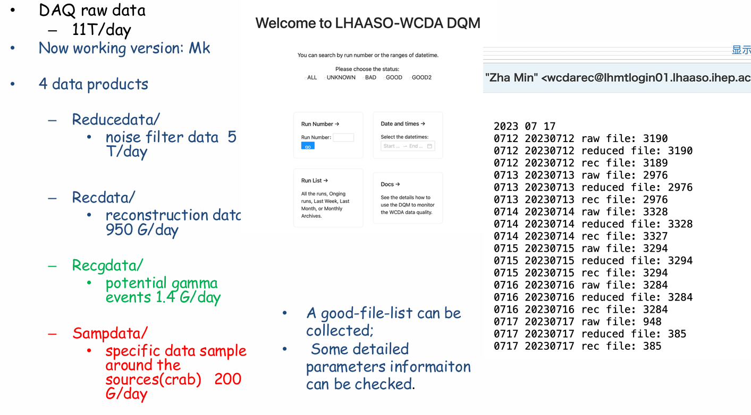

Slide 29
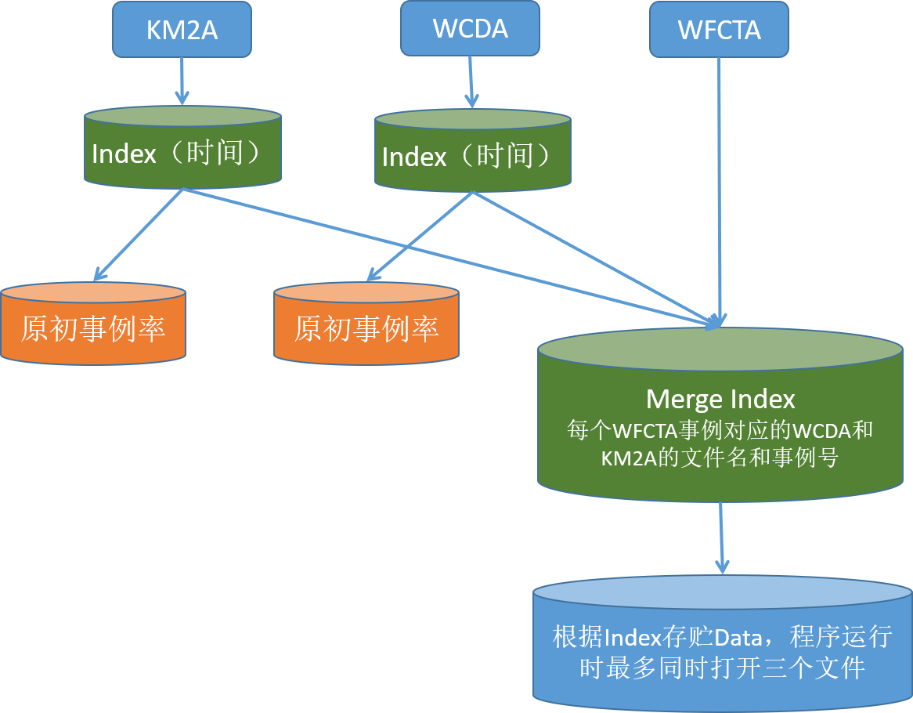
WFCTA和WCDA、KM2A事例符合逻辑框图
难点1：数据量庞大（>3TB，~4000个文件/晚），且在LHAASO建设过程中文件格式等发生变化；以及计算资源方面的限制，如磁盘空间大小、eos应用等。
难点2：随着LHAASO全阵列建设，数据分析全面展开，各物理分析组不断地对各子阵列数据进行优化和更新，如：WFCTA波形积分、KM2A不同标定版本数据等。
使用索引（Index）可以压缩符合时读取数据量，减小作业所需的内存和带宽。
根据索引检测KM2A和WCDA的原初事例率，判断探测器是否正常工作。

Slide 30
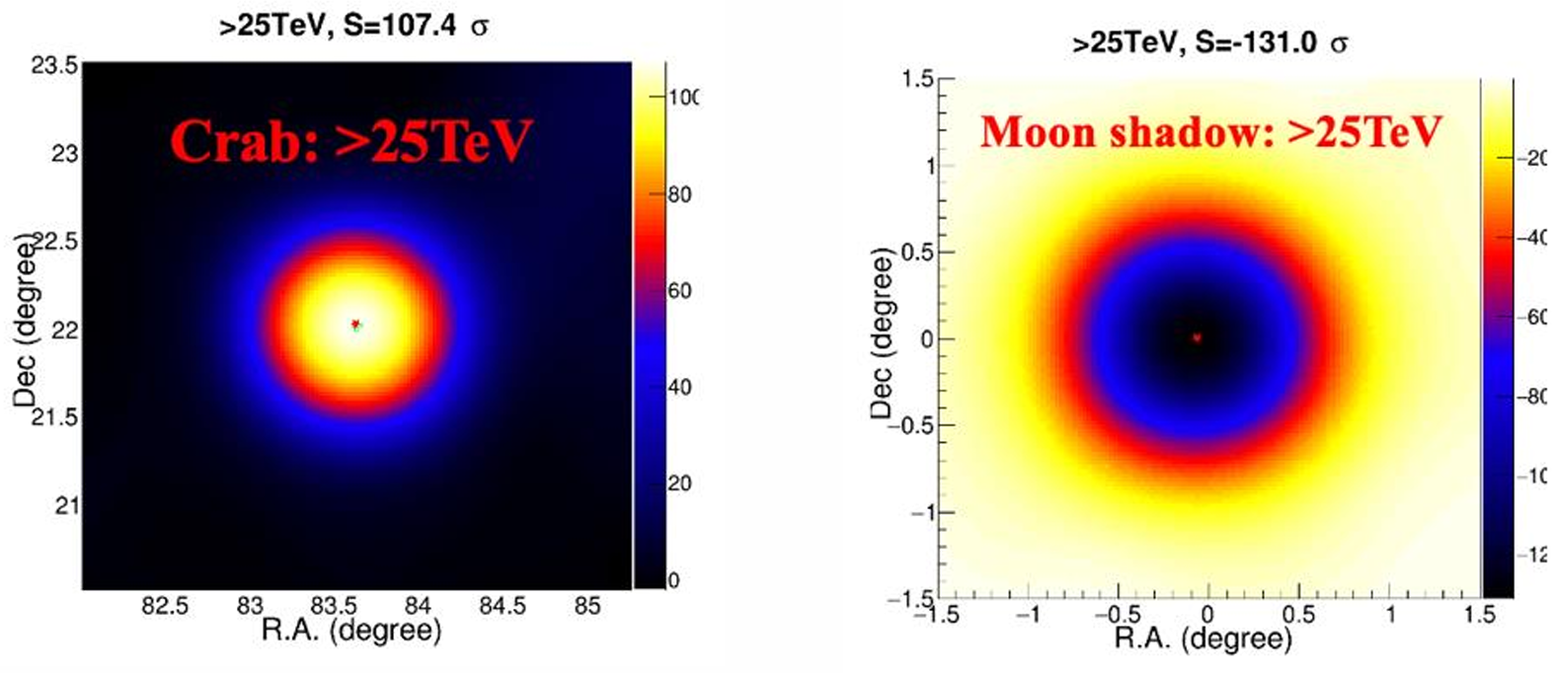
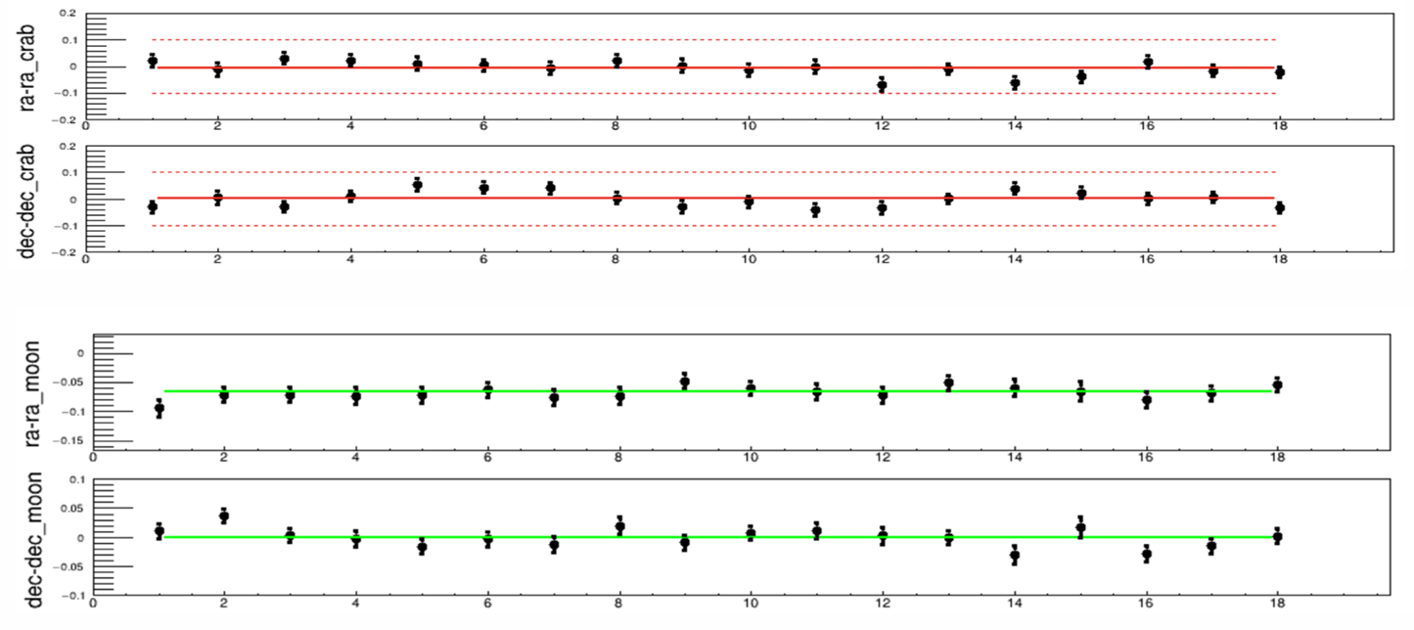
利用月影的中心位置检验阵列指向精度：<0.1°
利用月影扩展尺度（SED）得到的阵列角分辨。
Crab的长期监测显示，阵列的指向精度及角分辨，在全年运行期间满足指标要求，且无明显变化。
对γ射线重建质量的监测
对宇宙线（带电粒子）重建质量的监测

Slide 31
利用月影的中心位置检验阵列指向精度：<0.1°
利用月影扩展尺度（SED）得到的阵列角分辨。
Crab的长期监测显示，阵列的指向精度及角分辨，在全年运行期间满足指标要求，且无明显变化。
对γ射线重建质量的监测
对宇宙线（带电粒子）重建质量的监测

Slide 32




望远镜的运行环境和状态挑选
云天仪（<-65）
DAQ
开关门
月亮与望远镜夹角（>30°）
高压电压>75V
高压电流<1.5A
事例率
L/W
符合时间

