Slide 1


HOM coated loads
29.04.2025
Pablo Martinez-Reviriego; Alexej Grudiev
pablo.martinez.reviriego@cern.ch

Slide 2
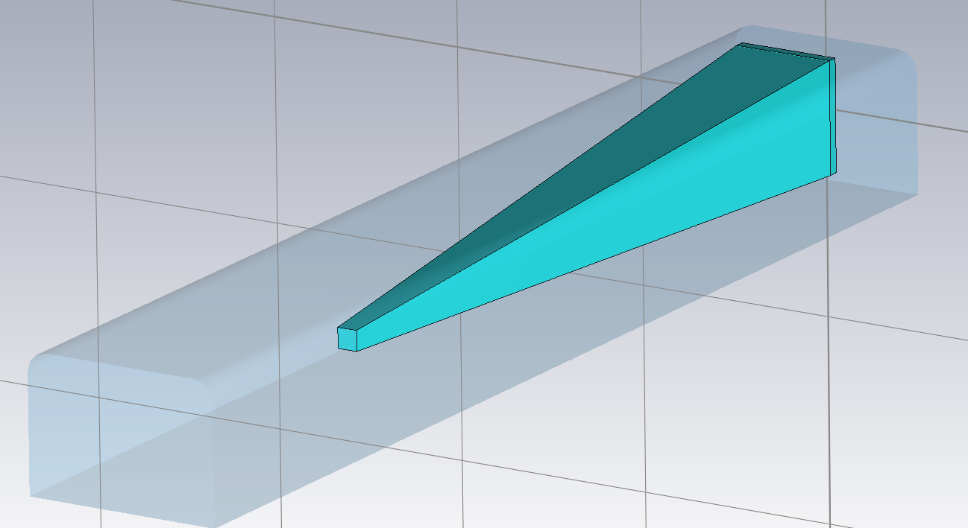
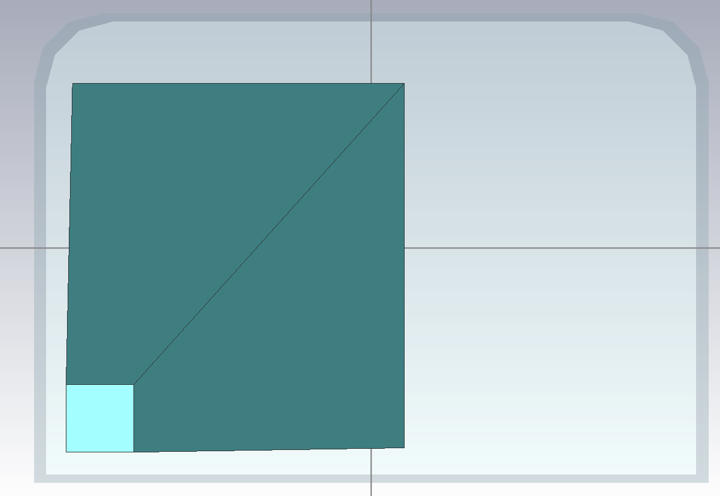
dx
dy
RF Load design
dz
dt
Shape: Pyramid centered on the corner
dt
Mz
tl
Mx

Slide 3
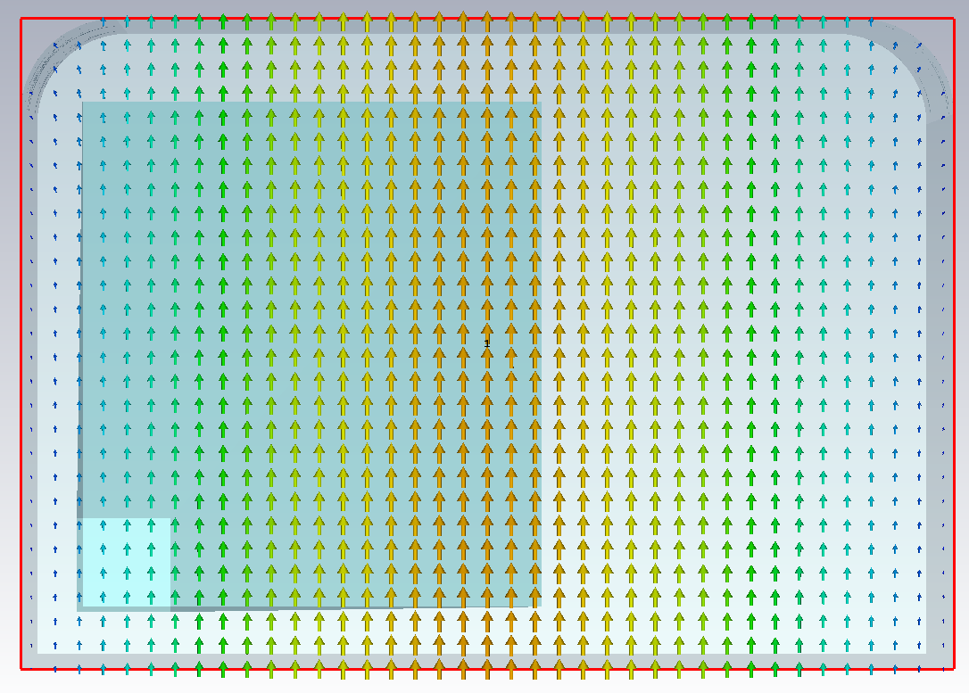
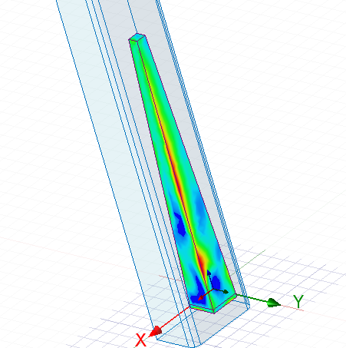
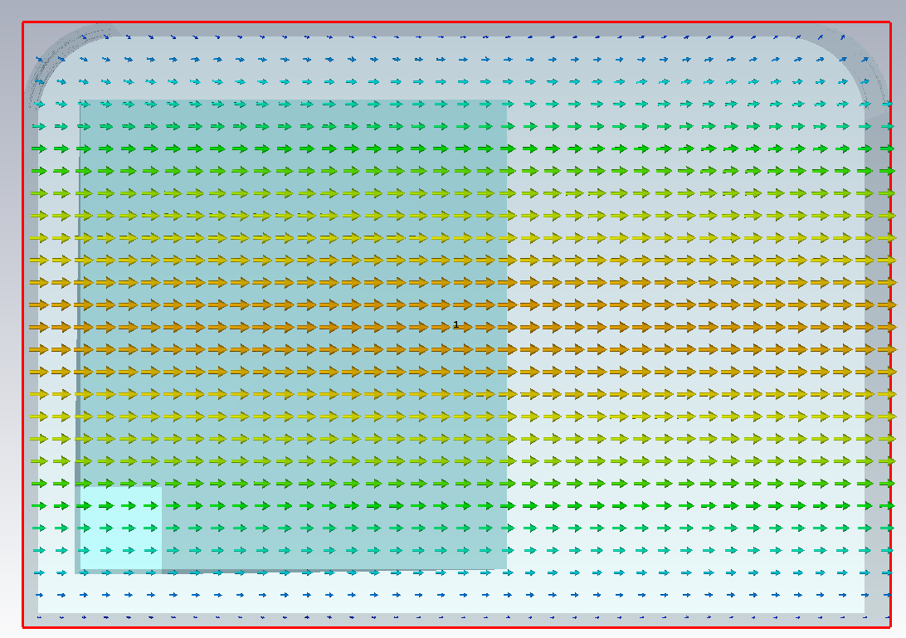


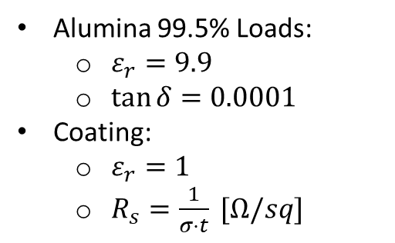
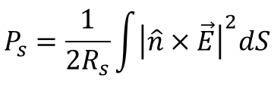
Waveguide modes
$TE_{10}:f_{c}=15.3889$ GHz
$$P_{s}=\frac{1}{2R_{s}}\int{{\left|\hat{n}×\vec{E}\right|}^{2}dS}$$
Alumina 99.5% Loads:
$ε_{r}=9.9$
$\tan{δ}=0.0001$
Coating:
$ε_{r}=1$
$R_{s}=\frac{1}{σ⋅t} [Ω/sq]$
$TE_{01}:f_{c}=22.0701$ GHz

Slide 4
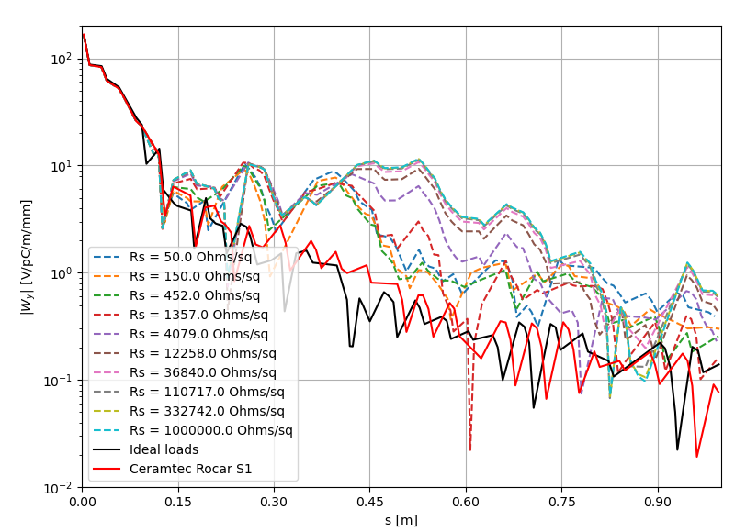
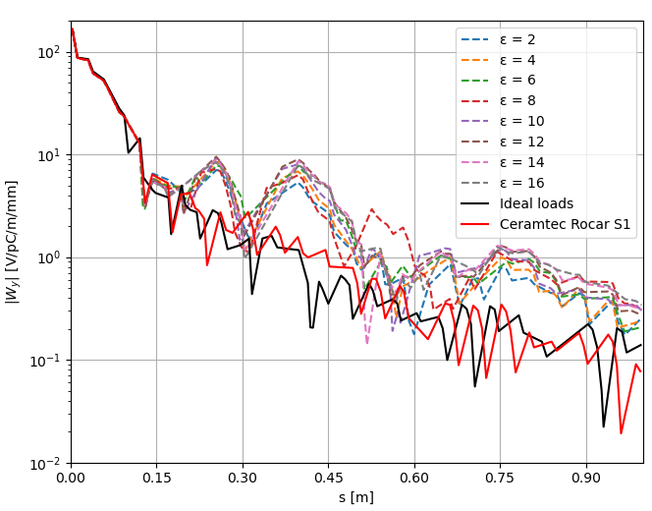
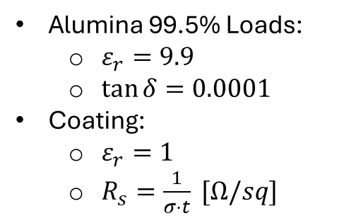

Coating loads
Alumina 99.5% Loads:
$ε_{r}=9.9$
$\tan{δ}=0.0001$
Coating:
$ε_{r}=1$
$R_{s}=\frac{1}{σ⋅t} [Ω/sq]$
$$R_{s}=100 \left[Ω/sq\right]$$

Slide 5
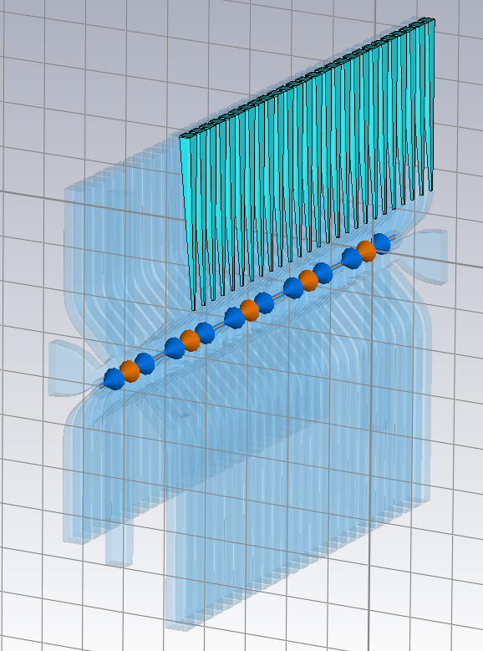
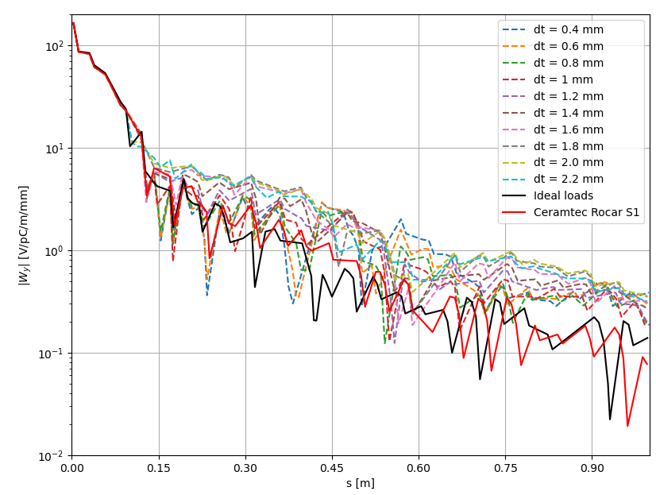


Optimization
Alumina 99.5% Loads:
$ε_{r}=9.9$
$\tan{δ}=0.0001$
Coating:
$ε_{r}=1$
$R_{s}=\frac{1}{σ⋅t}=100 Ω/sq$
$tl=74.5, dy=0.5, dx=dz=5$[mm]

Slide 6
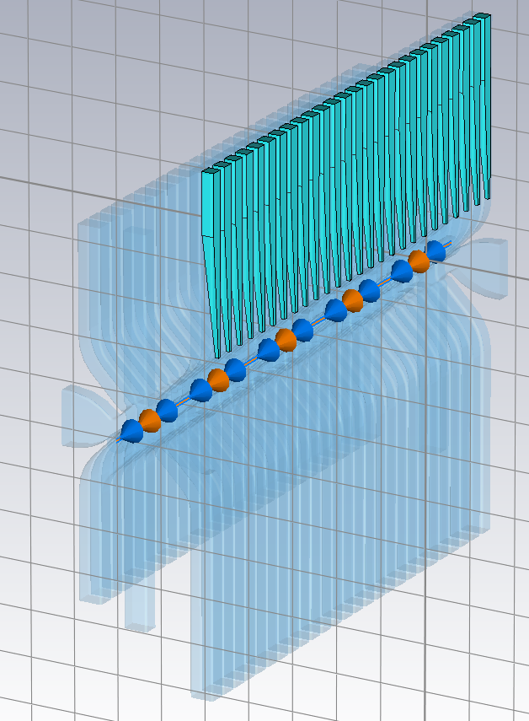
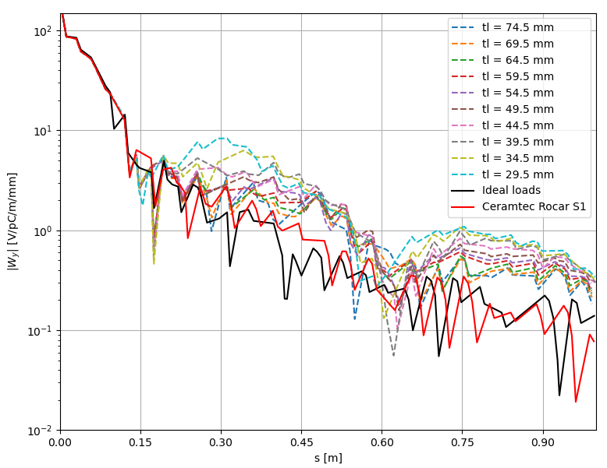

Optimization
Alumina 99.5% Loads:
$ε_{r}=9.9$
$\tan{δ}=0.0001$
Coating:
$ε_{r}=1$
$R_{s}=\frac{1}{σ⋅t}=100 Ω/sq$
$dt=1, dy+tl=75,dx=dz=5$[mm]

Slide 7
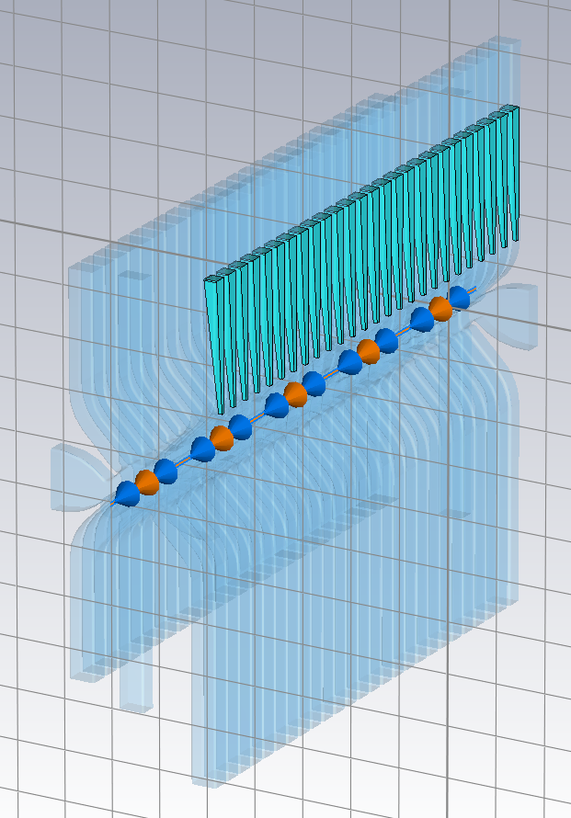
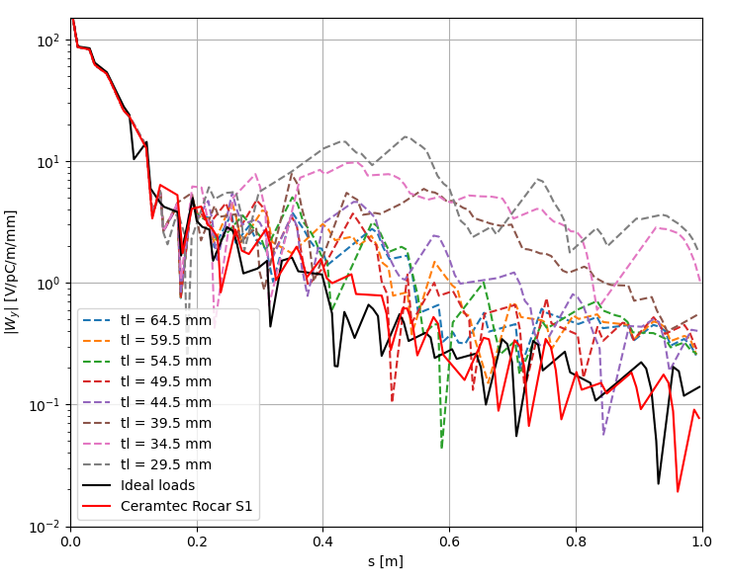

Optimization
Alumina 99.5% Loads:
$ε_{r}=9.9$
$\tan{δ}=0.0001$
Coating:
$ε_{r}=1$
$R_{s}=\frac{1}{σ⋅t}=100 Ω/sq$
$dt=1, tl_{0}=59.5, dy=0.5$ [mm]

Slide 8
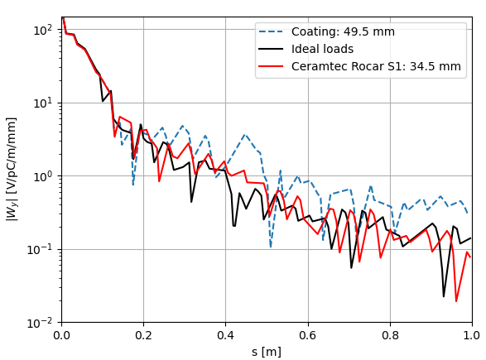


Final result
Alumina 99.5% Loads:
$ε_{r}=9.9$
$\tan{δ}=0.0001$
Coating:
$ε_{r}=1$
$R_{s}=\frac{1}{σ⋅t}=100 Ω/sq$
$dt=1, tl_{0}=59.5, dy=0.5$ [mm]

Slide 9

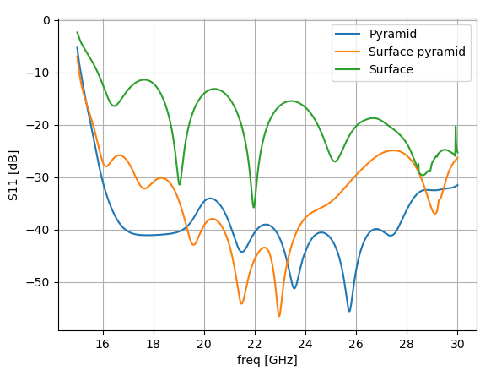
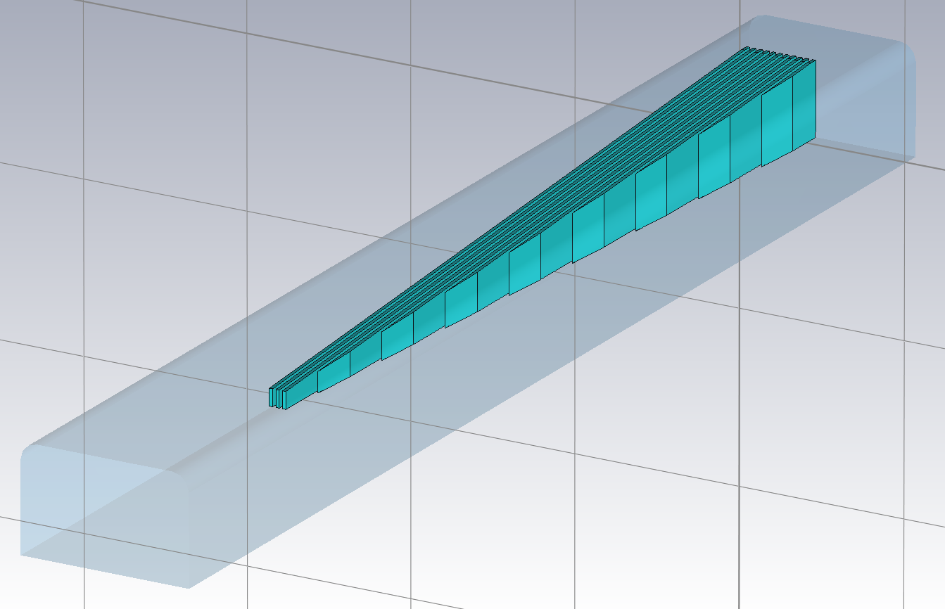
New geometries
Parallel uniform layers
Surfaces with pyramid shape

