Slide 1
Overview of Beam Diagnostics Linac-4
Linac-4 Instrumentation review
CERN, 18.10 2011
Uli Raich BE/BI

Slide 2
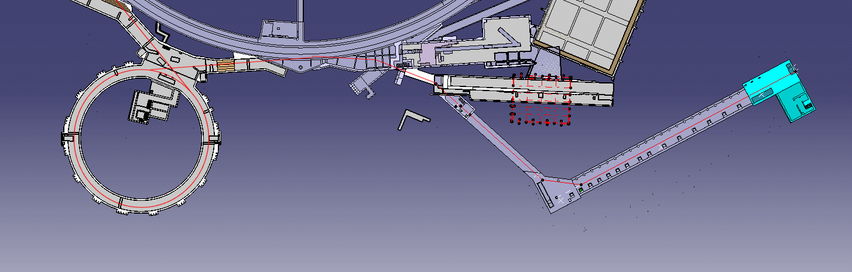
Linac-4 placement in the injector chain
LT
LTB
Linac2
BHZ20
PS Booster
Linac4

Slide 3
Linac-4 parameters
Ion Species | H⁻
Output Energy | 160 | MeV
Bunch Frequency | 352.2 | MHz
Max. Repetition Rate | 2 | Hz
Max. Pulse length | 1.2 | ms
Max. Beam Duty Cycle | 0.24 | %
Beam Chopping Factor | 62 | %
Chopping scheme | 222 transmitted, 133 empty buckets
Source current | 80 | mA
RFQ output current | 70 | mA
No. of particle per pulse | 10¹⁴
Transverse emittance | 0.4 | π mm mrad

Slide 4
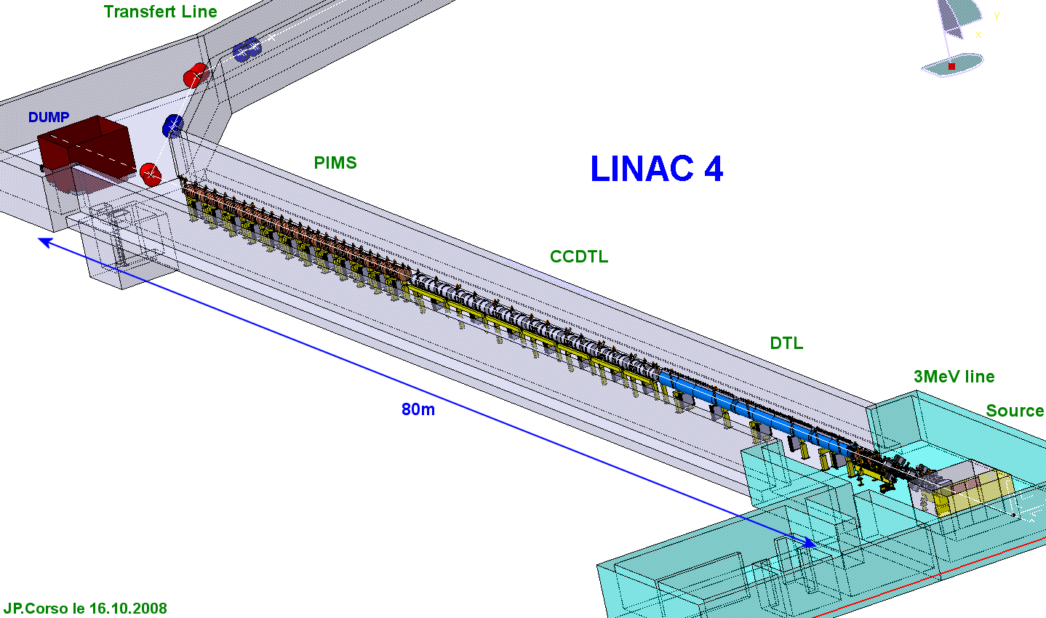
Layout of the Linac

Slide 5
Parameters to be measured
Intensity at different energies (connected to interlock system)
Beam trajectory and energy (phase)
Beam profile
Energy spread, will be measured at low energy up to 3 MeV only
Transverse emittance at 45 keV, 3 Mev, 12 MeV, 160 MeV
Chopping efficiency
Bunch shape
Beam loss (connected to interlock system)
max beam loss: 1 W/m
not more than 1 full beam pulse may be lost
Diagnostics for charge exchange injection into the Booster

Slide 6
Wide variety of beams
The Booster produces a wide variety of beams with different characteristics:
Beam properties (intensity variations) to be defined mainly by chopping
User | description | Intensity per ring | Emittance hor,ver,long [mm mrad] [ eVs] | Bunch length [ns]
LHCPROBE | LHC probe beam | 5 10⁹ | <1,<1,0.2 | 75
LHC25 | 25 ns LHC beam | 1.6 10¹² | 2.5, 2.5, 1.3 | 180
CNGS | CNGS beam for neutrino | 0.6 – 8 10¹² | varying,varying,1.6 | 180
NORMGPS | Isolde beam | up to 10¹³ | <15, <9, 2.3 | 230
TOF | Neutron TOF | 9 10¹² | 20, ~10, 2.1 | 230

Slide 7
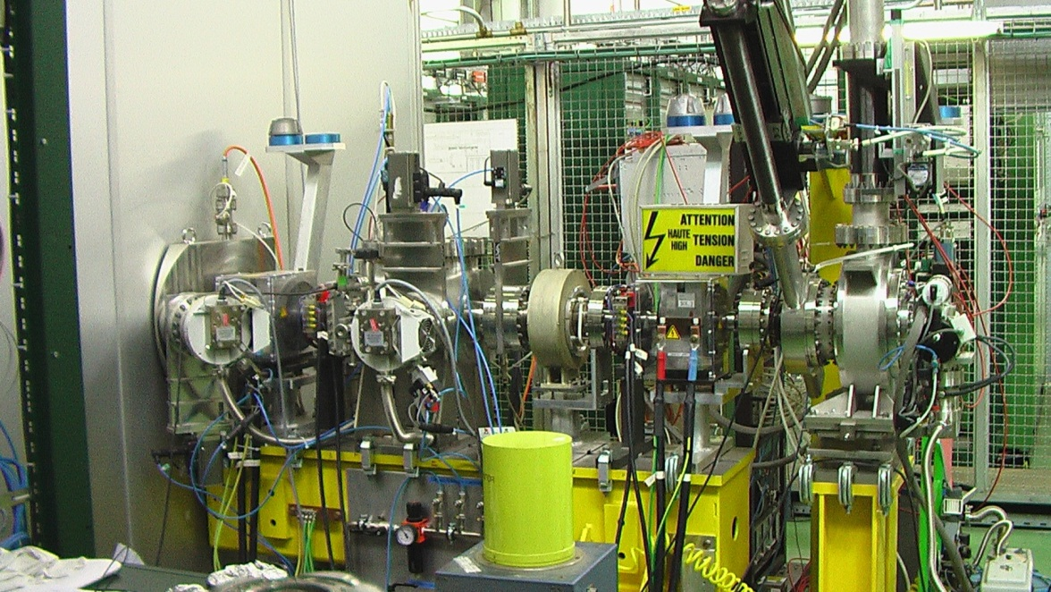
Machine sections and their instrumentation
Installed at the 3 MeV test stand
Ion source and LEBT:
  Currently: proton source, ~ 40 mA, 450 μs
  Faraday Cup, SEMGrid, transformer and transverse emittance meter (slit/grid) are installed and running.

Slide 8
RFQ, Chopper and measurement line
RFQ and chopper line
  RFQ is foreseen to arrive in October.
  Measurement line is in preparation:
    2 transformers
    3 BPMs measuring position and phase
    Transverse emittance meter with new slit
    Bunch shape monitor being assembled and tested in October
    Halo monitor to test chopping
    Spectrometer with SEMGrid
  Will be moved after use and finally removed from the machine
  Chopper Line
    2 transformers
    2 wire scanners

Slide 9
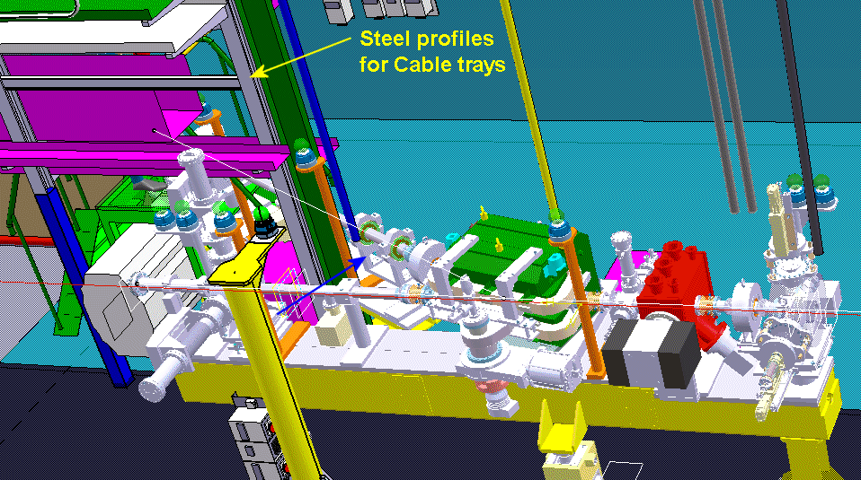
Measurement line for commissioning only

Slide 10
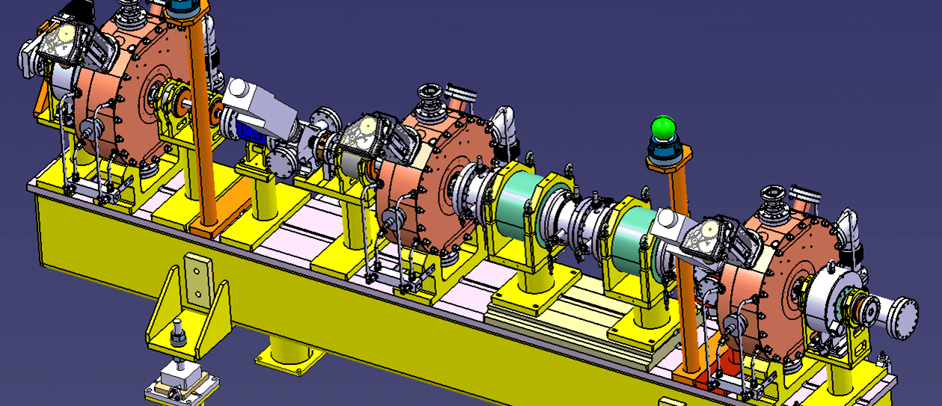
Chopper Line
Avoid losses when switching the distributor
Inject into waiting RF buckets of the Booster

Slide 11
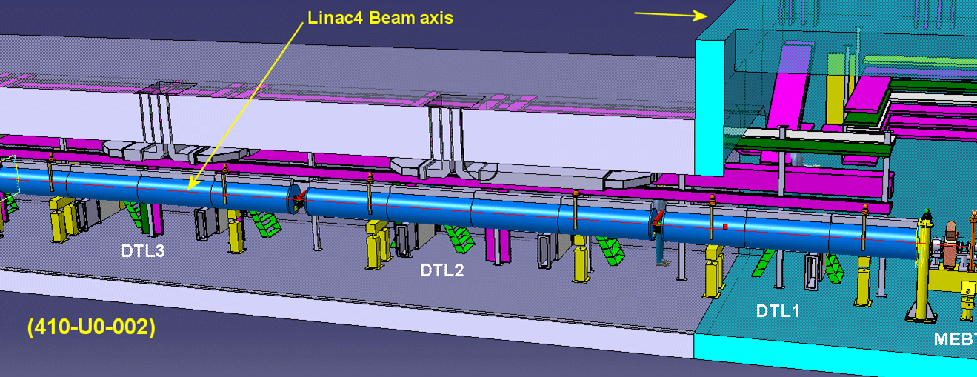
DTL
3 BPMs
1 BCT
1SEMGrid
Very little space, needed dedicated design for all devices

Slide 12
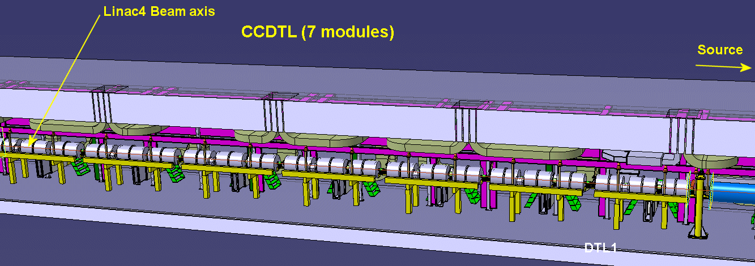
CCDTL
BPMs after each module
BCT after the last module
Profile measurements, alternating SEMGrids and wire scanners after tanks 1,3,5,7

Slide 13
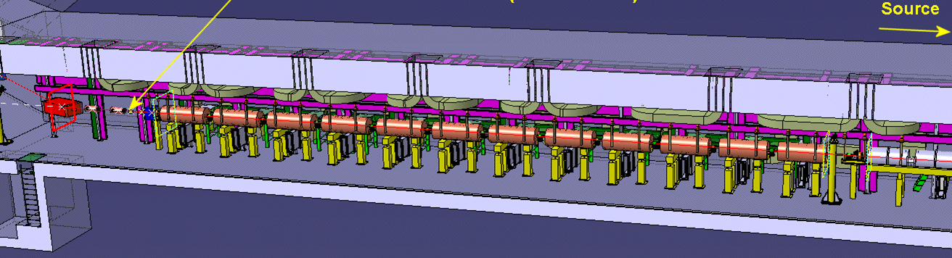
PIMS
BPM after module 2,4,6,8,10,12
Profile measurement after module 3, 5, 9 (W,S,W)
BCT after module 12

Slide 14
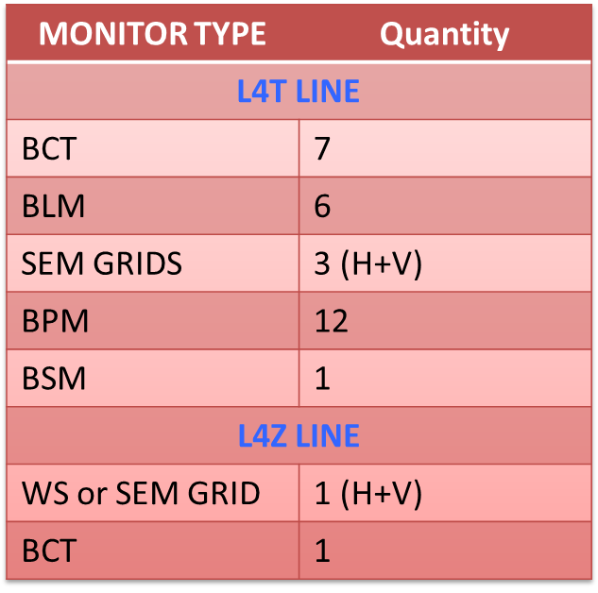
Dump Line and transfer line
Layout has been frozen only recently
Emittance measurement using 4 SEMGrids
Final position of BSM
R&D foreseen for profile and emittance measurements using laser stripping.
BCTs, SEMGrids, BPMs (see table)

Slide 15
List of instruments
Instrument | number | location | energy | details
Faraday Cup | 2 | LEBT | 45 KeV | only scope
Emittance meter | 1 1/2 | LEBT, MEBT | 45 KeV 3 MeV – 12 MeV
BPMs | 31 | MEBT - Booster | 3 MeV – 160 MeV L2-Booster transfer | Pos, intensity Phase
SEMGrids | 18 | LEBT – Booster | 45 KeV – 160 MeV
Transformers | 16 | LEBT - Booster | 45 KeV – 160 MeV
BSM | 1 | MEBT - PIMS | 3 MeV – 160 MeV | Russian coll
Halo Monitor | 1 | MEBT | 3 MeV | M. Hori (finished)

Slide 16
List of Instruments
Instrument | number | Location | energy | details
Wire Scanners | 6 | MEBT, CCDTL, PIMS | 3 MeV – 160 MeV
BLMs | 26 | MEBT - Booster | 3 MeV – 160 MeV | Positions to be confirmed
Laser Wire tests | 1 | MEBT - Booster | 3 MeV – 160 MeV | R&D for SPL
Emittance meter at 160 MeV | 2 | L4Z, LBE | 160 MeV

Slide 17
Schedule
Designs of almost all instruments are finished
First cabling campaign finished
Measurements on RFQ foreseen for beginning 2012
Construction of all sensors + electronics in 2012
Installation in the tunnel starting from 2013 to be finished in 2014
Test beam onto dump from 2014 onwards

