Slide 1
Development of BPMs for the Linac4
J. TAN, M. SORDET, L. SØBY, F. GUILLOT-VIGNOT, D. GERARD, M. LUDWIG, D. STEYAERT
BE/BI
Linac4 Instrumentation Review
18th October 2011

Slide 2
Outline
BPM
  Layout
  Functional specs
  The monitor and low beta beams
STATUS
  Drawings and prototyping
  BPM test bench and Acquisition chain
  First BPM characteristics
  Todo list
Spare policy
Planning
Summary

Slide 3
BPMs layout and specs
3 MeV
50 MeV
102 MeV
160 MeV
L4L ~ 12 m
L4D ~18 m
L4C ~22 m
L4P ~14 m
L4Z ~10 m
H- source
LEBT
RFQ
MEBT (chopper)
DTL
CCDTL
PIMS
Dump Line
Observable 1: Beam position
Transfer Line to PSB
Observable 2: Relative beam intensity between two BPMs
L4T- LT- LTB-BI ~178 m
Observable 3: Beam phase wrt RF reference
Observable 4: Energy via TOF between two BPMs
Line | # of Monitors | Beam position |  | Rel. Beam Int. | Beam phase | TOF | Comments
 |  | Resolution | Accuracy
L4D | 2 | 0.1mm | 0.3mm | 1% wrt to peak current | 0.5° | 1 per mille
L4C | 7
L4P | 6
L4T to PSB | 27

Slide 4
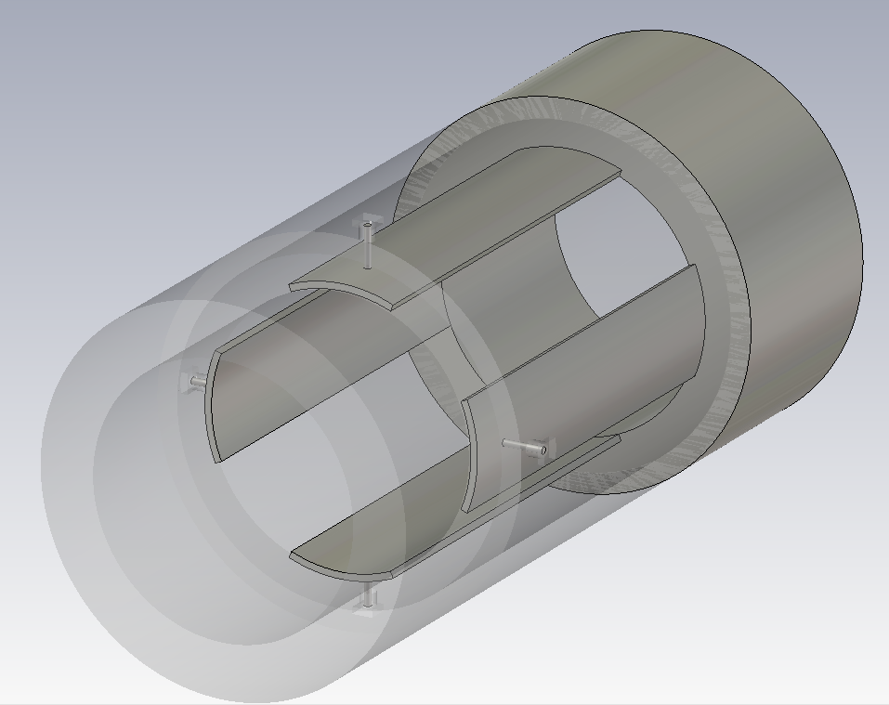
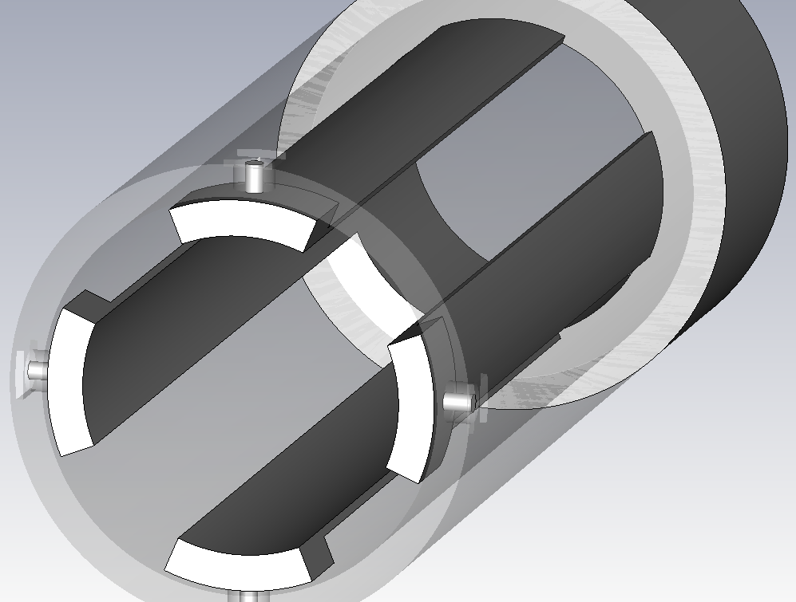
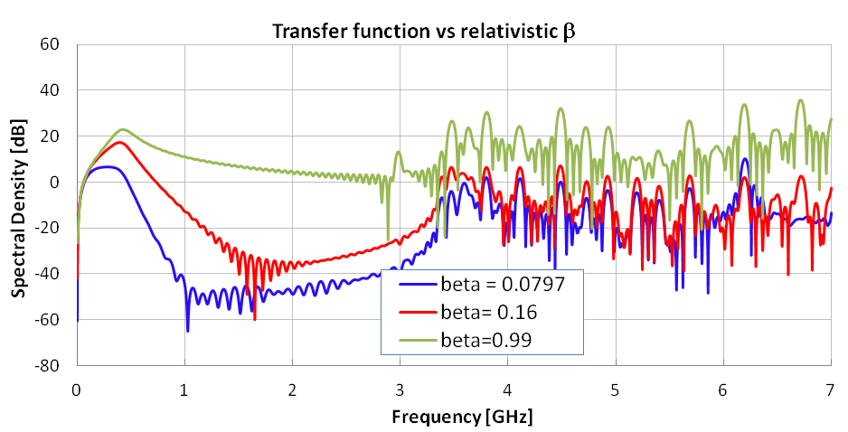
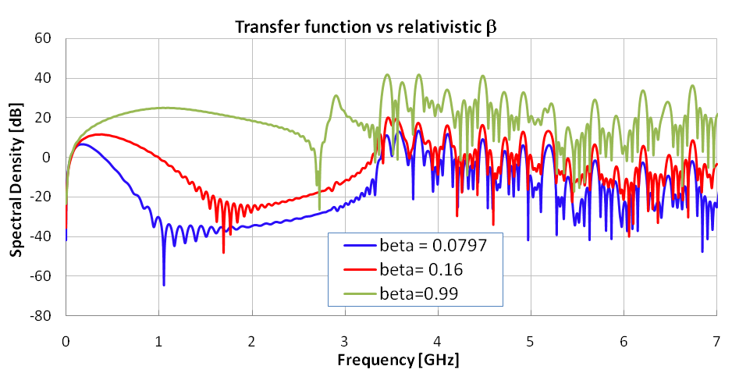
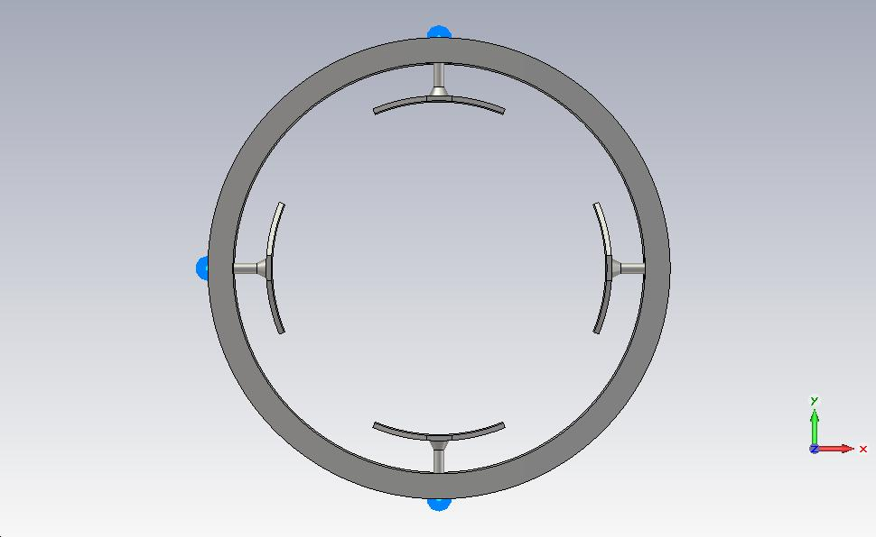
Linac4 BPM (1)
Shorted
Shorted Stripline
Linear
Fair sensitivity
Compact
Reasonable price
Resonating
β-dependent
Z₀= 50Ω
45°

Slide 5
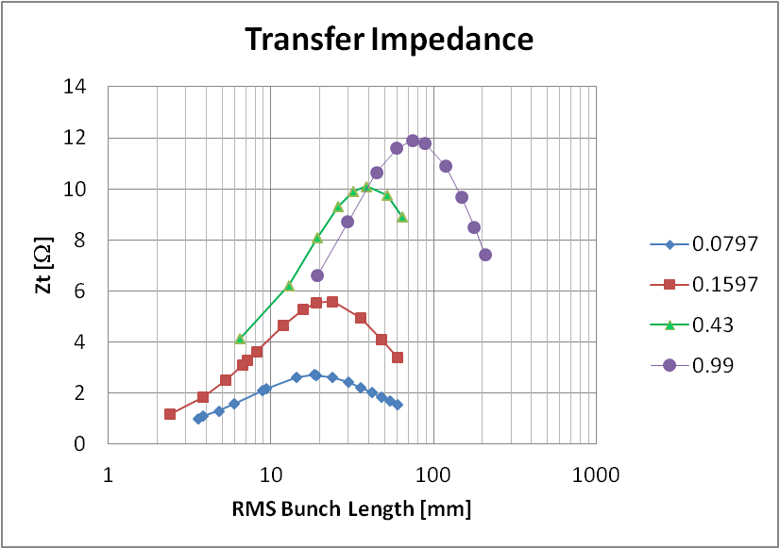
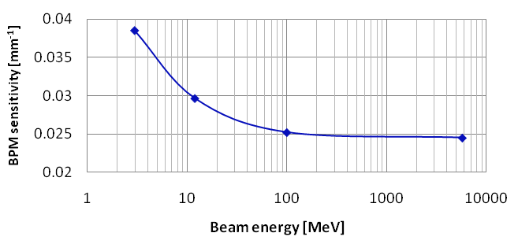
Dealing with low-β beams
Movable test bench BPM
Transfer impedance changes with β and bunch length
PU sensitivity changes with β
These simulations confirm
Shafer’s theorem (1994)
The values obtained from the simulations will be implemented in the software
β
Sensitivity at 352MHz

Slide 6
Outline
BPM
  Layout
  Functional specs
  The monitor and low beta beams
STATUS
  Drawings and prototyping
  BPM test bench and acquisition chain
  First BPM characteristics
  Todo list
Spare policy
Planning
Summary

Slide 7
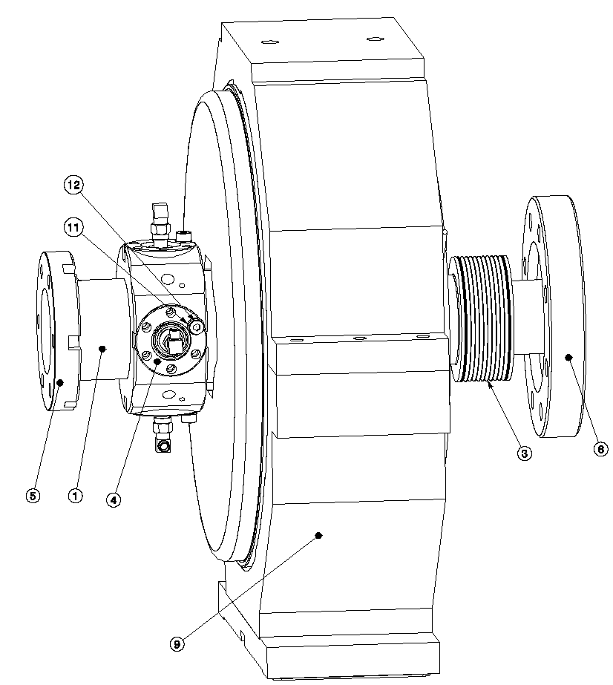
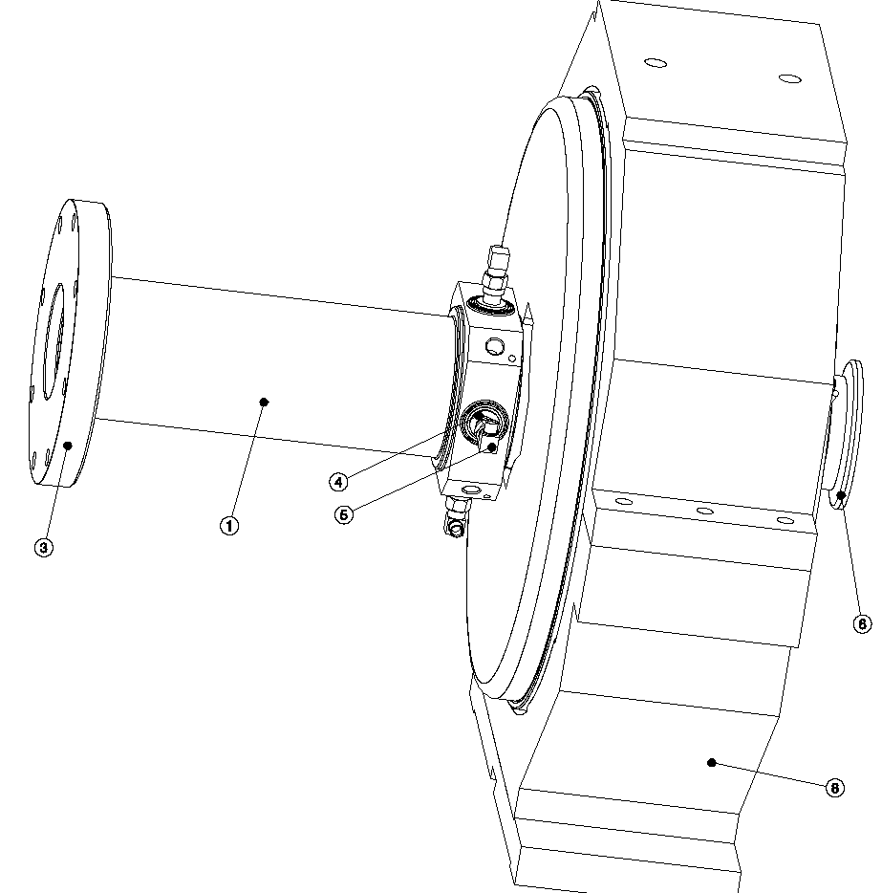
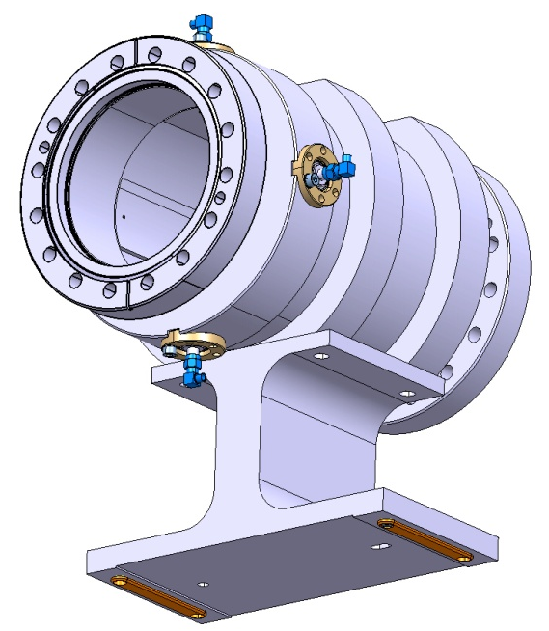
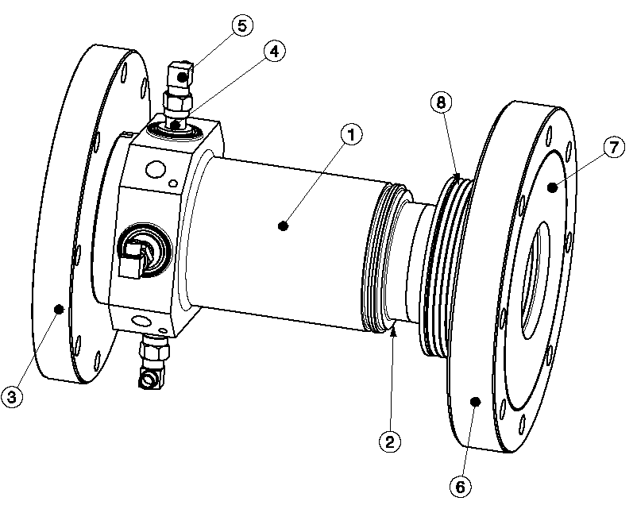
Multiple BPM designs
L4L ~ 12 m
L4D ~18 m
L4C ~22 m
L4P ~14 m
L4Z ~10 m
H- source
LEBT
RFQ
MEBT (chopper)
DTL
CCDTL
PIMS
Dump Line
DTL
Beam aperture: 34 mm
Electrode length: 117 mm
Transfer Line to PSB
L4T- LT- LTB-BI ~178 m
Quad
CCDTL and PIMS
Beam aperture: 39 mm
Electrode length:117 mm
TRANSFER LINE
Beam aperture: 100 mm
Electrode length:140 mm
Beam aperture: 34 mm
Electrode length: 72 mm
3 BPMs with welded feedthroughs onto the body
39 BPMs with feedthroughs mounted on CF flanges

Slide 8
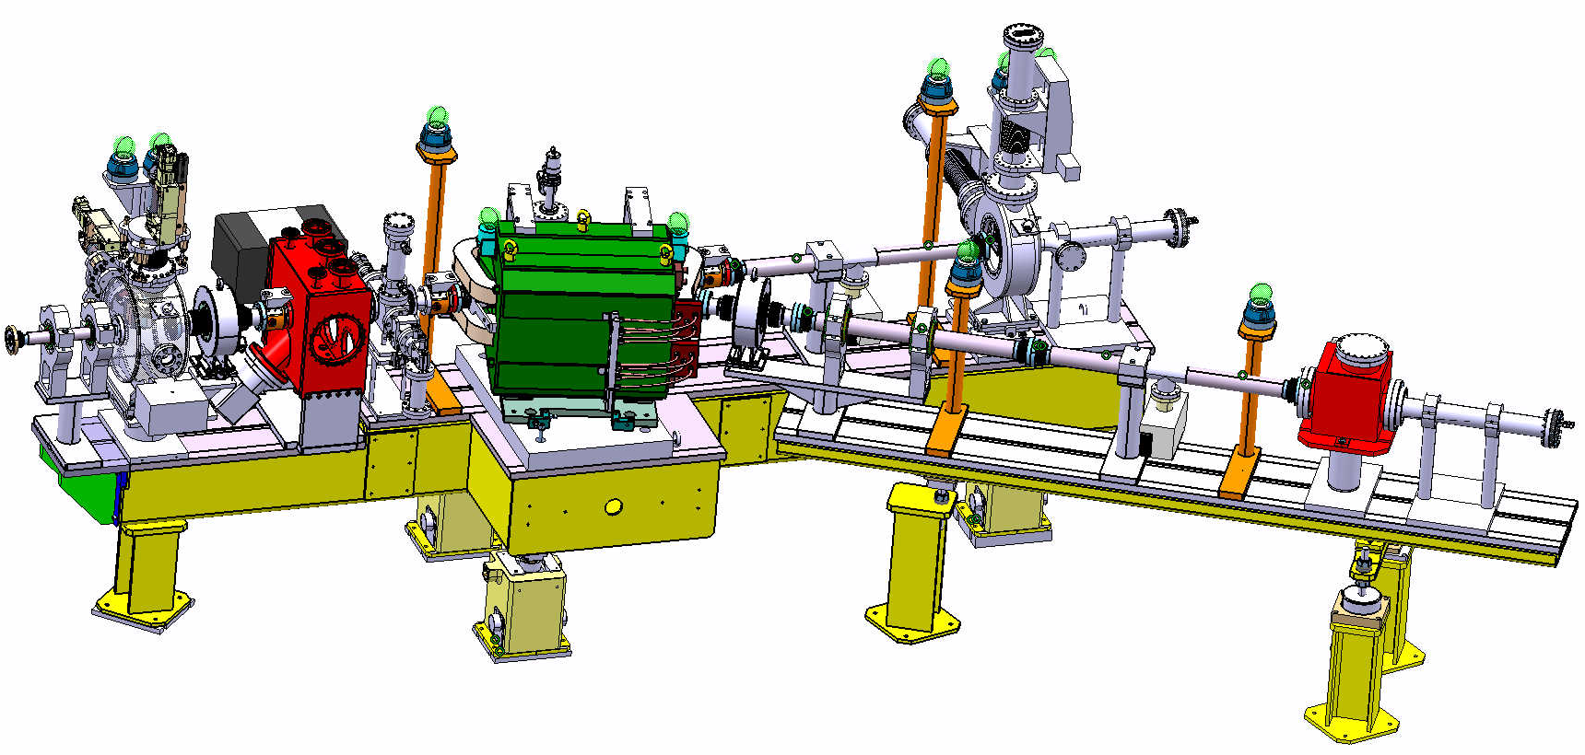
Movable Test Bench BPMs
Modular commissioning of RFQ, MEBT and DTL tank1
Transverse : profiles, emittances, halo, position
Longitudinal : transmission, av. energy, halo, ΔE/E, bunch phase spread
Three BPMs
Beam aperture: 67 mm
Electrode length: 60 mm

Slide 9
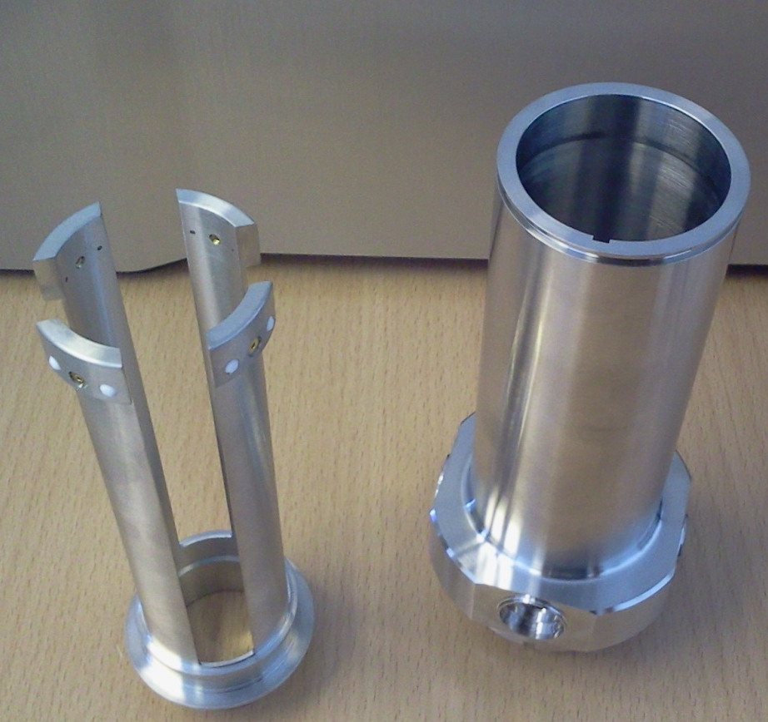
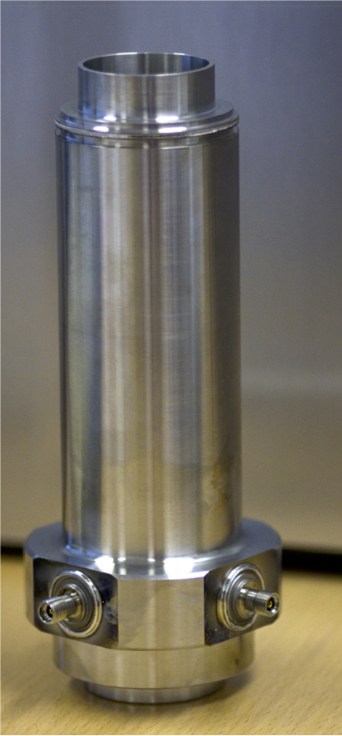
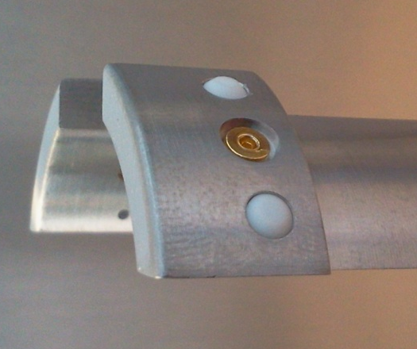
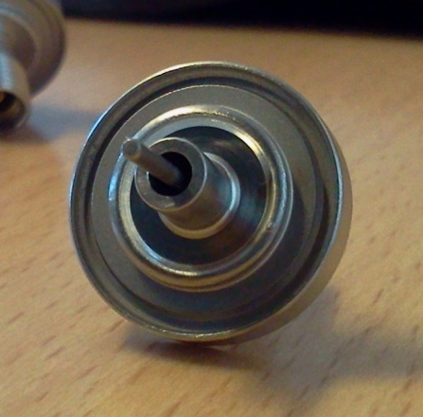
Prototype of a DTL BPM (1)
Electrode
Body
Mounted unit with
Welded feedthroughs
detail
Feedthrough
Feedthrough

Slide 10
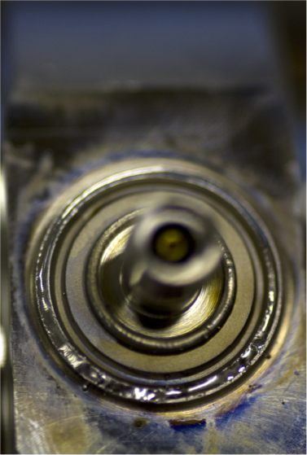
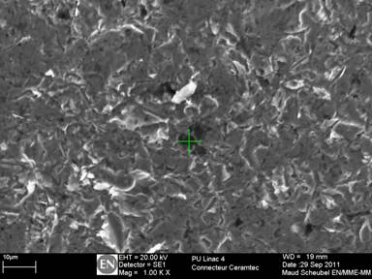
Prototype of a DTL BPM (2)
Issues
During e⁻ bombardment welding
Three feedthroughs affected by :
Manufacturer’s procedure:
glass-ceramic seal
No sand blasting
Ultrasonic cleaning +acetone rinsing before
Scanning electron microscopy
Standard 304 grade stainless steel
Surface not inlayed with dust particles
Traces of Si, Na, Mg, Ca
Sparks
Material spray
Multi-pass welding needed
Welded
feedthroughs

Slide 11
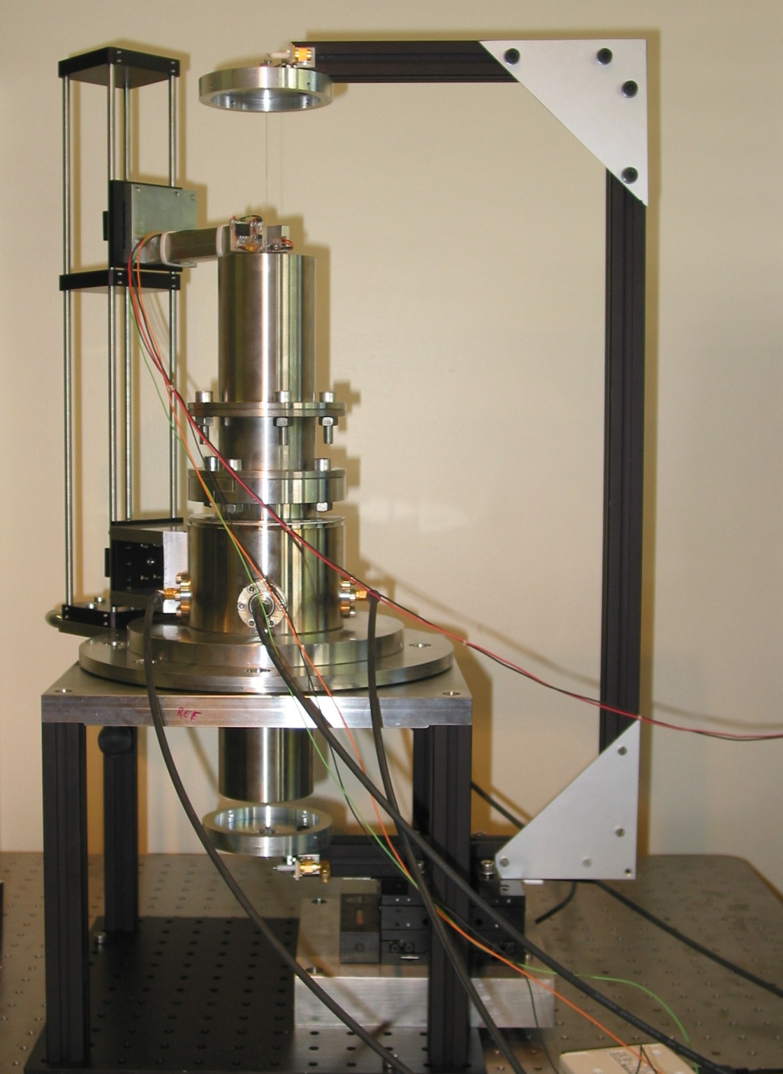
BPM test bench
Wire technique w/ standing waves
Optical sensor for mechanical centering : ±0.01mm
352MHz sine wave with a N.A.
Data acq by steps of 0.1mm
Commissioning issues
Black anodized coating =poor grounding.
Solution : Improve grounding. Done
Wire not terminated = Antenna
Solution : terminate the wire by a short circuit. Done
Optical rail : C-shape & 25mm cross section yield a lack of stiffness and 1mm electrical offset
Solution : Swap to a full frame of 34mm cross section. Pending action.

Slide 12
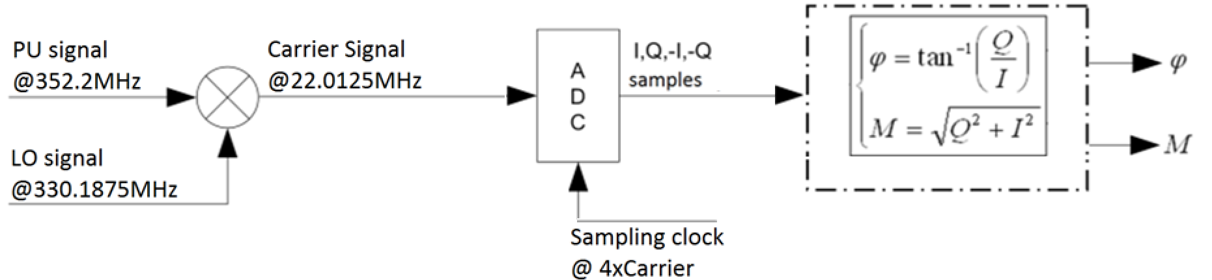
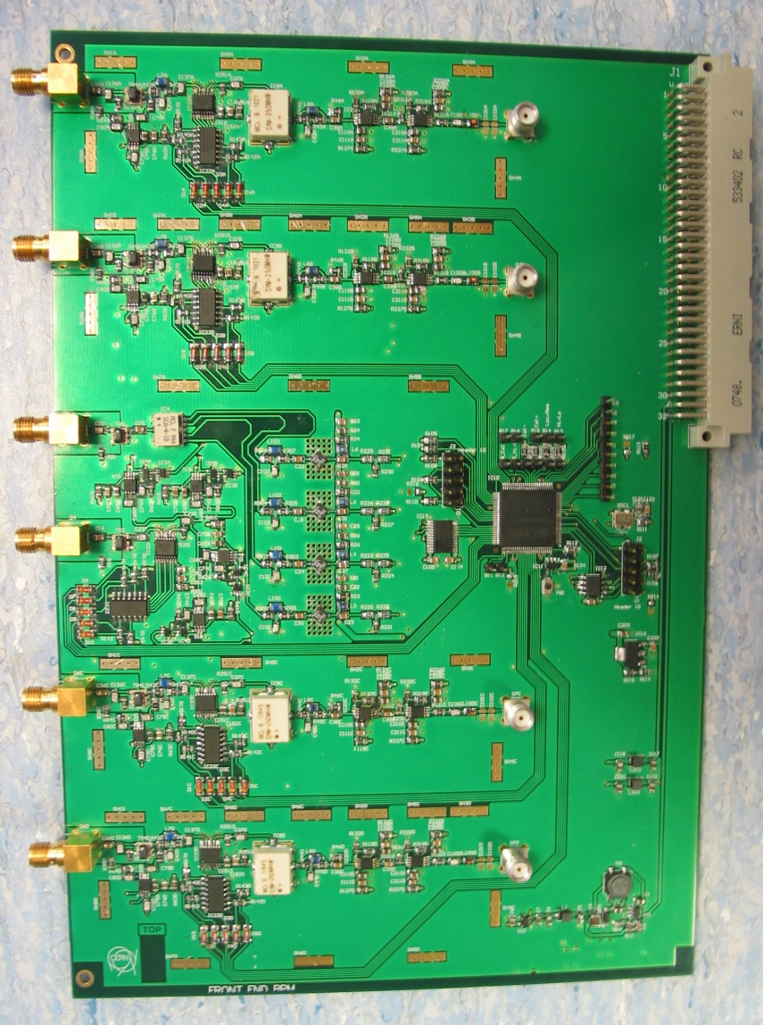
Analog Front End Board
FEATURES
Input Low pass filtering @1GHz
Down-mixing with LO
Variable gain with switchable attenuators
Band-pass filtering @22MHz
BPM Calibration
U
L
R
A
D
C
LO
D

Slide 13
Signal Processing
T_{carrier} =45.42ns
Clock jitter ~10ps
V_{R, ADC}
I_{R} Q_{R} –I_{R} -Q_{R}
M_{R}-M_{L}
Δx =
M_{R}+M_{L}+M_{U}+M_{D}
22.0125MHz Carrier Signal
ϕ = ϕ_{beam} - ϕ_{LO}
V_{L, ADC}
time
I = M_{R}+M_{L}+M_{U}+M_{D}
TOF = ϕ_{PU2} - ϕ_{PU1}
I_{L} Q_{L} –I_{L} -Q_{L}

Slide 14
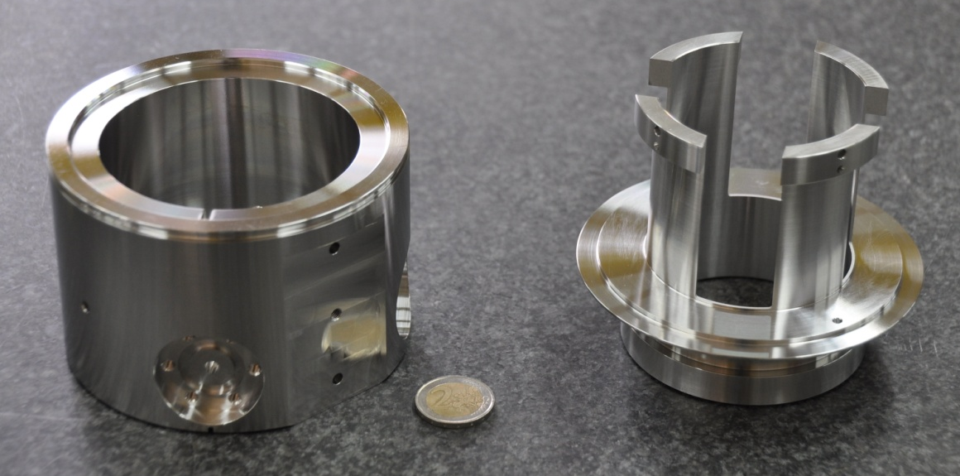
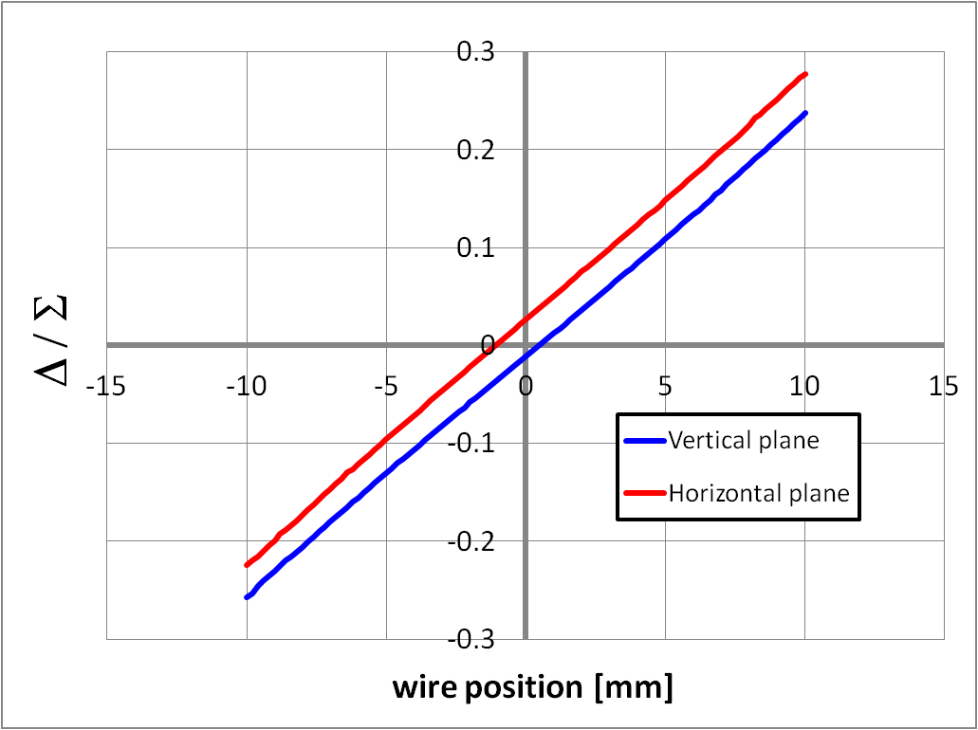
Stripline Characteristics
Beam aperture= 67mm
Electrode length = 60mm
 | THEORY | H plane | V plane
Slope [mm] | 40.32 | 41.79 σ=0.42 | 41.02 σ=0.56
Elec. Offset [mm] | - | -0.77 σ=0.18 | -0.19 σ=0.13
Coupling w/ adjacent electrodes | 7.3% | 6.56 | 6.6

Slide 15
First Measured characteristics
352MHz signal injected via the wire
Measured voltages amplitudes from electrodes : ~65mV
From the simulations, this is equivalent to a signal induced by a
  nominal beam of 1.14x10⁹ H⁻
  98° longitudinal phase (nearly debunched beam)
Position (averaged over pulse length 740μs ⇔ ~32k positions)
  Precision= 0.1mm
  Resolution = 0.1mm
  Resolution with few samples : to be done
RF phase wrt LO
  Precision = ±1° (room for improvement)

Slide 16
Todo List
Understand welding issues
Improve stiffness of lab test bench
Transfer impedance and characteristic impedance
Resolution with short pulses
Improve ADC clock jitter : the goal is ~200fs
Commissioning of BPM calibration procedure
Software : algorithm for I, Q, -I-Q determination
Measurement with a pair of BPMs
  TOF
  Relative beam intensity
Signal processing : Choose between
  SIS3302 (16bits – 13.4ENOB) : 6400CHF per board x25
  FMC (14bits – 11.7ENOB) : Status ? 25 boards. Unknown final price

Slide 17
Outline
BPM
  Layout
  Functional specs
  The monitor and low beta beams
STATUS
  Drawings and prototyping
  BPM test bench and Acquisition chain
  First BPM characteristics
  Todo list
Spare policy
Planning
Summary

Slide 18
Spare policy
Monitors
  Movable Test Bench : 3 +2 spares for lab commissioning
  Linac : 15 + 11 spares (one per version)
  Transfer line : 27 + 2 spares
  TOTAL : 55 BPMs
Acquisition chain
  Front end board : 45 + 15 spares
  ADC or FMC : 23 + 4 spares

Slide 19
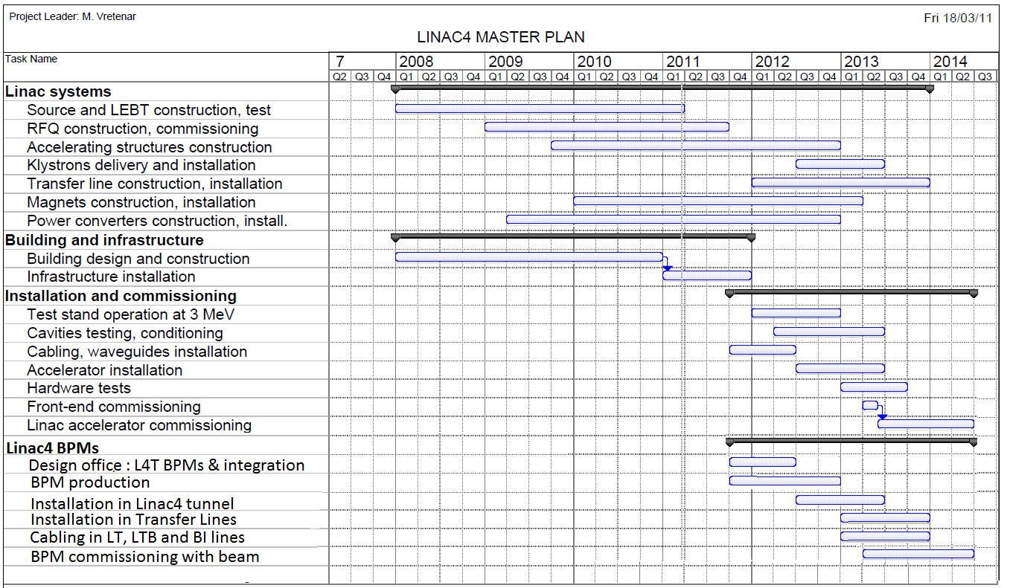
Planning
LS1
Start of TL construction & Installation
Start of Machine Installation
Start of Machine Commissioning

Slide 20
Summary
Very encouraging results yet still a lot of work ahead of us.
Ready for the Movable Test Bench commissioning
Planning in phase with Linac4 installation and LS1
Budget sligthly underestimated : overrun by ~200kCHF

Slide 21
Thank you for your attention
…Questions ?

Slide 22
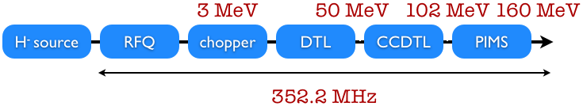
Linac 4 – Basic architecture
 | Movable test bench 3-12MeV | DTL 50MeV | CCDTL 102MeV | PIMS 160MeV | New TL -> LT.BHZ20 160MeV | Old TL -> PSB 160MeV
Number of BPMs | 3 | 2 | 7 | 6 | 10 | 17
Beam Ap. [mm] | 67 | 34 / 39 | 39 | 39 | 100 | 100
Long. Phase [° rms] | 6.4 /98 | 3 | 3 | 2.5 | 25 | 55
RMS length [ps] | 50 / 777 | 24 | 24 | 20 | 200 | 433
Bunch spacing : 2.84 ns

Slide 23
Simulation of non-relativistic beams
Nominal beam phase width evolution (1RMS)
Simulations with CST Particle Studio
  Multi-bunch
  Space charge effect
  Low β
 | MEBT | Linac4 | PSB strip. foil
Sigma [ps] | 200 | 20 | 433
Rel. beta | 0.0798 | 0.52 | 0.52

Slide 24
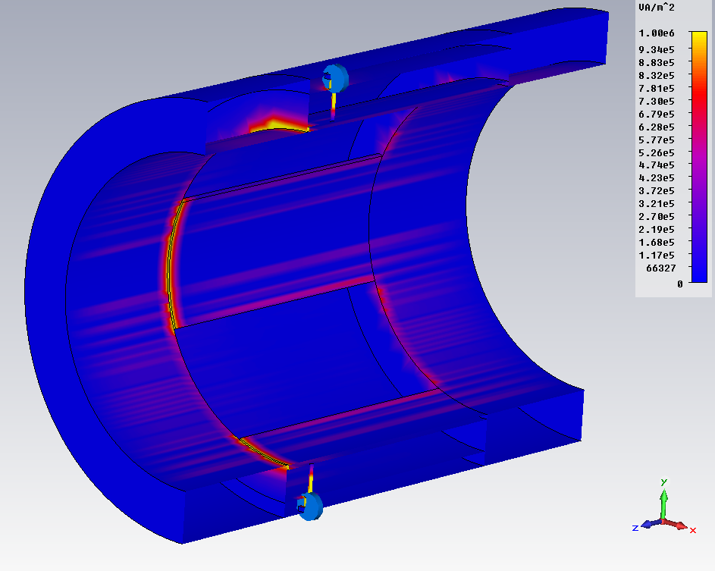
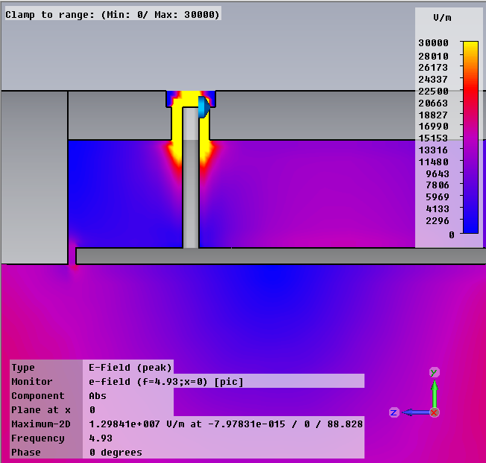
High Frequency Losses
Power flow module
Electric field module
External diameter of the
RF feedthrough is important

Slide 25
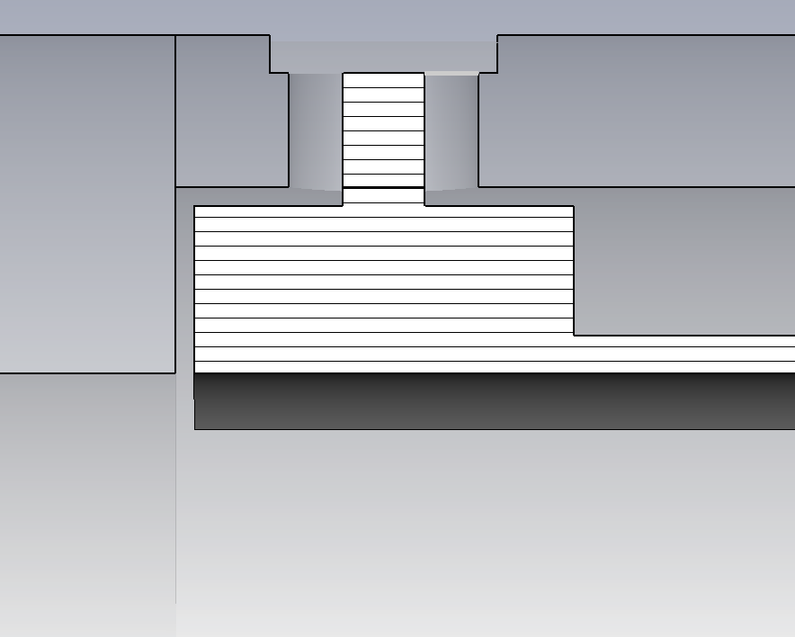
High Frequency Filter
gap 0.5mm
Body
C
Electrode
Capacitive effect : 9pF

