Slide 1
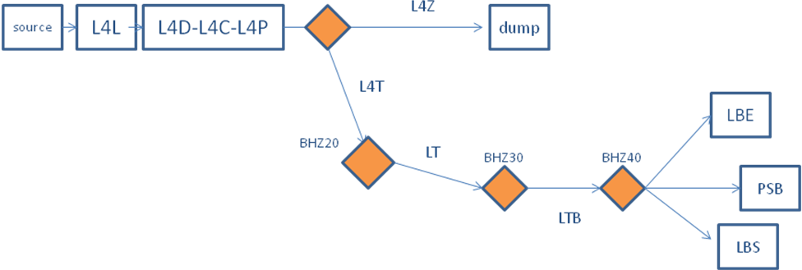
BI SW for LINAC4
On behalf of BE/BI/SW
BI software development process
Specifications
List of BI Systems
  Not covered: PSB ring systems
Conclusions

Slide 2
FESA framework
Application level
Daemons
OP GUIs
BI GUIs
VME front-end
CMW/Ethernet
Timing signals
Devices
Real-Time
COMM
HW
SHM

Slide 3
Development
Hardware:
VME
PLC
Software:
Existing (L2, L3, PSB)
New ideas
BI Software
Low-level
Expert GUIs
Specifications
-COMM (OP/ABP/RF/BI ..)
- OP-PSB

Slide 4
Hardware layout
Host-name: cfv-xyz-bln4 (crate specific)
CPU
CTRV
DIG
I/O
GRID
1-10
ADC GRID
1
ADC BPM
1-4
ADC BCT
1
Ethernet
Timing
Gain
Movement
Analogue signals/triggers
(which channel is what?)
Make sure we’ve foreseen enough VME crates, availability of external triggers etc

Slide 5
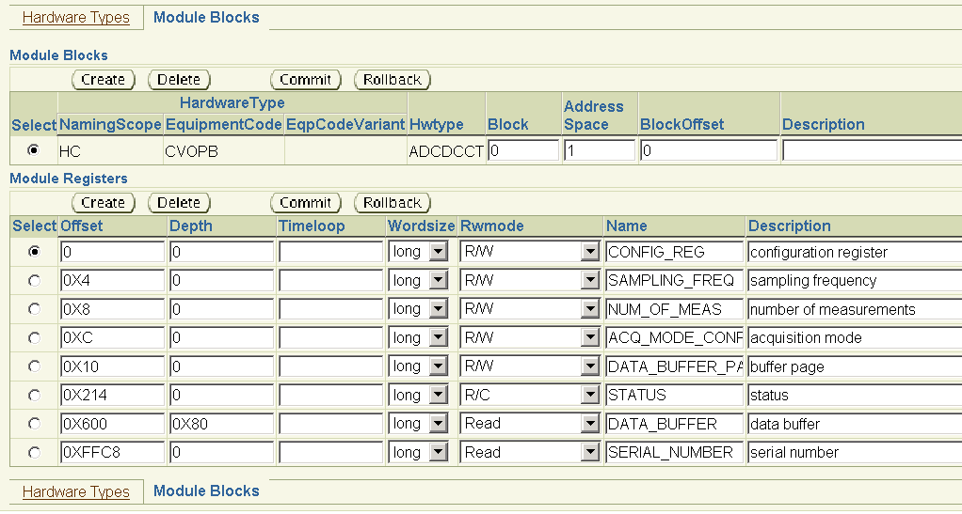
VME Hardware modules
List of available registers (CCDB)
Instrument may use a subset of these (hardware specification)
Allow standardisation (HW/SW)

Slide 6
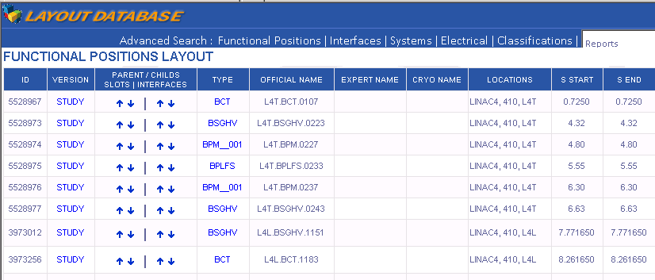
Software devices
LINAC4 functional layout database
= Name of software device

Slide 7
Functional specifications:
“BEAM MEASUREMENTS FOR LINAC4 AND ITS TRANSFER LINES”
EDMS Id: 1063849 (2010)
LIST OF DIAGNOSTICS REQUIREMENTS (observables):
  POSITION, INTENSITY AND PHASE (from BPM)
  BEAM INTENSITY
  BEAM PROFILE & EMITTANCE
  BEAM LOSS
  BUNCH LENGTH
BI/SW provides software interfaces to these observables for client applications
Important points:
Re-use hardware/software as much as possible
(software APIs from LINAC2/PSB systems)
Use 3MeV test-stand for proto-typing
Face-to-face discussions
Spec’s last week
No final Spec’s

Slide 8
BI Systems
Date of expected initial use
(3MeV test-stand ++):
Faraday-cup
Emittance-meter
SEM-grids
BCT
Beam Wire Scanner
Beam Position Monitor
Beam Loss Monitor
BTVs (?)
Bunch Shape Monitor

Slide 9
Faraday cup
Scope:
  Test-stand + LINAC4
Present status:
  Acquired with local oscilloscope
Wish:
  Time resolved (cross-calibrated) current readout for LINAC4 source installation (2013)
  Plans to be made

Slide 10
Emittance-meter
Scope:
  3MeV test-stand
  Source re-commissioning
Status:
  Time resolved beam profiles with HOR/VER slit control
  Acquisition and control implemented (FESA/Labview/C++)
Plans:
  New slits (allowing for higher energies) (Delphine’s talk)
  RFQ tests early 2012
  Low-level software changes no/minimal changes for application

Slide 11
SEM-grids
Scope:
  3MeV test-stand, LINAC4 (<30MeV)
Status:
  Acquisition + motor control for test-stand spectrometer SEM-Grids done (FESA/JAVA)
  Time resolved profiles (~6usec)
Plans:
  Acquisition/control hardware for final LINAC4 being designed (Gerrit-Jan)
  Test-stand beam tests during 2012

Slide 12
BCTs #1
Scope:
  Test-stand, LINAC4, Transfer-lines (new, old)
Status:
  Proof of principle for electronics and software during 2011
    Time resolved intensity measurement
    Average current & total number of charges per LN4 pulse
Plans:
  Commissioning of acquisition electronics and software
  New spec’s being evaluated
  5 BCT devices on 3MeV test-stand (2012)
  Intensity watch-dog (interlock)
    Functional specifications well advanced (combination of hardware and software for added flexibility)
    EDMS: L4-CIB-ES-0003

Slide 13
BCTs #2
Based on comparing 2 BCT values
  Which ones depend on beam destination
Two levels of interlock:
  ‘Relatively low’ (OP setting):
    Count number of consecutive pulses (PPM) and compare to OP threshold
    If too many cycles, disable beam for next occurrence of particular cycle until OP reset
  ‘Relatively high’ (OP setting):
    If loss > threshold cut next cycle until OP reset (who’s allowed?)

Slide 14
Wire-scanners
Scope:
  Test-stand, LINAC4 ..
Status:
  HW/SW being tested
  SW resembles slow ISOLDE scanners
  Time resolved profiles
Plans:
  Beam tests foreseen early 2012

Slide 15
BPMs
Scope:
  Test-stand, LINAC4, Transfer-lines
Status:
  HW design/production on-going
  Software will provide:
    Position and (cross-cal.) Intensity:
      Time resolved along LN4 batch @22MHz
      Derived signals to be discussed
    Phase with respect to the RF freq.
      Being specified
Plans:
  Beam tests starting 2011:
    3 BPMs on test-stand

Slide 16
BLMs
Scope:
  (Test-stand), LN4, Transfer-lines
Status:
  Hardware design (analogue/digital) on-going
  Interlocking spec’s to be finalized
Plans:
  Lab tests during Q4 2011
  Software design to start early 2012
  Will provide:
    Time resolved losses (2usec)
    Integral over 1msec

Slide 17
BTVs
Scope:
  3 devices in dump line (?)
  1 in new transfer-line (?)
  3 new in LBE line (?)
  4 at PSB injection (stripper foil)
Status:
  Reuse hardware and software
Plans to be made when LN4 connection date is known

Slide 18
Bunch Shape
Scope:
  Test-stand + LN4
  Complete system built by JINR
Status:
  Will come with Labview software on PC for test-stand
Plans:
  Control system integration TBD

Slide 19
Conclusions
Software design and delivery
  follows test-stand schedule and hardware design and availability
  Mix of planning ahead and feedback
Operational systems
  deployed and tested when front-end computers become available
Standing agreement with OP
  provide APIs for discussion
3MeV test-stand
  Very important for proto-typing
Decisions
  VME hardware layout must be fixed soon
  Some specifications missing

