Slide 1
BLM for the Injectors project LINAC4 & PSB - additions
Beam Instrumentation Review – 19/10/2011

Slide 2
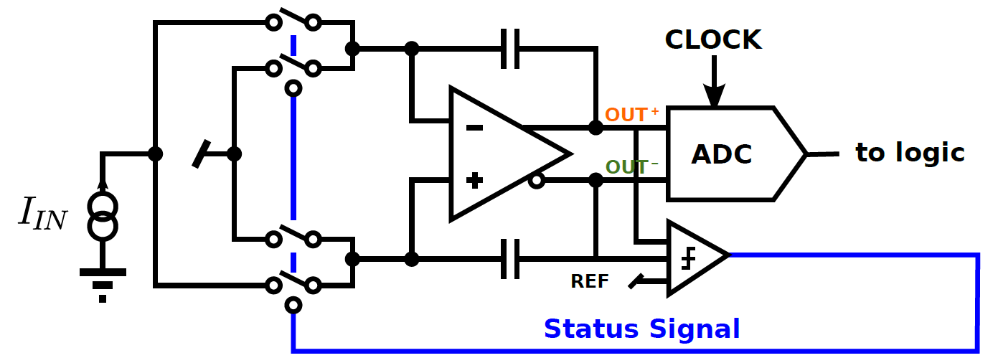
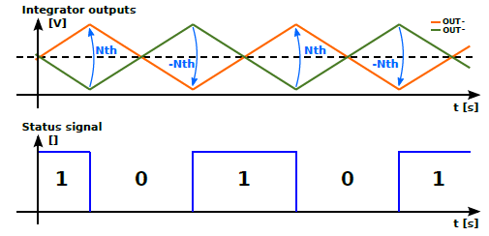
ACFC principle
A status signal selects in which branch of a fully deferential stage the input current is integrated.
Two comparators check the deferential output voltage against a threshold, whenever is exceeded, the status signal changes to the complementary value (0 ! 1 or 1 ! 0) and the input current is integrated in the other branch.

Slide 3
ACFC data processing
counts
thhigh
ADC values
thLow
0
2 μs
2 μs
2 μs
Time
The number of counts accumulated are combined with the ΔADC values to provide the integrated loss over 2 μs.
Most of the operation is handled by the FPGA . That is, counting of pulses , clock the ADC and make difference of the ADC values.

