Slide 1
MS-5024: Supply of Transmitters for the HL-LHC High Power RF System

Slide 2
RF system
HPRF High Power RF station (including power transmission lines)
FPC Fundamental Power Coupler
HOMC High Order Mode Coupler
LLRF Low Level RF
HPRF
FPC
Cryomodule
Controls
LLRF
HOMC

Slide 3
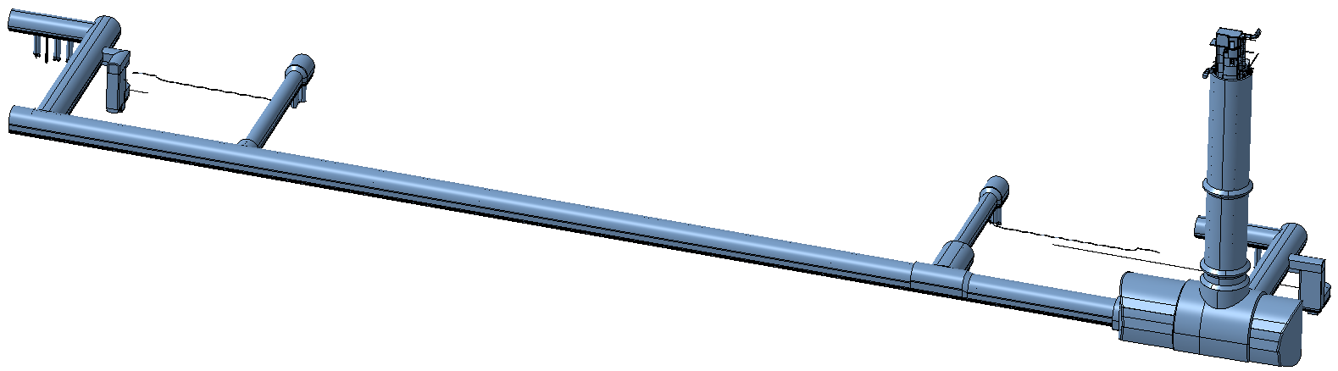
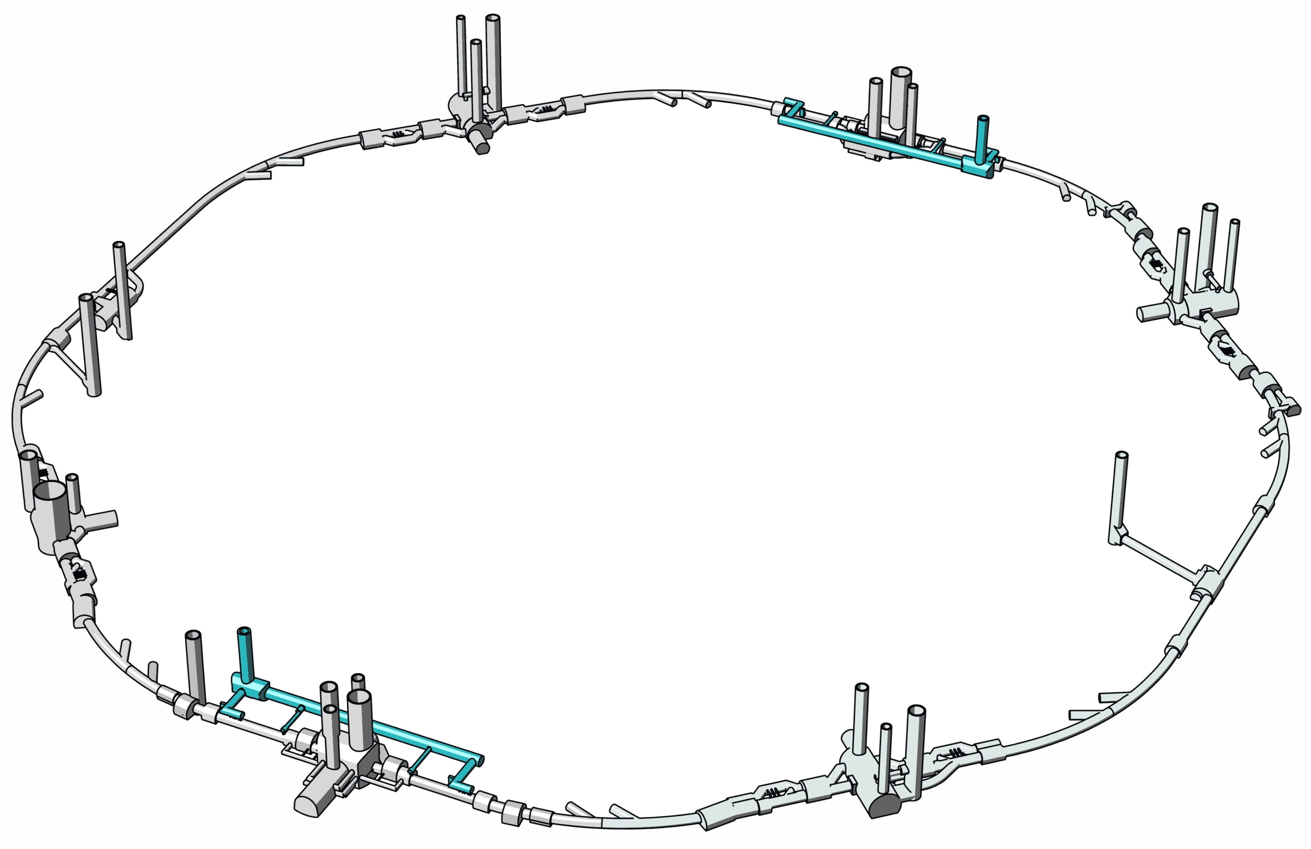

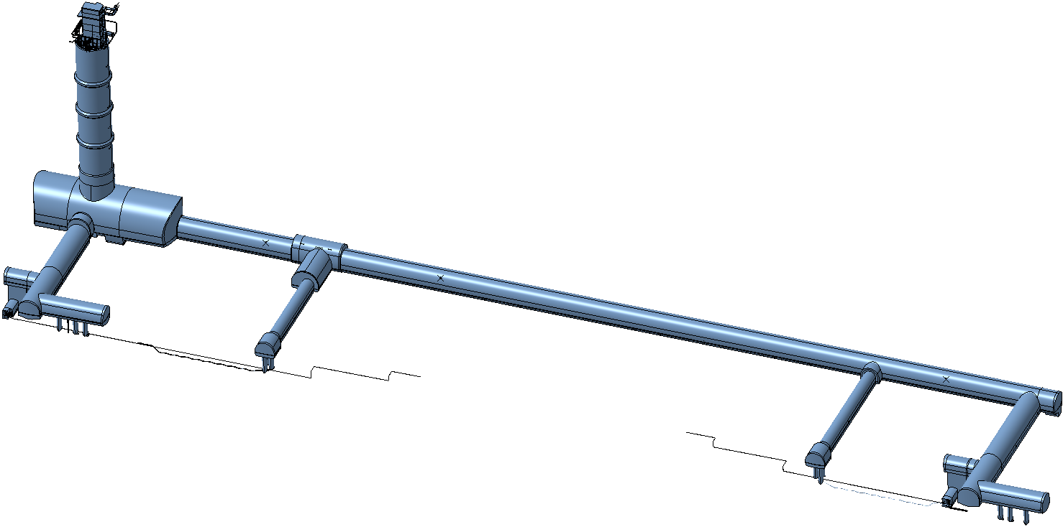
LHC undergroud
Integration HPRF
Surface
100m
Four different places with four HPRF stations each
Total 16 HPRF stations
Underground
8 Crab Cavities
8 Power Amplifiers IOT
8 Circulators
8 Loads
2 Faraday Cage
P5 - CMS
P1 - ATLAS
8 Crab Cavities
8 Power Amplifiers IOT
8 Circulators
8 Loads
2 Faraday Cage

Slide 4
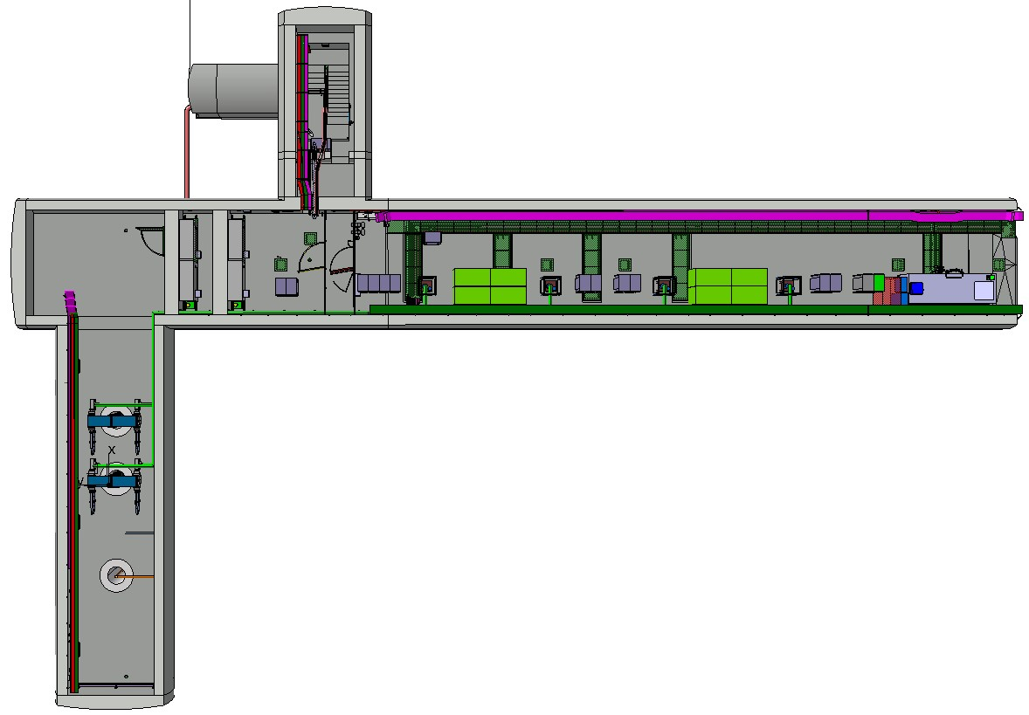
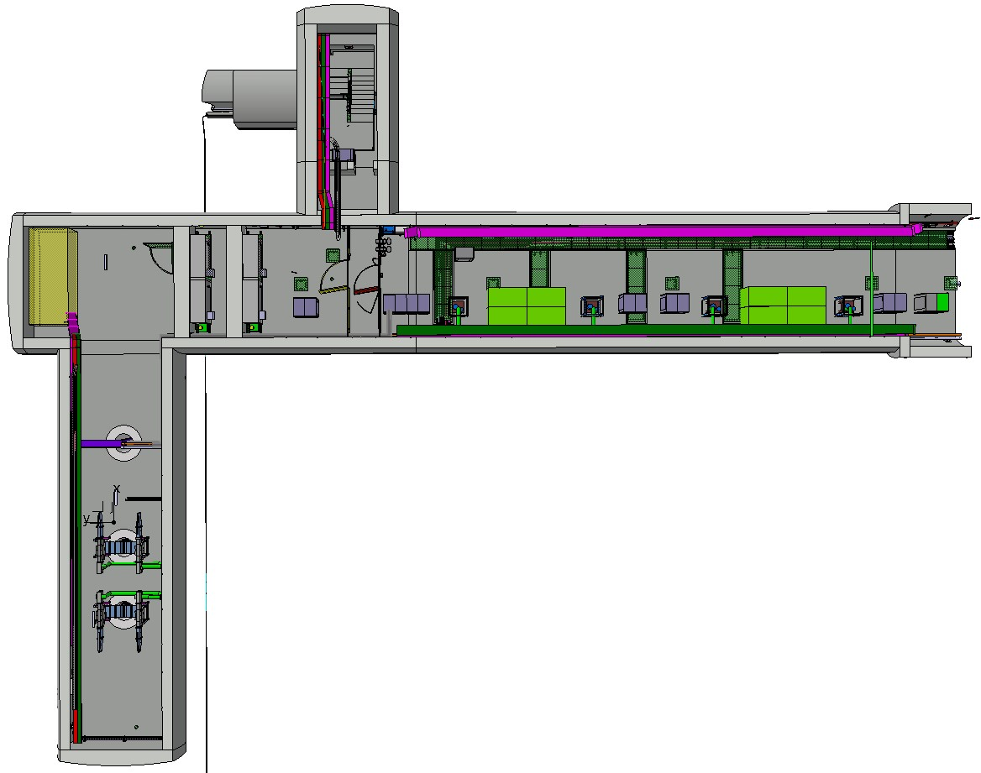
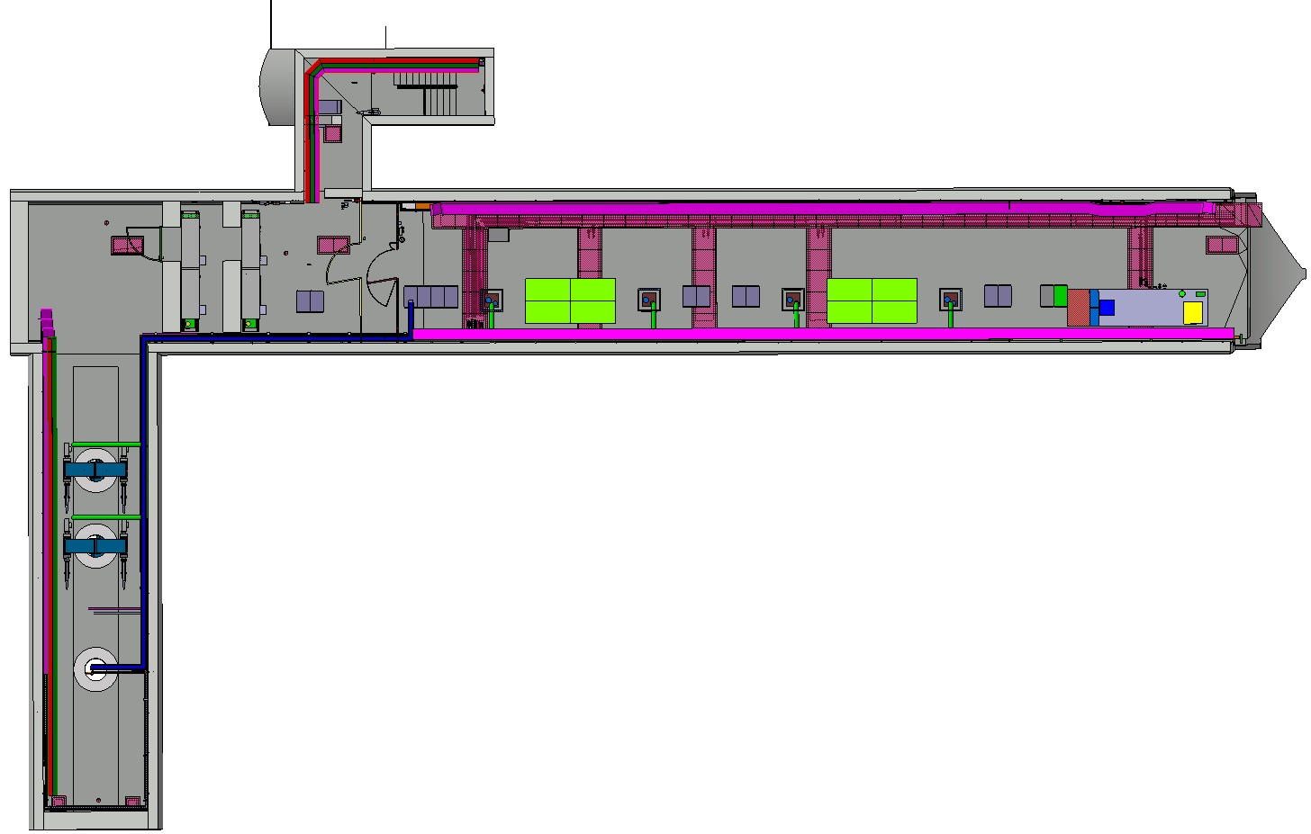
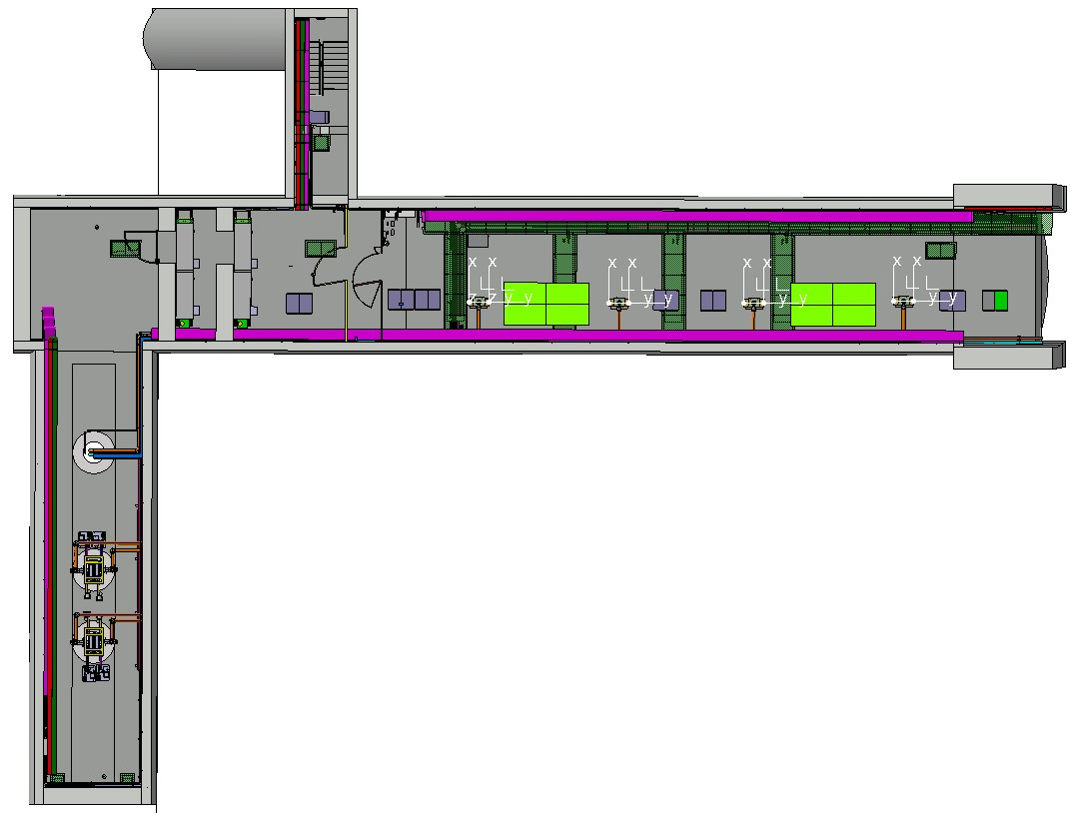
Integration of the HPRF in the galleries
Right side
Left side
Point 1
The 4 circulators and 4 loads are placed close the access holes, to be connected with the WR2300 adapter.
The cavities are powered by 4 amplifiers IOT 400MHz.
One for each cavity.
Point 5

Slide 5
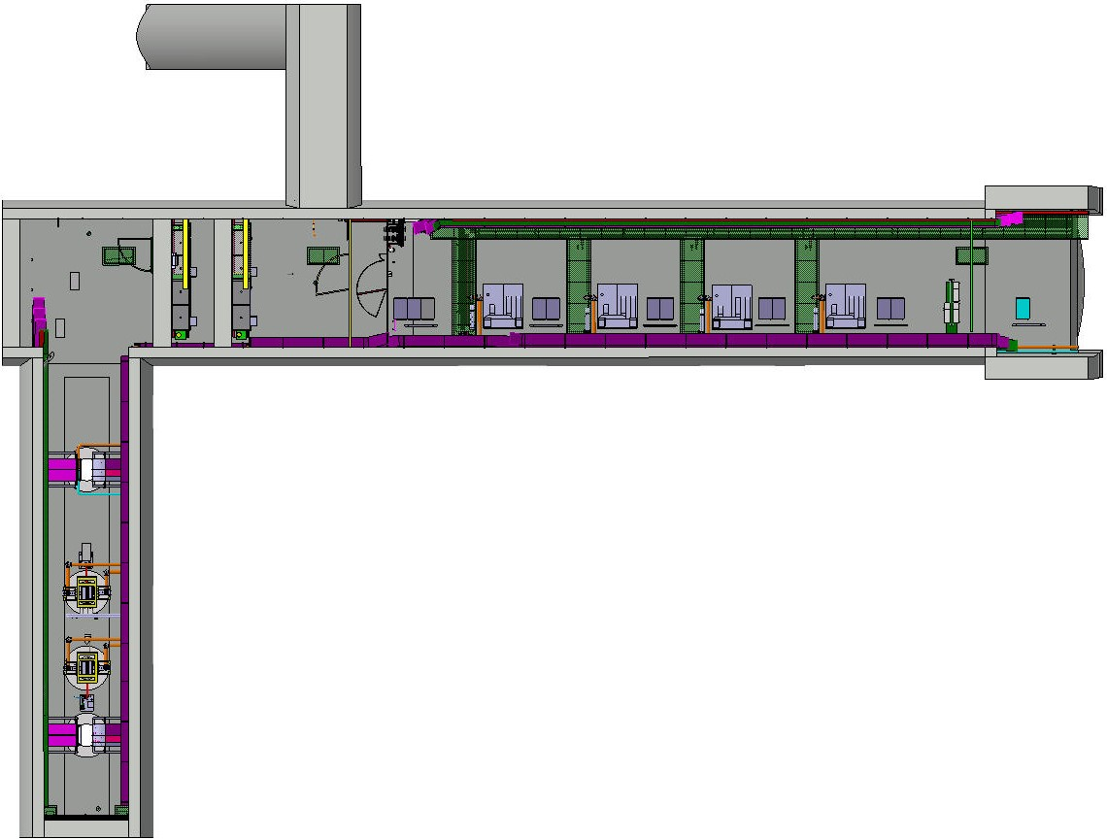
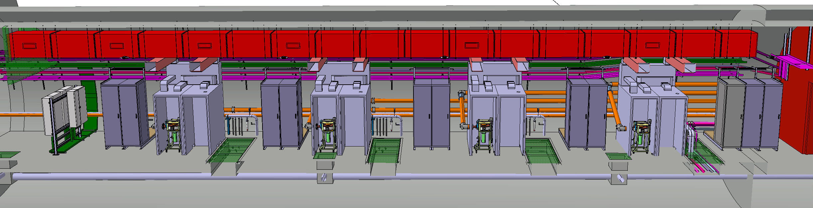
Integration of the HPRF in the galleries
1
2
3
4
The cavities are powered by 4 amplifiers IOT 400MHz. One for each cavity.

Slide 6
Power requirements from HPRF system
RF output power [kW]
Average output power is ~ 50 [kW]
10 ms
80 kW → 100 kW
40 kW → 50 kW
10 seconds
0 kW
Time

Slide 7
HPRF stations Technical Specification
High Voltage Power Supply;
Satellite auxiliary power supplies (heater, coil, grid, ionic pump, controls, etc…);
Tube protective system (crowbar);
Cooling subsystems;
PLC control system (monitoring, interlocks, sensors, interfaces, etc…).
PARAMETERS AND CONDITIONS | VALUES
Maximum dimensions (L x l x h) | 2.0 × 2.0 × 2.5 meters
Input power | 480 VAC / 250 A – 50 Hz
Collector voltage | 35 to 40 KV, by steps of 0.5 kV
Focus power supply | 0 to 30 V / 0 to 30 A, floating at minus collector voltage from ground
Ionic pump power supply | 5 kV / 5 mA, floating at minus collector voltage from ground
IOT Grid power supply | 0 to minus 200 V / 0 to 1 A, floating at minus collector voltage from ground
Continuous operation | 24/24 hours, 7/7 days, 11/12 months per year

Slide 8
Integration of the HPRF in the galleries
Volume L x l x h each HPRF station must be
maximum 2 x 2 x 2,5 meters all inclusive
Inside a gallery ⇨ NO possibility to increase the size !

Slide 9
Detailed Schedule – MS-5024: Supply of Transmitters for the HL-LHC High Power RF System
Tender Process Milestones | Provisional Schedule
MS-5024 documents dispatched to firms | 18 November 2024
MS Industry Webinar | 12 May 2025
MS answers submission | Link still open on CERN’s forthcoming page: https://forthcoming-ms.app.cern.ch/#!/
Dispatch of IT documents to firms | Mid-May 2025
Submission deadline for bidders | Mid-June 2025
Finance Committee and contract award | September 2025
Contract start-up | September 2025

Slide 10
MS-5024 – Key Qualification requirements
Distribution of the Contract performance
  The Lead Firm shall provide the design.
Minimal annual turnover of 6m CHF per annum and appropriate levels of staff resources
Proven competence and experience in design and manufacturing in the field of High-Power RF Systems.
  Design, Assembly and Testing of high-power electrical equipment for RF applications.
  Provide relevant references that are similar in scope, complexity and volume.

Slide 11
MS-5024: Distribution of Contract Performance
Technical deliverables and activities | Shall be performed by the Firm or the Lead Firm only | May be performed by any member of the Group of Firms | May be subcontracted
Contract management | x
Procurement of raw materials and components |  | x | x
Detailed Design File | x
Manufacturing of the Supply |  | x | x
Assembly of Supply |  | x | x
Factory Acceptance Tests |  | x | x
Technical documentation |  | x | x
Packing of the Supply |  | x | x
Commissioning |  | x | x
Additional deliverables and / or activities |  | x | x

