Slide 1
Beam pipe rope support from YE1 Status Update
Ali Karaki - CMS Engineering and Integration Office
Josef Sestak and Alessio Galloro- TE-VSC-BVO
Tristan Loic Loiseau - CMS Technical Coordination
28/04/2025

Slide 2
Introduction
A new support system for the beam pipe on YE1 has been developed, allowing remote support from the tower.
The design uses wire ropes passing through the obsolete alignment holes of the spacer ring.
It is intended for use when the endcaps are in the closed configuration, to reduce the total number of strokes and facilitate the opening of CMS.
A test was conducted on site during the last YETS, and the results will be presented and discussed.

Slide 3
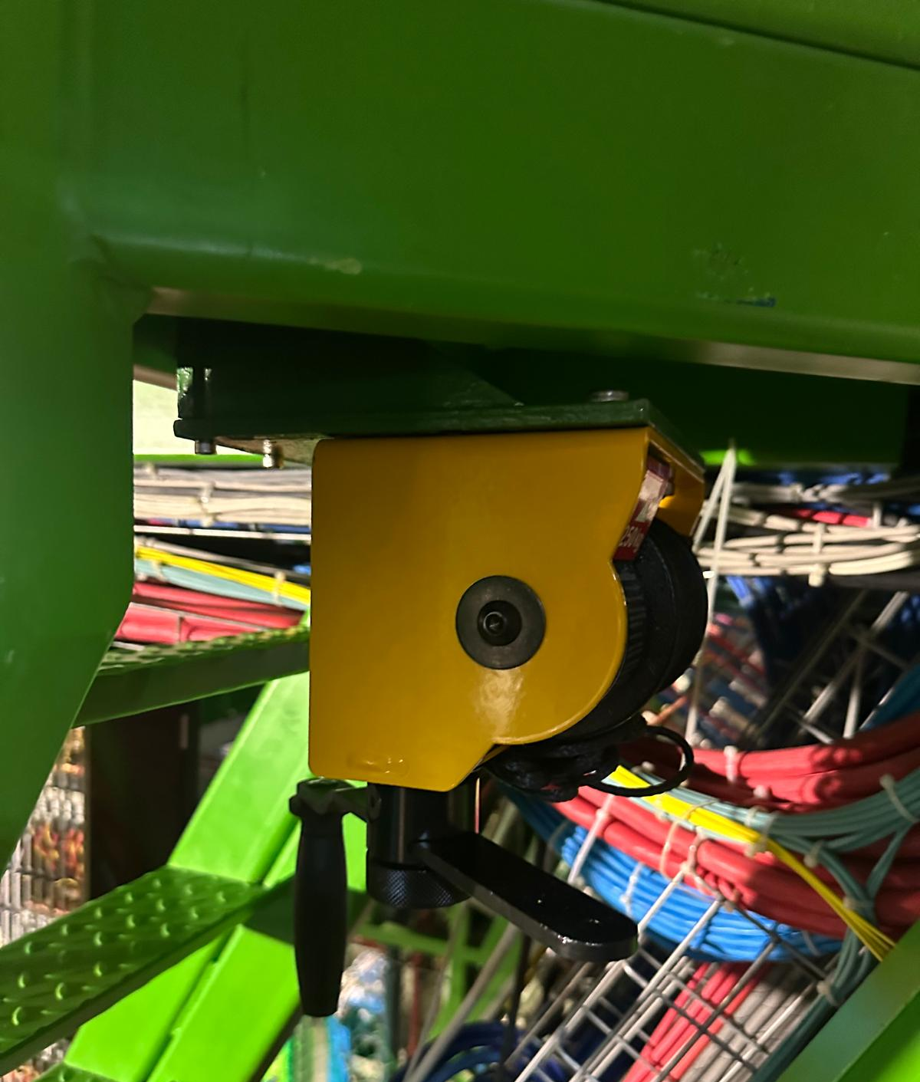
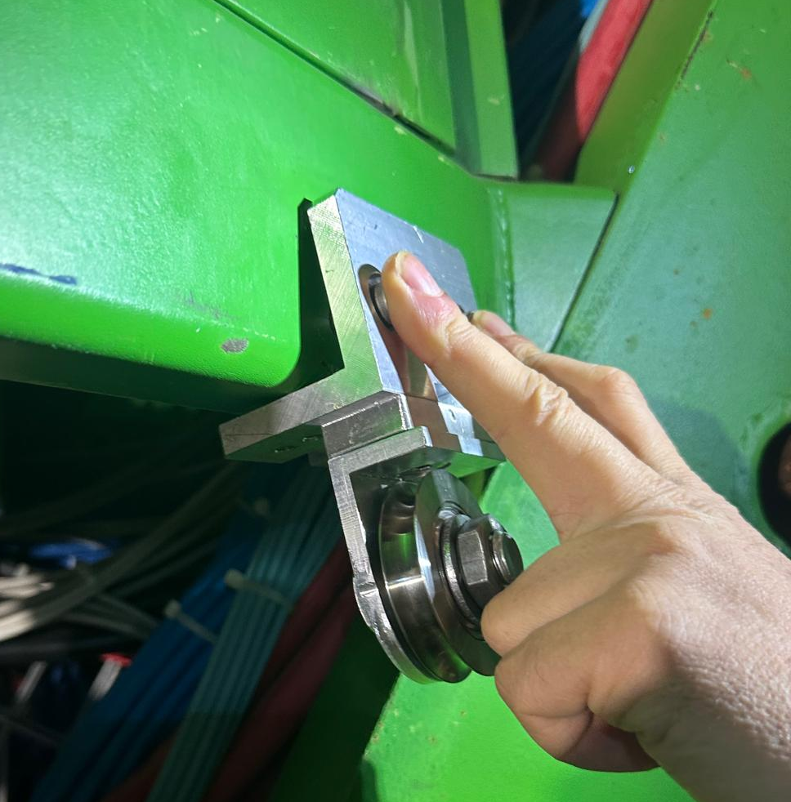
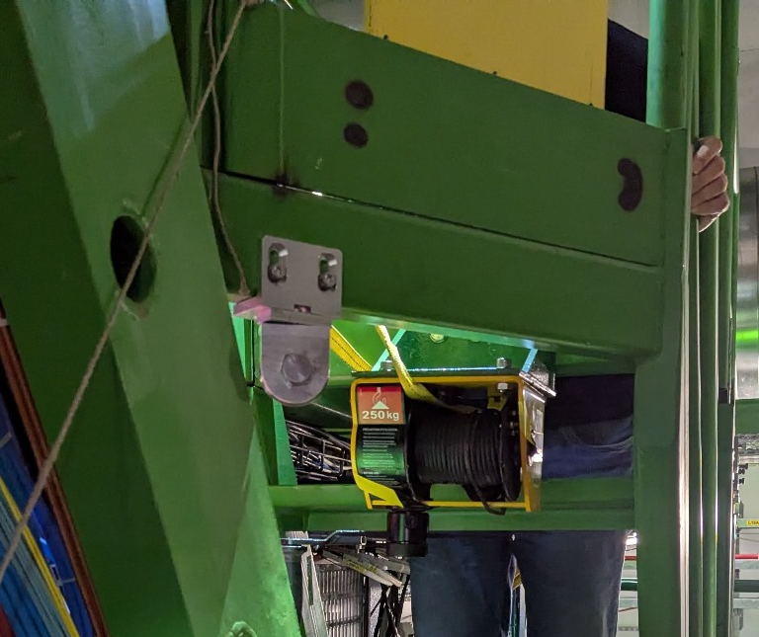
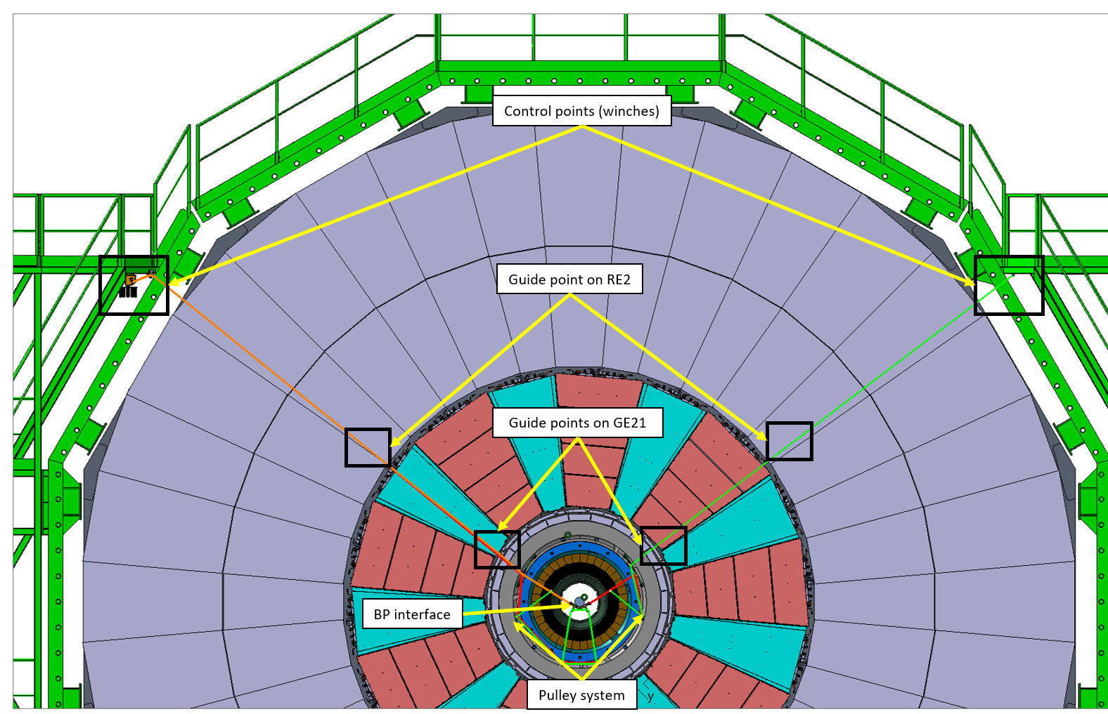
Winch and pulleys installation on the tower
Holes drilled on the tower were off by 2 mm.
Corrected by machining a slot on the bracket.
Metallic Floor removed for better access
Near
Far

Slide 4
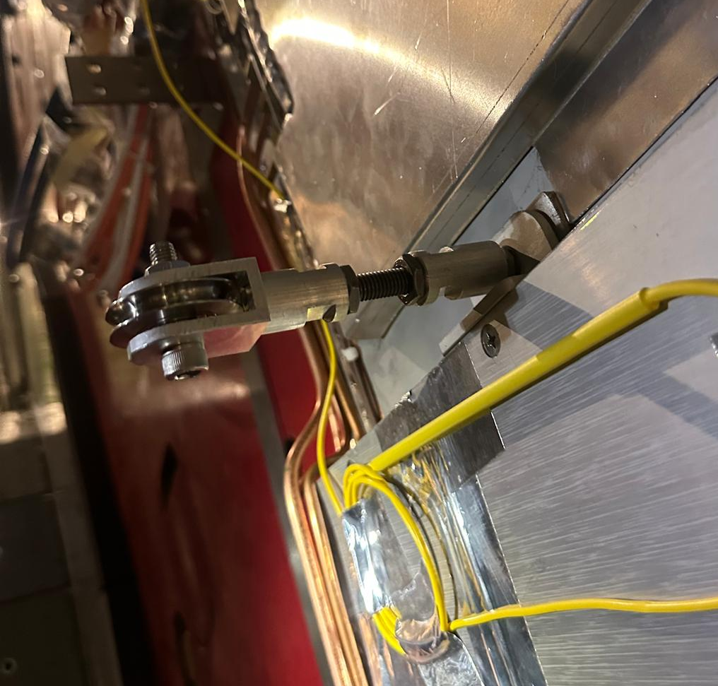
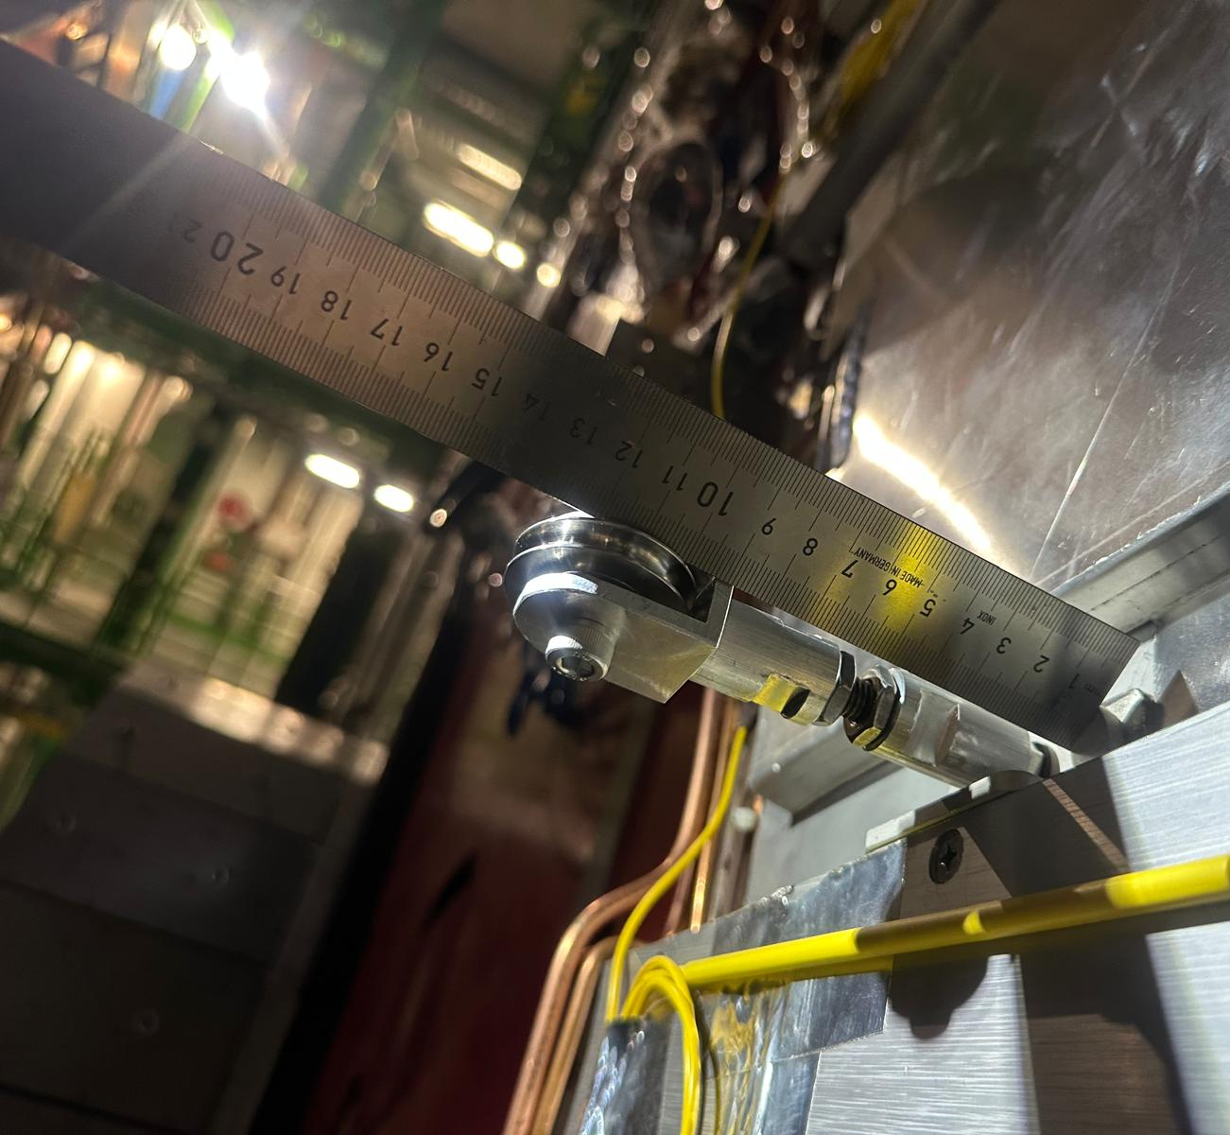
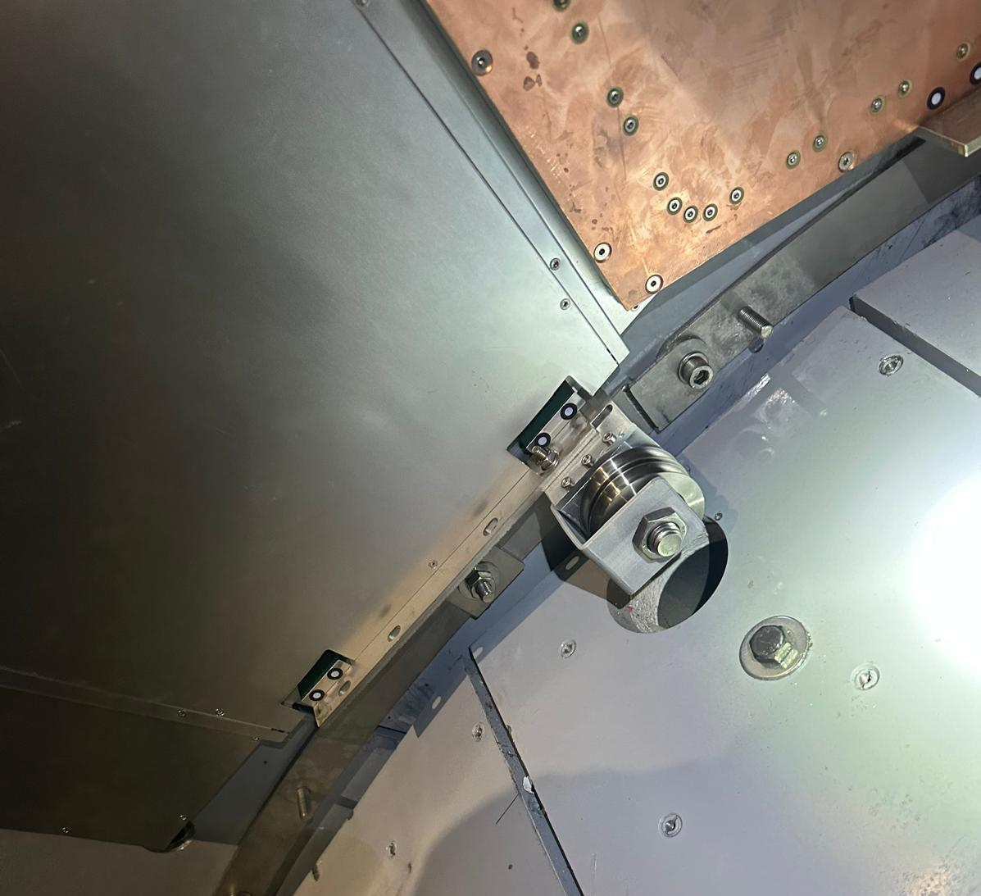
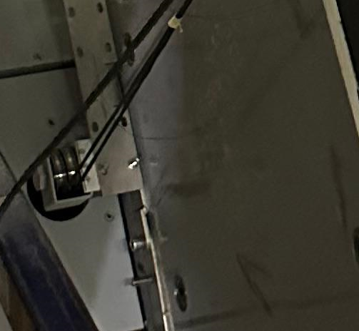
Pulleys on GE21 and RE21 brackets
RE21 pulleys
GE21 brackets installed directly on the bracket on the Near side. On the Far side, the GE21 bracket had to be installed before, as the chambers were not yet installed.
Chamber
No Chamber
Near
Far

Slide 5
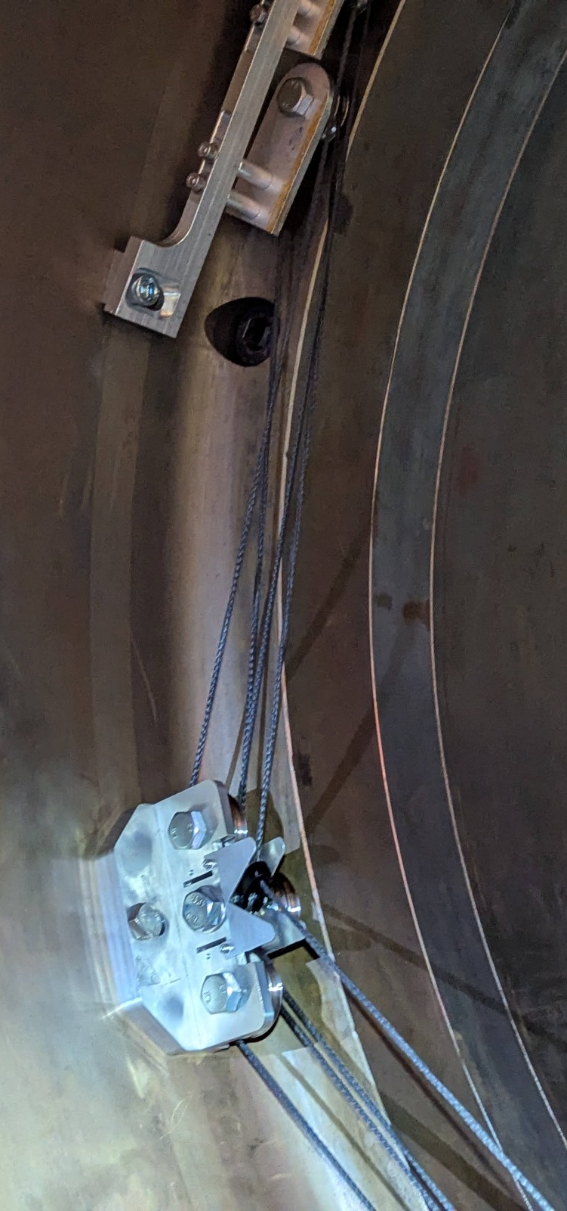
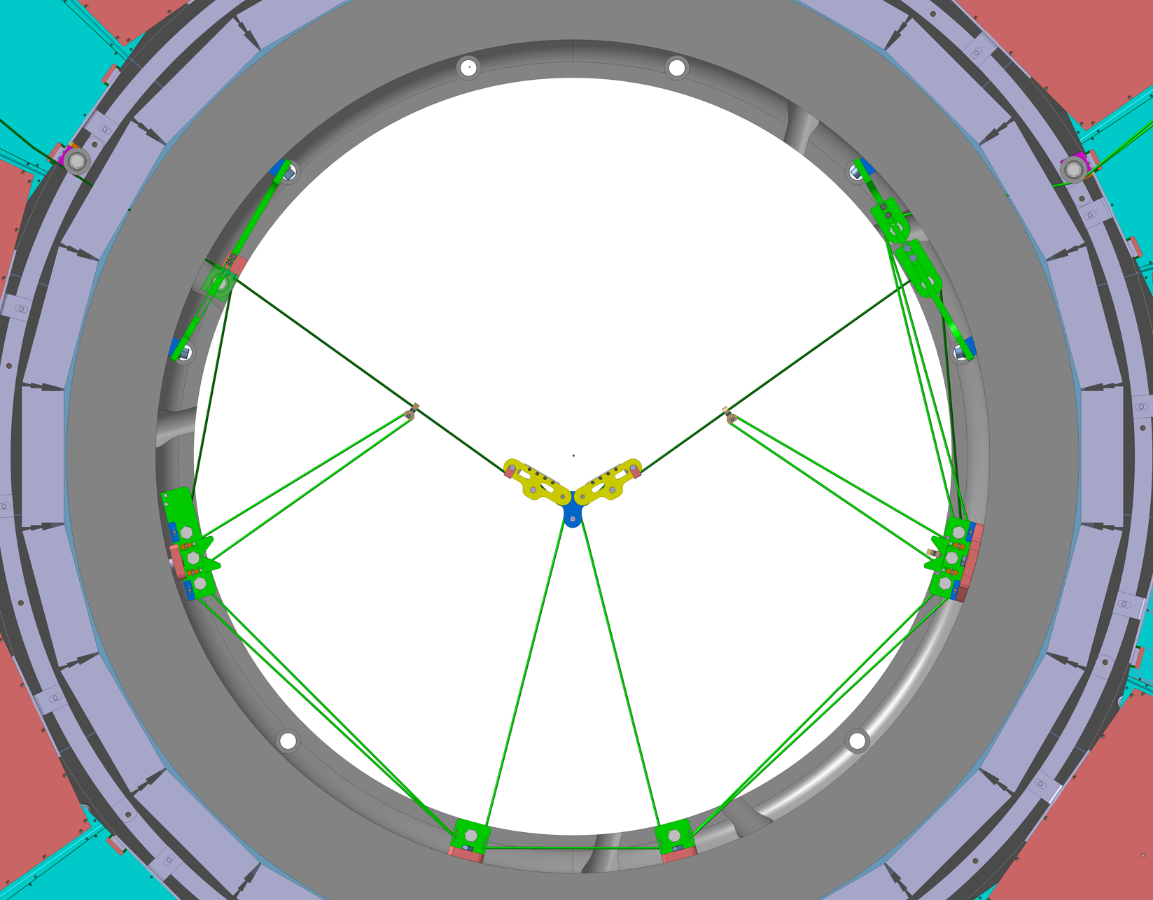
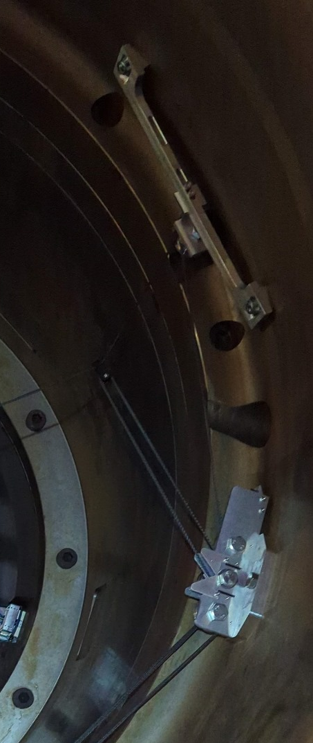
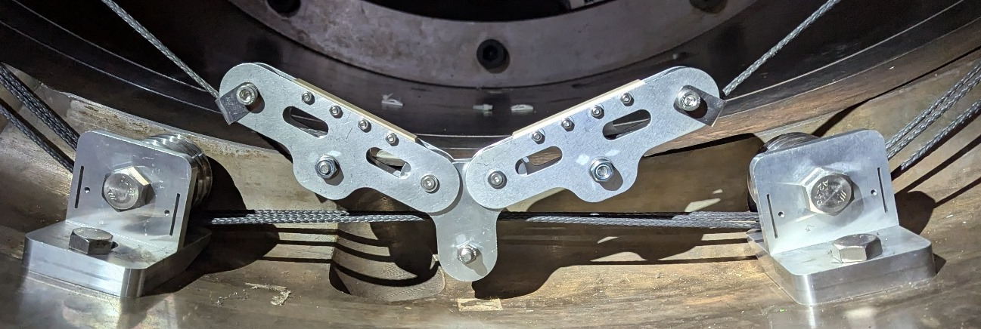
Pulleys inside YE1 ring

Slide 6
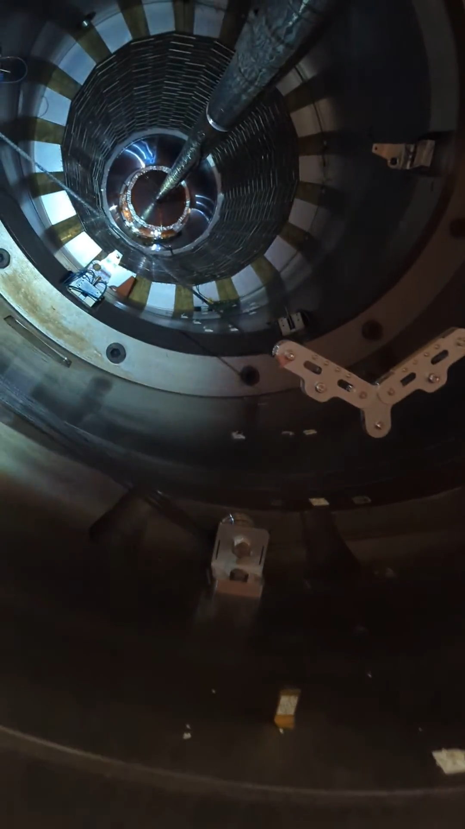
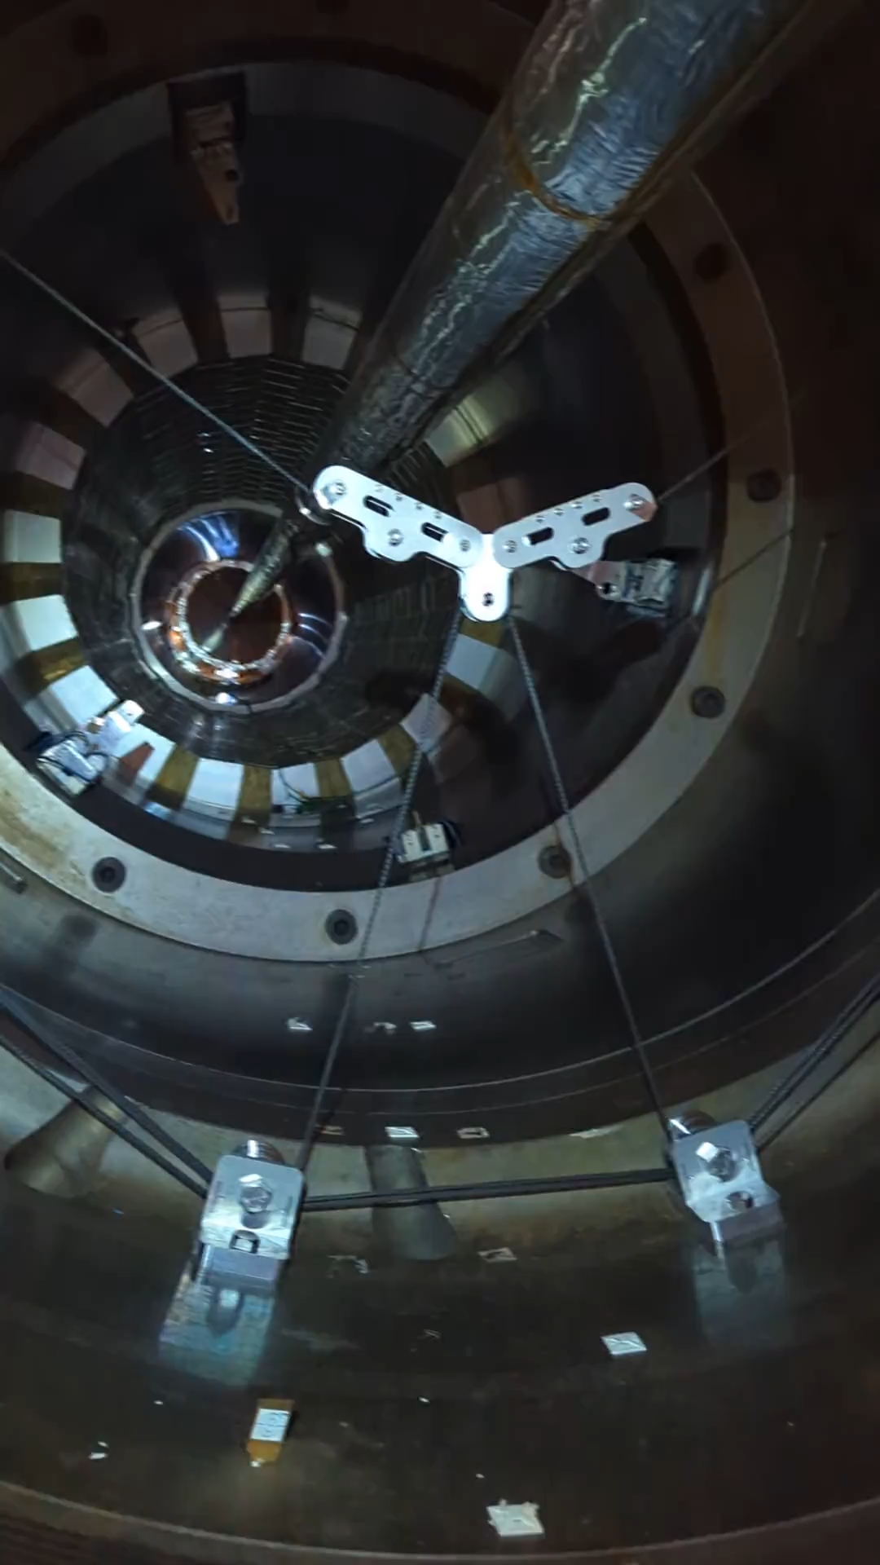
Smooth manipulation
Easy to lift and lower the support with the winches
No derailment occurred after several tries (34 pulleys)
UP
DOWN

Slide 7
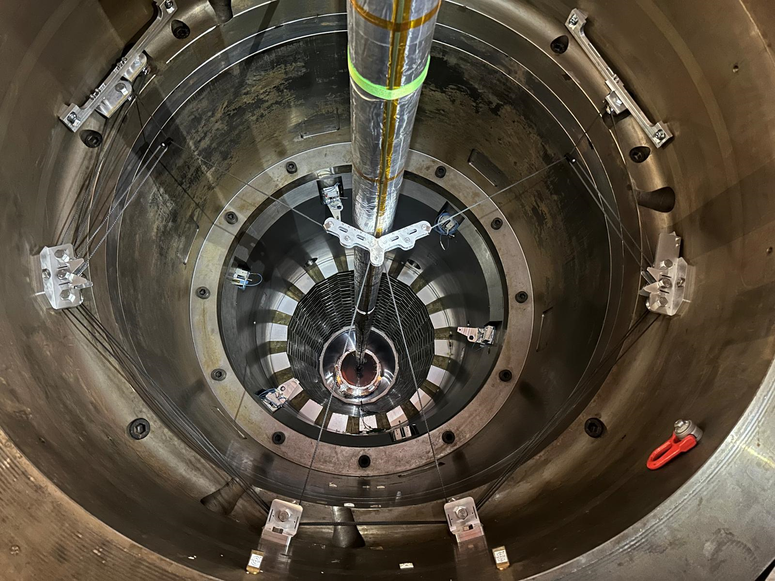
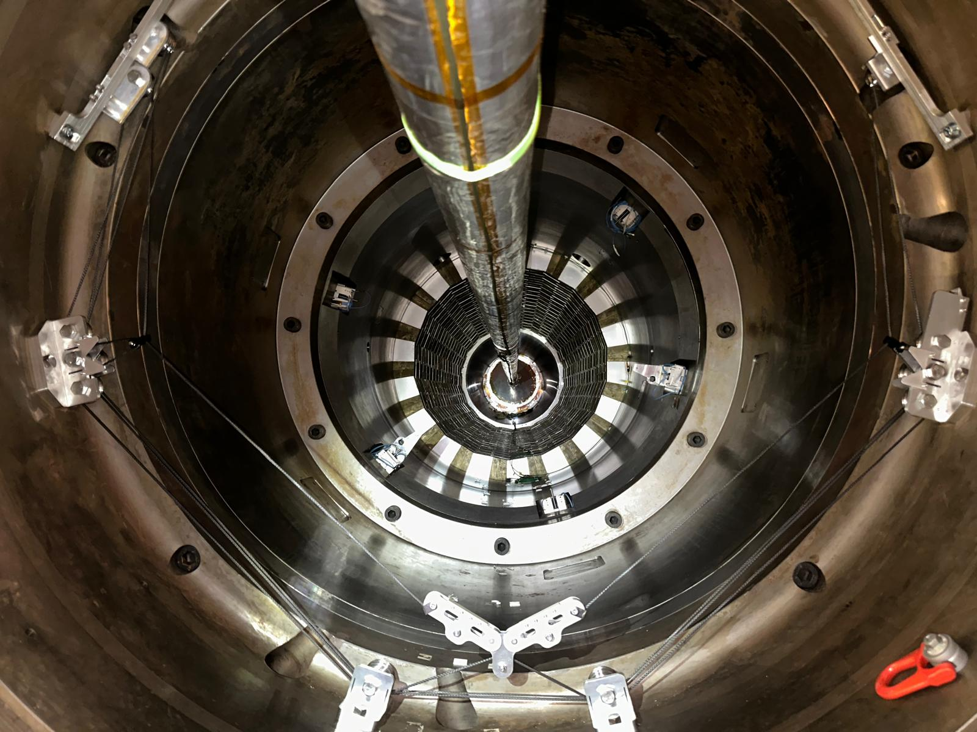
More pictures
Support Up
Support Retracted

Slide 8
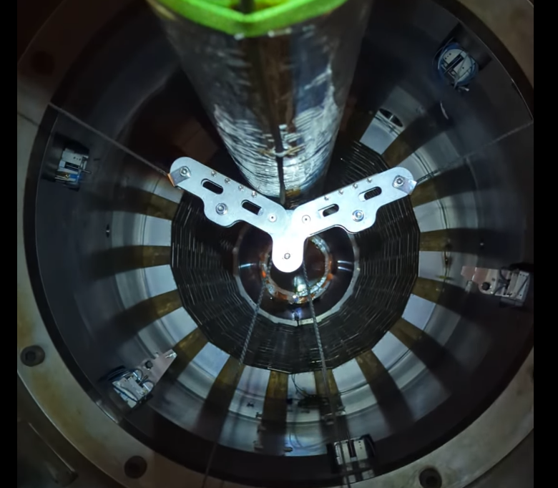
Misalignment in X
When the support made contact with the BP, it was observed to shift toward the Far side (the pulling side), causing the BP to be pushed unevenly to one side.
Despite further upward movement, the support did not realign itself due to friction, instead inducing a horizontal displacement in the BP.
After a total displacement of 5 mm in the X direction (as measured by the survey), the test was stopped.
~ 1.5 - 2 cm
Near
Far

Slide 9
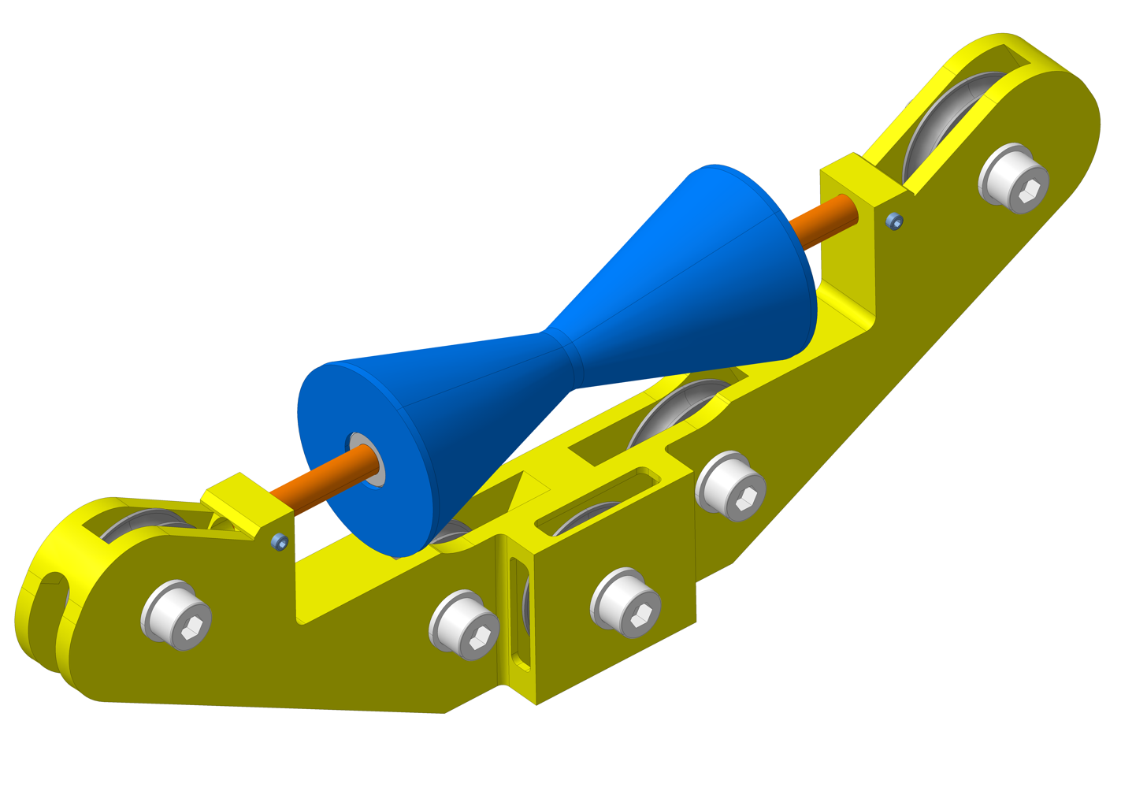
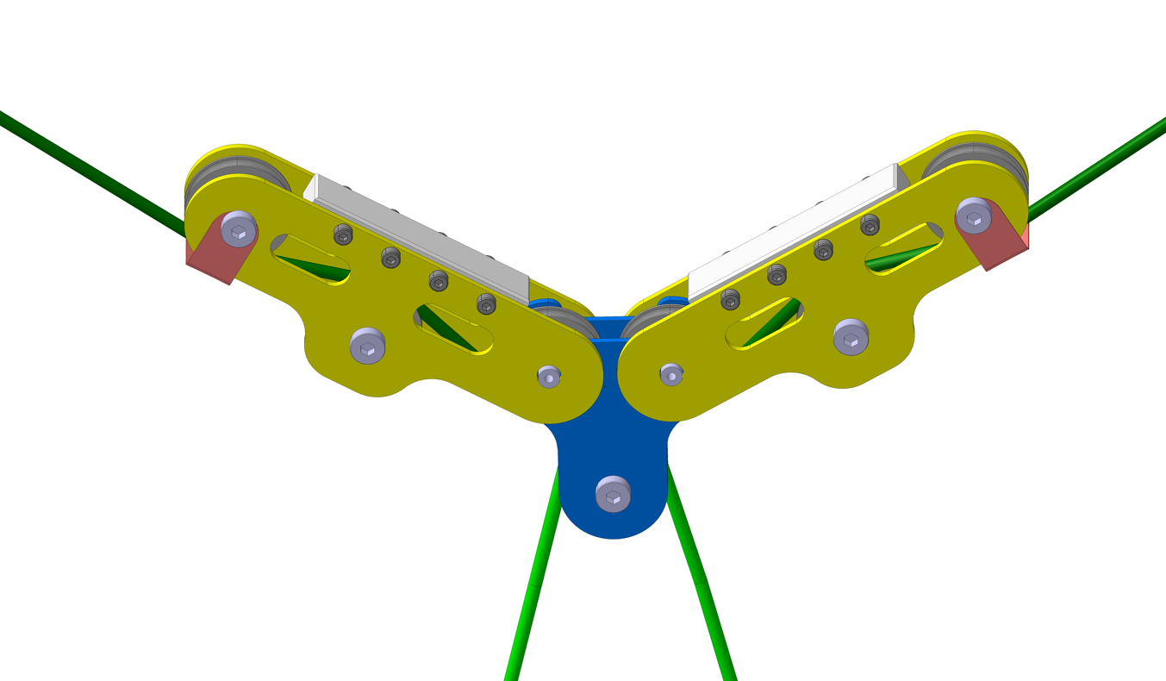
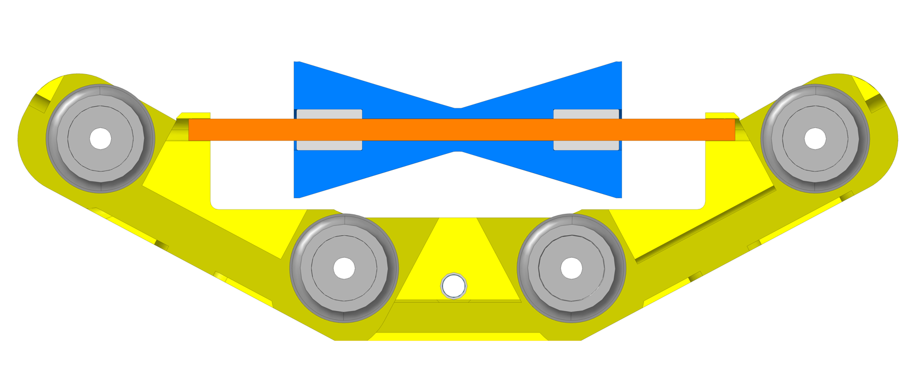
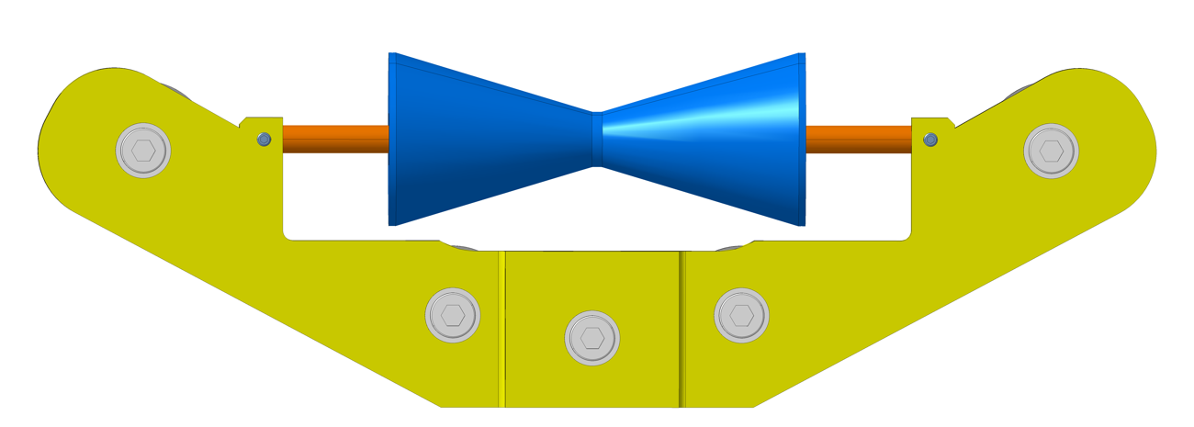
New interface design
Allows a free sliding in X direction
More robust design: one block
New Design
Current Design
PEEK Roller
Aluminum Block
Retraction pulley
Linear bearings
Shaft D8
30mm
30mm
Slots for rope

Slide 10
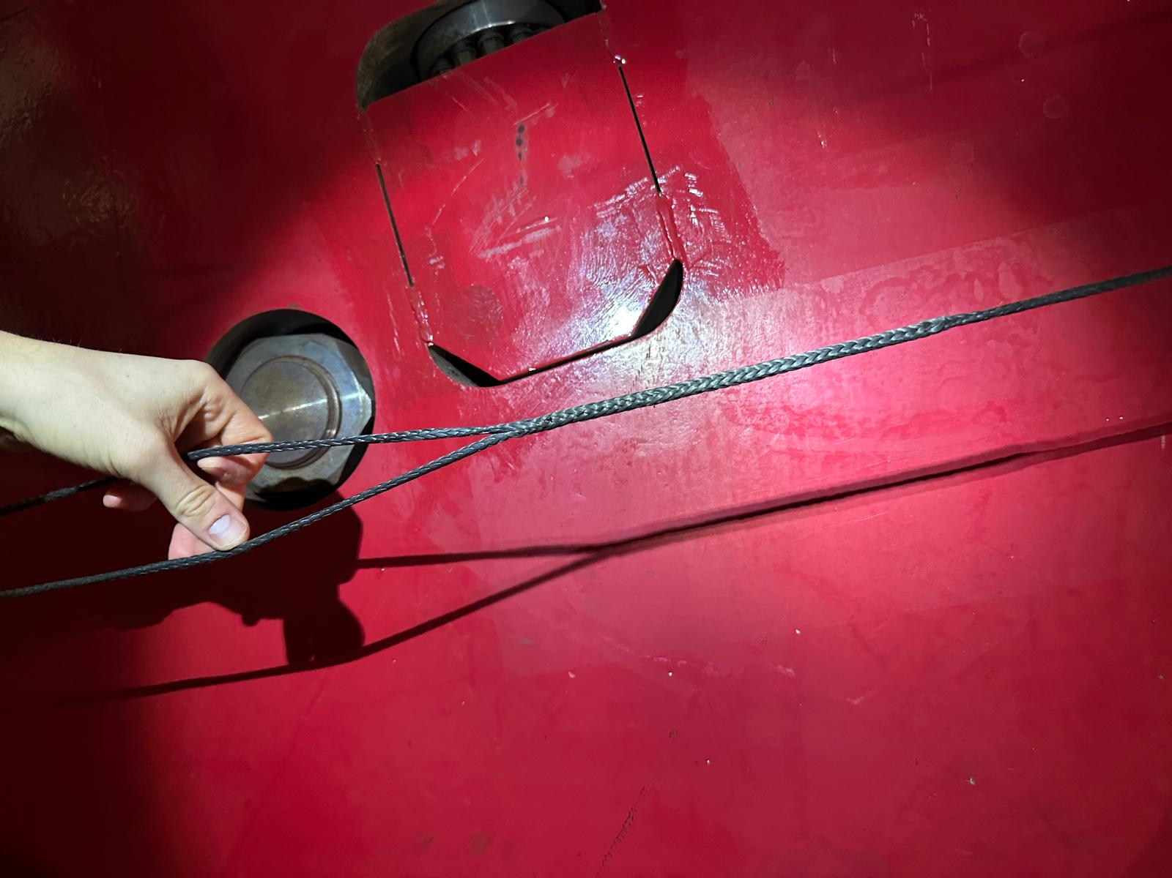
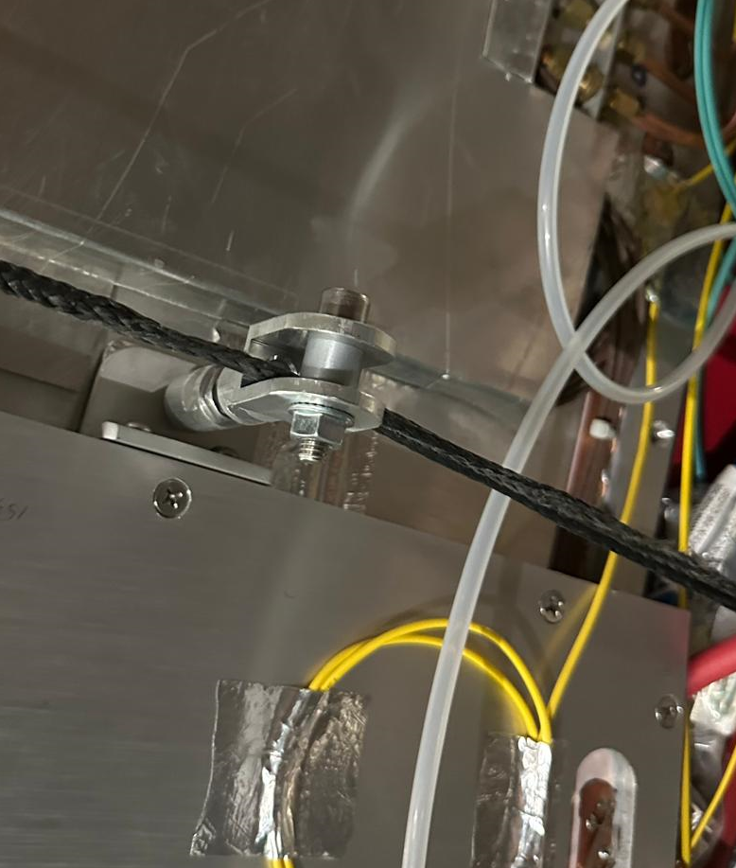
Epissure
The rope loop was closed using an “épissure” knot.
The knot got stuck with the RE21 pulley during manipulation due to the pulley's tight groove.
The pulley was replaced with a simple ring, resolving the issue; for future setups, the knot will be placed away from the pulley.
Pulley
Ring

Slide 11
Conclusion
The installation of the different components of the supports was successful.
Winch operation was easy and smooth, with no derailments observed.
When the support is in contact with the beam pipe, the support shifted toward the pulling side due to high friction in the interface and low beam pipe stiffness in the X direction.
A new interface design is proposed to introduce the missing degree of freedom and solve the observed shift.
Irradiation tests to be done on the new rope.

