Slide 1
Electron gun & collector for the new AD e-cooler
Numerical assessment
Teresa Guillen Hernandez
10/04/2025

Slide 2
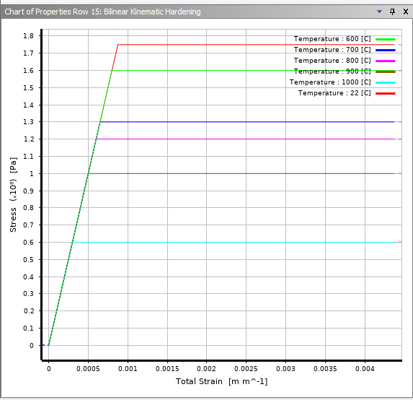
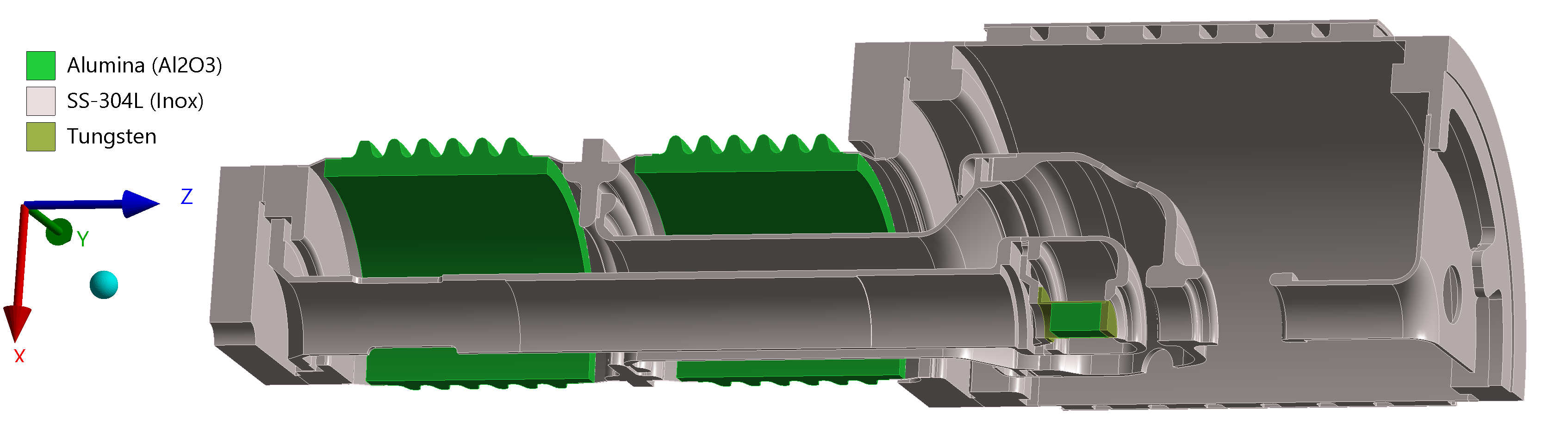
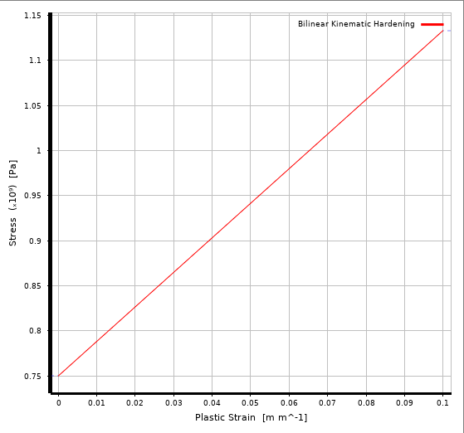
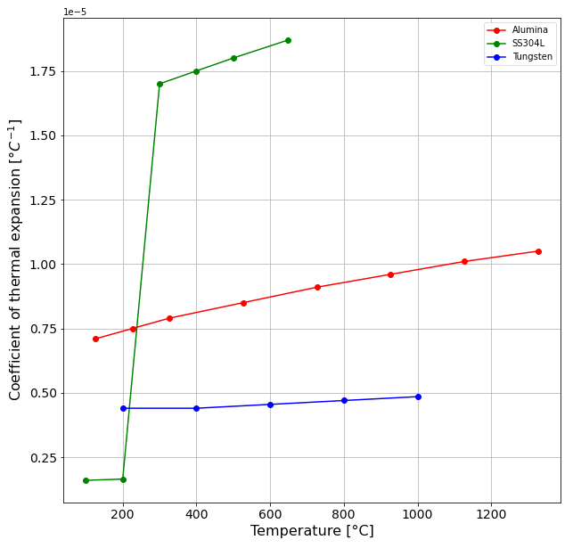
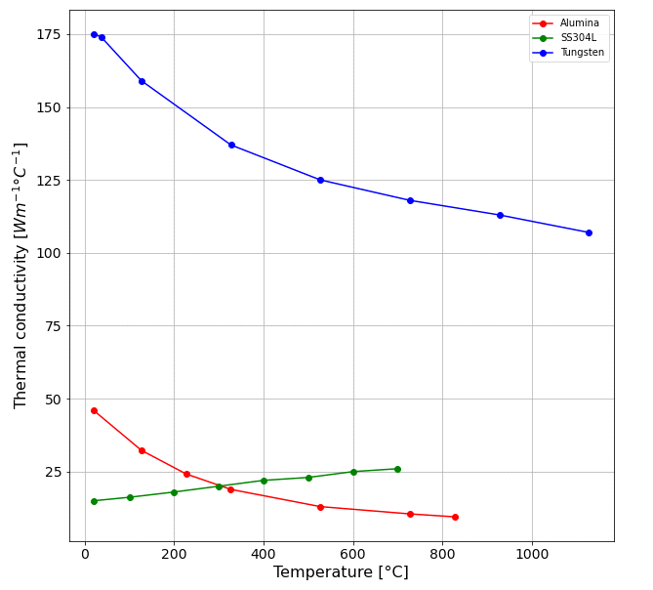
Geometry and materials
Plasticity 304L
Symmetry
Material | Elastic modulus [MPa] | Yield stress [MPa] | Ultimate stress [MPa]
Alumina | 390 | 300 | 400
SS 304L | 200 | 175 | 450
Tungsten | 405 | 750 | 980
Thermal conductivity
Coef. of thermal expansion
Plasticity Tungsten
Notes:
58% elongation at break inox

Slide 3
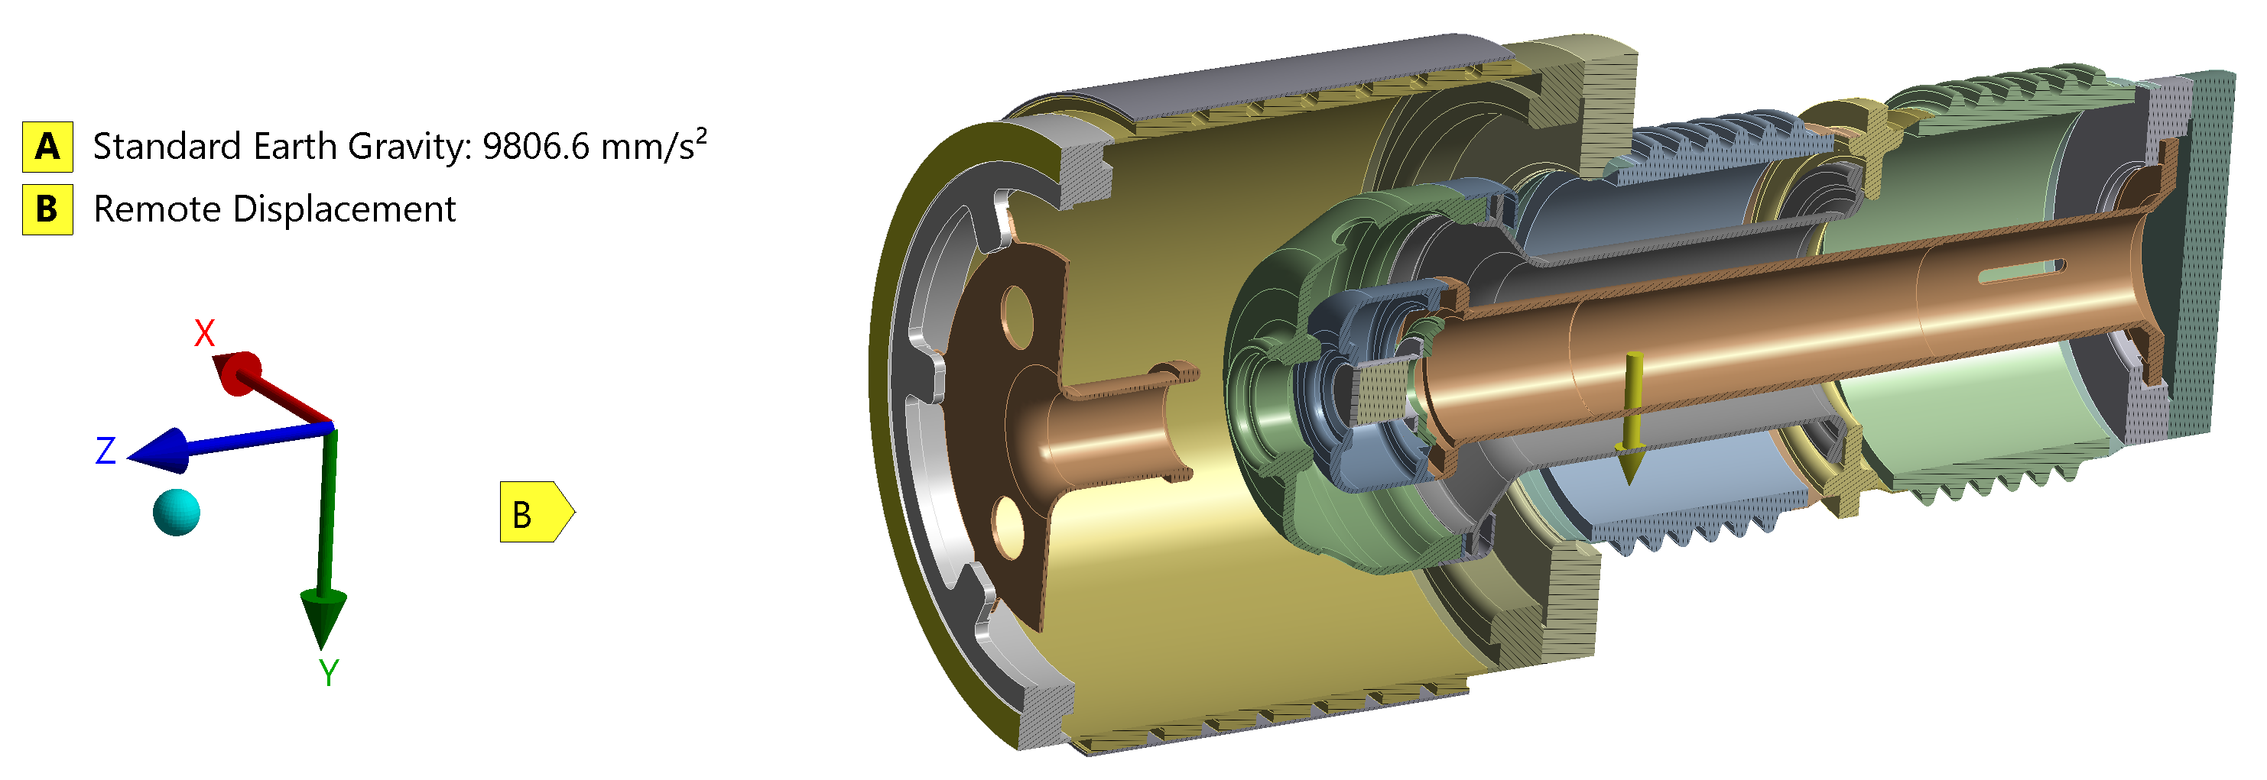
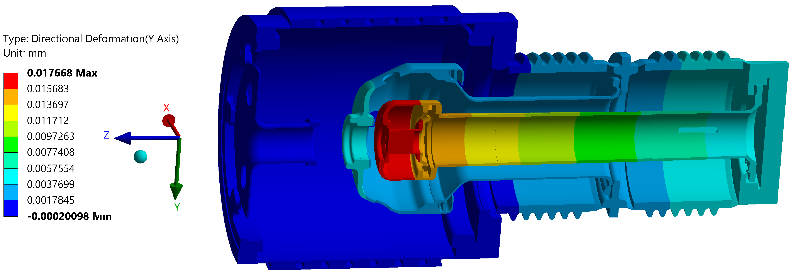
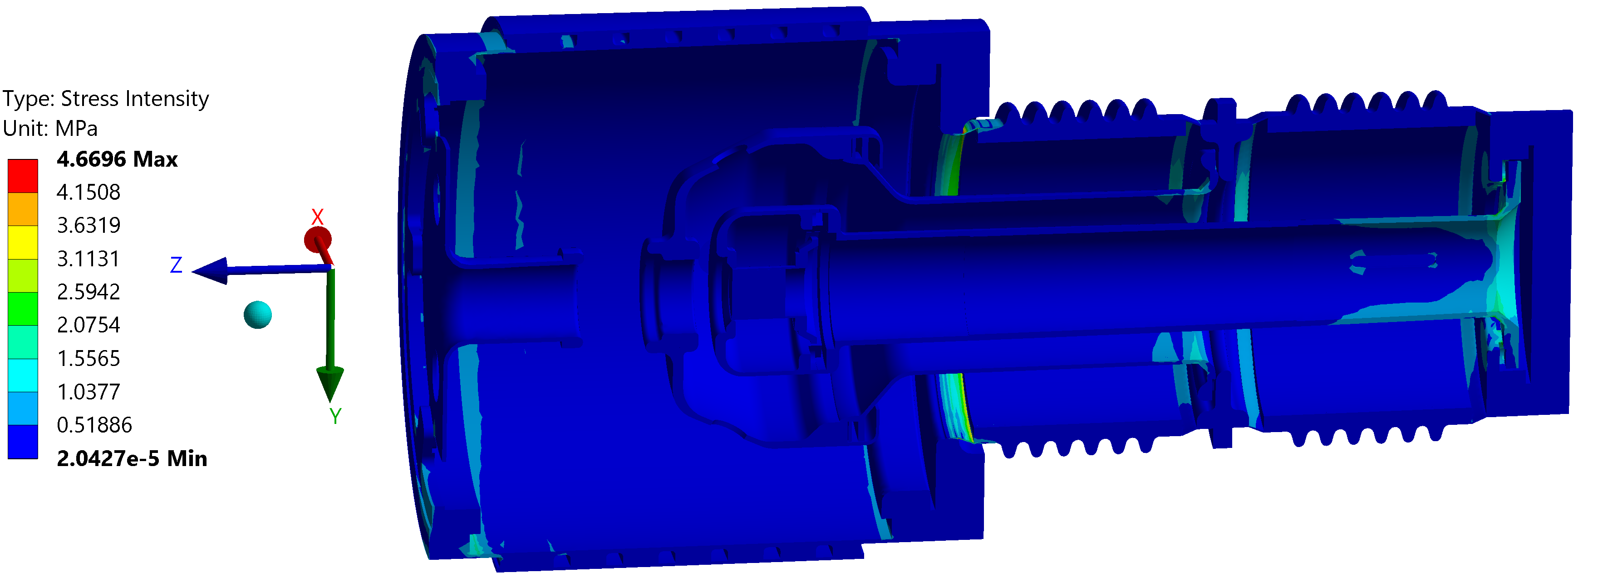
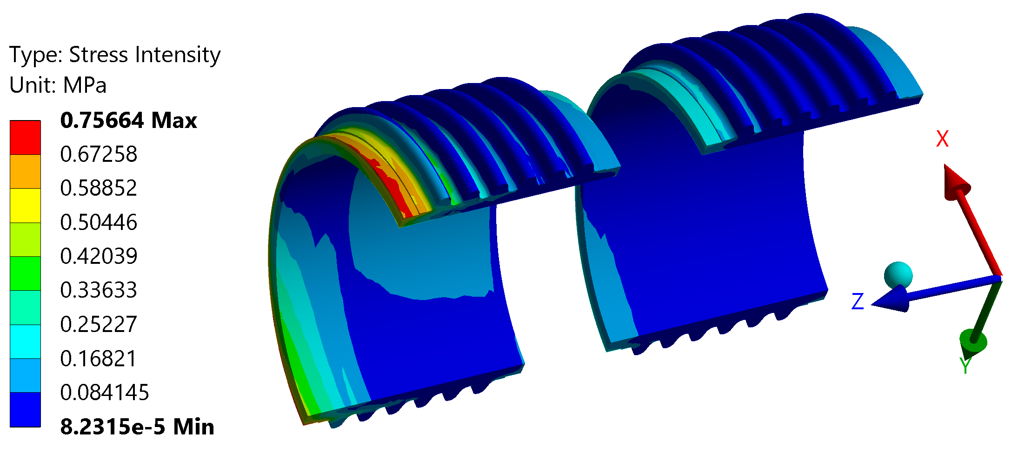
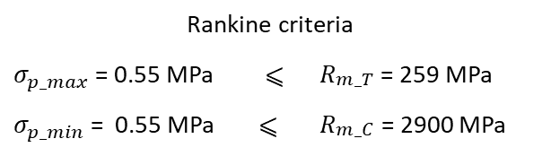
Mechanical analysis - gravity
Operation support
Rankine criteria
$σ_{p_max}$ = 0.55 MPa | ⩽ | $R_{\begin{aligned}m_T \\ \end{aligned}}$ = 259 MPa
$σ_{p_min}$ = 0.55 MPa | ⩽ | $R_{\begin{aligned}m_C \\ \end{aligned}}$ = 2900 MPa
Very low stresses
Notes:
OPERATION SUPPPORT - Fixed support at 205mm from the flange.

Slide 4
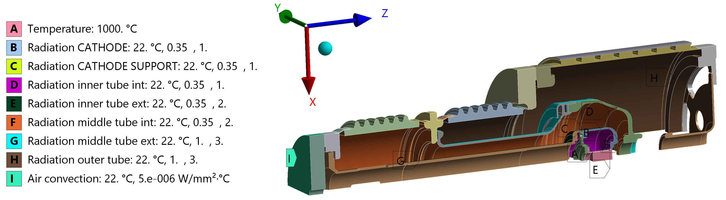
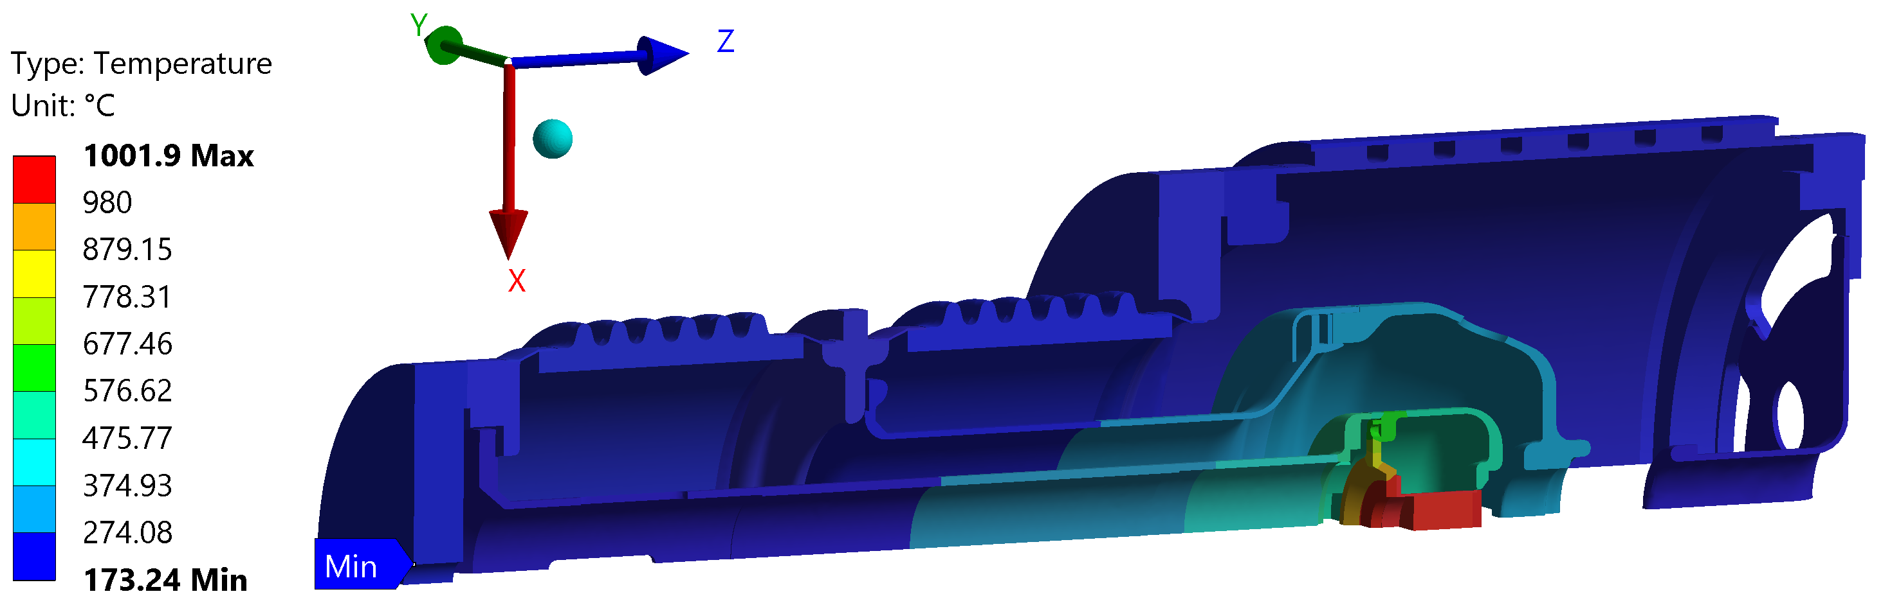
Cooling ?
Cooling needed

Slide 5
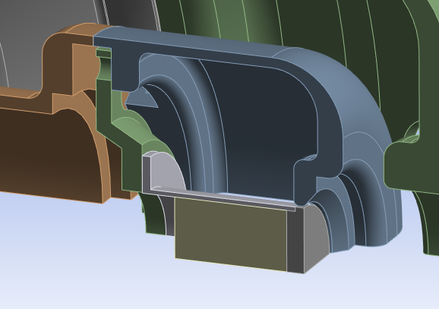
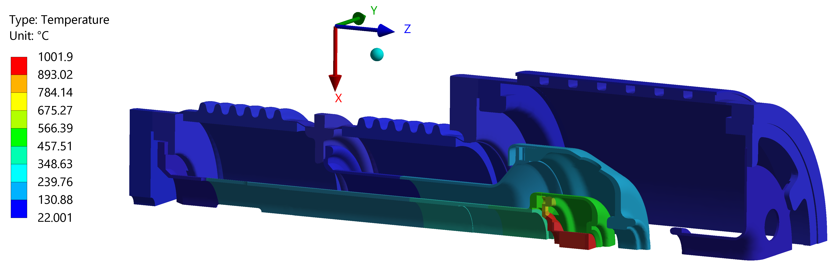
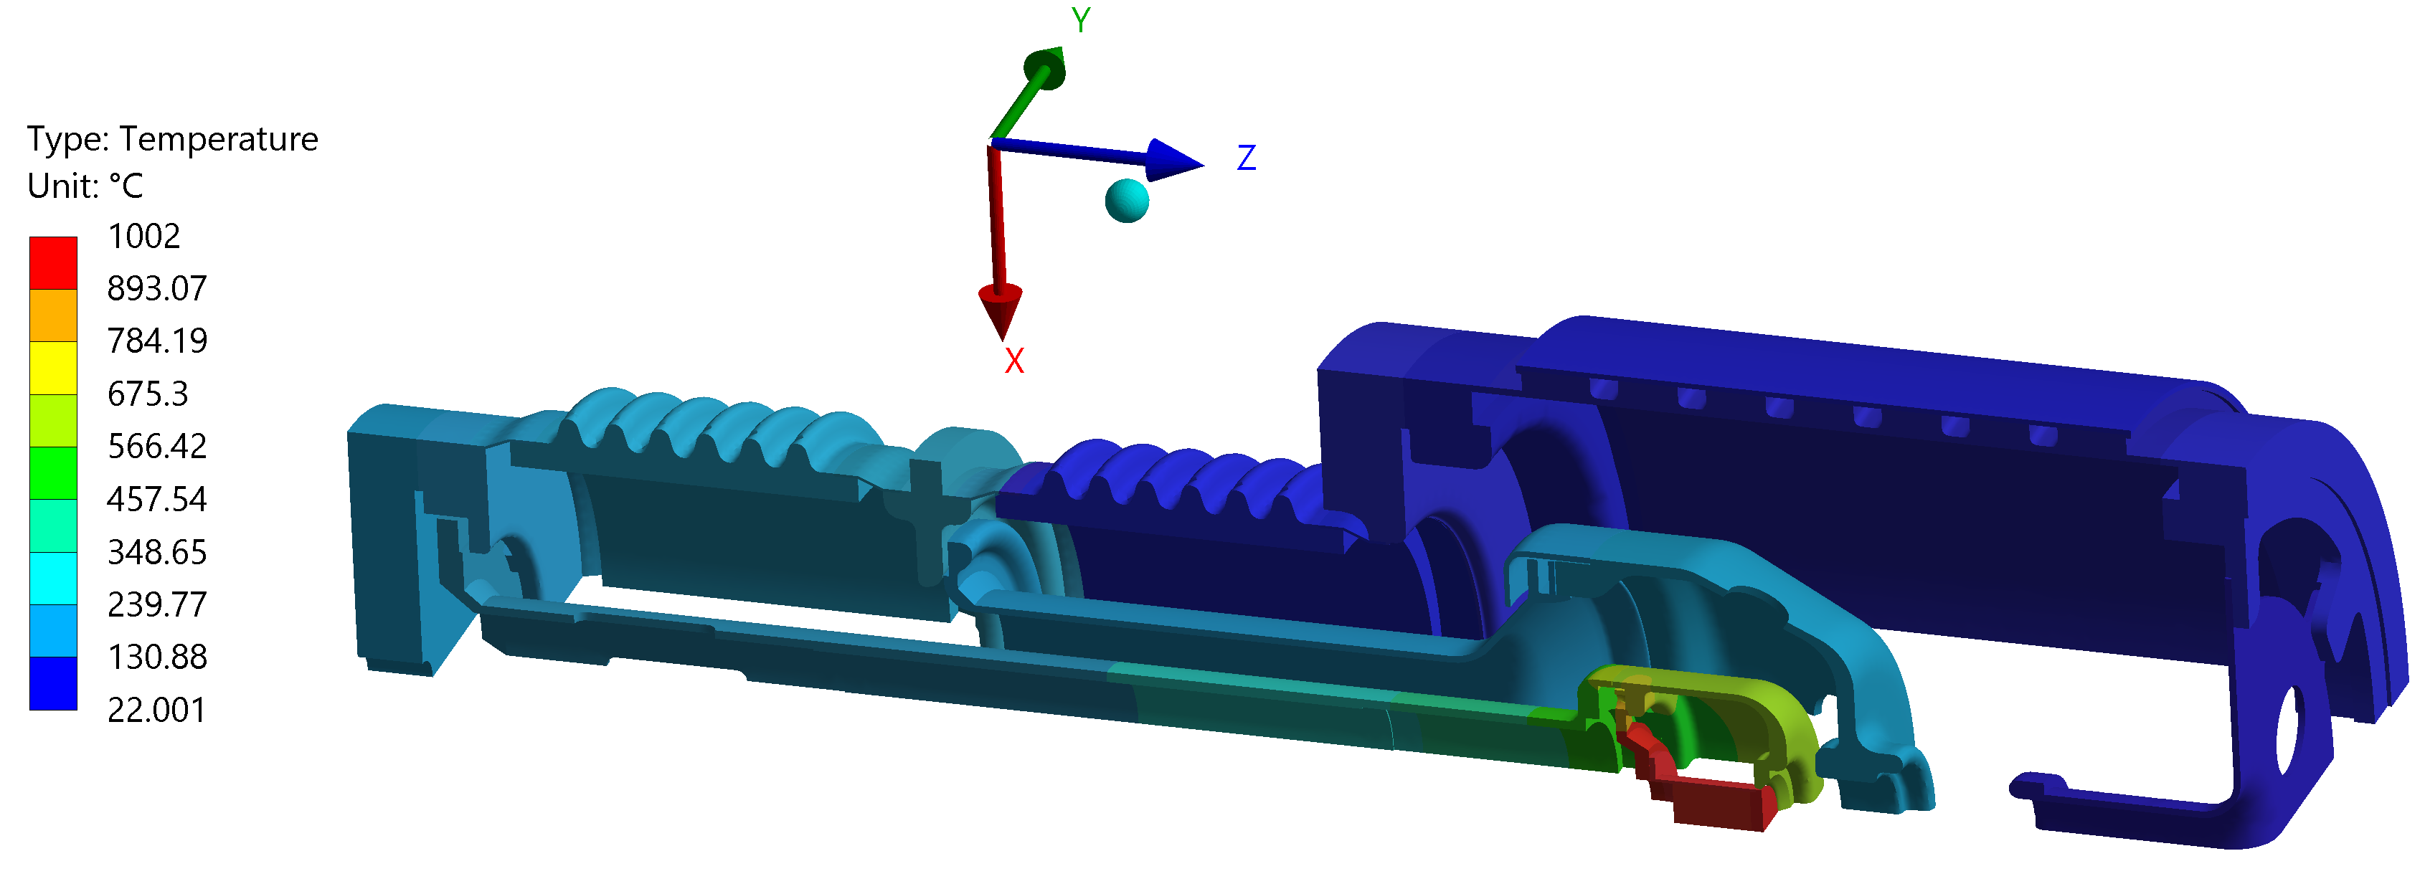
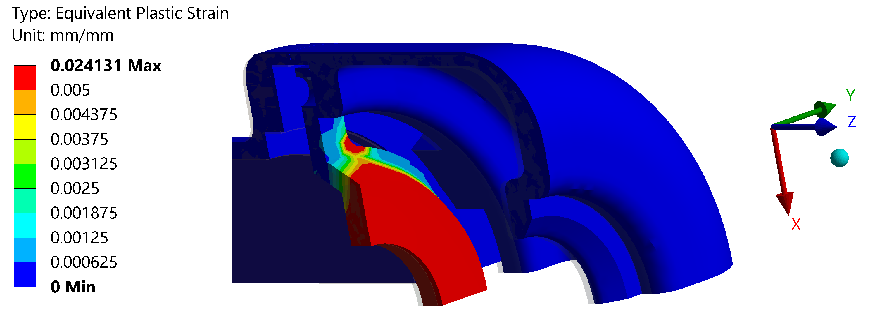
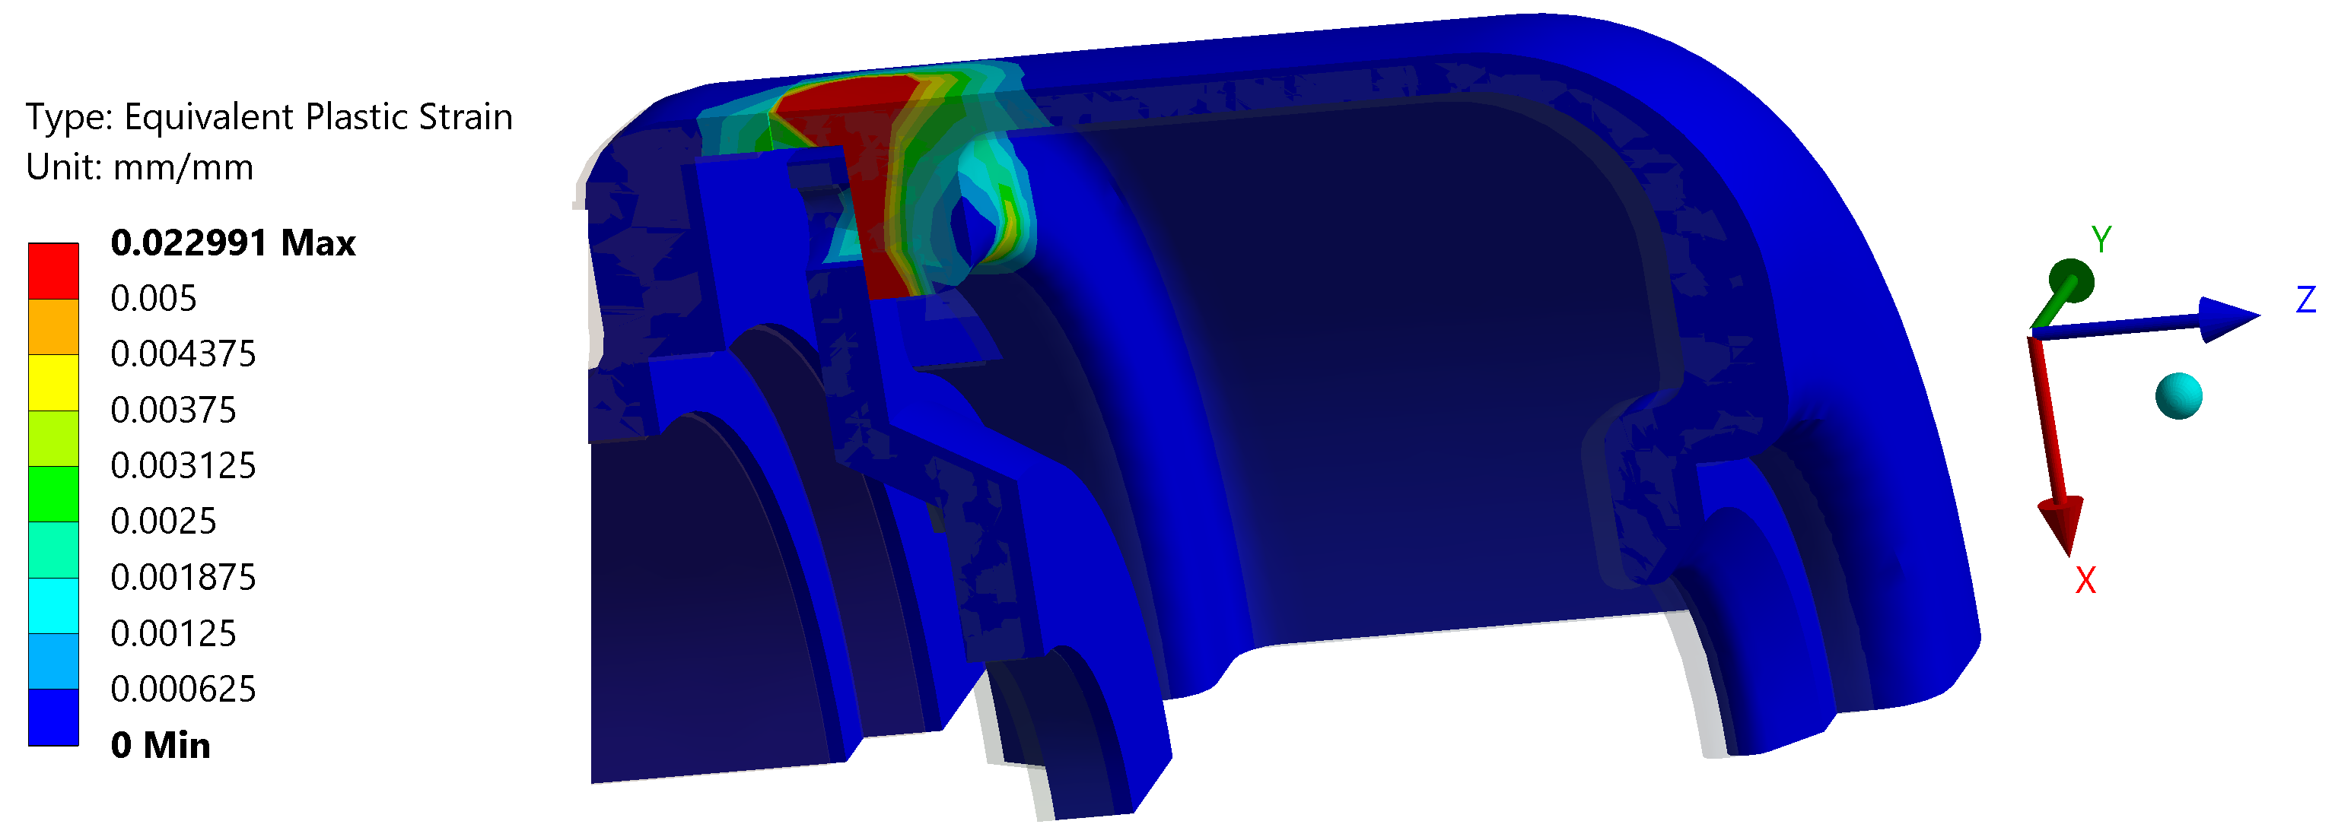
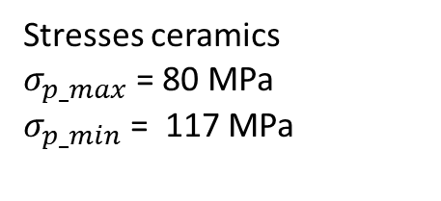
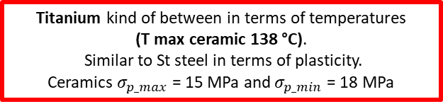
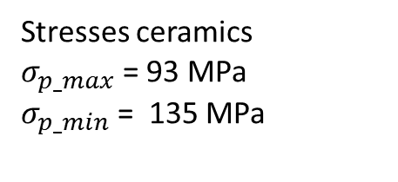
Thermo-mechanical analysis – No tantalum
St steel
Tungsten
(T max ceramic 115 °C)
Higher temperatures
(T max ceramic 147 °C)
smaller area
Stresses ceramics
$σ_{p_max}$ = 80 MPa
$σ_{p_min}$ = 117 MPa
Titanium kind of between in terms of temperatures
(T max ceramic 138 °C).
Similar to St steel in terms of plasticity.
Ceramics $σ_{p_max}$ = 15 MPa and $σ_{p_min}$ = 18 MPa
Stresses ceramics
$σ_{p_max}$ = 93 MPa
$σ_{p_min}$ = 135 MPa
Notes:
Which is the limit of plasticity we can afford?? To be checked how much is this plasticity in terms of deformation
Ratcheting – 20% in 15 cycles (from 2.4% to 2.9%)
Tungsten higher thermal conductivity, so we are hotter (conduction), and we have more radiation.
Thermal expansion of Titanium smaller, less stresses on the ceramic

Slide 6
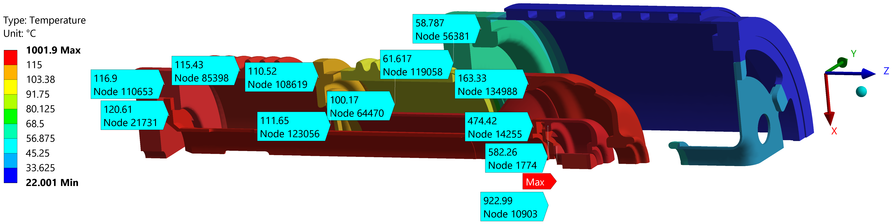
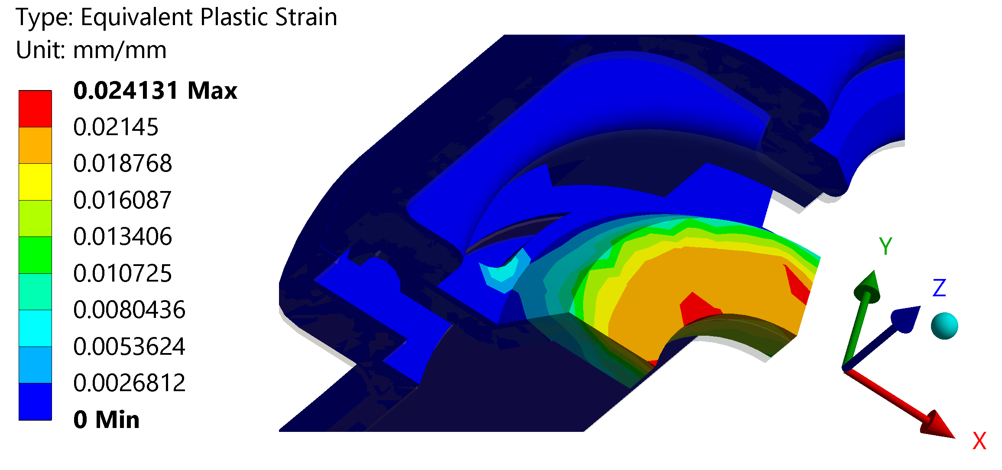
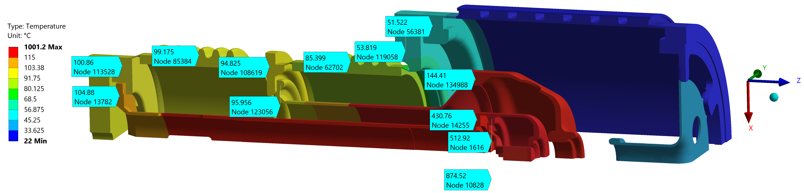
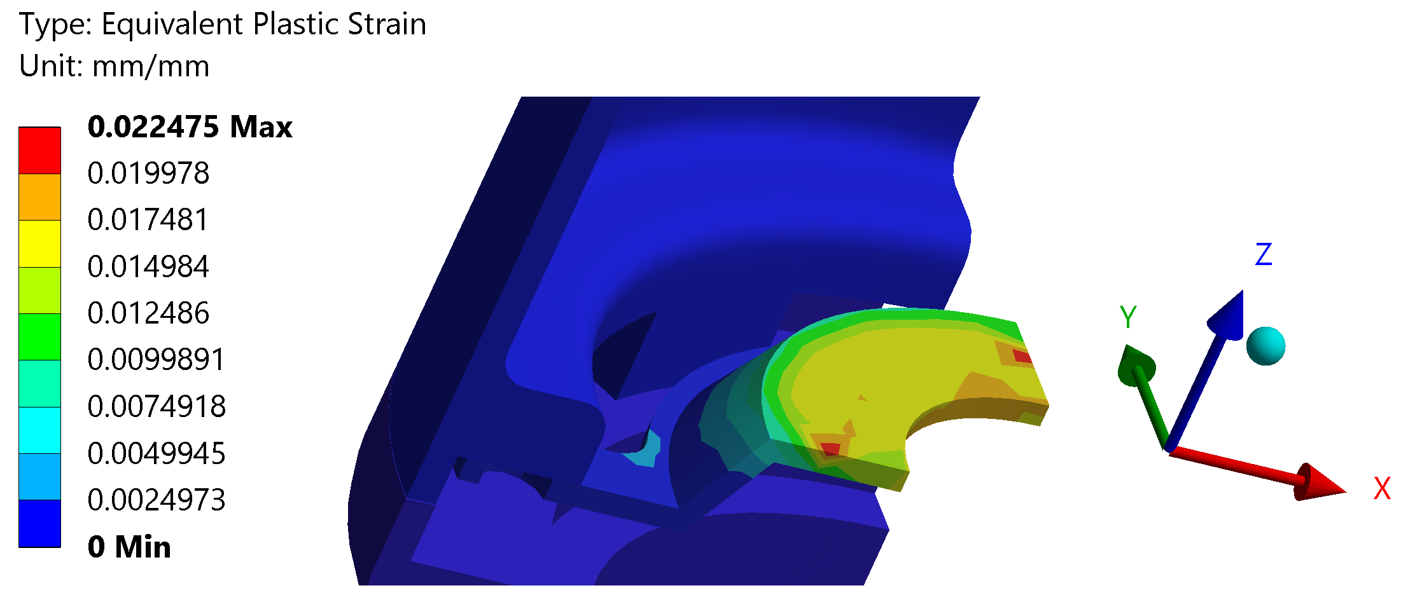
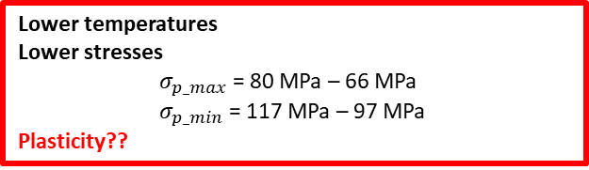
Thermo-mechanical analysis – new conf to reduce plasticity
Thicker and bigger contact
Thinner and smaller contact
Lower temperatures
Lower stresses
$σ_{p_max}$ = 80 MPa – 66 MPa
$σ_{p_min}$ = 117 MPa – 97 MPa
Plasticity??
Notes:
LOWER TEMP. Less conduction, so colder and therefore, less radiation
Lower stresses everywhere
Plasticity???? Not much difference

Slide 7
Conclusions
Cooling needed
Titanium flanges reduce the stresses on the ceramics
We will have plasticity. How much we can afford?
Ratcheting is a problem
Reduce the thermal contact and made it more flexible

