Slide 1
CI Update
O. Stringer, S. Sethi & H. Zhang

Slide 2
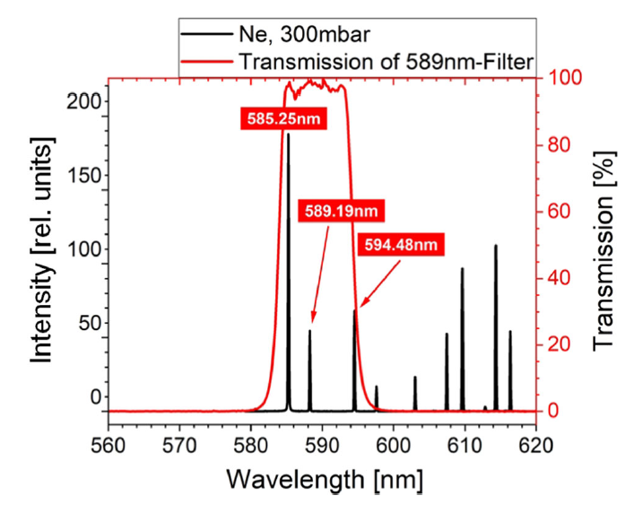
Cross Section Discussion
Potential for additional fluorescence lines to be detected.
Ignoring red transmission line (different filter).
585.25nm = ~185 (Arb.U.)
589.19nm = ~55 (Arb.U.)
594.48nm = ~70 (Arb.U.)
Ion beam induced fluorescence lines (R. Hampf, Eur. Phys. J. D 2023)
2s²2p⁵(²P°_{1/2})3s Transition

Slide 3
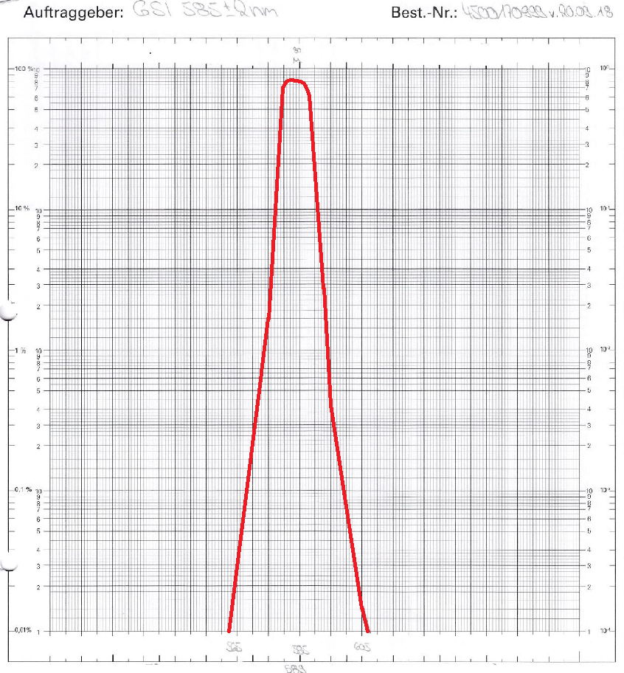
Cross Section Discussion
585nm GSI filter QE.
Peaks at 584nm, Transmission max = 82%
At 589nm = 30%
At 594nm = 0.8%
Expected 90.2% signal from 585nm and additional 9.8% from 589nm line.

Slide 4
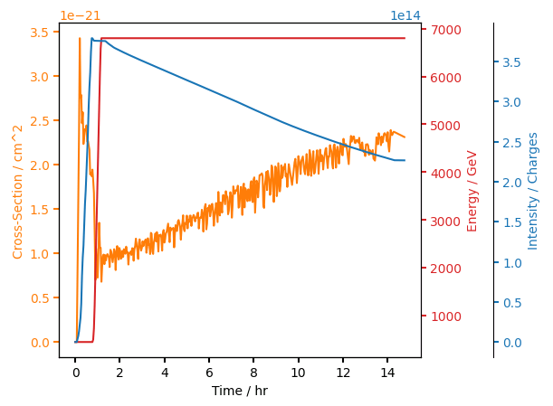
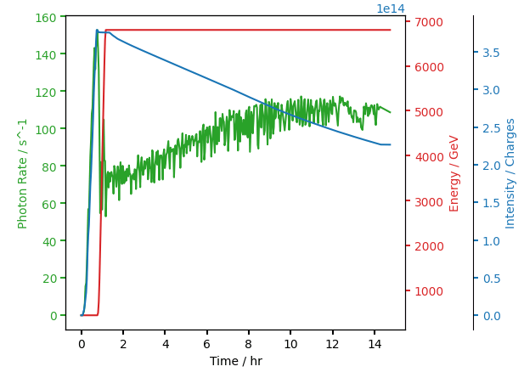
Cross Section & Photon Rate
Expecting a flat line for cross-section and a photon rate proportional to intensity

Slide 5
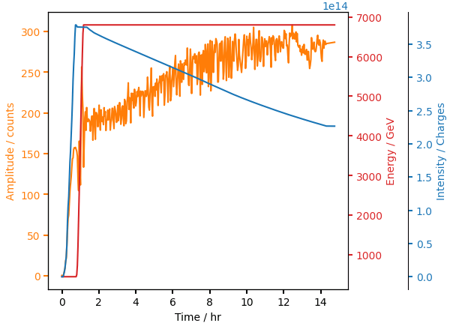
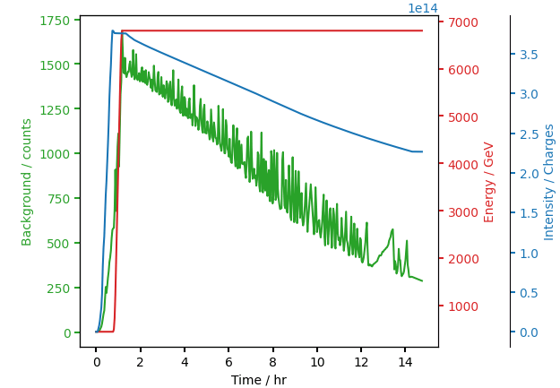
Signal & Background
Heavily dominated by background.
Best S/Bg ~= 1, worst S/Bg ~= 0.1

Slide 6
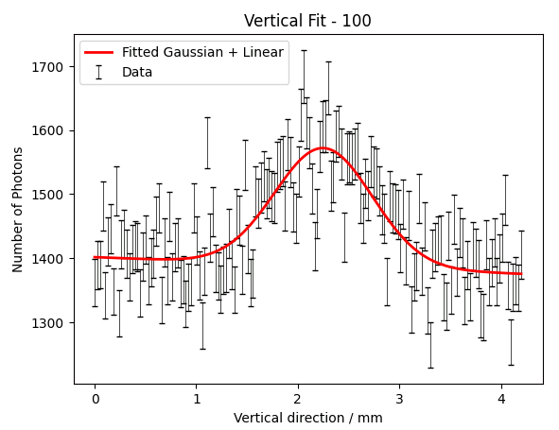
Near start of stable beams
Background = ~1400
Amplitude = ~ 175

Slide 7
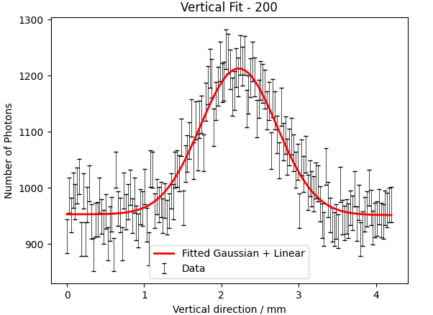
Approx. middle of fill
Background = ~950
Amplitude = ~ 250

Slide 8
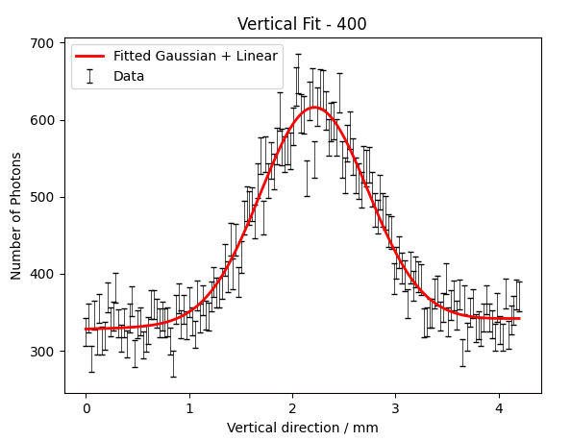
Near end of fill
Background = ~330
Amplitude = ~ 300

Slide 9
Discussion
Variable cross section is unexpected from predictions, anticipated a result of high background losing signal photons during photon counting.
Supported by increasing photon rate & gaussian amplitude over fill (non-physical as intensity reduces).
Currently running analysis on different fills, including data varying frame time over a fill.

