Slide 1
BGC Regular Meeting
BGC Integration v4
L.Margerison 11.04.2025

Slide 2
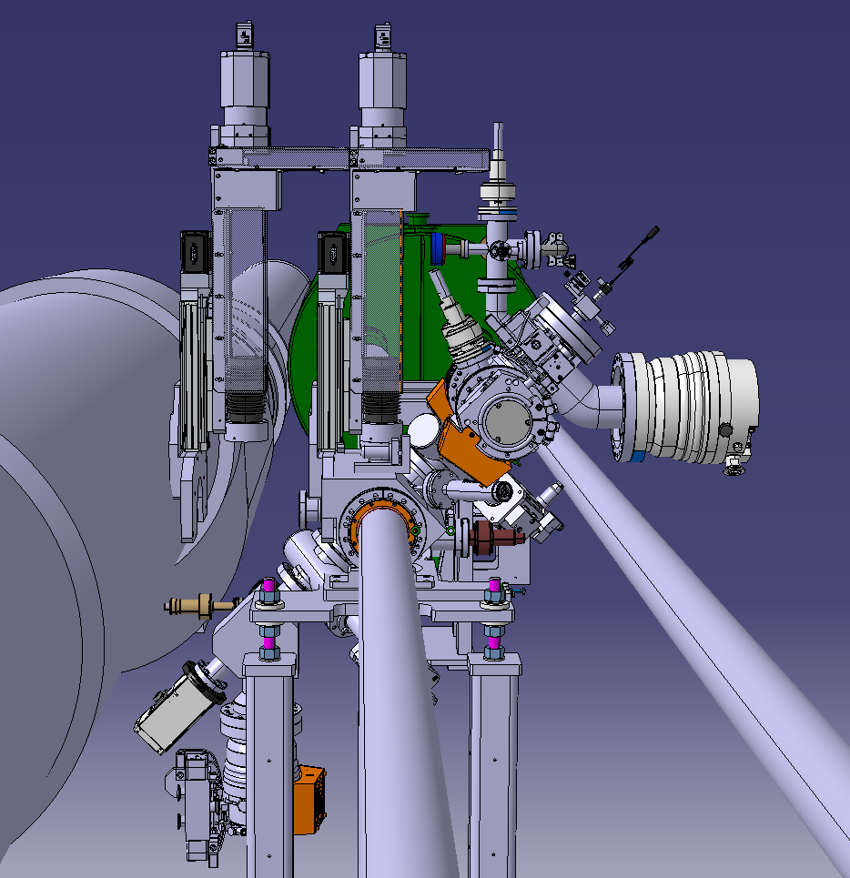
Previous steps/conclusions
Alter Gas Dumb Assembly so TMP sits vertically Done
Relocation of 2nd target - Done
Relocate penning gauge on main chamber to avoid clash with injection chamber – Done
Investigate compatibility of DN40 with 3rd and 4th skimmer - Done
Start work on support structure – Pending
Optimise 1st injection chamber pump pipe connection/positioning - Pending
Calculate potential max lens size (opening angle?) - Pending

Slide 3
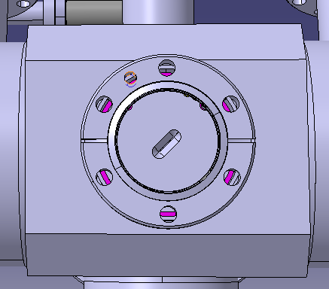
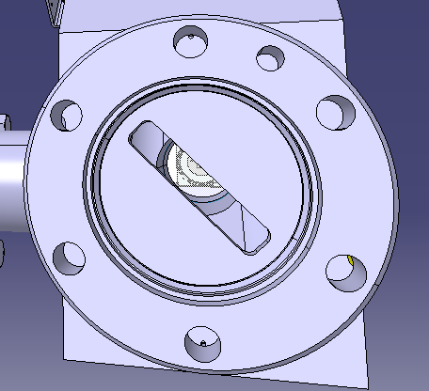
Gate Valves
Injection
Chamber
w/DN40
  DN63 Gate Valve on injection chamber clashes with the optical assembly
  Transition fitting to go from DN63 on current injection chamber to DN40 on gate valve
  Change to a DN40 valve
  3rd skimmer fits within DN40 flange diameter
  Taper from injection chamber diameter to DN40 valve
  Should be space to incorporate DN40 valves and maintain distances on injection side
Dump
Chamber
w/DN40

Slide 4
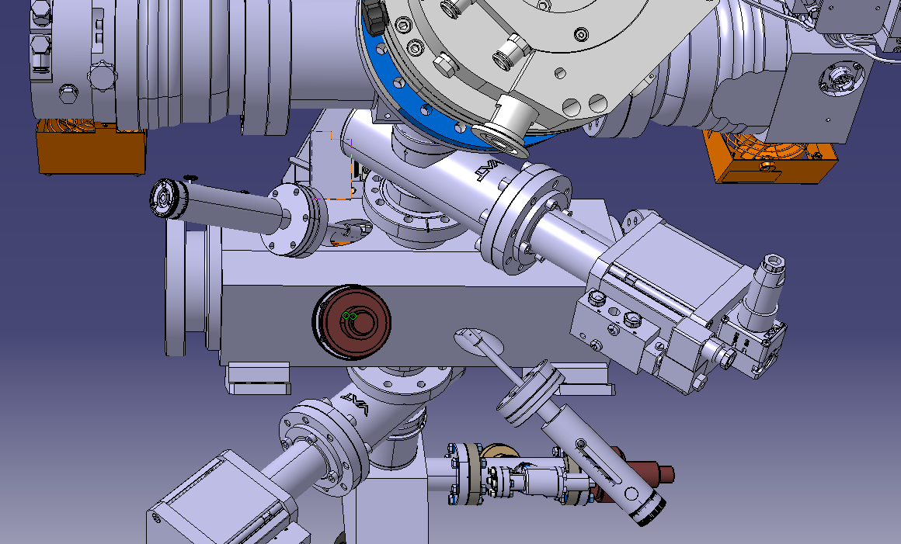
Optical Target
Original Target
  Moved second target to avoid collisions with other components
  And find a space that is easier to access
  Will need to integrate a second blackened plate
Moved Penning Gauge Position
Second Target

Slide 5
Next steps
Instrument Support Assembly
Transitions and integration of different diameter components (gate valves and pump)
Add 2nd blackened plate for 2nd optical target
Main Chamber refinement and detailing

